Slide 1
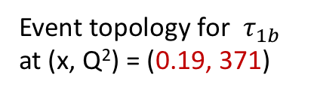
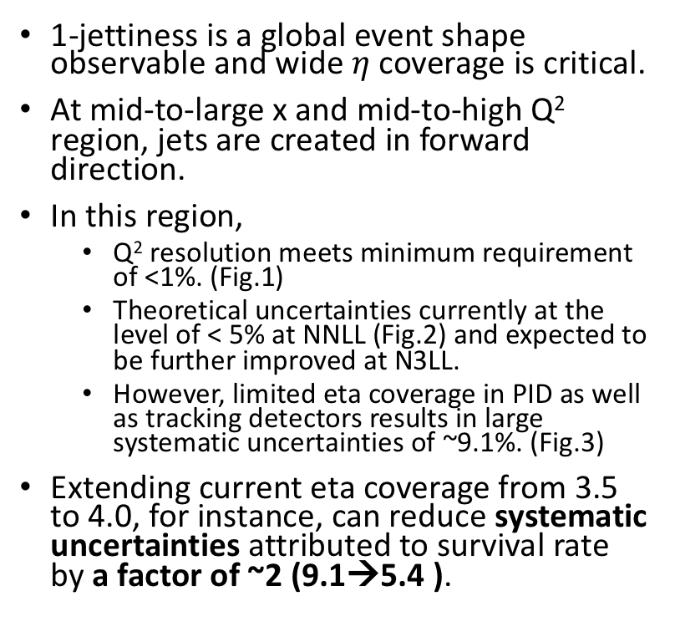
PID requirement for
1-jettiness type measurements:
Extended eta coverage in forward region
E_{p} =275 GeV, E_{e}= 18 GeV
1-jettiness is a global event shape observable and wide $η$ coverage is critical.
At mid-to-large x and mid-to-high Q² region, jets are created in forward direction.
In this region,
  Q² resolution meets minimum requirement of <1%. (Fig.1)
  Theoretical uncertainties currently at the level of < 5% at NNLL (Fig.2) and expected to be further improved at N3LL.
  However, limited eta coverage in PID as well as tracking detectors results in large systematic uncertainties of ~9.1%. (Fig.3)
Extending current eta coverage from 3.5 to 4.0, for instance, can reduce systematic uncertainties attributed to survival rate by a factor of ~2 (9.1→5.4 ).
Event topology for $τ_{1b}$
at (x, Q²) = (0.19, 371)

Slide 2
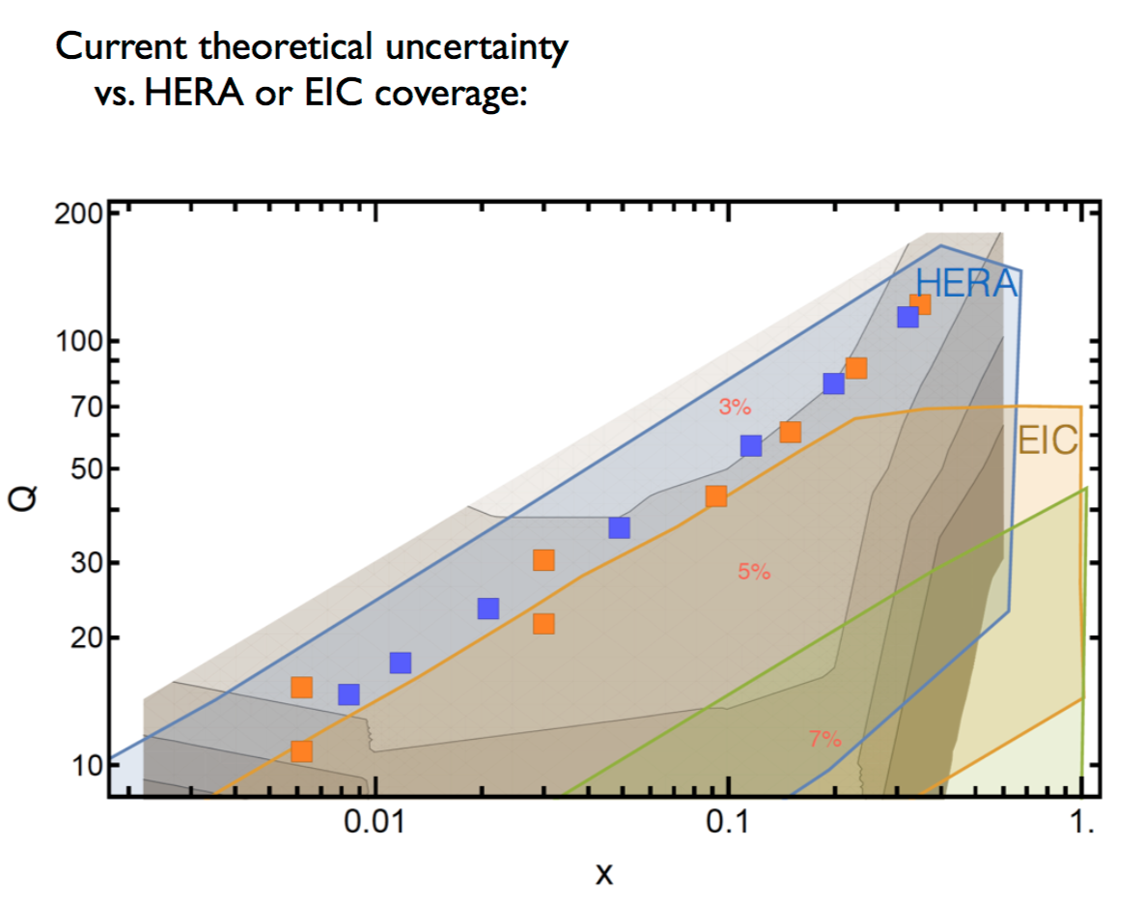
Figure 1
Figure 2
y = 0.1
(x, Q²) = (0.19, 371)

Slide 3
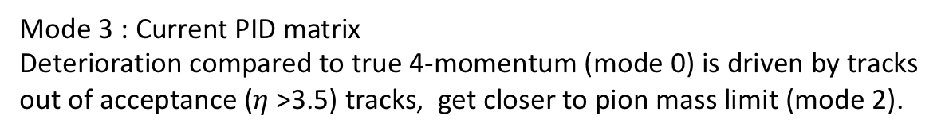
Figure 3
Mode 3 : Current PID matrix
Deterioration compared to true 4-momentum (mode 0) is driven by tracks out of acceptance ($η$>3.5) tracks, get closer to pion mass limit (mode 2).

Slide 4



Figure 4
Survival rate = $\frac{{reco τ}_{1}}{true τ_{1}}$
$η$ < 3.5
$η$ < 4.0
Sys. Uncertainty 9.1% at 68% CL
Sys. Uncertainty 5.4% at 68% CL

Slide 5
Extra

