Slide 1



Constraining the gluon Sivers function at a future EIC
L. Zheng, E.C. Aschenauer, J.H. Lee,
Bo-Wen Xiao, and Zhong-Bao Yin

Slide 2


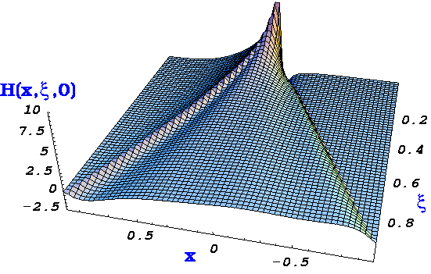
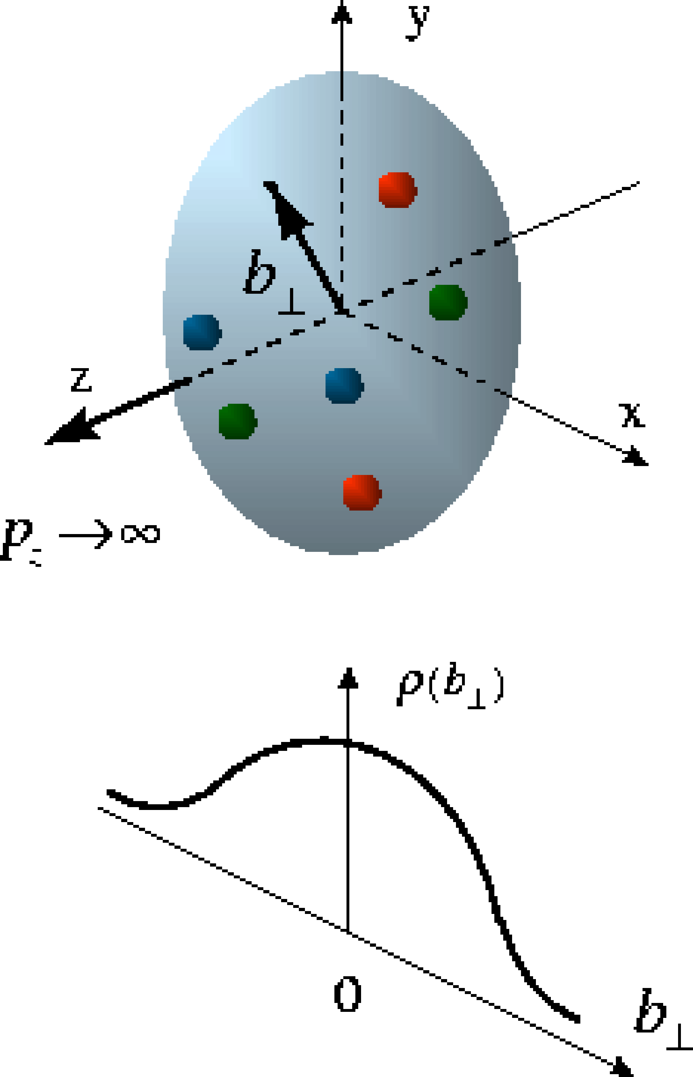
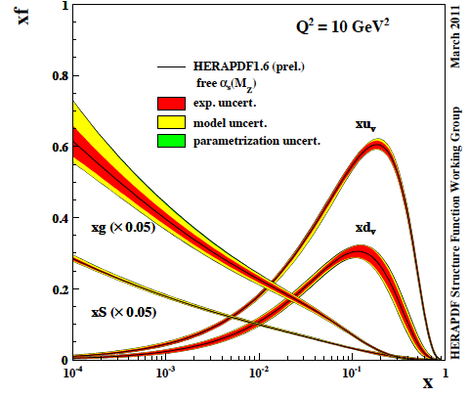
The Path to Imaging Quarks and Gluons
Wigner function
4+1-D
not related by
Fourier transf.
2+1-D
transv. mom. dep. PDF
impact par. dep. PDF
generalized PDF
semi-inclusive DIS
exclusive processes
1-D
parton densities
form factor
WHY TMDs:
provide a way to image the nucleus / nuclei in transverse and longitudinal momentum space (2+1d)
provide access to spin-orbit correlations
provide constrains to quark-gluon-quark correlations in the proton and in fragmentation
1st Mellin Moment of transversity → tensor “charge”
  tensor charge not directly accessible in
  low-energy footprint of new physics at higher scales ?
un-integrated gluon density g(x,Q²,k_{T}) important for physics at small x
→ CGC
→ many applications at LHC, i.e. Higgs production

Slide 3
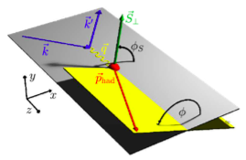
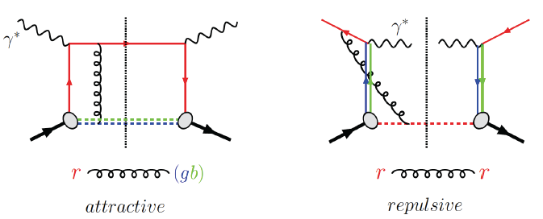
transverse momentum dependent PDFs & FFs
What is the dynamic structure of the proton and nuclei
2D+1 picture in momentum space
Visualize color interactions in QCD
collective phenomena and correlations in fragmentation
New physics due to confined motion
Features:
very different evolution then collinear PDFs pertubative & non-pertubative contributions
reveals non-trivial aspects of QCD color gauge invariance
Observable for TMDs:
azimuthal modulations of 6-fold
differential cross section
DIS:
γq-scattering
attractive FSI
pp:
qqbar-anhilation
repulsive ISI
QCD:
TMD_{DIS} = - TMD_{DY/W/Z0}

Slide 4
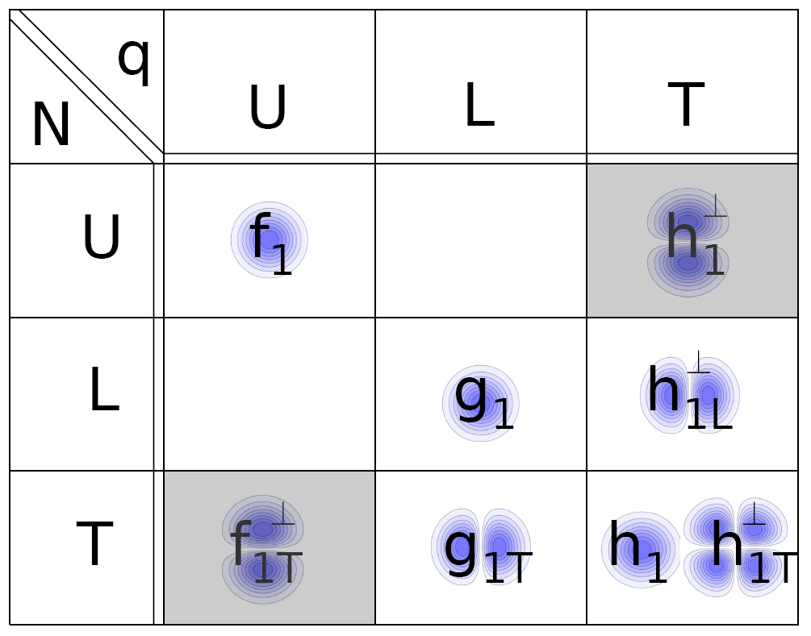
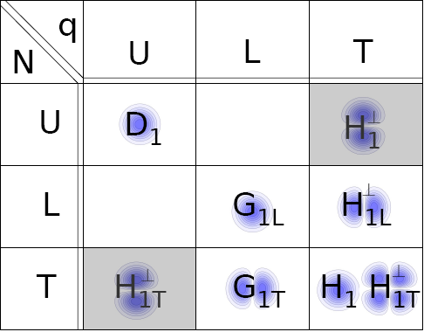
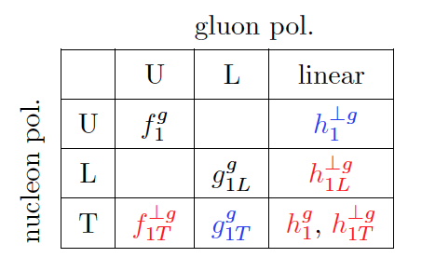
transverse momentum dependent PDFs & FFs
slew of different TMDs can be defined
Leading Twist q-TMDs
Leading Twist TMD FF
Leading Twist g-TMDs
g
N
Three types of modulations:
Monopole
Dipole
Quadrupole

Slide 5
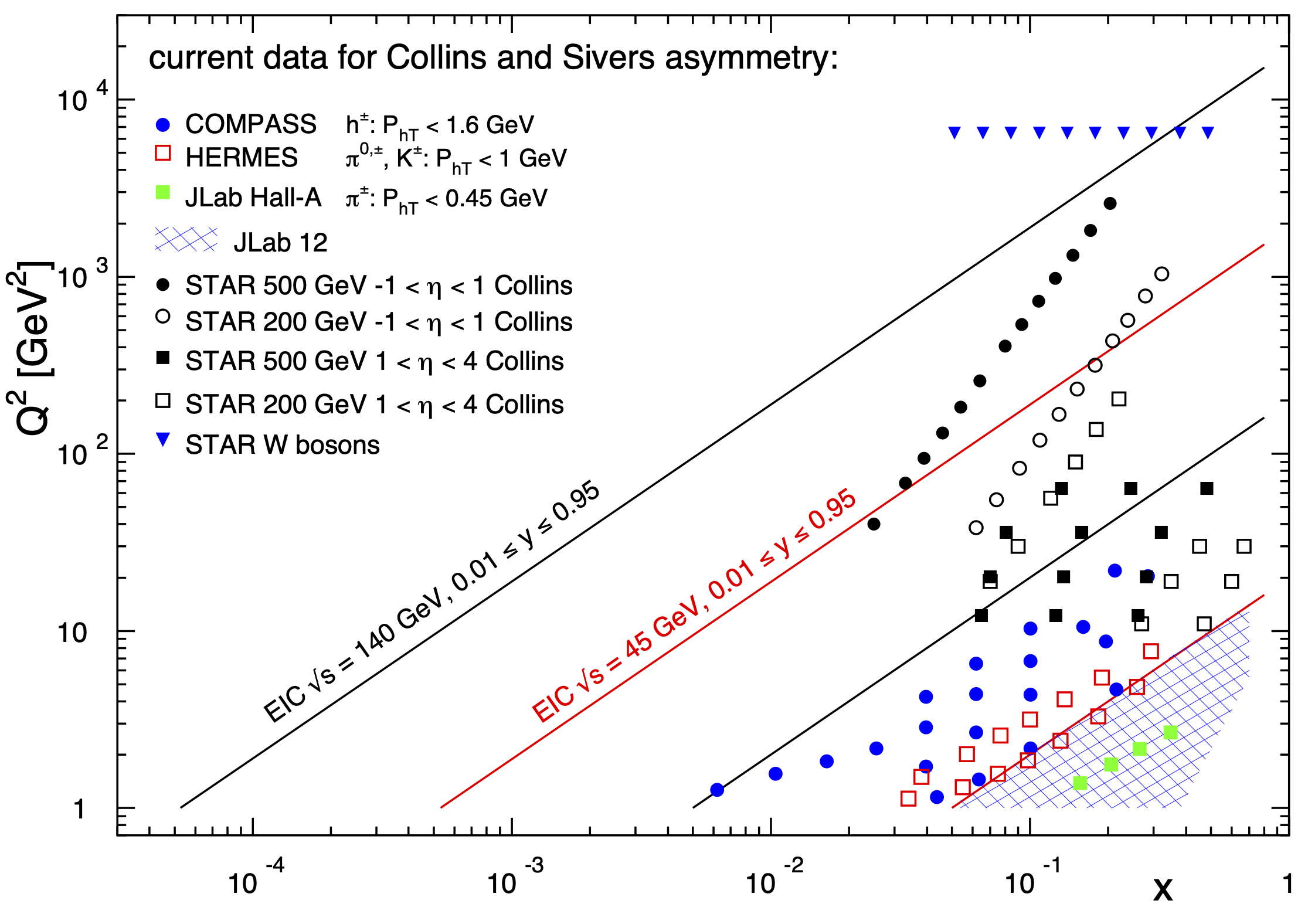
TMDs around the World
Till today TMDs from ep came only from fixed target data → high x @ low Q²
RHIC established TMDs survive at at high Q² and low x
EIC provides extra ordinary wide kinematic coverage
Know very little about gluon TMDs
Notes:
separate forward region in plot

Slide 6
How to access Gluons in DIS
Several different complementary channels to access gluons
Scaling Violation
all x-Q² x_{g} = x_{Bj}
only limited by detector acceptance
Scaling Violation | F_{L}
all x-Q² x_{g} = x_{Bj} | only accessible if y is large x_{g} = x_{Bj}
only limited by detector acceptance | need several beam energies
 |  | Photon Gluon Fusion
Scaling Violation | F_{L} | Di-jets
all x-Q² x_{g} = x_{Bj} | only accessible if y is large x_{g} = x_{Bj} | wide coverage in x_{Bj}-Q² x_{g} =x_{Bj}(1+M²/Q²⁾ > x_{Bj}
only limited by detector acceptance | need several beam energies | need a wide acceptance detector
 |  | Photon Gluon Fusion
Scaling Violation | F_{L} | Di-jets | Charm
all x-Q² x_{g} = x_{Bj} | only accessible if y is large x_{g} = x_{Bj} | wide coverage in x_{Bj}-Q² x_{g} =x_{Bj}(1+M²/Q²) > x_{Bj} | same coverage in x_{Bj}-Q² as incl. F₂ x_{g} ≳x_{Bj}
only limited by detector acceptance | need several beam energies | need a wide acceptance detector | needs excellent m-vertex detector and particle ID

Slide 7
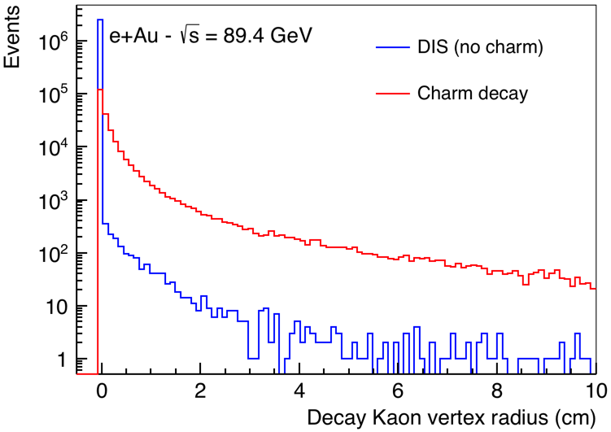
Tagging Charm
Standard charm tagging through displaced leptons → 6.5%
EIC:
advantage: Detector with π, K, p PID over a wide range in rapidity (-3.5 < η < 3.5)
combined with excellent vertex resolution
Kaon vertex distribution
Cut: 0.01 cm < vtx < 3 cm
momentum spectrum of K from
charmed mesons
→ excellent fit to PID with dE/dx
and aerogel RICH
Charm efficiency: 30%
Bckg. from non-charm < 2%

Slide 8
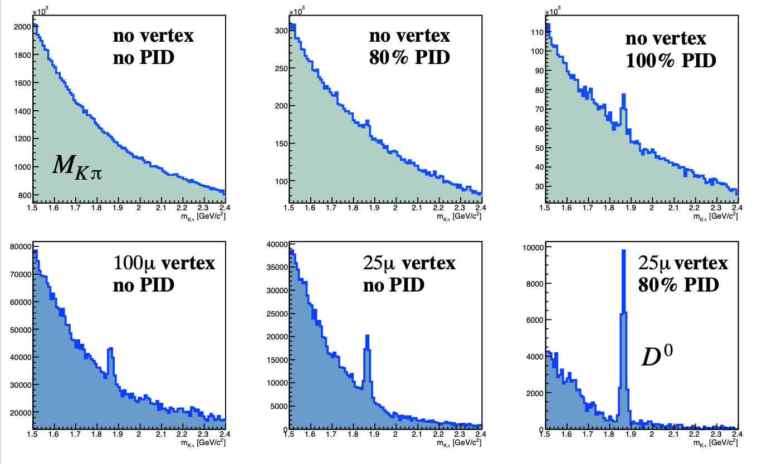
Open-Charm@EIC
Impact of PID performance and Vertex detector resolution
Boson (photon or Z) Gluon Fusion (BGF)
Example:
D0-meson reconstruction using exclusive decay
D⁰ → K⁻$π$⁺
ep (10 GeV x100 GeV), Q² > 10 GeV² and
x_{B} > 0.05,
vertex cut > 100 μm

Slide 9
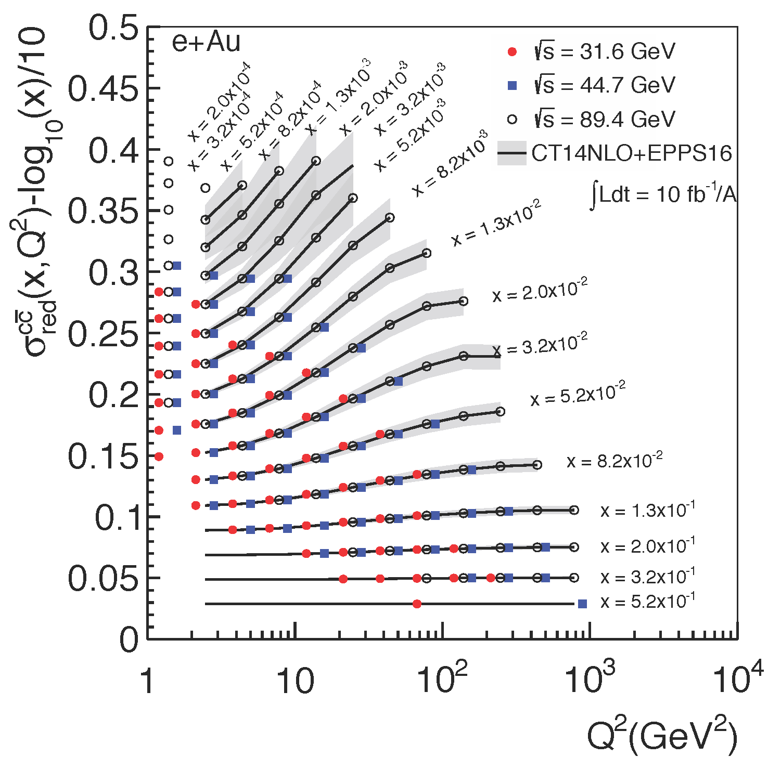
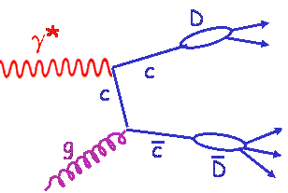
Inclusive Cross-Sections in eA
arXiv:1708.05654
Direct Access to gluons at
medium to high x by tagging
photon-gluon fusion through
charm events
Gluon distribution ~ dσ(x,Q²)/dlnQ²

Slide 10
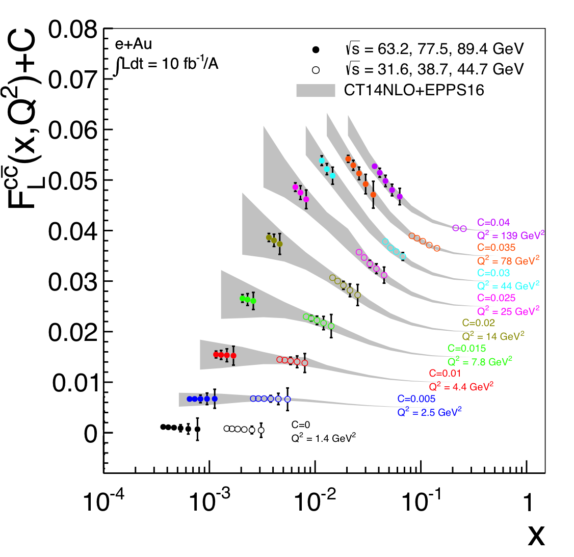
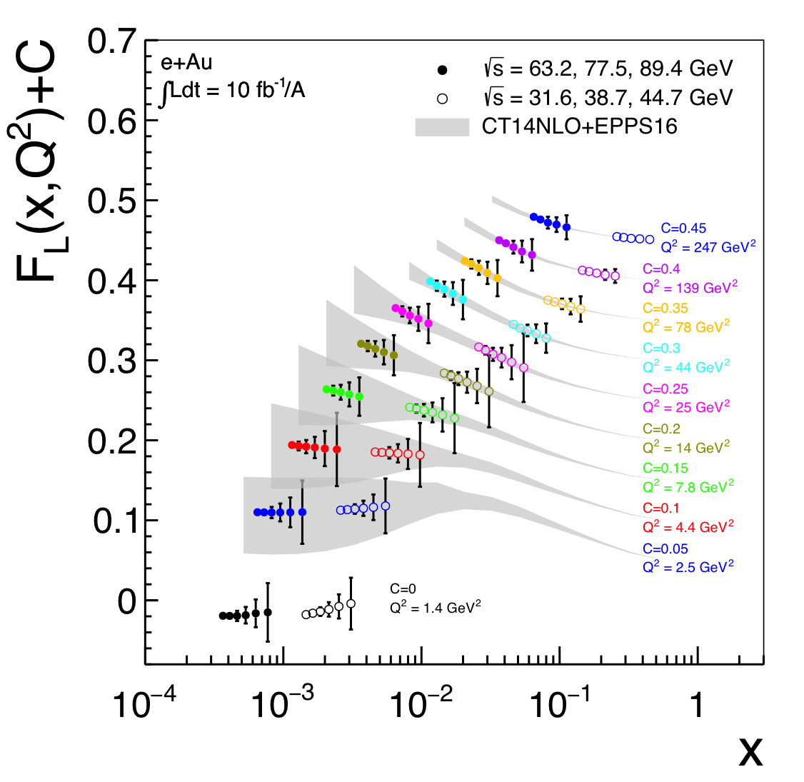
Direct Access to Gluons in eA
For Details: arXiv:1708.05654
Direct Access to gluons at
medium to high x by tagging
photon-gluon fusion through
charm events
high precision F_{L}^{charm} will offer an
opportunity to benchmark different
GM-VFNS schemes with an
unprecedented precision.

Slide 11
EIC: Impact on the Knowledge of 1D Nuclear PDFs
√s < 45 GeV
√s < 90 GeV
Ratio of PDF of Pb over Proton
Without EIC, large
uncertainties
→ With EIC significantly
reduced uncertainties
Complementary to RHIC
and LHC pA data.
Provides information on
initial state for heavy ion
collisions.
Does the nucleus behave
like a proton at low-x?
→ relevant to very
high-energy cosmic
ray studies
→ critical input to AA
arXiv:1708.05654

Slide 12
What Do We Know about Gluon TMDs

Slide 13
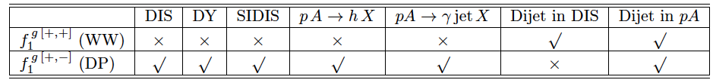
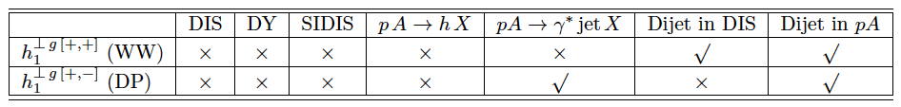
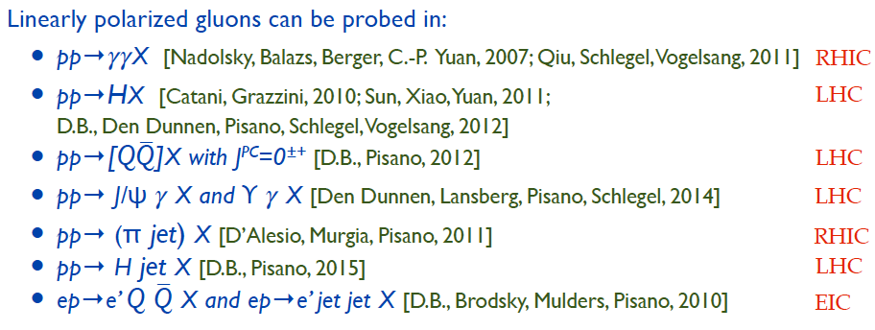
What data are needed
pA: for low x physics → gluon distribution
Need measurements to separate
G_{WW}(x,k⊥) is the conventional gluon distribution
G_{DP}(x,k⊥)
Different processes for unpolarised gluon distributions:
Different processes to access linear polarised gluon distributions:

Slide 14
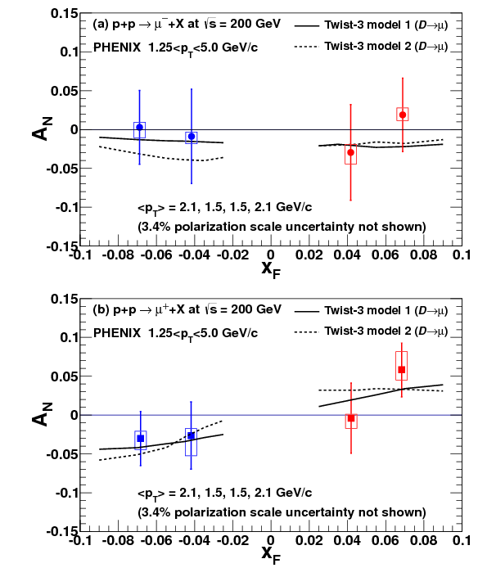
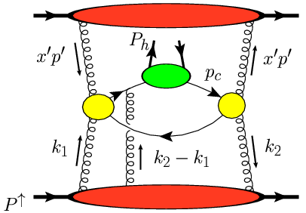
Sensitivity to Gluon “TMDs”
Phys.Rev. D95 (2017) 112001
Heavy flavor asymmetries most sensitive to Twist-3 counterpart of Gluon Sivers and tri-gluon correlator,
no final state effects expected due to heavy quark mass
Both contributions poorly known
Model calculations from: Koike et.al. Phys.Rev. D84 (2011) 014026

Slide 15
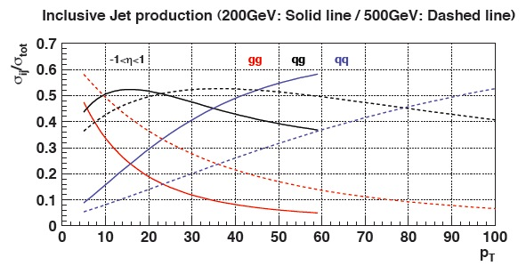
“Twist-3 Sivers” Through Jets
Asymmetries shown as function of particle-jet p_{T}
Corresponding parton-jet p_{T} lower by 0.6-1.4 GeV
Horizontal errors include uncertainties from statistics, calorimeter gains, efficiencies, track momentum, and tracking efficiency
No sign of sizable azimuthal asymmetry in jet production at √s = 500 GeV
Consistent with expectation from inclusive jets, di-jets, and neutral pions at √s = 200 GeV
p_{T} [GeV/c]
Notes:
----- Meeting Notes (9/26/13 11:10) -----
specify p_T range on left-hand plot
specify eta range

Slide 16
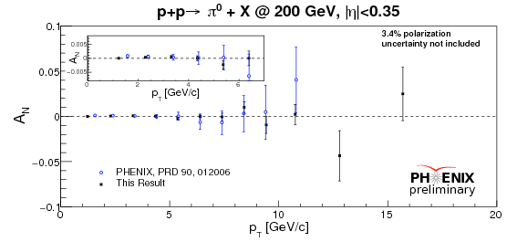
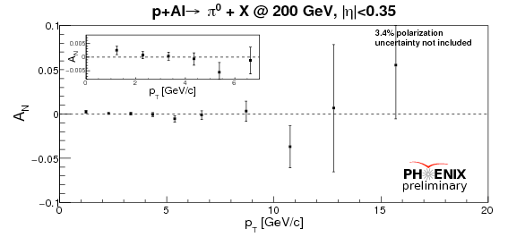
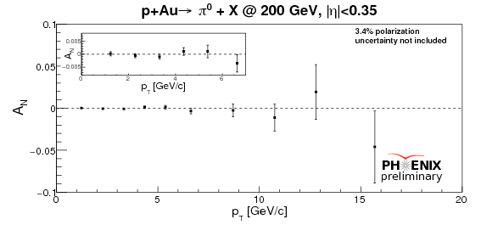
Sensitivity to Gluon “TMDs”
pp
pp:
Improved results from 2015!
Consistent with 0
to 3~10⁻⁴ precision level at low p_{T}
constrain of gluon Sivers effect
Anselmino et al, PRD 74 (2006), 094011
D’Alesio et al, JHEP 1509 (2015), 119
pA:
high precision test of nuclear effects
pAl
pAu

Slide 17
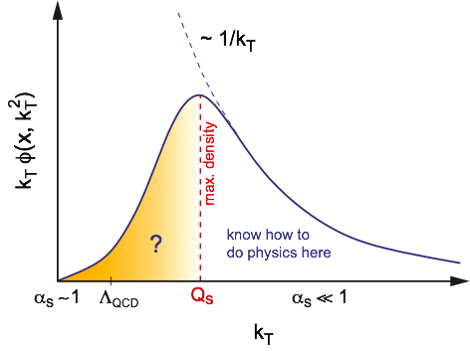
Gluon TMDs at an EIC
shows emerges of a scale Qs
where gluon density saturates

Slide 18
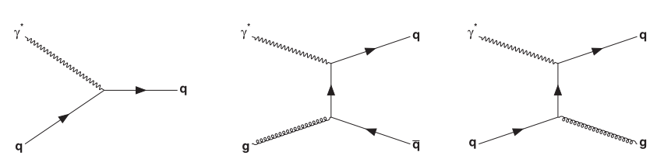
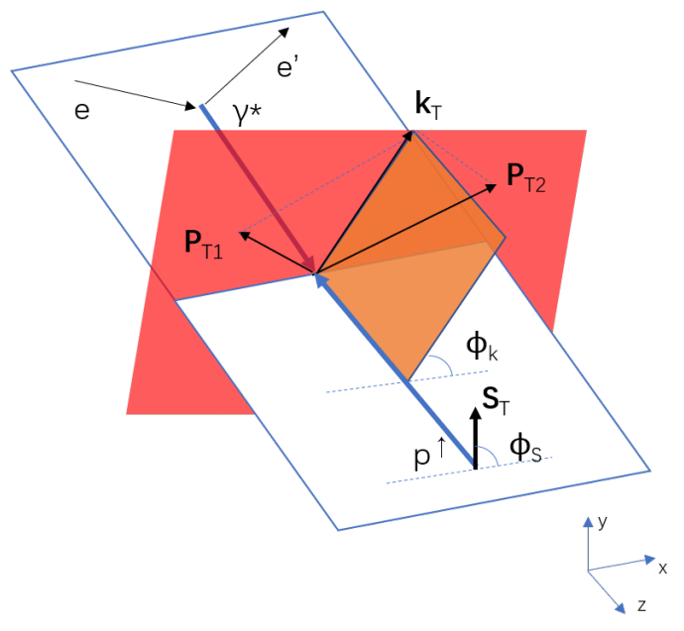
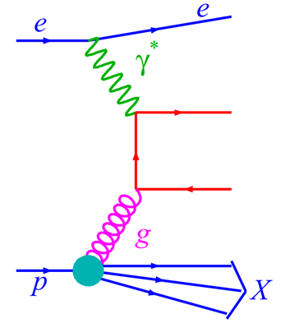


Accessing gluon Sivers at EIC
Photon-gluon fusion (PGF)
Leading order DIS (LODIS)
P_{T1}
P_{T2}
QCD compton (QCDC)
Tag signal process PGF
Vector sum of p_{T1} and p_{T2} reconstruct the gluon k_{T} in
γ*p c.m.s frame.
Design kinematic cuts to suppress the quark contributions.
Single Spin Asymmetry (SSA)
Back-to-back limit:
P_{T}’ =|P_{T}^{h1}-P_{T}^{h2}|/2
k_{T}’ = |P_{T}^{h1}+P_{T}^{h2}|
k_{T}’ << P_{T}’
Final state observables
Open charm
Charged hadron pair
Dijet pair

Slide 19
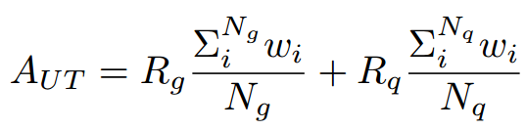
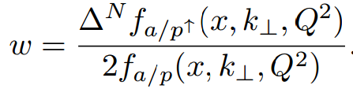
Event weighting method
Weighting events in a final state observable
PYTHIA
event generator
Beam energy
Partonic flavor, kinematic info
Leading order DIS
hadronization
Photon-gluon fusion
SSA in final state observable
QCD compton
Sivers weight event-by-event（signal, background）

Slide 20


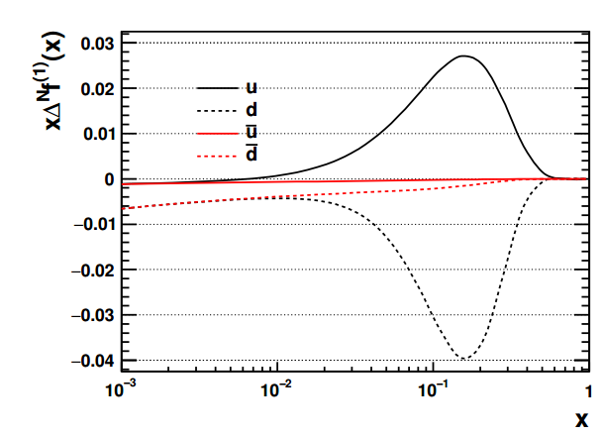
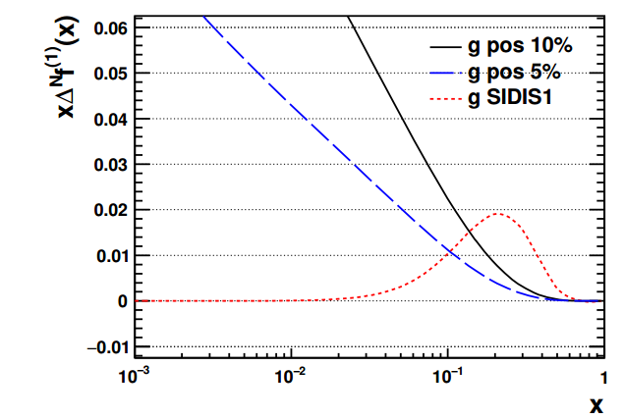
Inputs to the model calculation
Quark Sivers: u and d quarks
JHEP 04(2017) Anselmino et. al.
Gluon Sivers:
u, d + Kretzer FF (SIDIS1)
JHEP 09 (2015) 119 D’ Alesio et. al.
Positivity bound ansatz:

Slide 21
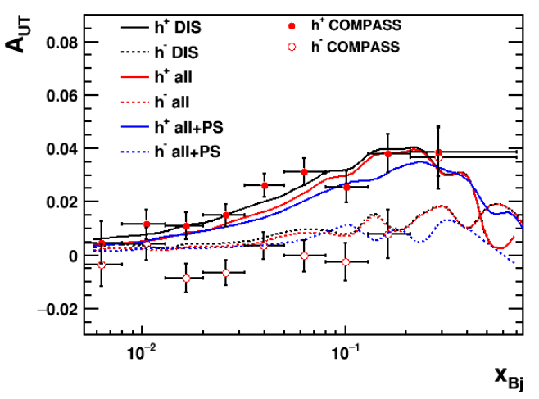
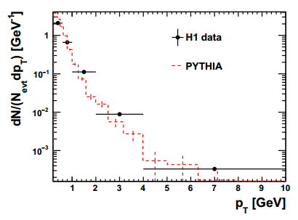
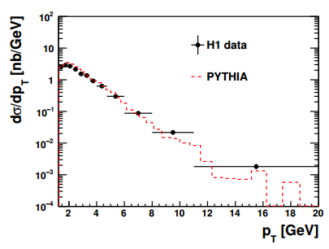
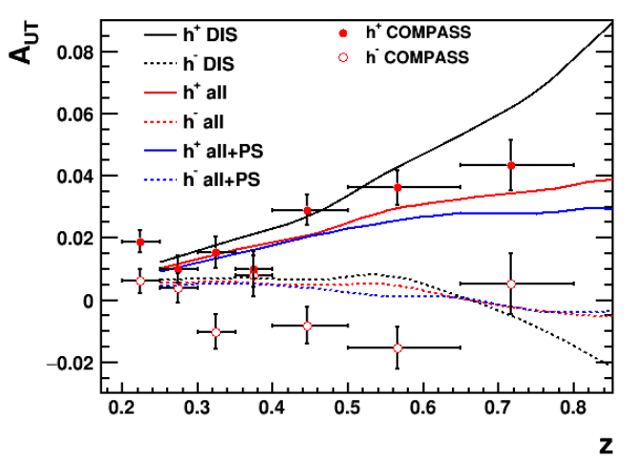
MC: Comparing to existing Data
Unpolarized Data from H1:
Ep: 27.6 GeV x 920 GeV
5<Q²<10, 0.0005<x_{Bj}<0.002
p_{T}*, η* defined in gamma-hadron center of mass frame
Polarized Data (Sivers) from COMPASS
160 GeV μ beam on fixed target
0.1<y<0.9, Q²>1, W>5
Phys. Lett. B717, 383 (2012)
Charged particle
Eur. Phys. J. C73, 2406 (2013),
The MC reproduces a wide range of data
over a wide range of kinematics
extremely well
D*
Eur. Phys. J. C71, 1769 (2011)

Slide 22
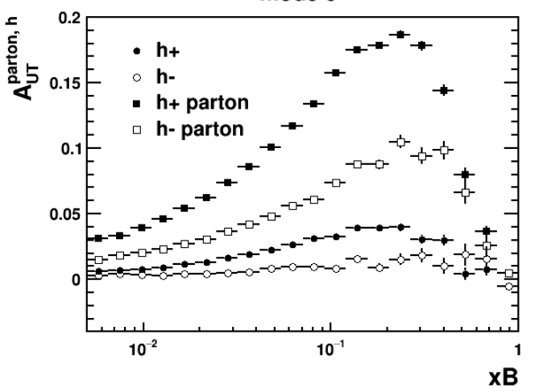
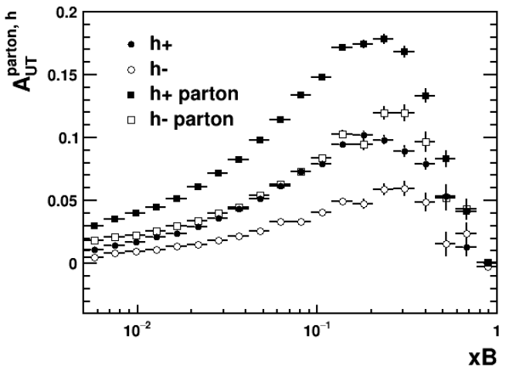
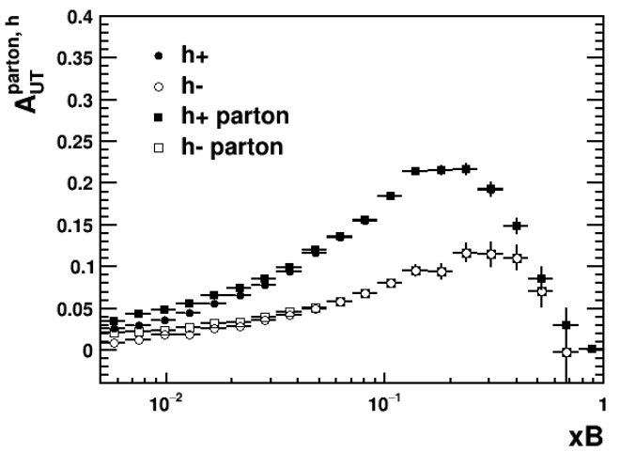
Dilution of parton level asymmetry
Full simulation
PARJ(21)=0
Turn off
frag p_{T}
Turn off decay
of resonances
PARJ(21)=0,MSTJ(21)=0
Fragmentation momenta smearing and resonance decay contribution accounts for the parton to hadron level asymmetry dilution at COMPASS energy.

Slide 23
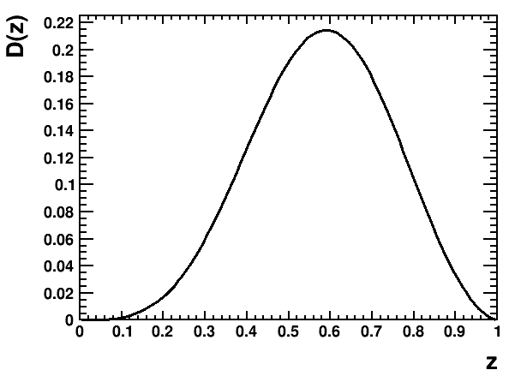
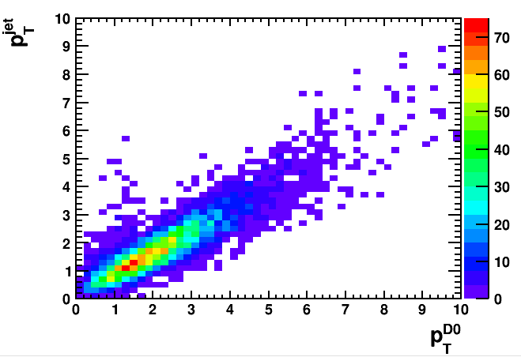
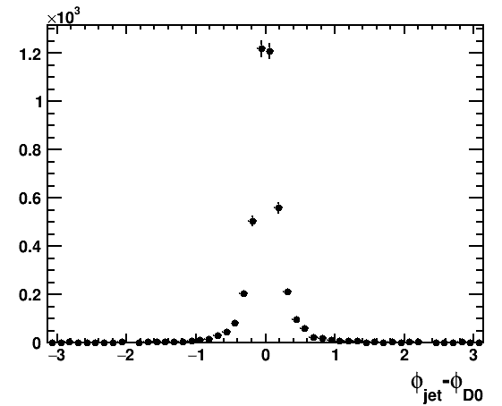
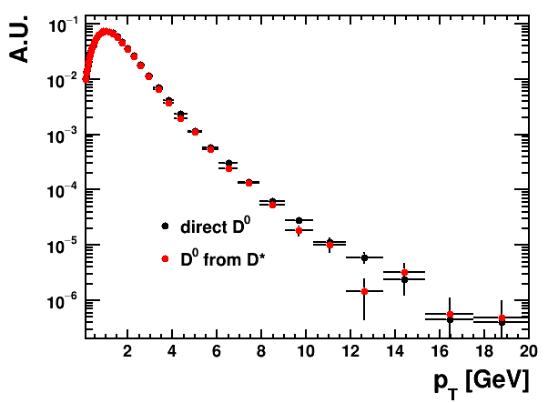
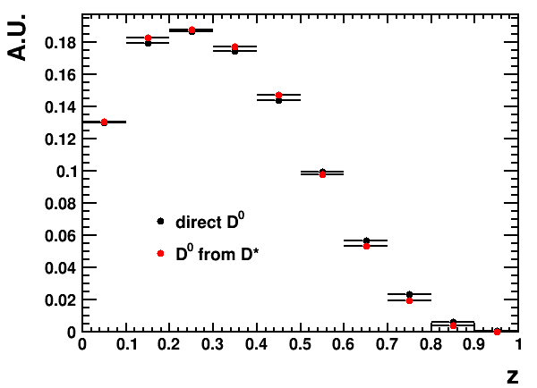
Small Primer on D⁰s
D meson takes a large fraction of the charm quark energy, serves as a proxy to the charm jet information.
D⁰ from D* decay similar to the directly generated D⁰s, therefore all D⁰s are analyzed.

Slide 24
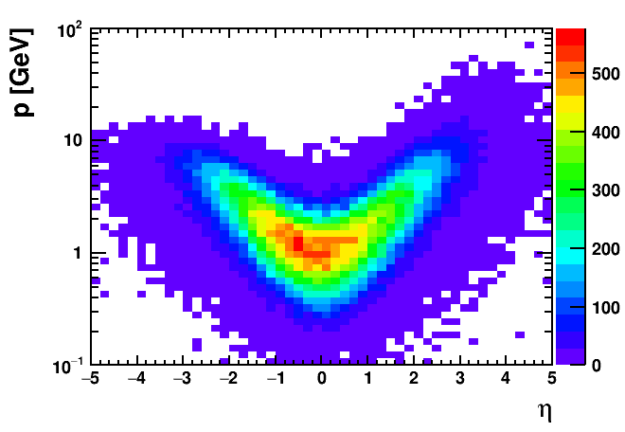
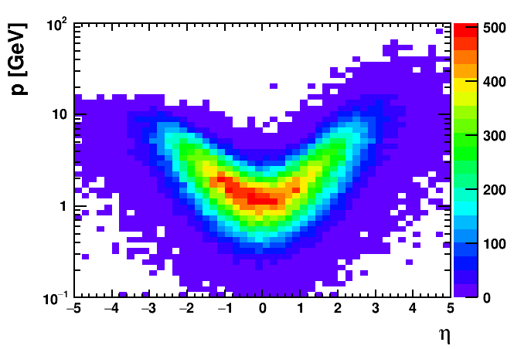
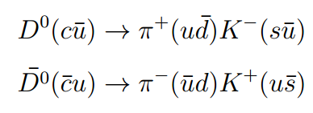
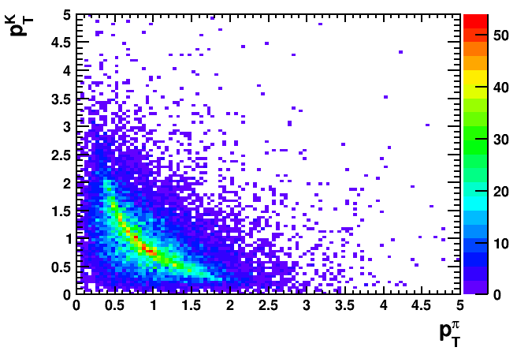
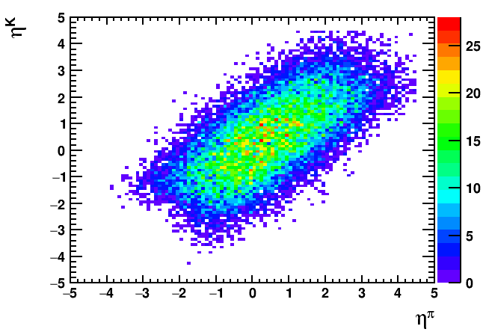
Gluon-Sivers: D-Mesons
Branching ratio: 3.9%
Pion
Kaon
Acceptance for PID is assumed to be |η|<3.5
Decay products from D mesons are mostly less than 10 GeV in mid-rapidity.
Decay products p_{T}>0.2 GeV.

Slide 25
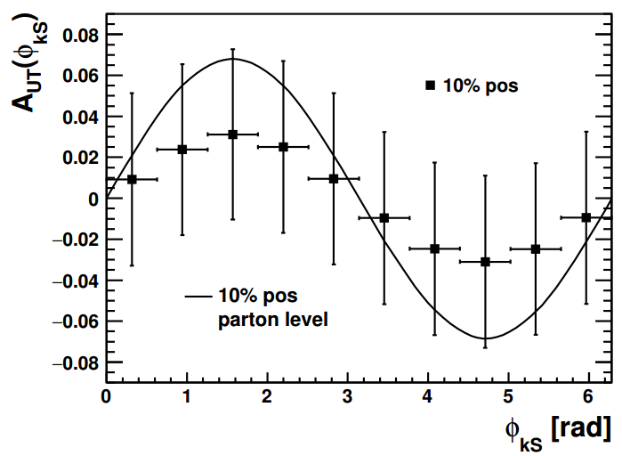





Gluon-Sivers: Open Charm
Assumptions on D⁰ reconstruction:
D->K + pi (3.9%)
Acceptance: |η|^{pi/K}<3.5
p_{T}^{pi/K}>0.2 GeV, p_{T}^{D}>0.7 GeV, z^{D}>0.1
∫Ldt = 10 fb⁻¹
$$D^{0}\overline{D^{0}}$$
Sensitive to gluon kinematics
D⁰⁻pair statistically challenging
10% positivity can be distinguished in single D⁰ probe
$$D^{0}$$
$$D^{0}\overline{D^{0}}$$

Slide 26


Gluon-Sivers: Di-Jets
Assumptions on di-jet reconstruction:
Anti-k_{T}, R=1
jet constituents:
p_{T}>250 MeV, π/K/p/γ, |η|<4.5
p_{T}^{jet1}>4.5 GeV, p_{T}^{jet2}>4 GeV
∫Ldt = 10 fb⁻¹
Gluon initiated process dominant at small x_{B}
Stronger correlation between final state observable to parton level kinematics
Resolution down to 5% positivity bound gluon Sivers size

Slide 27



Gluon-Sivers: Di-Jets
Strong correlation of jet momentum to its mother parton
Direct handle on parton kinematics put stronger constraint such as x_{parton}
Large statistics allow to explore SSA in multidimensional analysis.

Slide 28


Dilution of parton level asymmetry: Di-jets
Hadron fragmentation momentum smearing and resonance decay are important
Other smearing effects in dijet processes → parton radiation

Slide 29

Summary
Gluon Sivers function and other TMDs is an ingredient to complete 3D imaging of nucleon.
It can be uniquely accessible and constrained in a wide kinematic range at EIC.
Di-jet method more statistically favored compared to the open charm production.
Different probes complement each other at EIC.

Slide 30


Slide 31


2+1 dimensional Imaging of Quarks & Gluons
Wigner function
W(x,b_{T},k_{T})
QCD genetic map
Momentum
space
Coordinate
space
∫d²b_{T}
∫ d²k_{T}
f(x,k_{T})
f(x,b_{T})
Quarks
Quarks
down quark
x
Spin-dependent 3D momentum space
images from semi-inclusive scattering
Spin-dependent 2+1D coordinate space images from exclusive scattering

Slide 32



Di-hadron pair selection
Assumptions on h-Pair reconstruction:
Pairs of π,K,p
Acceptance: |η|^{h1h2}<4.5
p_{T}>1.4 GeV, z_{h}>0.1
Back-to-Back limit: k_{T}’<0.7p_{T}’
∫Ldt = 10 fb⁻¹
Large z prefers forward rapidity
Hadron pair distribution
Acceptance for all charge

Slide 33




Charged hadron vs kaon spectrum
Charged hadron
Charged Kaon

Slide 34

What data are needed
How to access the Gluon sivers function:
Need high precision data to solve the current TMD challenges
test factorization is broken and to what level
constrain TMD evolution
test the predicted universality breaking of TMDs
RHIC Run-17 is devoted to p↑p with ∫L dt = 400 pb⁻¹
to get TMDs for low x in pA we need to go forward η at RHIC
→ forward upgrades for RHIC in 2020+ for the pA and pp runs
and analyze the wealth of LHC data for TMD sensitive observables

Slide 35


Sensitivity to Gluon “TMDs”
Surprising nonzero J/Psi A_{N}s seen in pAu collisions while pp Asymmetries are mostly consistent with zero
Nonzero effect only visible at the lowest available P_{t}
Diffractive effects as cause not very likely due to coincidence with hard collision trigger
pAl data is being analyzed

Slide 36
Collins like Asymmetry
Until now, Collins-like asymmetries completely unconstrained
→ Sensitive to linearly polarized gluons
Shaded bands represent
maximal predictions from
U. D’Alesio, F.Murgia, and
C. Pisano, arXiv:1707.00914
utilizing Kretzer and DSS FF

Slide 37


Gluon-Sivers: Di-Hadrons
Assumptions on h-Pair reconstruction:
Pairs of π,K,p
Acceptance: |η|^{h1h2}<4.5
p_{T}>1.4 GeV, z_{h}>0.1
Back-to-Back limit: k_{T}’<0.7p_{T}’
∫Ldt = 10 fb⁻¹
Gluon initiated process account for a large fraction of events at small x_{B}
Parton asymmetry dilution larger than open charm
Statistically more favored than open charm, resolve 5% positivity bound gluon Sivers size

Slide 38



Gluon-Sivers: Di-Hadrons
Single out the asymmetry amplitude
Asymmetry size dependence on x_{B}, Q² can be identified with 5% positivity bound
No significant Q² trend as missing TMD evolution.
x_{B} sensitive to the x dependence of input Sivers function

Slide 39

TMDs and “QGP” in small systems
Collective flow signatures
seen even in the smallest
systems and at the lowest
RHIC energies
Phys. Rev. C 95 (2017) 034910
TMD formalism in DIS predicts a distribution for linearly polarized gluons in an unpolarized target. This is reflected in cos(2φ) asymmetries in dijet production
Study azimuthal anisotropy as a function of the rapidity dis-balance of the jets
Process sensitive to unpolarized and linearly polarized gluon distribution
Phys.Rev. D94 (2016) no.1, 014030
Phys.Rev.Lett. 115 (2015) no.25,252301
Phys.Rev. D91 (2015) no.7, 074006
Phys.Lett. B743 (2015) 134-137

