Slide 1



The FLUKA (re)interaction models
A (very) short introduction to FLUKA nuclear interaction models
Workshop on Target Fragmentation Physics with EIC
Stony Brook 28-30 September 2020
Alfredo Ferrari,
for the FLUKA Collaboration
Gangneung-Wonju National University, Korea

Slide 2
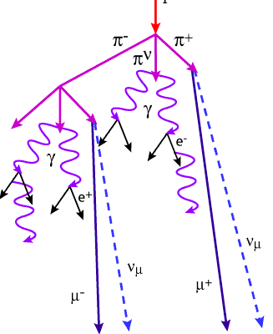
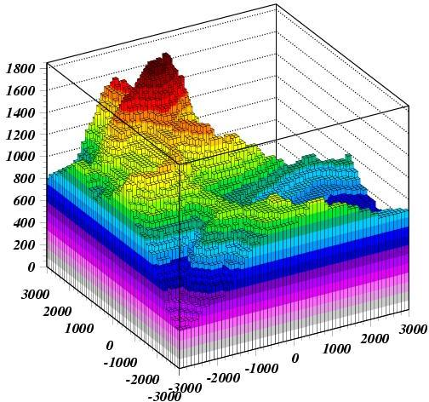
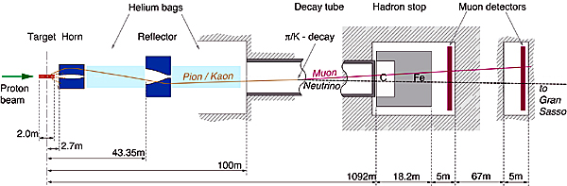
FLUKA Applications:
FLUKA (A.Fasso`,A.Ferrari,J.Ranft,P.R.Sala):
FLUKA is a general purpose tool for calculations of particle transport and interactions with matter
Cosmic ray physics
Neutrino physics
Accelerator design (→ n_ToF, CNGS, LHC systems, μCollider)
Particle physics: calorimetry, tracking and detector simulation etc.
(→ ALICE, ICARUS, ...)
ADS systems, waste transmutation, (→”Energy amplifier”, FEAT, TARC,…)
Shielding design
Dosimetry and radioprotection
Radiation damage
Space radiation
Hadron therapy
Neutronics

Slide 3
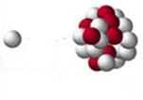
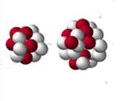
Fluka hA/AA models:
PEANUT
2⋅10⁴ > E > ~0.01 GeV
Photonuclear interactions
ElectroMagneticDissociation
Leptonuclear interactions
DPMJET-3
10⁸ > E > 2⋅10⁴ GeV
10⁸ > E/n > 5-10 GeV
Extended rQMD
5-10 > E/n > 0.1-0.15 GeV
BME
100-150 > E/n > ~5 MeV

Slide 4
Hadron Nucleon interactions in FLUKA (threshold ~ few TeV lab)

Slide 5
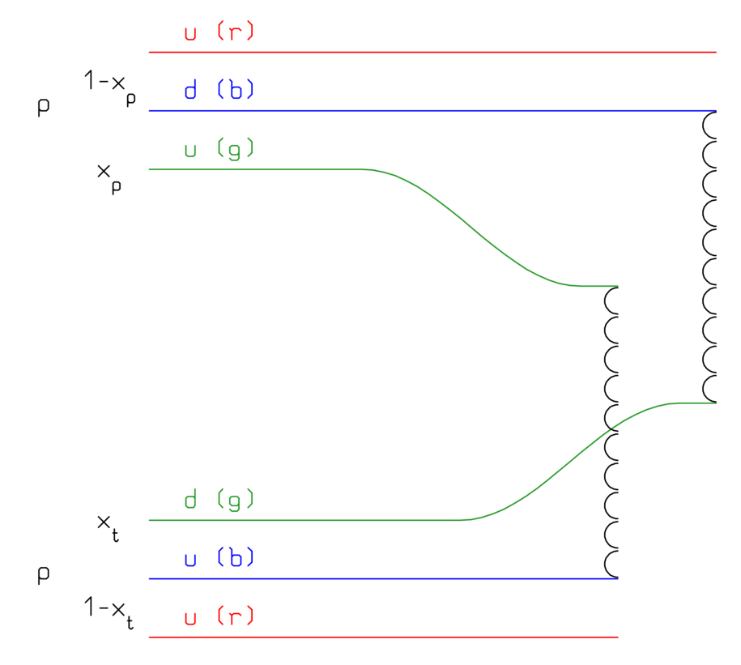
Nonelastic hN interactions: (very) short summary
Up to a few GeV’s:
Dominance of the Δ and of the N∗, ρ… resonances
→ isobar model
→ all reactions proceed through an intermediate state containing at least one resonance
N₁ + N₂ → N”₁ + Δ(1232) → N₁’ + N₂’ + π
π + N → Δ(1600) → π’+ Δ(1232) → π’ + π“+ N’
N_{’1}+ N₂ → Δ₁(1232) + Δ₂(1232) → N₁’ + π₁ + N’₂ + π₂
FLUKA: ≈ 60 resonances, and ≈ 100 channels
At energies above a few GeV’s:
Interacting strings (quarks held together by gluons into the form of a string)
Interactions treated in the Reggeon-Pomeron framework (Dual Parton Model, DPM)
Each hadron splits into 2 colored partons
  → combination into 2 colourless chains
  → 2 back-to-back jets
each jet is then hadronized into physical hadrons
Fluka contains its own hadronization model
pp: 1 cut pomeron

Slide 6
Pion production in p-p collisions:
Inclusive cross section for the production of π⁰ (blue), π+ (red), and π⁻ (green) in p-p collisions as a function of the proton kinetic energy. Lines: simulations, symbols exp. Data.
(figure from AstrPhys81, 21 (2016))

Slide 7
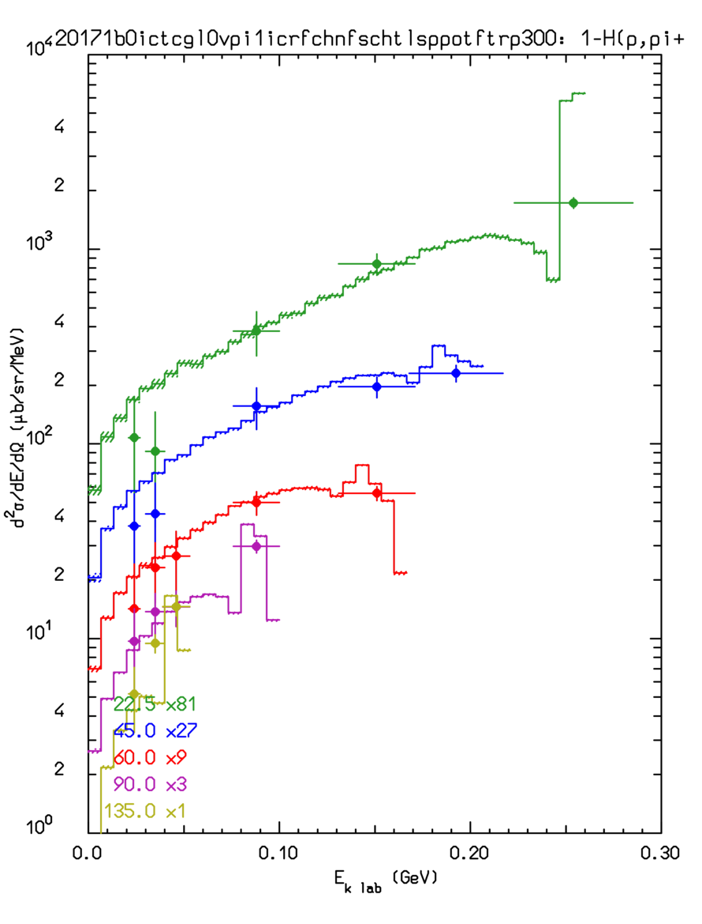
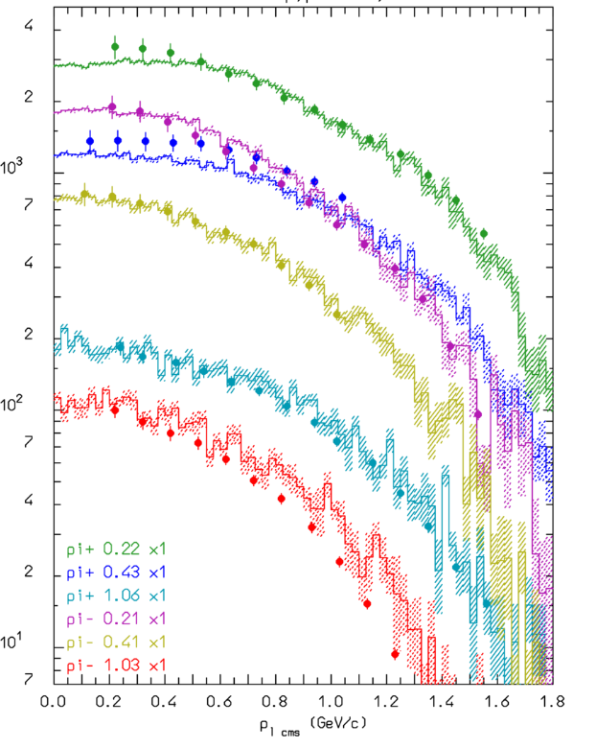
pH→πX @ 585 MeV and12.2 GeV/c
LEFT: π⁺ production from proton – proton interactions at 585 MeV at different angles.
RIGHT: π⁻ emission from proton-proton interactions at 12.2 GeV/c. at different angles
Symbols: data, histograms: Fluka
p_{T}²
E_{k}

Slide 8
(γ,μ,ν,e^{+/-}) and hadron Nucleus interactions in PEANUT

Slide 9
FLUKA (PEANUT) modeling of nuclear interactions
Target nucleus description (density, Fermi motion, etc)
t (s)
10⁻²³
10⁻²²
10⁻²⁰
10⁻¹⁶
Glauber-Gribov cascade with formation zone
(Generalized) IntraNuclear cascade
Preequilibrium stage with current exciton configuration and excitation energy
(all non-nucleons emitted/decayed + all nucleons below 30-100 MeV)
Evaporation/Fragmentation/Fission model
γ deexcitation

Slide 10
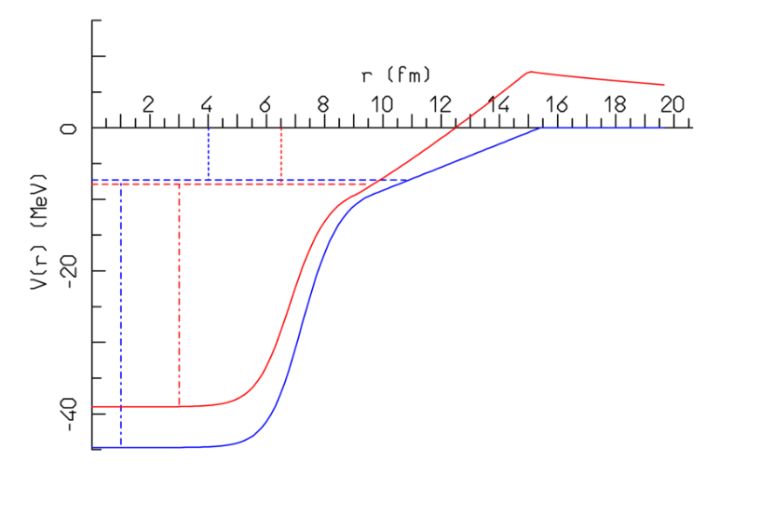
Fermi motion: Nucleon levels inside the nuclear potential
Blue: neutron
Red: proton
S_{n}
S_{p}
Local Fermi momentum, smeared according to uncertainty principle assuming a position uncertainty = √ 2 fm
p/n are grouped on energy levels space according to the shell model (blue lines, shown for neutrons)
Depending on the level, the maximum radius for the corresponding nucleon is less or equal to the nucleus radius (equal for the nucleons on the Fermi level)
The potential well depth depends on the nucleon energy (not yet implemented for neutrino and electron interactions)
Hit nucleon must go above Fermi level, can stay below separation energy (Pauli blocking)
E_{F}^{n}
E_{F}^{p}

Slide 11
(Generalized) IntraNuclear Cascade in PEANUT
Primary and secondary particles moving in the nuclear medium
Target nucleons motion and nuclear well according to the Fermi gas model
Interaction probability
σ_{free} + Fermi motion × ρ(r) + exceptions (ex. π)
Glauber cascade at higher energies
Classical trajectories (+) nuclear mean potential (resonant for π)
Curvature from nuclear potential → refraction and reflection throughout the nucleus
Interactions in projectile-target nucleon CMS → Lorentz boosts
Multibody absorption for π, μ⁻, K⁻
Quantum effects (Pauli, formation zone, coherence length, correlations…)
Energetic light ion production by coalescence
Together with the preequilibrium and evaporation steps → exact conservation of energy, momenta and all additive quantum numbers, including nuclear recoil

Slide 12
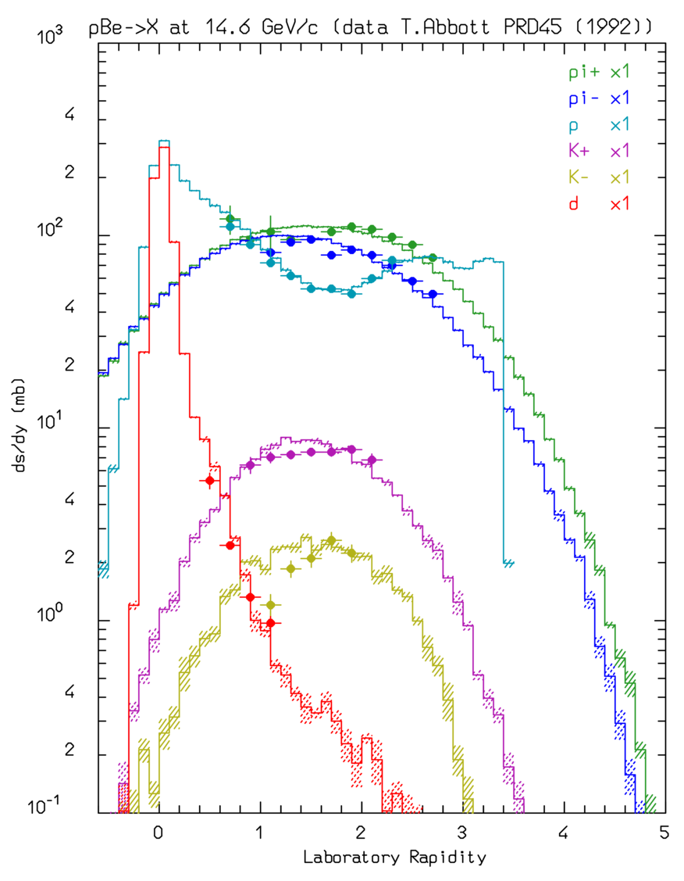
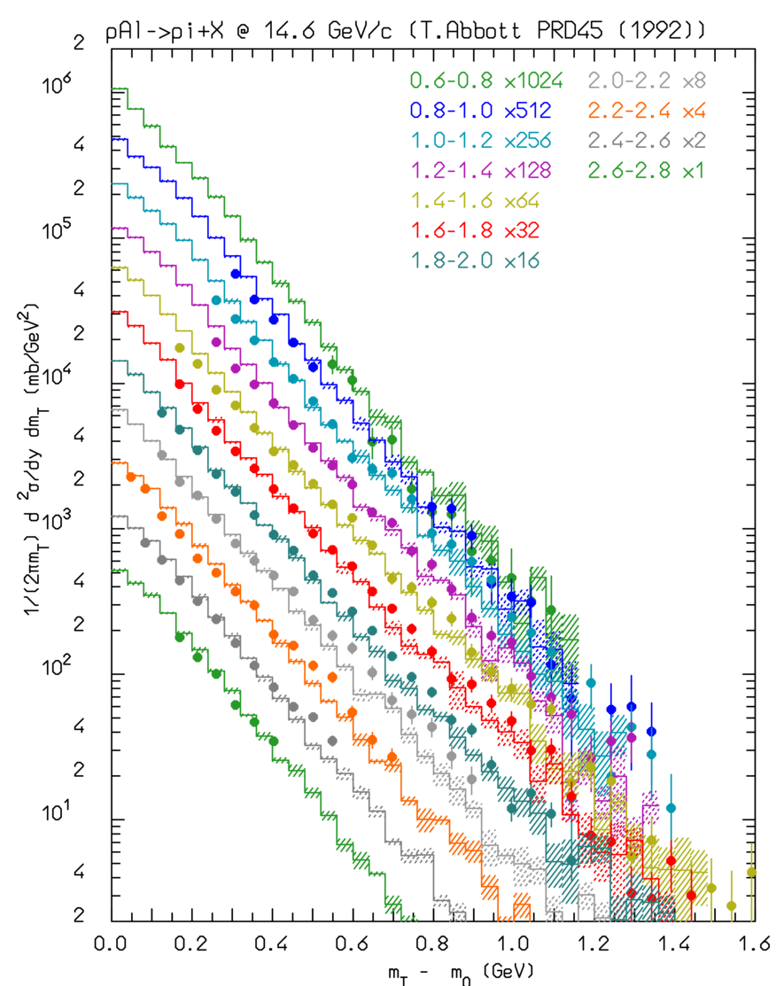
pBe, pAl @ 14.6 GeV/c
π⁺, π⁻, K⁺, K⁻, p, d, rapidity distributions for pBe @ 14.6 GeV/c (left)
π⁺ production double differential cross section for pAl @ 14.6 GeV/c as a function of the transverse mass, for different rapidity intervals
Symbols: exp. data
Histos: FLUKA

Slide 13
Glauber-Gribov cascade, formation zone* (→ classical INC will never work)
At energies below a few GeV: hA interactions → single primary collision hN, followed by re-interaction of secondary particles (INC).
Projectile
frame
At higher energies, Glauber calculus: multiple primary collisions
Laboratory frame
Formation time: naively “materialization" time. Qualitative estimate:
In the frame where p|| =0
* J.Ranft applied the concept, originally proposed by Stodolski, to hA and AA nuclear interactions
Going from the produced hadron
p|| =0 frame to the nucleus system
Due to the relativistic length contraction and the uncertainty principle, at high energy most of the newly produced particles escape the nucleus without further re-interaction

Slide 14
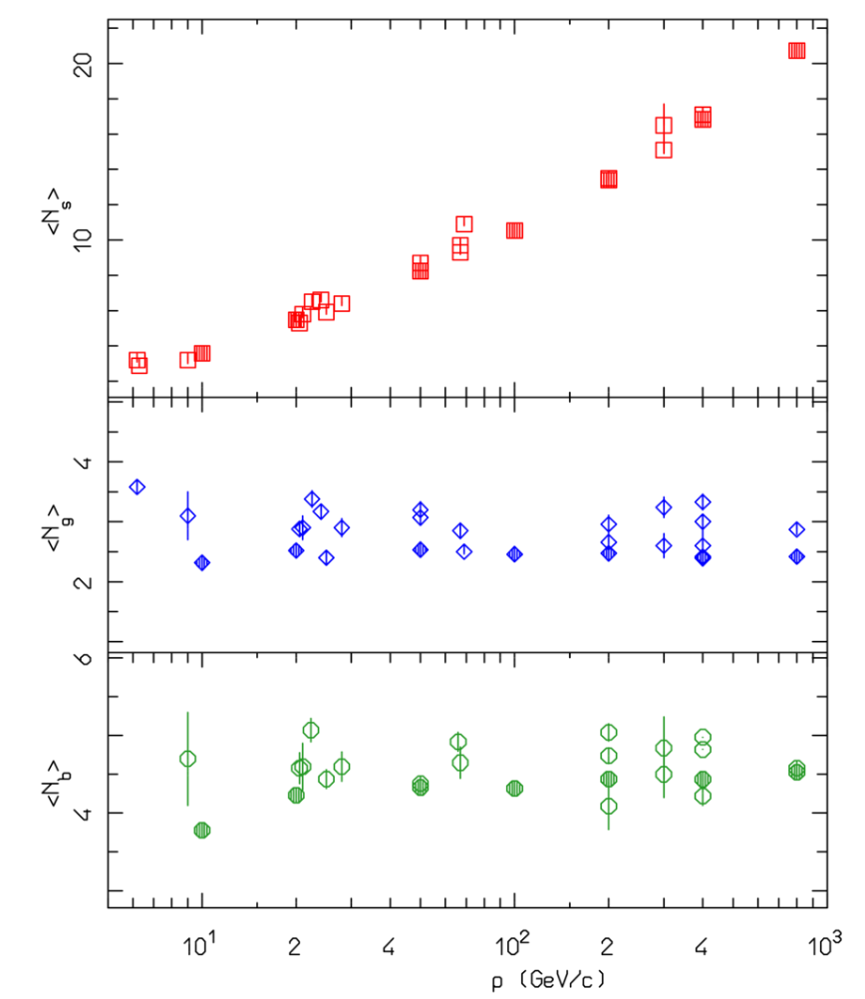
Formation zone: early evidence
Average multiplicities in proton-emulsion experiments
Many early experiments with high energy beams were using emulsions as target and recording media at the same time
Charged particle tracks were classified into:
Shower or fast tracks: weakly ionizing particles, around the ionization minimum (E> 2-3 times their mass), mostly pions → a measure of the particles produced in the primary collisions
Grey tracks: mildly ionizing particles, typically intermediate energy protons, → a measure of re-interaction products
Black tracks: heavily ionizing particles, typically evaporation products (p, α, …), → a measure of the excitation energy left in the residual nucleus
Evidence: shower particles continue to grow as expected, cascade and evaporation ones, are fully saturated above 10 GeV
→ only the slowest fragment(s) of each primary interaction have a chance to re-interact and feed the intranuclear cascade and the excitation energy
Open symbols: exp.
Full symbols: model

Slide 15
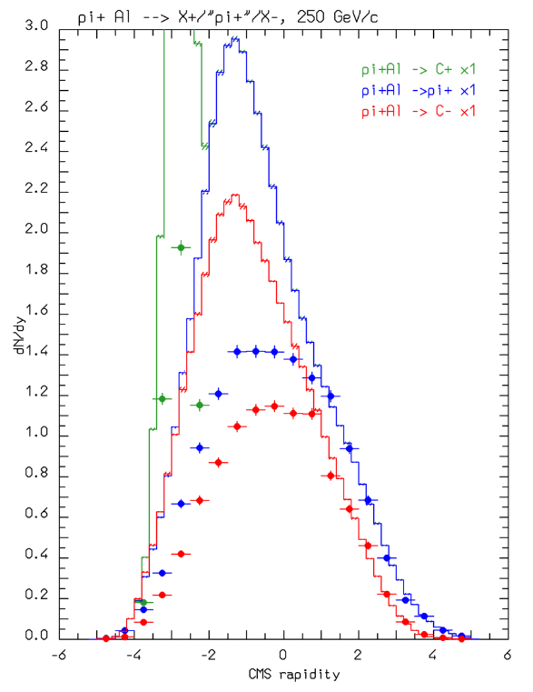
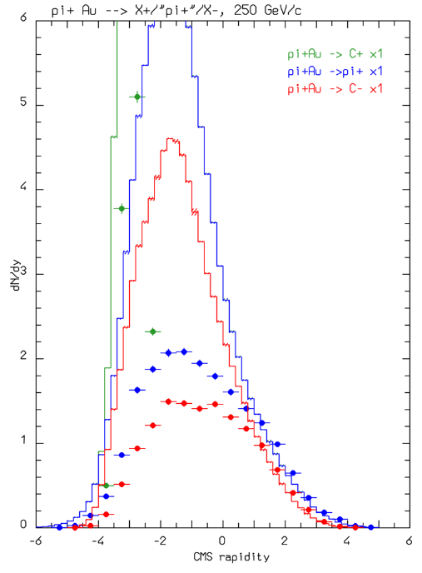
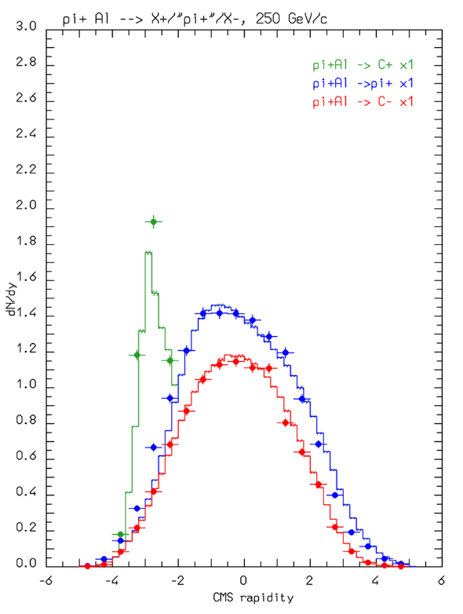
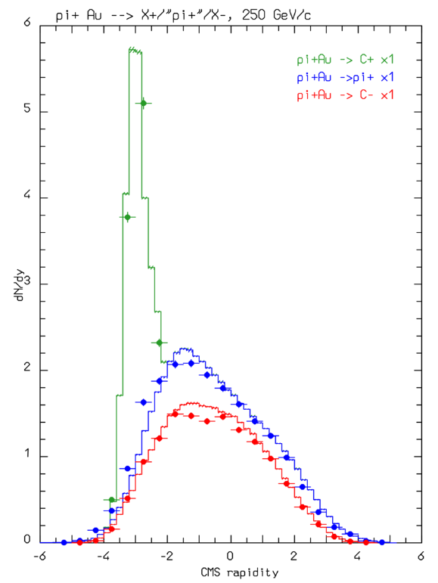
Formation zone: effect on hadron-induced reactions
Au
Al
Positive
Negative
π⁺
Positive
Negative
π⁺
Rapidity distribution of charged particles produced in 250 GeV π⁺ collisions on Aluminum (left) and Gold (right)
Histos: FLUKA
Points: exp. data (ZPC50, 361).
Top: without formation zone
Bottom: with formation zone
Al
Positive
Negative
π⁺
Positive
Negative
π⁺
Au

Slide 16
Nuclear optical potential for pions:
For pions, a complex resonant nuclear potential can be defined out of the π-nucleon scattering amplitude to be used in conjunction with the Klein-Gordon equation
The real part of the pion optical potential for π⁺ on ¹⁶O (left) and π⁻ on ²⁰⁸Pb (right) as a function of radius for various pion energies (MeV)

Slide 17
Pions in FLUKA: nuclear medium effects
Free π N interactions ⇒ | ⇒ | Non resonant channel
 | ⇒ | P-wave resonant Δ production
π + N → Δ in nuclear medium | ⇒ | decay | ⇒ elastic scattering, charge exchange
 | ⇒ | reinteraction | ⇒ Multibody pion absorption
Assuming for the free resonant σ a Breit-Wigner form with width Γ_{F}
An “in medium” resonant σ (σ^{A}_{res}) can be obtained adding to Γ_{F} the imaginary part of the (extra) width arising from nuclear medium
(Oset et al., NPA 468, 631)
quasielastic scattering, two and three body absorption
The in-nucleus σ_{t}^{A} takes also into account a two-body s-wave absorption σ_{s}^{A} derived from the optical model

Slide 18
Pion absorption:
Emitted proton spectra at different angles , 160 MeV π⁺ on Ni
Phys. Rev. C41,2215 (1990), Phys. Rev. C24,211 (1981)
Proton spectra extend up to 300 MeV!!
Pion absorption cross section on Gold and Bismuth in the Δ resonance region (Black dots: exp data, colored ones: model)
Symbols: exp. Data
Histos: model

Slide 19
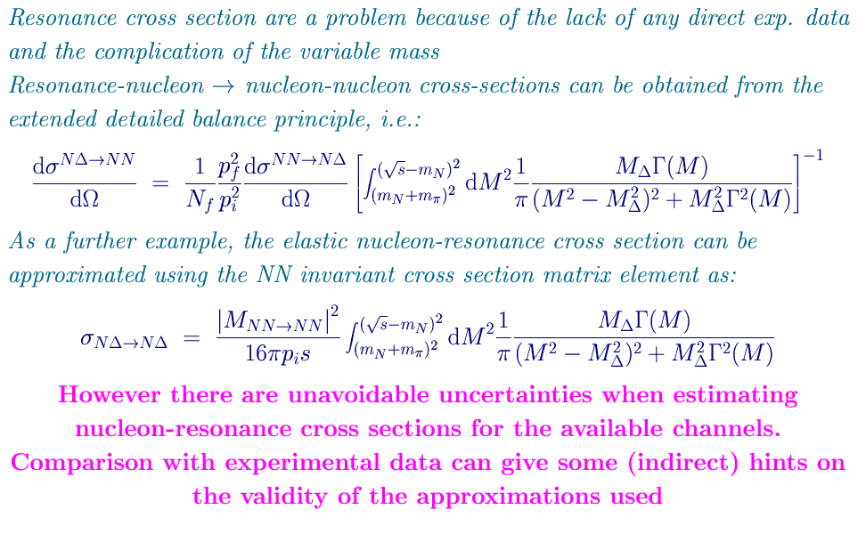
Resonance reinteractions: work (again) in progress
Resonance cross sections: difficult because of the lack of any direct exp. data (and the complication of the variable mass)
Resonance-nucleon → nucleon-nucleon cross sections can be obtained from the extended detailed balance principle:
As a further example, elastic nucleon-resonance cross section can be approximated using the NN invariant cross section matrix element as:
Algorithms worked out in the late ’90 for Peanut, but abandoned because of too small σ’s
Others (J.Cugnon in INCL) multiplied them by an empirical factor ~3
However Cugnon (PRC66 44615) now suggests that the conditions for the detailed balance to be valid are not met by resonances → a semi-quantitative enhancement correction factor ~3 (!!) is suggested → worthwhile a second look

Slide 20
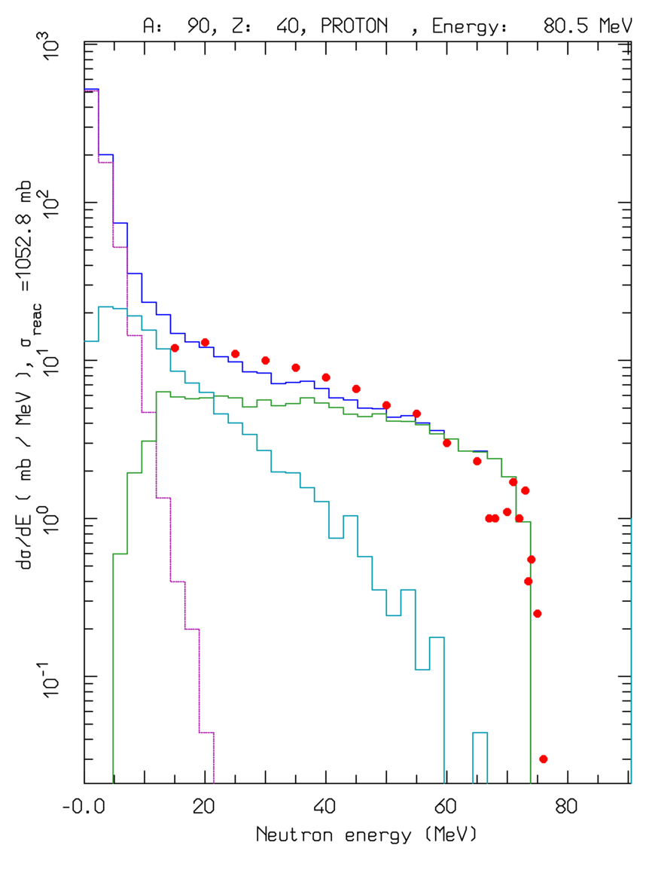
Preequilibrium emission:
For E > π prod. threshold → only (G)INC models. At lower energies INC becomes increasingly inapplicable → preequilibrium models == share the excitation energy among many nucleons/holes
Statistical assumption:
any partition of the excitation energy E* among N, N = N_{h} +N_{p}, excitons has the same probability to occur
Step: nucleon-nucleon collision with N_{n+1}=N_{n}+2 (“never come back approximation”)
Chain end = equilibrium = N_{n} sufficiently high, or excitation energy below threshold
N₁ depends on the reaction type and cascade history
dσ/dE ⁹⁰Zr(p,xn) at 80.5 MeV
Lines: total, INC, preequilibrium, evaporation contributions
Data • :from Phys. Rev. C39, 452
Preeq. in FLUKA: directly for p/n induced reactions below 30-100 MeV, or all remaining nucleons/clusters below 30-100 MeV/n.
In the latter case the initial configuration depends on the previous history.
Emission of p/n/light fragments (up to α’s)

Slide 21
Coalescence in FLUKA
FLUKA:
d, t, ³He, and alpha’s generated during the (G)INC and pre-equilibrium stage
FOM evaluation based on phase space “closeness” of emerging nucleons at the nucleus periphery used to decide whether a light fragment is formed rather than not
… (p,d) reactions at energies below few tens of MeV: badly reproduced by coalescence. A direct deuteron formation mechanism at the first pn elementary step has been introduced in FLUKA
Double differential t production from 542 MeV neutrons on Copper (NPA510, 774)

Slide 22
Equilibrium particle emission (evaporation, fission and nuclear break-up)
From statistical considerations and the detailed balance principle, the probabilities for emitting a particle of mass m_{j,} spin S_{j,}ħ and energy E, or of fissioning are given by*:
(i, f for initial/final state, Fiss for fission saddle point)
Probability per unit time of emitting a particle j with energy E
In FLUKA: ~600 possible emitted particles/states (A<25) with an extended (heavy) evaporation/fission/fragmentation formalism
For light nuclei (A<17): enhanced Fermi break up
Probability per unit time of fissioning
*Weisskopf-Ewing approach
ρ’s: nuclear level densities
U’s: excitation energies
V_{j}’s: possible Coulomb barrier for emitting a particle type j
B_{Fiss}: fission barrier
Q_{j}’s: reaction Q for emitting a particle type j
σ_{inv}: cross section for the inverse process
Δ’s: pairing energies
Neutron emission is strongly favoured because of the lack of any barrier
Heavy nuclei generally reach higher excitations because of more intense cascading

Slide 23
Fermi Break-up in FLUKA:
Statistical (evaporation) models are known to work poorly for light nuclei. An alternative, better performing, description of light nuclei de-excitation can be obtained with the Fermi break-up mechanism. The probability of splitting a nucleus A, Z, with excitation U into n fragments of given masses, m_{i}, spins, s_{i}, … is given by:
… however it implicitly assumes that the emission takes place in L=0.
Significant improvement can be obtained when the compound nucleus spin and parity, J^{π}, are known:
The minimum orbital momentum, L_{min}, required to match J^{π} is computed
S_{n} is restricted to the subset of spin combinations compatible with L_{min}
If L_{min} > 0, then E_{Coul} → E_{Coul} + B_{centrifugal}

Slide 24
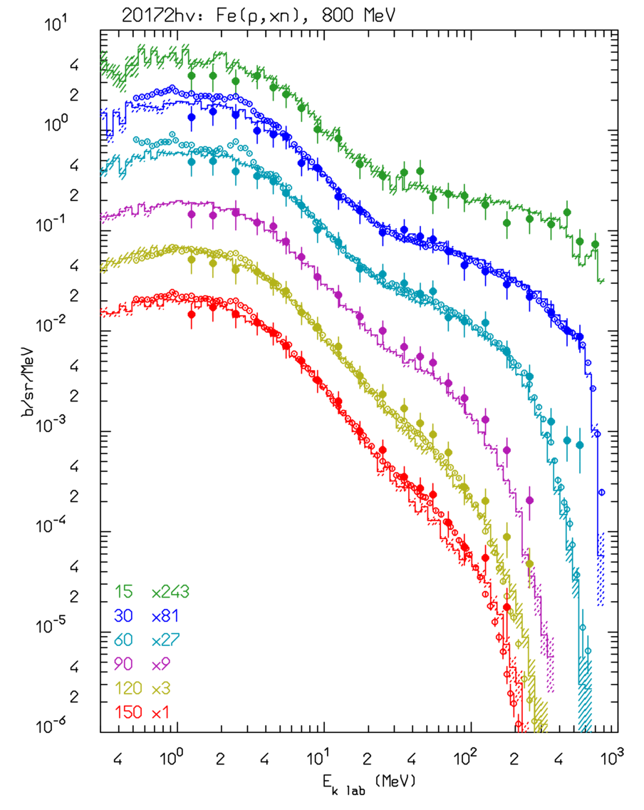
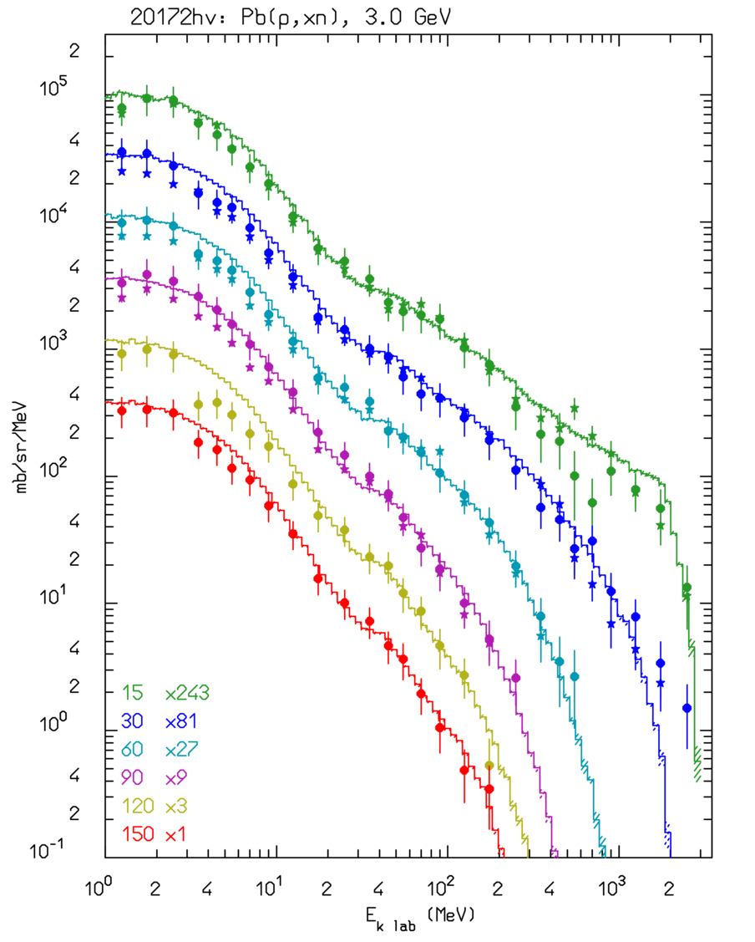
Thin target examples: neutrons
Double differential ← cross section d²σ/dEdΩ for Fe(p,xn) @ 800 MeV, thin target
Data: NSE112, 78 (1992), NST34, 529 (1997)
Cascade, preequilibrium neutrons
Evaporation
neutrons
Double differential cross section d²σ/dEdΩ for Pb(p,xn) @ 3 GeV → thin target
Data: NST32, 827 (1995)

Slide 25
Example of fission/evaporation
1 A GeV ²⁰⁸Pb + p reactions Nucl. Phys. A 686 (2001) 481-524
Data
Fluka
Fluka after cascade
Fluka after preeq
Quasi-elastic
Spallation
Evaporation
Fission
Deep spallation
Fragmentation

Slide 26
Real and Virtual Photonuclear Interactions
Photonuclear reactions
Giant Dipole Resonance interaction (special database)
Quasi-Deuteron effect
Delta Resonance energy region
Vector Meson Dominance at high energies
INC, preequilibrium and evaporation via the PEANUT model
Virtual photon reactions
Muon photonuclear interactions
Electronuclear interactions
Electromagnetic dissociation
Electro(Positro)Fission on ²³⁸U
Lines:FLUKA (E1+E2)
Symbols.: exp. data
With help from P.Degtiarenko and G.Kharashvili
Notes:
In not many other existing transport codes photonuclear reactions are simulated over the whole energy range

Slide 27
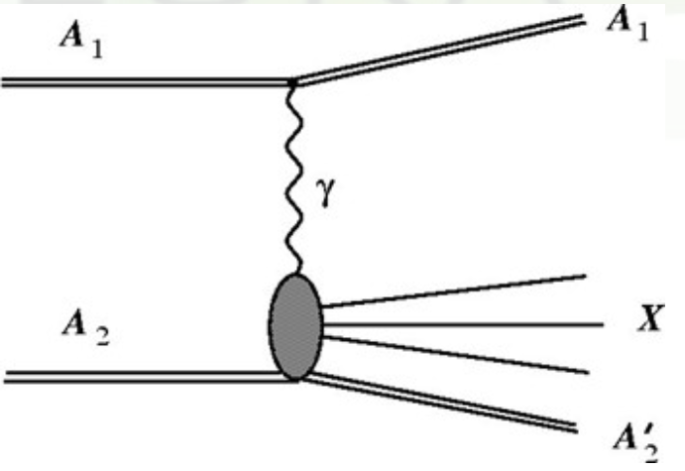
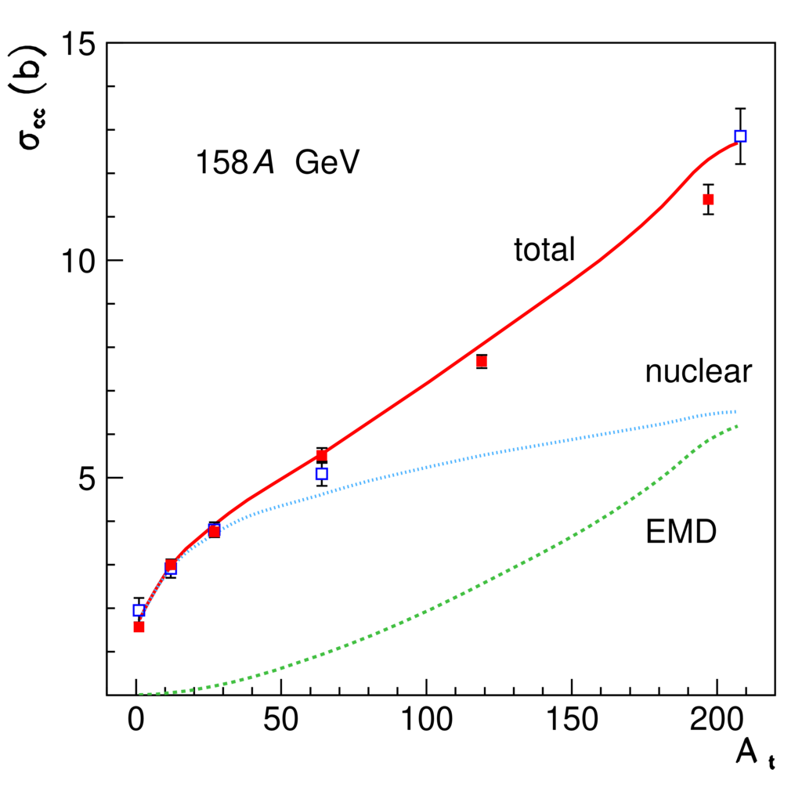
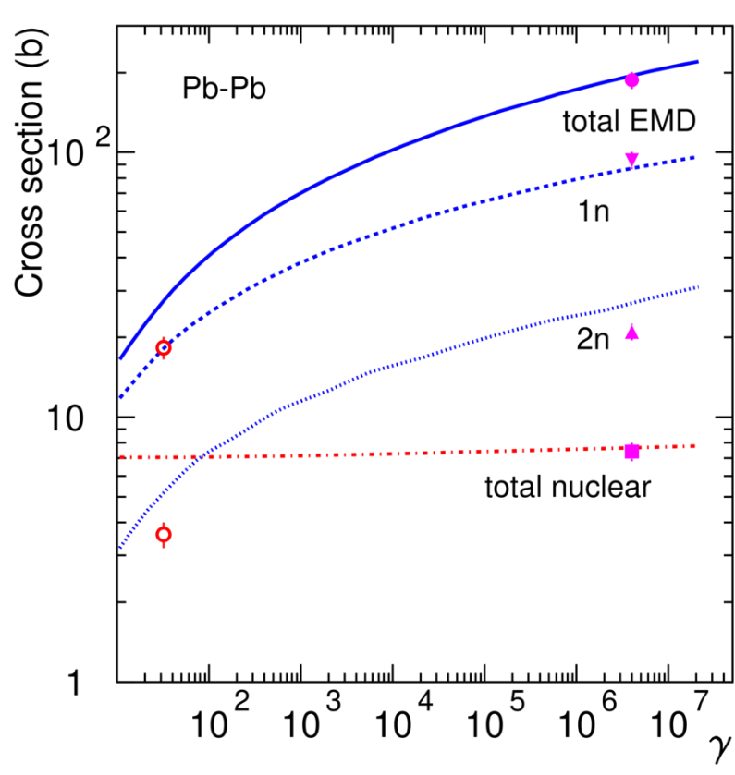
Electromagnetic dissociation*
Very peripheral collisions
Break-up of one of the colliding nuclei in the electromagnetic field of the other nucleus
… nuclear and, mostly, ElectroMagneticDissociation collisions on LHC machine elements or at IP’s produce a variety of (excited), possibly radioactive, fragments in flight
Pb ions on various targets
Alice:
√s_{nn}=2.8 TeV
Symbols: exp. data
Lines: Fluka*
*PRSTAB17 021006
Total charge changing cross section as a function of atomic mass
Total EMD, 1 n, 2 n, and nuclear cross sections as a function of the effective γ factor

Slide 28
(Anti)Neutrinos in FLUKA:
Acta Phys.Polon. B40 (2009) 2491-2505
CERN-Proceedings-2010-001 pp.387-394.
νN QuasiElastic (from ~0.1 GeV upward):
  Following Llewellyn Smith formulation
  Lepton masses accounted for
νN Resonance production
  From Rein-Sehgal formulation
  Keep only Δ production
  Non-resonant background term from DIS
μ
±
ν
ν
k’
μ
μ
k
2
2
Q = -q
±
q=k-k’
W
q
Z
0
p=xP
q
g
W
νN Deep Inelastic Scattering
  NunDIS model (developed ad hoc for FLUKA)
  Chains from νN DIS: → FLUKA hadronization
νN interactions embedded in PEANUT for νA (Initial State and Final State effects)
q
N
q
q
P
Hadronization

Slide 29
Comparison with data on total cross section
Isoscalar ν_{µ} - Nucleon total CC cross section
Fluka (lines) with two pdf options
vs
Experimental data
FLUKA can currently manage (anti)ν-A interations from ~0.1 GeV up to 1000 TeV

Slide 30
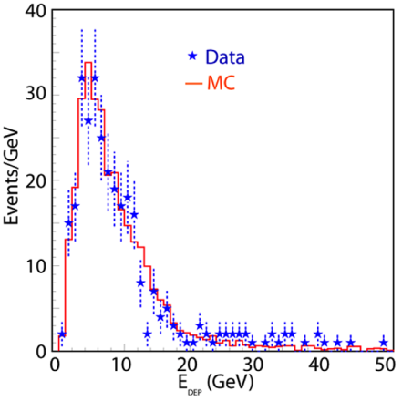
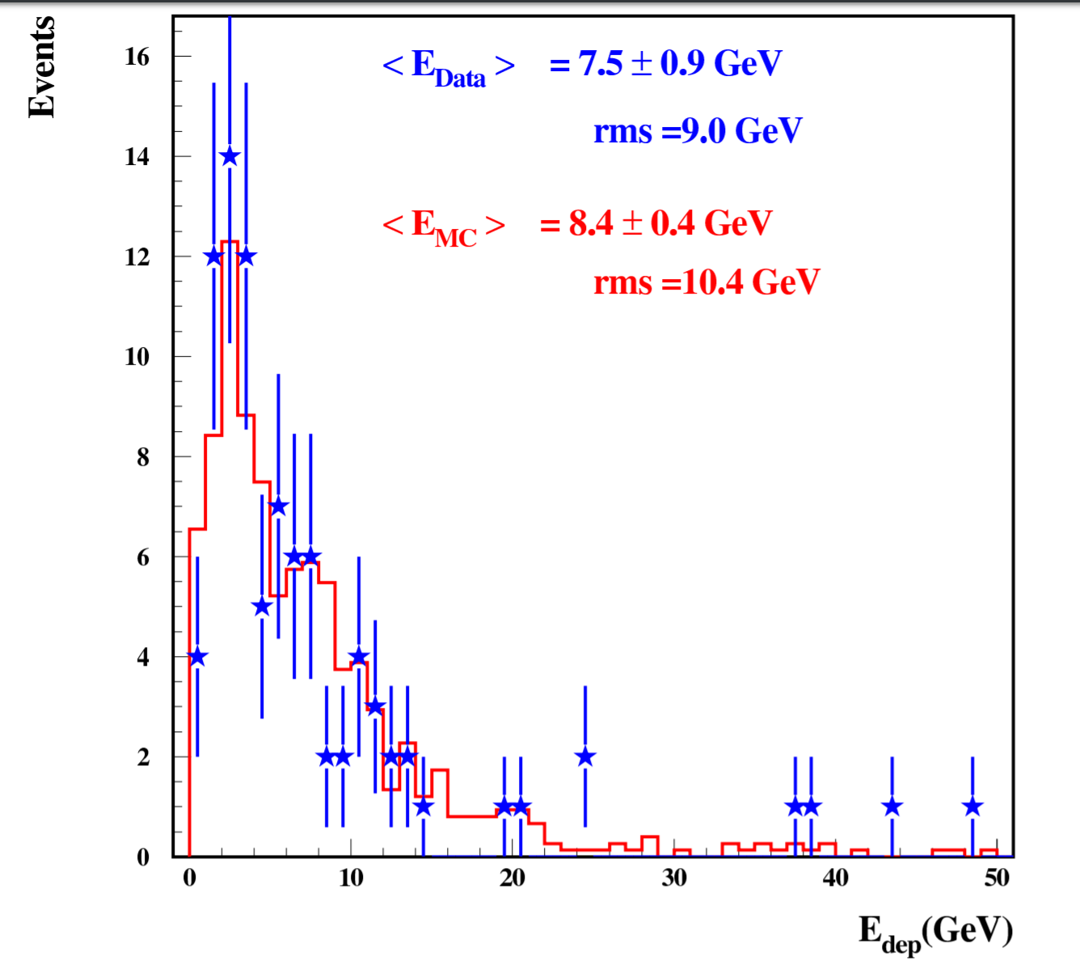
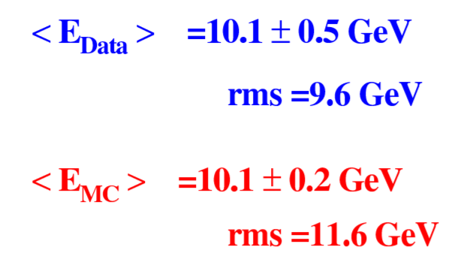
Reaction products: CNGS data (≈20 GeV <E_{ν}>)
Distribution of total deposited energy in the T600 detector
← Left:
ν_{µ} CC events
Right:→
ν NC events
Same reconstruction in MC and Data
Neutrino fluxes from FLUKA CNGS simulations
Absolute agreement on neutrino rates within 6%
Eur. Phys. J. C (2013) 73:2345
Phys. Lett. B (2014)

Slide 31
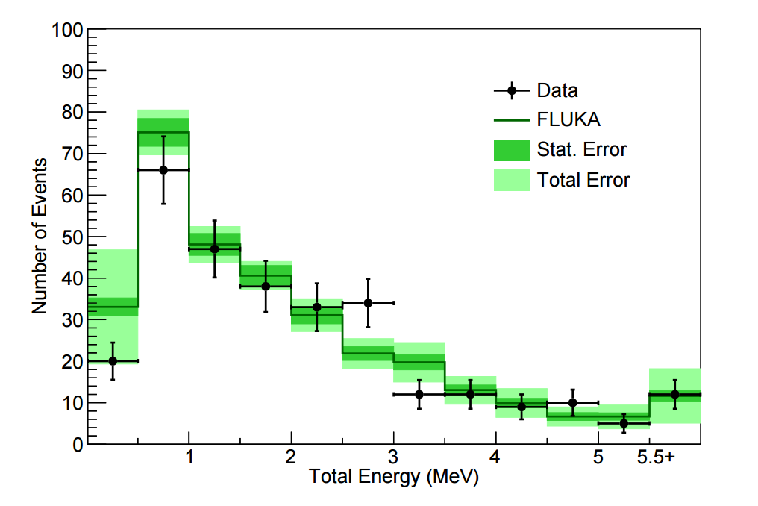
γ de-excitation application: neutrinos+neutrons
Detector: ARGONEUT operated in the NuMi beam, in front of the Minos near detector. Small LAr chamber
One of the measurements: de-excitation gamma-rays from neutrino interactions
Background to this search: mainly photons from unseen neutrons generated in the neutrino interaction
Simulations with FLUKA, internal neutrino generator + fully correlated pointwise low-energy neutron σ’s for Ar
Total reconstructed γ energy in an event for neutrino data and FLUKA MC events. Events with no reconstructed energy are not included
Phys. Rev. D 99, 012002 – Published 7 January 2019

Slide 32
Questions:
How can we help in general?
Would a Peanut interface to a eN generator (similar to the built-in one for Nundis) be of help?
What about formation time for DIS events?
…
Thanks for your attention

