Slide 1

Complementary Detectors at EIC
E.C. Aschenauer (BNL)
P.R. Newman (Birmingham)

Slide 2
We want it all
high Luminosity
at full acceptance
But there are some boundary conditions
accelerator
experiment

Slide 3
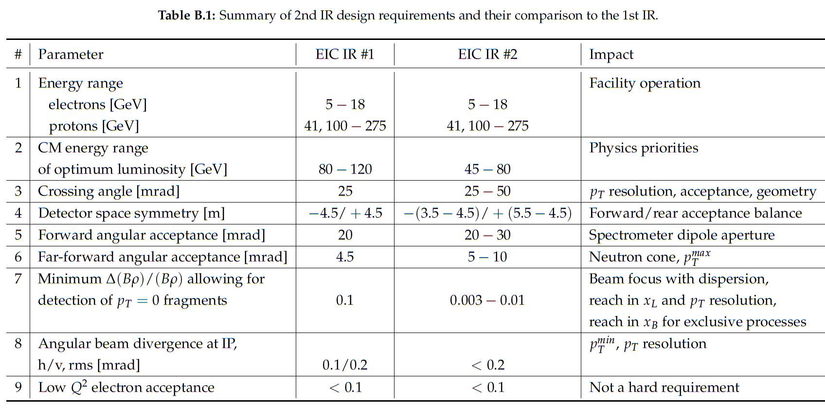
Boundary Conditions
Interaction Region:
All beams transport over full energy range
Magnet aperture-edge fields < 4.6 T
    Detune low-beta or do not run for E_{p}>~180 GeV
Sufficient DA and momentum aperture
Total beam-beam < 0.03 (p), 0.1 (e)
Beam aperture >10σ (p); >15σ_{x}/20σ_{x} H/V (e)
    Electron aperture accommodates non-Gaussian tails
Dispersion and dispersion’ constraints at crab cavities

Slide 4
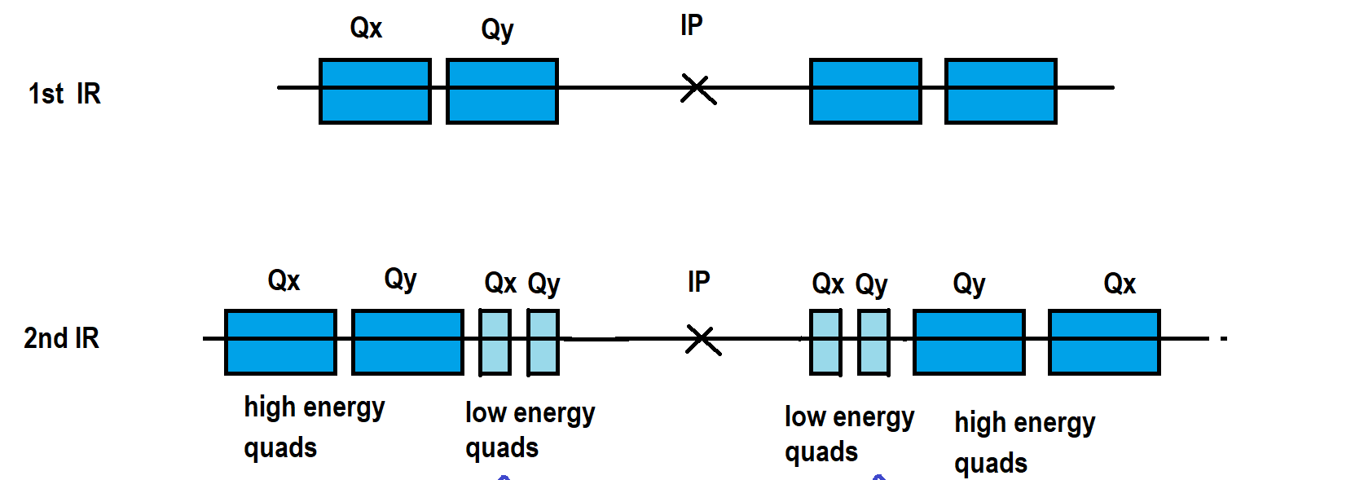
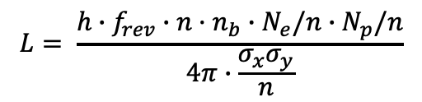
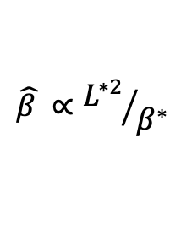
Luminosity vs. Detector Space
$$L= \frac{{h∙f}_{rev}∙{n·n}_{b}∙N_{e}/n∙N_{p}/n}{4π∙\frac{σ_{x}σ_{y}}{n}}$$
Luminosity:
but reduce emittances by factor n ( note n_{b} is original number of bunches, new is n·n_{b}), which requires much stronger cooling τ_{cool} ➔ τ_{cool} / 2,4, …
The original luminosity is then recovered
Luminosity can now be increased by squeezing the betas by a factor 2 which is possible since the envelope in the final focus quadrupoles has shrunk by a factor of √2 in x and y
One is left to deal with the enhanced IR chromaticity which went up by a factor of 2 which reduces the dynamic aperture by a factor ~2
How to reduce IR chromaticity?
Increase crossing angle to get final focus quadrupoles closer to IP
θ_{cross} ➔θ_{cross} x 2
→ Impact on detector: asymmetric material budget in outgoing hadron beam direction
asymmetric and reduced acceptance for high η hadrons
Electrons: final focus quadrupoles in the detector
Hadrons:
$$\hat{β }∝{L^{∗2}}/{β^{∗}}$$
L*
Detector Size directly coupled to Luminosity

Slide 5
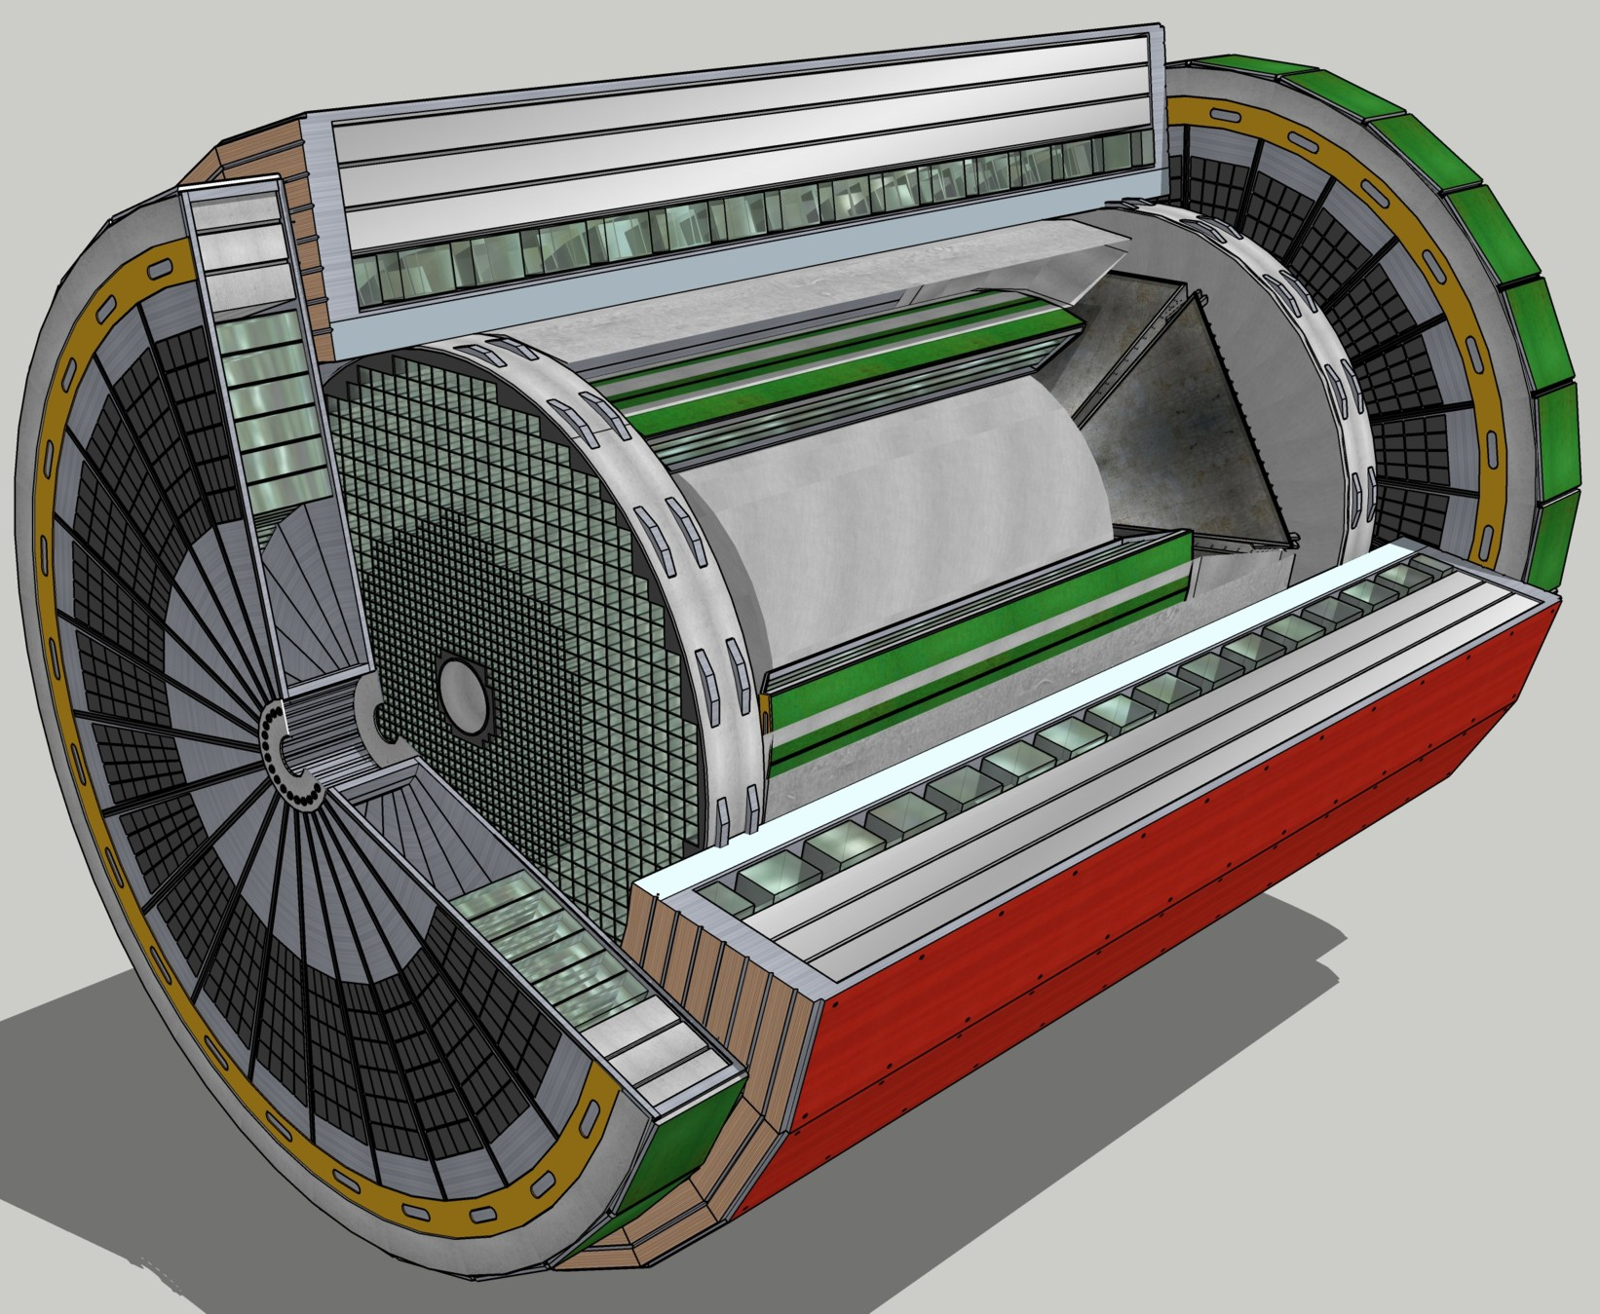
General Purpose Detector
Overall detector requirements:
Large rapidity (-4 < η < 4) coverage; and far beyond in especially far-forward detector regions
High precision low mass tracking
  small (μ-vertex) and large radius (gaseous-based) tracking
Electromagnetic and Hadronic Calorimetry
  equal coverage of tracking and EM-calorimetry
High performance PID to separate π, K, p on track level
  also need good e/p separation for electron-scattering
Large acceptance for diffraction, tagging, neutrons from nuclear breakup: critical for physics program
  Many ancillary detector integrated in the beam line: low-Q² tagger, Roman Pots, Zero-Degree Calorimeter, ….
High control of systematics
  luminosity monitors, electron & hadron Polarimetry
To date no argument was presented why to go away from this
overall concept

Slide 6
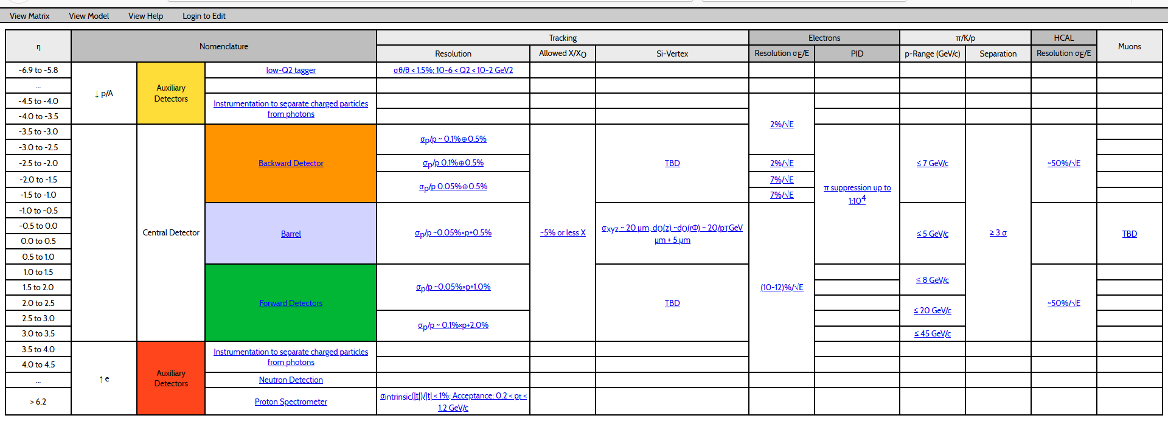
General Purpose Detector: Refined Requirements

Slide 7
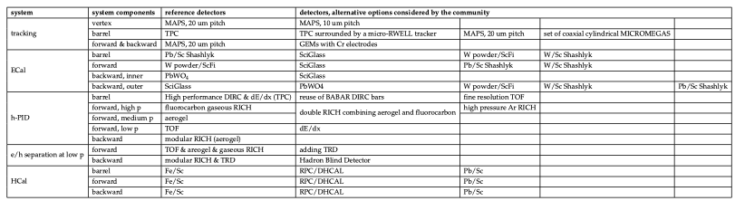
General Purpose Detector: Technology Possibilities
To get two detectors complementary in technology
but with equal performance one needs to optimize
the full detector and not only push individual subdetectors performances

Slide 8
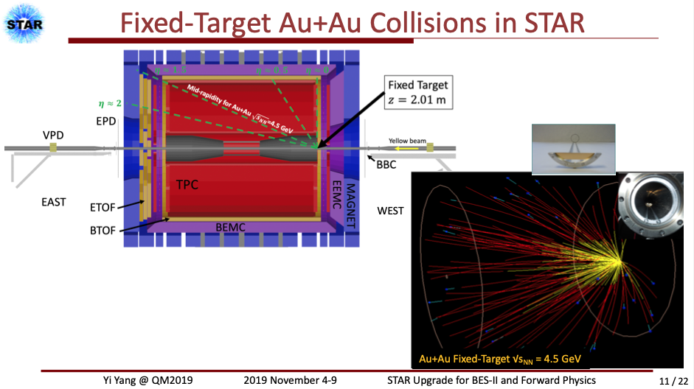
Additional Science Opportunities
Integrate fixed target into collider:
done at LHC (ALICE and LHCb) and STAR@RHIC
for EIC on can do
ep/A fixed target --> access to high x
pp/A important to test universality for TMDs, GPDs, ……

Slide 9
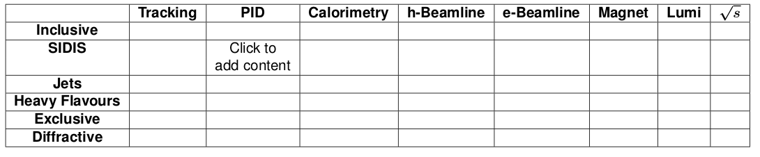
Complementarity Matrix
Collect information neatly via a ‘Physics Topic’ v ‘Detector Component’ matrix
- Each element clickable to add content (could leads to a page with list of files / links)
→ complementarity ideas (see list of questions asked to Working Groups)
→ problems arising from baseline design
→ …
- May need more rows, subdividing some of the PWGs (eg for SIDIS)
- ECA and PRN populate based on material from Complementarity meetings so far
- Invite others to add material before / during / after CUA meeting

Slide 10


