Slide 1
EICUG Polarimetry Working Group Kickoff Meeting
Polarimetry-related Capabilities and
SBIR Leveraged Research for the EIC
at Euclid Techlabs
15 Sept 2020
Euclid Techlabs LLC Eric Montgomery • Andrei Afanasev

Slide 2
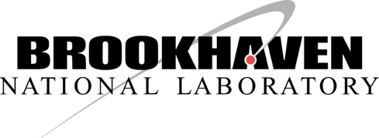
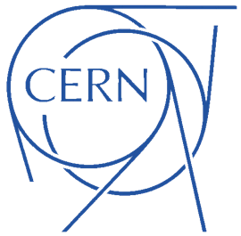
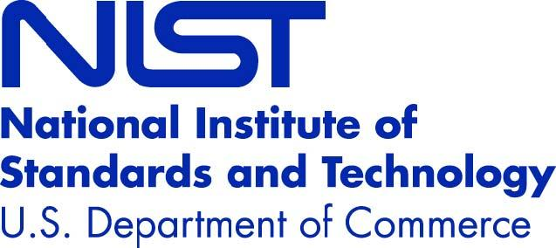
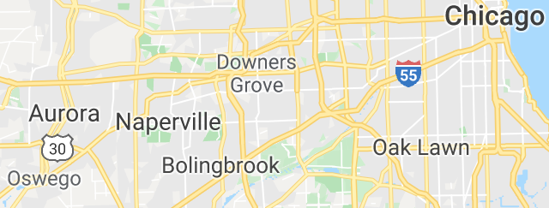
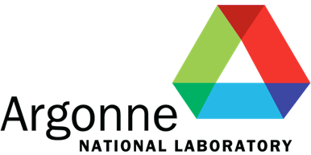
Euclid Techlabs LLC
Euclid Techlabs, LLC in Bolingbrook, IL, specializes in linear particle accelerators, ultrafast electron microscopy, and advanced material technologies for energy, defense, and medical applications.
20 researchers • engineers • technicians
10,000 ft² research space, and growing
time-resolved ultra-fast electron microscopy
ultra-compact linear accelerators
electron guns (thermionic, field, or photoemission)
fast tuners for SRF cavities
advanced dielectric materials
HPHT and CVD diamond growth and applications
thin-film applications in accelerator technologies
Current Collaborating Laboratories

Slide 3
Diamond Mott Polarimetry
Radiative corrections to Mott polarimetry may be quantified by comparing measured polarization with high and low Z targets
The existing 5 MeV Mott at JLab’s CEBAF may be suitable for a diamond target experiment (J. Grames) – recent 0.6% accuracy! Hope to push to 0.4% with this proposed work.
Euclid Techlabs has extensive synthetic diamond growth experience and has utilized specially prepared diamond in many applications from field emission cathodes to electron beam halo diagnostics (J. Butler, I. Ponomaryev, S. Kuzikov, C. Jing)
An SBIR Phase I proposal is in preparation (E. Montgomery, PI, A. Afanasev, theory/computation)
Euclid Techlabs welcomes collaboration and suggestions leading up to the mid-October 2020 proposal submission
E.Montgomery@euclidtechlabs.com

Slide 4
Euclid Capabilities for EIC polarimetry
electron detection expertise (such as our current electron halo detector with diamond embedded in an RF resonator for extreme sensitivity)
substantial diamond growth and fabrication expertise (including laser machining of diamond, HPHT and CVD growth experience)
Andrei's code for Möller radiative corrections and Mott, as well as codes by others to run Compton radiative corrections
superconducting device modeling/experiment experience
nanofabrication (electron beam lithography, optical lithography, wet and dry etching, RF and DC plasma sputter coating)

