Slide 1
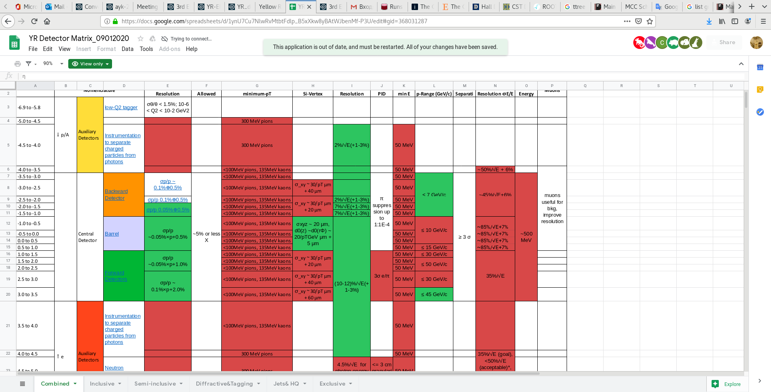
The matrix table from PWG

Slide 2
ŋ | Energy Resolution | Min E MeV | PID | Energy Resolution | Min E MeV
-4.2 to -2 | 2.2%/√E+1% Achieved with PMT readout > 35 cm space | 20 |  | 50%/√E+10% | 500
-2 to -1 | (4*-8)%/√E+1.5% Upper limit achievable with 40 cm space and projective geometry * better resolution required more (65 cm) space allocated | 50 |  | 50%/√E +10% Better resolution required more space and R&D | 500
-1 to 1 | (12-14)%/√E+(2-3)% Feasible with Shashlik Better resolution could be achievable with (8%/√E) sampling cal. and more space or with homogeneous materials PWO (2%/√E) and SciGlass (4-5%/√E) with ~30cm more space | 100 50 |  | 100%/√E +10% | 500
1 to 4.2 | (4*-12)%/√E+1.5% * better resolution required more (~65 cm) space allocated | 50 |  | 50%/√E+10% 35%/√E not possible | 500

