Slide 1


Groomed Event Shapes in e+p DIS + Lessons for EIC*
Henry Klest for the H1 Collaboration
HERA4EIC Workshop, June 8
*EIC Lessons are my personal opinions as a newcomer, not representative of the H1 collaboration!

Slide 2

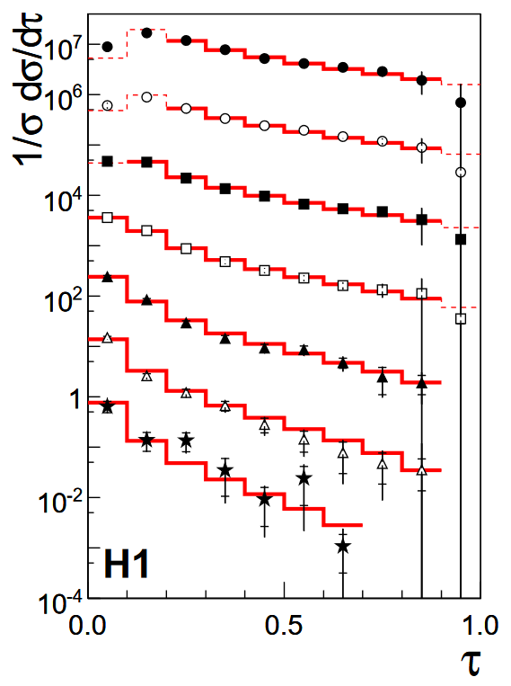
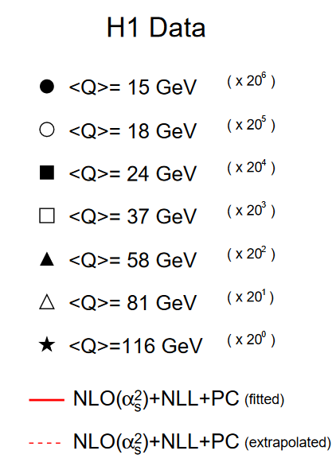
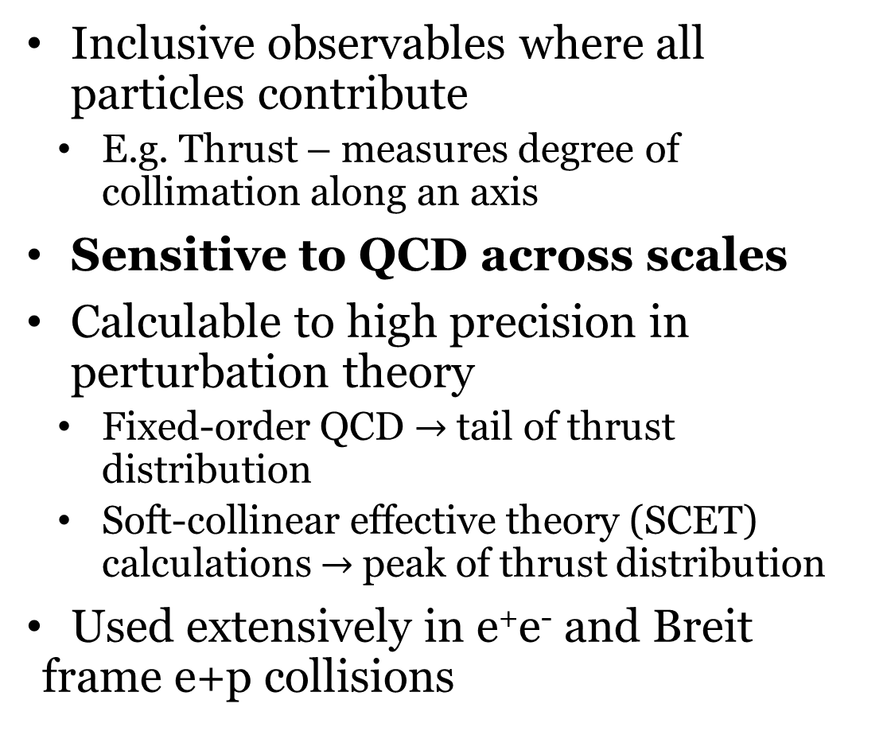
Event Shapes
Inclusive observables where all particles contribute
  E.g. Thrust – measures degree of collimation along an axis
Sensitive to QCD across scales
Calculable to high precision in perturbation theory
  Fixed-order QCD $→$tail of thrust distribution
  Soft-collinear effective theory (SCET) calculations $→$peak of thrust distribution
Used extensively in e⁺e⁻ and Breit frame e+p collisions
arXiv/0512014v1

Slide 3
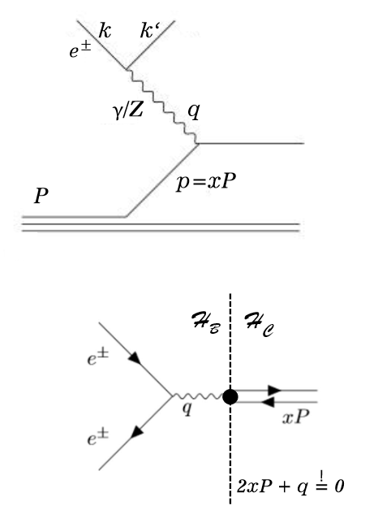


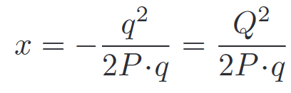
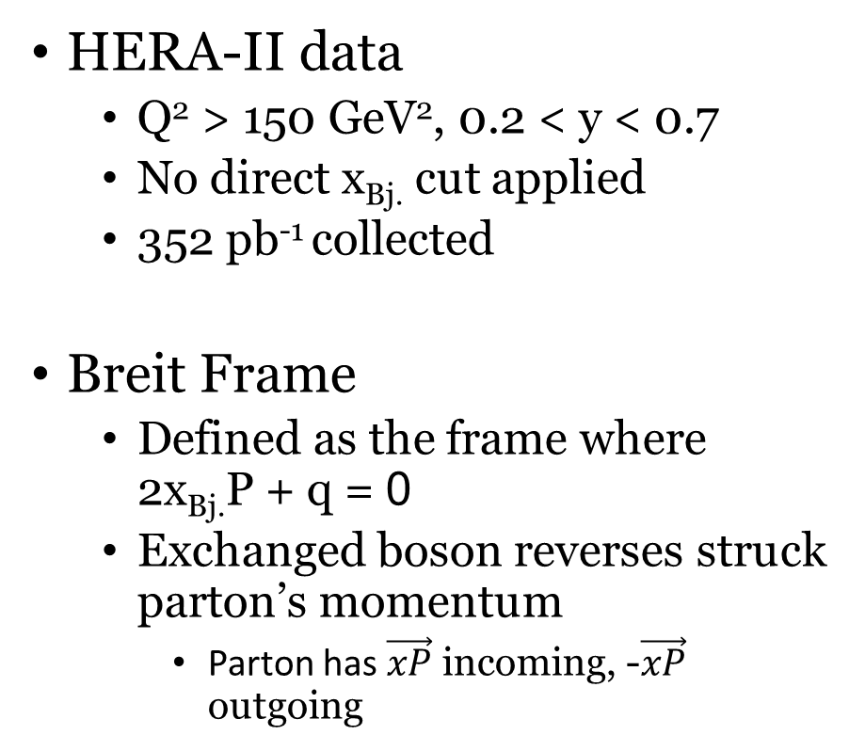
Inclusive DIS & Breit Frame
HERA-II data
  Q² > 150 GeV², 0.2 < y < 0.7
  No direct x_{Bj.} cut applied
  352 pb⁻¹ collected
Breit Frame
  Defined as the frame where 2x_{Bj.}P + q = 0
  Exchanged boson reverses struck parton’s momentum
    Parton has $\vec{xP}$ incoming, -$\vec{xP}$ outgoing
Current Hemisphere: Struck parton continues at η = -∞
Beam Hemisphere: Proton remnant continues at η = ∞
3

Slide 4
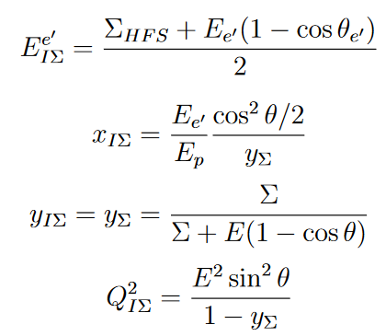
Inclusive DIS – Event Selection
DIS kinematics reconstructed with IΣ method
  Factors out QED ISR
  Does not assume that incoming electron has 27.6 GeV of energy at the hard vertex
    Infer electron energy from longitudinal momentum balance
Require 50 GeV < Σ(E-P_{z}) < 60 GeV
  Ensures low amount of QED ISR and detector losses in current hemisphere
    Effectively constrains an unmeasured ISR photon to have < 2.5 GeV of energy
    Also removes all non-DIS background (photoproduction, beam-gas, etc.)
Fiducial volume cut applied to ensure high electron purity

Slide 5
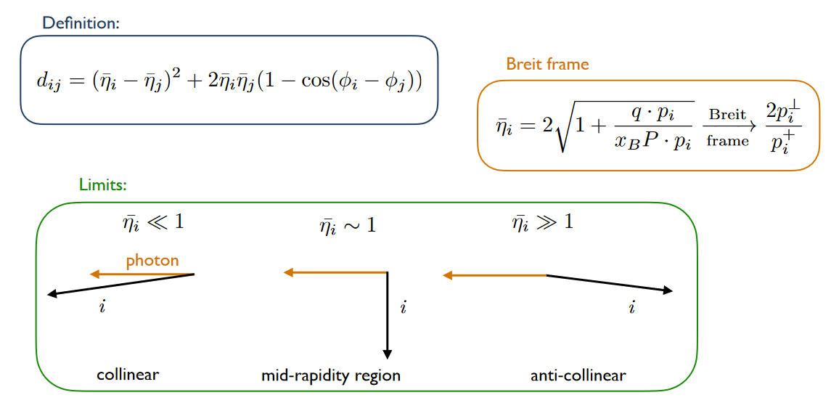
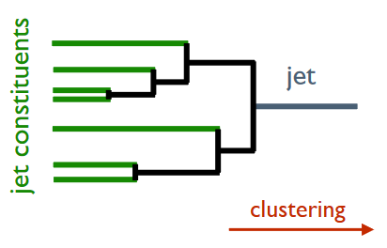
arXiv:2006.10751
Centauro
Jet algorithm with asymmetric clustering distance measure
  Suited for clustering Born-level DIS in the Breit frame
Here Centauro is used to produce a clustering tree for the full event
Fully Clustered Event
Event Constituents
Figures courtesy of Y. Makris [2]

Slide 6
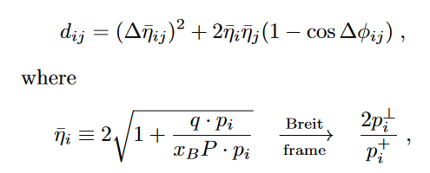


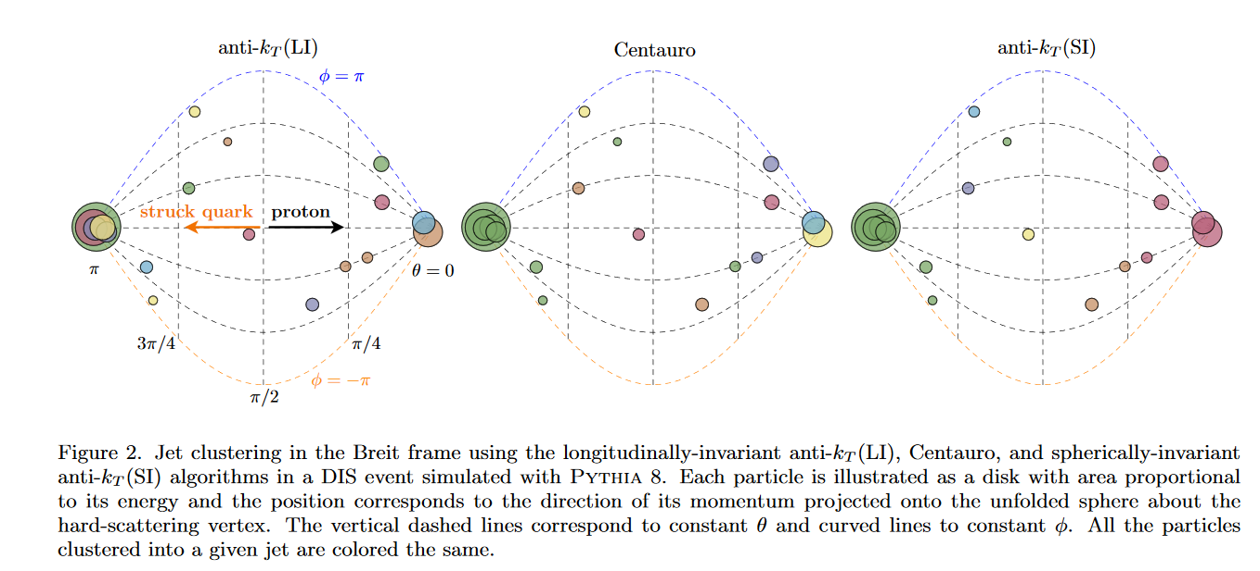
Centauro
Centauro jets will be an important EIC measurement!
vs.
vs.
Cluster at π has low P_{T} in Breit frame, smaller d_{ij}
Doesn’t preferentially capture struck quark
Not longitudinally invariant

Slide 7
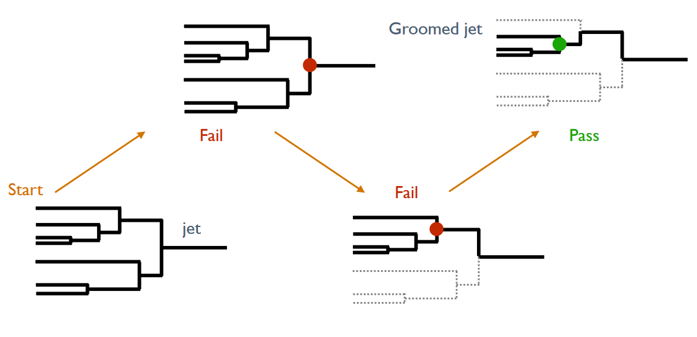

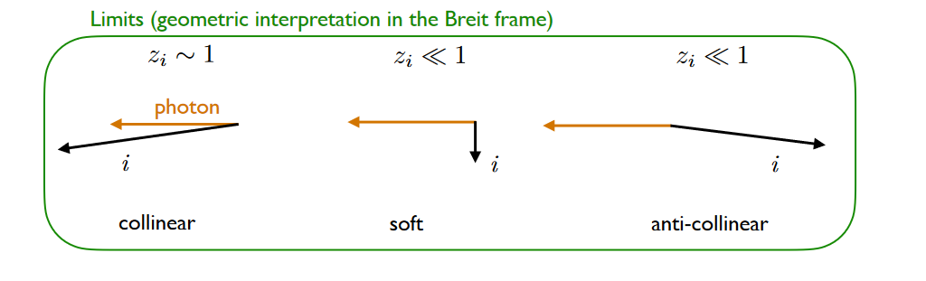


Groomed event
Event Grooming in DIS
Whole event is clustered into one “jet”
Iteratively de-cluster until grooming condition is passed
  Analogous to Soft Drop in p+p
Groomed events are similar to groomed jets!
Full event
p+p Soft Drop condition
DIS grooming condition

Slide 8
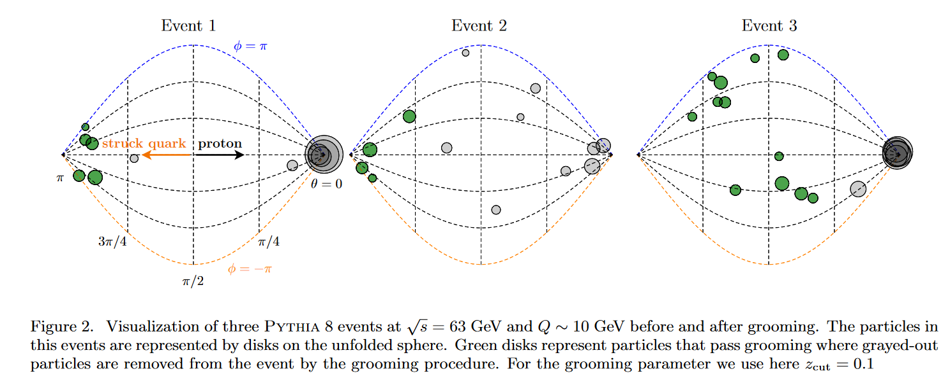
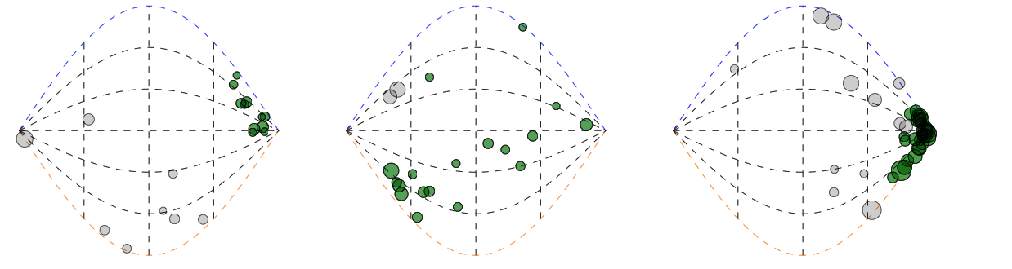

Breit Frame Event Displays

Slide 9
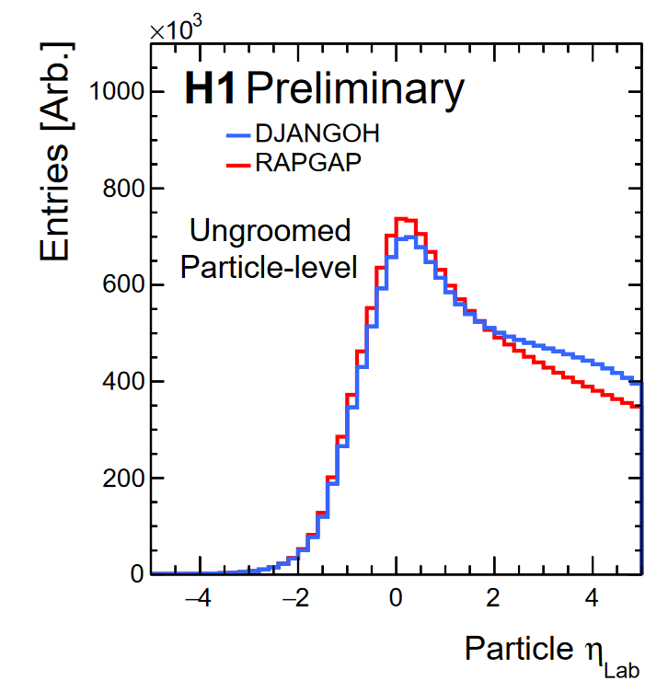
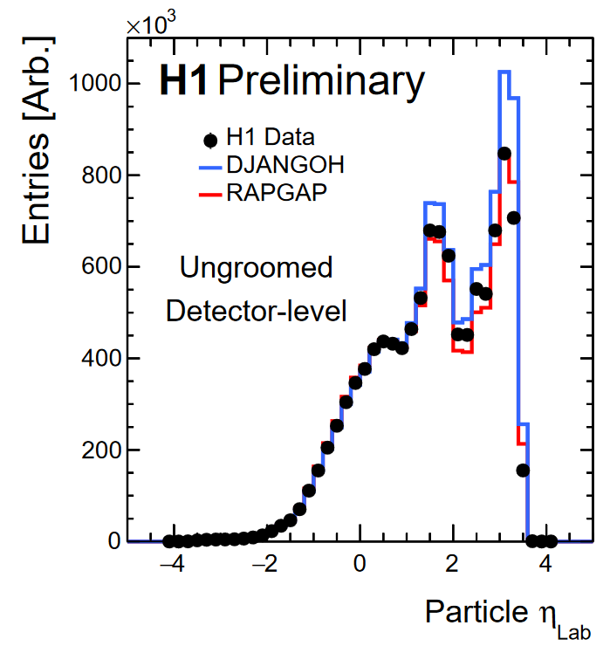
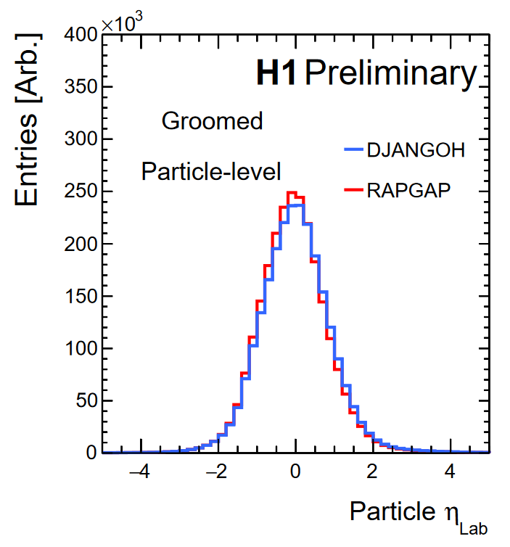
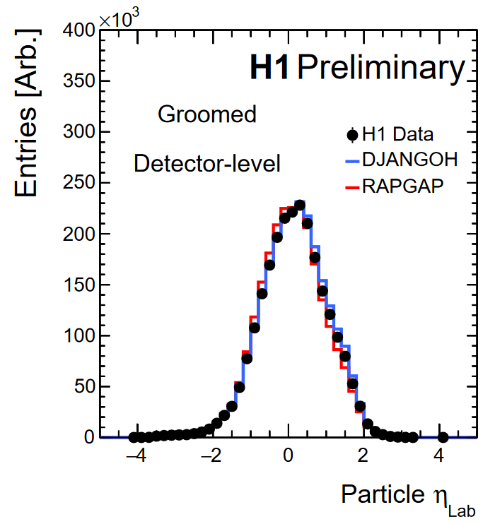
Grooming Benefits
No underlying event, why groom?
  Less affected by lab-frame detector acceptance
  Mitigate QCD remnant, ISR
  No theoretically challenging non-global logarithms
Ungroomed detector-level shows significant difference from particle-level
  Detector acceptance, efficiencies
Grooming events brings particle-level and detector-level distributions into much better agreement!
Z_{cut} = 0.2
Z_{cut} = 0.2

Slide 10
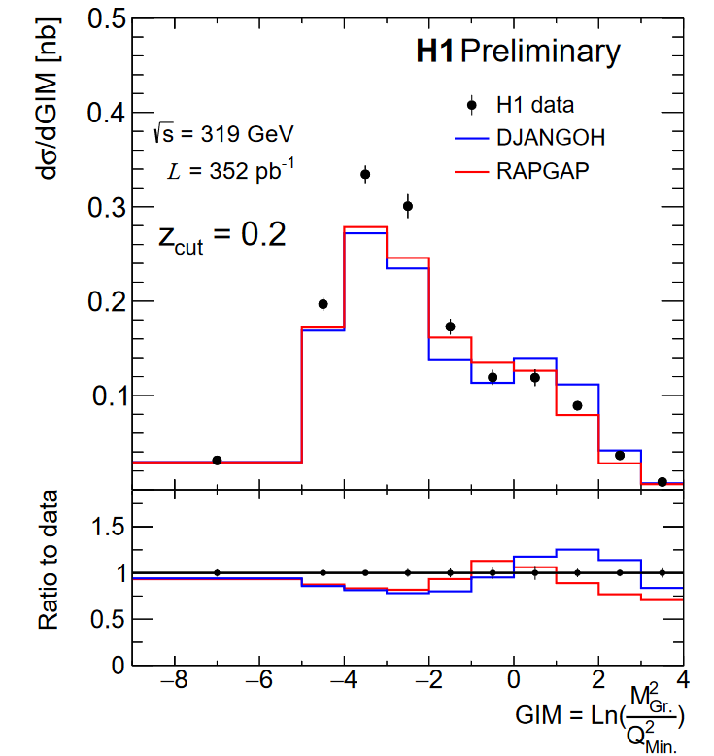
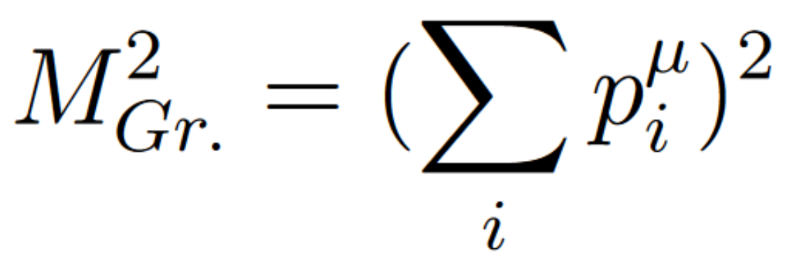
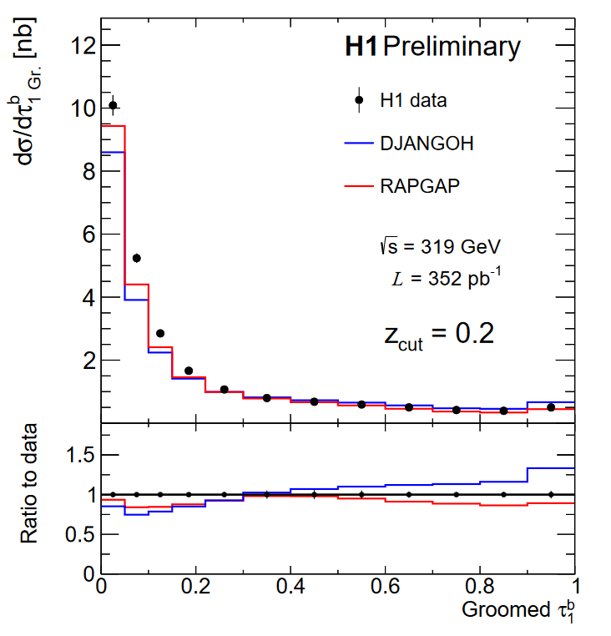
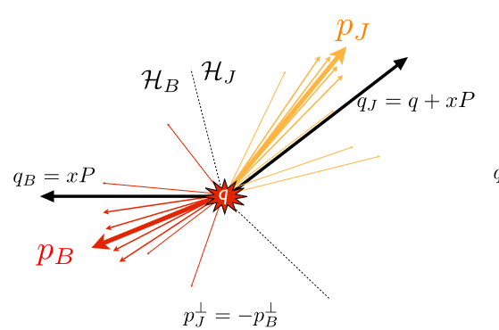
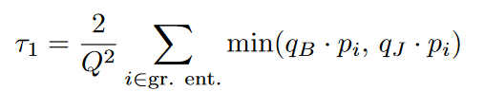
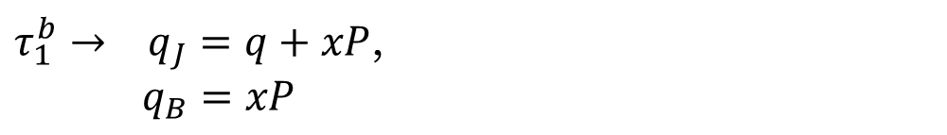
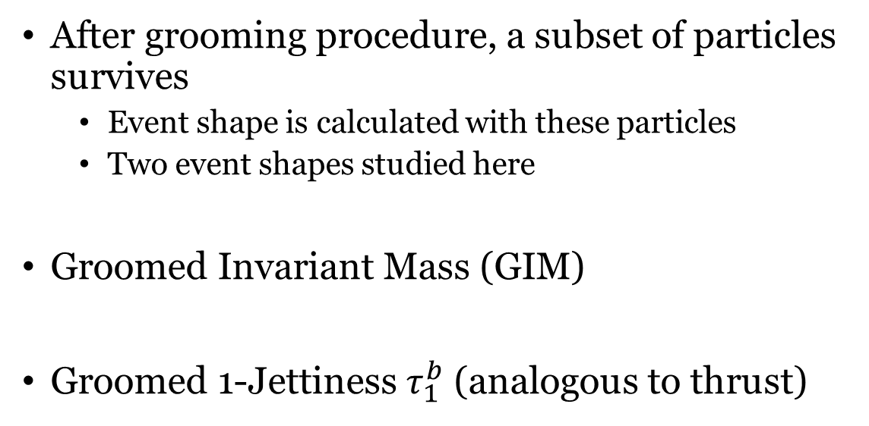
Observables
After grooming procedure, a subset of particles survives
  Event shape is calculated with these particles
  Two event shapes studied here
Groomed Invariant Mass (GIM)
Groomed 1-Jettiness $τ_{1}^{b}$ (analogous to thrust)
Non. Pert.
Non. Pert.
$τ_{1}^{b}→ q_{J}=q+xP$,
$q_{B}=xP$

Slide 11
Observables
Single jets, Intra-jet evolution
Multi-jets, hard splittings
Single jets, Intra-jet evolution
Multi-jets, hard splittings

Slide 12
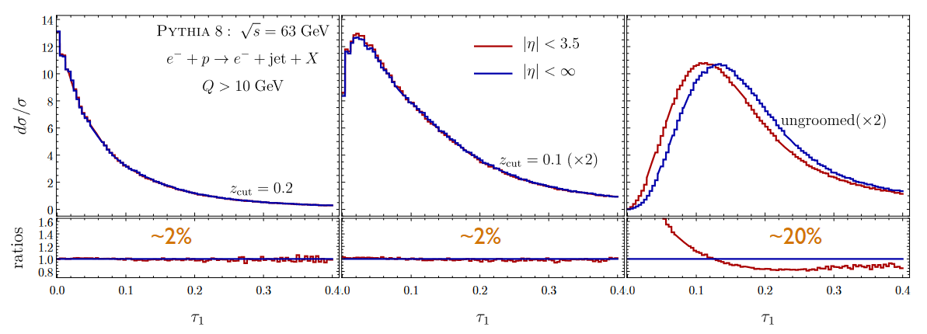
Groomed vs. Ungroomed 1-jettiness
Simulation at EIC energy
Grooming enables precision measurement!

Slide 13


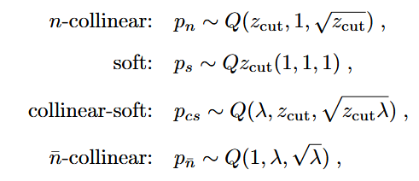

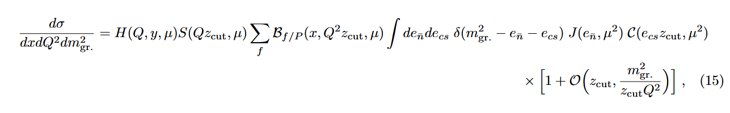
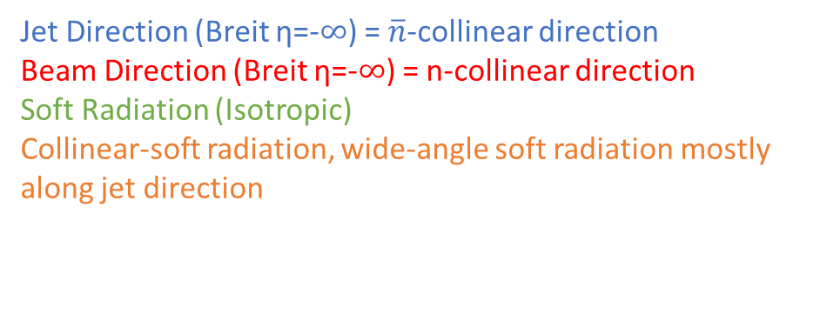
Groomed Invariant Mass - Factorization
Jet Direction (Breit η=-$∞$) = $\overline{n}$-collinear direction
Beam Direction (Breit η=-$∞$) = n-collinear direction
Soft Radiation (Isotropic)
Collinear-soft radiation, wide-angle soft radiation mostly along jet direction
In Region 1, shape of distribution should depend only on jet and collinear-soft functions, which are independent of Q

Slide 14
Groomed Invariant Mass - Factorization
Grooming causes only Jet and Collinear-soft radiation to contribute to shape of distribution in the single-jet (low invariant mass) limit!
In Region 1, shape of distribution should depend only on jet and collinear-soft functions, which are independent of Q

Slide 15
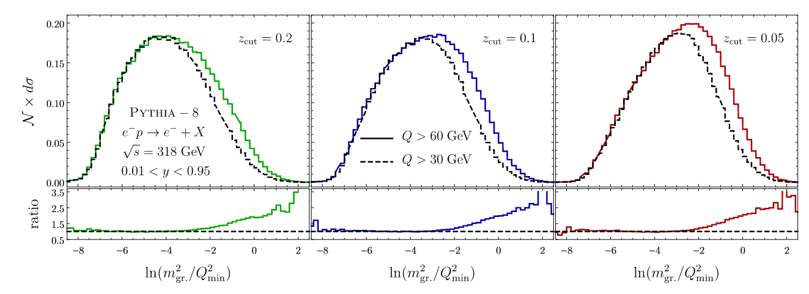
Groomed Invariant Mass - Factorization
Grooming causes only Jet and Collinear-soft radiation to contribute to shape of distribution in the single-jet (low invariant mass) limit!
Stay tuned for an
test of this prediction!
Shape of distribution should depend only on jet and collinear-soft functions, which are independent of Q!

Slide 16
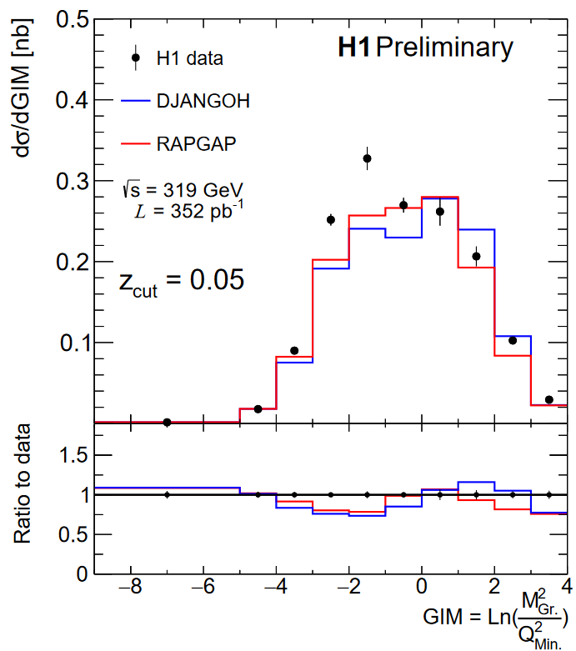
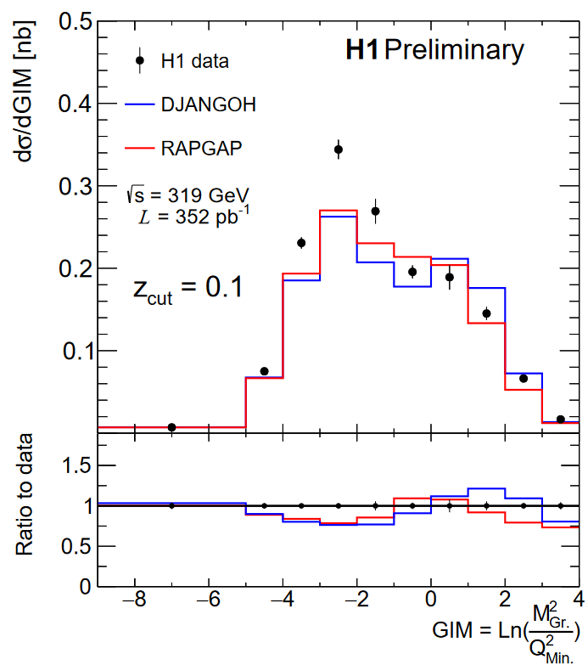
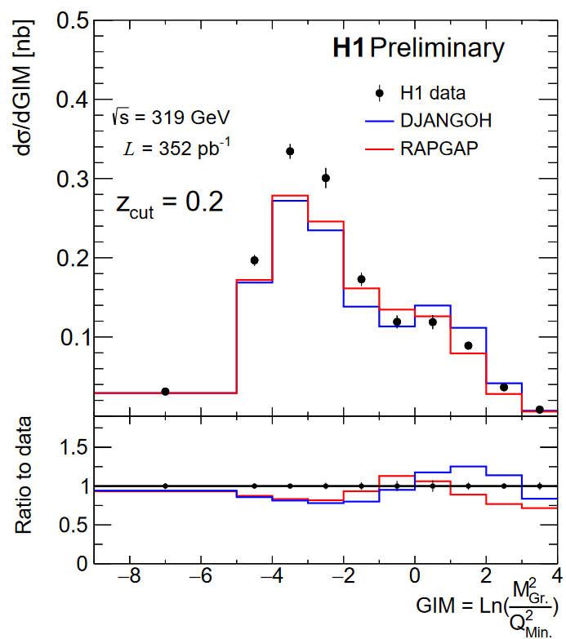
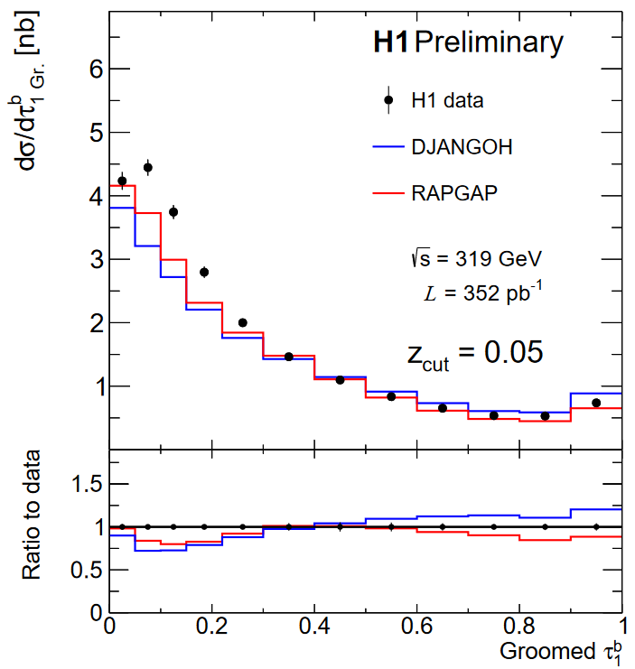
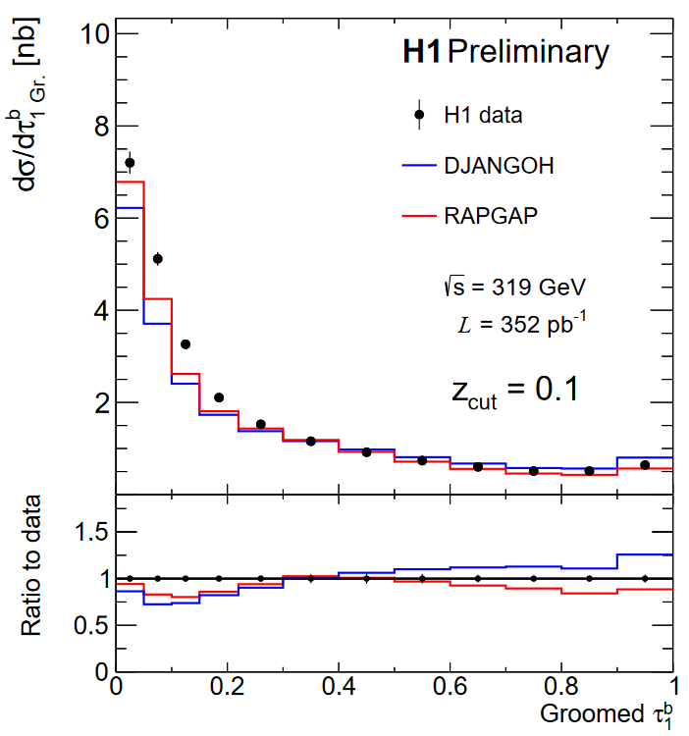
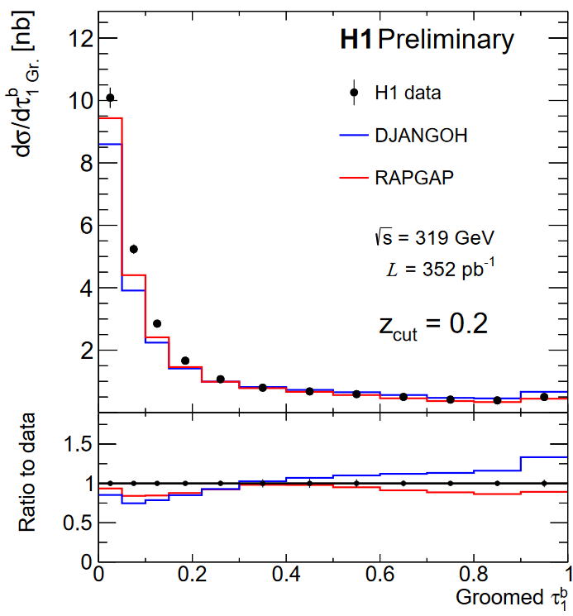
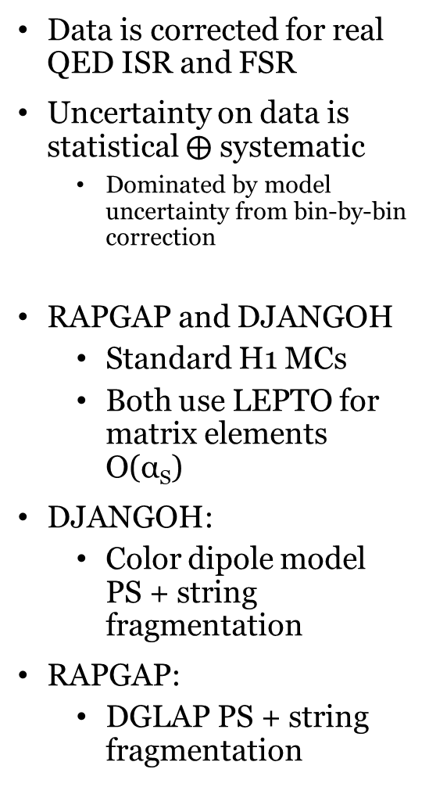
Results
Q²_{Min.}= 150 GeV²
Q²_{Min.}= 150 GeV²
Q²_{Min.}= 150 GeV²
Data is corrected for real QED ISR and FSR
Uncertainty on data is statistical $⨁$ systematic
  Dominated by model uncertainty from bin-by-bin correction
RAPGAP and DJANGOH
  Standard H1 MCs
  Both use LEPTO for matrix elements O(α_{S})
DJANGOH:
  Color dipole model PS + string fragmentation
RAPGAP:
  DGLAP PS + string fragmentation
Increasing z_{cut}, harsher grooming

Slide 17
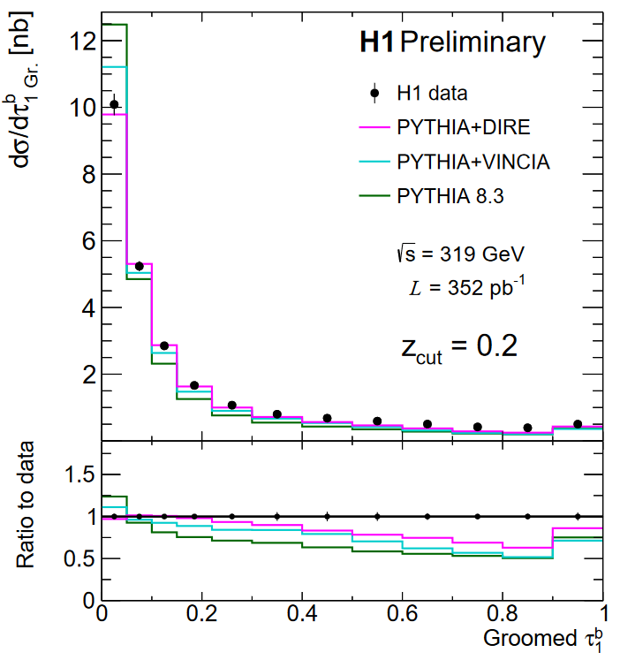
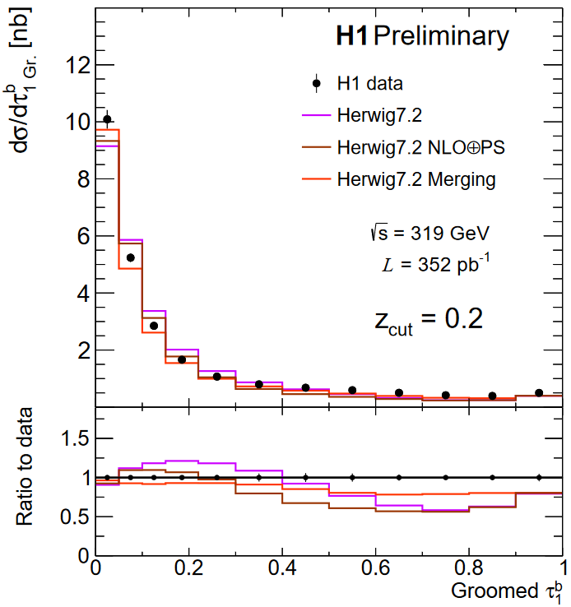
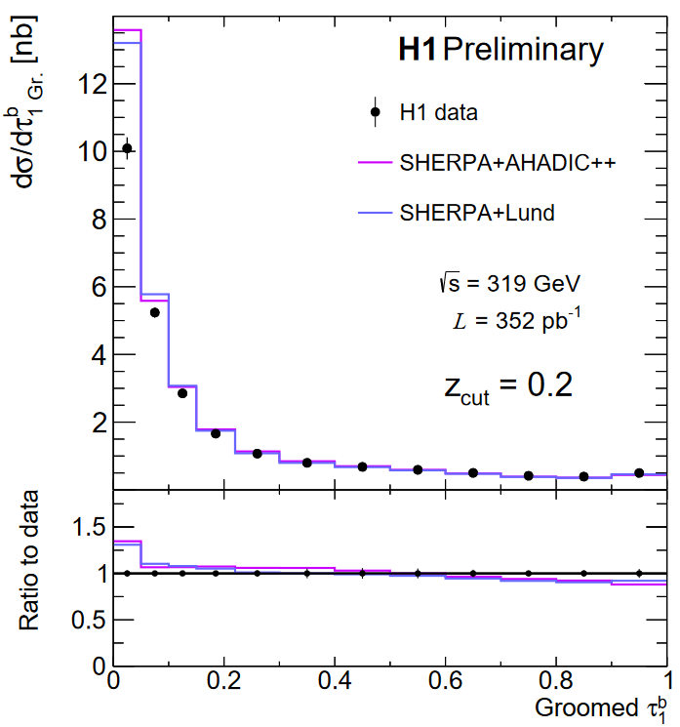
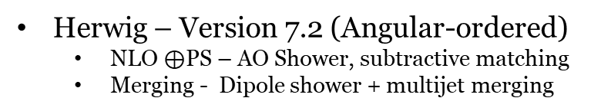
Results – Groomed 1 Jettiness
PYTHIA – Version 8.3
  VINCIA – Antenna Shower
  DIRE - Dipole shower + multijet merging
Best tail region from SHERPA, RAPGAP
  Fixed-order, multijets, hard splittings
Best peak region from DIRE, Herwig Merging
  Resummation, parton shower, hadronization
Herwig – Version 7.2 (Angular-ordered)
  NLO $⊕$PS – AO Shower, subtractive matching
  Merging - Dipole shower + multijet merging
SHERPA – Version 2.2.12 (MEPS@NLO)
  AHADIC++ - Cluster Fragmentation
  Lund – String Fragmentation
Notes:
The unreasonable effectiveness of SHERPA and VINCIA

Slide 18
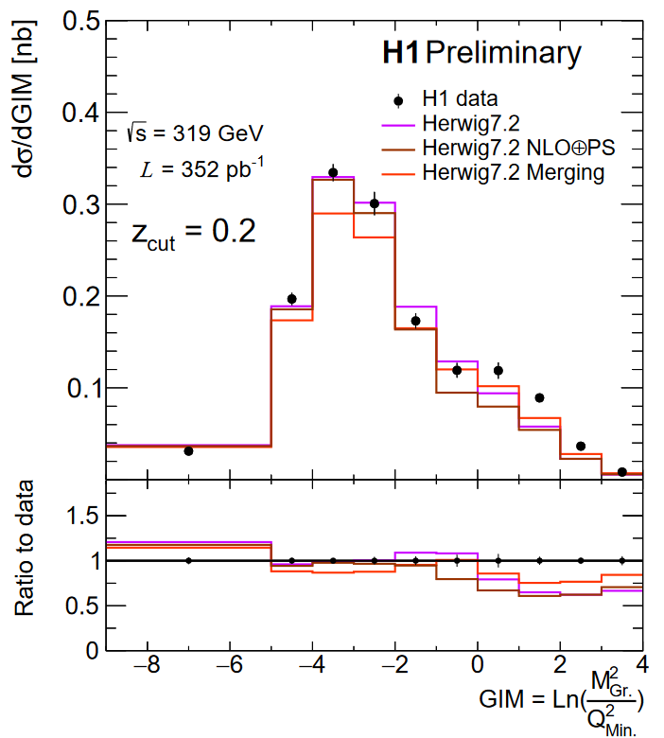
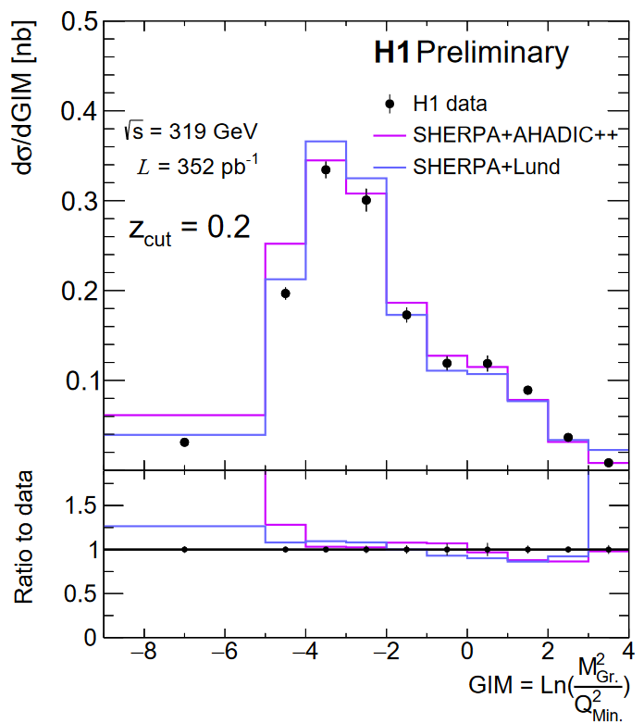
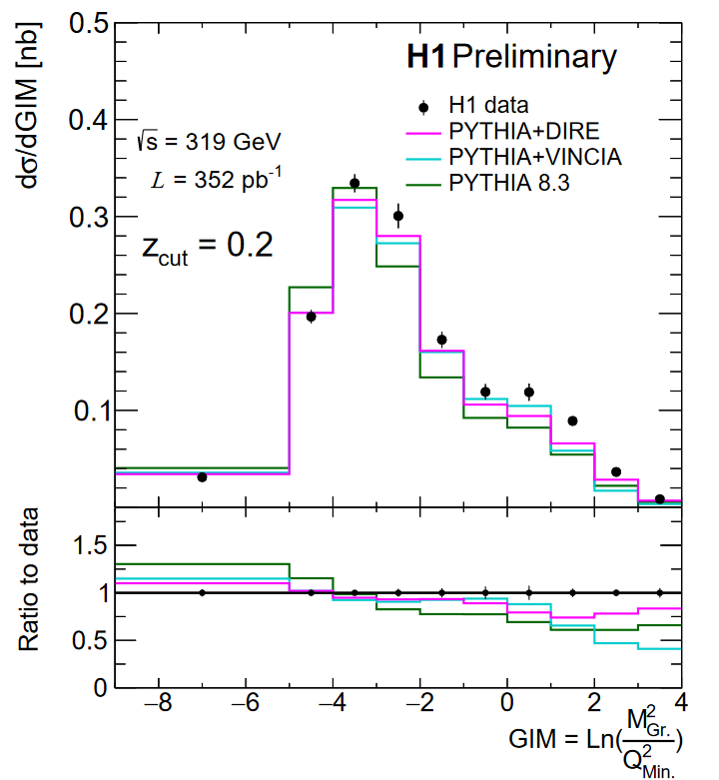
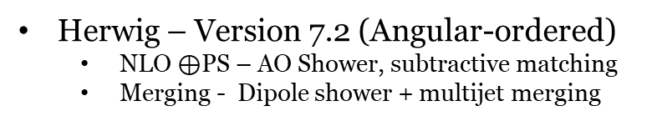
Results – Groomed Invariant Mass
PYTHIA – Version 8.3
  VINCIA – Antenna Shower
  DIRE - Dipole shower + multijet merging
Q²_{Min.} = 150 GeV²
Best high mass region from SHERPA
  Fixed-order, multijets, hard splittings
Best low mass region from Herwig, DIRE
  Resummation, parton shower, hadronization
Herwig – Version 7.2 (Angular-ordered)
  NLO $⊕$PS – AO Shower, subtractive matching
  Merging - Dipole shower + multijet merging
SHERPA – Version 2.2.12 (MEPS@NLO)
  AHADIC++ - Cluster Fragmentation
  Lund – String Fragmentation

Slide 19
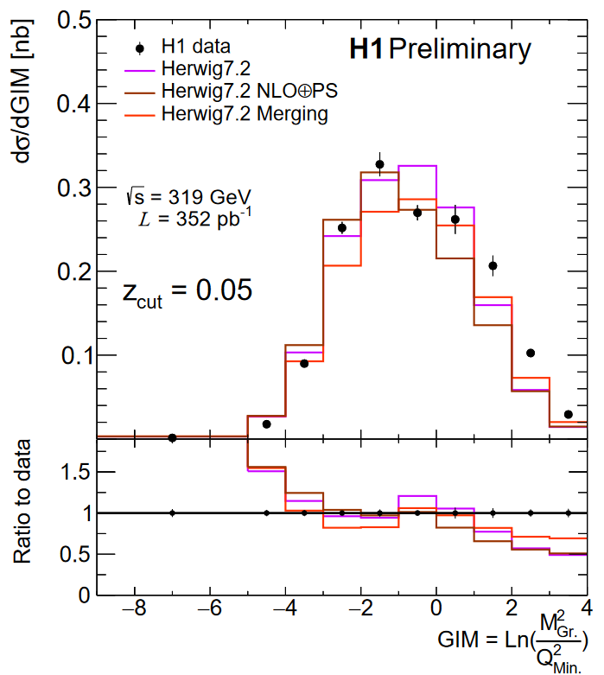
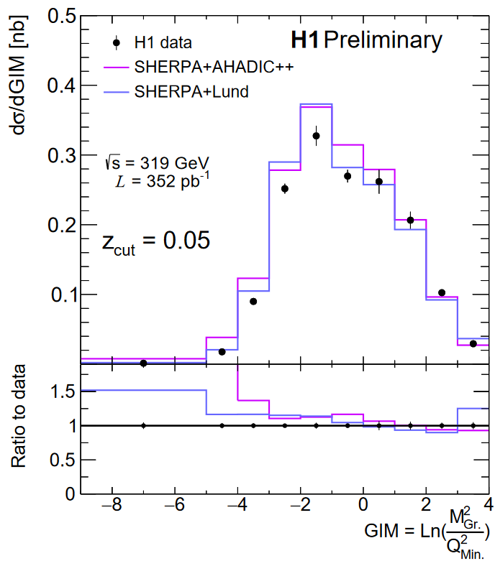
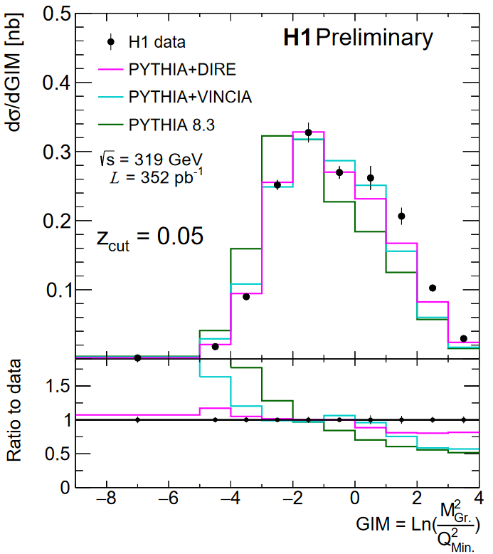
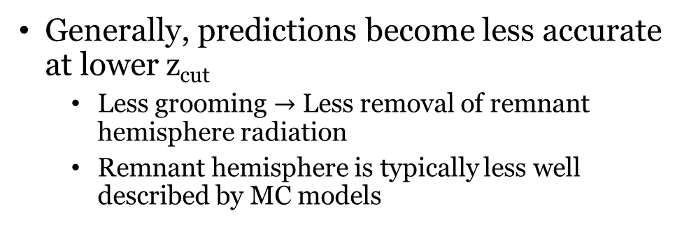

Results – Groomed Invariant Mass
PYTHIA – Version 8.3
  VINCIA – Antenna Shower
  DIRE - Dipole shower + multijet merging
Generally, predictions become less accurate at lower z_{cut}
  Less grooming $→$ Less removal of remnant hemisphere radiation
  Remnant hemisphere is typically less well described by MC models
Herwig – Version 7.2 (Angular-ordered)
  NLO $⊕$PS – AO Shower, subtractive matching
  Merging - Dipole shower + multijet merging
SHERPA – Version 2.2.12 (MEPS@NLO)
  AHADIC++ - Cluster Fragmentation
  Lund – String Fragmentation

Slide 20








Comparison to Analytic Prediction
Analytic - SCET
  From Y. Makris [1]
  Evaluated at two values of Ω_{NP}
    Shape function mean
  No fixed-order calculation yet incorporated
Agreement improves with increasing z_{cut,} Ω_{NP}
  Non-perturbative effects are significant!
  Factorization validity improves to higher z_{cut}

Slide 21

Groomed Invariant Mass - EIC
At small invariant masses, individual hadron masses play a large role
Analytic prediction formulated at small masses, in the region defined by:
EIC will have advantages in this region
  Hadron ID, high statistics
  More differential measurement possible
  New theory tools+data for high-precision studies of NP sector
Small angles also important
  Good angular resolution needed
M_{Gr.} < 1 GeV

Slide 22
Lessons for EIC – Breit Frame
Good reconstruction of event kinematics is vital for performing measurements in the Breit frame
Breit frame is a powerful tool for jet-related studies, but comes with additional uncertainty from boost reconstruction that needs to be under control
QED ISR/FSR can have devastating effects on Breit frame measurements if not properly handled
  These photons are typically quite energetic and at midrapidity in the Breit frame
  Easy to confuse for interesting hadronic final state effects!
η = ∞
η = -∞

Slide 23

Lessons for EIC – E - P_{z}
IΣ method first described by Bernardi & Bassler in 1994
  hep-ex/9412004
For this analysis, the IΣ method yielded the best boost reconstruction and thus the highest purity for the measurement
This method clearly relies very heavily on the measurement of Σ
E-P_{z} maximized by particles in electron-going (-z) direction, large for barrel, small for forward-going
  Important to reconstruct backward + barrel momenta well
  At low-x, IΣ method is similar to electron method in resolution, hadrons go mostly backward

Slide 24

Conclusion
H1 has performed the first measurement of groomed event shapes in DIS
  H1prelim-22-033
  See also the ungroomed 1-jettiness preliminary: H1prelim-21-032
Data has been compared to a variety of MC predictions from SHERPA*, PYTHIA, HERWIG, DJANGOH, RAPGAP, as well as analytic predictions from SCET
  Signifies that DIS MC models could use improvement, especially with EIC fast approaching
    HERA data will necessarily play an important role in this initiative!
Good Breit frame reconstruction enables a wide range of QCD studies
    Jets, TMDs, spin, hadronic physics, things yet unstudied $→$ maximize capability for generic tools
    *SHERPA authors already undertaking a DIS tuning campaign utilizing this data!

Slide 25
Bibliography
[1] - Revisiting the role of grooming in DIS, Y. Makris - arXiv:2101.02708
[2] – Groomed and energy-energy-correlation event shapes at EIC, Y. Makris - LBL Seminar: Oct. 2020
[3] – PYTHIA 8.3 Manual - arXiv:2203.11601
[4] – SHERPA 2.2.12 Manual - sherpa.hepforge.org/doc/SHERPA-MC-2.2.12.html
[5] – herwig.hepforge.org

Slide 26
Backup

Slide 27



H1 Detector
HERA
  World’s only high energy electron-proton collider
  352 pb⁻¹ collected in HERA-II run period from 2003-2007
H1 LAr Calorimeter Specifications
H1 Experiment
  Hermetic detector with asymmetric design
    Drift chamber + silicon tracking
    High-resolution LAr calorimeter
  Trigger on high-energy hadronic or EM LAr cluster
    > 99% efficient for y < 0.7

Slide 28

Lessons for EIC - QED
ISR typically unmeasured in detector
  For observables where all final state particles contribute, radiative MC can give significantly different results if ISR photon is included in final state
  E-P_{z} cut helps
  Having radiative and non-radiative MC
Typically want to compare data (radiative) to QCD theory (non-radiative)
  If you don’t measure the photon, only have to correct for lower e_{beam} energy at hard vertex
e^{-’}
FSR
e⁻
ISR

Slide 29
Lessons for EIC - QED
FSR handled by recombining particles within a lab-frame cone of R = 0.2 of the scattered electron with the scattered election
  FSR photon is very close to scattered election, typically within calorimeter position resolution
  FSR photon conversions can fake as HFS tracks
Cone cut removes genuine HFS particle only 0.75% of the time, typically low energy
  Momentum balance disfavors HFS particles being near election
e^{-’}
FSR
e⁻
ISR

Slide 30
Lessons for EIC – Kine Reco
At HERA, electron method was made difficult in kinematic regions where the electron was low energy (high y) and/or near to HFS particles (low x)
  These regions are vital to EIC physics
At EIC, PID detectors should make purity of scattered electron a bit better
  Low mass detectors will also improve the feasibility of the electron method
However, electron method will always suffer from QED radiation

Slide 31


Slide 32

Results
Q²_{Min.}= 150 GeV²
Q²_{Min.}= 150 GeV²
Q²_{Min.}= 150 GeV²
Data is corrected for real QED ISR and FSR
Uncertainty on data is statistical $⨁$ systematic
RAPGAP and DJANGOH
  Standard H1 MCs
  Both use LEPTO for matrix elements O(α_{S})
DJANGOH:
  Color dipole model for parton shower + string fragmentation
RAPGAP:
  DGLAP parton shower + string fragmentation

Slide 33



Results
SHERPA
  Version 2.2.12
  MEPS@NLO
AHADIC++:
  SHERPA native cluster hadronization model
Lund:
  Lund string model from PYTHIA
Both models provide good description of fixed-order region
Notes:
Sherpa tends to overestimate

Slide 34




Results
Herwig
  Version 7.2.2
NLO$⊕$PS:
  Herwig internal implementation of MC@NLO via Matchbox
Merging:
  Dipole shower with multijet merging

Slide 35



Results
PYTHIA
  Version 8.3
  No external matrix elements
DIRE:
  Dipole resummation
  Excellent description in resummation region
VINCIA:
  Antenna shower

Slide 36



Slide 37


Centauro
Jet algorithm with asymmetric clustering measure
  Treat current hemisphere and beam hemisphere differently
Typical longitudinally-invariant jet algorithms cluster in (rapidity, azimuthal angle) space and fail to capture the born-level configuration in the Breit frame
  Particles close to struck-parton direction have divergent rapidity, and therefore divergent distance between each other!
    Makes study of single-jet Born level configuration impossible!
Use spherically invariant clustering (polar angle, azimuthal angle) in the struck-parton direction and longitudinally invariant in beam direction
Tends to create one hard jet in struck-parton direction and many weak single particle jets in beam direction, which can easily be filtered away

Slide 38


Slide 39


