Slide 1
Helicity Distributions and
Orbital Angular Momentum at Small x
Yuri Kovchegov
The Ohio State University
Based on work done with Dan Pitonyak and Matt Sievert (2015-2018, 2020-2021), Florian Cougoulic (2019-2020), Yossathorn Tawabutr (2020),
Daniel Adamiak, Wally Melnitchouk, Nobuo Sato (JAM-smallx, 2020-2021).

Slide 2
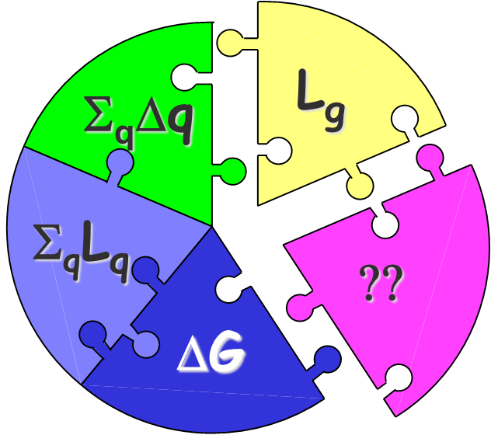
Proton Spin Puzzle
Helicity sum rule (Jaffe-Manohar form):
with the net quark and gluon spin
The helicity parton distributions are
with the net quark helicity distribution
L_{q} and L_{g} are the quark and gluon orbital angular momenta

Slide 3
Our goal
The goal is to constrain theoretically the amount of proton spin and OAM coming from small x.
Any existing and future experiment probes the helicity distributions and OAM down to some x_{min} .
At very small x (for the proton), saturation sets in: that region likely carries a negligible amount of proton spin. But what happens at larger (but still small) x?

Slide 4

Quark Helicity Observables at Small x
One can show that the g₁ structure function and quark helicity PDF (Δq) and TMD at small-x can be expressed in terms of the polarized dipole amplitude (flavor singlet case):
Here s is cms energy squared, z_{i}=Λ²/s,
$$=ΔΣ\left(x,Q^{2}\right)$$

Slide 5
Polarized Dipole
All flavor-singlet small-x helicity observables depend on one object, “polarized dipole amplitude”:
Double brackets denote an object with energy suppression scaled out:
unpolarized quark
polarized quark: eikonal propagation,
non-eikonal spin-dependent interaction

Slide 6
Evolution for Polarized Quark Dipole
One can construct an evolution equation for the polarized dipole:
Spin-dependent (non-eikonal) vertex
polarized
particle
similar to the
unpolarized
BK evolution
box =
target shock
wave (proton)

Slide 7
Large-N_{c} Evolution
In the strict DLA limit and at large N_{c} we get (here Γ is an auxiliary function we call the ‘neighbor dipole amplitude’) (KPS ‘15)
The initial conditions are given by the Born-level graphs

Slide 8
Small-x Polarized DIS Data
We have analyzed all existing world polarized DIS data with x<0.1 (122 data points) using the large-N_{C} KPS evolution with the Born-inspired initial conditions (8 parameters for 2 flavors, 11 parameters for 3 flavors).
It worked well with chi²/dof of about 1 and even smaller.
Work in preparation with D. Adamiak, W. Melnitchouk, D. Pitonyak, N. Sato, M. Sievert in the JAM Collaboration framework.

Slide 9
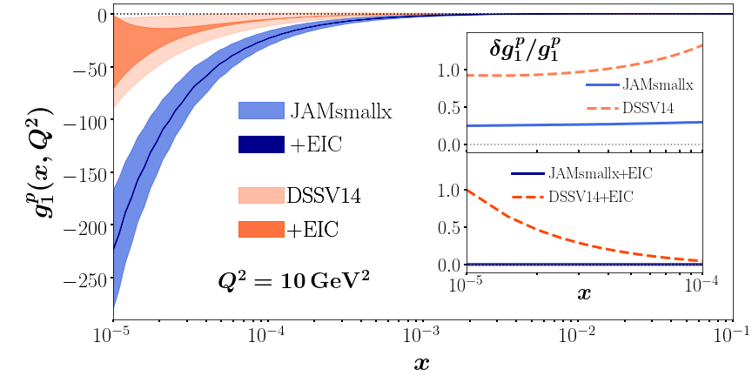
Prediction for g₁ structure function
Work in preparation with D. Adamiak, W. Melnitchouk, D. Pitonyak, N. Sato, M. Sievert
in the JAM Collaboration framework. With the EIC pseudo-data we have 1096 data points.

Slide 10
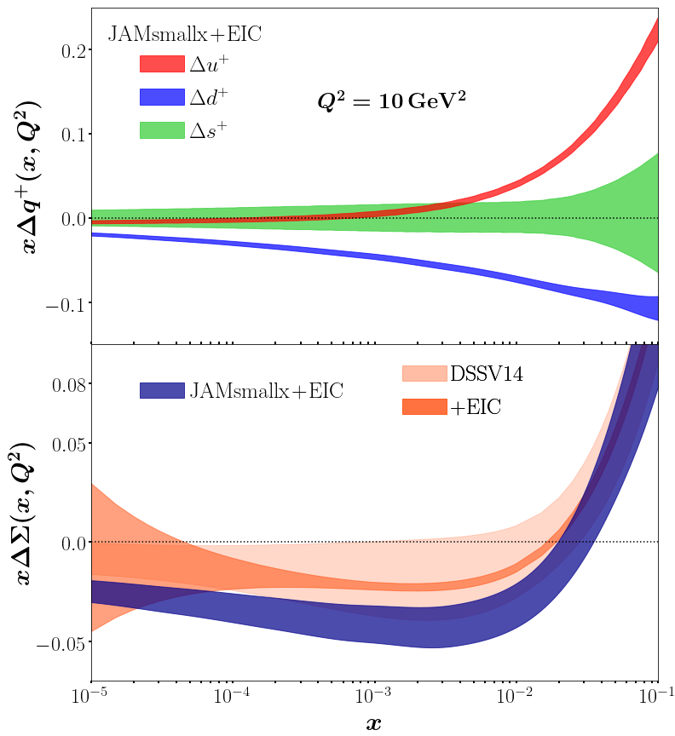
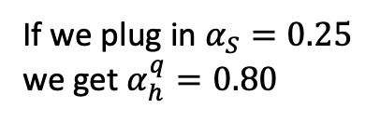
Predictions for helicity PDFs
Work in preparation with D. Adamiak,
W. Melnitchouk, D. Pitonyak, N. Sato,
M. Sievert in the JAM Collaboration
framework.
If we plug in $α_{S}=0.25$
we get $α_{h}^{q}=0.80$

Slide 11
Small-x Evolution at large N_{c}&N_{f}
The resulting equations are

Slide 12
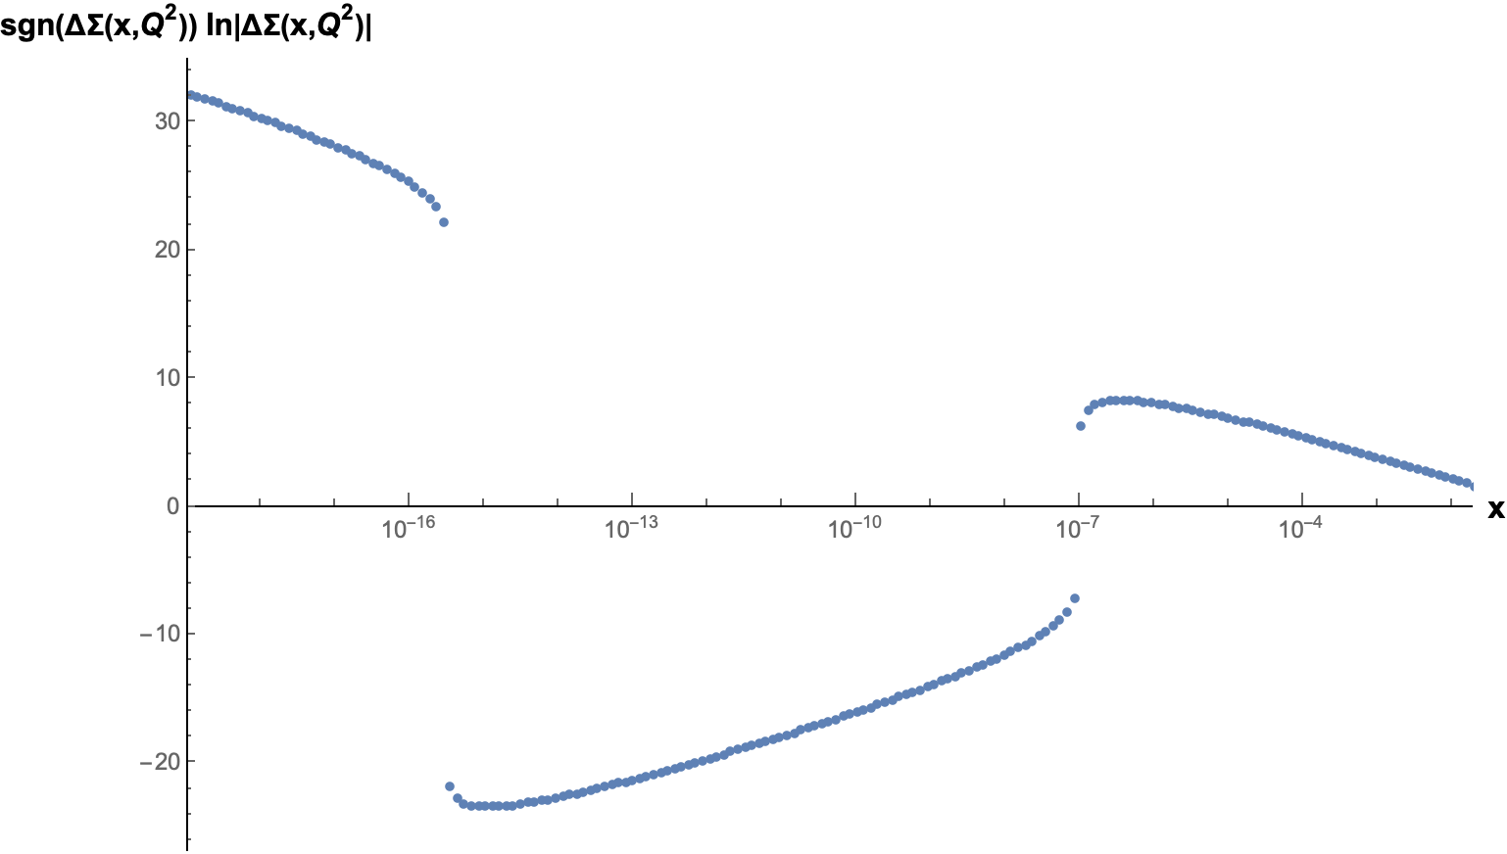
Small-x Asymptotics at large N_{c}&N_{f}
Large N_{c}&N_{f} can be solved only numerically, due to their complexity.
This was done by Y. Tawabutr and YK in arXiv:2005.07285 [hep-ph].
The solution exhibits an interesting qualitative change compared to large-N_{c}: it oscillates with ln(1/x)!

Slide 13
Quark and Gluon OAM
Similar calculations for quark and gluon OAM lead to
and
The small-x asymptotics is (at large N_{C})

Slide 14
Conclusions
Small-x physics can contribute to the resolution of the proton spin puzzle.
Evolution equations are written at DLA with LLA corrections on the way.
Initial effort at describing the existing polarized DIS data and making the predictions for EIC is almost complete (JAM-smallx).
More effort is needed in terms of improving the evolution kernels (e.g., a la BK) and solving the resulting evolution equations to describe the data and to generate more precise predictions for EIC. Helicity evolution mixes with the unpolarized BK/JIMWLK one, so a proper interface of the two is important.

