Slide 1
Deeply Virtual Compton Scattering at Small-x
Feng Yuan
Lawrence Berkeley National Laboratory
Hatta-Xiao-Yuan 1703.02085

Slide 2
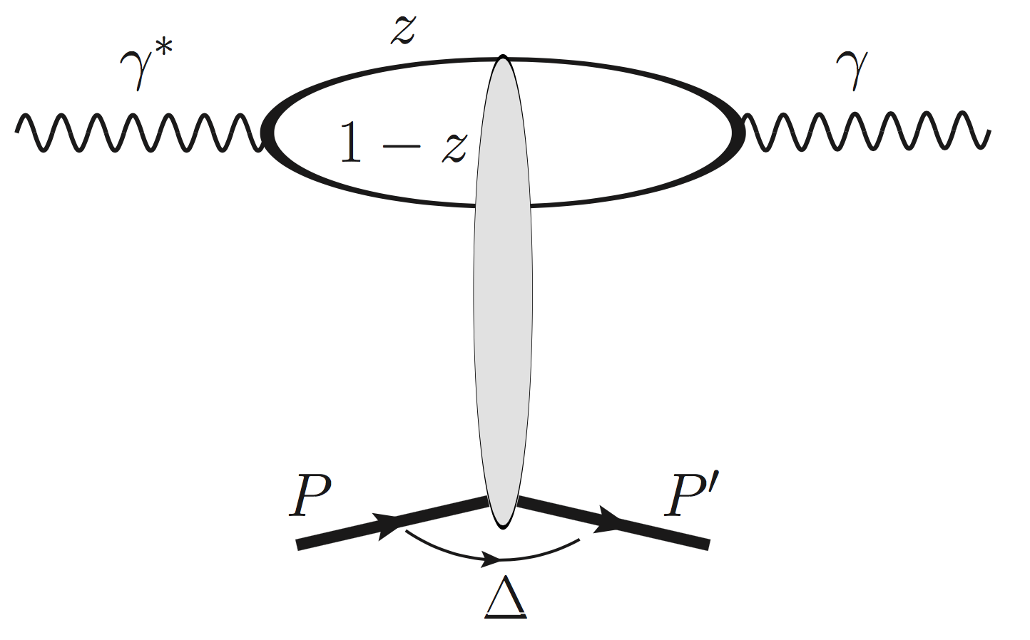
DVCS and GPDs at small-x
Hoodbhoy-Ji 98
Diehl 01
All other GPDs suppressed at small-x

Slide 3
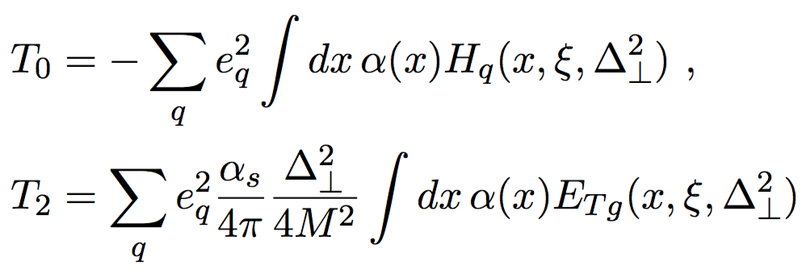
DVCS: Collinear factorization
Imaginary part at xi=x
Hoodbhoy-Ji 98
Vanishes at LO

Slide 4
Dipole formalism
Elliptic gluon distribution (Hatta-Xiao-Yuan 16)

Slide 5
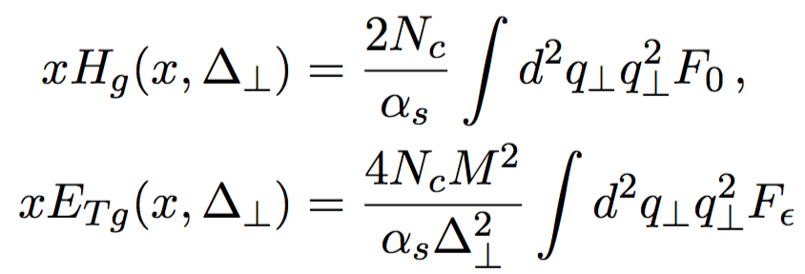
GPDs and dipole
Elliptic gluon
distribution
Hatta-Xiao-Yuan 1703.02085

Slide 6
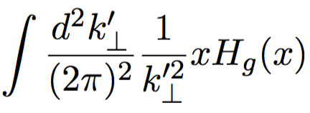
DVCS: Helicity-conserved Amp.
μ
ν
Dominant contributions from z~1 or 0,
Hatta-Xiao-Yuan 1703.02085

Slide 7
Helicity-flip amplitude
In the DVCS limit, Q>>Δ
Hatta-Xiao-Yuan 1703.02085

Slide 8
Quark/GPD quark at small-x
DGLAP splitting dominated by gluon distribution/GPD gluon
GPD quark distribution
Ji 97,
Radyushkin 97

Slide 9
We have established the consistency between the small-x dipole formalism and the collinear GPD framework
The cos(2phi) asymmetry in DVCS will provide information on the elliptic gluon distribution at small-x

