Slide 1
Welcome to the 7th Streaming Readout Workshop!
Martin Purschke (BNL) and Jan Bernauer (SBU and RBRC)
With lots of help and contributions from the SRO community (MIT, SBU, Jlab, INFN, BNL, …)
and
Mariette Faulkner (PHENIX Group, BNL) and Chris Weaver (ITD)

Slide 2
First, a few welcome words…
James Dunlop, BNL Physics Department

Slide 3
Why are we here?
The Electron-Ion Collider is becoming a reality!
There is an accelerator to build/upgrade …
There are experiment(s) to build …
… and there are detectors to be read out!
That’s why we are here!
Find common ground across communities (us, CERN, GSI/FAIR, others) for standards, technologies, best practices
Avoid re-inventing wheels
Share developments, ideas, etc

Slide 4
Why “Streaming Readout”?
There seems to be wide consensus that SRO is the way of the future
Case in point: for a recent report we could find no one who would make the case for a “classic” event-based readout. No one.
Several experiments (ALICE, LHCb, CBM) are committed to SRO or have already implemented it
Large assortment of different groups devoted to SRO research (MIT, BNL, Jlab, EIC “Yellow Report” DAQ contingent, eRD23, …)

Slide 5
A word about EIC-themed R&D
There are many different R&D projects going on in the EIC orbit
Most visible/formal the eRDx projects:
eRD1-Calorimetry, 6-Tracking, 14-PID, 17-Event generators, 20—Software, 21-Backgrounds, 22-TRD, 23 – SRO, 25-Silicon Tracking, + new proposals
R&D around the EIC “Yellow Report”
Several LDRD projects (LDRDs are a specialty of National Labs funding innovative research) – this will stop for the EIC as it is now a project
Lots of R&D synergy with ongoing experiments (CLAS12, Hall D, sPHENIX, STAR, many more)
(I think I personally started EIC-related R&D with a test beam at Fermilab in 2013)

Slide 6
The Streaming Readout Workshop VII
Yes, we count them in Latin numerals like the Super Bowls…
January 2017 at MIT
January 2018 at MIT
December 2018 at Christopher Newport University/JLab
May 2019 Camogli, Italy (hosted by INFN)
November 2019 Riken BNL Research Center
May 2020 Jefferson Lab ( virtual)
November 2020 - here we are!

Slide 7
The Program
With the exception of today (speakers’ conflicts - 10:30 and 2pm), we will start at 10am and 1PM
Rough “theme”:
Remember that this is a workshop, not a conference
Ample room for discussion built in
Please check the agenda page for last-minute changes
Detector Support I
Detector Support III
Data rates/ requirements / capabilities
Detector Support II
Data Formats / APIs / Standards
Hardware / Vendors
Summary

Slide 8
Some housekeeping
This is a virtual conference, so the main venue is Zoom
You all have the link, it’s open 24/7 through Wednesday
In the first block this morning we’ll see if we need to use the Zoom “raise hand” feature, let’s try without first, and just ask your questions
(I‘m not a fan of it in workshops, runs counter to interactivity – we’ll see)
But when you ask a question, please say who you are so we all get to know each other more

Slide 9
Presentations / Material Upload
We could find most of you already in the BNL Indico system
We assigned your presentation slot to you and you can upload your material
For others, we entered you manually with your email address
Then you can either:
Point us to your presentation and we’ll put it there
Or make an account in our Indico and upload it yourself
Speakers should normally share their screen and control the presentations
We’ll help out in case of issues.

Slide 10
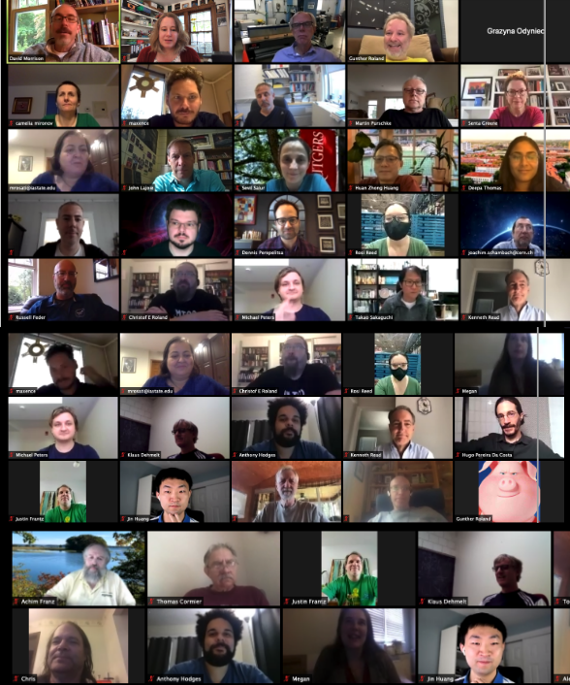
Workshop Picture
In a real meeting, at some point our photographer would shepherd us onto the Physics Dept. front lawn and try to get a picture with everyone smiling
This afternoon we will try the virtual version of it
At some point during the session when we have a large number of us, please be prepared to turn on your camera and we’ll try to get that picture
Not your time zone? We understand. I’ll try to get stragglers after the other sessions.

Slide 11
With that…
… let’s kick off the workshop!

