Slide 1


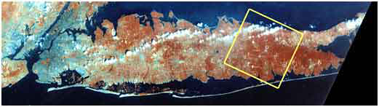
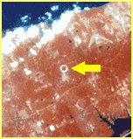
Streaming Readout of the Tracking System
Triggered and Streaming Readout –
The sPHENIX DAQ System
Martin L. Purschke
Manhattan
Long Island, NY
RHIC from space

Slide 2
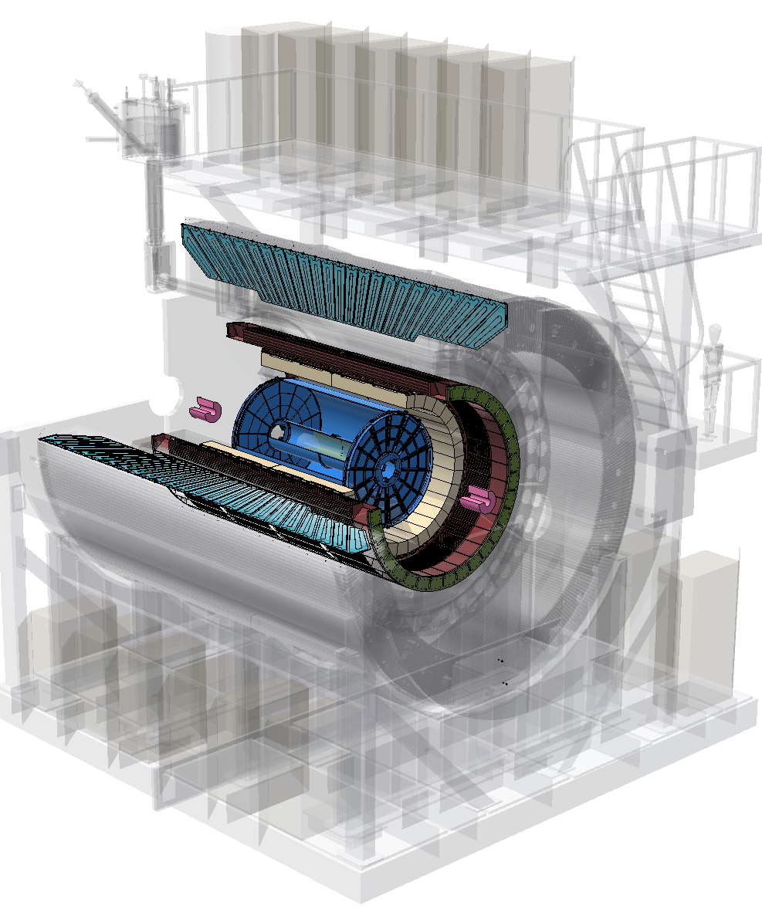
sPHENIX – the Concept
Hadronic Calorimeter(s)
Electromagnetic Calorimeter
Time Projection Chamber (TPC)
Minimum Bias Detector (MDB)
Intermediate Tracker (INTT)
MicroVertex Detector (MVTX)

Slide 3
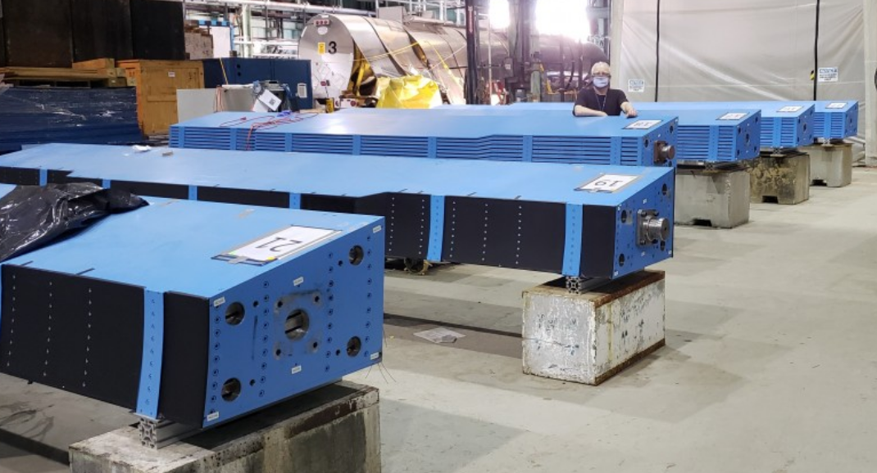
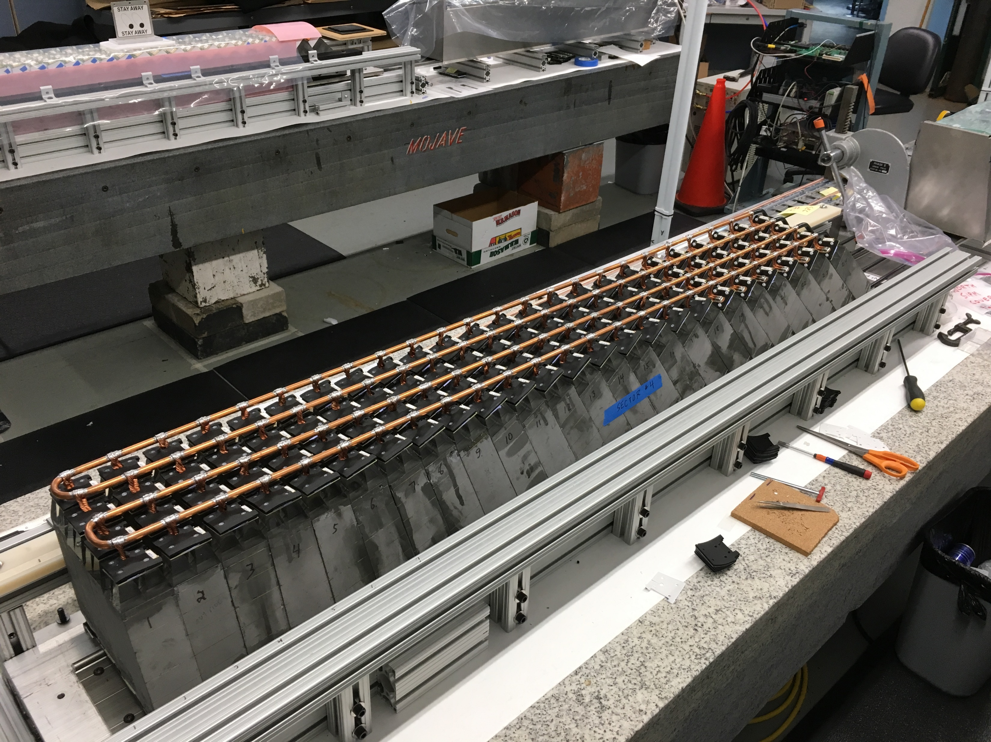
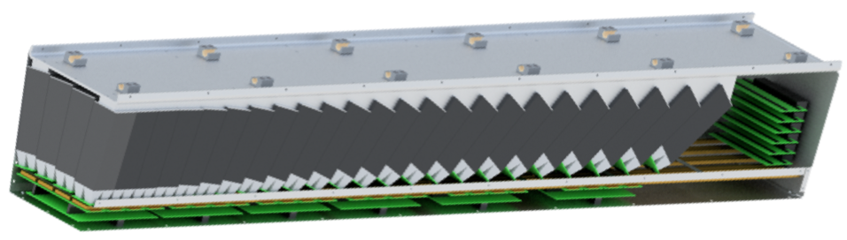
sPHENIX … getting real
Me
(~0.08 tons)
Hadronic Calorimeter
32 such modules, ~390 tons
Electromagnetic Calorimeter 1 module of 64 total

Slide 4
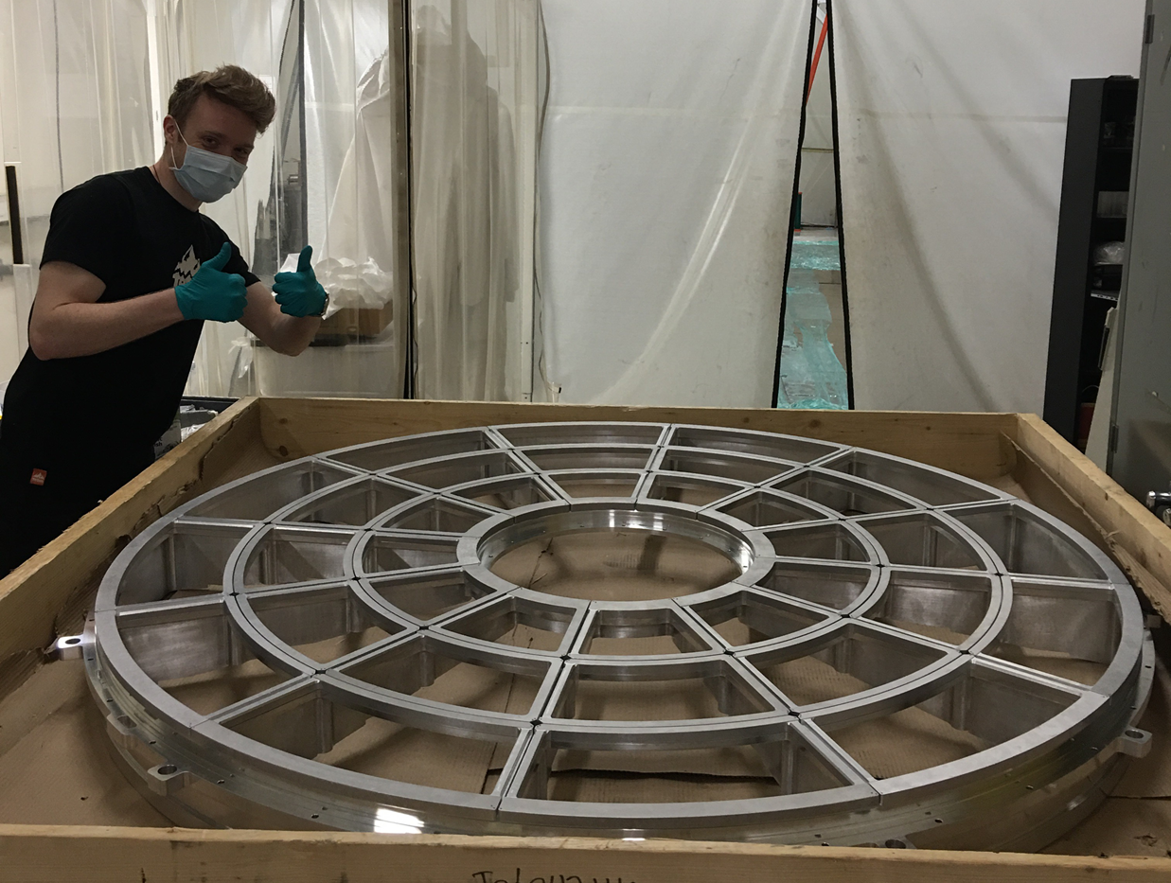
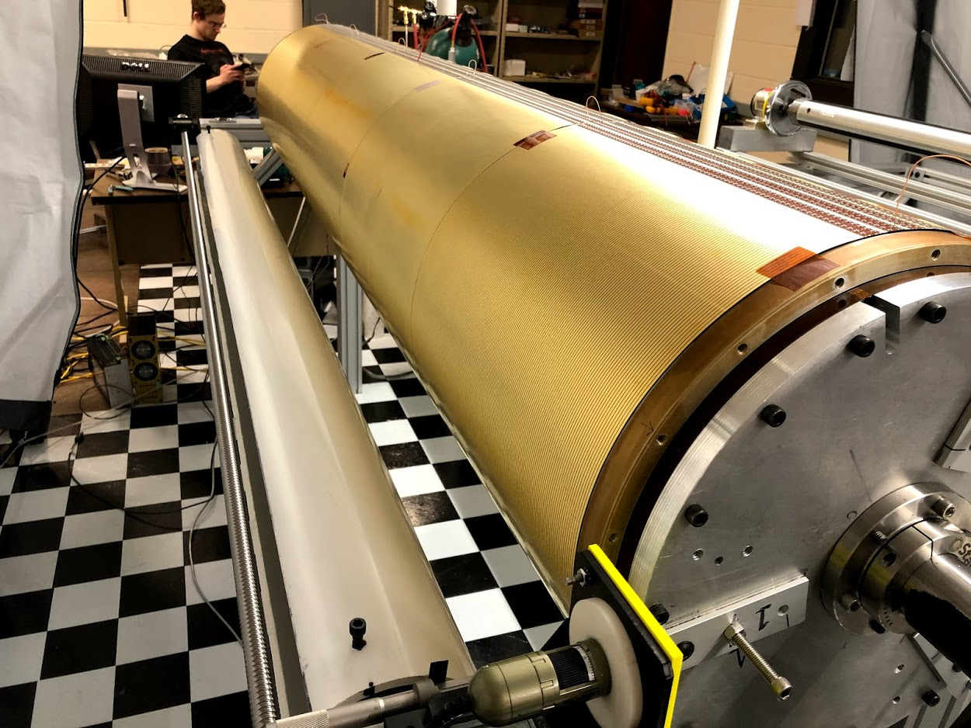
sPHENIX … getting real
TPC End Cap Support (“Wagon Wheel”)
TPC Inner Field cage

Slide 5
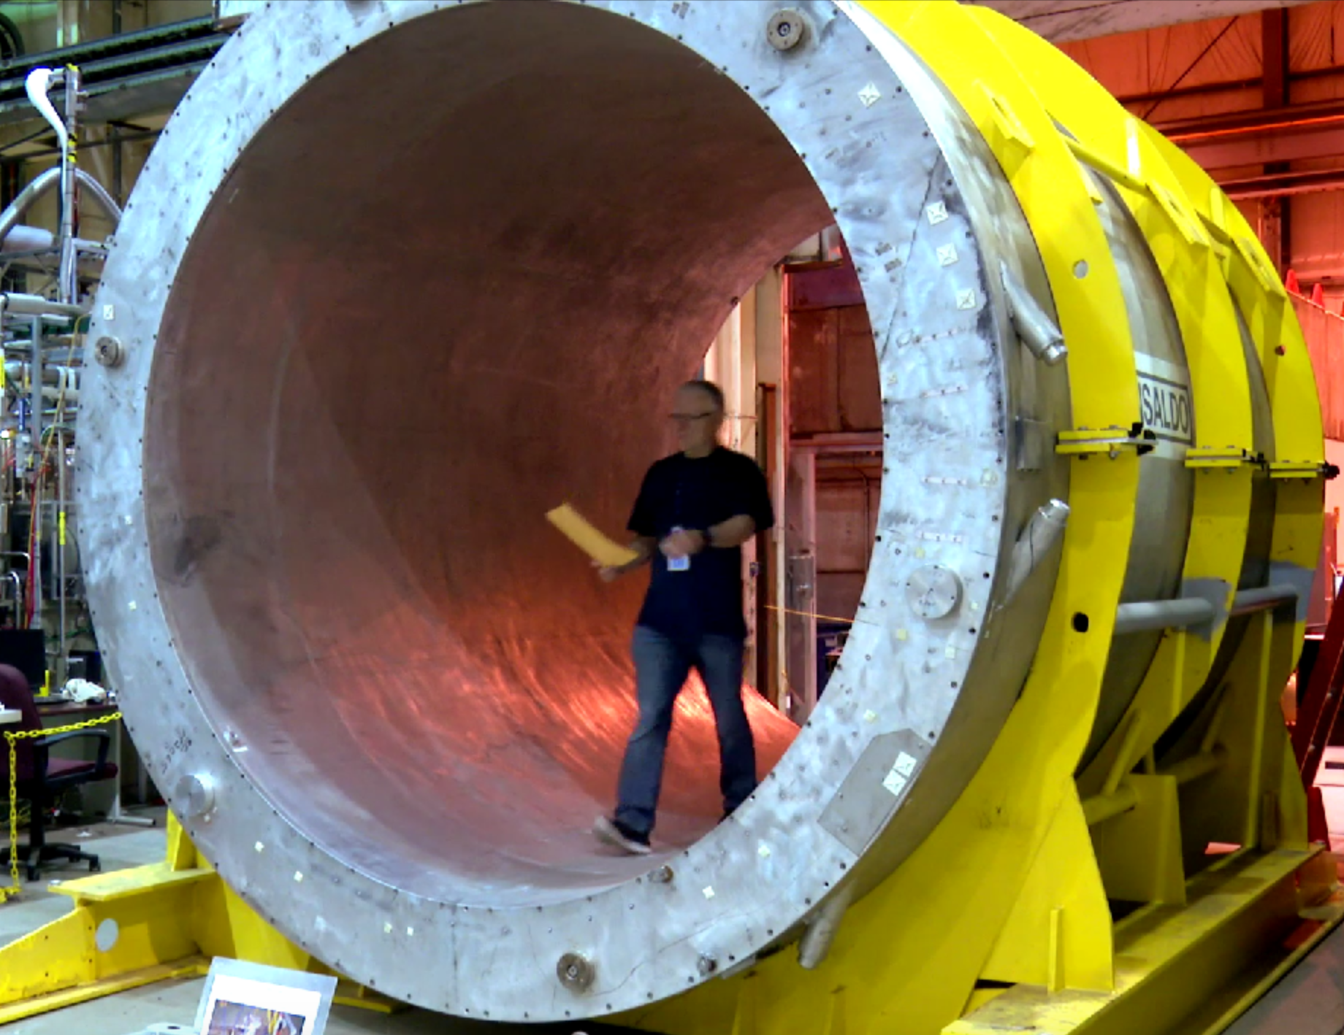
sPHENIX … getting real
Former BaBar magnet

Slide 6
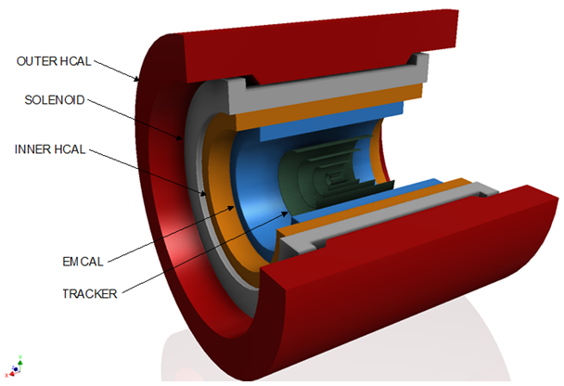
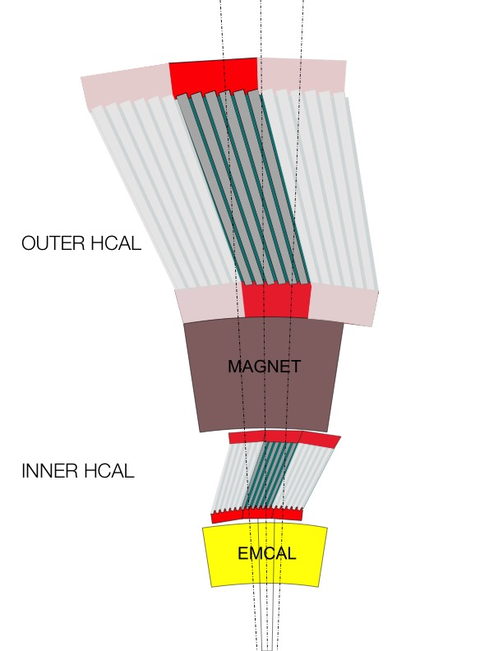
sPHENIX – Calorimetry
We have already presented the calorimeters last time, I’ll focus on the tracking (and the TPC) today
HCAL steel and scintillating tiles with wavelength shifting fiber
  2 longitudinal segments.
  An Inner HCal inside the solenoid.
  An Outer HCal outside the solenoid.
  Δη x Δφ ≈ 0.1 x 0.1
  2 x 24 x 64 readout channels
  σ_{E}/E < 100%/√E (single particle)
SiPM Readout
Outer HCAL ≈3.5λ_{I}
Magnet ≈1.4X₀
Inner HCAL ≈1λ_{I}
EMCAL ≈18X₀≈1λ_{I}

Slide 7
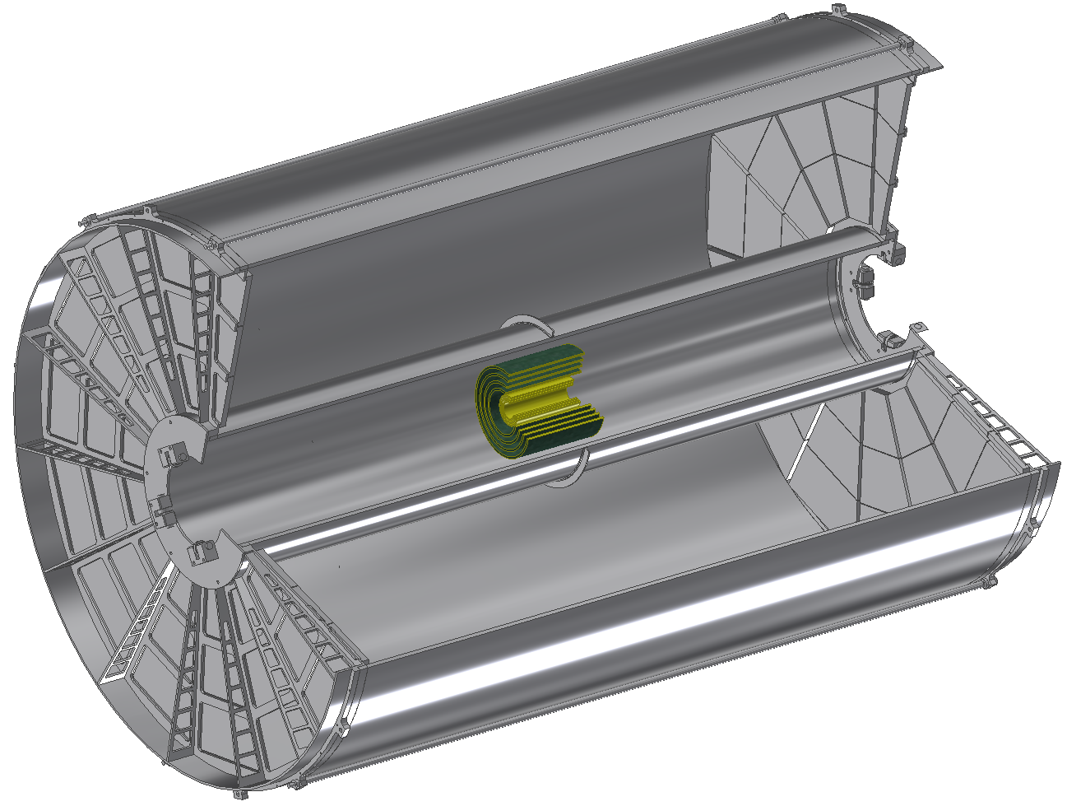
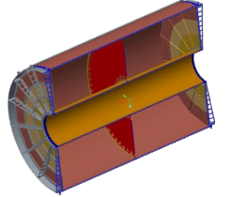
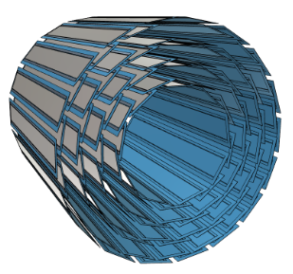
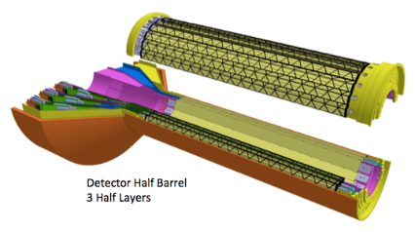
Three Tracker Components
Micro-Vertex Detector (MVTX) Three-layers identical to Inner ALICE ITS ( r = 2.3cm, 3.1 cm, 3.9 cm)
Intermediate Silicon Strip Tracker (INTT) Four layer Si strip detector. (r = 6 cm, 8 cm, 10 cm, 12 cm)
Compact Time Projection Chamber (TPC) (20 cm < r < 78 cm)
All cover at minimum | η | < 1.1 and 2π in azimuth
TPC
INTT
MVTX

Slide 8
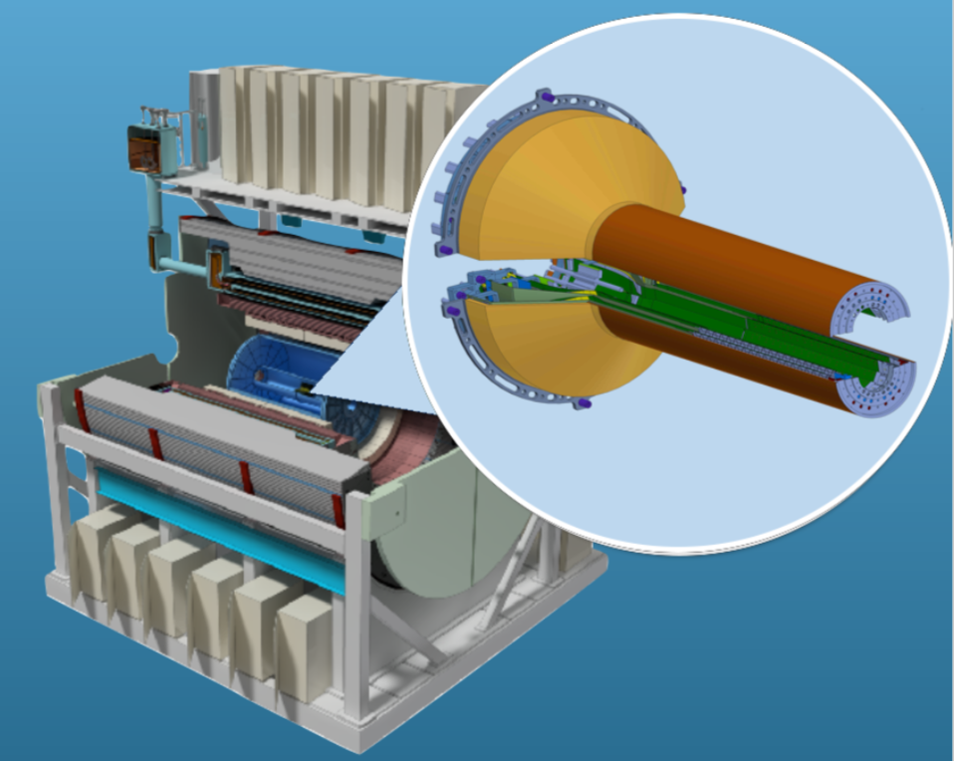
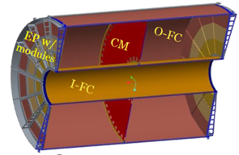
Streaming Readout Detectors
TPC
INTT
MVTX
I will mostly concentrate on the TPC.
8

Slide 9
Data and more data
MVTX (MAPS) ~ 20GBit/s
Intermediate Silicon Strip Tracker (INTT) ~ 7GBit/s
Compact Time Projection Chamber (TPC) ~ 100Gbit/s
Calorimeters (primarily Emcal, hadronic cal.) ~ 8GBit/s
____________
135GBit/s
Easy to remember number: 1.4 PetaByte/day

Slide 10
DAQ Overview
FEM
100+ Gigabit
Crossbar
Switch
DCM
DCM2
DCM
DCM
DCM
DCM
FEM
DCM
SEB
Buffer Box
DCM
DCM
DCM2
DCM
DCM
DCM
Buffer Box
FEM
DCM
SEB
DCM
To
HPSS (Computing Center)
DCM
DCM
DCM2
DCM
SEB
Buffer Box
DCM
DCM
FEE
Buffer Box
DCM
DCM
DAM
EBDC
DCM
FEE
Buffer Box
DCM
DCM
DAM
EBDC
DCM
FEE
Buffer Box
DCM
DAM
EBDC
DCM
DCM
Data Concentration
On Detector
Rack Room
Rack Room
Rack Room
DCM-2 receives data from digitizer, zero-suppresses and packages
SEB collects data from a DCM group (~20)
EBDC Event Buffer and Data Compressor (~40)
Buffer Box data interim storage before sending to the computing center (6-8)

Slide 11
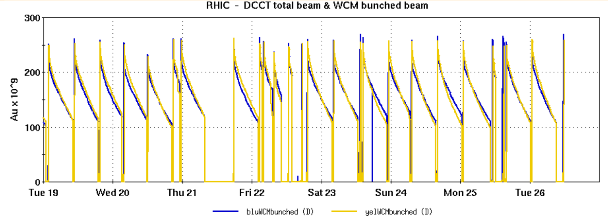
Quick detour: Buffering at sPHENIX
100+ Gigabit
Crossbar
Switch
We heard from Alex that he sees direct logging from DAQ to remote (meaning < 10km distance) in the future. I agree on the technology part
But: We have traditionally always had “buffer boxes” in PHENIX, and will in sPHENIX
Why? The data rate at a collider is “bursty” – high luminosity at the begin of a RHIC store, then ”burning off” – change of a factor of 2
Buffer Box
Buffer Box
Buffer Box
Buffer Box
Buffer Box
Buffer Box
2016 (last PHENIX run) beam intensity over a week
11

Slide 12
Buffering at sPHENIX
The HPSS storage system performs best when fed a steady, rather than bursty, data rate
It is also cheaper to level the peaks with buffering at the < 100m network level, and do the much more expensive <10km at lower average rates
Also, since the start of PHENIX, we have been worrying about what we termed the “bulldozer incident” that would sever the data fibers (no redundant paths!). Never happened, but…
The buffer boxes provide us with O(100hrs) storage capacity to ride out such outages
Can that happen? Well…
12

Slide 13
Severing the network
What you see here is BNL’s ESNET fiber burning to a crisp
And we do have redundant fiber paths… happened right when the other fiber was down, too, after a poorly planned manhole access 30 miles west of the Lab (neither we nor ESNET manage those fibers)
So things can happen!
December 16, 2017
21 hrs total network outage for BNL
(No one at the accident scene got severely hurt)
13

Slide 14
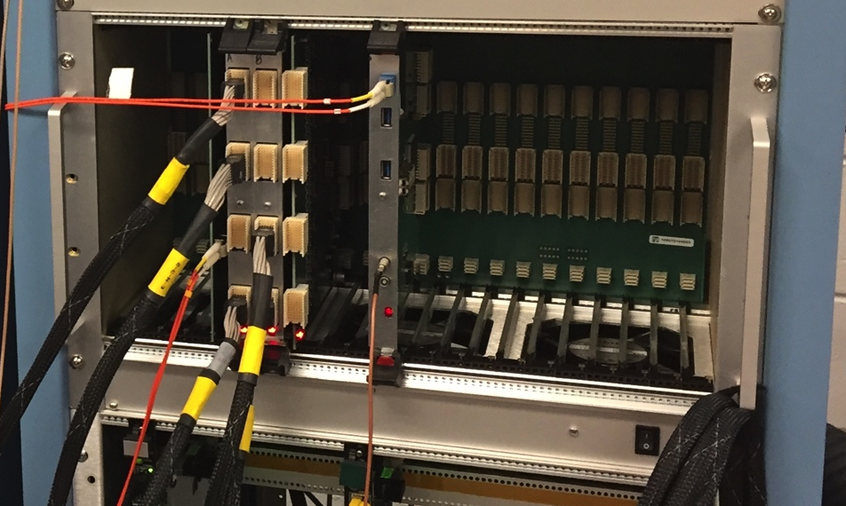
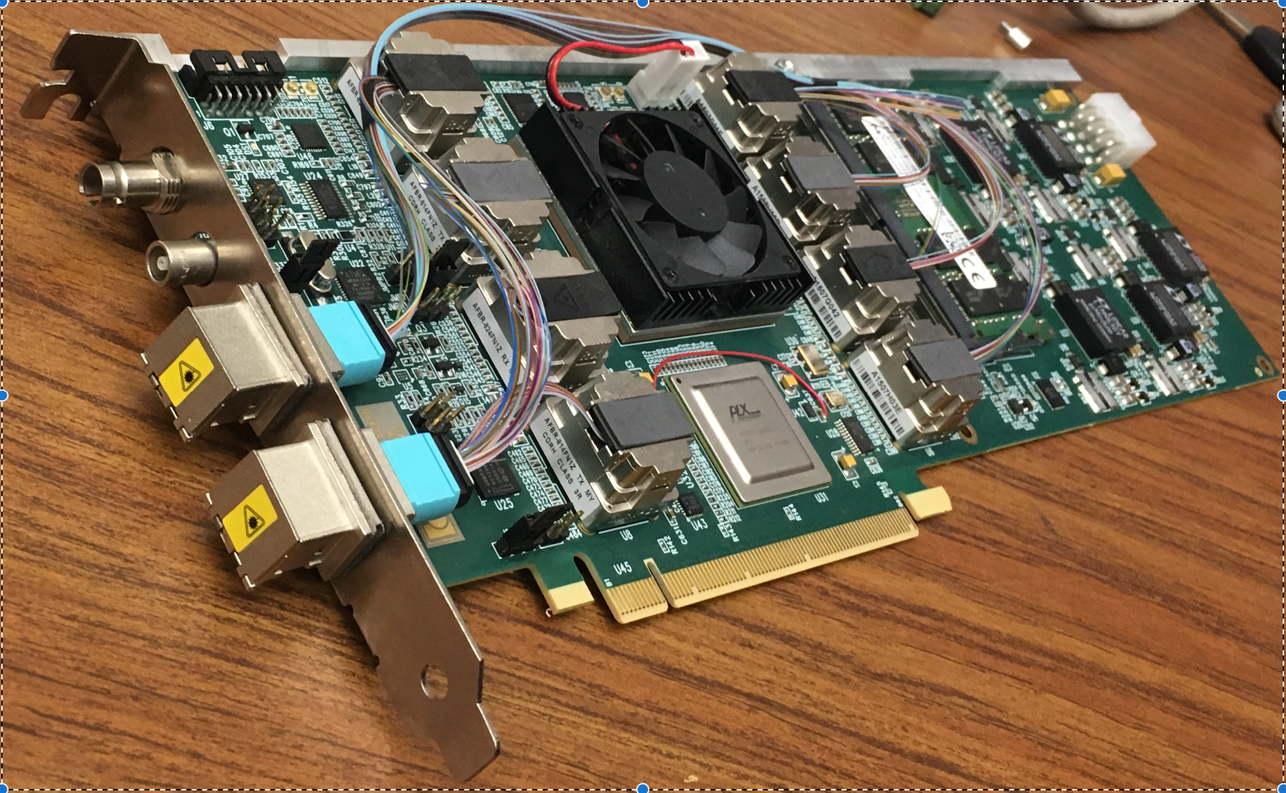
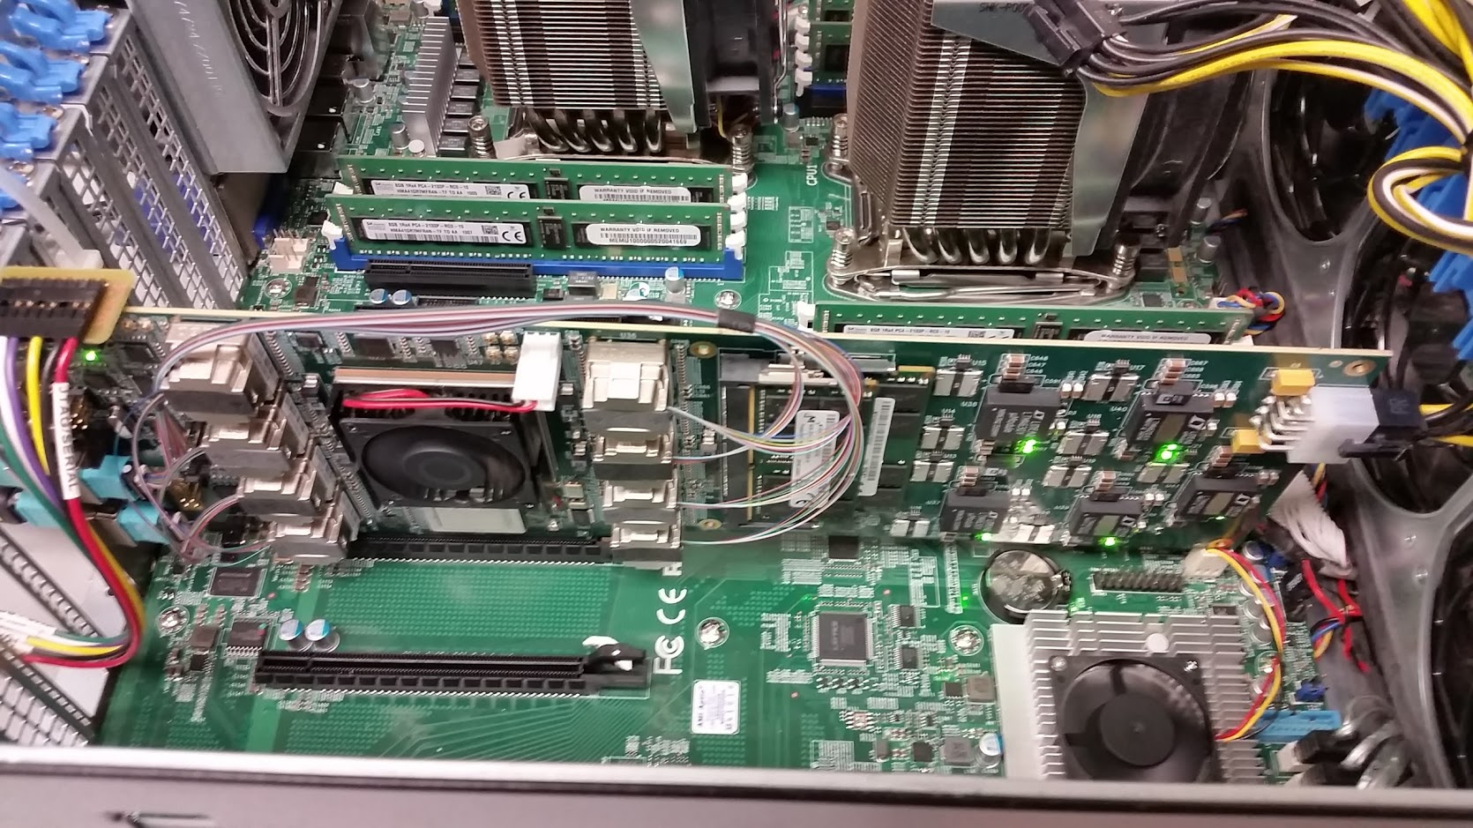
Triggered and Streaming Readout
The calorimeters and the MBD re-use the PHENIX “Data Collection Modules” (v2)
FEM
DCM
DCM2
DCM
DCM
DCM
DCM
FEM
DCM
DCM
DCM
DCM2
DCM
DCM
DCM
FEM
DCM
DCM
DCM
DCM
DCM2
DCM
Calorimeters, MBD
DCM
DCM
Triggered readout
The TPC, the MVTX, and the INTT are read out through the ATLAS “FELIX” card directly into a standard PC
FEE
DCM
DCM
FELIX
PC
DCM
FEE
DCM
DCM
FELIX
PC
DCM
TPC, MVTX, INTT
FEE
DCM
FELIX
PC
DCM
DCM
Rack Room
Streaming readout
ATLAS FELIX Card
Installed in a PC

Slide 15
How I explain Streaming Readout to the Public Affairs guys
Think of the recordings of a shopping mall’s security cameras
You keep, say, a month worth of video
Most of the time, absolutely nothing of interest happens
But when there’s something going on, a burglary or so, you go back and cut out the 15 minutes of video in question for the cops
Think of those 15 minutes as the long-term stored data
Translation to sPHENIX…
We record the arrival of charge continuously
But at the end, we are really mostly interested of the piece of “recording” at the time we triggered an actual event
So stored “events” for the TPC will be a series of short “charge recording segments” covering the times when we triggered the rest of the experiment.
15

Slide 16
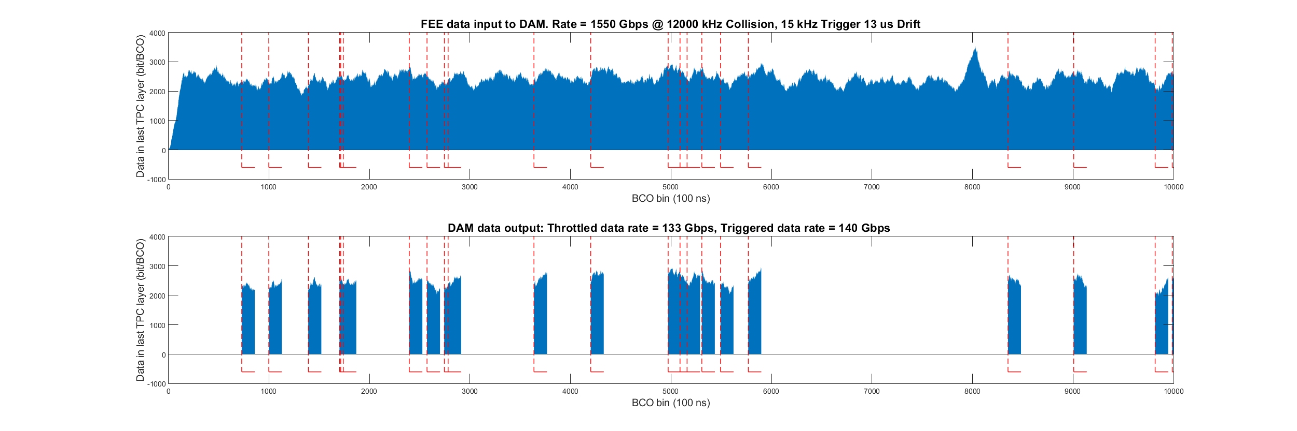
“Must-have” Triggered+Streaming events…
Chunks correlated with triggered events
In this way, we guarantee that we are reading “full” events here with information from all detectors
These are really our “baseline” data.
But there are ”reserves”!

Slide 17
… plus “opportunistic” streaming-only events
must-have
opportunistic
In addition, we can read “tracking-only” events without the calorimeters
Greatly enhances the statistics for several physics signals
Our Heavy Flavor group paved the way, others will soon discover the benefits
We can “back-fill” our storage limit with those events, open/close throttle as needed

Slide 18
Combined Triggered/Streaming readout tests
This wasn’t actually even formally planned at that stage…
We took a TPC prototype to the FermiLab test beam last year, FELIX readout, multiple front-ends…
Running in triggered-only mode would severely limit our event rates
We still needed to read out the Facility-provided beamline instrumentation (Cherenkov detectors, etc), triggered
But we “flipped” the TPC into streaming-readout mode
Our data acquisition system, “RCDAQ”, has support for streaming readout built in
$ dlist tpc-00002343-0000.evt -i
-- Event 1 Run: 2343 length: 5242872 type: 2 (Streaming Data) 1550500750
Packet 3001 5242864 -1 (sPHENIX Packet) 99 (IDTPCFEEV2)
$
18

Slide 19
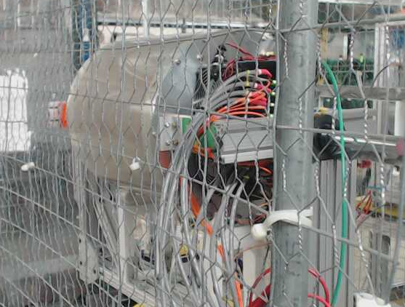
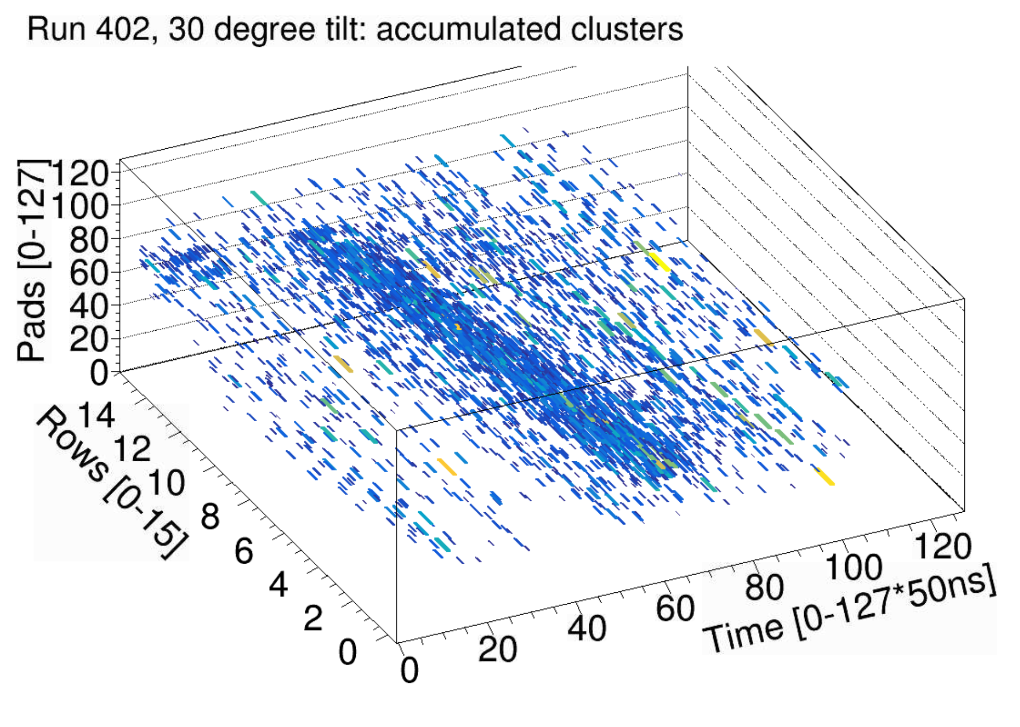
TPC Prototype
The prototype in the beam. Can move and rotate to make different tracks though the volume
Readout
Drift
Beam
Detector could move perpendicular to the beam
And it worked!
Reconstruction of tracks at a particular setting (several overlaid)
19

Slide 20
Let’s go back here for a sec
“Running in triggered-only mode would severely limit our event rates.”
Why?
When you have a “classic” triggered event, you accept the trigger, read out the detectors, done. Next event. One event is a well-contained thing.
I have come to regard a particular feature of SRO as the defining property, even if you ultimately trigger your front-end:
There is no synchronized end to a given event!
While “event” n is streaming, in other places, event n-1 (or -2) isn’t finished yet
20

Slide 21
Now what do you do?
“Events”
Now you could throttle your event rate with busies to not let that happen:
Or, if you insist on “event boundaries” in your data, you could buffer those event fragments in DAQ memory, assemble them, then write out
You have brought the event builder back, have to do it online, have to do it right the first time…
much better to just store the streaming data and do all that in the much more forgiving offline environment
21

Slide 22
That’s why SRO is faster
Just stream!
Yes, you need to check that you can line up the “event” fragments offline
Disentangle the “Event” chunks that belong together by their distributed clock counter or similar (for us: RHIC beam clock counter)
We are using the same technology for formally triggered devices with the same “no sync’ed end” feature
The Saclay DREAM electronics for GEM readout is one of those
Has allowed us to increase the event rates here, too, will use this at the next FNAL test beam
22

Slide 23
Summary
sPHENIX is on a good track to taking data in 2023
We got a jump start taking streaming data last year, good
We have demonstrated that we can reconstruct the TPC data taken in SRO mode
We have a good concept combining triggered and streaming data in the experiment.
Thank you!

Slide 24
Intermission

Slide 25
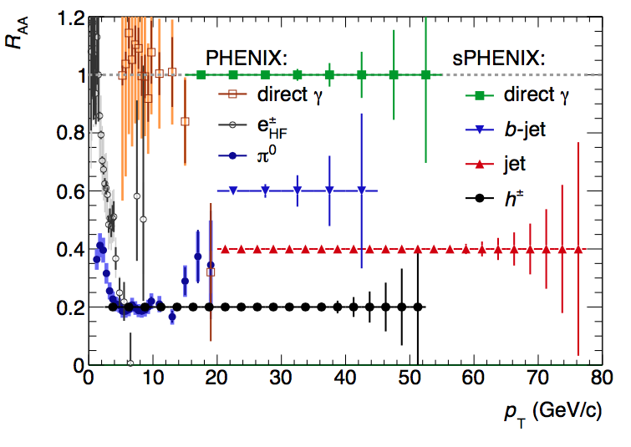
T-Shirt Plot: Statistical Reach for some probes
The way PHENIX gets to high PT is through π⁰s
That reaches to ~20GeV/c
In sPHENIX, we can get to
4x that with jets
Limit of PHENIX’s statistical reach
sPHENIX’s statistical reach

Slide 26
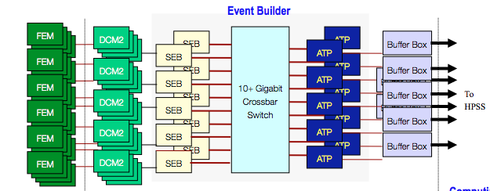
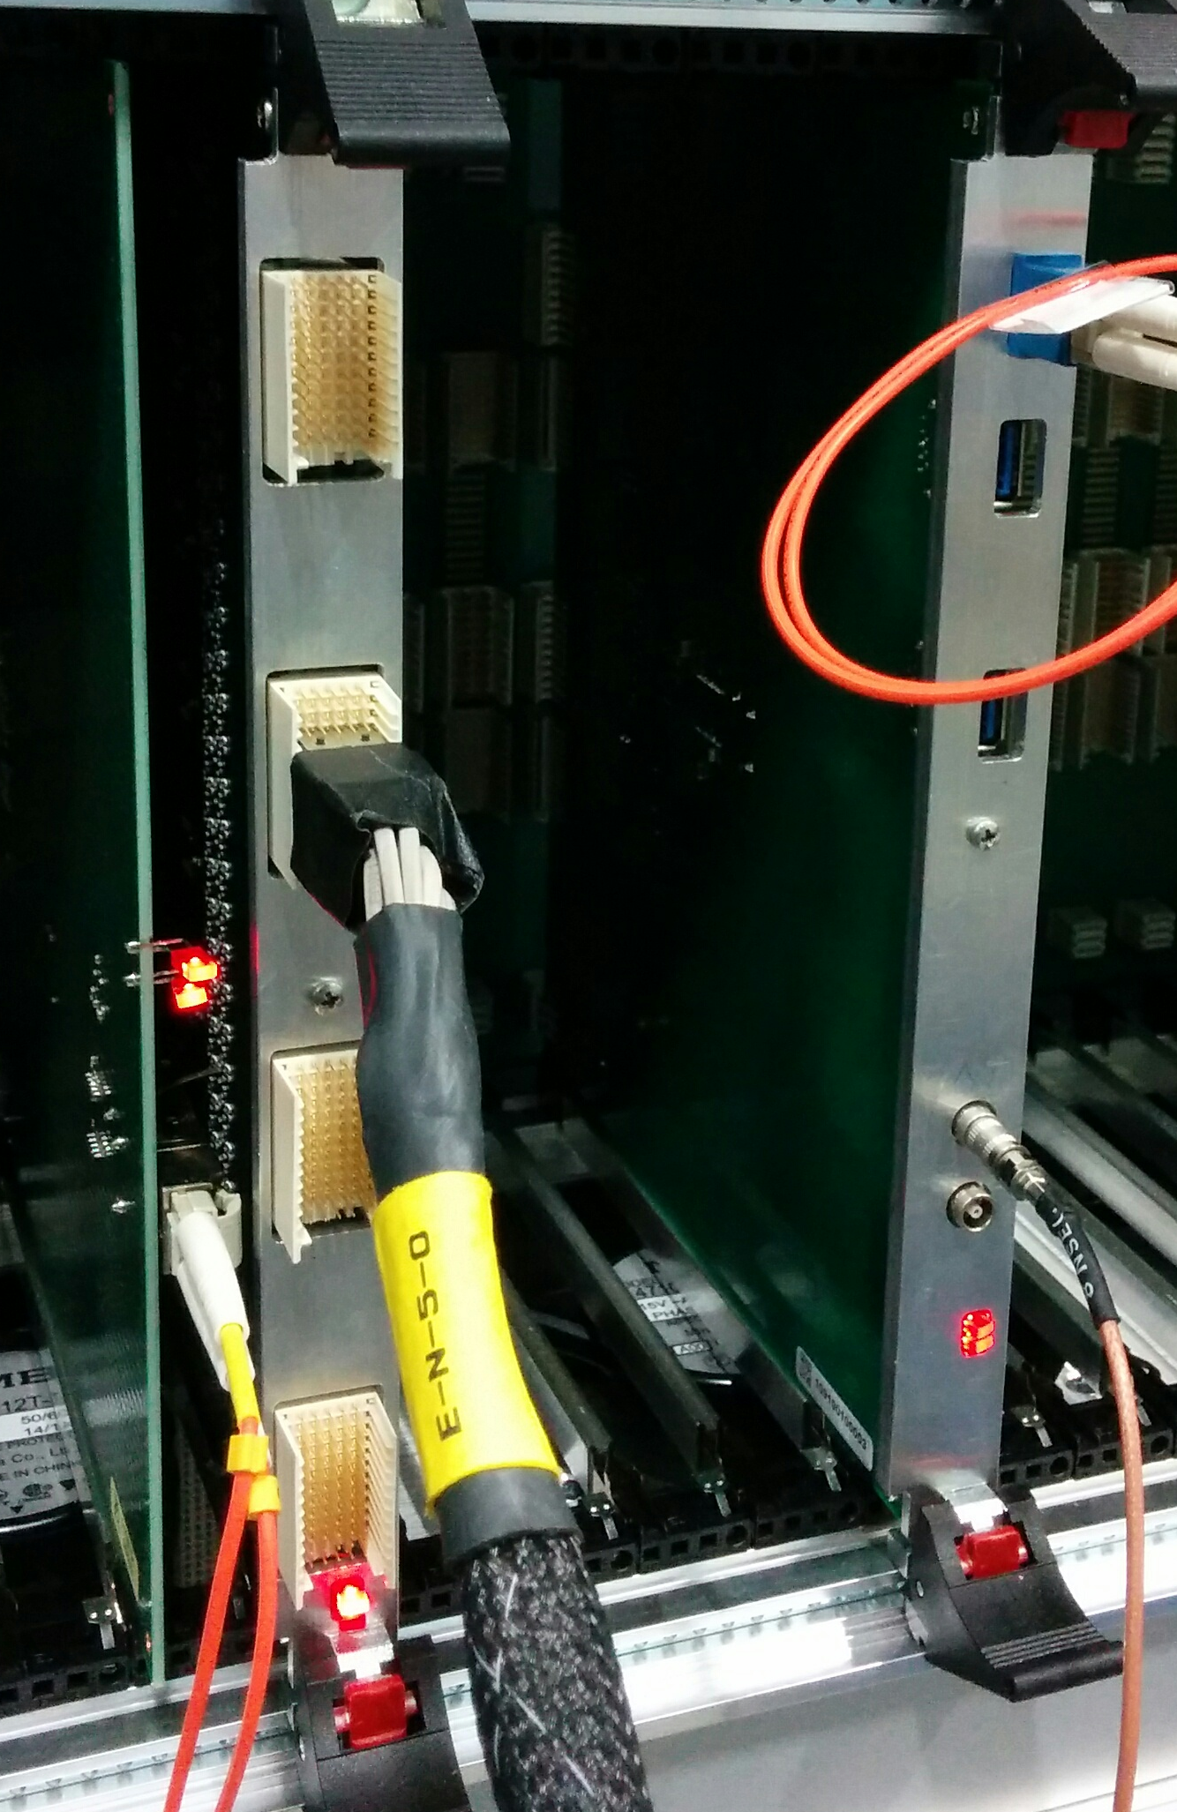
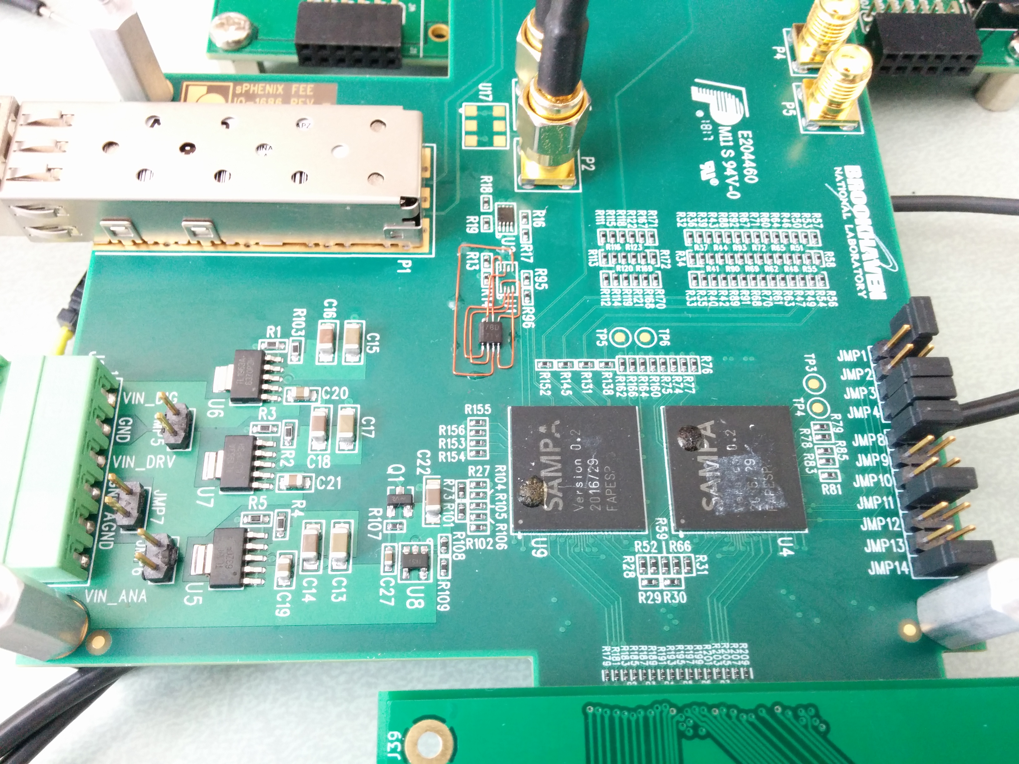
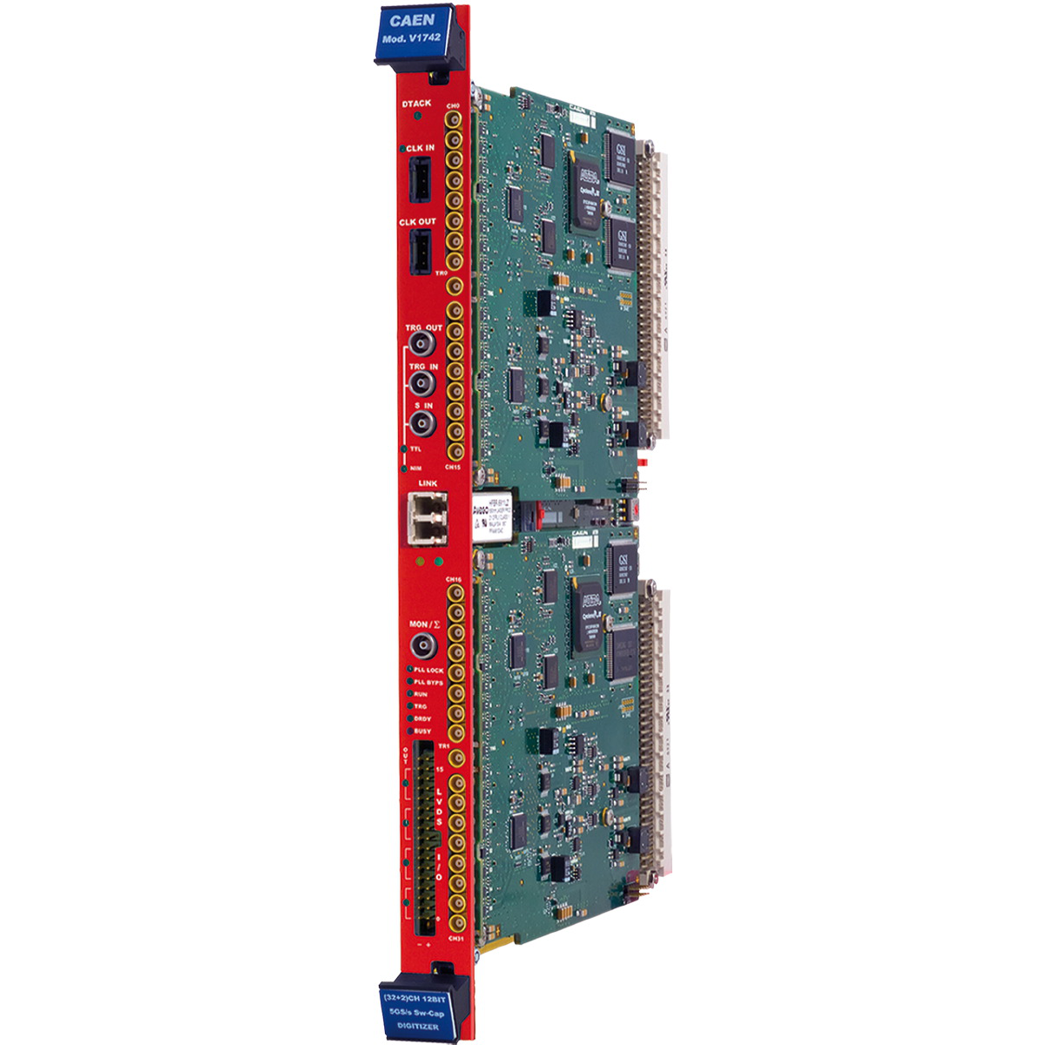
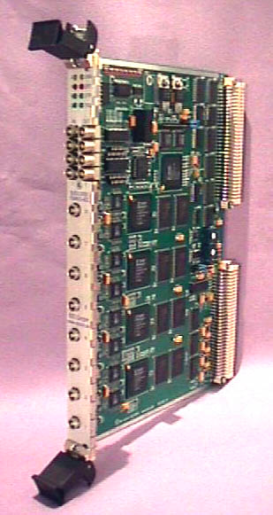
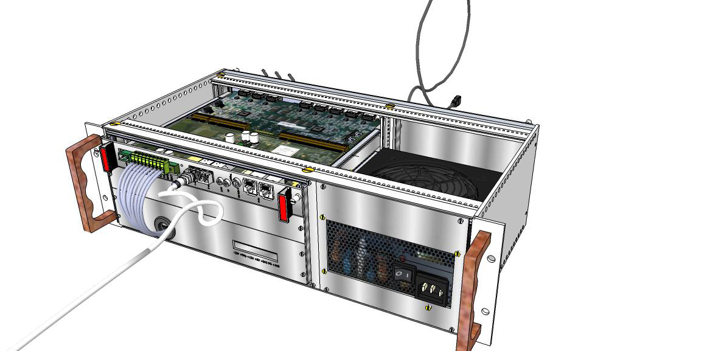
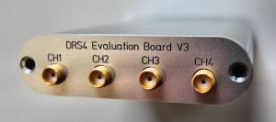
RCDAQ - R&D-themed part of the system
sPHENIX Calorimeter electronics
The RCDAQ DAQ System
Cut out the event builder (not much need right now)
Log data at the EVB “input point” instead
Same technology, reading out our front-end here will seamlessly integrate into the big thing
Powerful scripting/automation features
“Real” online monitoring often has it roots in test beam code
Addt’l support for a large variety of non-sPHENIX gear
~20 RCDAQ copies around in the sPHENIX orbit
About a dozen more systems in use by external groups
Supported on high-end 32core PC to Raspberry Pi
FEM
DCM
DCM
PC
DCM
DCM
TPC SAMPA Chip and ATLAS Felix Board
DAM
PC
PC
RD51 SRS, DRS4, VME gear…
some 40 supported devices

Slide 27
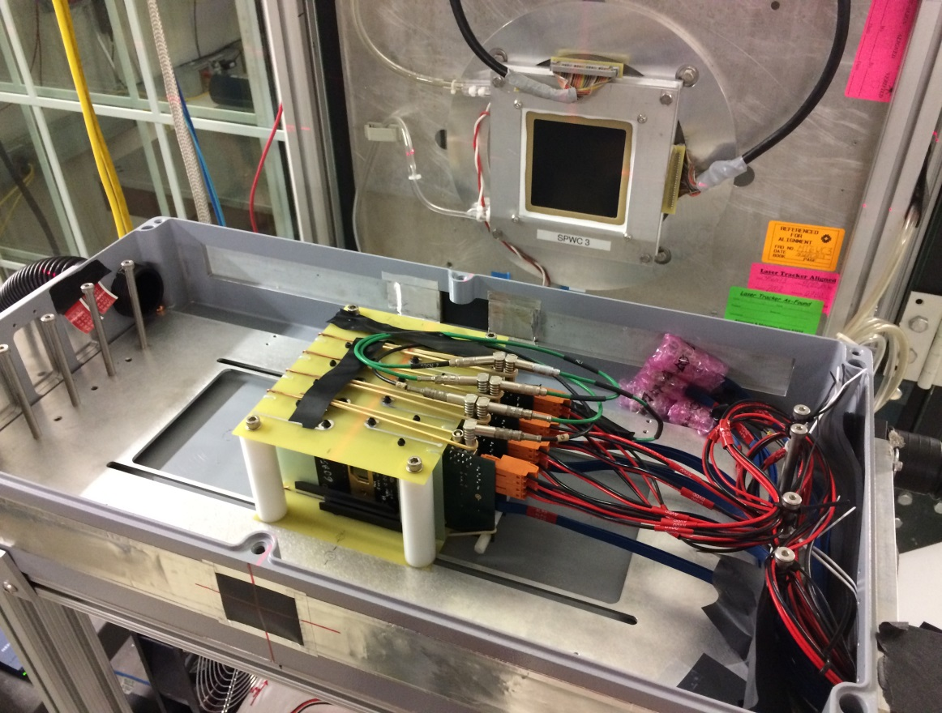
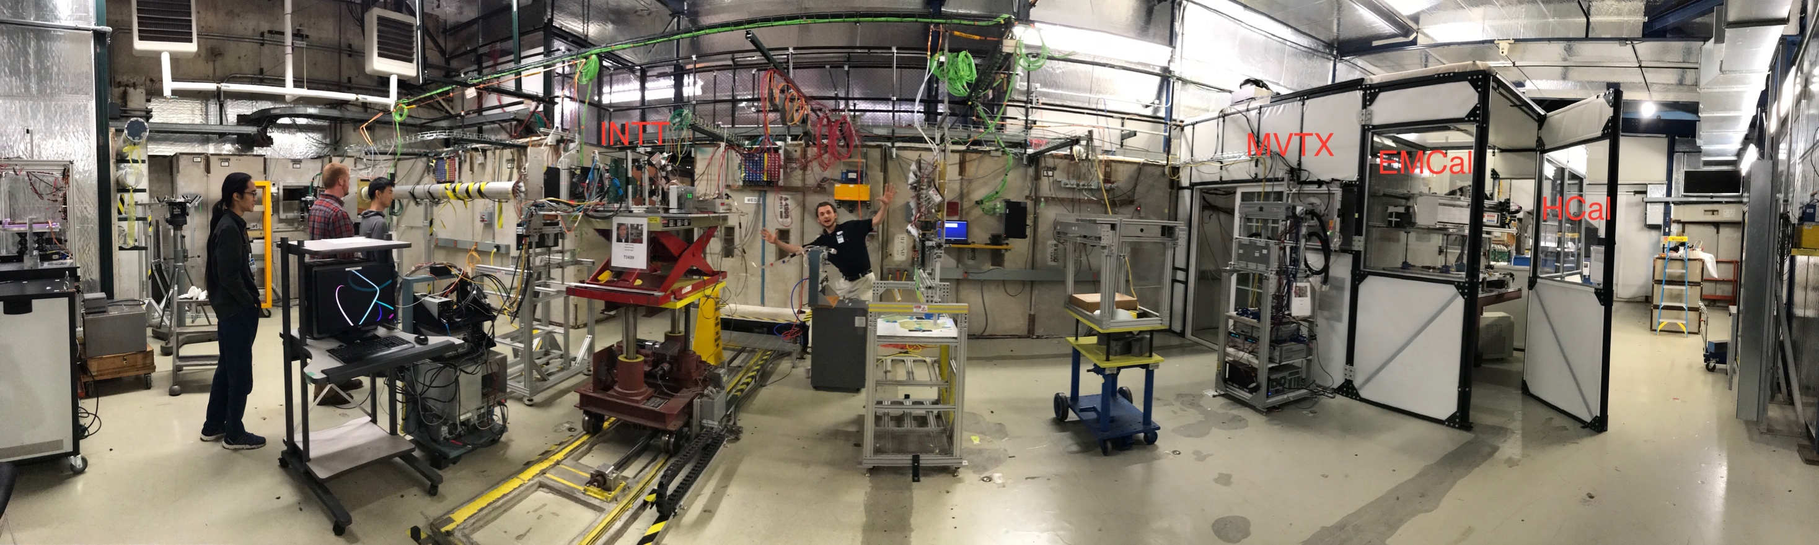
MVTX, briefly
The MVTX prototype was taken to the FermiLab test beam
ALICE “ALPIDE cards”
MVTX also uses the FELIX card (and RCDAQ)
4-layer “MAPS telescope”
4-ALPIDE Telescope;
5m long SamTec cables

Slide 28
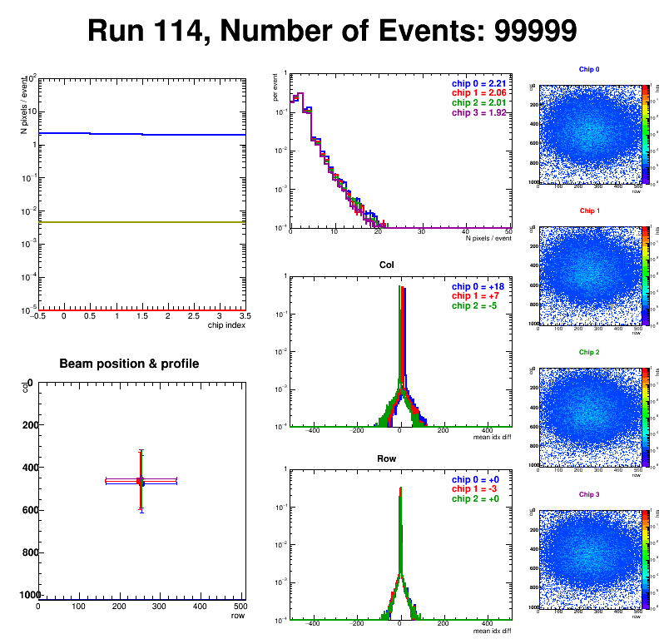
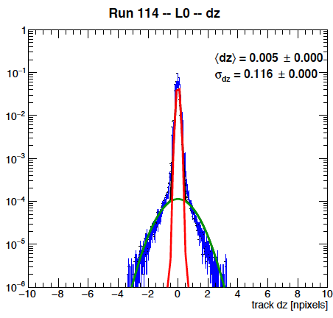
And it worked…
Successfully operated the full readout chain
  RU Configured and readout 4 ALPIDEs
  FELIX successfully integrated into RCDAQ
Sensor Performance
  Cluster Size
  Threshold parameters
  trigger delay
High multiplicity events
  ALPIDE occupancy runs with 10cm lead bricks
Online Monitoring
  Hit distribution, relative alignment
Analysis confirmed telescope performance
  Hit resolution < 5 um

Slide 29
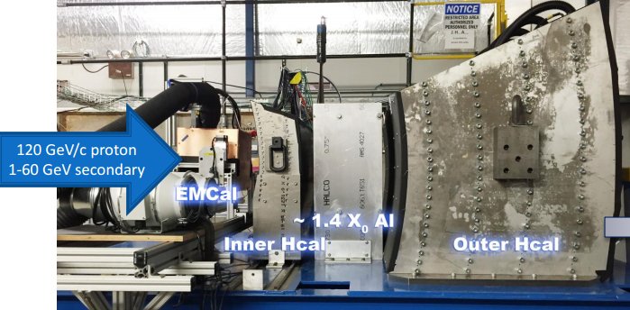
The last Test Beam

Slide 30
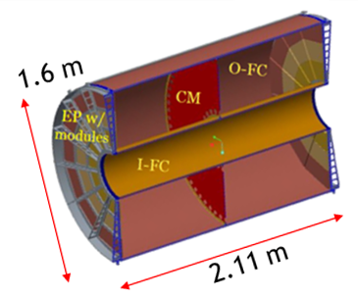
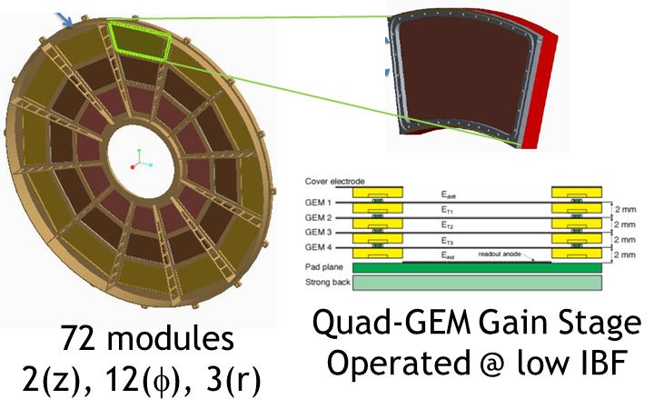
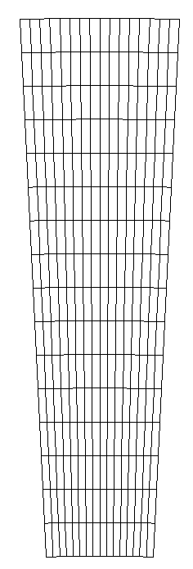
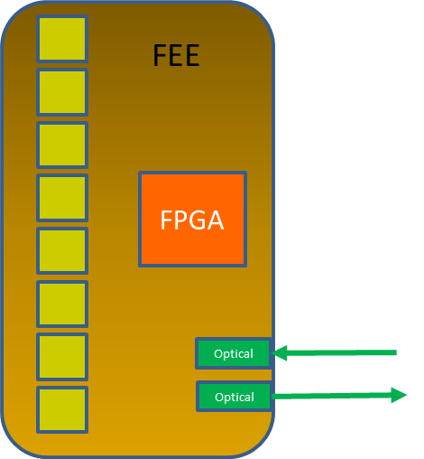
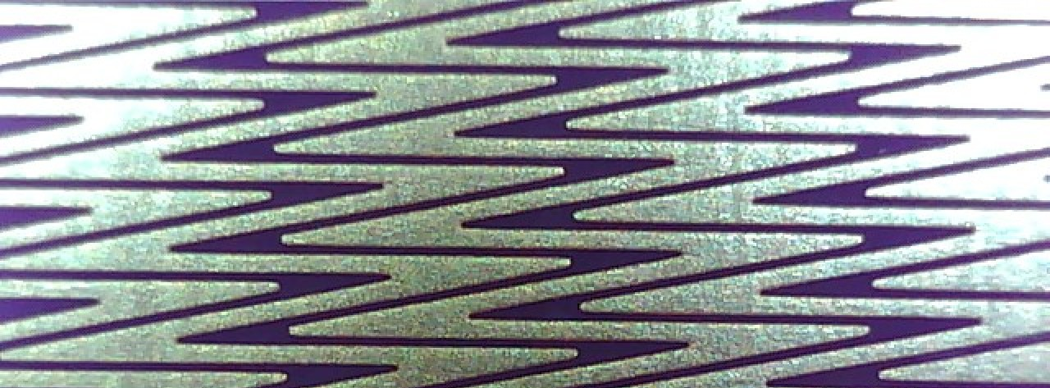
The TPC
16 rows ~1.25 cm
“Wedge”
“Wedge”
EBDC 1/DAM
256 pads/FEE
25 FEE/sector
Storage
charge
Digitized
DAM Cards
Clustered
Zig-Zag
Pads
30
DAM = “Data Aggregation Module” EBDC – “Event Buffer and Data Compression”

Slide 31
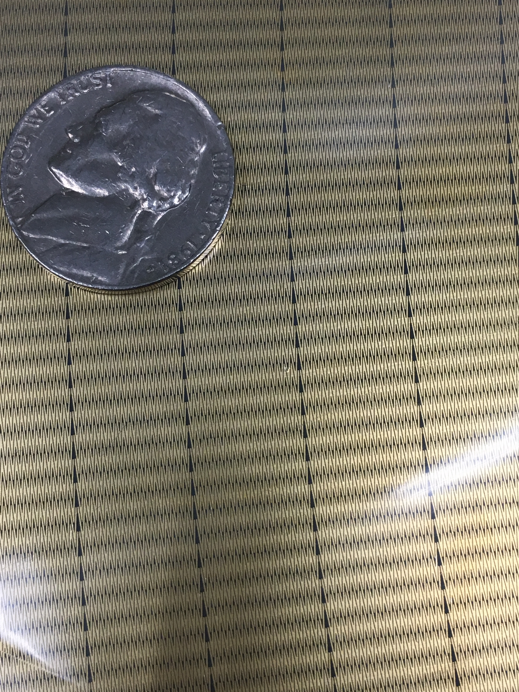
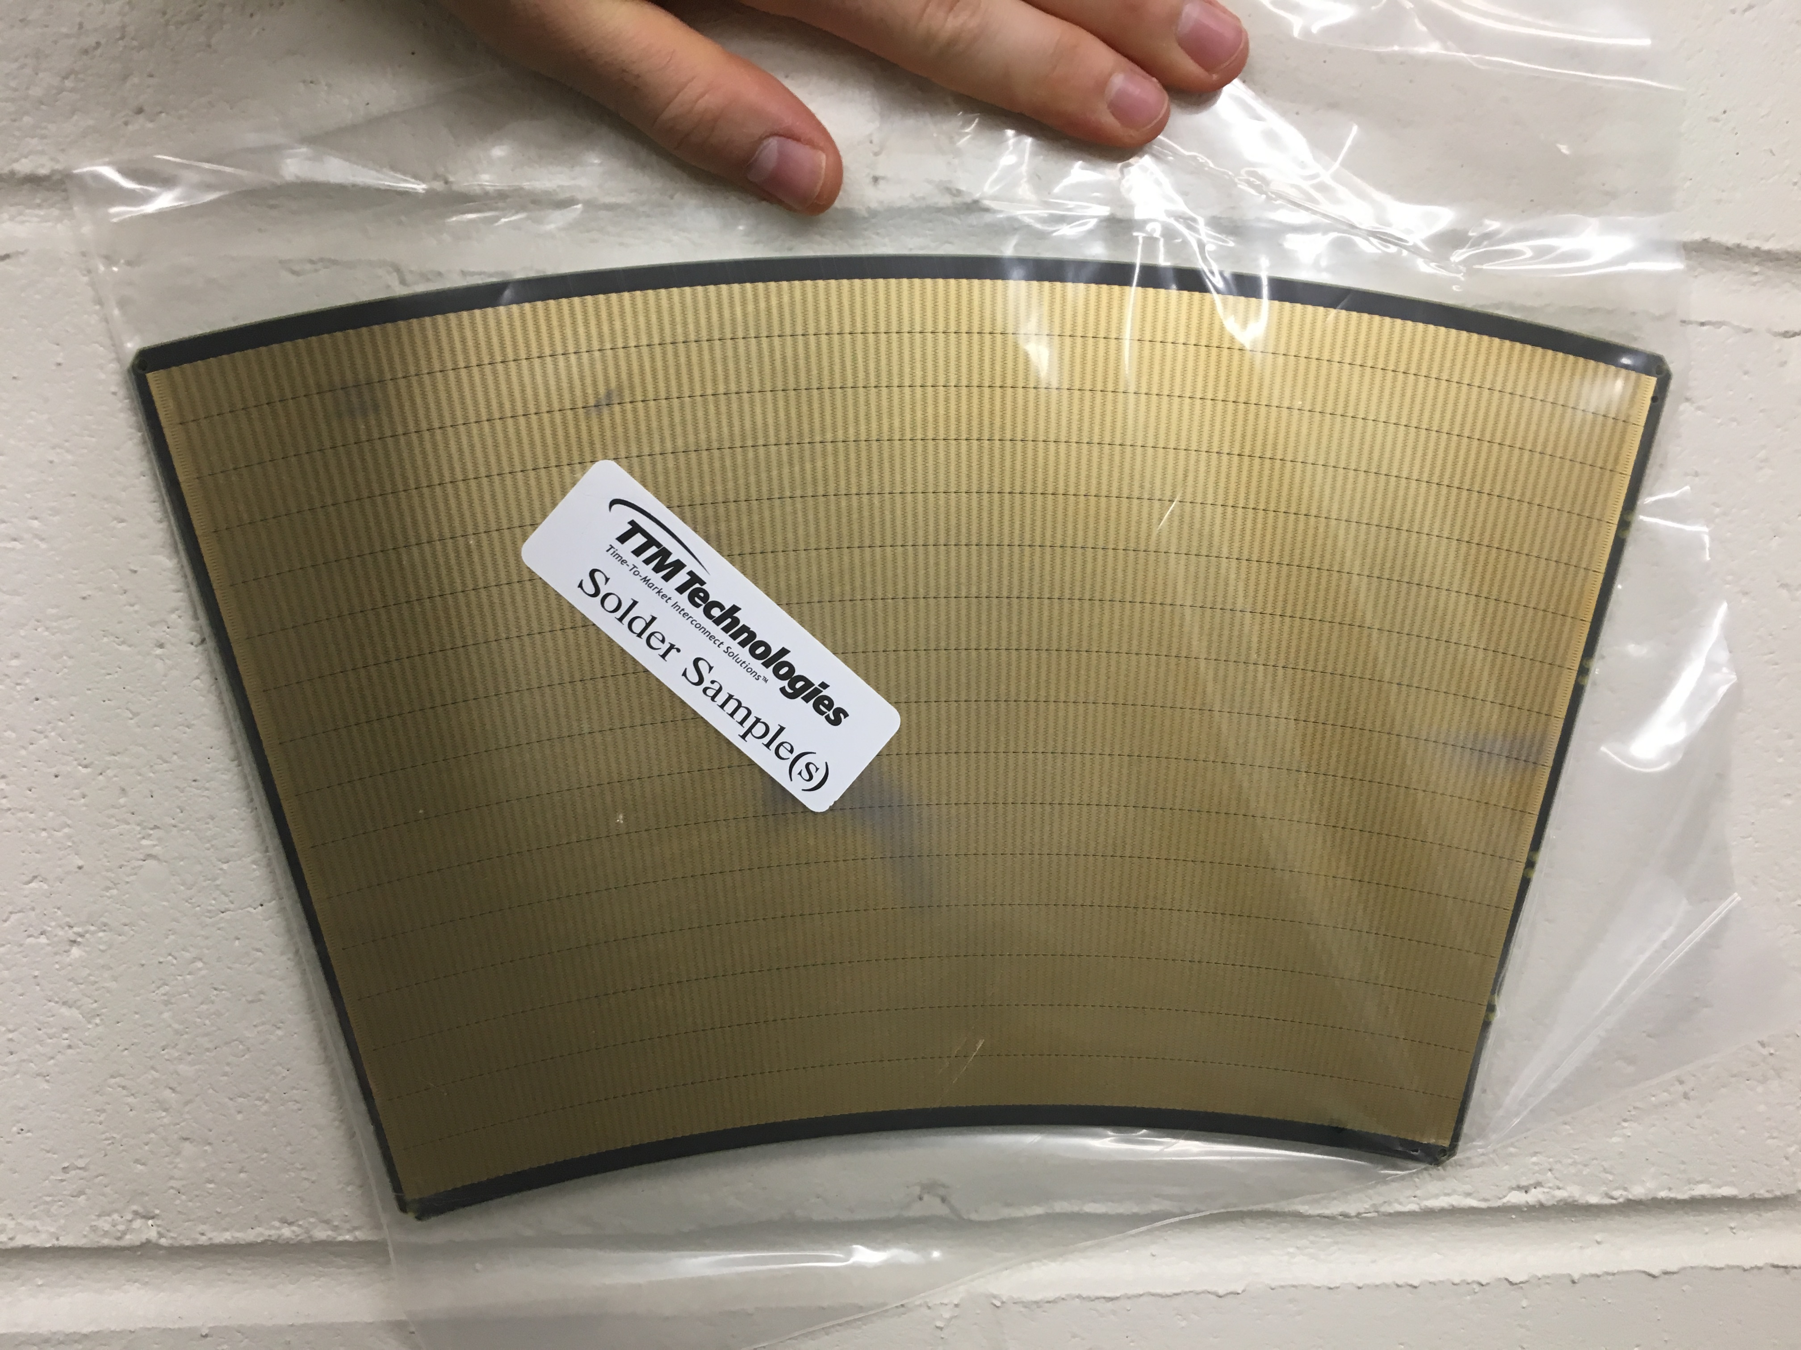
The ZigZag Pads
12.5mm resolution in r
150 μm in phi
~160,000 ADC channels
Zig-Zag
Pads

Slide 32
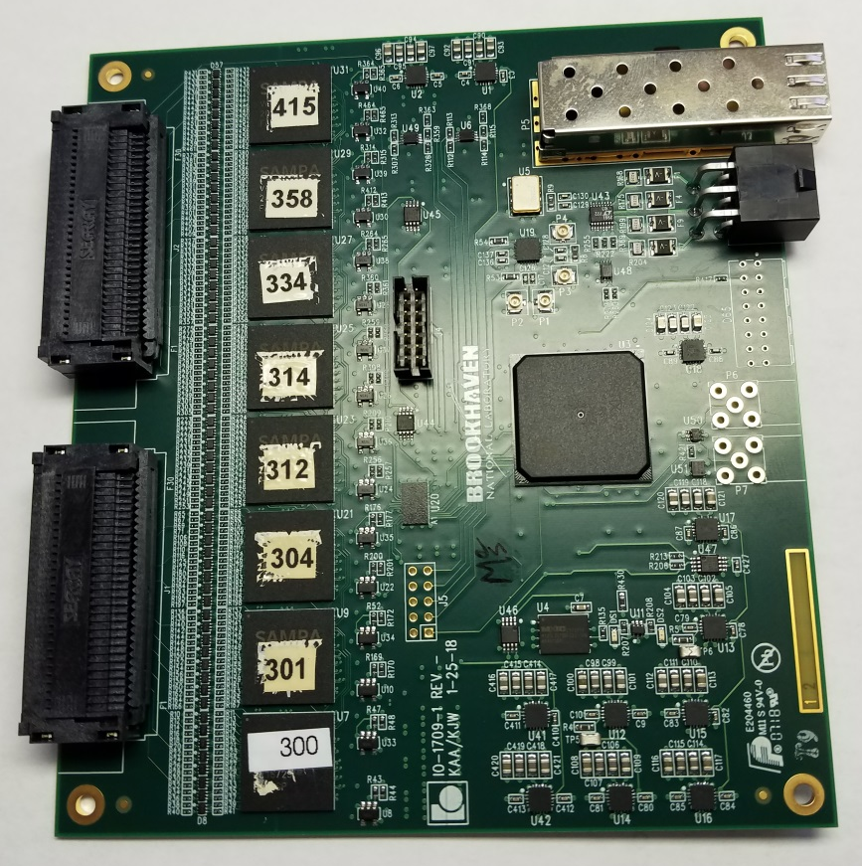
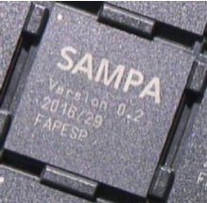
The Readout
ALICE SAMPA chip
32 channels 10bit sampling ASIC
Preamp/shaper, ADC
Optional DSP functions
5GBit/s fiber link
256 pads/FEE
25 FEE/sector
FEE with 8 SAMPAs
256 channels
ATLAS FELIX Card (“DAM”) – 24 FEE’s
FELIX Card in a standard PC (“EBDC”)

Slide 33
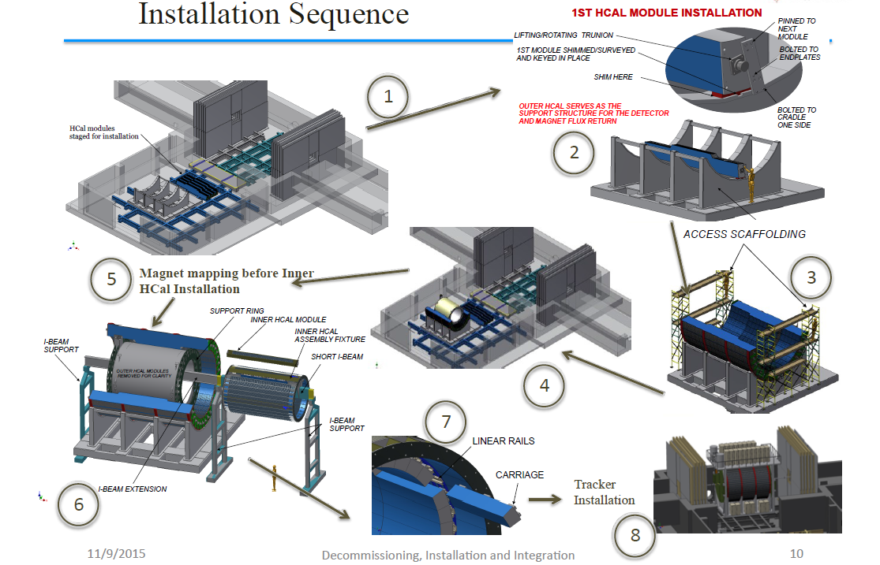
Assembly Instructions ☺
sPHENIX Monteringsföljd
Första HCal-modulinstallationen
Lyftande svängtapp
Första modulen shimsad
undersökt och injusterad.
Fastsatt med
nästa modul
Bultad till
ändplattorna
Yttre HCal fungerar som stödstruktur för detektorn och retur av magnetiskt flöde
Bultad till
hållaren en sida
HCal-moduler
förberedda
för installation
Byggnadsställningar
Kartläggning av magnetflöden
innan inre HCal-installationen
Stödring
Inre HCal-modul
I-balkstöd
monteringsfixtur
Kort I-balk
I-balkstöd
Linjärskenor
Vagn
I-balkförlängning
Detektorinstallation

