Slide 1
ERSAP: Environment for Real-Time Streaming Acquisition and Processing
Reactive micro-services based data stream processing framework
V. Gyurjyan presenting on behalf of the JLAB EPSCI group
Streaming Readout Workshop VII
16-18 November 2020

Slide 2
On EIC Data Processing Software Framework Design Requirements
Basic questions
Future technology tolerant/welcoming
Maintenance or evolution
Open source or closed source

Slide 3
None of us is as smart as all of us
ERSAP
CODA + CLARA + JANA
Stream Source
Infrastructue
Processing
Notes:
I will start describing the problem we are trying to address and why we thing micro-services architecture and FBP are one of the solutions to this problem, then I will briefly describe CLARA framework focusing on it’s internal workflow management system.

Slide 4
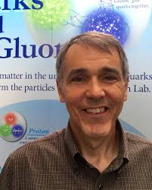
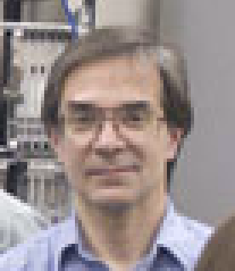
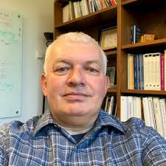
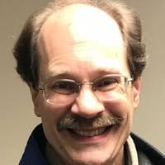
JLAB CODA Group
Common DAQ, control and data-processing support group
Graham Heyes
David Abbott
Ed Jastrzembski
Carl Timmer
Vardan Gyurjyan
Bryan Moffitt
William Gu
Notes:
For those who does not know….

Slide 5
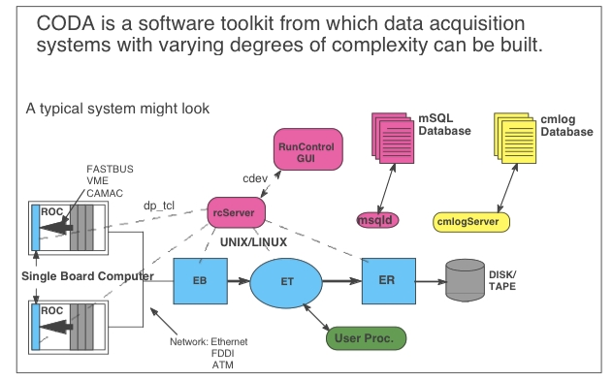
History of CODA
CODA betta release January 1992
“CODA: a scalable, distributed data acquisition system” WA Watson, J Chen, G Heyes, E Jastrzembski, D Quarrie IEEE transactions on nuclear science 1994 41 (1), 61-68
Notes:
We are witnessing Big data 3V expansion….
Traditional computing model

Slide 6
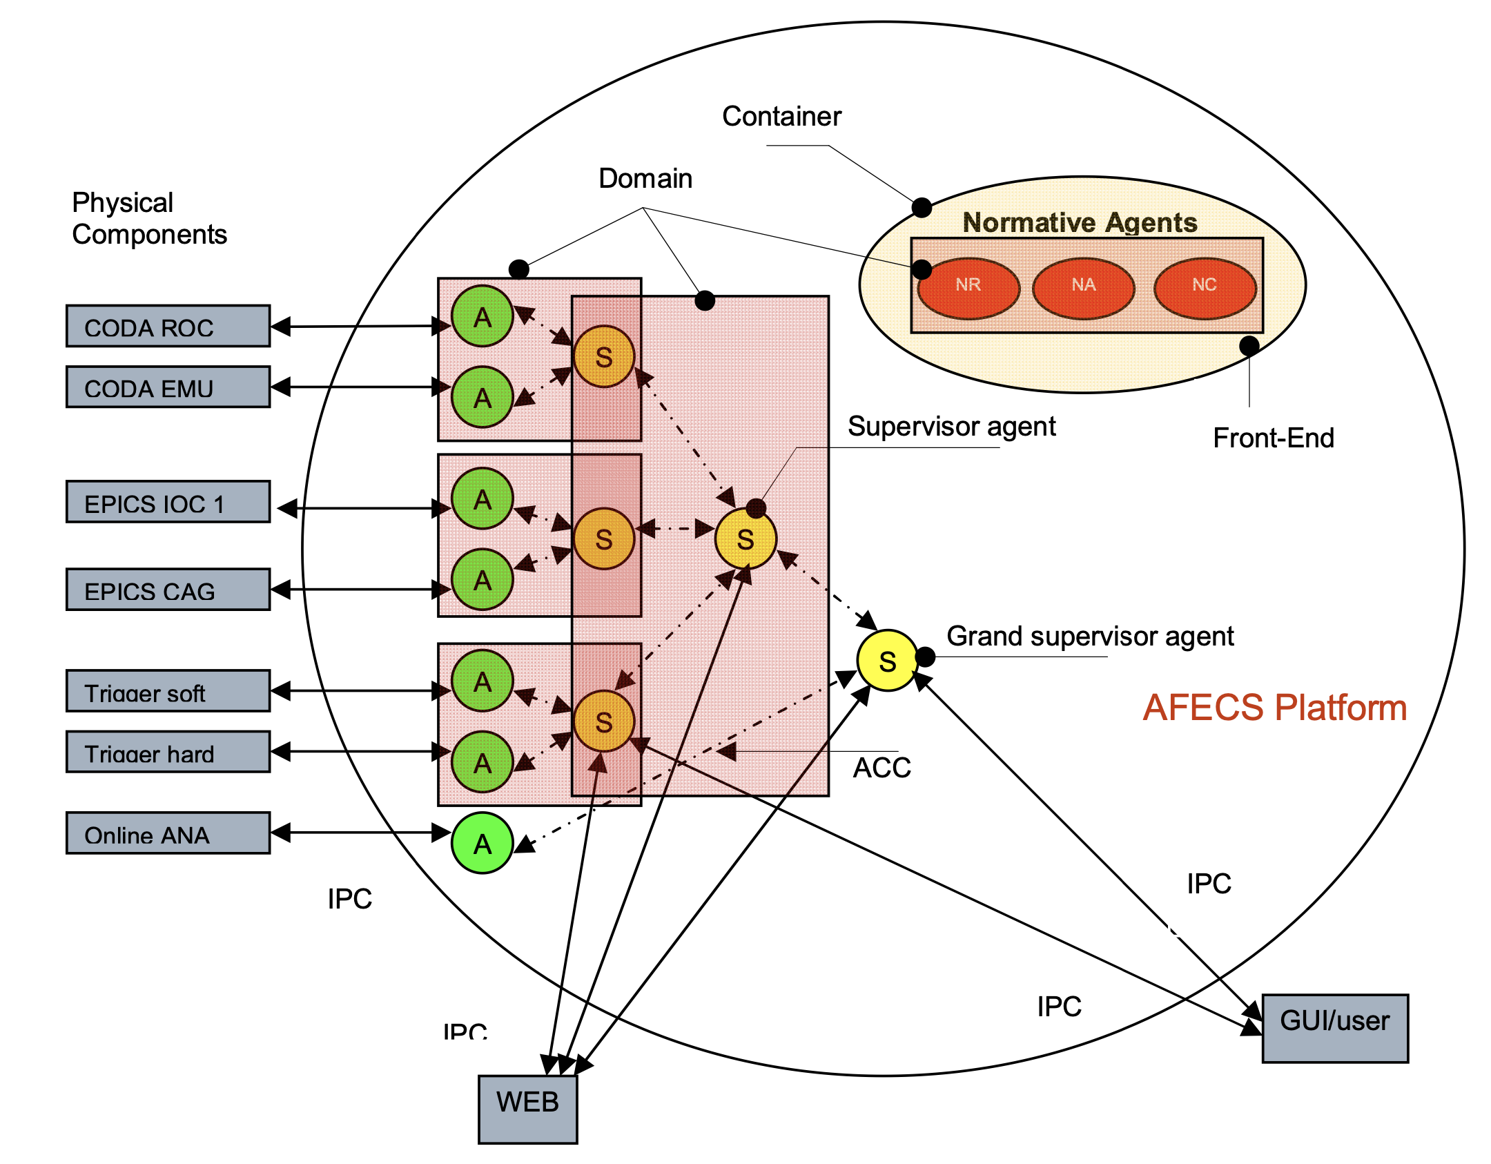
CODA Run Control. From OO to IAT
Monolithic application, built using Eiffel OO language in conjunction with OSF/Motif and DataViews for 1992 – 2002.
Design of the distributed run-control system in 2002
“FIPA agent based network distributed control system” D Abbott, V Gyurjyan, G Heyes, E Jastrzembski, C Timmer, E Wolin, JLAB-PHY-03-09; DOE/ER/40150-2462
„AFECS. multi-agent framework for experiment control systems“ V Gyurjyan, D Abbott, G Heyes, E. Jastrzebski, C. Timmer, E. Wolin, Journalof Physics , 2008 - iopscience.iop.org
Notes:
We are witnessing Big data 3V expansion….
Traditional computing model

Slide 7
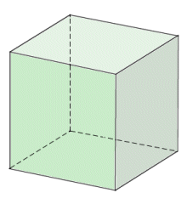
New approach for CLAS12 offline
How to develop an environment that can break the complexity of the CLAS12 detector reconstruction algorithm, that can be easy to maintain, be able to evolve over time, adopt technological advancements and encourage contribution.
Scale by splitting similar things , Y-axis
such as events
Suggested Z axis scaling, i.e. decomposition of the application into small independent applications is the basis for the micro-services architecture.
Vertical scaling or multi-treading
Scale by splitting different things, Z-axis
such as by function
Micro-services
Horizontal scaling
Scale by cloning things, X-axis
such as multiprocessing
The Art of Scalability. by Martin L. Abbott and Michael T. Fisher. ISBN-13: 978-0134032801
Notes:
We are witnessing Big data 3V expansion….
Traditional computing model

Slide 8
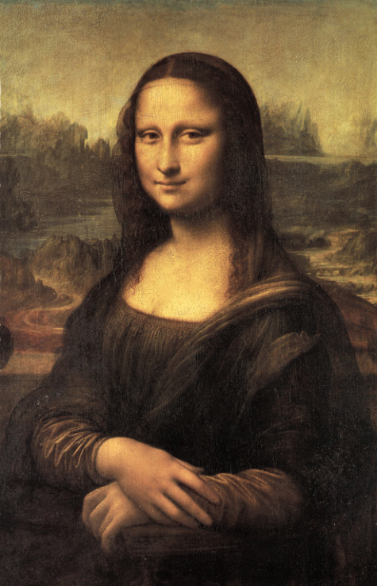
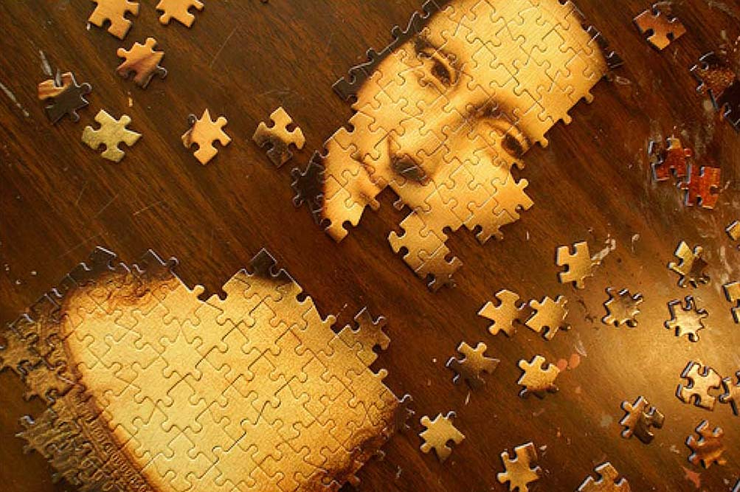
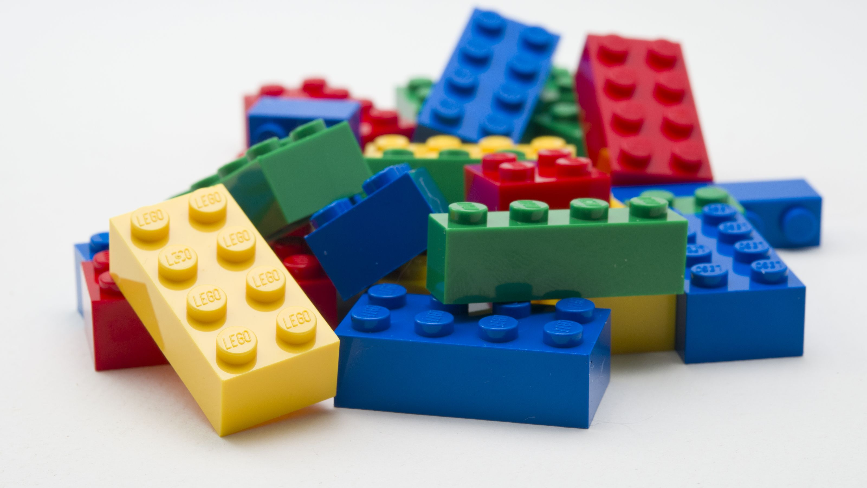
IAT for data processing?
IAT can satisfy most of this requirement, yet may be an overkill.
AFECS -> CLARA. Birth of the CLARA proposal for the CLAS12 in 2009.
Betta release of the CLARA (late 2009) meant to speed-up CLAS12 reconstruction software development.
Proof of concept DC reconstruction engine development by S. Paul, using Sebastian P. algorithms (SOCRAT).
2012 first release of the CLARA C++ binding to aid the SCRAT (JANA based Clas12 reconstruction) project.
v.s.
Notes:
We are witnessing Big data 3V expansion….
Traditional computing model

Slide 9
ERSAP Infrastructure framework (IF)
Reactive, event-driven data-stream processing framework that implements micro-services architecture and FBP
Micro-services orchestration framework
Defines streaming transient-data structure
Provides service abstraction (data processing station) to present user algorithm (engine) as an independent service.
Service orchestration
Defines service communication channel (data-stream pipe) outside of the user engine.
Stream-unit level workflow management system and API
Supports C++, JAVA, Python languages
Data–stream pipe
Data processing station
S9
S10
S10
S3
S1
S2
S4
S5
S6
S’3
Service engine
S7
S8
CLARA: A Contemporary Approach to Physics Data Processing, 2011, J. Phys.: Conf. Ser. 331 032013 doi:10.1088/1742-6596/331/3/032013
Workflow manager
Notes:
So, what is ERSAP IF in one slide.

Slide 10
ERSAP basic components and micro-service anatomy
Data Processing Station
Data-Stream Pipe
Orchestrator
JANA processing Engine
Data Processing Station
Data Processing Micro-Service
https://github.com/JeffersonLab/clara-java.git
CLARA Language Bindings
https://github.com/JeffersonLab/clara-cpp.git
https://github.com/JeffersonLab/clara-python.git
http://claraweb.jlab.org
https://claraweb.jlab.org/clara/docs/clas/hands-on.html
https://github.com/JeffersonLab/xmsg-java.git
xMsg Language Bindings
https://github.com/JeffersonLab/xmsg-cpp.git
https://github.com/JeffersonLab/xmsg-python.git
Notes:
There is a minimal interaction with users. User develops his/her algorithm independently, tests, debugs as a standalone application. The requirement for the engine is to accept data at its input and present data at it output. Data will be packaged in the transient data envelop and will be transport to the addressees through data pipe. Data pipe will define the optimum transport protocol and communication patterns based on the service deployment requirements. I will come back to this in a minute and will describe on an example what I mean.

Slide 11
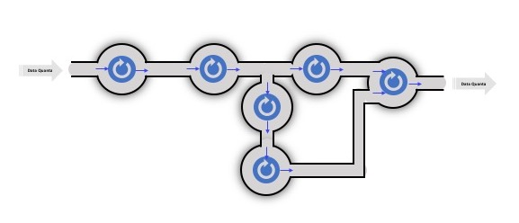
ERSAP application composition
Data Processing Micro-Service
Data-Stream Pipe
Data Processing Micro-Service
Notes:
Note that ERSAP infrastructure framework allows multiple input input engines, allowing parallel and hierarchical data processing application service compositions.

Slide 12
ERSAP IF Layers
Orchestration Layer
Local Registration
Local Registration
DPE
DPE
SC
SC
FE
SC
SC
Registration
gateway
security
Local Registration
Local Registration
DPE
DPE
SC
SC
SC
SC
Service Layer
Meta-Data (protobuf/flatbuf)
Data (usaer/protobuf/flatbuf)
ZeroMQ(xMsg)
POSIX Shared Memory (FIPC)
in-Memory Data-Grid
Notes:
ERSAP infrastructure framework consists of 3 basic layers: data layer or service communication layer or a data stream pipe., which is shown here in details (lower 2 layers) describing supported transport mechanisms, such as ZeroMQ, Posix shared memory and in-memory data grid or data lake playing the role of temporary data cooling. Also here is shown default metadata data format, that is based on googl’s protobuf and currently we are designing and testing flatbuffers. Frameworks data layer is agnostic to the user data format , and will transport arbitrary user data serialized in a byte array. Serialization and decerialization of the user data will be done by the framework, assuming that user provides serialization and deserialization routines. However Framework provides native data format in case user wants to use it, and the native data format also is based on protobuf and flatbuf. In case of the native data format user will not worry about data serialization and deserialization. Native data format provides a hierarchical data format of (payload straucture) of all primitive data types and arrays of primitive types.
Second layers is a service layer, where services are grouped in service containers running in language or hardware specific data processing environments.
Framework also provides standard or normative services for service registration, discovery s well as gateway and security services for data encoding/ decoding and overall data security.
Orchestration layer is responsible for the application composition and deployment, which means services deployment, recovery, their configuration and application execution. It is worth wile to mention that workflow orchestrator is not interfering to the streaming data processing and assumes a passive observer role during the data processing. So, it monitors (subscribes reporting messages from micro-services), does real-time benchmarking for each micro-service for example. It also presents stream unit level workflow management system that works in conjunction with the file based workflow management system of a farm or cloud to guarantee a proper execution and monitoring of a data processing application. ERSAP provides workflow orchestration API to build and/or customize custom workflow management systems. It optimizes service deployments in real time to achieve optimum performance. It also monitors new DPE actions and if configured will elastically expand and/or reduce the running application. For example, if new nodes become available on the farm based on the farm orchestrator will be responsible to horizontally scale application, or in case one of the DPE’s or node goes offline it will continue application with reduced number of micro-services. Orchestrator also handles data-set provisioning for the processing by staging it on a node local file system for optimized IO performance. Orchestrator is a front-end of the data processing that is presented to a user in the form of rich command line interface (CLI) or UI.

Slide 13
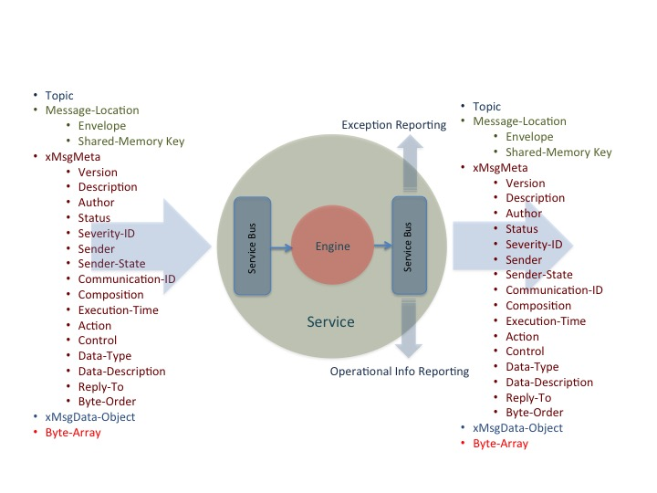
ERSAP IF Transient Data Unit (meta-data + data)
Meta-data
Data
Notes:
This slide shows CLARA transient data unit (data-quantum) structure. Here I show also micro-service internal structure showing that data communication is handled outside of the user engine, so that user never warries how and where the data is coming at the input of the data professing engine whether it was serialized before or not. User engine gets always a data object. Since transient meta-data communication pattern is pub-sub it contains a topic, which is what micro-services are subscribing to. Followed by a section describing the location of data quantum. Note that when “envelope” field is set that will indicate that the serialized data object is within this transient data object, in the data object section. There are set of fields describing version, description and the author of the micro-service upstream of the receiver micro-service, as well as status of the data processing that resulted the received data, the registered name of the micro-service (author of the data received), the state of the author micro-service after producing data. Communication ID allows micro-services to participate in multiple data-processing applications, due to the design requirements that micro-service must be stateless. The composition filed caries a critical information that describes entire data-processing pipeline in terms of micro-service positions inside of the data stream. Each micro-service will parse this only once to define where it should broadcast his data-processing results, i.e. who are subscribers. Note that composition can be changed dynamically, allowing application functional elasticity at runtime (we can add or remove micro-service from the pipeline at runtime creating different streams and branches of the stream processing application). Meta-data also contains information about the data-type, data-description and data byte-order. There are 2 reserved fields that can be used in real-time to control the behavior of the data receiving micro-service, if of course it is equipped with this functionality.
“Reply-to” field can be used for additional data routing and/or handshake required by the sending micro-service.

Slide 14
ERSAP Stream Routing
In-Memory Data-Grid
Meta-data
Detector-2
POSIX Shared Memory
Detector-1
1
2
3
4
5
6
7
In-Process SHM
In-Process SHM
In-Process SHM
DPE-1
DPE-2
DPE-3
Node-1
Node-2
Notes:
This slides shows a hypothetical streaming application, composed of 7 micro-services, deployed in 3 data processing environments, distributed among 2 nodes. Left 2 services are reacting on detector events and storing the processed results in a shared memory. In this case, since these services are sharing the same DPE, they are using in-process shared memory (as usually non-blocking, indexed array). The second service might need detector 1 processed data for its own processing, so it might touch in-process memory twice. Event then is processed by the third micro-service from the left and result is pushed into the in-memory data grid. Black arrows represent meta-data communication path. Transport of meta-data is done using ZeroMQ based engine of the service-bus/communication layer (communication is pub-sub). If we assume that DP1 and DP2 are of the same technology there is no need for data serialization and de-serialization and also no data copies up to the micro-service number 5. The fact that there are 2 DPE deployments on the node 2 tells us that they are of different technology. In this case data must be serialized and stored into a POSIX shared memory, where from micro-service number 6 will receive a serialized Byte Array and will de-serialize it into a proper data object for processing. Data communication between micro-service 6 and 7 will be through in-processes shared memory and micro-service 7 in this particular example must serialize the result and copy it into the POSIX IPC, indicating that the next service in the data-processing pipeline is going to be running on DP2. Note that data in the in-memory data-grid can be serialized or un-serialized object, depending of differences in technologies used in upstream and downstream micro-services.
CLARA will automatically change the transport engines to minimized data migration, data copy and data serialization, based on communicating micro-services deployed location. All micro-services deployed in the same DPE, sharing the same technology will communicate data through in process shared memory, in case micro-services communicating data across technology barriers, such as two different DPE’s on the same node: data will be communicated through POSIX shared memory. In this case the data is going to be serialized and de-serialized at the data consumer service. Incase data is communicated between services deployed in different nodes, than data will communicated through in-memory data grid (Redis currently).

Slide 15
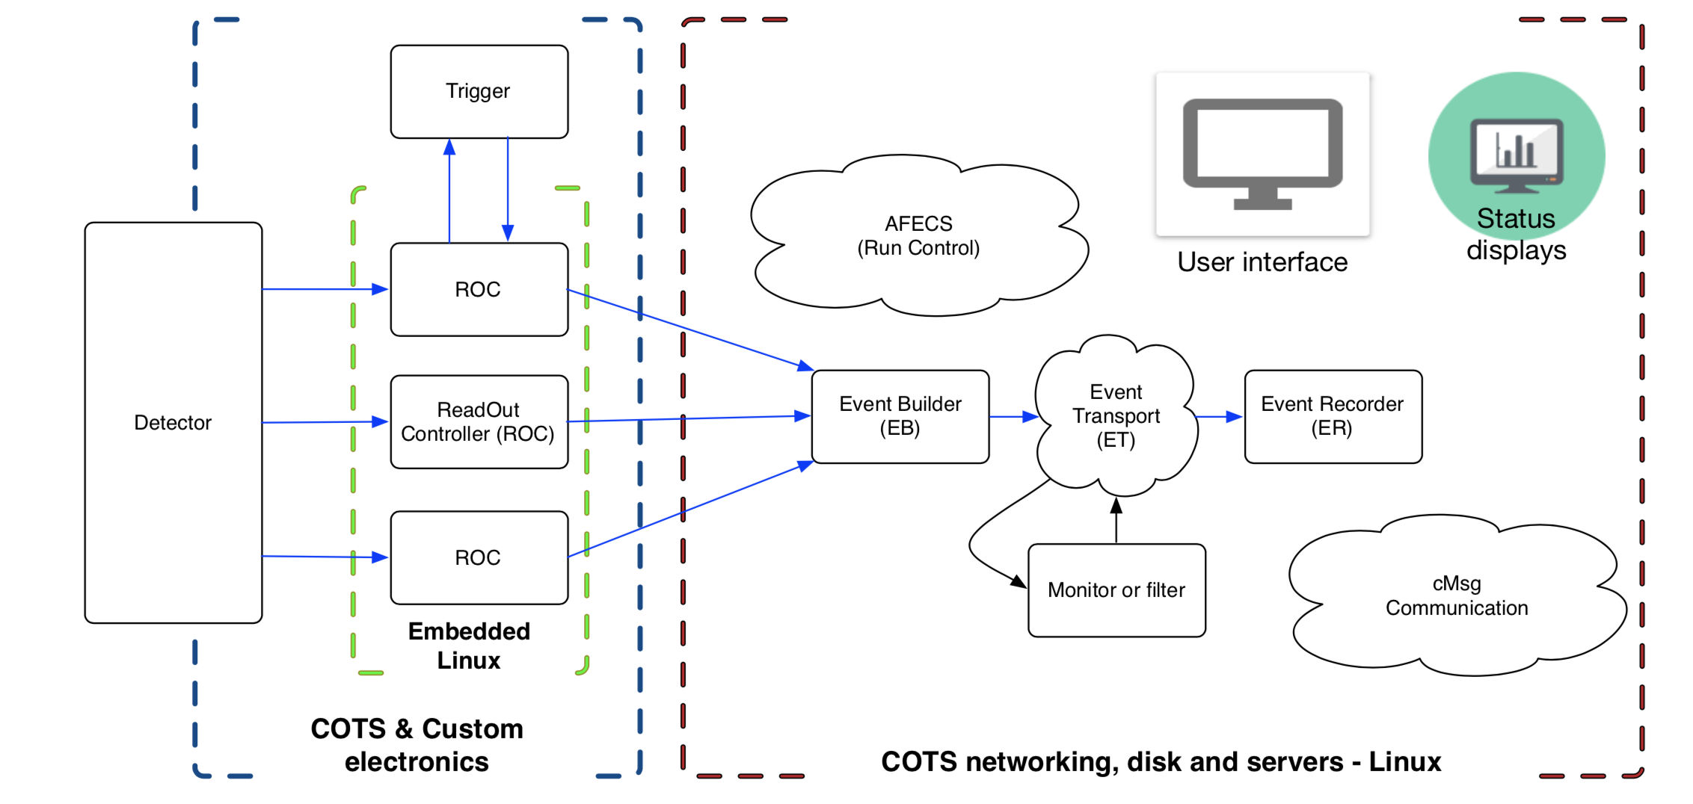
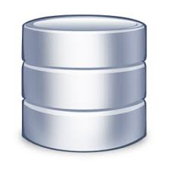
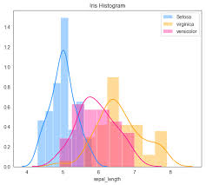
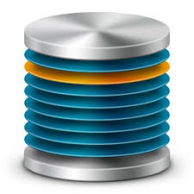
CLAS12 Data Processing Applications, using ERSAP IF
Event Reconstruction Application
MAGF
FCAL
FTHODO
FTEB
DCHB
FTOFHB
EC
CVT
EBTB
FTOFTB
DCTB
EBHB
LTCC
HTCC
BAND
CND
Data Acquisition System
CDG
Data Quality Assurance
Data Provisioning
Physics Analysis Application
J/$ψ/TCS$
$$π0 , e−γγ$$
$$Inclusive Hadron$$
$MesonX/VS$
$$e−π+N$$
$$e−P$$
$$ppX$$
Notes:
All this is not a concept, but rather mature environment that serves for all data processing needs at JLAB Hall-B (CLAS12) for almost 10 years, as well as in NASA for processing EOS sattelite data.
Yes, Hall-B is using streaming data processing for almost 10 years. Data processing applications, such as reconstruction, physics analysis trains, etc. does not know anything about a file and are processing streaming data ( in this case build events after CODA EB). In case of batch processing specialized IO services are reading data files and creating a stream of events. So, reconstruction application works without a change in online and ofline regimes, just changing a single micro-service.

Slide 16
SRO processing with the existing CLAS12 data-stream processing applications
Event Reconstruction Application
MAGF
FCAL
FTHODO
FTEB
DCHB
FTOFHB
EC
CVT
EBTB
FTOFTB
DCTB
EBHB
LTCC
HTCC
BAND
CND
VTP
Decoder
Aggregator
Decoder
Aggregator
VTP
Decoder
Decoder
Aggregator
CDG
Data Quality Assurance
Decoder
VTP
Decoder
Aggregator
Aggregator
Decoder
Data Provisioning
Physics Analysis Application
J/$ψ/TCS$
$$π0 , e−γγ$$
$$Inclusive Hadron$$
$MesonX/VS$
$$e−π+N$$
$$e−P$$
$$ppX$$

Slide 17
Summary
ERSAP IF provides an environment for designing, deploying and operating micro-services based data stream processing applications
Application is made of micro-services presents the following advantages
Small, independent, easy to understand, develop and maintain
Independent scaling
Independent optimization
Fault isolation
Ability to utilize legacy software components, followed by gradual functional decomposition
Eliminates long term commitment to a single technology stack.
Frameworks based on the micro-services architecture are in a better position to address massive parallelism and heterogeneity of current and future computing facilities.
ERSAP IF is a mature, micro-services based, data stream processing framework in production-use at JLAB and NASA.

Slide 18
Thank You
Notes:
We are witnessing Big data 3V expansion….
Traditional computing model

Slide 19
Passive vs Reactive
S1: Proactive, responsible for change in S2
S2: Passive, unaware of the dependency
Passive programming
S1
S2
S1: Broadcasts it’s own result
S2: Subscribes S1 change events and changes itself
S1
S2
Publisher/Producer
Subscriber/Consumer
Reactive programming
Enables event driven stream processing
t2
t1
t0
Feedback to control backpressure
Notes:
Clara micro-services are also reactive following reactive programming concepts. In the traditional imperative programming paradigm S2 is passive and S1 is responsible for changes in S2, however in reactive programing S1 and S2 are decoupled. S1 plays the role of the producer, yet production does nothing until S2 expresses interest in S1 production (subscribes data of S1) in which point data is pushed to S2. So S2 reacts on changes in S1 thus is called reactive service. In Clara reactive consumer service also implements feedback to producer to control backpresure.

Slide 20
Event-Driven vs Message-Driven
Event Driven
S1
Message Driven
S1
S2
S1 event broadcasting
S1 message has a clear destination
Notes:
Reactive micro-service adds the concept of an actor , which are chain together and form data processing pipeline. Applying actor also returns an intermediate publisher, in fact Clara micro-service is both subscriber to the data upstream micro-service and publisher for the downstream one. Also important difference compared to alfa framework that Clara is not a message drive but event driven framework

Slide 21
Event Reconstruction Application (sub-event level parallelization)
FCAL
FTHODO
FTEB
CVT
CND
EBHB
DCTB
RICH
EBTB
CTOFTB
MAGF
DCHB
FTOFHB
FTOFTB
EC
LTCC
HTCC

Slide 22
Workflow orchestrator
Application Monitoring,
Real-time Benchmarking
Command-Line Interface
Hardware Optimizations
Application Deployment
and Execution
Service Registration/Discovery
Orchestrator
Exception Logging and Reporting
Data-Set Handling
and Distribution
Farm (batch or cloud) Interface
Notes:
Event level, internal workflow management system is the front end of the Clara micro-services application. It is presented to the user as a command line as well as GUI environment, where user can deign , deploy, execute, monitor micro-services based applications. Among many functionalities, such as farm interfaces, data set provisioning, service auto-recovery and etc. I will focus on hardware optimization functionalities of the workflow management system.

Slide 23
Heterogeneous deployment algorithm
C++-DPE
DCHBg
$$\sum_{1}^{ti}{CRDCHB−GPU(ti)}$$
P_{g}=$\frac{\sum_{1}^{ti}{CRFTOF(ti)} }{\sum_{1}^{ti}{CRDCHB−GPU(ti)} }$
P_{c}=$\frac{\sum_{1}^{ti}{CRFTOF(ti)} }{\sum_{1}^{ti}{CRDCHB−CPU(ti)} }$
In-Memory Data-Grid
DCHBc
EC
FTOF
$$if Pg<Pc \\ \text{route} \text{data}\text{−}\text{stream} \text{through} \text{DCHBg}$$
$$\sum_{1}^{ti}{CRDCHB−CPU(ti)}$$
In-Process SHM
$$\sum_{1}^{ti}{CRFTOF(ti)}$$
Java-DPE
Farm Node
CLARA micro-service
Can be deployed as a separate process or
a thread within a process. Multi-threaded
CLARA micro-service
Can be deployed as a separate process or
a thread within a process. Multi-threaded
CLARA micro-service
Can be deployed as a separate process or
a thread within a process. Multi-threaded
CLARA micro-service
Can be deployed as a separate process or
a thread within a process. Multi-threaded
CLARA transient data-stream
Message passing through pub-sub middleware. No dependencies between micro-services.
CLARA transient data-stream
Message passing through pub-sub middleware. No dependencies between micro-services.
CLARA transient data-stream
Message passing through pub-sub middleware. No dependencies between micro-services.
CLARA transient data-stream
Message passing through pub-sub middleware. No dependencies between micro-services.
FCAL 0.08ms
FTEB 0.05ms
FHOD 0.05ms
DCHB 34.05ms
DCTB 63.7ms
FTOF 1.16ms
FCAL 0.08ms
FTEB 0.05ms
FHOD 0.05ms
DCHB 34.05ms
DCTB 63.7ms
FTOF 1.16ms
FCAL 0.08ms
FTEB 0.05ms
FHOD 0.05ms
DCHB 34.05ms
DCTB 63.7ms
FTOF 1.16ms
FCAL 0.08ms
FTEB 0.05ms
FHOD 0.05ms
DCHB 34.05ms
DCTB 63.7ms
FTOF 1.16ms
Processing Node/DPE
RS
0.07ms
EBTB 0.38ms
EC 0.75ms
EBHB 0.37ms
LTCC 0.05ms
HTCC 0.14ms
CTOF 0.19ms
Processing Node/DPE
RS
0.07ms
EBTB 0.38ms
EC 0.75ms
EBHB 0.37ms
LTCC 0.05ms
HTCC 0.14ms
CTOF 0.19ms
Processing Node/DPE
RS
0.07ms
EBTB 0.38ms
EC 0.75ms
EBHB 0.37ms
LTCC 0.05ms
HTCC 0.14ms
CTOF 0.19ms
Processing Node/DPE
RS
0.07ms
EBTB 0.38ms
EC 0.75ms
EBHB 0.37ms
LTCC 0.05ms
HTCC 0.14ms
CTOF 0.19ms
Monitor Node/DPE
WS
0.25ms
Monitor Node/DPE
WS
0.25ms
Monitor Node/DPE
WS
0.25ms
Monitor Node/DPE
WS
0.25ms
FCAL HS/TLS
FHOD HS/TLS
FTEB HS/TLS
DC HS/TLS
CTOF HS/TLS
EC HS/TLS
HTCC HS/TLS
LTCC HS/TLS
EB HS/TLS
FCAL HS/TLS
FHOD HS/TLS
FTEB HS/TLS
DC HS/TLS
CTOF HS/TLS
EC HS/TLS
HTCC HS/TLS
LTCC HS/TLS
EB HS/TLS
FCAL HS/TLS
FHOD HS/TLS
FTEB HS/TLS
DC HS/TLS
CTOF HS/TLS
EC HS/TLS
HTCC HS/TLS
LTCC HS/TLS
EB HS/TLS
FCAL HS/TLS
FHOD HS/TLS
FTEB HS/TLS
DC HS/TLS
CTOF HS/TLS
EC HS/TLS
HTCC HS/TLS
LTCC HS/TLS
EB HS/TLS
Filter
TLS
DST
Data
DST
WS
Filter
TLS
DST
Data
DST
WS
claraweb.jlab.org
Filter
TLS
DST
Data
DST
WS
claraweb.jlab.org
Filter
TLS
DST
Data
DST
WS
Clara
Monitor
Server
InfluxDB
service
claraweb.jlab.org
Grafana
InfluxDB
service
claraweb.jlab.org
Grafana
Clara
Monitor
Server
DB
Clara
Monitor
Server
InfluxDB
service
DB
Grafana
Clara
Monitor
Server
InfluxDB
service
DB
Grafana
DB
Binary/HIPO
JSON data-format
Binary/HIPO
Binary/HIPO
Histogram
Analyzer
JSON data-format
Archiver
DB
DST
Remote
Client
Binary/HIPO
Histogram
Analyzer
DST Node/DPE/process
JSON data-format
Archiver
DB
DST
Remote
Client
Histogram
Analyzer
DST Node/DPE/process
JSON data-format
Archiver
DB
DST
Remote
Client
Histogram
Analyzer
DST Node/DPE/process
Archiver
DB
DST
Remote
Client
DST Node/DPE/process
Notes:
Micro-services are units of extreme low coupling. They communicate with each other with minimum dependency, that is by data only. This model present s an ability of designing data processing pipelines that span over heterogeneous … To improve CLAS12 data analytics… In the heterogeneous environment the need to track service affinity or to determine which resource offers the most cost-performance tradeoff for a particular micro-service becomes critical. Also accounting for heterogeneity in the farm where resources are share between jibs and uses is much more difficult. So, Clara workflow manager is equipped wit the adaptive functionality to guarantee optimum performance of the data processing applications and maximize recourse utilization in a shared heterogeneous environment.
Define service affinity using real-time calculated relative computing rate…

Slide 24
Data-quantum size and GPU occupancy
C++-DPE
DCHBg
In-Memory Data-Grid
set data-quantum size
FTOF
EC
In-Process SHM
Java-DPE
Farm Node
CLARA micro-service
Can be deployed as a separate process or
a thread within a process. Multi-threaded
CLARA micro-service
Can be deployed as a separate process or
a thread within a process. Multi-threaded
CLARA micro-service
Can be deployed as a separate process or
a thread within a process. Multi-threaded
CLARA micro-service
Can be deployed as a separate process or
a thread within a process. Multi-threaded
CLARA transient data-stream
Message passing through pub-sub middleware. No dependencies between micro-services.
CLARA transient data-stream
Message passing through pub-sub middleware. No dependencies between micro-services.
CLARA transient data-stream
Message passing through pub-sub middleware. No dependencies between micro-services.
CLARA transient data-stream
Message passing through pub-sub middleware. No dependencies between micro-services.
FCAL 0.08ms
FTEB 0.05ms
FHOD 0.05ms
DCHB 34.05ms
DCTB 63.7ms
FTOF 1.16ms
FCAL 0.08ms
FTEB 0.05ms
FHOD 0.05ms
DCHB 34.05ms
DCTB 63.7ms
FTOF 1.16ms
FCAL 0.08ms
FTEB 0.05ms
FHOD 0.05ms
DCHB 34.05ms
DCTB 63.7ms
FTOF 1.16ms
FCAL 0.08ms
FTEB 0.05ms
FHOD 0.05ms
DCHB 34.05ms
DCTB 63.7ms
FTOF 1.16ms
Processing Node/DPE
RS
0.07ms
EBTB 0.38ms
EC 0.75ms
EBHB 0.37ms
LTCC 0.05ms
HTCC 0.14ms
CTOF 0.19ms
Processing Node/DPE
RS
0.07ms
EBTB 0.38ms
EC 0.75ms
EBHB 0.37ms
LTCC 0.05ms
HTCC 0.14ms
CTOF 0.19ms
Processing Node/DPE
RS
0.07ms
EBTB 0.38ms
EC 0.75ms
EBHB 0.37ms
LTCC 0.05ms
HTCC 0.14ms
CTOF 0.19ms
Processing Node/DPE
RS
0.07ms
EBTB 0.38ms
EC 0.75ms
EBHB 0.37ms
LTCC 0.05ms
HTCC 0.14ms
CTOF 0.19ms
Monitor Node/DPE
WS
0.25ms
Monitor Node/DPE
WS
0.25ms
Monitor Node/DPE
WS
0.25ms
Monitor Node/DPE
WS
0.25ms
FCAL HS/TLS
FHOD HS/TLS
FTEB HS/TLS
DC HS/TLS
CTOF HS/TLS
EC HS/TLS
HTCC HS/TLS
LTCC HS/TLS
EB HS/TLS
FCAL HS/TLS
FHOD HS/TLS
FTEB HS/TLS
DC HS/TLS
CTOF HS/TLS
EC HS/TLS
HTCC HS/TLS
LTCC HS/TLS
EB HS/TLS
FCAL HS/TLS
FHOD HS/TLS
FTEB HS/TLS
DC HS/TLS
CTOF HS/TLS
EC HS/TLS
HTCC HS/TLS
LTCC HS/TLS
EB HS/TLS
FCAL HS/TLS
FHOD HS/TLS
FTEB HS/TLS
DC HS/TLS
CTOF HS/TLS
EC HS/TLS
HTCC HS/TLS
LTCC HS/TLS
EB HS/TLS
Filter
TLS
DST
Data
DST
WS
Filter
TLS
DST
Data
DST
WS
claraweb.jlab.org
Filter
TLS
DST
Data
DST
WS
claraweb.jlab.org
Filter
TLS
DST
Data
DST
WS
Clara
Monitor
Server
InfluxDB
service
claraweb.jlab.org
Grafana
InfluxDB
service
claraweb.jlab.org
Grafana
Clara
Monitor
Server
DB
Clara
Monitor
Server
InfluxDB
service
DB
Grafana
Clara
Monitor
Server
InfluxDB
service
DB
Grafana
DB
Binary/HIPO
JSON data-format
Binary/HIPO
Binary/HIPO
Histogram
Analyzer
JSON data-format
Archiver
DB
DST
Remote
Client
Binary/HIPO
Histogram
Analyzer
DST Node/DPE/process
JSON data-format
Archiver
DB
DST
Remote
Client
Histogram
Analyzer
DST Node/DPE/process
JSON data-format
Archiver
DB
DST
Remote
Client
Histogram
Analyzer
DST Node/DPE/process
Archiver
DB
DST
Remote
Client
DST Node/DPE/process
Notes:
Clara orchestrator also will monitor device occupancy constantly and will adjust the data quantum size to achieve maximum resource utilization. This is achieved by requesting stream source service to buffer events and present group of events for processing as a new data quantum.

Slide 25
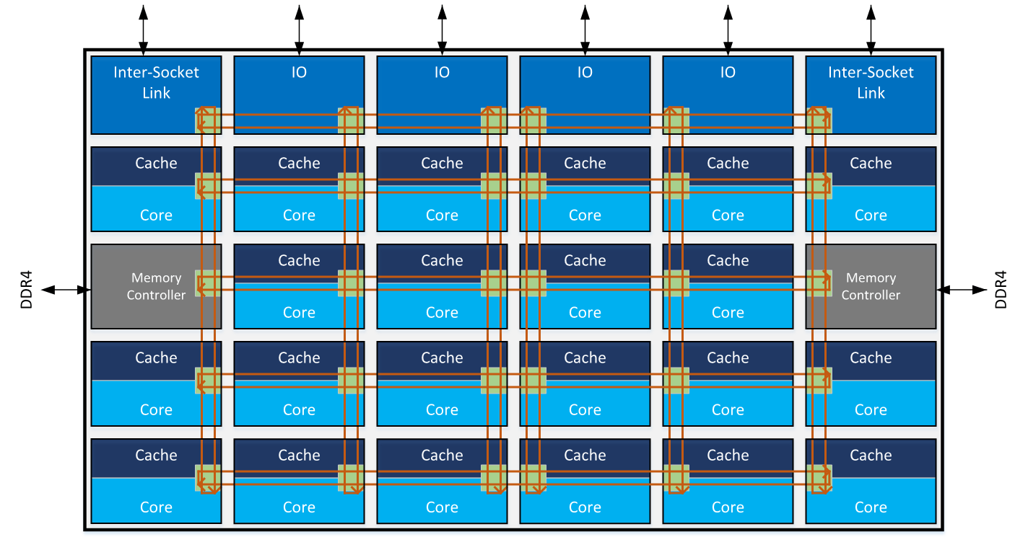
Thread motion and DVFS
Per-core, independent voltage control becomes impractical
Limited number of independent DVFS systems for multicore systems
Large core density systems are deploying a new power management technique that migrates threads from core to core to adjust power and performance to the time-varying needs of a running program.
Intel Mesh Interconnect Architecture
Notes:
Increase number of cores per chip made independent voltage control impractical, instead ….dynamic voltage frequency scaling… are introduces.
SkyLake, KNL, etc. From the perspective of the von Neumann architecture, which is an in-memory computing platform, it will operate best if processor is as closed to it’s memory state as possible. So this is achieved by Clara orchestrator, first defining NUMA Node structure of a node where the job is landed, then pining data processing application to a NUMA, allocating all the application memory on a single NUMA and vertically scaling data processing application over the threads defined for a NUMA node. As a result we get decreased memory access times, and when say two micro-services communicating with each other by passing transient data and metadata the minimum memory distance is guaranteed since these services will share the same L3 cache.

Slide 26
Data-processing chain per NUMA
Start DPE pined to a NUMA socket.
Java-DPE
In-Process SHM
Back pressure control
NUMA 0
Java-DPE
In-Process SHM
NUMA 1
Farm Node
CLARA micro-service
Can be deployed as a separate process or
a thread within a process. Multi-threaded
CLARA micro-service
Can be deployed as a separate process or
a thread within a process. Multi-threaded
CLARA micro-service
Can be deployed as a separate process or
a thread within a process. Multi-threaded
CLARA micro-service
Can be deployed as a separate process or
a thread within a process. Multi-threaded
CLARA transient data-stream
Message passing through pub-sub middleware. No dependencies between micro-services.
CLARA transient data-stream
Message passing through pub-sub middleware. No dependencies between micro-services.
CLARA transient data-stream
Message passing through pub-sub middleware. No dependencies between micro-services.
CLARA transient data-stream
Message passing through pub-sub middleware. No dependencies between micro-services.
FCAL 0.08ms
FTEB 0.05ms
FHOD 0.05ms
DCHB 34.05ms
DCTB 63.7ms
FTOF 1.16ms
FCAL 0.08ms
FTEB 0.05ms
FHOD 0.05ms
DCHB 34.05ms
DCTB 63.7ms
FTOF 1.16ms
FCAL 0.08ms
FTEB 0.05ms
FHOD 0.05ms
DCHB 34.05ms
DCTB 63.7ms
FTOF 1.16ms
FCAL 0.08ms
FTEB 0.05ms
FHOD 0.05ms
DCHB 34.05ms
DCTB 63.7ms
FTOF 1.16ms
Processing Node/DPE
RS
0.07ms
EBTB 0.38ms
EC 0.75ms
EBHB 0.37ms
LTCC 0.05ms
HTCC 0.14ms
CTOF 0.19ms
Processing Node/DPE
RS
0.07ms
EBTB 0.38ms
EC 0.75ms
EBHB 0.37ms
LTCC 0.05ms
HTCC 0.14ms
CTOF 0.19ms
Processing Node/DPE
RS
0.07ms
EBTB 0.38ms
EC 0.75ms
EBHB 0.37ms
LTCC 0.05ms
HTCC 0.14ms
CTOF 0.19ms
Processing Node/DPE
RS
0.07ms
EBTB 0.38ms
EC 0.75ms
EBHB 0.37ms
LTCC 0.05ms
HTCC 0.14ms
CTOF 0.19ms
Monitor Node/DPE
WS
0.25ms
Monitor Node/DPE
WS
0.25ms
Monitor Node/DPE
WS
0.25ms
Monitor Node/DPE
WS
0.25ms
FCAL HS/TLS
FHOD HS/TLS
FTEB HS/TLS
DC HS/TLS
CTOF HS/TLS
EC HS/TLS
HTCC HS/TLS
LTCC HS/TLS
EB HS/TLS
FCAL HS/TLS
FHOD HS/TLS
FTEB HS/TLS
DC HS/TLS
CTOF HS/TLS
EC HS/TLS
HTCC HS/TLS
LTCC HS/TLS
EB HS/TLS
FCAL HS/TLS
FHOD HS/TLS
FTEB HS/TLS
DC HS/TLS
CTOF HS/TLS
EC HS/TLS
HTCC HS/TLS
LTCC HS/TLS
EB HS/TLS
FCAL HS/TLS
FHOD HS/TLS
FTEB HS/TLS
DC HS/TLS
CTOF HS/TLS
EC HS/TLS
HTCC HS/TLS
LTCC HS/TLS
EB HS/TLS
Filter
TLS
DST
Data
DST
WS
Filter
TLS
DST
Data
DST
WS
claraweb.jlab.org
Filter
TLS
DST
Data
DST
WS
claraweb.jlab.org
Filter
TLS
DST
Data
DST
WS
Clara
Monitor
Server
InfluxDB
service
claraweb.jlab.org
Grafana
InfluxDB
service
claraweb.jlab.org
Grafana
Clara
Monitor
Server
DB
Clara
Monitor
Server
InfluxDB
service
DB
Grafana
Clara
Monitor
Server
InfluxDB
service
DB
Grafana
DB
Binary/HIPO
JSON data-format
Binary/HIPO
Binary/HIPO
Histogram
Analyzer
JSON data-format
Archiver
DB
DST
Remote
Client
Binary/HIPO
Histogram
Analyzer
DST Node/DPE/process
JSON data-format
Archiver
DB
DST
Remote
Client
Histogram
Analyzer
DST Node/DPE/process
JSON data-format
Archiver
DB
DST
Remote
Client
Histogram
Analyzer
DST Node/DPE/process
Archiver
DB
DST
Remote
Client
DST Node/DPE/process
Notes:
As a result we get 20% performance improvement utilizing CLARA NUMA aware workflow management. Here you see CLARA orchestrator running a DPE per NUMA node and scaling over cores attached to the NUMA node in a 2 NUMA node machine.

Slide 27
Results
AMD EPYC 7502 : 1.5MHz, 128/128, NUMA-2
Xeon E-2687A: 2.6GHz, 32/32, NUMA-2
Xeon Gold 6148: 2.4GHz, 40/40, NUMA-4
NUMA socket physical core limit for each node
99.5% parallel efficiency over physical cores

