Slide 1
Data format designs / APIs
Event / Streaming Data / detector “packet” format
Considerations that went into the design
Resilience in the presence of errors
Versatility
“Information hiding” (not just in the C++ sense) from reco/user code
Inspection tools
I’m going on a lot about what PHENIX / sPHENIX has been doing, as examples, not as a shamless plug…

Slide 2
Data Formats in general…
One of the trickiest parts when developing a new application is defining a data format
It can take up easily half of the overall effort – think of Microsoft dreaming up the format to store this very PowerPoint presentation you are seeing in a file. We used to have ppt, now we have pptx – mostly due to limitations in the original format design
A good data format takes design skills, experience, but also the test of time
The tested format usually comes with an already existing toolset to deal with data in the format, and examples – nothing is better than a working example
Case in point: Parts of the PHENIX Raw Data Format (PRDF) have their roots at the CERN-SPS, and the Bevalac Plastic Ball experiment in the 80’s – that’s a solid “test of time”
Note: I’m not “selling” my own “RCDAQ” system here – but obviously I did implement here what I think it takes, so forgive me when I bring some RCDAQ-themed examples

Slide 3
Design Goals, also known as Buzzwords
Modularity
Data integrity, robustness and resilience
No exposure of analysis code to internals
Binary payload format agnostic
No preferred endianess
Different event types
Set of tools to inspect / display / manipulate files
OS integration
Interface APIs to community analysis tools ( these days: root and 3rd-party frameworks)
It’s gotta be fun to use!
That’s quite a list. Let’s go through and see what all that means

Slide 4
Resilience and error recovery
Imagine a data format where one bit error, or one error in some length field, in the data renders the entire file unreadable
Obviously not a good design – you will have such errors, corrupt tapes, recovered disk files, and you cannot allow to lose a significant portion of your statistics
Corrupt data is far more common than you think!
Data can be corrupted by the storage medium
Data structures can also be corrupt from the get-go by some bug in the DAQ
“Resilience in depth” – any corrupt entity must be able to be skipped, the remainder of the data recovered
You must also be able to account for what was lost
“You must be able to erroneously feed your mail file to your analysis. It shouldn’t find events, but it shouldn’t crash, either.”

Slide 5
How did we implement this?
This is a storage-level layer, usually invisible
A variable number of Events per buffer
Data structures from individual detectors
The error recovery works on the smallest corrupted entity, a packet, an event, or a buffer.

Slide 6
Error Recovery
A good amount of the physical storage concept is derived from what was the main storage medium back in the 80’s and 90’s – tapes
Of course, in 2018 , we still write the majority of our data to tapes, just not directly
Useful leftovers from the days of direct tape reading:
Our Buffers are a multiple of 8Kb “records” – tape drives used to write physical chunks of 8Kb
Got a corrupt data? Skip 8Kb records until you find the start of a new buffer. It must start on a record (8Kb) boundary. Without that constraint, you have no chance to find that.
Inside buffers, parts of the data of an event can be corrupt but the “outer” structure intact – skip event
Inside an event, the data structure from a detector can be corrupt – skip this and take a (user) decision whether or not to accept the event
At any time, you are in charge of dealing with the situation in a manner that suits your analysis.

Slide 7
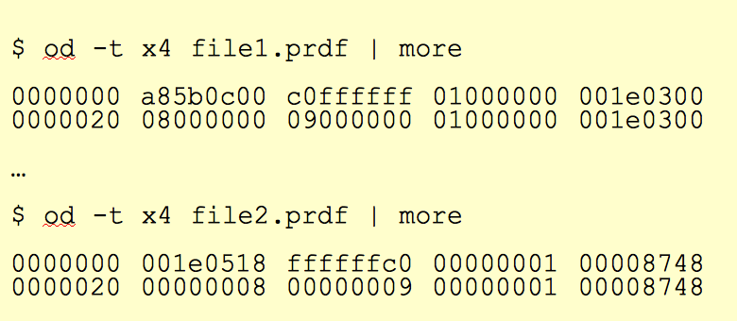
No Preferred Endianess – what does that mean?
This is less of an issue today as it was 10 years ago when we had a lot of VME-based stuff and Motorola 68K and PowerPC CPUs in front-ends (all big-endian) and Intel/AMD for analysis (all little-endian)
Endianess – the order how a 2 or 4-byte variable is stored
int i = -64 -> 0x FF FF FF C0
Little Endian – least significant bit is at lowest address
Memory location | Little-endian | Big-endian
Offset +0 | C0 | FF
+1 | FF | FF
+2 | FF | FF
+3 | FF | C0
Files with different endianess with a
“-64 1” sequence Variables from files with the wrong endianess need to be byte-swapped
That can be time-consuming!
Have the DAQ write in its native endianess and let the analysis software do the byte-swapping as needed. Don’t waste time with that in the DAQ!

Slide 8
Modularity and Extensibility
No one can foresee and predict requirements of a data format 20 years into the future.
Must be able to grow, and be extensible
The way I like to look at this:
FedEx (and UPS) cannot possibly know how to ship every possible item under the sun
But they know how to ship a limited set of box formats and types, and assorted weight parameters
Whatever fits into those boxes can be shipped
During transport, they only look at the label on the box, not at what’s inside
We will see a surprisingly large number of similarities with that approach in a minute
“packets”

Slide 9
“Binary payload agnostic” – what is that?
Most of the “devices” we read out provide their data in some pre-made (and usually quite good) compact binary format already. Usually done in some FPGA.
Actual formatting/packing/zero-suppression in the CPU is rare these days
All you want to do is to grab the blob of data, stick it into a packet, put a label (packet header) on that says what’s in it, done.
That is literally all we do to the data
From that point forward, the DAQ does not care. The “FedEx” approach – they ship boxes, we ship packets.
More generally: Usually we store data from our readout devices, but we must be able to store literally anything in our data stream.
Want to store an Excel spreadsheet? A text file? A jpeg image? Shouldn’t cause a problem.
If you think ”why would one want to do that!”, just wait a few minutes.

Slide 10
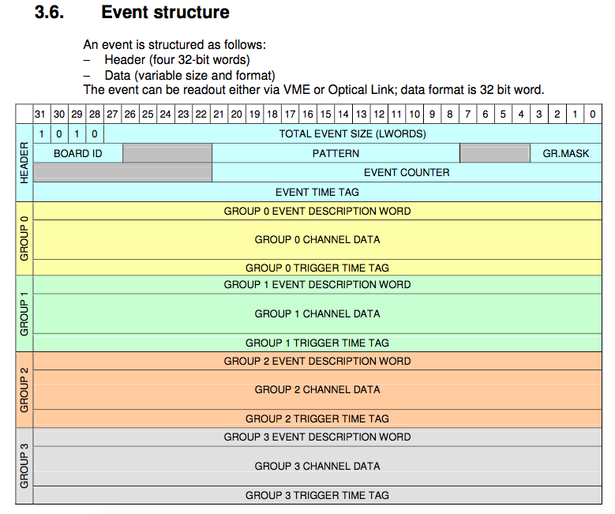
Example: CAEN’s V1742 format
We just take that blob of memory, “put it in a box”, done.
The analysis software takes care of the unpacking and interpretation later
Just grab it. Don’t waste time here.

Slide 11
How do we accomplish that?
The “box” / packet has what I call “envelope information” – a header describing what’s inside
The hitformat is an enumerated value that determines how the data needs to be unpacked
I have about 400 such formats defined
The packet id uniquely identifies what piece of a given detector this packet holds, or the data from which device
Word | 16 bit | 16 bit
0 | Length
1 | Packet id | Swap unit
2 | Hitformat | Padding size
3 | Reserved | reserved
4 + | DATA
n+4 | padding
The order of the packets within an event is irrelevant – a “mini database” – allows to change the read order without breaking anything
Padding – we pad the packet as needed to remain 64- or 128-bit aligned

Slide 12
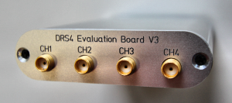
A packet header example (the DRS4 board you see here)
$ $ od -j 163888 -t d2 -N 16 beam_0000000042-0000.evt 0500060 5126 0 1001 4 81 1 0 0
$ dlist beam_0000000042-0000.evt Packet 1001 5126 -1 (ONCS Packet) 81 (IDDRS4V1)
Word | 16 bit | 16 bit
0 | Length 5126
1 | Packet id 1001 | Swap unit 4
2 | Hitformat 81 | Padding size 1
3 | Reserved 0 | Reserved 0
4 + | DATA
n+4 | padding
This packet says:
I contain data in the hitformat 81 (DRS4 version1 format)
That determines how the data are to be interpreted and decoded later

Slide 13
Data Encapsulation
The unpacker/decoder selected through the hitformat shields the user code from the changing internals of the encoding
The only constant is that the same channels – usually a readout board that we call FEM, Front-End Module – feeds its data into a packet with a never-changing packet id
The packet id identifies a FEM, and a piece of detector “real estate”
We often refer to a given FEM by its packet id (“we had a problem with 4033 last night”)
But: how the data are encoded changes over time.
We do not want our analysis code to break because of that!
The packet id tells you what is stored in the packet
The hitformat says how it is encoded
I can change the encoding for a more efficient one at any time; I just tag it with a new hitfomat (and implement the new decoder acting on that format)
No user software will break!

Slide 14
A real PHENIX event…
This is an actual PHENIX event with the full detector
3827 packets in total in this event
$ dlist /a/eventdata/EVENTDATA_P00-0000459344-0000.PRDFF
Packet 14001 52 0 (Unformatted) 714 (IDGL1)
Packet 14007 10 0 (Unformatted) 716 (IDNTCZDC_LL1)
Packet 14002 9 0 (Unformatted) 701 (IDBBC_LL1)
Packet 14009 14 0 (Unformatted) 717 (IDGL1_EVCLOCK)
Packet 14011 13 0 (Unformatted) 914 (IDGL1PSUM)
Packet 8180 21 0 (Unformatted) 1508 (IDEMC_FPGA3WORDS0SUP)
Packet 8165 42 0 (Unformatted) 1508 (IDEMC_FPGA3WORDS0SUP)
Packet 8166 48 0 (Unformatted) 1508 (IDEMC_FPGA3WORDS0SUP)
. . .
Packet 25121 83 0 (Unformatted) 425 (IDFVTX_DCM0)
Packet 25122 198 0 (Unformatted) 425 (IDFVTX_DCM0)
Packet 25123 99 0 (Unformatted) 425 (IDFVTX_DCM0)
Packet 25124 46 0 (Unformatted) 425 (IDFVTX_DCM0)
Packet 21351 356 0 (Unformatted) 1121 (IDMPCEXTEST_FPGA0SUP)
Packet 21352 319 0 (Unformatted) 1121 (IDMPCEXTEST_FPGA0SUP)
Packet 21353 238 0 (Unformatted) 1121 (IDMPCEXTEST_FPGA0SUP)
Packet 21354 323 0 (Unformatted) 1121 (IDMPCEXTEST_FPGA0SUP)
Notes:
----- Meeting Notes (1/27/16 16:27) -----

Slide 15
APIs
A “packet” provides you with a set of a dozen or so standard APIs to access information from it
This does not relieve you from knowing a bit about what that “device” is capable of
But it takes the pain of all the decoding of the data out of it.
And (I keep coming back to this) shields your code from changes in the encoding.
We don’t use them any more, but a very simple example would be the old LeCroy 2249
“just a vector of 12 shorts” – nothing else
As simple as it gets.
int channel2 = p->iValue(2);
Notes:
----- Meeting Notes (1/27/16 16:27) -----

Slide 16
APIs
Modern devices are usually more complex than that
Let’s look at a waveform sampler (like the CAEN V1742, but may others)
(Pretty much every device in sPHENIX gives a waveform)
The ”2-dimensional” API:
int channel = 5;
for (int sample =0; sample < Nsamples; sample++)
{
waveform[sample] = p->iValue(channel, sample);
}
Notes:
----- Meeting Notes (1/27/16 16:27) -----

Slide 17
Misc. info
Almost always there is a lot of additional info hiding in the data
“How many samples did we configure?”
This misc. info interface type gives you things like temp readings, error flags, what have you
And you see that you still need to “know your device”
int channel = 5;
int Nsamples = p->iValue(0, “NSAMPLES”);
for (int sample =0; sample < Nsamples; sample++)
{
waveform[sample] = p->iValue(channel, sample);
}
Notes:
----- Meeting Notes (1/27/16 16:27) -----

Slide 18
Some select APIs
virtual int iValue(const int channel) =0;
virtual int iValue(const int channel, const char * what) =0;
virtual int iValue(const int channel, const int y, const char * what) =0;
virtual int iValue(const int channel,const int iy) =0;
virtual int iValue(const int channel,const int iy, const int iz) =0;
virtual int iValue(const int channel,const int iy, const int iz , const char *what) =0;
virtual float rValue(const int channel) =0;
virtual float rValue(const int channel, const char * what) =0;
virtual float rValue(const int channel, const int iy) =0;
virtual double dValue(const int channel);
virtual double dValue(const int channel, const char *what)
virtual double dValue(const int channel, const int iy)
virtual long long lValue(const int channel)
virtual long long lValue(const int channel, const char *what)
virtual long long lValue(const int channel, const int iy)
There are also APIs that give you more info (e.g. an entire waveform) in one fell swoop
Notes:
----- Meeting Notes (1/27/16 16:27) -----

Slide 19
Dump functions
Each packet provides a tailored-to-the-info dump function to show data in a human-redable way
You can also have a od-style generic hex/octal/whatnot dump
Here is a dump from a DRS4 eval board (1024 samples, 4 ch + time)
$ ddump -p 1020 beam_0000004094-0000.evt
Packet 1020 5126 -1 (sPHENIX Packet) 81 (IDDRS4V1)
Samples 1024 enabled channnels: 0 1 2 3
ch | time ch0 ch1 ch2 ch3
0 | 0 -2.2 -1.4 -1.3 -0.4
1 | 0.992839 -0.8 -2.5 -1.8 -1.7
2 | 1.98568 -2.6 -2.5 -1 -0.1
3 | 2.97852 -1.8 -1.5 -3.5 -3.2
4 | 3.97135 -2 -1.2 -1.2 -1.1
5 | 4.96419 -2.9 -2.1 -3.6 -3.3
6 | 5.95703 -1 0.3 -1.4 -1.1
7 | 6.94987 -2.9 -2.9 -3.7 -2.4
8 | 7.94271 -1.8 -2 -1.5 -0.9
9 | 8.93555 -1.8 -2.8 -3.6 -2.5
10 | 9.92839 -2.8 -2.7 -3 -2.4
11 | 10.9212 -3.1 -4.1 -3.7 -4.2
12 | 11.9141 -2.9 -2.9 -0.7 -0.9
13 | 12.9069 -4 -3.9 -2.7 -3.5
14 | 13.8997 -3.5 -2.8 -2.6 -1.9
. . .
Notes:
----- Meeting Notes (1/27/16 16:27) -----

Slide 20
Dump functions
Here is a dump from the CERN/RD51 SRS system:
ddump -p 1020 srs-00000001-0000.evt
Packet 1020 8122 -1 (sPHENIX Packet) 70 (IDSRSV01)
Number of Hybrids: 4
Framecounter: 0
HDMI Channel: 0
Description: ADC
Words: 4050
Time samples: 28
Sample 0 1 2 3 4 5 6 7 8 9 10 11 12 13 14 15 16 17 18 19 20 21 22 23 24 25 26 27
Addr 156 159 153 152 128 129 135 132 128 131 129 128 224 225 227 224 228 231 225 224 248 249 255 252 240 243 241 240
Error 0 0 0 0 0 0 0 0 0 0 0 0 0 0 0 0 0 0 0 0 0 0 0 0 0 0 0 0
----------------------------------------------------------------------------------------
0 | 3060 3049 3206 3155 3094 3103 3216 3169 3148 3146 3203 3050 3026 3011 3091 3163 3106 3026 3168 3096 2983 3035 3165 3030 3064 3059 3160 3056
1 | 3019 2993 3160 3165 3108 3057 3174 3148 3091 3046 3125 3042 3059 2979 3039 3152 3064 2965 3104 3095 2985 2993 3108 3041 3058 2995 3101 3070
2 | 3011 2980 3142 3156 3091 3052 3175 3163 3111 3064 3133 3060 3075 2967 3028 3140 3075 2973 3135 3088 2970 2985 3094 3035 3057 2995 3086 3057
3 | 3009 2965 3113 3146 3093 3045 3171 3149 3081 3034 3117 3029 3023 2956 3004 3102 3030 2959 3119 3100 2963 2960 3063 3008 3030 2979 3070 3037
4 | 3012 2802 2365 2097 2073 2157 2360 2456 2540 2613 2769 2761 2821 2797 2879 2995 2960 2902 3069 3076 2978 2981 3083 3033 3058 2984 3070 3051
5 | 3007 2969 3113 3176 3116 3076 3195 3181 3122 3060 3126 3048 3056 2986 3042 3147 3036 2953 3105 3114 2990 3004 3102 3047 3070 2997 3087 3057
6 | 2989 2942 3119 3147 3074 3038 3169 3135 3087 3034 3123 3022 3014 2955 3008 3093 3033 2940 3099 3076 2965 2978 3100 3037 3042 2979 3071 3025
7 | 3016 2977 3149 3175 3095 3048 3176 3147 3066 3017 3098 3013 3039 2974 3021 3128 3052 2966 3096 3084 2976 3001 3094 3025 3061 2999 3069 3030
8 | 3032 2990 3154 3175 3126 3073 3176 3169 3113 3063 3158 3086 3086 3000 3054 3159 3085 2983 3125 3122 3005 3014 3121 3041 3040 2994 3087 3065
9 | 2997 2976 3132 3168 3065 3024 3160 3135 3087 3048 3111 3018 3042 2951 3006 3105 3024 2950 3099 3073 2959 2969 3065 3019 3047 2985 3058 3047
10 | 3001 2955 3120 3157 3073 3045 3175 3154 3092 3030 3111 3017 3016 2950 3021 3128 3038 2946 3112 3102 2995 3001 3088 3011 3039 2984 3062 3017
11 | 2992 2942 3104 3168 3088 3029 3169 3152 3080 3044 3121 3037 3050 2971 3015 3124 3041 2945 3084 3071 2960 2971 3077 3018 3035 2973 3068 3050
12 | 2967 2751 2347 2095 2070 2147 2367 2451 2524 2589 2743 2735 2804 2792 2872 2999 2973 2897 3057 3056 2945 2961 3059 3005 3026 2968 3040 3022
13 | 2995 2944 3077 3150 3079 3070 3175 3155 3086 3046 3120 3039 3055 2970 3009 3114 3038 2958 3096 3095 2991 2994 3090 3026 3070 2996 3070 3049
14 | 3018 2973 3125 3130 3036 3007 3165 3146 3086 3016 3076 2991 2999 2939 3002 3096 3039 2953 3100 3063 2941 2948 3077 3022 3043 2986 3060 3037
. . .
For each hitformat there is a special dump function that shows the data in a “good” way
Notes:
----- Meeting Notes (1/27/16 16:27) -----

Slide 21
“Binary payload agnostic”
I was advertising that as a great feature that the data structure should let you capture anything
I gave the example of a picture (like a jpeg), text files, entire excel spreadsheets…
Let me explain, and introduce event types in a moment

Slide 22
Think of a test beam setup (or your Lab setup) for a moment
In the “real” experiment that’s running for a few years (think PHENIX, ATLAS, what have you) you are embedded in an environment that supports all sorts of record keeping
We have the PHENIX run database as an example – we log “everything”, AND there’s infrastructure and support so most people know how to get at it.
I’m not disputing the need for a database, I’m saying that a test beam or your test lab needs a different kind of “record keeping support”
What was the temperature? Was the light on? What was the HV? What was the position of that X-Y positioning table?
A database allows you to search for runs with certain properties. But capturing this information in the raw data file is more flexible and the data cannot get lost
I often add a webcam picture to the data so we have a visual confirmation that the detector is in the right place, or something
A picture captures everything…
Remember our concept of being payload agnostic?

Slide 23
Reading different things with different Event Types
You would think of the DAQ as “reading your detector”
Very often, it is necessary to read different things at different times.
Let’s go to the CERN-SPS (or the BNL AGS) for an example:
acceleration
SPS or AGS
extraction
“spill”
Begin-run event
End-run event
Spill-On event
Read and clear scalers
Flush buffers
Data Events
Read your detector channels, ADCs, TDCs...
Spill-Off event
Read and clear scalers
(allows spill intensity-based corrections)
23
In addition to your data, you need information about the spill itself – each one is different
You need to make intensity-dependent corrections on a spill-by-spill basis
So you put some signals on scalers and get an idea about the intensity, dead times, microstructures, etc

Slide 24
Documenting things in special events
We add the DAQ’s own setup script file into our begin-run event for posterity
This “device” captures a file as text into a packet
This “9” is the event type of the beg-run
And this refers to the name of the file itself
#! /bin/sh
rcdaq_client create_device device_file 9 900 ”$0”
rcdaq_client load librcdaqplugin_drs.so
rcdaq_client create_device device_drs -- 1 1001 0x21 -150 negative 140 3
So this gets added as packet with id 900 in the begin-run
It’s not the whole story, but you get the idea

Slide 25
You can capture “everything”
Many times you capture things only “just in case”
You don’t routinely look at them in your analysis (such as cam pictures shown before)
But if you have some inexplicable feature, you can use the data to do “forensics”
Find out what, if anything, went wrong
The more data you capture, the better this gets
Think of it as “black box” on a plane…

Slide 26
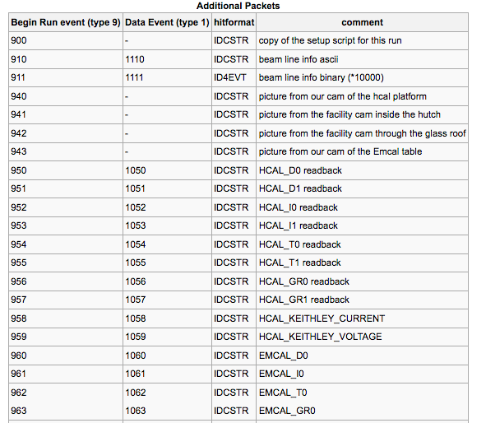
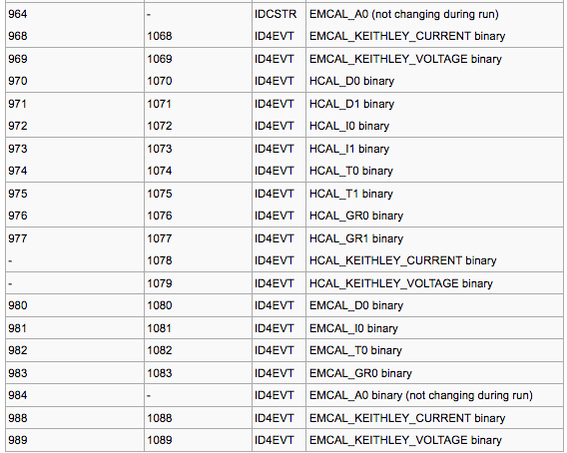
“Meta Data” Packet list from a recent test beam
More than 72 environment-capturing packets (accelerator params, voltages, currents, temperatures, pictures, …)
Captured at begin-run
Captured again at spill-off

Slide 27
Forensics
“It appears that the distributions change for Cherenkov1 at 1,8,12,and 16 GeV compared to the other energies. It seems that the Cherenkov pressures are changed. […] Any help on understanding this would be appreciated.”
Martin: “Look at the info in the data files:”
$ ddump -t 9 -p 923 beam_00002298-0000.prdf
S:MTNRG = -1 GeV
F:MT6SC1 = 5790 Cnts
F:MT6SC2 = 3533 Cnts
F:MT6SC3 = 1780 Cnts
F:MT6SC4 = 0 Cnts
F:MT6SC5 = 73316 Cnts
E:2CH = 1058 mm
E:2CV = 133.1 mm
E:2CMT6T = 73.84 F
E:2CMT6H = 32.86 %Hum
F:MT5CP2 = .4589 Psia
F:MT6CP2 = .6794 Psia
$ ddump -t 9 -p 923 beam_00002268-0000.prdf
S:MTNRG = -2 GeV
F:MT6SC1 = 11846 Cnts
F:MT6SC2 = 7069 Cnts
F:MT6SC3 = 3883 Cnts
F:MT6SC4 = 0 Cnts
F:MT6SC5 = 283048 Cnts
E:2CH = 1058 mm
E:2CV = 133 mm
E:2CMT6T = 74.13 F
E:2CMT6H = 37.26 %Hum
F:MT5CP2 = 12.95 Psia
F:MT6CP2 = 14.03 Psia

Slide 28
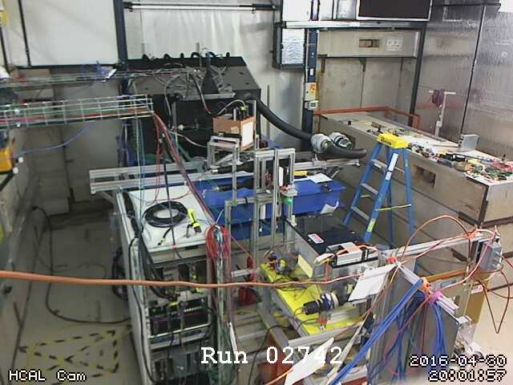
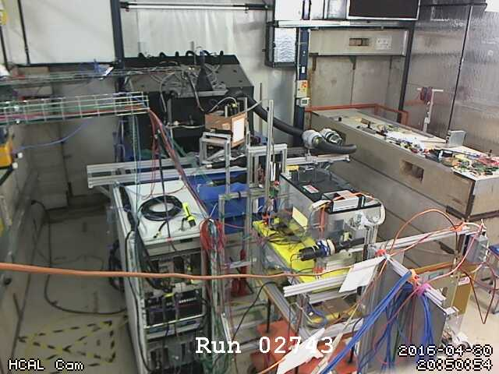
More Forensics (my poster child why this is so useful…)
“There is a strange effect starting in run 2743. There is a higher fraction of showering than before. I cannot see anything changed in the elog.”
Look at the cam pictures we automatically captured for each run:
$ ddump -t 9 -p 940 beam_00002742-0000.prdf > 2742.jpg
$ ddump -t 9 -p 940 beam_00002743-0000.prdf > 2743.jpg

Slide 29
This page is intentionally left blank

Slide 30
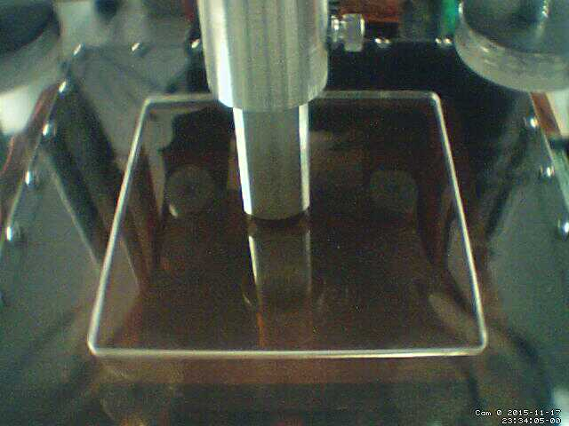
More things from a previous setup
Here you see two scripts executed which reach out to the positioning system and reads back the motor positions, and capture an image from a webcam
eicdaq2 ~ $ ddump -O -p 910 -t 9 ZZ48_0000001600-0000.evt
8031
8377
eicdaq2 ~ $ ddump -O -p 910 -t 9 ZZ48_0000001601-0000.evt
8031
8393
eicdaq2 ~ $ ddump -O -p 910 -t 9 ZZ48_0000001602-0000.evt
8031
8409
eicdaq2 ~ $ ddump -O -p 910 -t 9 ZZ48_0000001603-0000.evt
8031
8425
This makes the analysis a snap – throw all 4900 files at your analysis process. Each file contains the x/y position – making the x-y gain map here is totally easy!
We are scanning in y direction here
We include the generated “positions.txt” files both as text as as numbers in 910 and 911
#add the position information
rcdaq_client create_device device_command 9 0 /home/eic/struck/getmotorpositions.sh
rcdaq_client create_device device_file 9 910 /home/eic/struck/positions.txt
rcdaq_client create_device device_filenumbers_delete 9 911 /home/eic/struck/positions.txt
# add the camera picture
rcdaq_client create_device device_command 9 0 "/home/eic/capture_picture.sh /home/eic/struck/cam_picture.jpg"
rcdaq_client create_device device_file_delete 9 940 /home/eic/struck/cam_picture.jpg
8031
8377

Slide 31
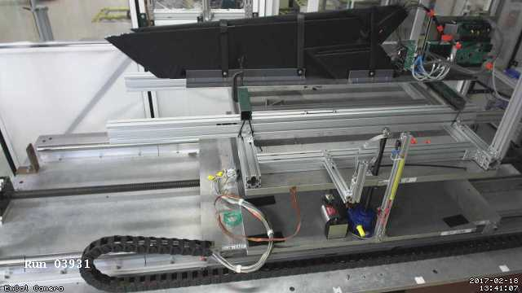
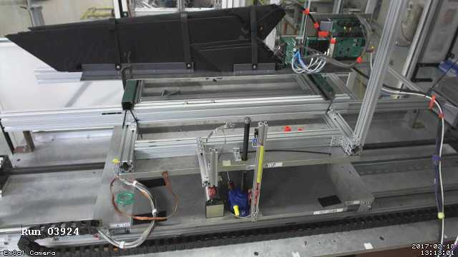
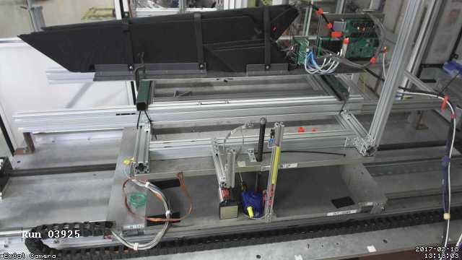
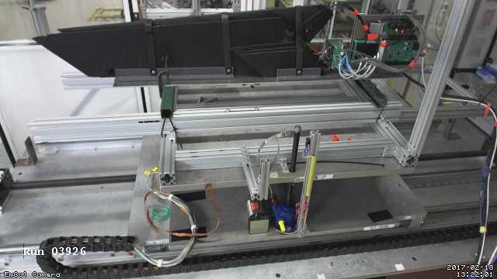
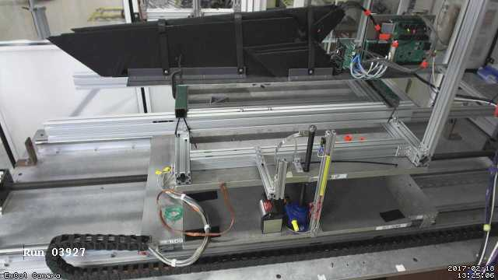
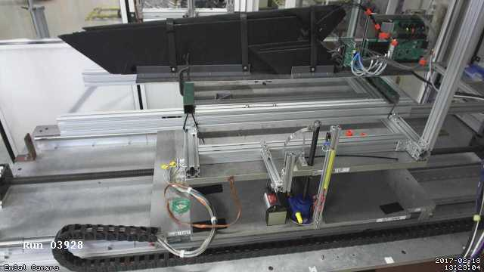
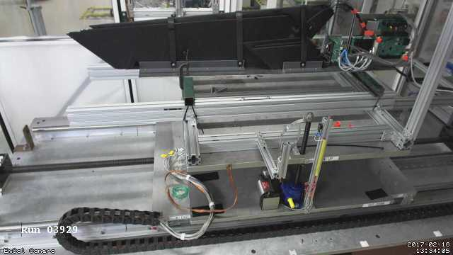
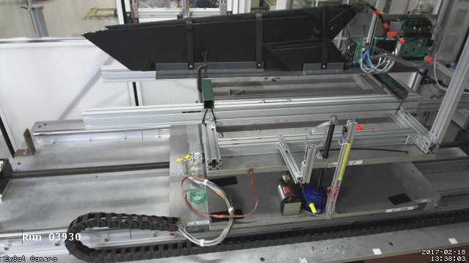
Autopilot example: “Tile Mapping” at the Fermi Test Beam Facility
“Tile mapping” refers to mapping the position-dependent response of a hadronic calorimeter tile.
About 200 individual positions of the tile relative to the beam – you’d go nuts doing all that manually, and you are bound to make mistakes
The FTBF M2.6 table is controlled via the accelerator controls (ACNET) – some caution required
This setup exercises most of the aforementioned features: scripting and reacting to the FTBF spill, network transparency (we cannot access ACNET from the DAQ machine, but an ACNET-enabled machine can control our DAQ)
I told you about my cameras, right?

