Slide 1
Project Management - Far Detector
Jim Stewart

Slide 2
BNLs Roles in LBNE
BNL is deeply involved and has major responsibilities in the LBNE Project in support of the central project office
Project Scientist – M. Bishai
Project Systems Engineer – J. Dolph
Project controls lead for the Far Detector - P. Novakova
BNL is the host of the Far Detector Project Office with:
Far Detector manager – J. Stewart
Co-manager for the TPC – B. Yu
Manager for the Cold Electronics – B. Hackenburg

Slide 3
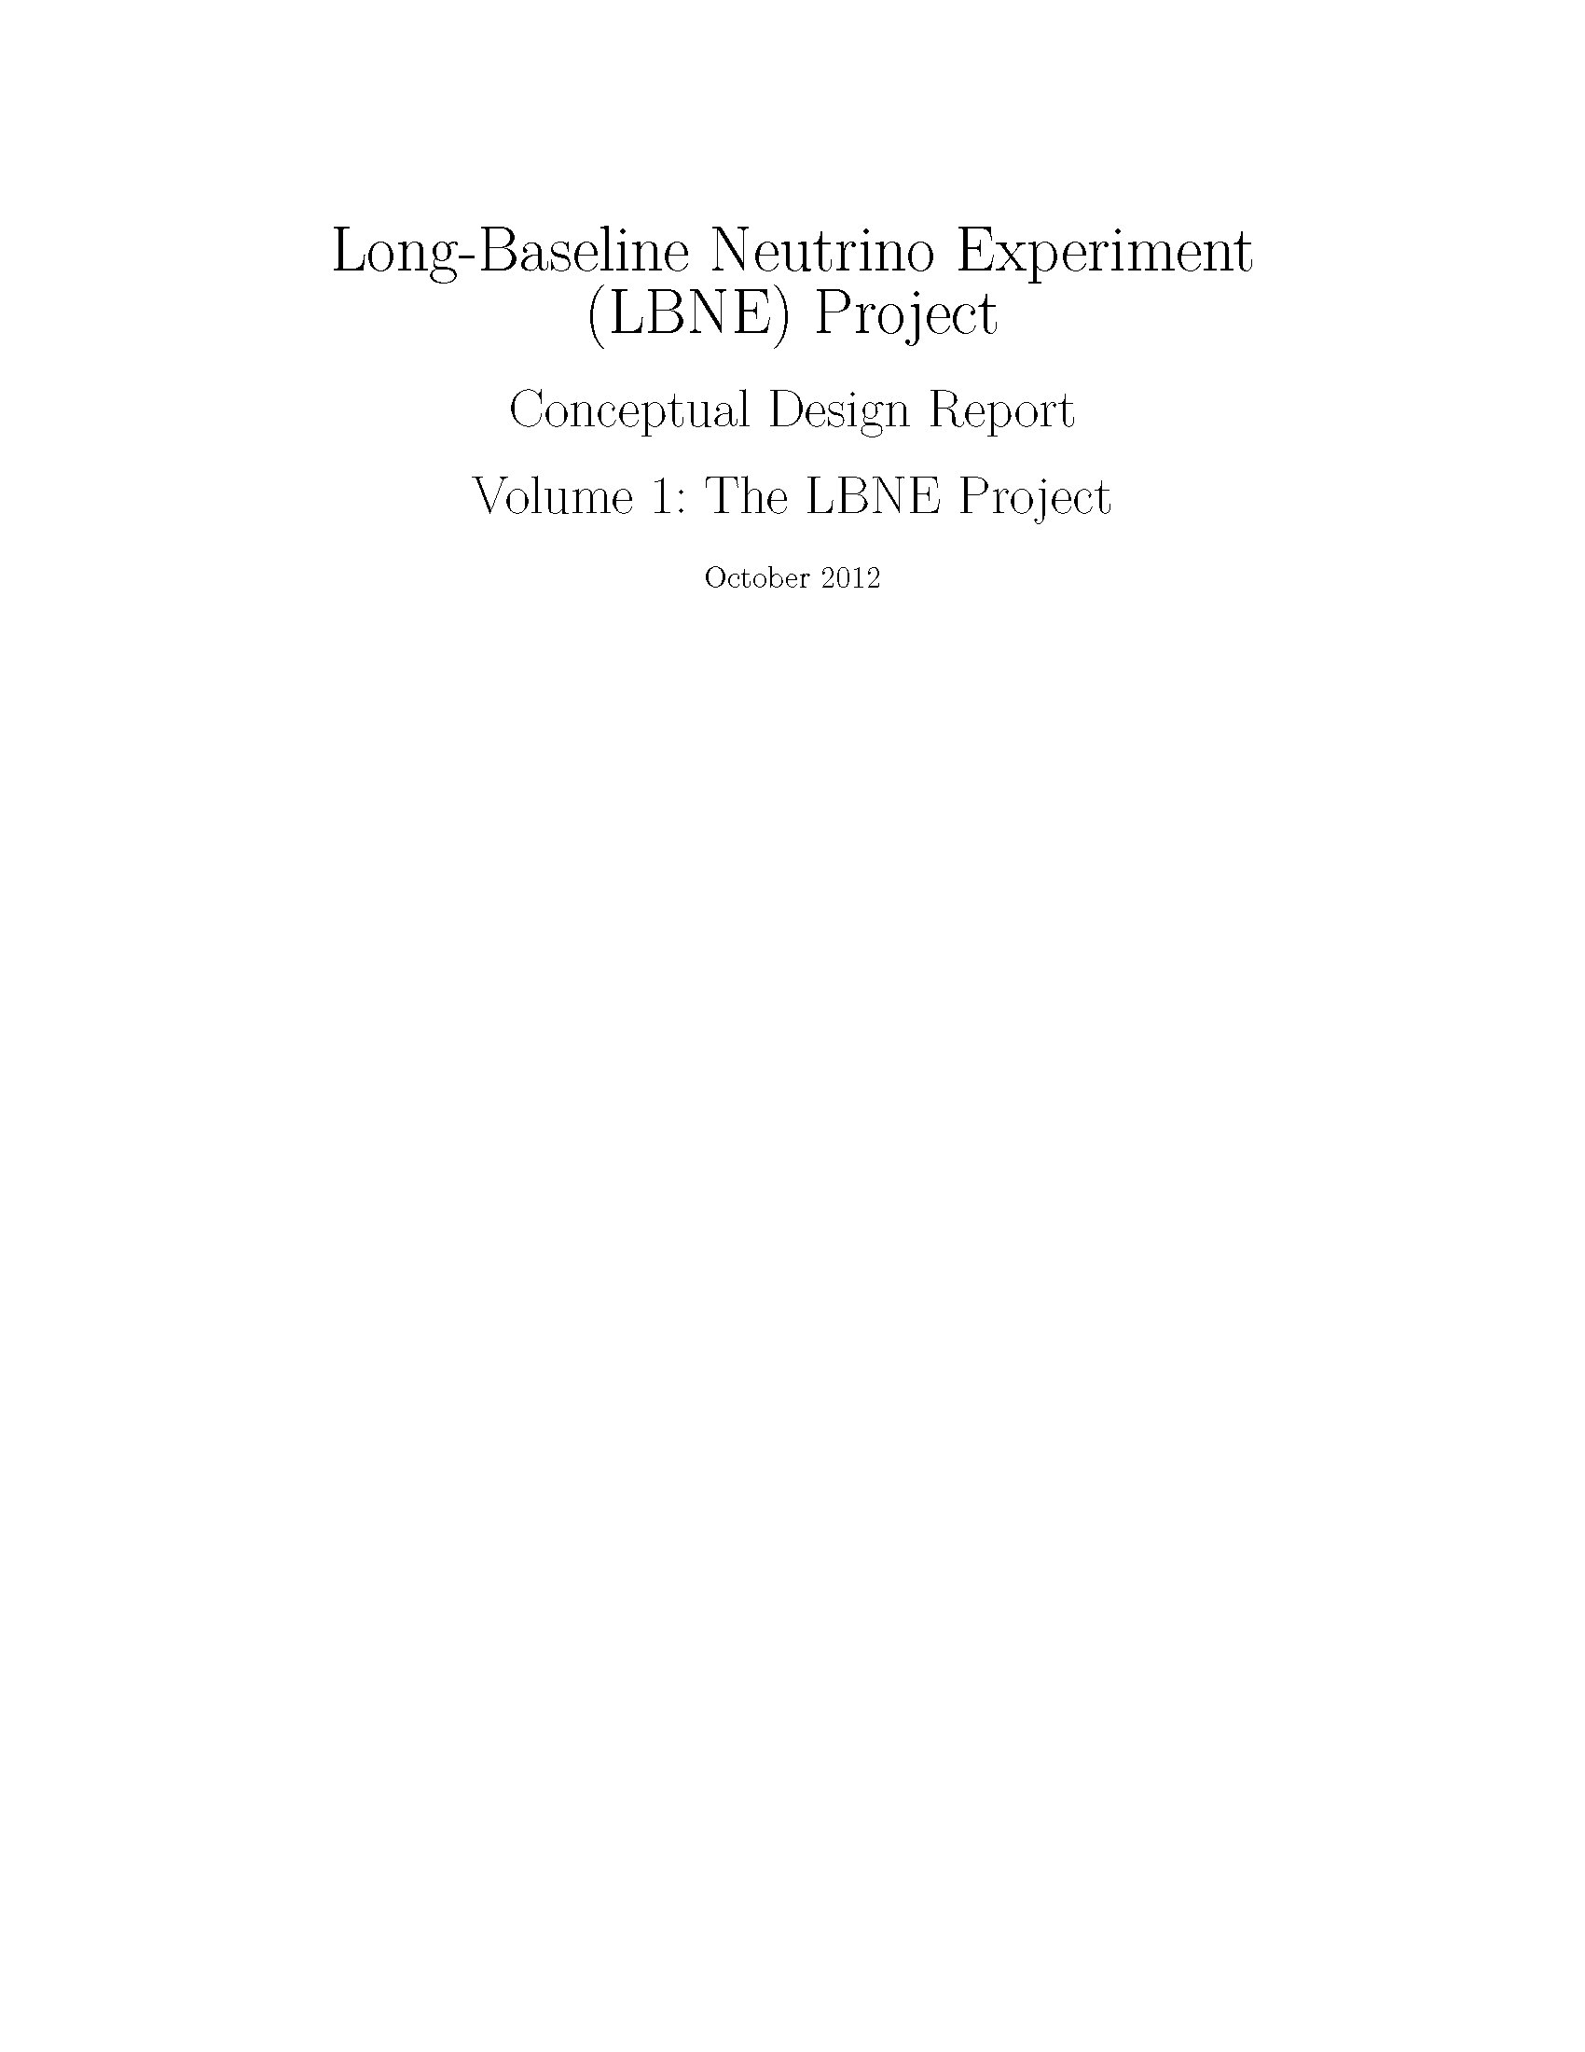
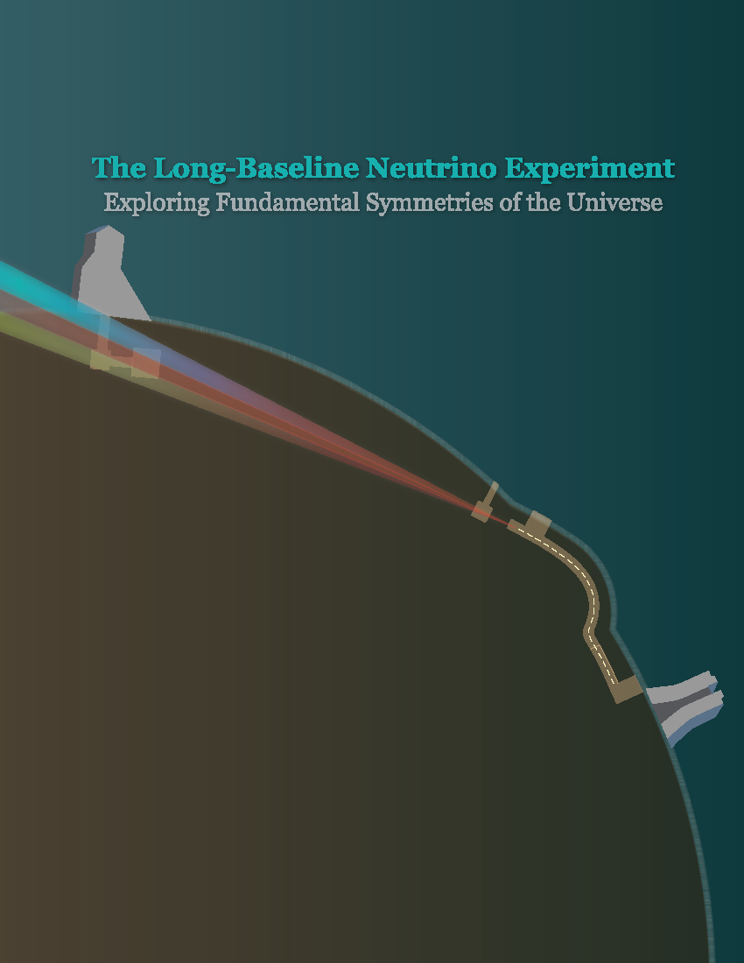
LBNE Management
Scientific liaison between project and collaboration
Responsible for CDR Vol 1
Mary was the main scientific editor for the Sci Op document
Responsible for seeing that the project meets scientific goals
Requirements Definition
Risk management
Change Control
Configuration management
- Team Center
Drafting Engineering manual

Slide 4
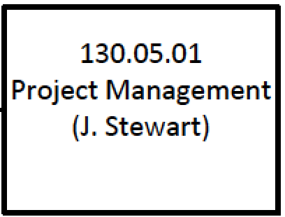
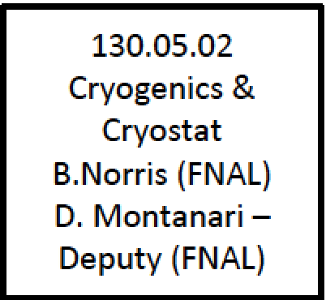
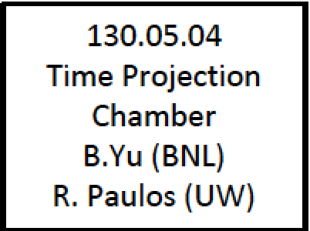
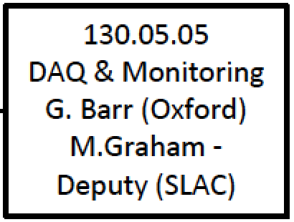
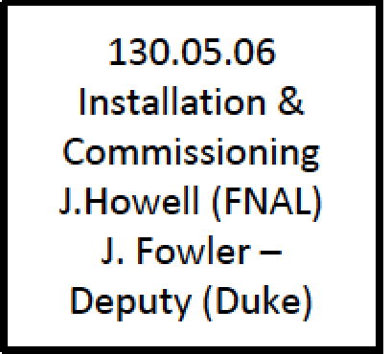
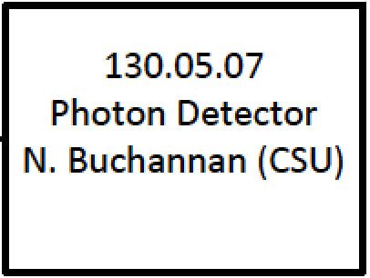
LBNE Far Detector Management
J. Stewart Manager BNL
P. Novakova Controls Lead BNL
R. Rucinski Lead ME FNAL
T. Shaw Lead EE FNAL
J. Stewart Responsible Far Detector Management
B. Yu Co-manager for the TPC
B. Hackenburg Manager of Cold Electronics
BNL’s responsibilities distributed among the TPC, Electronics and Management.

Slide 5
Far Detector Project Controls
Penka is overseeing all the aspects of the far site project controls.
Scheduling
Budgeting
Finance
Contracting
Reporting
Far detector management is logistically more difficult than the other sub-systems due to the large number of institutions under contract.

Slide 6
LBNE Far Detector US Institutions Under Contract or MOU
Argonne National Lab
Photon Readout. Photon Calibration
Brookhaven National Lab
Cold Electronics and TPC
Colorado State University
Photon Detectors
Duke
TPC and Integration
Fermilab
Cryogenics and Cryostat
Indiana University
Photon Detectors
Los Alamos National Lab
Laser Calibration
Louisiana State University
Photon Detectors
Princeton University
TPC
SLAC
TPC backend readout
Stony Brook
Electronics
University of Hawaii
Photon sensors
University of Maryland
DAQ - Run Control
University of Pennsylvania
35t and electronics
University of Wisconsin – PSL
TPC
Contracts modified several times per year as funding dictates.
UK groups are leading the DAQ development

Slide 7
Far Detector Organizaiton
The detector responsibilities are distributed throughout the US groups.
The organization reflects a merger of the water Cherenkov detector and the liquid Argon detector groups.
This restructuring was done in close cooperation with the collaboration management.

Slide 8
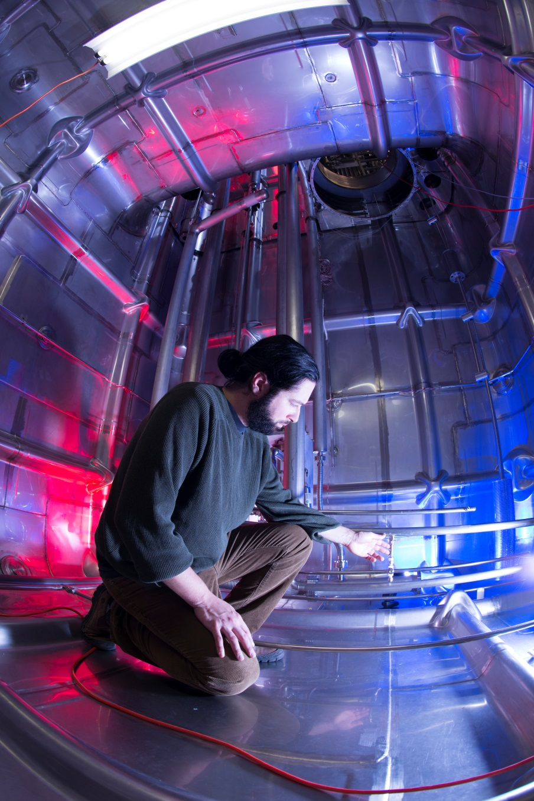
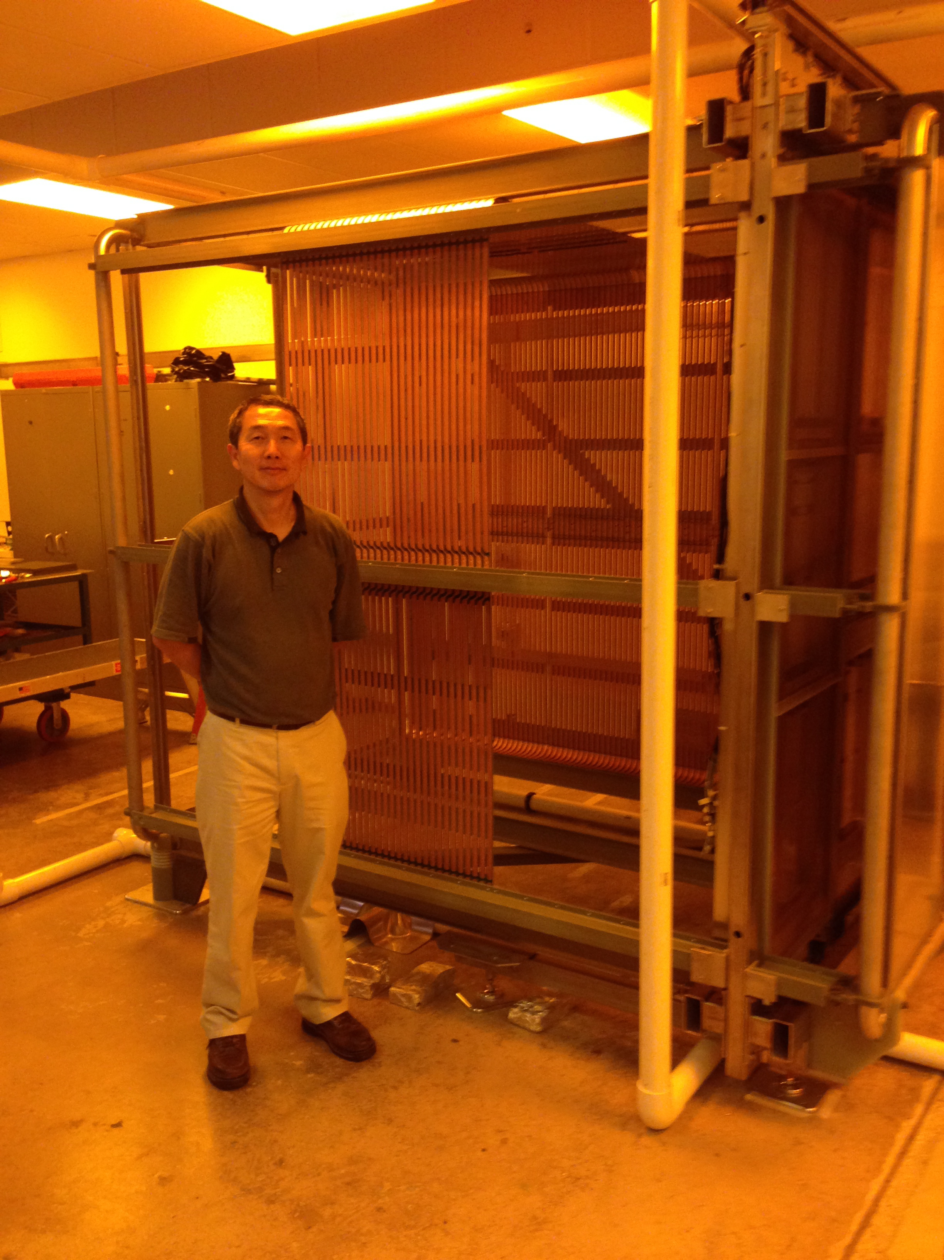
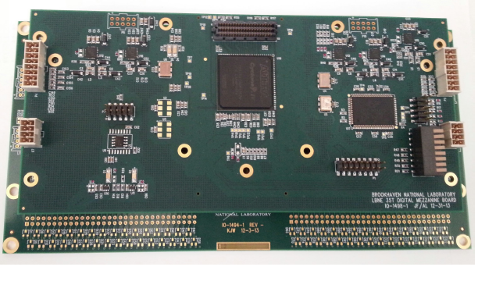
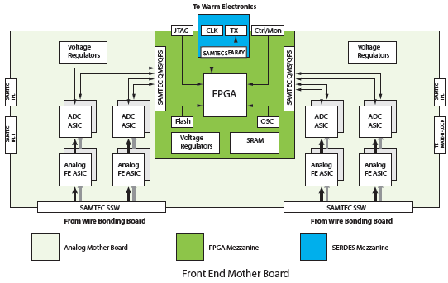
Far Detector Prototyping
The 35t prototype tests all the unique feature of the LBNE detector but in small scale.
Wound wire planes, FR4 field cage, Cold pre-amp and ADC, SLAC frontend readout, ArtDAQ based DAQ.

Slide 9
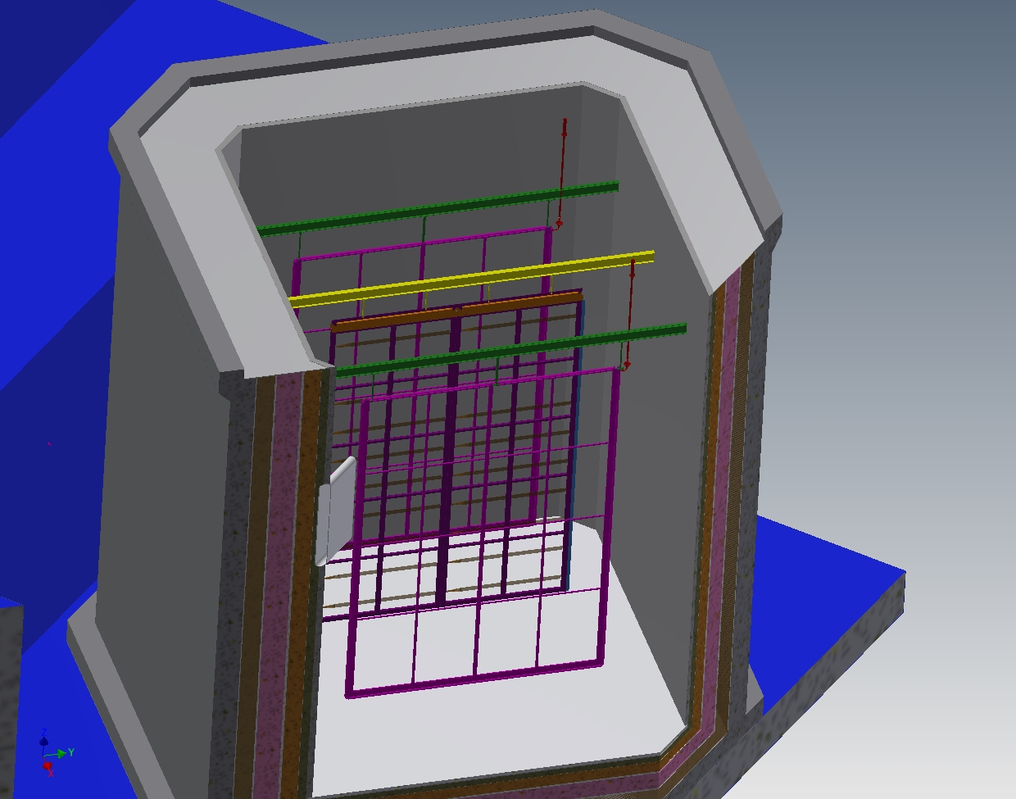
Full Scale Detector Testbeam at CERN
CERN neutrino platform opens possibility of testing the full scale TPC modules with beam.
Will design full size detector elements in 2015/2016
Will construct two scale (2.3m by 6m) wire planes and electronics instrumented.
High voltage and field cage suitable for final detector will be built
Will be instrumented with photon detectors
Testbeam in 2017-2018
2 APA planes
Expression of interest was drafted by J. Stewart. BNL is coordinating the engineering, budget, and planning.

Slide 10
Future Prospects
BNL is coordinating the Far Detector development which requires integrating efforts of a highly qualified but widely distributed team.
Local expertise in Electronics and TPC design make BNL well suited for the Far Detector coordination.
BNL intends to continue to play are central role in the ELBNF Far Detector Project.
BNL Project Management team is ready to help in the transition to the new organization.

