Slide 1
BNL’s Roles in U.S. ATLAS are similar to Fermilab’s Roles in U.S. CMS
Howard Gordon
Deputy Chair of BNL Physics Department
ATLAS Collaboration Board Chair

Slide 2
BNL’s Roles in (U.S.) ATLAS
Contributed to the design, fabrication, installation, commissioning, operation (performance) of the Liquid Argon Calorimeter, Cathode Strip Chambers for forward muons, trigger
Lead physics analysis on Higgs topics, Vector Boson Scattering, search for SUSY and dark photons.
Design, fabricate etc. items for the Phase I Upgrade Project for the Liquid Argon Calorimeter, new muon Small Wheel, and trigger

Slide 3
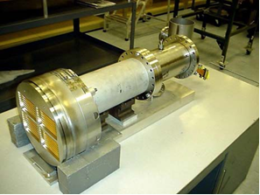
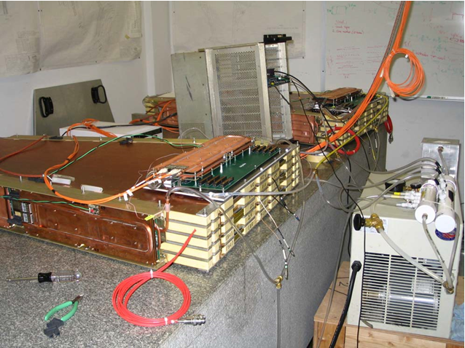
Examples of Pieces of ATLAS Built at BNL
Liquid Argon Signal Feedthroughs 200k channels – ideas could help LBNF
Cathode Strip Chambers proposed as a Cosmic Ray Veto for Mu2e.

Slide 4
BNL Role’s continued
Lead U.S. ATLAS Operations Program (M&O, Computing, Upgrade R&D, Physics Support)
Manager: Srini Rajagopalan, Deputy Jim Cochran
Computing Manager: Torre Wenaus, Deputy Mark Neubauer
Facility Manager: Michael Ernst, who also leads the RHIC Computing Facility and the ATLAS Computing Facility (aka Tier 1)
Software: PanDA including extensions to HPC and beyond ATLAS and the LHC
43 Institutions; 342 authors; 988 individuals in our database
Physics Support: Analysis Support Center (one of three)
Project management of the U.S. ATLAS Phase I Upgrade – Project Manager: Jon Kotcher, Deputy Chris Bee

Slide 5
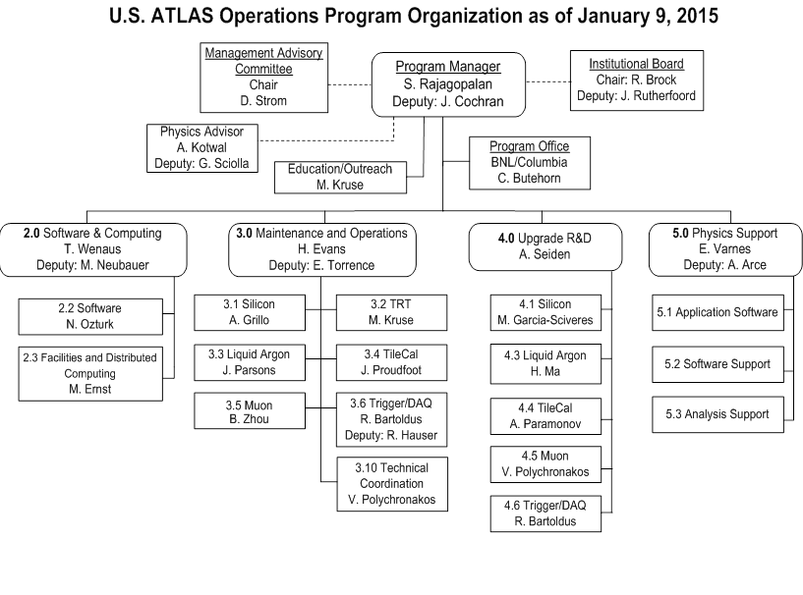

Slide 6
Project Organization Breakdown Structure
Project personnel have been involved in ATLAS physics analysis, operations, and upgrade R&D. Many were principals in the original detector construction.
Integrated BNL/Stony Brook management. DOE- and NSF-funded deliverables treated on equal footing.

Slide 8
BNL and Fermilab Common Interests
Complete U.S. / CERN MOU Extension
Preserve healthy Operations Programs
Encourage DOE to move on CD-0 for Phase II Upgrades
Produce a strong physics case for the Phase II Upgrade for NSF
Cooperate on new ESNET Trans-Atlantic data link
Cooperation on software for the LHC

