Slide 1
Nuclear & Particle Physics at BNL
Berndt Mueller
Jan 12, 2015

Slide 2
NPP Directorate
Physics Department
  Nuclear Physics
    PHENIX, STAR, RHIC Spin, Nuclear & Lattice Theory
  Particle Physics
    ATLAS, Daya Bay, LBNE, μBooNE, g-2, (μ➔eγ),
    Accelerator Technology (LARP, SMD)
    Particle Phenomenology & Lattice Theory
  Astrophysics
    BOSS, DES, DESI, LSST
  RACF
Collider-Accelerator Department
  RHIC, AGS, ATF, NSRL, BLIP
Superconducting Magnet Division
Instrumentation Division

Slide 3
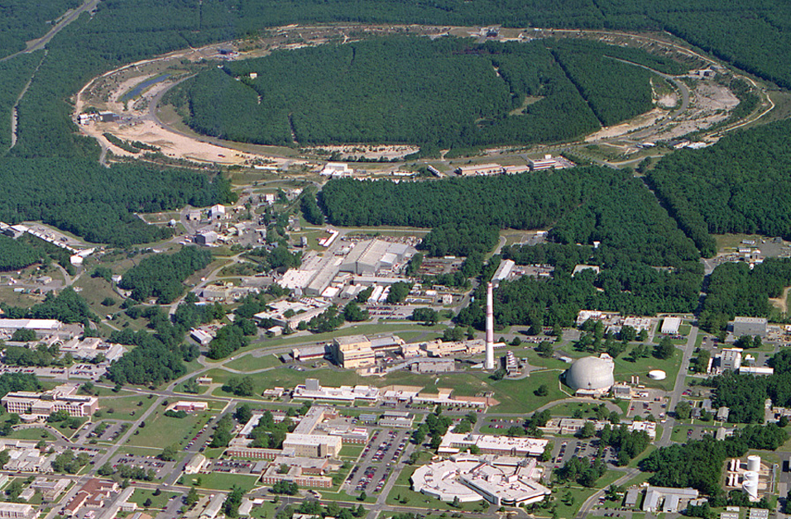
RHIC – Hadron & Nucleus Collider
Polarized Jet Target
12:00 o’clock
10:00 o’clock
RHIC
(CeC)
2:00 o’clock
PHENIX
8:00 o’clock
RF
4:00 o’clock
STAR
6:00 o’clock
LINAC
NSRL
Test
ERL
EBIS
Booster
BLIP
AGS
Operated modes (beam energies):
Au – Au 3.8/4.6/5.8/10/14/32/65/100 GeV/n
U – U 96.4 GeV/n
Cu – Cu 11/31/100 GeV/n
p↑ – p↑ 11/31/100/205/250/255 GeV
d – Au* 100 GeV/n
Cu – Au* 100 GeV/n
³He – Au* 100 GeV/n
Planned or possible future modes:
Au – Au 2.5 GeV/n
p↑ – Au* 100 GeV/n
p↑ – ³He↑* 166 GeV/n
SMD
Tandems
ATF
Achieved peak luminosities:
Au – Au (100 GeV/n) 195×10³⁰ cm⁻² s ⁻¹
p – p (255 GeV) 210×10³⁰ cm⁻² s ⁻¹
Other large hadron colliders (scaled to 255 GeV):
Tevatron (p – pbar) 110×10³⁰ cm⁻² s ⁻¹
LHC (p – p) 490×10³⁰ cm⁻² s ⁻¹

Slide 4
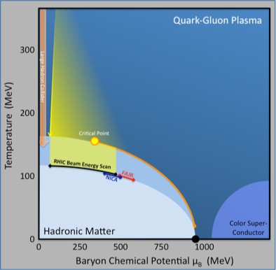
RHIC explores the Phases of Nuclear Matter
LHC: High energy collider at CERN with 13.8 - 27.5 times higher beam energy: Pb+Pb, p+Pb, p+p collisions only.
FAIR & NICA: Planned European facilities at lower energies.
RHIC: Spans largest swath of the phase diagram in the preferred collider mode.
Range of matter
explored at RHIC
Range of matter
explored at RHIC
(location unknown)
Message
(location unknown)
Internal fixed target ?
Atomic
nuclei
RHIC is perfectly suited to explore the phases of nuclear matter and the perfectly liquid quark-gluon plasma.
If RHIC did not exist, someone would have to build it (...but no one could afford it - a >$2B value!)
Matter known
before RHIC

Slide 5
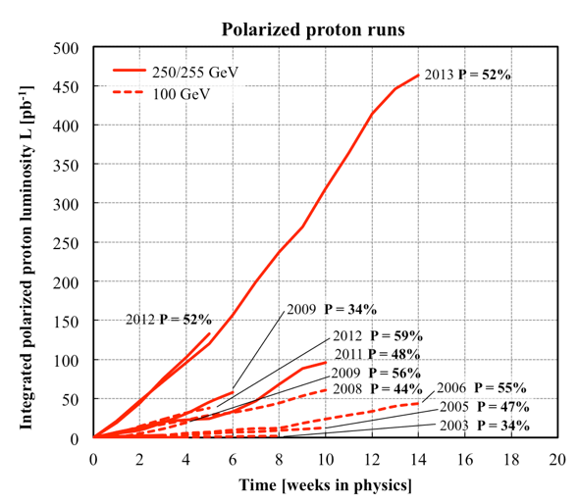
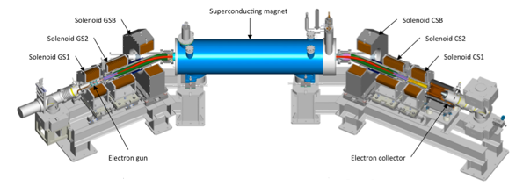
RHIC – the First Polarized Proton Collider
Successful development of all necessary tools to accelerate polarized protons in the injector and in RHIC (polar. source, [partial] Siberian snakes, polarimeters)
Polarized proton collisions in RHIC:
  √s=200 GeV: P~59%, L_{peak}~0.5x10³² cm⁻²s⁻¹
  √s=510 GeV: P~52%, L_{peak}~2.5x10³²cm⁻²s⁻¹
Ongoing upgrade: Luminosity increase with electron lenses to compensate for beam-beam interactions (commissioned)
Absolute Polarimeter (H↑ jet)
pC Polarimeters
Siberian Snakes
RHIC
Siberian Snakes
PHENIX
STAR
Spin Rotators
(longitudinal polarization)
Spin Rotators (long. pol.)
LINAC
BOOSTER
5.9 % Helical Partial
Siberian Snake
Pol. H⁻ Source
AGS
200 MeV Polarimeter
pC Polarimeter
10 % Helical Partial Siberian Snake
p+p luminosity from Run-13 exceeds all previous p+p runs combined

Slide 6
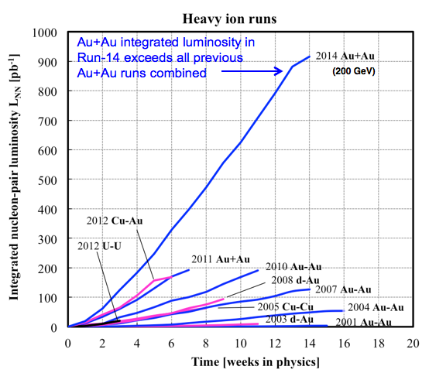
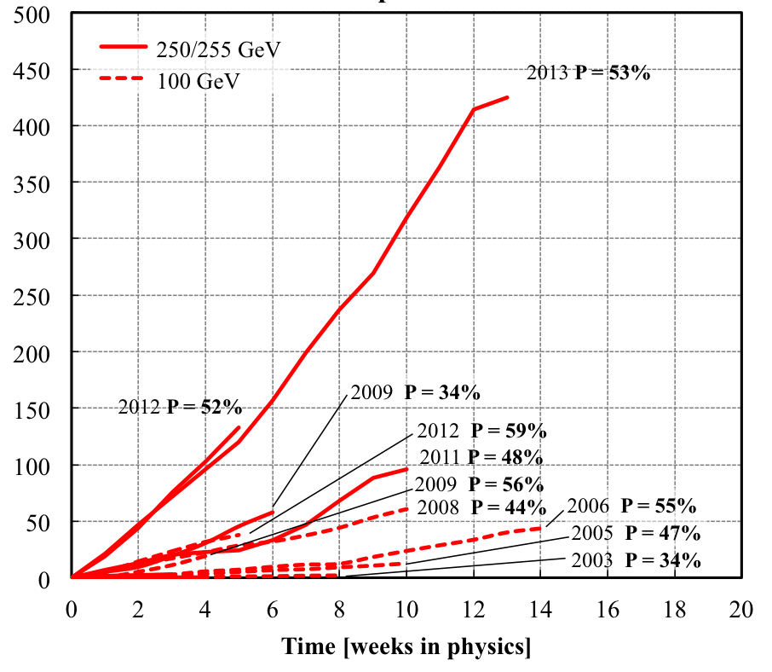
RHIC performance
Polarized proton runs
Integrated luminosity L [pb⁻¹]

Slide 7

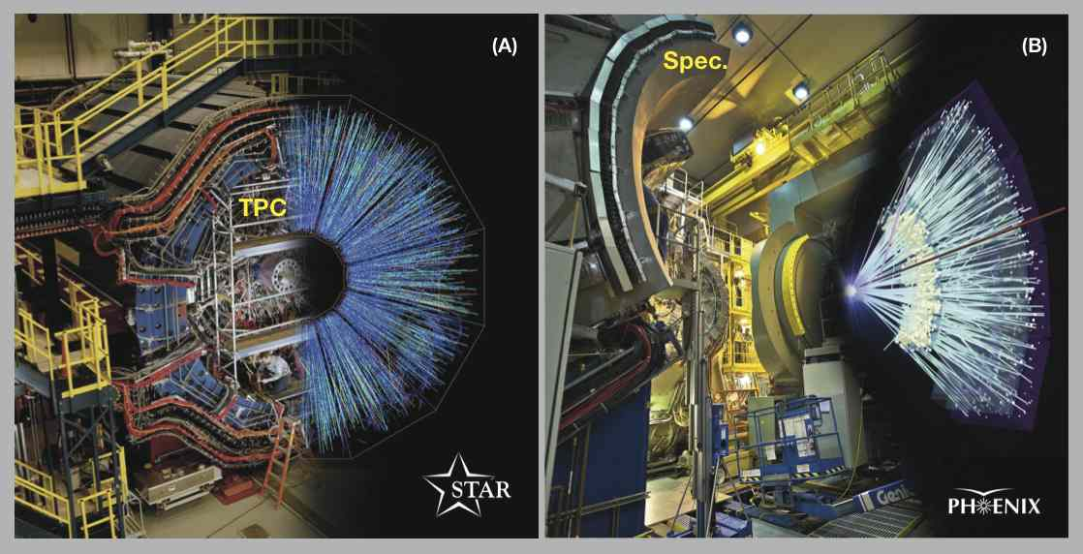
Detector Collaborations
~580 collaborators from 13 countries
~550 collaborators from 15 countries
7

Slide 8
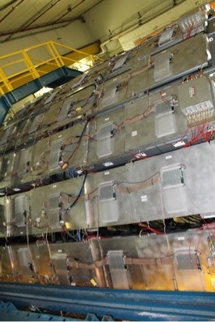
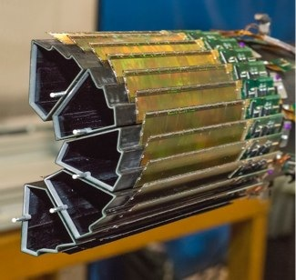
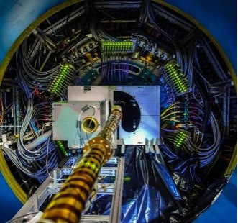
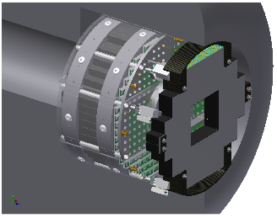
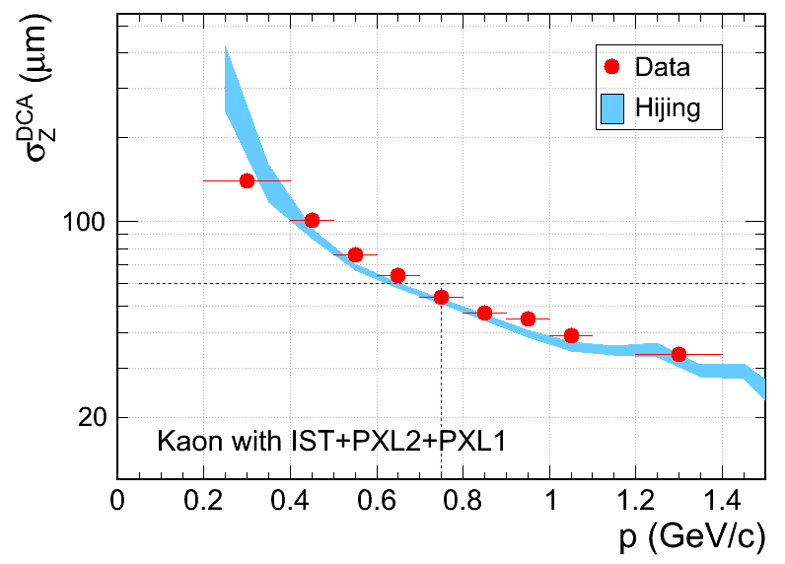
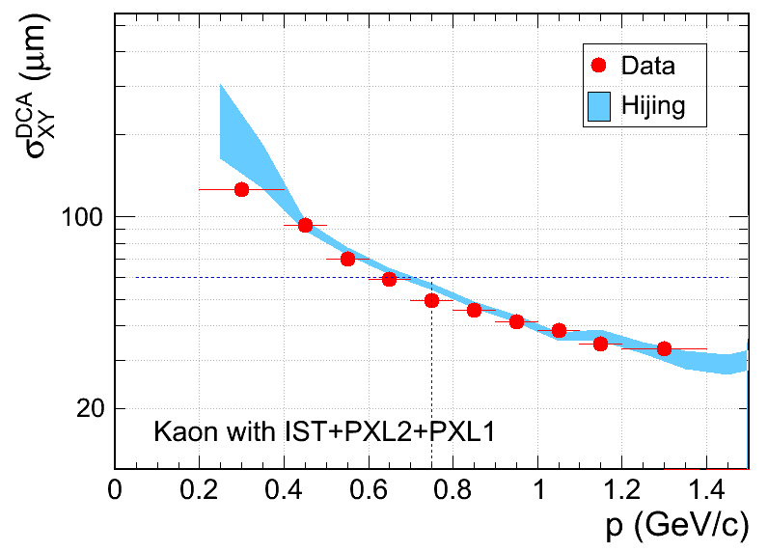
Recent RHIC Detector Upgrades
Fully reconstruct open charm/beauty hadrons with displaced vertex
Muon Telescope
Detector (STAR)
Enhances triggering
capabilities for heavy quarkonia
STAR HFT
Enables forward γ detection in Run15
Muon Piston Calorimeter extension
Completed on schedule and below cost
Run 14 data
Distance of Closest Approach to Vertex
PHENIX

Slide 9



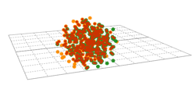






Exploring Hot QCD Matter
“Big Bang”
Penetrating probe: photons
Chemical probes: light nuclei
Bulk probe: temperature fluctuations
distributions and correlations of produced particles
kinetic
freeze-out
QGP Phase Boundary
lumpy initial energy density
“Little Bang”
Penetrating probes: photons, jets
Chemical probes: hadrons
Bulk probe: flow fluctuations
QGP phase
quark and gluon degrees of freedom
Initial-state quantum fluctuations propagate
into to “macroscopic” final-state fluctuations
by hydrodynamic response.
9

Slide 10
Main RHIC Discoveries
Hot nuclear matter produced in high energy nuclear collisions is a quark-gluon plasma (QGP) containing individually flowing quarks, not quarks bound into baryons and mesons.
The QGP is a strongly coupled, nearly “perfect” liquid with η/s near the holographic quantum limit.
Light quarks (u,d,s) and maybe even c-quarks are thermalized in the QGP and recombine into hadrons during hadronization.
Energetic quarks and gluons moving through the QGP rapidly lose energy by rescattering, causing jets to be strongly quenched.
Charmonium states “melt” in the QGP due to color screening and ionization.
Gluon spin contributes a sizable fraction to the proton spin.

Slide 11
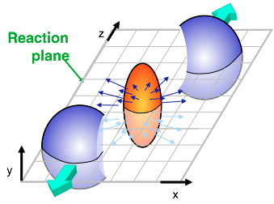
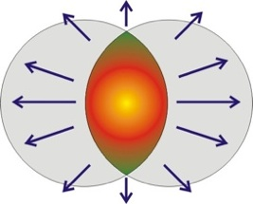
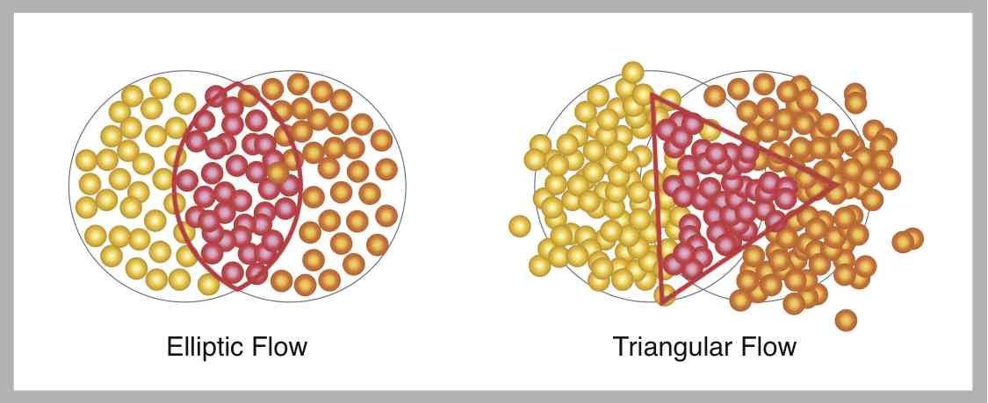
Anisotropic flow
Only matter in the overlap area gets compressed and heated
11

Slide 12
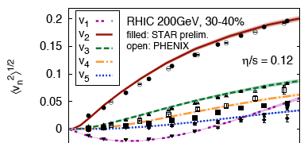

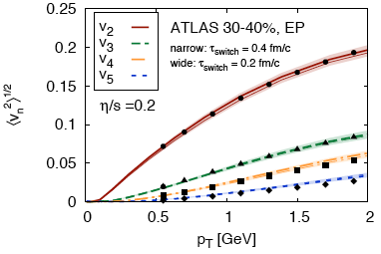
RHIC’s “Perfect Liquid” More Perfect than LHC’s
Studies of the flow of particles emitted by the quark-gluon plasma at the Relativistic Heavy Ion Collider (RHIC) and the Large Hadron Collider (LHC) suggest that the effective shear viscosity, or impedance to flow, is 40% lower at RHIC than the LHC, and therefore closer to the ideal limit used to define a “perfect” fluid.
The result, which is consistent across finer and finer detailed analyses of particle flow patterns, demonstrates remarkable synergy between BNL theory and RHIC experiments.
These findings indicate that viscosity increases away from the ideal limit with the increasing temperatures reached at LHC.
RHIC
LHC
Conclusion: RHIC is in the “sweet spot” for studies of the perfectly liquid quark-gluon plasma

Slide 13

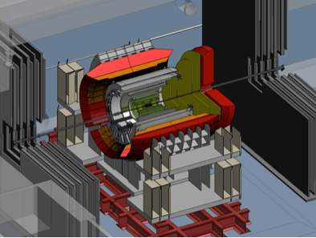
Completing the RHIC science mission
Status: RHIC-II configuration is complete
Vertex detectors in STAR (HFT) and PHENIX
Luminosity reaches 25x design luminosity
Plan: Complete the RHIC mission in 3 campaigns:
2014–16: Heavy flavor probes of the QGP using the micro-vertex detectors Transverse spin physics
2017: Install low energy e-cooling
2018/19: High precision scan of the QCD phase diagram & search for critical point
2020: Install sPHENIX upgrade
2021/22: Precision measurements of jet quenching and quarkonium suppression
2023-25: Transition to eRHIC?
  STAR HFT
sPHENIX
RHIC remains a unique discovery facility
Notes:
The suite of upgrades of the RHIC accelerator and its detectors is now complete: The beam intensity of RHIC has been vastly increase thanks to 3-dimensional stochastic cooling, and the STAR and PHENIX detectors have been equipped with silicon vertex detectors that permit the identification of rapidly decaying heavy (charm and bottom) quarks. The integrated luminosity reach in this year’s RHIC run with gold beams exceeded that achieved in all 13 previous RHIC runs combined!
Our plan is now to complete the scientific mission of RHIC in 3 multi-year campaigns: In 2014-16 we will probe the properties of the strongly coupled QGP using heavy quarks, which are especially well suited to explore its interactions. After installing a new type of cooling more effective at low beam energies, using electrons as the cooling medium, in 2017, we will perform a high precision scan of the QCD phase diagram in 2018-19. One objective of this campaign is to find and locate a conjectured critical point in the phase diagram. We will then upgrade the PHENIX detector to a more powerful configuration, named superPHENIX, which will allow RHIC to perform precision measurements in 2021-22 of the interactions of quark jets and atoms of heavy quarks called quarkonia with the quark-gluon plasma. These probes will help us elucidate the internal structure of the quark-gluon plasma. We then plan to shut RHIC down and transition the RHIC complex to an electron-ion collider facility (eRHIC) to begin operations as early as 2025, budgets permitting.
For the next several years, however, RHIC will remain an extraordinarily productive, unique discovery facility producing approximately 30 PhDs per year and garnering more than 3,000 citations of its scientific publications.

Slide 14
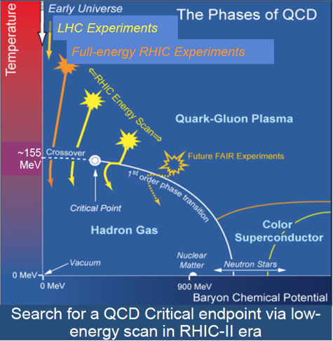
Low Energy e-Cooling for Au+Au
Cooling of low energy heavy ion beams (3.8–10 GeV/n) with bunched electron beam increases luminosity by up factor 10
Enables a QCD critical point search with second, high luminosity Beam Energy Scan
Use Cornell-built DC gun and existing SRF cavity for cost effective implementation
Start commissioning in 2018

Slide 15
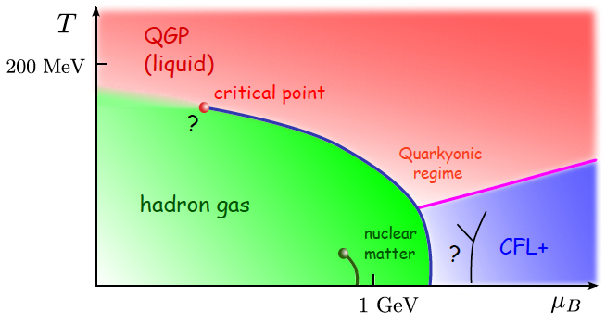
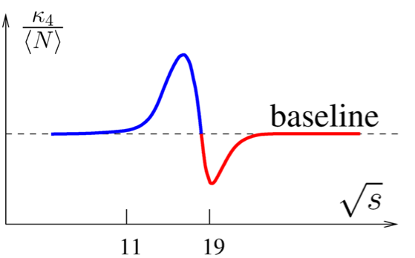
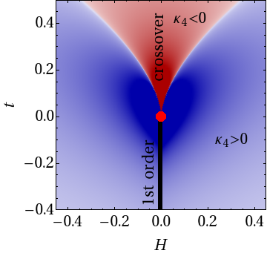
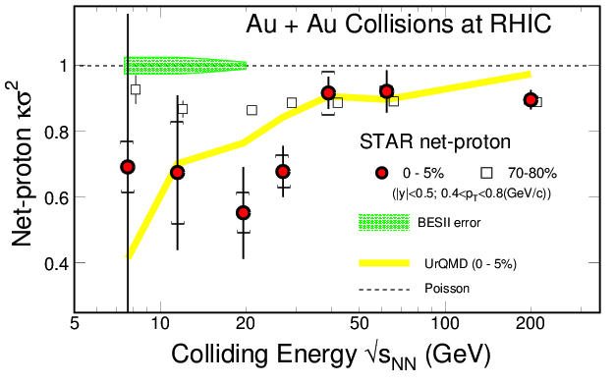
Quest for critical fluctuations
Possible scenario
Increasing beam energy
Phys. Rev. Lett. 112 (2014) 32302
Sign change of net baryon kurtosis κ4

Slide 16
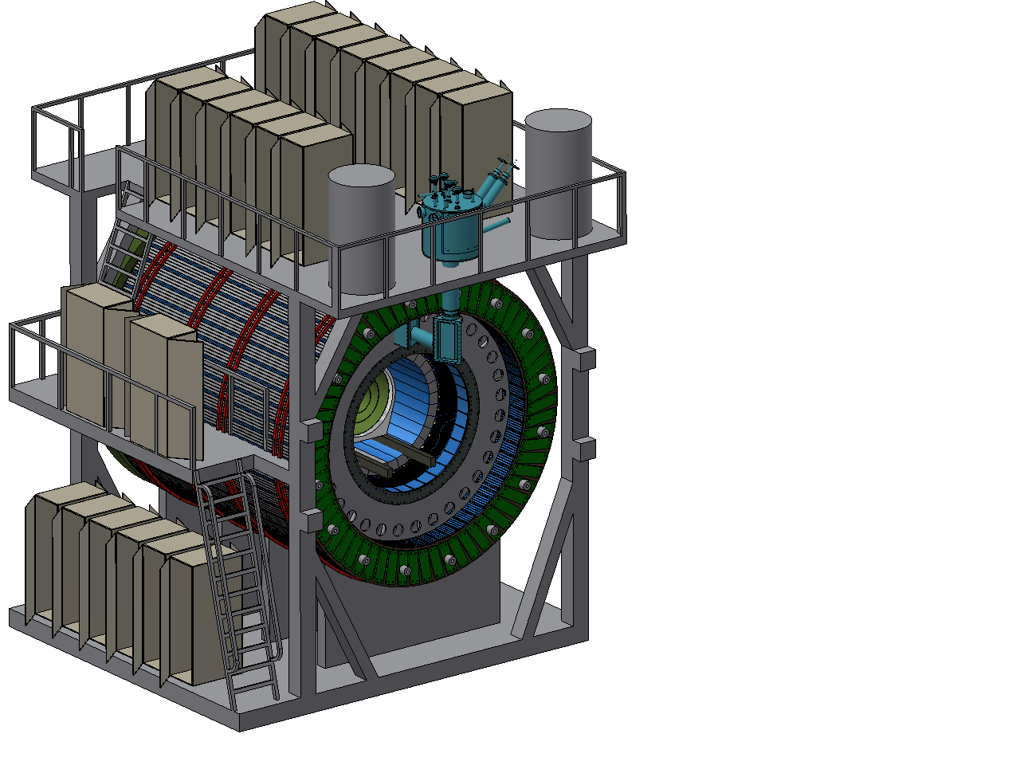
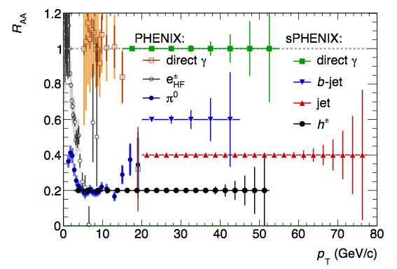
sPHENIX upgrade
An (almost) complete makeover of the PHENIX detector to make precision measurements of hard probes of the QGP at strongest coupling (near Tc) and with the largest resolution range
Built around the BaBar solenoid – now being shipped to BNL

Slide 17
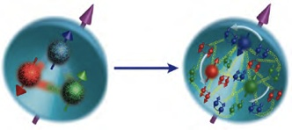
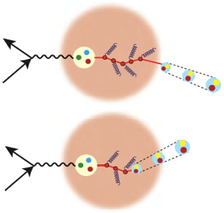
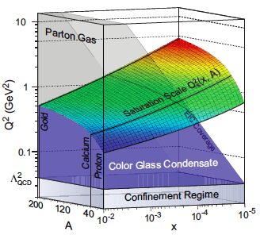
EIC will be a QCD laboratory
Gluon and sea quark structure of the proton, or what gives matter (most of) its mass ?
Use the nucleus as a
fm-scale vertex detector
to probe confinement
Is there a universal saturated
gluon ocean (CGC) at low x ?
17

Slide 18
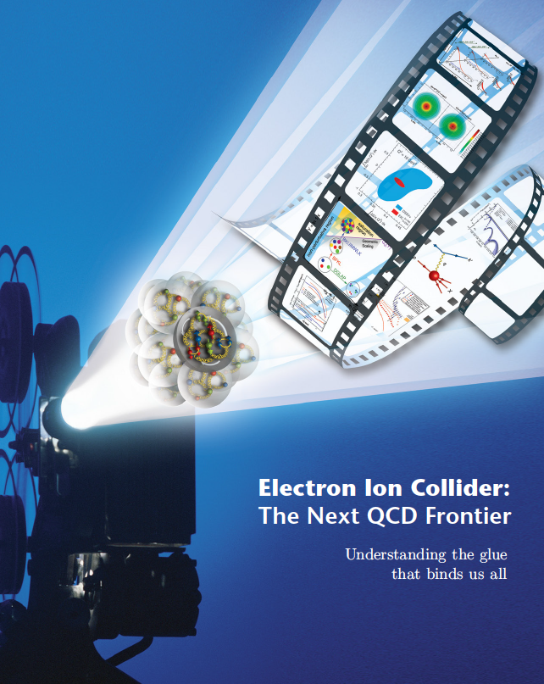
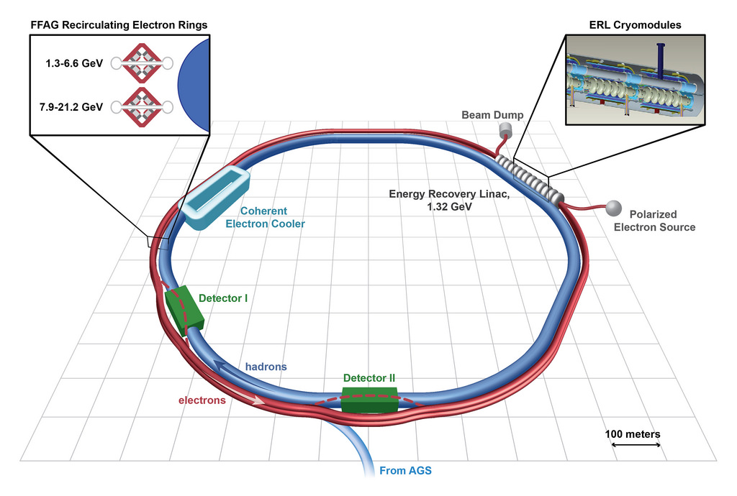
e-RHIC: An EIC at BNL
eRHIC will combine several innovative, cost-effective accelerator concepts:
World’s first Linac-ring collider
Coherent electron cooling for record high beam brightness
Energy Recovery Linac (ERL) reduces power consumption to ~20 MW
Fixed field alternating gradient (FFAG) arcs circulate beams with multiple energies simultaneously
18

Slide 19
BNL Role in HEP – Science Driven
BNL has made scientific investments in each of the three frontiers as well as the foundation that enable us to contribute to the science.
The investments have created a core expertise that is essential for successful physics analysis.
Energy Frontier
Intensity
Frontier
Cosmic
Frontier
Experimental
Accelerators
Theory
Simulation
Physics Frontiers
Detectors
Computing
Along the Paths
Solid Foundation
  Enabled by
As a national lab we strive to have a balanced program to effectively enable the DOE mission.

Slide 20
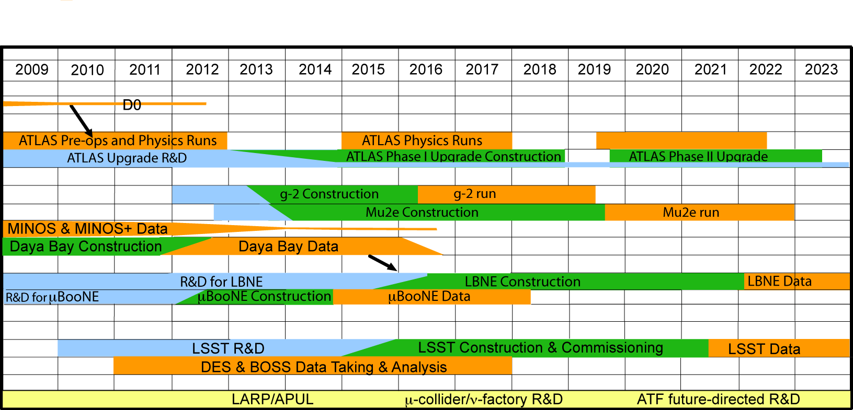
Long-Term Vision for BNL HEP
Goal: Technical & intellectual leadership in key experiments at the three frontiers (energy, intensity, cosmology), supported by theory, advanced accelerator and detector R&D, and computing.
ATLAS, LBNE, LSST are our physics priorities in the three frontiers for the coming decade.
Notes:
Our goal than is to have the technical and intellectual leadership in key experiments at the three frontiers.
You see here the time line for the experiments that BNL is committed to.
In the Energy frontier it is based on the ATLAS experiment.
In the Intensity frontier our main thrust is in neutrino physics Minos, Daya Bay , MicroBooNE leading to LBNE.
In addition as you will see we are making critical contributions to Rare process.
The Cosmic frontier our main thrust is toward LSST – but our experimentalists are busy analyzing BOSS and DES data.
To maintain our Scientific and technical capabilities we need to maintain a balance between R&D, Construction and analysis at any given time.

Slide 21
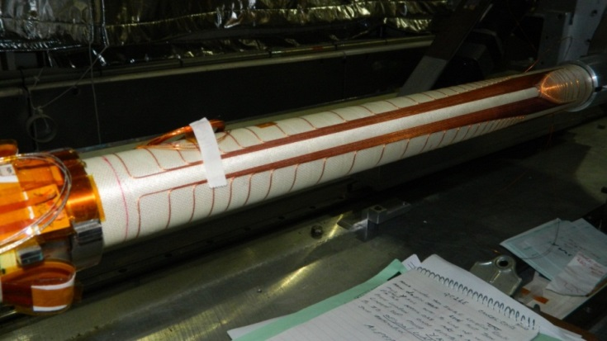
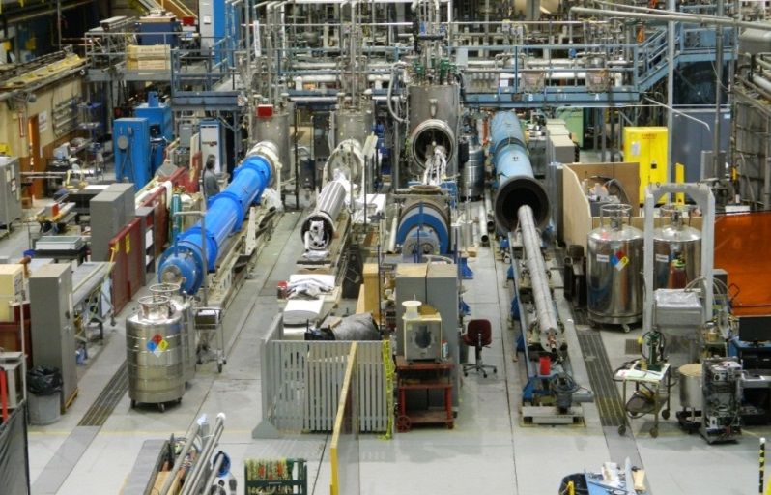
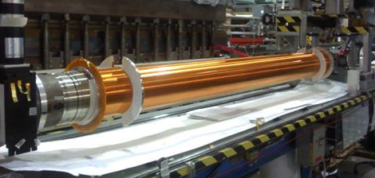
Magnet Division
Super Conducting cable development
Energy Storage
  SMES
  Army – Mobile Energy Storage devices.
LHC Upgrades
SuperKEKB - IR Magnets
  43 Corrector Magnets
RHIC
  e Lens magnets.
FRIB
  Special HTC Beam Magnets
SuperKEKB: IR magnets.
Test Stand
Cold Mass
APUL (LHC) Two Magnets
E Lense 6 T, 2.5 m, 200 mm

Slide 22
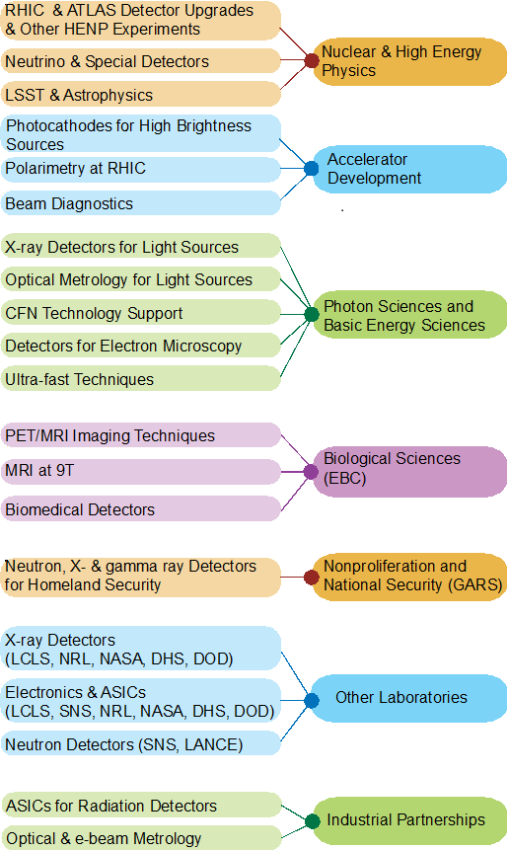
Instrumentation Division
Mission: “To develop state-of-the art instrumentation required for experimental research programs”
Goal: to make the BNL scientists and science programs more competitive by development of enabling technologies
Key recent accomplishments:
LSSTCam CD2 formally approved by DOE
ATLAS Phase I upgrade CD2 Approved by DOE
Range of Si-detectors for RHIC experiments
Advances in multi-alkali photocathodes
Wide range of ASIC designs, e.g., ATLAS/LHC muon detector, nuclear non-proliferation detectors, medical imaging.
Beam position monitors for photon science.
New generation of thermal neutron detectors.
22
Notes:
22

Slide 23
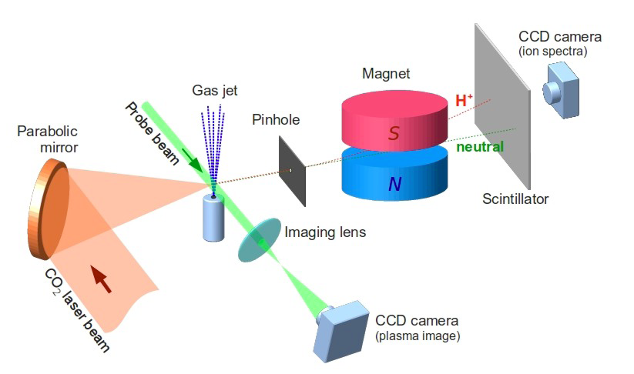
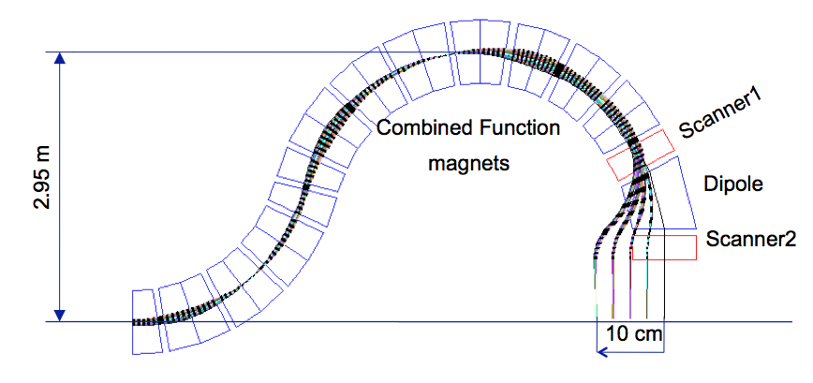
Accelerator Science, R&D, and Applications
Accelerator R&D for the next generation accelerators:
  Intense, high brightness particle sources
  High intensity Energy Recovery Linacs (ERL)
  Next generation beam cooling techniques
  Laser-driven acceleration
  High Temp. Superconducting magnets
Accelerators for medical, energy, & defense applications
  Compact cancer therapy accelerators; ultra compact treatment gantries
  ERL for MW Free Electron Lasers
  Cost effective drivers for nuclear waste transmutation
Energy Storage.
  Energy storage using Super Conducting Magnets.
CASE: (Cluster Hire at Stonybrook)
  Training the next generation accelerator scientists at the BNL/SBU Center for Accelerator Science and Education
Laser-driven accelerator
Ultra-compact gantry
SMES

