Slide 1
BNL HEP Program Visit by Nigel Lockyer and Joe Lykken 1/12/2015
David Lissauer
Deputy ALD for Nuclear and
Particle Physics
Notes:
In the next half hour I will give an overview of the BNL HEP program.
Following my talk you will hear more detailed talks and tomorrow in the break out sessions more details will be given.
Today we will be here in Berkner Hall and tomorrow’s breakout will be all in Physics.

Slide 2
Agenda
Overview of HEP Program D. Lissauer
LHC Experiments – ATLAS H. Gordon
Magnet Division P. Wanderer
LPP Collider B. Palmer
Accelerator R&D and eRHIC I. Ben-Zvi
Tour of RHIC J. Dunlop, G. XiaoFeng
Lunch
Intensity Frontier L. Littenberg
Neutrino – Theory Overview B. Marciano
LBNF M. Diwan
SBN – Science Q. Xin
SBN-LBNF Technology H. Chen
LBNE/F FD Project Office J. Stewart
Tour Instrumentation Division G. Smith, V. Radeka, b. Yu, H, Chen
Dinner
Notes:
This are the different breakout sessions and the rooms for tomorrow.
Note that the close out will be in room 2-160.

Slide 3
Office of the Associate Laboratory Director Nuclear and Particle Physics
Berndt Mueller
Associate Laboratory Director
David Lissauer
Deputy Associate Laboratory Director
NPP HR Manager
Donna Dowling
Sr. Admin. Assistant
E. Zukowski
Special Asst. to the ALD
P. Yamin
Sr. Special Asst. to the ALD
J. Hauser
Collider Accelerator Dept.
T. Roser
Physics Dept.
L. Littenberg
Superconducting
Magnet Division
P. Wanderer
Instrumentation Div.
G. Smith
Associate Director
ILC
M. Harrison
Accelerator
Development
I. Ben-Zvi
HEP
H. Gordon
NP
J. Dunlop
Energy Frontier
H. Ma
APUL
LARP
Superconductor
R&D
ATLAS: ASIC Development
LSST: CCD/Science Raft
LAr TPC
ATF
MAP
Intensity Frontier
S. Kettell
Crab Cavity
Cosmic Frontier
M. May
PAS
A. Klimentov
Quality Assurance Rep. – R. Lebel
ES&H Coordinator – M. Zarcone
RACF
M. Ernst
Notes:
The HEP activities are embedded in the NPP Directorate.
Berndt Muller is the Associate Lab Director for NPP – unfortunately he can not be here this morning but will join us for dinner tonight.
The Accelerator research is nested in CAD where they benefit from synergy with the NP accelerator work.
The experimental and theoretical research programs are nested in the Physics department with significant help in instrumentation from the instrumentation division.
The magnet development is done in the Superconducting Magnet Division and is where the LARP and GARD work on superconducting magents technolog is done.

Slide 4
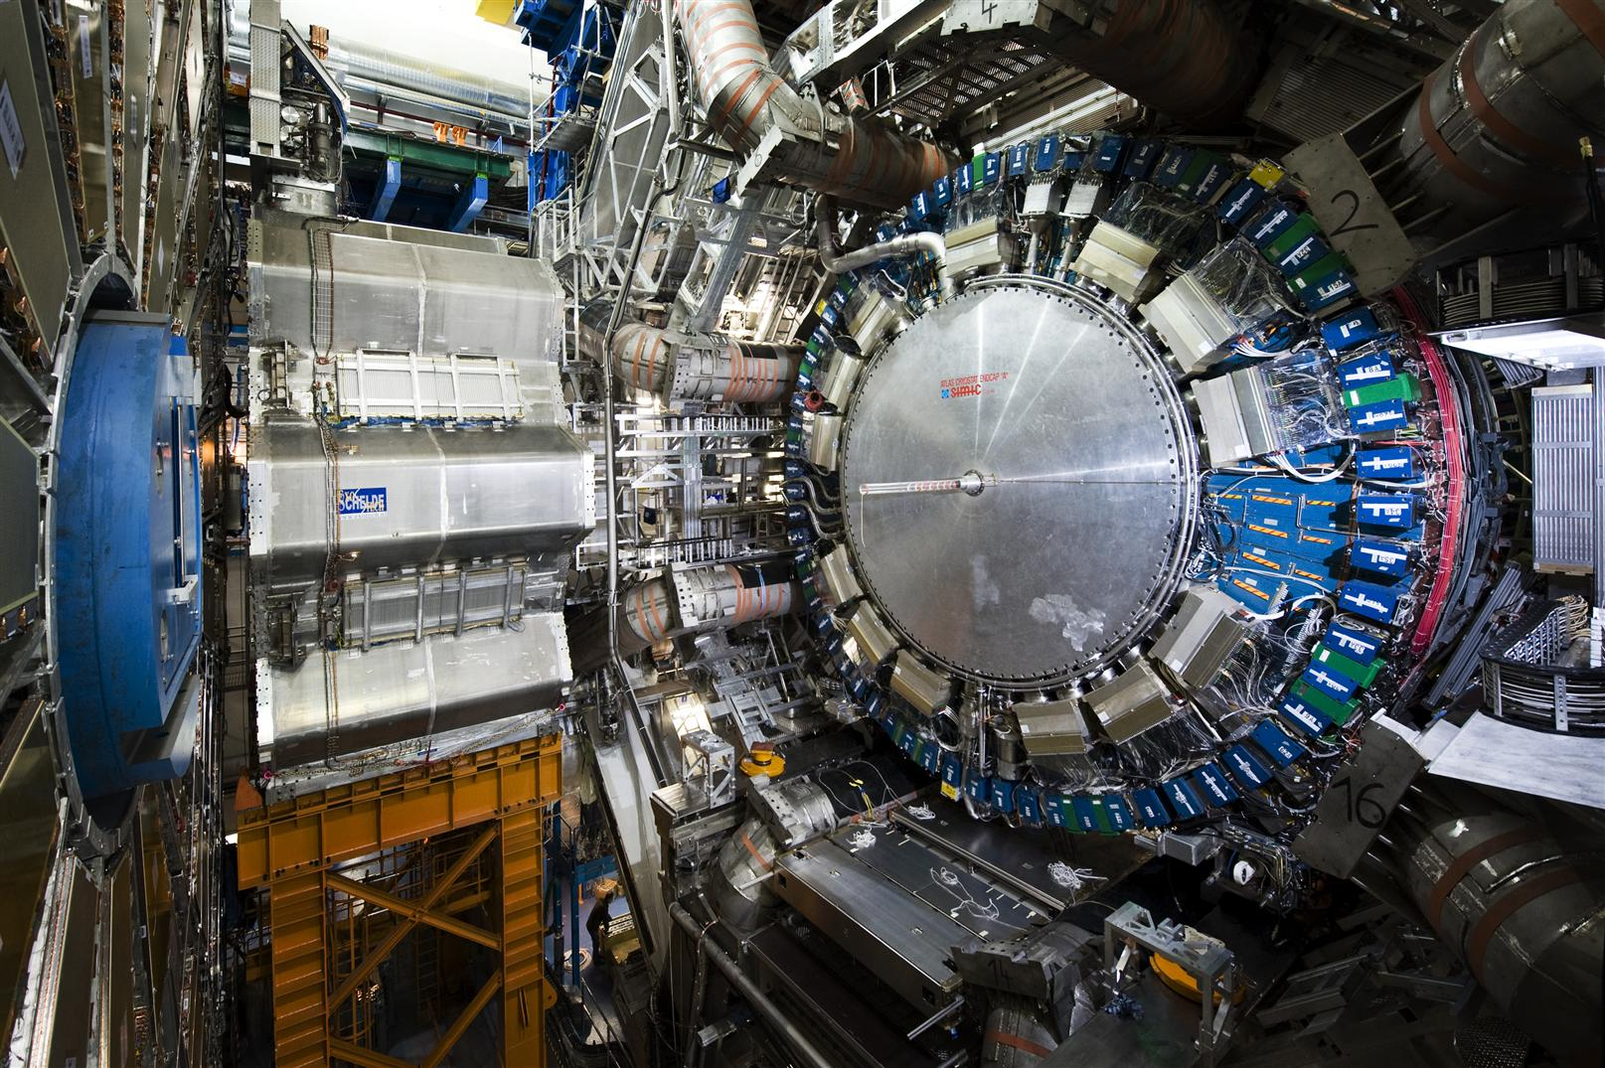
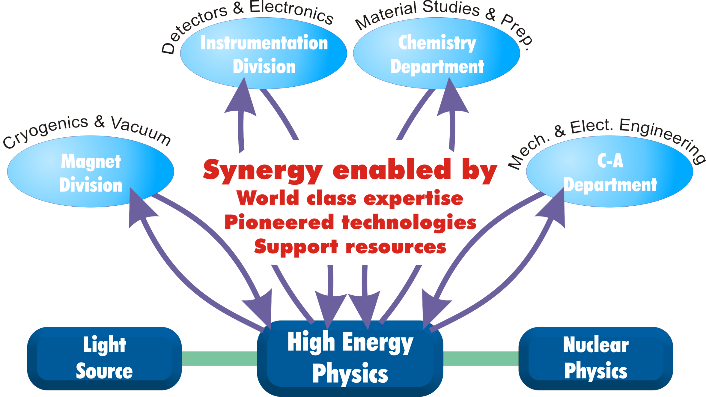
Broad Leveraging of HEP Program
Accerator stewardship
BNL HEP Program relies heavily on expertise at different departments to develop and implement the physics program.
In particular we leverage special expertise in the Instrumentation Division, the Chemistry Department, SMD and C-AD to develop and implement new technologies for accelerators and experiments.
Notes:
BNL is a multidisciplinary Lab and we benefit from synergy with the other Lab divisions. In particular

Slide 5
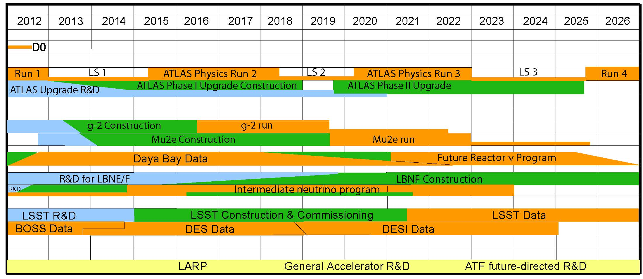
Long-Term Vision for BNL HEP
Goal: technical & intellectual leadership in key HEP experiments supported by theory, advanced accelerator studies, detector R&D, and computing.
ATLAS, LBNF, LSST are our physics priorities addressing significant part of the HEP science drivers for the coming decade.
Notes:
In HEP we are a users facility – in the Energy frontier our main thrust is on ATLAS and is at CERN, Intensity frontier mostly at FNAL and Cosmic Frontier is LSST – will end up in Chile.

Slide 6
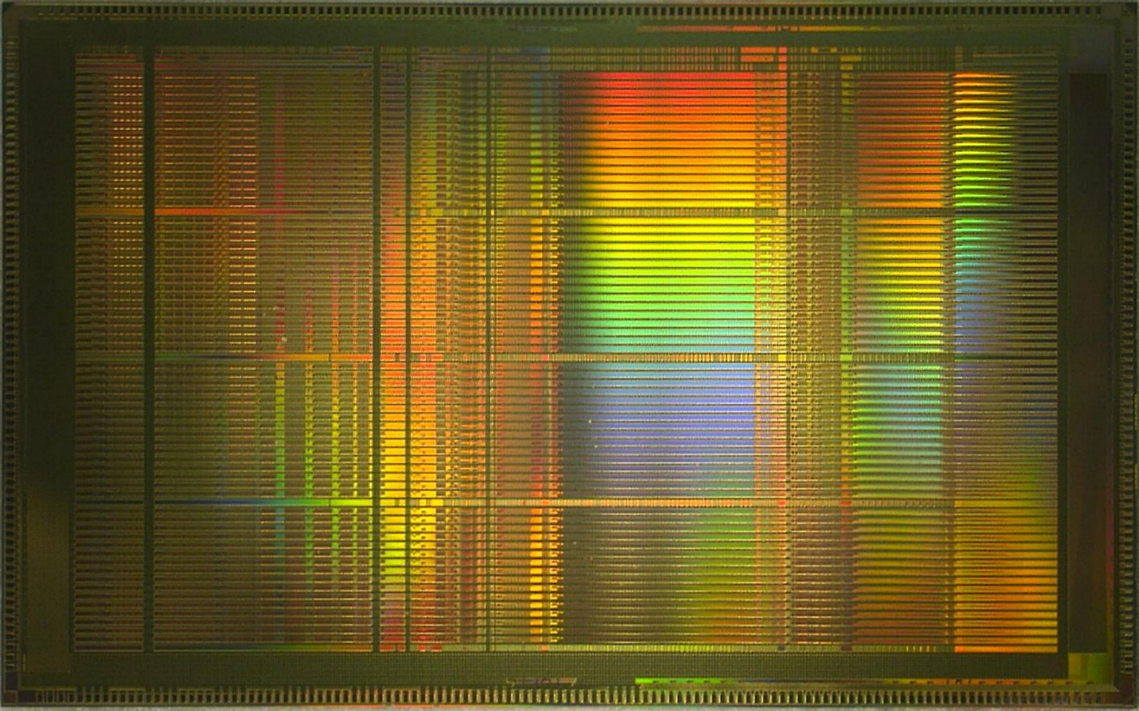
Detector R&D
Built on the strength of BNL’s Instrumentation Division with decades of investments in unique capabilities with transformational technologies that are enabling new experiments.
Focus on few promising technologies that will benefit the next generation of experiments – aim to be transformative in nature enabeling “cheaper, faster and better experiments”.
e.g: Cold Electronics → SBN and LBNF, ASIC’s for ATLAS muon system and Mu2e CR test stand, CCD→ LSST Camera.
Development for ATLAS VMM DAQ on a CHIP
’12 50 mm² 500k MOSFETs
’14 115 mm²
> 5M MOSFETs
~’15 130 mm²
> 6M MOSFETs
DSP
Notes:
You will have a chance to look at

Slide 7
Detector R&D BNL
ASIC developments: G. DiGeronimo
Cryogenic electronics for neutrino and dark matter detectors
ASICs for micropattern gas detectors. V. Polychronakos
Integration of DAQ into front-end electronics H.Chen
Noble Liquids:
Fundamental properties of noble liquids C. Thorn
TPC’s: electrode geometry design and signal optimization B. Yu
Noble liquid calorimeters: readout (from electrodes to DAQ) H. Chen
Fast DAQ and trigger system F. Lanni
Si Detectors
Low-mass high-density Si tracking system D. Lynn
Radiation effects in Si detectors; radiation-hard designs W. Chen
Water-Based and Metal-Loaded Liquid Scintillators. M.Yeh
Water-based scintillators D. Jaffe
Metal-loaded scintillators
Radiation-Tolerant Electronics and Mitigation of SEU Effects H.Takai
Radiation facilities, FPGA’s, ADC’s , optical links,…
Detector R&D feeds new experiments and enables new science.
Notes:
The R&D efforts concentrates on our strength , enhance synergy with ongoing projects and prepare for potential new experiments in the future.
These are area that are crucial for preserving our ability to contribute to future experiments.
ASIC developments cover many areas and continues to evolve transforming the way we think about what is possible.
Noble Liquids are critical to calorimetric, Large LAr TPC’s ,
Si detectors that are crucial for tracking devices,
Water based Scintillators for Reactor experiments and DM Veto systems.

Slide 8
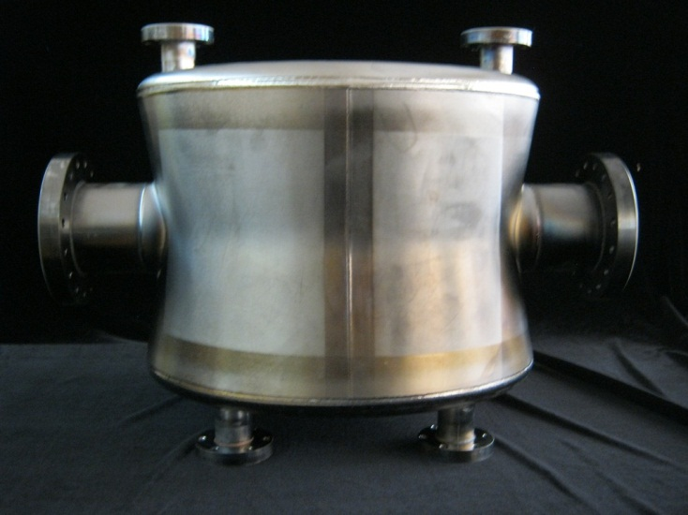
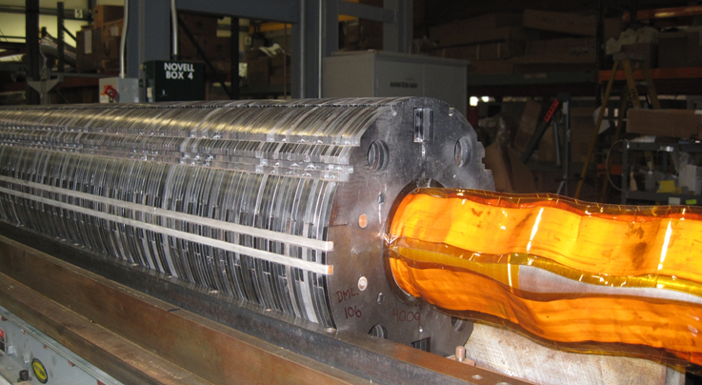
Accelerator Project to Upgrade the LHC (APUL) – successful coil assembly
Accelerator Technologies
Highly productive user facility in ATF; world-leading expertise in superconducting (esp. HTS) magnet design ⇒ Strong LARP roles; intellectual leadership in μ Collider design & simulation, ILC and Future colliders.
Synergies with strong accelerator groups funded by ONP (RHIC → eRHIC).
Double-Quarter-Wave-Resonator cavity: BNL original design of a compact crab cavity that fits into the LHC ring. Achieved 4.5 MV crab voltage (LHC spec 3.3 MV per cavity)
Notes:
READ
I would like to mention that there is an ongoing search for a cluster hire at Stony Brook in Accelerator Science. We expect that this will increase the collaboration between the two institutions.

Slide 9
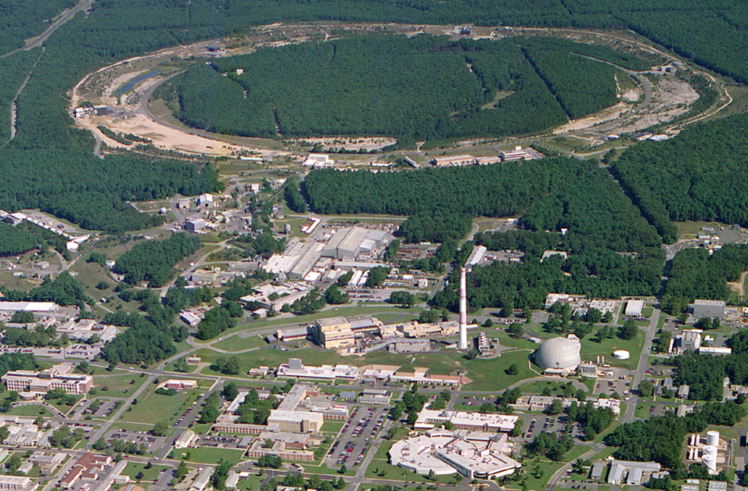
Accelerator Science- Collider Accelerator Department
Polarized Jet Target
RHIC → eRHIC
PHENIX
RF
STAR
LINAC
RHIC only high energy collider
HI and Polarized protons
e-RHIC in design
A test facility for accelerator Science
EBIS
NSRL
Booster
ATF
AGS
BLIP
Tandems
μ Accelerator
New Accelerator Technologies: Siberian Snake, 3D stochastic cooling, Electron Cooling, SRF Developments, ERL, FFAG.
Notes:
BNL now has the only high energy collider in the US. Capable of running HI and polarized protons. A unique test bed for new ideas among them:
We are now developing an eRHIC design that is a very innovative one and will use many state of the ART technologies many of them for the first time. ERL, FFAG as an example.

Slide 10
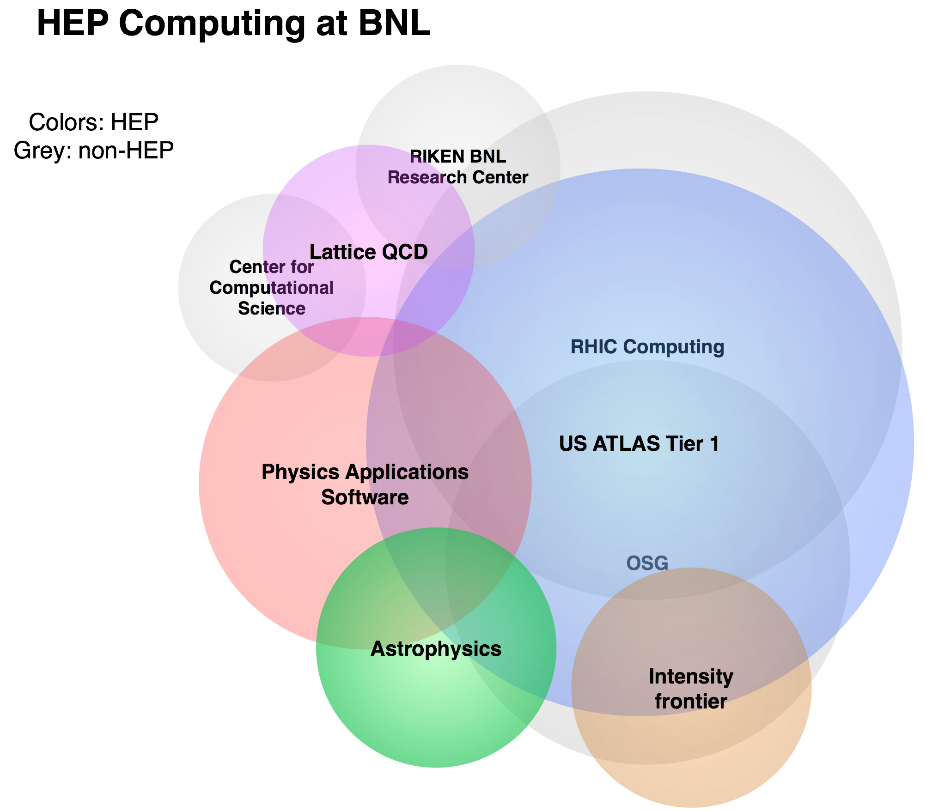
Computing
BNL has developed Big Data and High Throughput Computing as a core competency through a very successful HEP and NP computing.
HEP Computing dominated by ATLAS Tier I – synergy with RHIC computing.
Largest and most successful ATLAS Tier 1. (8M CPU walltime hours/month, ~10PB disk space)
Maintain leadership in Facilities and distributed computing
Provide peta- to exascale computing and storage capacities and performance to HEP (and NP) programs
PanDA production and distributed
analysis (1.5M jobs/day)
Green Computing
Lattice QCD: Long history of developing
dedicated hardware in collaboration with
RBRC, Columbia, IBM, U Edinburgh.
Notes:
READ:
1st bullet –
PanDa:
There is a growing interest in utilizing Panda outside LHC.
LSST is looking in to using Panda.
Green computing is not only good for the enviourments. But it reduces the cost of infrastructure that we need to support.

Slide 11
Theory
Mission: Leadership in defining the HEP experimental program
Lattice gauge theory
Highly focused on connection with experimental observables
Hardware/software/algorithm/theoretical contributions
Precise understanding of the 126 GeV scalar
Higher-order QCD corrections for LHC phenomenology
LBNE, Mu2e, neutrinos, (g − 2)_{µ} , EDM’s
The intellectual leadership in precision experiments.
Model building for electroweak symmetry breaking
Model building is also tightly connected to experiment
Super B factory, LHCb: CKM and CP violation
Notes:
Read the text-
You will see that we have serious budget issue with support of the Theory group.
The group has shrunk over the last few years and even after the reduction we are unable to support the group at its present size.
Lattice work has really matured over the last years and is now making very detailed prediction that are critical to the interpretation of experimental results.

Slide 12
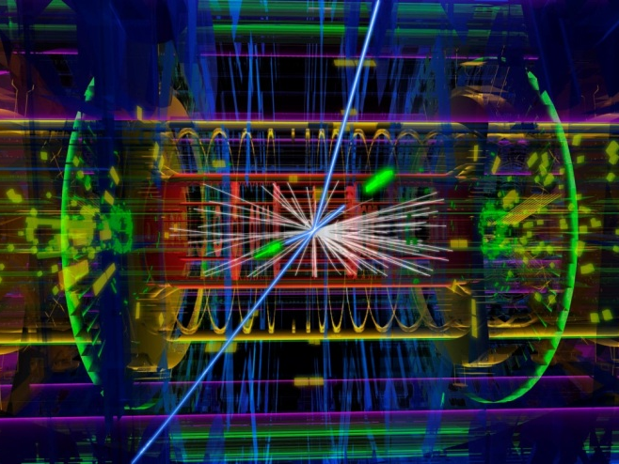
Energy Frontier
US-ATLAS host institution (U.S. Operation Program Management , Tier I Computing , Phase I Project Office, and preparation for Phase II upgrades), leadership roles in detector ops, upgrades, software & computing, physics analysis & analysis support.
Effort is backed by strong efforts in theory, cutting-edge instrumentation development and by computing facility with world-leading performance
Notes:
Read:
We expect that the involvement in with Phase I and Phase II will take is to the later part of the next decade.

Slide 13
ATLAS Upgrades
PHASE I:
Approval by CERN Research Board(3/12/14)
Phase I project office at BNL (J. Kotcher) - CD2/3
BNL played crucial roles in the ATLAS Phase-I Upgrade
Physics motivations for the upgrade
Technical solutions, based on the strong detector R&D effort
Proposed and designed the high granularity calorimeter trigger
front-end readout of the muon new small wheel upgrade
global feature extractor for large-area jet trigger (gFEX)
Phase II:
LOI presented to LHCC in March 2013
Lanni as LOI co-editor and LAr Deputy PL for Upgrade
Lynn was on the LOI editorial board for Inner Tracker
U.S. ATLAS Phase-II BNL Director’s Review July 2014
U.S. aspiration – cost and scope range.
Notes:
BNL has important role to play the ATLAS Phase I upgrade where the project office is here and is headed by John Kotcher – BNL had significant input in developing the technical solution that were adopted in the Phase I upgrade.
We are now getting organized in preparation for Phase II – our scientists had major input to the LOI and we plan a Directors review of the US program in anticipation and preparation for CD0 where the US scope will have to be defined.

Slide 14
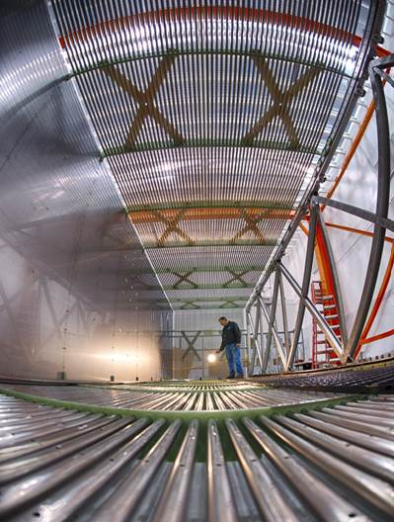
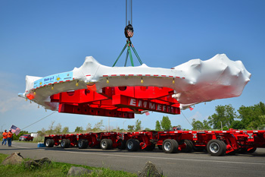
Intensity Frontier
Intellectual leadership in Intensity Frontier physics; host LBNE far detector project office, leading scientific case, pioneering work enabling LArTPC; leadership of Daya Bay; lead roles on SBN Program μBooNE, LAr-ND; small but critical contributions to g-2.
Backed by strong efforts in LQCD flavor physics and EW theory, cutting-edge instrumentation development and unique nuclear chemistry expertise
Design of MicroBooNE LArTPC
BNL g-2 ring to FNAL
Notes:
READ

Slide 15
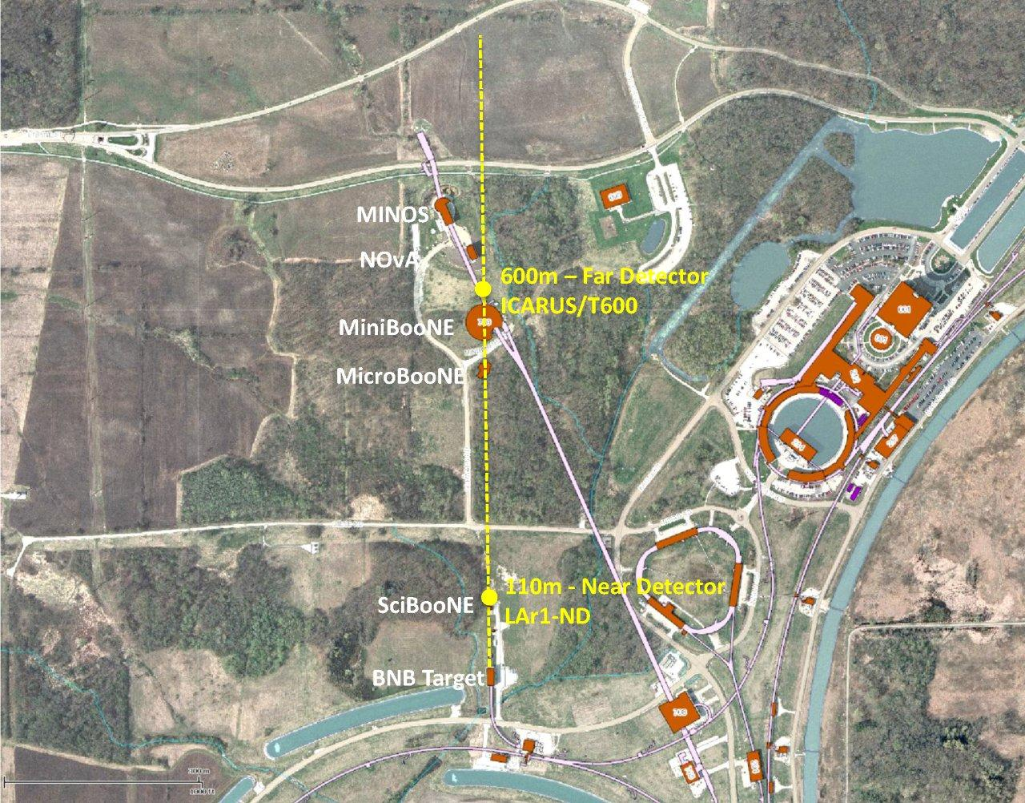
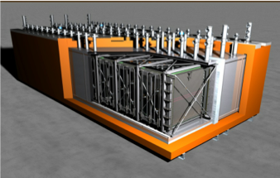
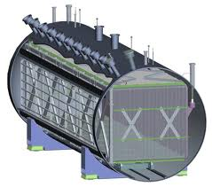
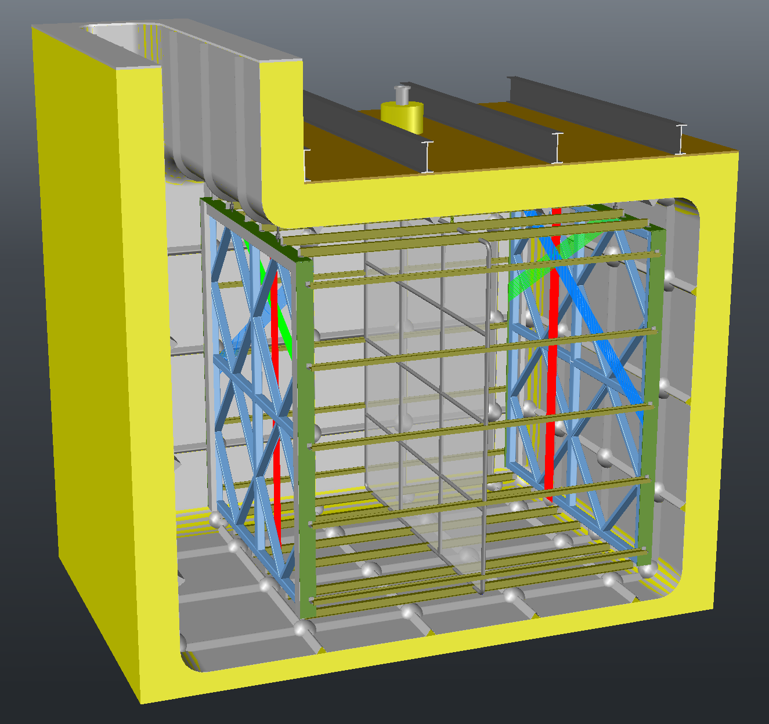
SBL at the FNAL Beam
Tests of cold electronics.
Possible use in ICARUS.
ICARUS T600
Craig Thorn Deputy Project Manager Active Detector
Xin Qian Physics, ν-Ar Cross Section analysis Mary Bishai Physics, Simulation and Analysis
Yichen Li Electron & Photon transport
Chao Zhang Simulation, LArSoft
(Susan Duffin) Cryostat Manager
(Bo Yu) TPC Design
(Hucheng Chen) Electronics Manager
(George Mahler) Detector Assembly Integration Manager New postdocs: Brian Kirby, Michael Mooney, Jyoti Joshi
NuMi Line
MicroBooNE
LAr1-ND

Slide 16
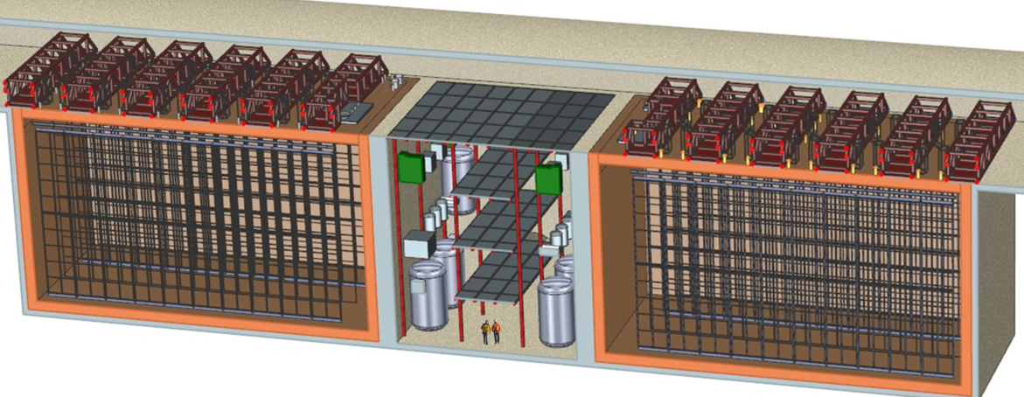
LBNF
Decisive contributions to the Long Baseline from the beginning.
Physics Leadership
Milind Diwan – Co-Spokesperson
Mary Bishai – Project Scientist
Elizabeth Worcester – Oscillation co-convenor
Elizabeth Worcester – Systematics convenor
Project Leadership
L2 Far Detector PM – Jim Stewart
LBNE System Engineer – Jeff Dolph
L3 Electronics Mgr. – Bob Hackenburg
L3 TPC Mgr. – Bo Yu
Technology Leadership
Beam Design – M. Bishai
TPC design – B. Yu
Cold Electronics – G. De Geronimo
Readout electronics – H. Chen
Software – M. Potekhin, B. Viren
Science case
BNL cold electronics are an enabling technology for large LArTPC’s.
LBNE/F Science Opportunities Document has been a major effort by BNL this year.
Notes:
READ:
Posr P5 DOE and FNAL are in the process of reorganizing LBNE and transforming it to LBNF. We expect that BNL will continue to play a major role in the Project, the science and in the collaboration.

Slide 17
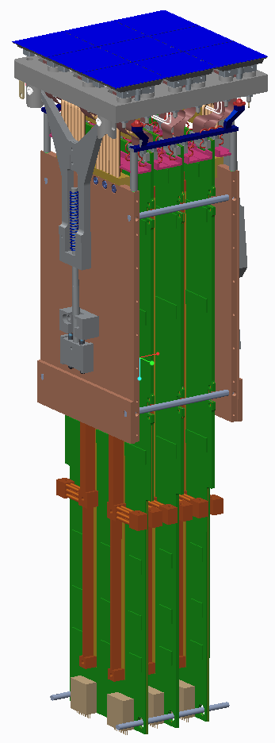
Cosmic Frontier
Cosmology: Small effort with outstanding young particle astro-physicists contributing to BOSS, DES ,DESI & LSST – Primary responsibility for LSST Science Raft, Science Raft Subsystem Management backed by strong instrumentation development.
Four faculty hires planned at Stony Brook in collaboration with BNL LSST, two this year, (One hired made) two next. Potential to increase collaboration in Cosmic Frontier.
CCD’s
raft baseplate
V-grooves for
kinematic Mount
flex circuits
conductance barrier
hold-down arm
thermal strap
raft electronic crate
cryo plate attach
cooling bars
raft electronic
boards
cold plate attach
Science Raft
Notes:
READ:
Emphasis the importance of cluster hire at Stonybrook.

Slide 18
Conclusions
The national HEP priorities as stated by the P5 were championed by BNL.
Our program benefits from significant synergies with the Instrumentation Division, RHIC computing, Magnet Division, Chemistry Department and NP-funded components of Physics and CAD. There is strong Lab support.
BNL – FNAL have an ongoing productive collaboration since the mid ‘90’s on US -LHC LARP.
BNL plans on a balanced program for the future - our involvement at FNAL neutrino program as a key to our future.
The following presentations will highlight the scientific and technical capabilities at BNL, explore how our collaboration
can be optimized and explore additional opportunities for collaboration.
Notes:
Loss of 4.5

