Slide 1

g-2 and Reactor Experiments
L. Littenberg
BNL efforts in
  g-2
  Daya Bay
  Other reactor experiments
1/12/15

Slide 2
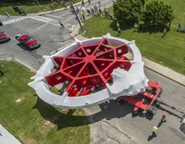
BNL’s contributions to g-2 are crucial
Physics Dept Group: J. Crnkovic, W. Morse,
Y. Semertzidis (on leave), V. Tishchenko
CAD (project & consulting): L. Snydstrup, W. Meng, J. Benante, H. Sayed, L. DeSanto, A. Zhang
B. Parker (SMD)
Theorists: H. Davoudiasl, W. Marciano, C. Lehner, T. Izubuchi
g-2 ring leaving BNL to FNAL
It’s not just the ring, the specific hardware, simulation or analysis projects
It’s also the corporate memory and unique expertise
Bill Morse gets three calls a week, “how does this work?”, “where does that go?”
Moreover, to go further than E821 went, you need a complete understanding of what was done.

Slide 3
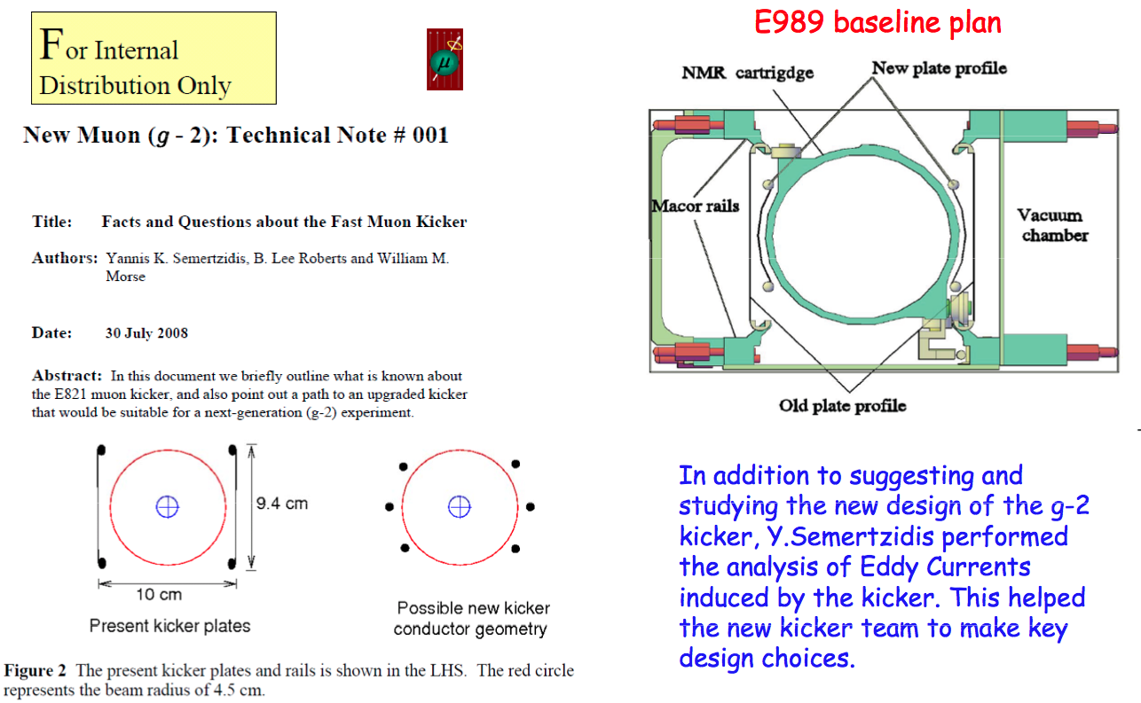
In addition to your own improvements you can guide others (e.g. kicker team at Cornell)
30% more statistics, reduced CBO systematic

Slide 4
g-2 @ FNAL is Hard!
To improve on E821 by a factor four, you need
  at least 16 times more statistics
  And you have to get the systematics BNL E821 dealt with down commensurately.
  And you have to get all the systematics you didn’t have to deal with in E821 under control
  And you have to make sure there are no intractable systematics you were previously unaware of.
Error | E821 | E989
Statistical | 0.46 ppm | 0.1 ppm
Systematic | 0.28 ppm | 0.1 ppm
Total | 0.54 ppm | 0.14 ppm

Slide 5
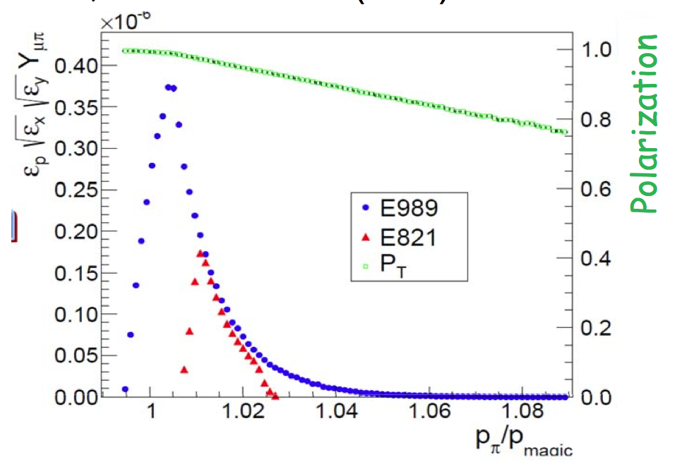
Statistics
Back at the TDR stage, Volodya Tishchenko’s simulations established that one could get a big increase in muons/pion:

Slide 6
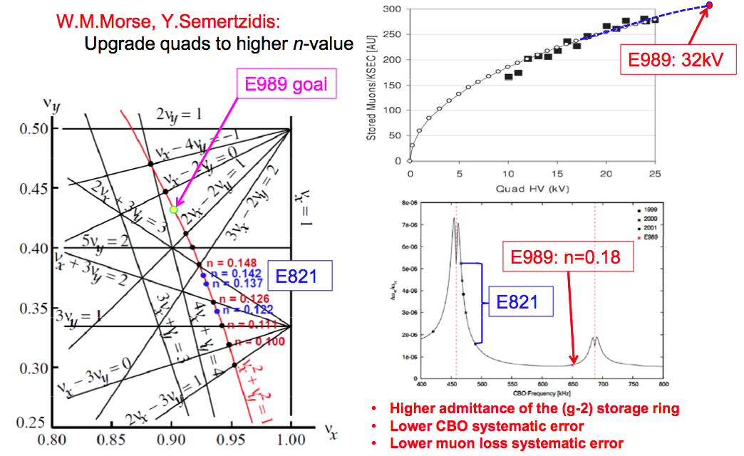
Reducing known systematics
BNL proposed raising the electrostatic quad HV from 24 to 32 kv to go to higher n value. Reduced the CBO systematic by a factor ~ 4.
Jason Crnkovic figured out how to get rid of this entirely

Slide 7
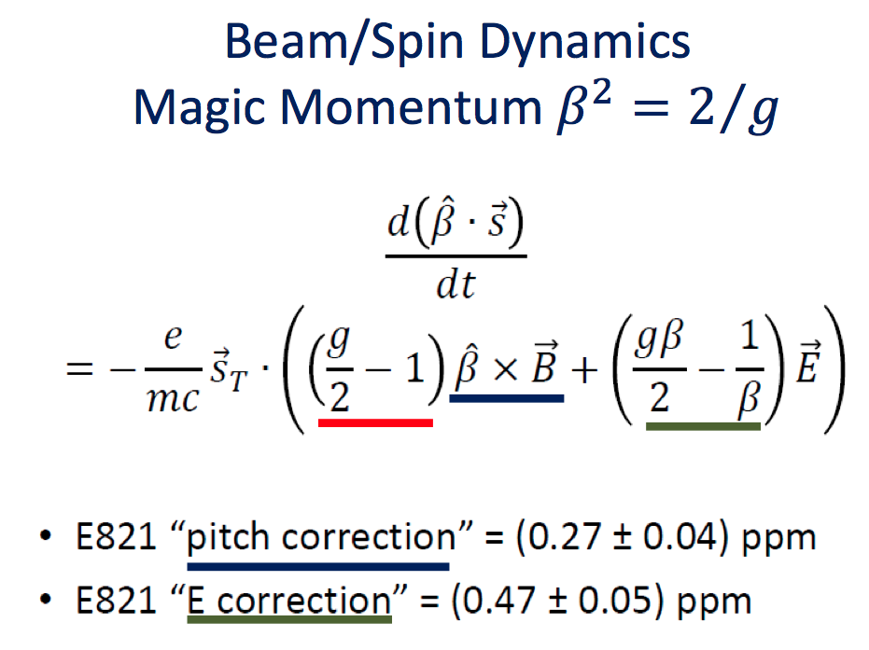
Reducing systematics you could live with in E821
Want to reduce these to ±0.01ppm - simulation being led by BNL

Slide 8
Uncovering a previously unknown systematic
Differential decay systematic
  Discovered by the BNL team after E821
  Lower momentum muons decay earlier, changing the spin angle with time (just what g-2 does)
  Muon lifetime = γτ₀.
  E821 Kicker: <+0.06 ppm
  E821 Beamline ±0.045ppm
  These don’t matter too much if overall systematic is 0.280ppm
  But if you are trying to achieve 0.100ppm, you have to fix them
  Can be reduced to ~ 0.01 each, but first you have to know they exist!

Slide 9
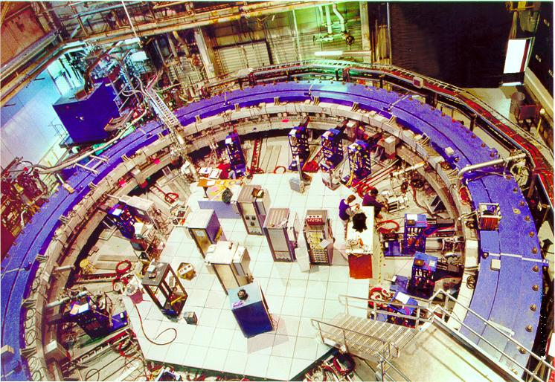
BNL contributions to g-2 @ FNAL
The ring
Crucial ideas on how to go further than E821
Systematics
Beam/Spin dynamics systematic error studies and coordination (Morse)
End-to-End beam line simulations studies and coordination (Tishchenko, Sayed)
Systemic fitting error in the presence of beam dynamics. (Crnkovic)
Electrostatic Quad Upgrade L3 Manager (Tishchenko)
  Refurbish electric quadrupoles (ESQ) (Morse, Tishchenko, Crnkovic)
    ESQ to run at higher field-focusing index to ~eliminate CBO systematic error.
    Test full prototype and refit all modules with the upgraded design.
  Develop CBO elimination using RF at CBO injection r frequency and phase shifting at the end of beam scraping. (Morse, Tishchenko, Crnkovic)
  High voltage measurements using electro-optic Kerr effect (Crnkovic)
  Study beam and spin dynamics related to CBO and influence on g-2 result (Morse, Tishchenko, Crnkovic)
  Study muon losses as a function of beam scraping and optimize muon storage. (Morse, Tishchenko, Crnkovic)
CAD: Continue to consult on technical and engineering issues for the ring.
  Beam/Spin Dynamics Systematic Errors: CBO, Lost muons, Differential decay for Debuncher, E821 kicker, etc. (Morse, Tishchenko, Crnkovic)
Participating in inflector upgrade calculations with Brett Parker (Magnet Division, BNL), Kicker upgrade (Cornell), DAQ (UKY) (Morse, Tishchenko)

Slide 10
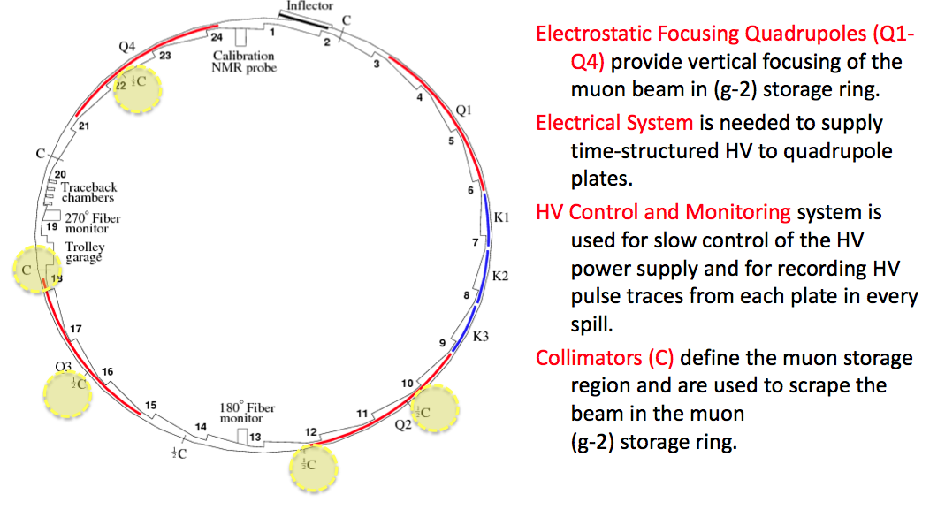
BNL hardware responsibility: quads & collimators

Slide 11
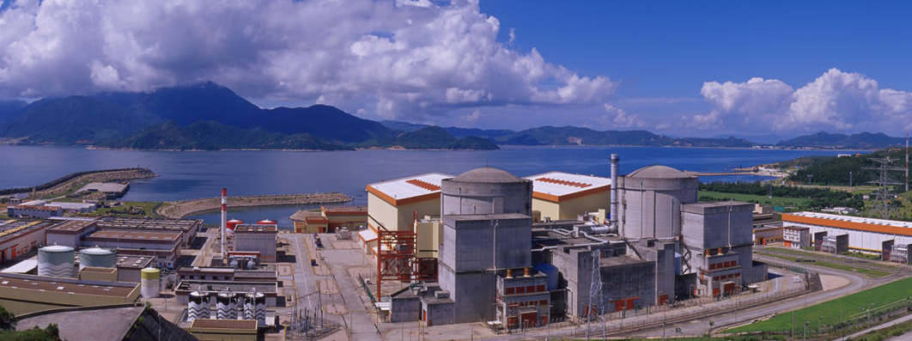

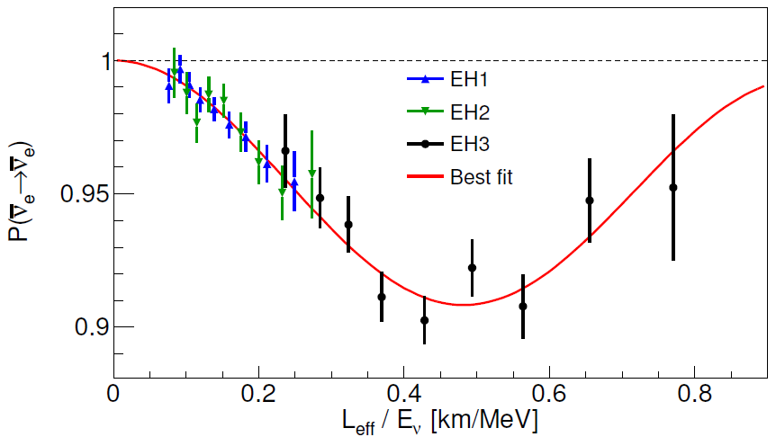
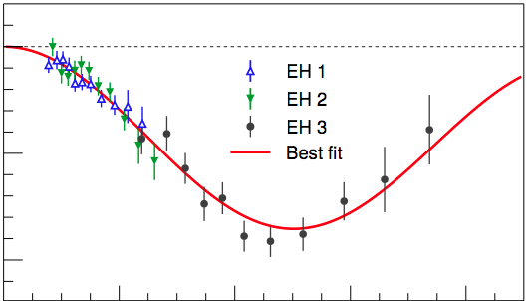
Daya Bay
One of Science’s top 10 breakthroughs of 2012. “…the Daya Bay result may mark the moment when the field took off.”
2012: Discovery of non-zero θ₁₃ established that the electron neutrino contains all 3 mass states and opens the door to LBNE measurement of CP violation (PRL108:171803 >1070 cites)
2013: First measurement of atmospheric mass splitting with electron neutrinos (Δm²_{ee}) is consistent with muon neutrino (Δm²_{μμ}) measurements from accelerator and atmospheric neutrinos — confirming the 3 neutrino model of oscillations (PRL112:061801, >75 citations) 2014: sin²2θ₁₃ improved to 6.0% and Δm²_{ee} to 4.1% — comparable to MINOS Δm²_{μμ}. Light sterile neutrino search yields best limit on sin²2θ₁₄ for |Δm²₄₁ |< 0.1 eV²
BNL enabled university contributions:
Hardware, Software, Analysis
Observation of a full oscillation cycle
Experimental Hall #1
Experimental Hall #2
Experimental Hall #3
Bishai, Diwan, (Gill,) Hackenburg, (Hans, Hu,) Jaffe, Kettell, (Littenberg,) Qian, (Rosero,) Tang, Viren, Worcester, (Yeh,) Zhang
Previous members: (Beavis, Brown, Chasman, Hahn,) Isvan, Ling, (Pearson,) Tanaka, Themann, Wang, Whitehead, K. Zhang
P(ν_{e}→ν_{e})
3.6 x more data
11

Slide 12
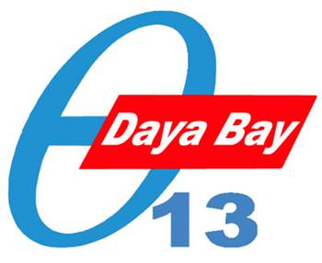
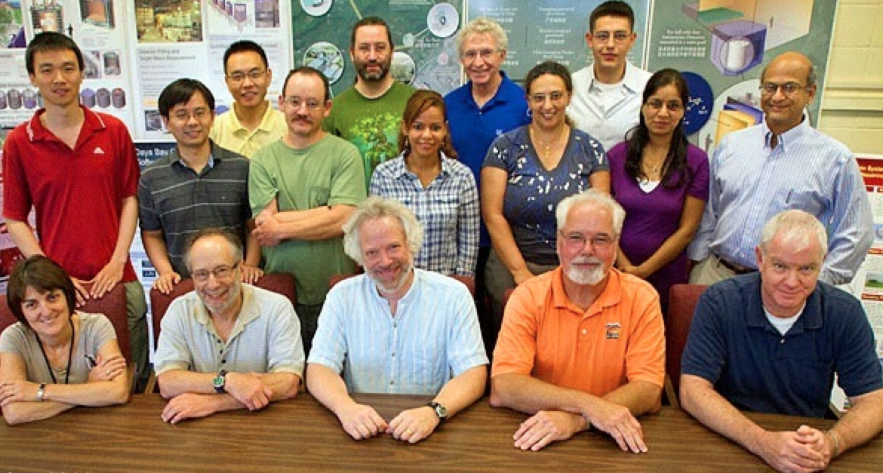
Some facts about Daya Bay
The US Daya Bay involvement became viable when BNL joined.
BNL has had the largest, most active US group.
  In the construction faze we had the U.S. Chief Engineer, Chief Scientist & Deputy Project Manager, the Veto Subsystem Manager, the simulation & analysis leader, etc.
  Once the data became available we led the US oscillation analysis
Daya Bay was designed to measure a sin²2θ₁₃ as small as 0.01.
It was designed to be the best reactor experiment but was not expected to be the first to measure sin²2θ₁₃
Beyond sin²2θ₁₃ several other important measurement, not anticipated in the CDR have been made by the experiment (we’ve played a key role in all)
  |Δm²_{ee}|
  Sin²2θ₁₃ using neutron capture in hydrogen instead of Gd.
  Sterile neutrino limits (pioneered by BNL)
  Reactor spectrum measurements

Slide 13
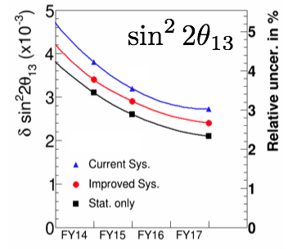
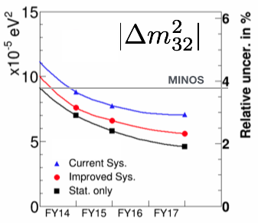
Daya Bay Plans
Operations through 2017; research thru ~2019
Near term analysis
  Search for sterile neutrino (idea initiated and driven by BNL: ex-postdoc Ling, Diwan, Qian, Zhang)
  New θ₁₃ measurement from n-H capture (led by BNL ex-postdoc Wang, review by BNL: Qian)
  Reactor flux/spectrum measurement (Zhang)
  Update of θ₁₃ and Δm²_{ee} with x4 statistics (continuing BNL effort: Qian, Tang, Zhang, Jaffe)
Long term
Most precise measurement of sin²2θ₁₃ for the foreseeable future . Precision measurement of Δm²_{ee} is complementary to accelerator measurements. (BNL leadership Qian, Zhang, Jaffe, Kettell, Diwan, Worcester, Tang)
  Enhance capability of CPV search in LBNE
  Unitarity test of PMNS matrix with LBNE
  Test of νSM
  Initial hints of neutrino mass hierarchy
Improve absolute flux uncertainty σ(ε_{det})∼1% (Qian, Zhang, Worcester)
Measure reactor flux (Zhang)
Understand energy response of LS/electronics (Qian, Zhang, Worcester)

Slide 14
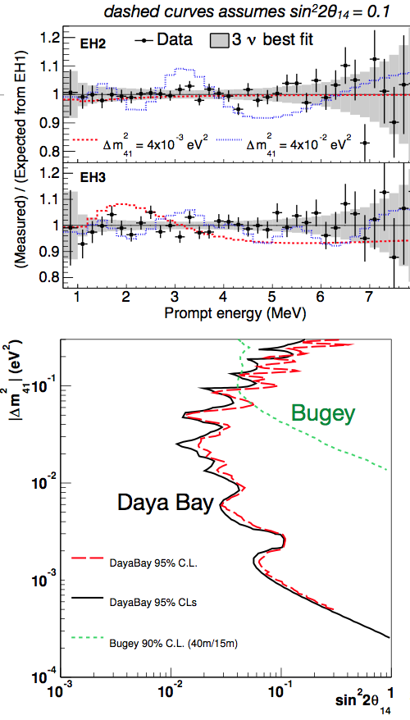
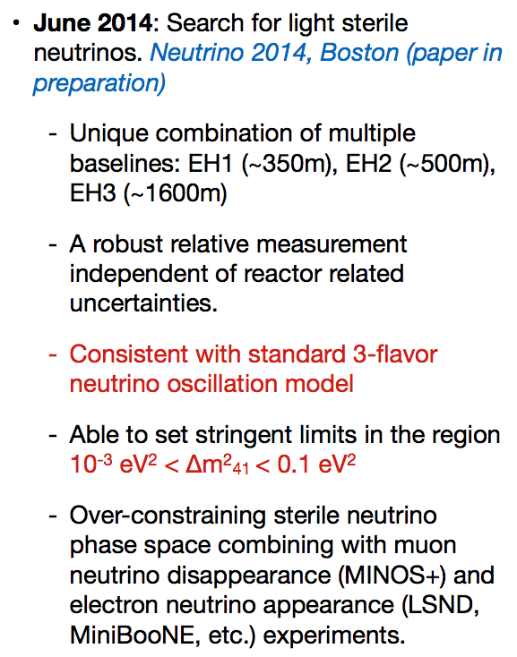
Sterile Neutrino Analysis
PRL:113, 141802

Slide 15
Daya Bay Plans
Operations through 2017; research thru ~2019
Near term analysis
  Search for sterile neutrino (idea initiated and driven by BNL: ex-postdoc Ling, Diwan, Qian, Zhang)
  New θ₁₃ measurement from n-H capture (led by BNL ex-postdoc Wang, review by BNL: Qian)
  Reactor flux/spectrum measurement (Zhang)
  Update of θ₁₃ and Δm²_{ee} with x4 statistics (continuing BNL effort: Qian, Tang, Zhang, Jaffe)
Long term
Most precise measurement of sin²2θ₁₃ for the foreseeable future . Precision measurement of Δm²_{ee} is complementary to accelerator measurements. (BNL leadership Qian, Zhang, Jaffe, Kettell, Diwan, Worcester, Tang)
  Enhance capability of CPV search in LBNE
  Unitarity test of PMNS matrix with LBNE
  Test of νSM
  Initial hints of neutrino mass hierarchy
Improve absolute flux uncertainty σ(ε_{det})∼1% (Qian, Zhang, Worcester)
Measure reactor flux (Zhang)
Understand energy response of LS/electronics (Qian, Zhang, Worcester)

Slide 16
Daya Bay Plans
Operations through 2017; research thru ~2019
Near term analysis
  Search for sterile neutrino (idea initiated and driven by BNL: ex-postdoc Ling, Diwan, Qian, Zhang)
  New θ₁₃ measurement from n-H capture (led by BNL ex-postdoc Wang, review by BNL: Qian)
  Reactor flux/spectrum measurement (Zhang)
  Update of θ₁₃ and Δm²_{ee} with x4 statistics (continuing BNL effort: Qian, Tang, Zhang, Jaffe)
Long term
Most precise measurement of sin²2θ₁₃ for the foreseeable future . Precision measurement of Δm²_{ee} is complementary to accelerator measurements. (BNL leadership Qian, Zhang, Jaffe, Kettell, Diwan, Worcester, Tang)
  Enhance capability of CPV search in LBNE
  Unitarity test of PMNS matrix with LBNE
  Test of νSM
  Initial hints of neutrino mass hierarchy
Improve absolute flux uncertainty σ(ε_{det})∼1% (Qian, Zhang, Worcester)
Measure reactor flux (Zhang)
Understand energy response of LS/electronics (Qian, Zhang, Worcester)

Slide 17
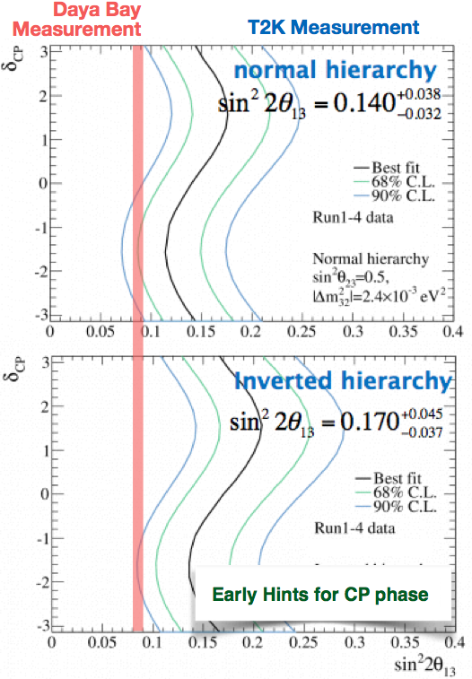
  Enhance capability of CPV search in LBNE
Some people think we’re already doing this!

Slide 18
Daya Bay Plans
Operations through 2017; research thru ~2019
Near term analysis
  Search for sterile neutrino (idea initiated and driven by BNL: ex-postdoc Ling, Diwan, Qian, Zhang)
  New θ₁₃ measurement from n-H capture (led by BNL ex-postdoc Wang, review by BNL: Qian)
  Reactor flux/spectrum measurement (Zhang)
  Update of θ₁₃ and Δm²_{ee} with x4 statistics (continuing BNL effort: Qian, Tang, Zhang, Jaffe)
Long term
Most precise measurement of sin²2θ₁₃ for the foreseeable future . Precision measurement of Δm²_{ee} is complementary to accelerator measurements. (BNL leadership Qian, Zhang, Jaffe, Kettell, Diwan, Worcester, Tang)
  Enhance capability of CPV search in LBNE
  Unitarity test of PMNS matrix with LBNE
  Test of νSM
  Initial hints of neutrino mass hierarchy
Improve absolute flux uncertainty σ(ε_{det})∼1% (Qian, Zhang, Worcester)
Measure reactor flux (Zhang)
Understand energy response of LS/electronics (Qian, Zhang, Worcester)

Slide 19
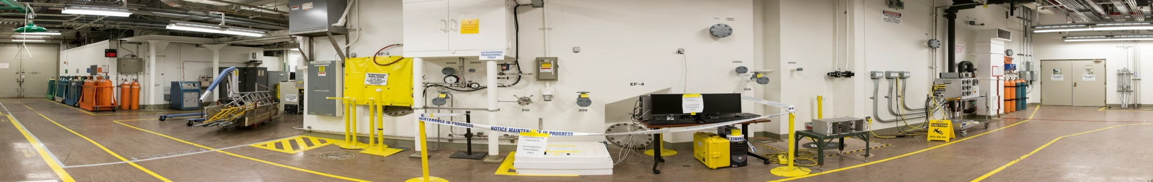
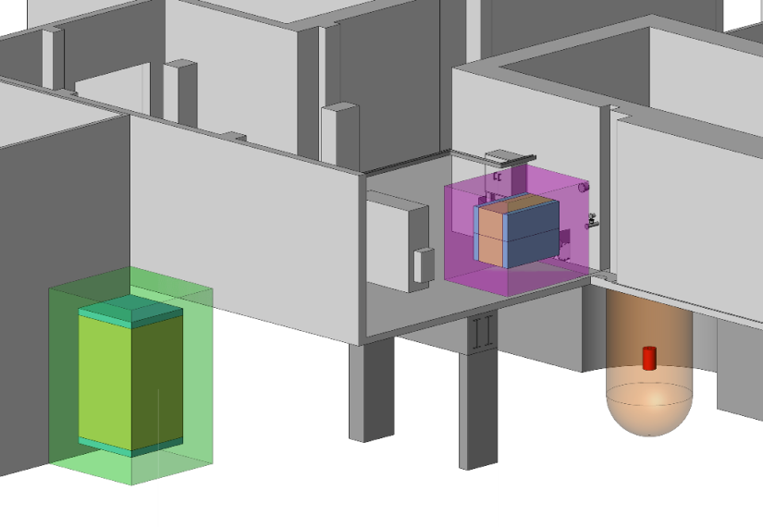
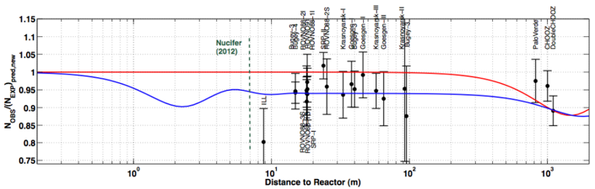
PROSPECT — Precision Reactor Neutrino Oscillation and Spectrum Experiment
HFIR @ ORNL
Map out L/E Oscillations
near detector @ ~7 m
far detector @ ~18 m
Compact reactor
~1-ton near detector
~10-ton far detector
⁶Li doped LS (BNL)
reactor core
Physics Goals
Search for sterile νe oscillations at short-baseline.
Probe “reactor anomaly”.
Precision measurement of reactor νe spectrum for physics and safeguards.
Sensitivity
Near+Far
Near

Slide 20
PROSPECT Physics Goals
Search for sterile neutrino oscillations at short baselines
  Definitely discover or exclude sterile neutrinos in the eV² range (indicated by the “Reactor Anomaly”) via spectrum distortion
Precision measurement of reactor neutrino spectrum
  Important input to future reactor neutrino oscillation experiments such as JUNO
  Important input to nuclear physics calculations
  Synergies with non-proliferation and safeguards
Sensitivity
Near+Far
Near
BNL Plans
Development & production of ⁶Li-doped LS with high PSD capability (Yeh)
Precision energy scale calibration study (Qian, Zhang)
Responsible for boron-loaded poly shielding (Jaffe, Sharma, Dolph, Zhang)

Slide 21
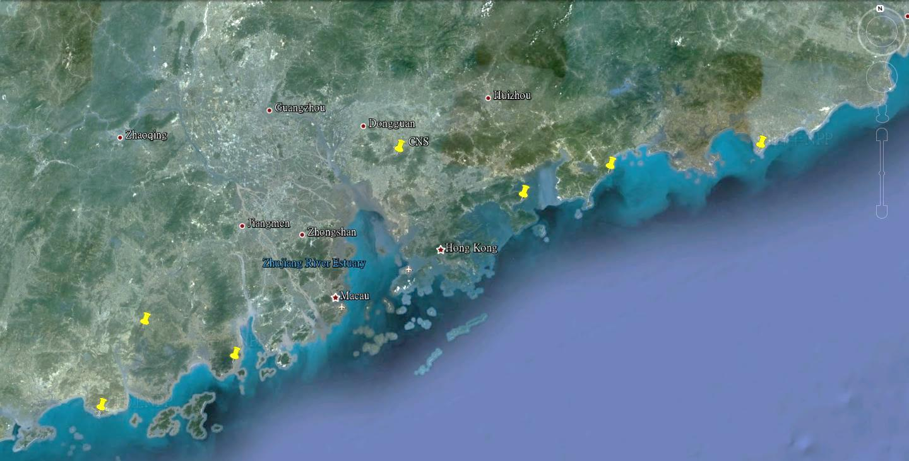
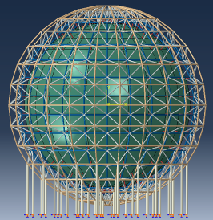

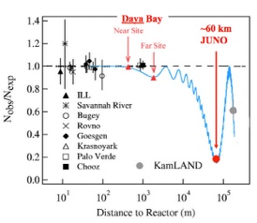
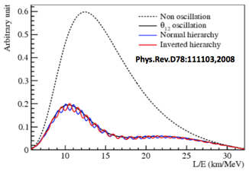
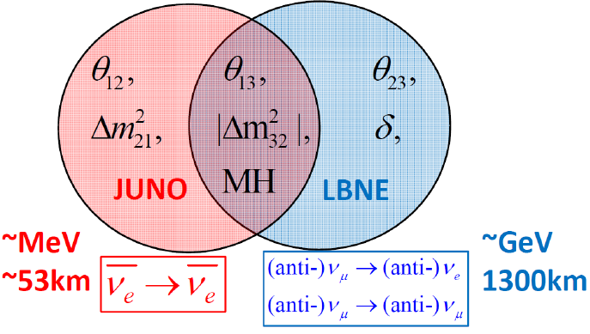
JUNO
Reactor Power: 36 GW
Baseline: 53 km
Detector: 20 kton LS
σ_{E}: 3%
ν rate: ~60/day
Background:
  Accidentals (10%)
  ⁹Li (<1%)
  Fast neutrons (<1%)
Guangzhou
Shenzhen
Daya Bay NPP
700 m underground
Hong Kong
53 km
Macau
53 km
Taishan NPP
Acrylic Tank + SS structure
Yangjiang NPP
Δm²₂₁
Δm²₃₂

Slide 22
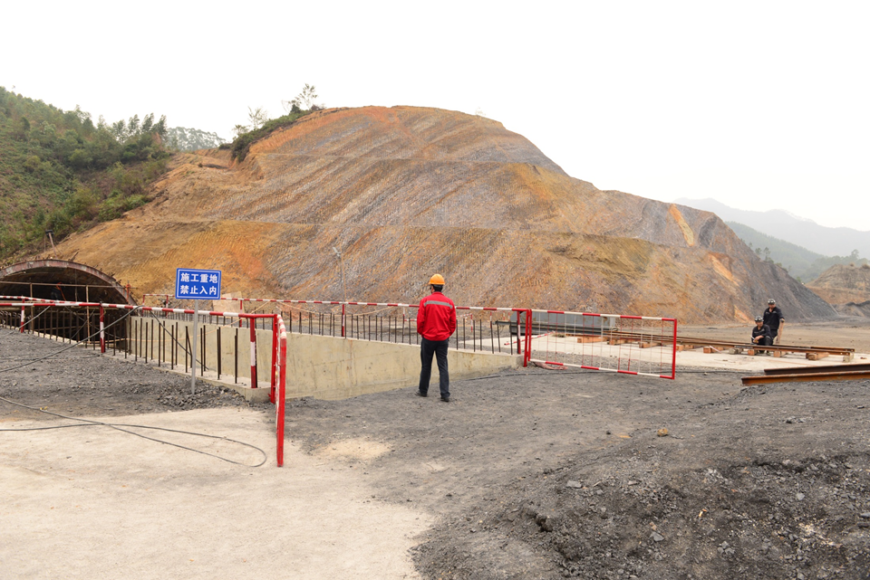
More about JUNO
JUNO groundbreaking 10 January 2015
Natural continuation of the very successful US-China collaboration on Daya Bay
Strong synergies with LBNx (physics and personnel)
Strong US team (many links with LBNE team)
Team is supported to do JUNO R&D but must wait on DOE decision

Slide 23
Take-Aways
BNL role in g-2 has been and will be crucial to the experiment
Without the BNL group there would have been no US Daya Bay
Daya Bay will run through 2017 and measure both sin²2θ₁₃ and |Δm²_{ee}| to <3%.
The Daya Bay results will increase the reach of LBNE for CP-violation
The Daya Bay experience puts the group in position for a leadership role in future reactor experiments
It also deepens and extends the overall neutrino expertise of the group, which as you will hear, we want to apply to LBNF

Slide 24
BACKUP

Slide 25
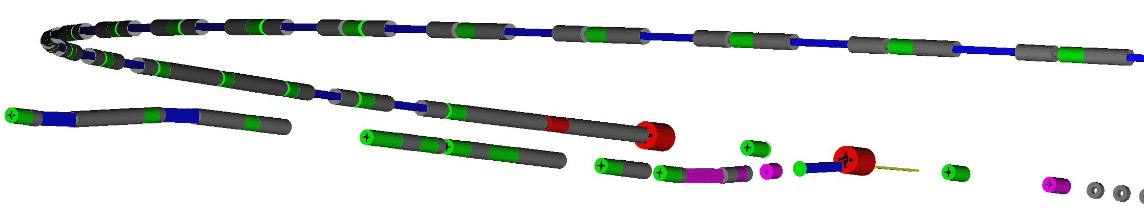
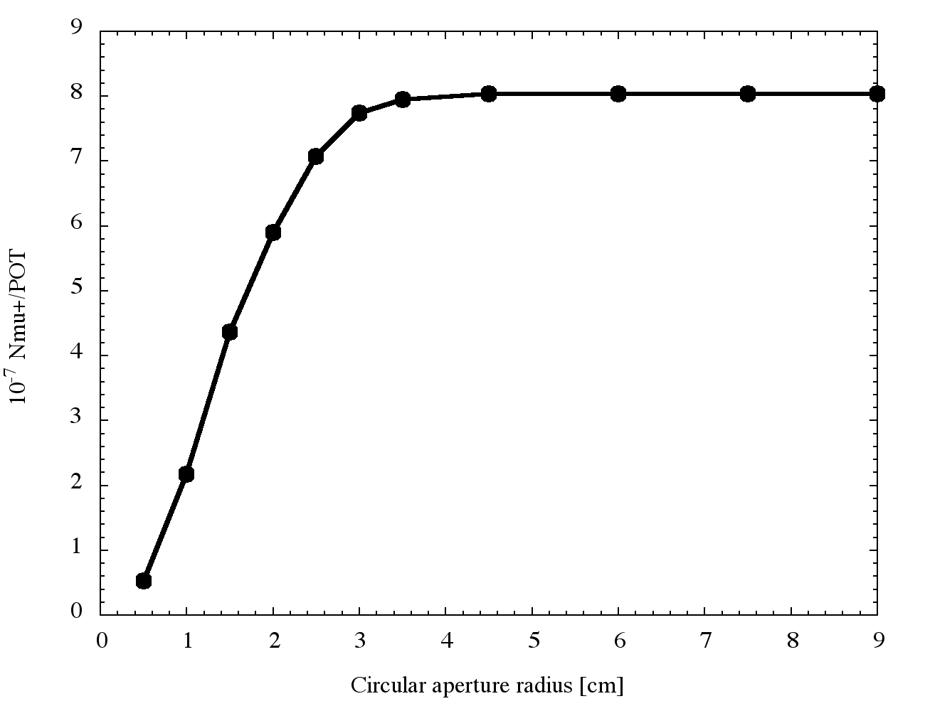
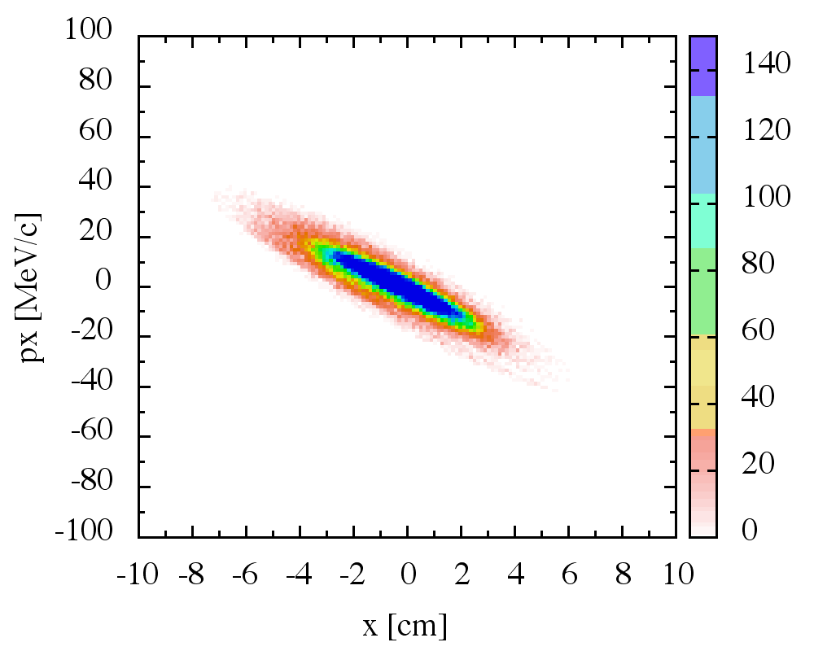
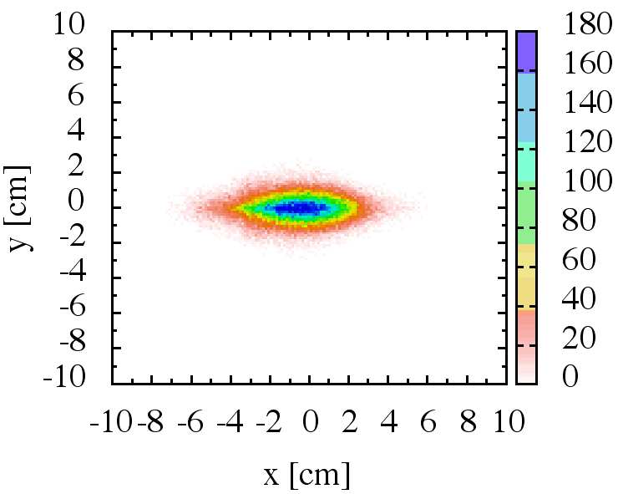
Hisham Kamal Sayed (BNL) contribution to g-2
Beamline simulations and optimization studies:
● G4beamline simulation for the Final g-2 Beamline Design
● Improve modeling of magnet fringe fields and apertures, in injection and Extraction
● Validate modeling of spin of “production” muons
● Simulation study for background calculations
● Study time distribution of beam off of the target into the Storage Ring
● Optimize beam instrumentation placement and generate diagnostic procedures
● Perform analysis of: tolerance to misalignment, field error tolerances, correction/adjustment algorithms etc.
● Study hadron clean-up after n turns in DR
● Beamline Genetic Optimization studies

Slide 26
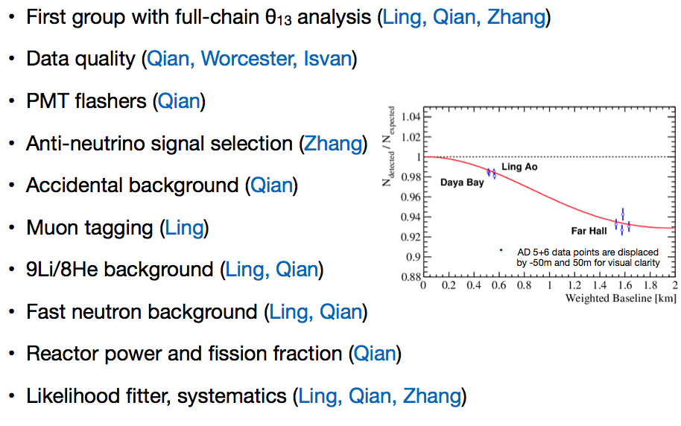
BNL Daya Bay Analysis Highlights

Slide 27
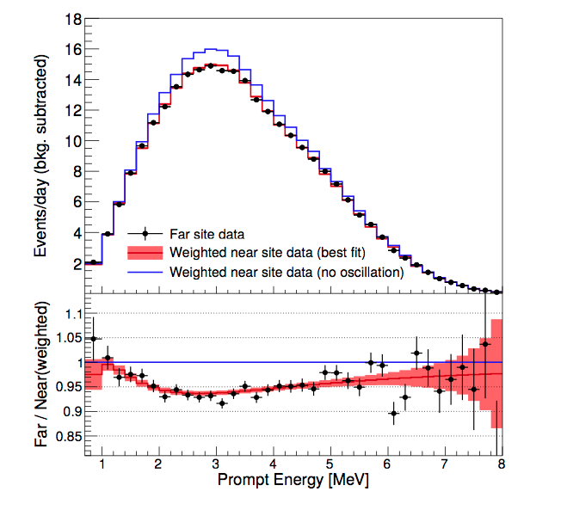
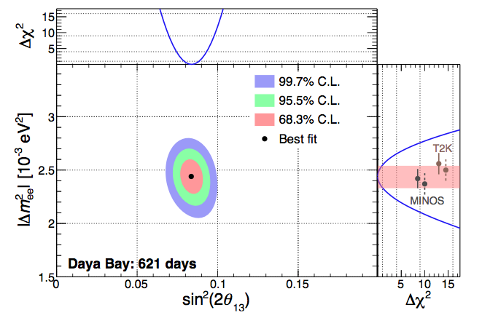
Latest Daya Bay Results
sin²2θ₁₃ = 0.084± 0.005
|Δm²_{ee}| = (2.44+0.10-0.11) x 10⁻³ eV²

Slide 28
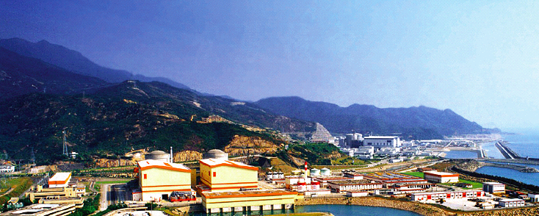
Highlights of 2013 BNL Daya Bay achievements
Ling, Qian, and Zhang led the main 6-AD analysis for θ₁₃ and |Δm²_{ee}|using rate & spectra: published in PRL 112, 061801 (2014). Jaffe was co-editor of paper
Ling, Qian, Zhang and Diwan leading sterile neutrino search (paper in preparation)
Zhang is leading analysis of absolute reactor flux (paper in preparation)
Worcester, Tang, Zhang and Qian leading improved absolute flux determination
Qian one of main reviewers of nH capture θ₁₃ measurement (paper in preparation)
Zhang is co-convener of Monte Carlo Working Group
Zhang maintains the Offline Data Monitor
Hackenburg is editor of muon veto system NIM paper
Themann was run coordinator
Isvan and Worcester: simulation and analysis of manual calibration system data
Kettell manages Operations program (host lab); Gill manages safety; Hackenburg manages muon operations; Yeh manages liquid monitoring (LS, oil, water)
Kettell on EB, Jaffe on IB & Publication, Littenberg on Speaker Committee
BNL has had lead role in Operations Review, oscillation whitepapers for Snowmass and Run Plan (submitted to P5)

