Slide 1


BNL’s Science and Technology Contributions to the Short-Baseline Accelerator Neutrino Program
~eV Sterile Neutrino?
MicroBooNE
Xin Qian
EDG
LAr-ND/T600
(Anti)-Neutrino-Argon
Cross Section
LBNF
MH, CPV
Unitarity Test

Slide 2
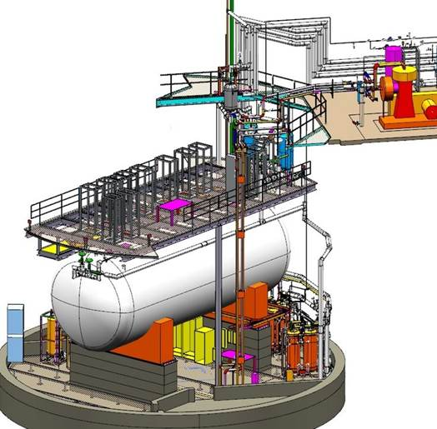
Craig Thorn Deputy Project Manager Active Detector
Xin Qian Physics, ν-Ar Cross Section Analysis
Mary Bishai Physics, Simulation and Analysis
Michael Mooney Simulation/Calibration of Space Charge
Jyoti Joshi Optimization of Cold Electronics setting
Brian Kirby Validation of Neutrino Event Generator
Yichen Li Electron & Photon transport
Chao Zhang Simulation, LArSoft
Susan Duffin Cryostat Manager
Bo Yu TPC Design
Hucheng Chen Electronics Manager
George Mahler Detector Assembly Integration Manager
MicroBooNE @ BNL
10.4 m
2.5 m
BNL has been playing crucial roles to the development of MicroBooNE
One of three initial institutions (BNL + Columbia + Yale)
Major part of design was developed by BNL
Lead contributor to the construction: Cryostat, TPC, Front-end electronics
Tremendous collaboration with university groups
TPC designed at BNL, constructed at Yale and Syracuse
Cold electronics @ BNL, warm electronics @ Columbia
CD4 received recently

Slide 3
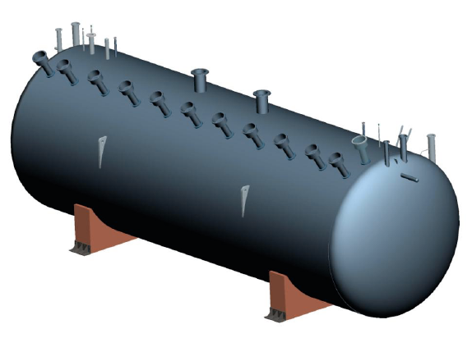
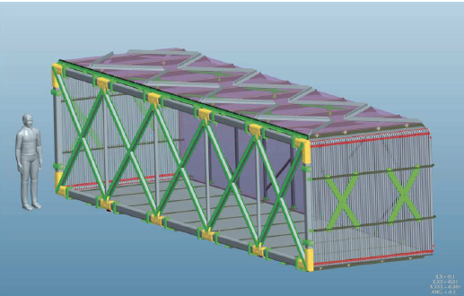
MicroBooNE @ BNL
Susan Duffin:
Cryostat Design & Fabrication
Stainless steel vessel
Foam insulation 16’’ thick < 15 W/m²
Foam supports 1 fixed, 1 sliding
Bo Yu: TPC Design
Stainless and FR4 structure
3456 Y collection,
2400 U & V induction wires
Cathode @ 125 kV
500 V/cm drift field for 2.5 m drift
Notes:
Evacuable, but we do not plan to do so
Bo did a very careful job to keep the field low

Slide 4
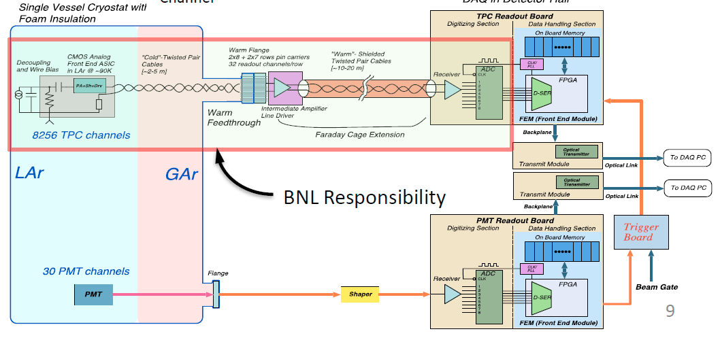
MicroBooNE @ BNL
Hucheng Chen: Readout electronics
Design & Fabrication
BNL low-noise (half) cold CMOS ASIC
Warm intermediate amplifiers
with commercial ADCs
Noise is ~550e⁻ with C_{D} = 150pF in LN₂ (1us, 14mV/fC)
RMS Noise (e⁻)
Channel

Slide 5
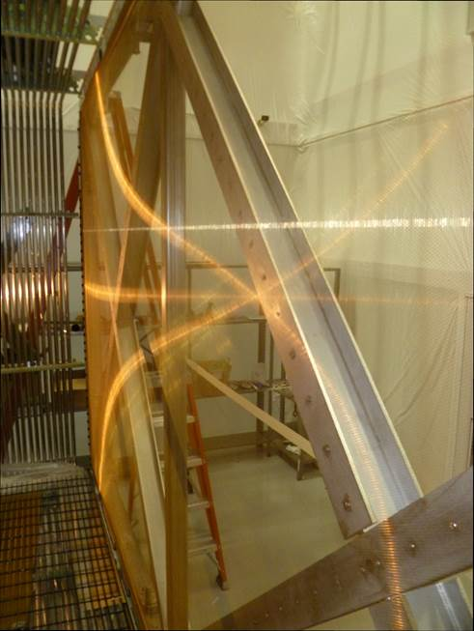
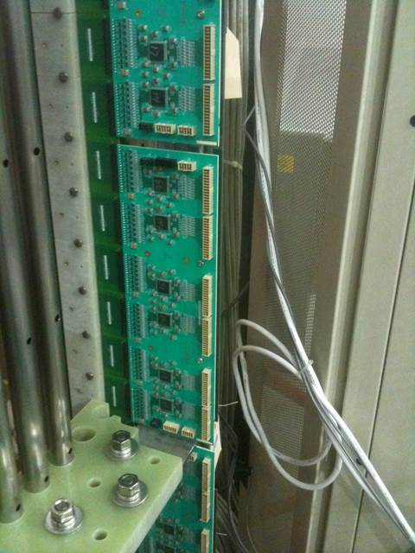
Recent BNL-led Achievements
Cryostat
  Vessel and foam supports complete at FNAL
  Endcap welded with TPC & PMTs inside
TPC
  Assembly complete, wire tensioning complete
  TPC is installed in the cryostat
  Field cage voltage divider fixed
Readout Electronics
  All electronics installed on the TPC
  All electronics installed on feedthroughs
  Full chain, through DAQ, verified for all channels
George Mahler
Detector Assembly Integration

Slide 6
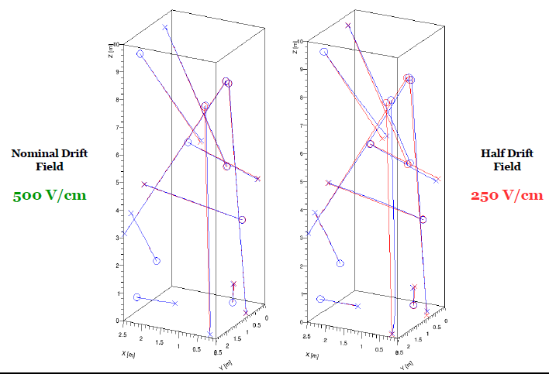
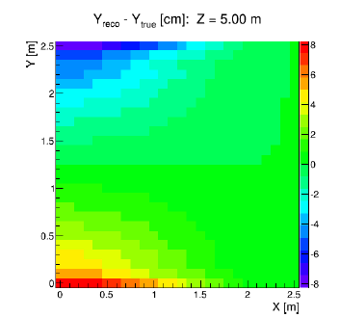
Simulation/Calibration of Space Charge Distortion
Space Charge: excess electric charge (slow-moving ions) distributed in space due to cosmic muons
  Modified E field in TPC, thus track/shower reconstruction
  Challenges for the surface LAr TPC
  Magnitude of distortion scaled with Dimension³ and E^{-1.7}
Space Charge Simulation
cm
Michael Mooney
Xin Qian
Craig Thorn
Bo Yu

Slide 7
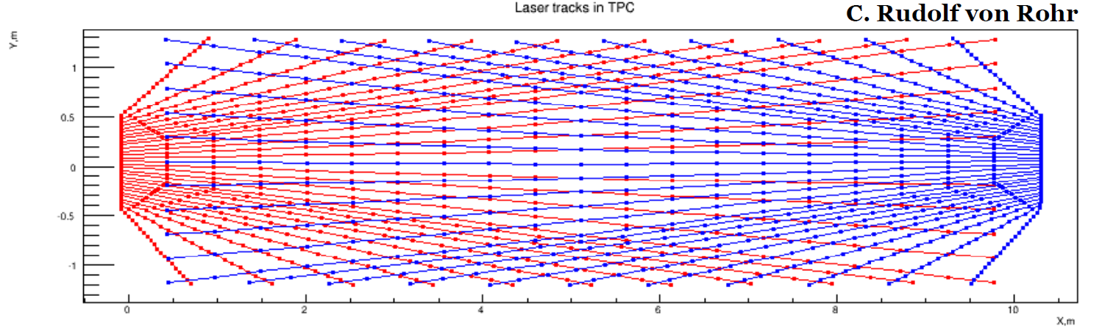
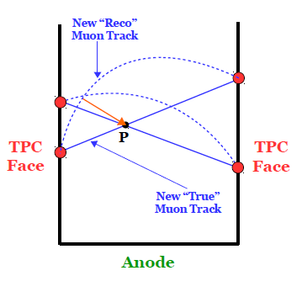
Space Charge Tomography Calibration
Calibration: {x,y,z}_{reconstructed} → {x,y,z}_{true}
Use laser and TPC geometry to obtain points with known pos.
Together with anode (signal) plane and
laser crossing points, we have
first-order pool of anchor points
With cosmic rays, we enable a new
set of anchor points
Iteration process to full-volume calibration
Tomography:
Laser +
Cosmic Muons
Michael Mooney
Xin Qian

Slide 8

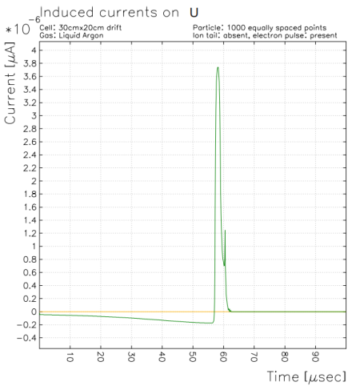
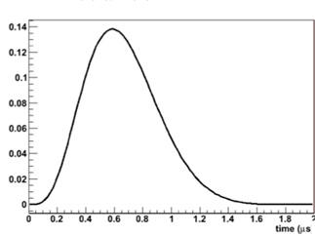
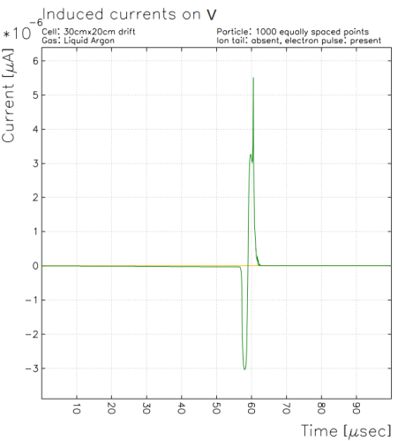
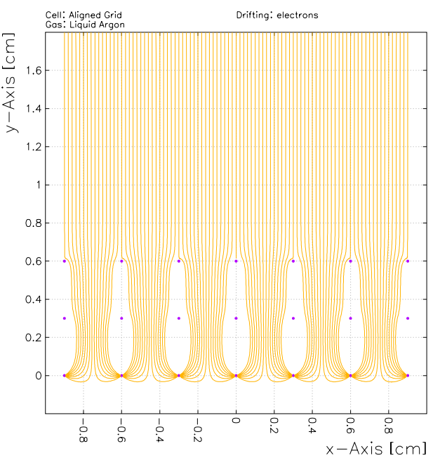
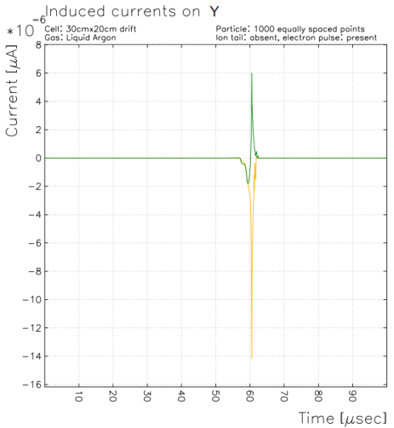
TPC signal response
Improving signal response simulation in LArSoft
The wire signal response is a convolution of
  Field response : simulated by Garfield in 2D
  Electronics response: simulated by SPICE
U
electrons
V
Yichen Li
U
Y
Validating and improving existing LArTPC simulation software LArSoft is an important part of our work
V
Y

Slide 9
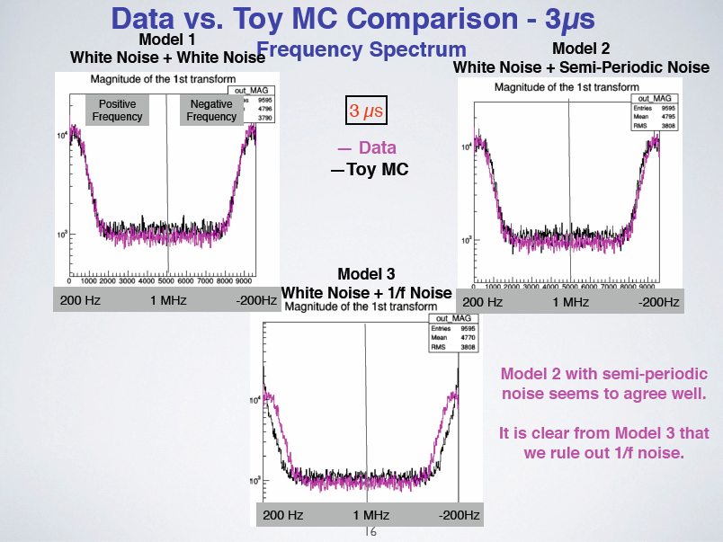
Jyoti Joshi

Slide 10
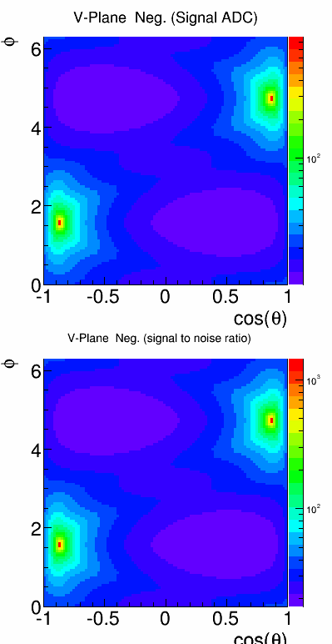
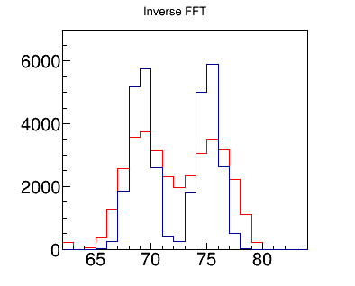
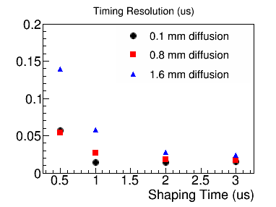
Optimization of Cold Electronics Parameters
Metrics considered:
  Peak Signal (saturation)
  Signal to Noise Ratio (deconvolution)
  Positron resolution (timing)
  Two-track separation after deconvolution
Jyoti Joshi, Brian Kirby
Xin Qian

Slide 11
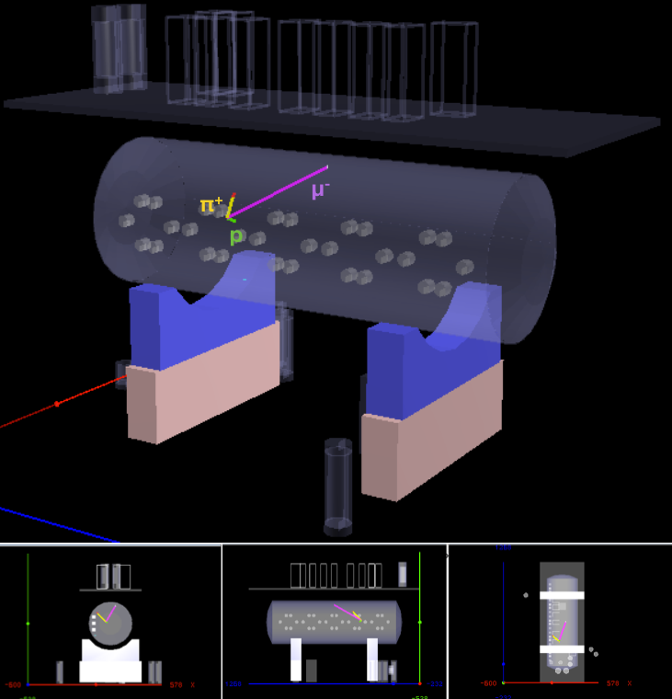
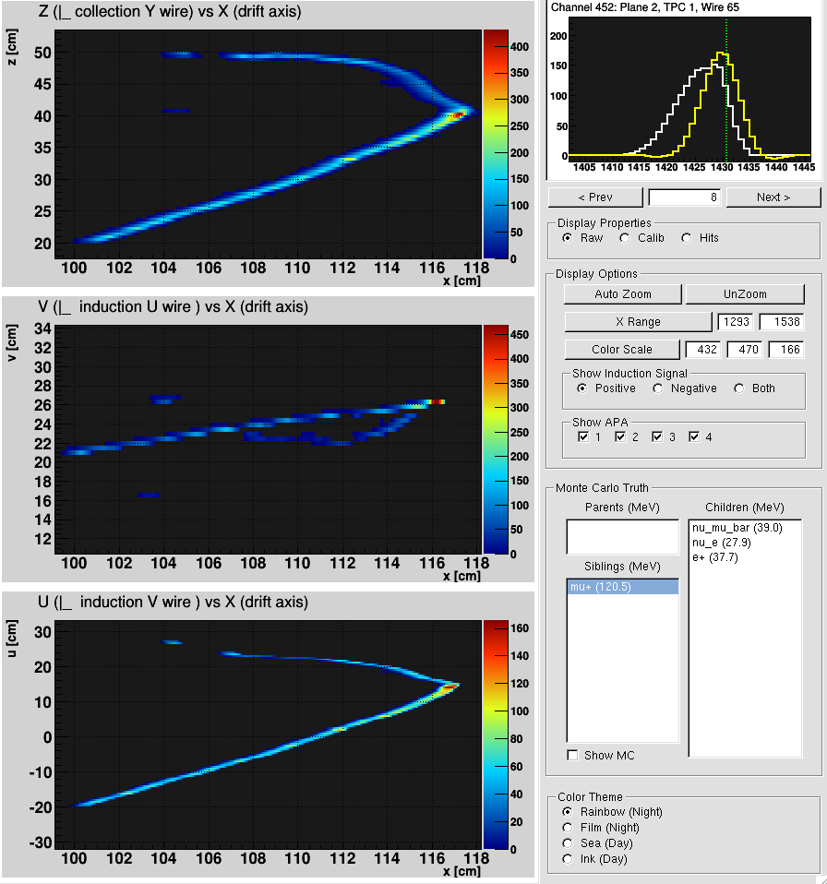
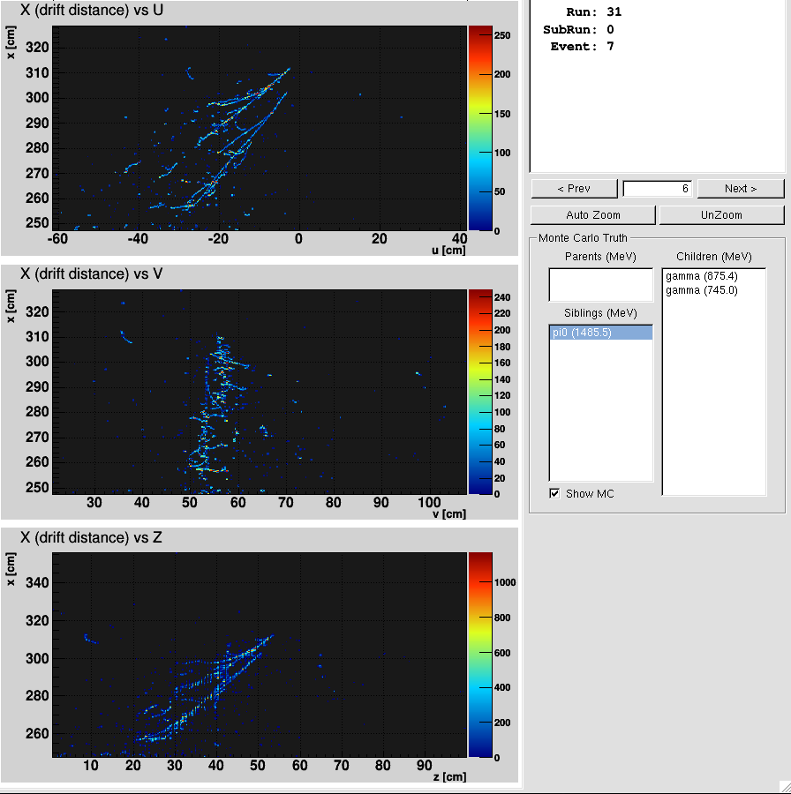
Preparation for Data
LArSoft successfully installed @ RACF
Validation of
  LAr properties in LArSoft
  TPC response in LArSoft
2D + 3D event display tools constructed
to assist further development of automated reconstruction
Chao Zhang
Mary Bishai
Brett Viren
Notes:
Talk a little bit about Yale workshop

Slide 12
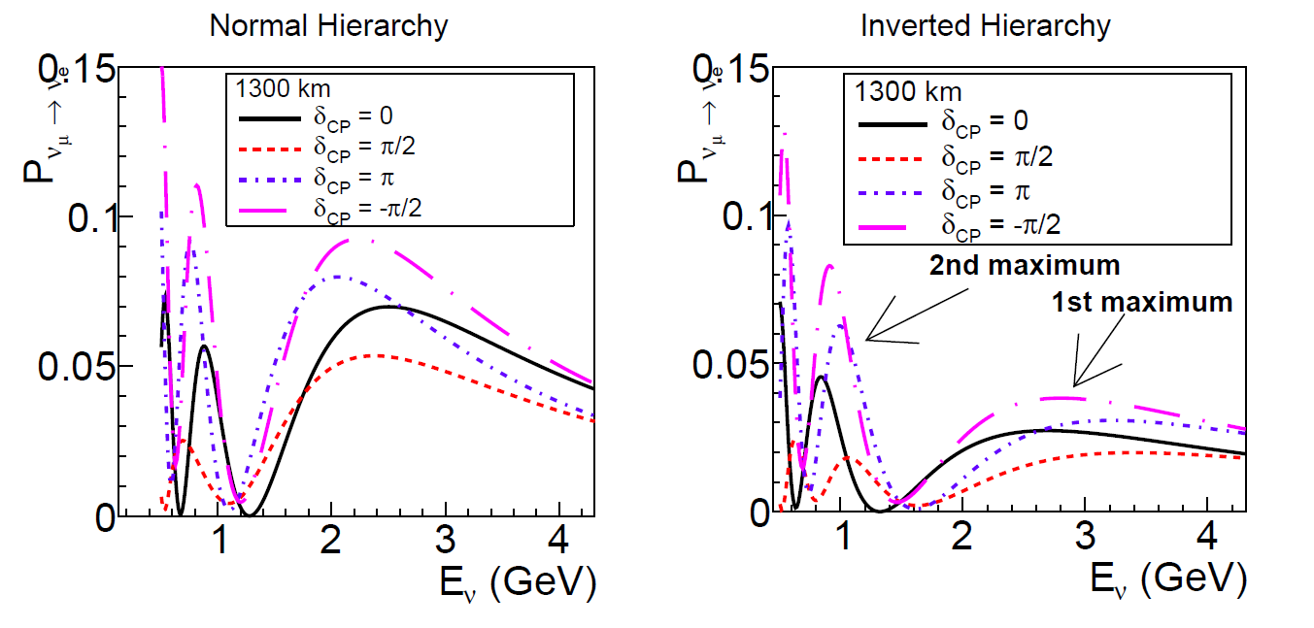
SBN Physics Goals and Synergy with LBNF
MicroBooNE TPC design experience, will play an essential role in the next generation of large LAr TPCs
  BNL’s technical effort extends to the design of LAr-ND
  Technology development and R&D for LBNF
Measure ν-Ar cross section @ LBNF 2nd osc. max.
  Crucial for Mass Hierarchy
  ψ-scaling, Short-Range Correlation, emphasizing the hadron side
Understand the MiniBooNE low energy excess
uBooNE
neutrino energy range
Notes:
Label bottom one MicroBooNE 6e20 POT
Nuclear modeling
The first physics motivation of the SBN program is to search for ~ eV sterile neutrino, which is suggested by the LSND/MiniBooNE anomaly.
In particular, the uBooNE is going to use the unique e/gamma separation of LArTPC to study the MiniBooNE low energy excess.
The second physics motivation is to the neutrino-argon cross section @ 0.8 GeV region. The Phase-II/III will study the anti-neutrino-argon cross section.
The Booster neutrino energy range covers the second oscillation maxima of LBNF. A good understanding of the neutrino-argon cross section and event topology is crucial for the MH determination, and future precision measurement of CP phase.
The third, but in my view the most important motivation of the SBN program is the technology development and R&D for LBNF

Slide 13
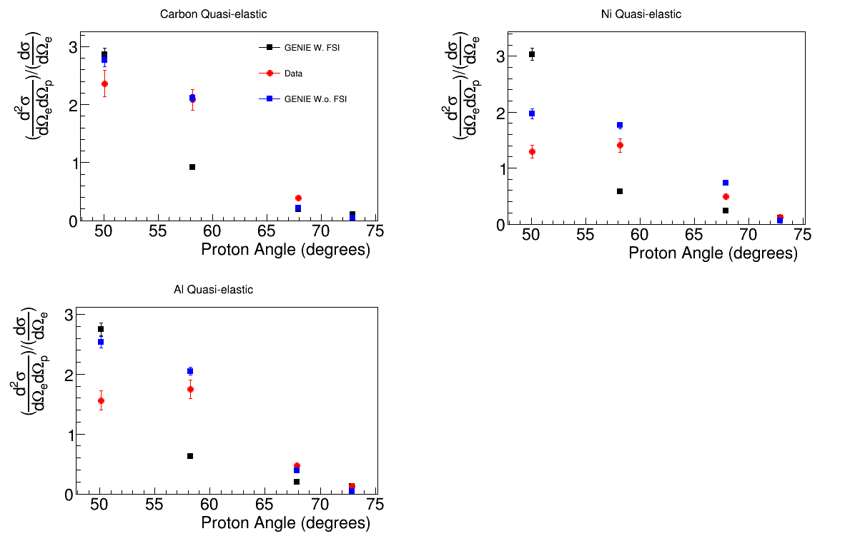
Validation of GENIE with Electron Scattering data
Xin Qian
Validation of GENIE neutrino event generator is crucial for cross section extraction
  Garino et al. PRC 45 (1992)
  Importance to understand Quasi-elastic mechanism
  Important to understand the Final State Interaction (subsequent)
Notes:
Pattern recognition, cosmic ray’s challenge

Slide 14
Synergies with BNL LAr R&D effort
Noble liquid R&D has been the backbone of many successful experiments
On-going BNL LAr R&D includes
  Optimization of photocathodes as a high brightness source of electrons in LAr
  Diffusion of electrons as a function of electric field for both longitudinal and transverse directions
  Attachment cross section (rate constants) of electrons for all impurities
    Early Career Award → toward improving LBNF’s purification system
1973
1980
R806
HELIOS
1990
D0
Noble liquid R&D
2000
NA48
ATLAS
2010
μBooNE
LAr-ND
LBNF
Craig Thorn, Xin Qian
Yichen Li, Jyoti Joshi

Slide 15
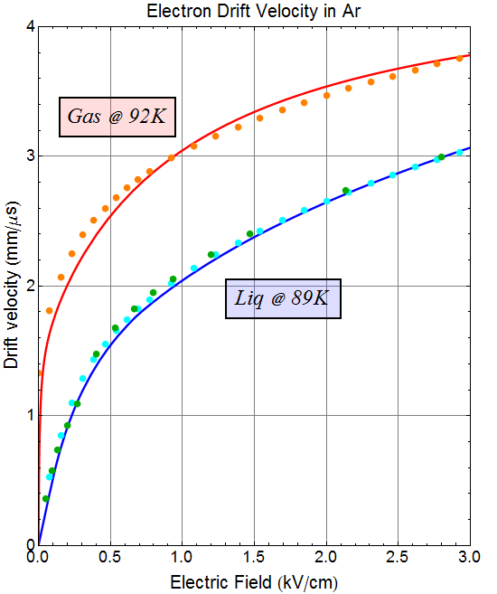
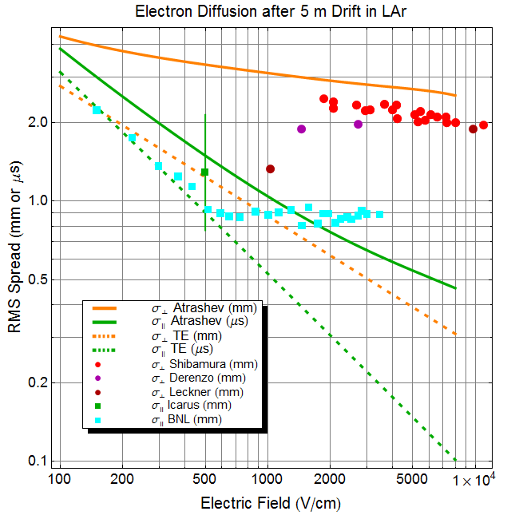
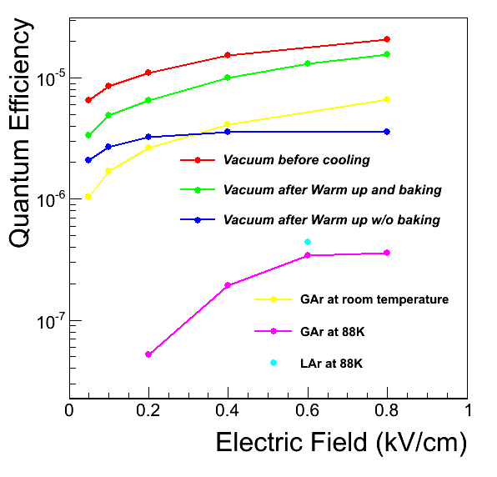
Preliminary Results
Yichen Li
Craig Thorn
Electrons are Thermal
Measurement of electron transport properties (diffusion, drift velocity and attachment) in LAr are crucial inputs to simulation
Notes:
Need to update a lot of plots … and sentences …

Slide 16
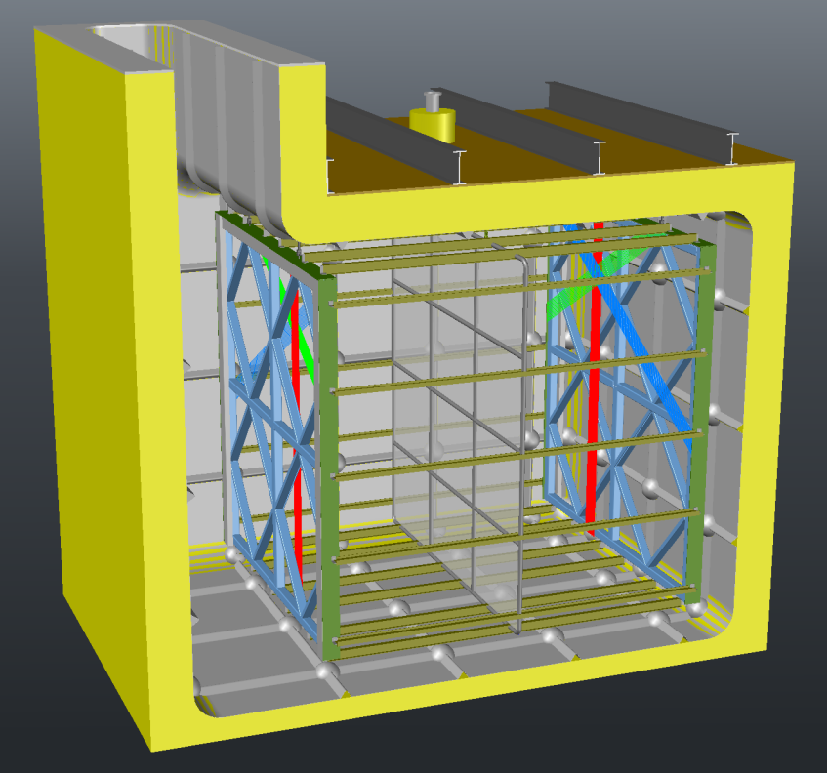
Stage II&III: LAr-ND + ICARUS-T600
Continuing technology developments towards LBNF
  Next generation cold electronics with ADC & multiplexing in the cold
  Wrapped-Wire TPC design
  Membrane cryostat technology
  Design for ultra purity
Craig Thorn, Bo Yu
Definite answer to the LSND/MiniBooNE anomalies
First Near/Far Setup with LArTPC
  Experiences accumulated and lessons learned from this setup are crucial for LBNF physics analysis
Mary Bishai: WG2 beam systematics
LAr-ND Conceptual Design
Notes:
1 on technolgy (next generation cold electronics, more multiplexing)
Sterile neutrino reach (correlated two detectors)
Near/Far in LArTPC

Slide 17
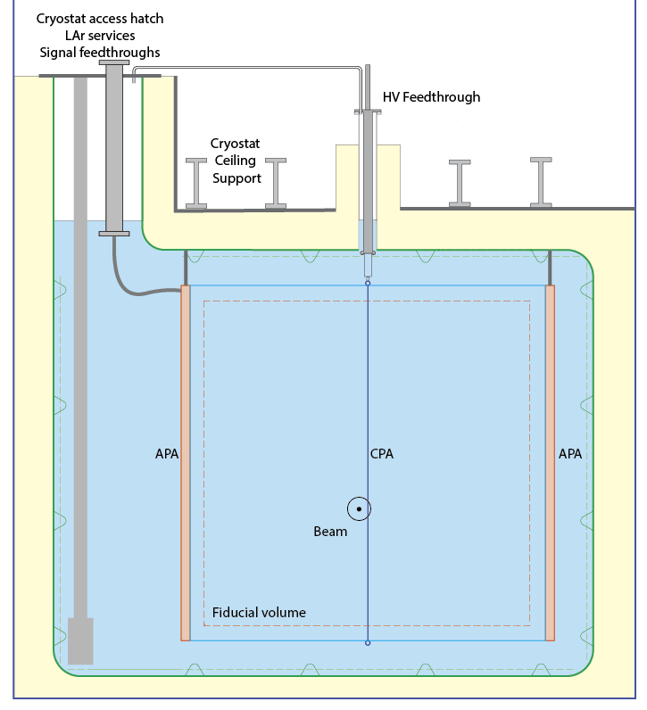
LAr-ND (BNL) Design Features
Craig Thorn, Bo Yu
Innovative aspects:
  The minimization of the ullage and liquid vapor contact.
  The use of cold feedthroughs.
  The idea of purifying only the boil off GAr from the ullage during operations (not the bulk of the liquid)
  The use of LN2 cooled heat exchange panels inside to control the LAr boil-off
A conceptual design has been developed
Preliminary requirements for the cryostat are established
Beginning to engineer the cryostat and cryogenic systems
Insulation
450 mm
1,000 mm
Upstream View
1,200 mm
Insulation
450 mm
Insulation
450 mm
Desired Side Penetration
for LAr pump.
4,800 mm
Insulation
250 mm
5,100 mm
See more in Hucheng’s talk
Active volume: ~ 50 ton

Slide 18
Summary
BNL is a tremendous resource for the community in LAr TPC and cold electronics development
  Major contributor to MicroBooNE and entire Short-Baseline Neutrino Program (SBN)
    Tremendous collaboration with university groups
  LAr R&D is crucial in understanding/simulating LAr detector physics → Great value to SBN and LBNF
SBN is a critically important test bed for LBNF
  Technology development
  Interesting physics reach for ~eV sterile neutrino and neutrino-Argon cross section
  Automated reconstruction and improvements in simulation will be of great value for LBNF
  We are contributing in a big way!

