Slide 1
sPHENIX PMG Agenda
Project Update
Update of Personnel hiring
Status of Procurements
Status of Track Reinforcement and Cryo Work
Impact of COVID on MIE and I&F schedule
Oversight of Carriage/Cradle production

Slide 2
sPHENIX MIE Overview (1.X)
TPC | Project Director | Last CD Achieved | % Complete | CPI | SPI
$27.0M | Edward O’Brien | PD-2/3 | 58.3% BCWP/BAC @ 9/30/2020 | 1.00 | 0.97
Scope
  Detector systems produced, tested and ready for installation: Time Projection Chamber w/ electronics, Electromagnetic Calorimeter w/ electronics, Hadronic Calorimeter w/ electronics, DAQ/Trigger, Minimum Bias Detector, Project Management
Not in scope
  SC-Magnet, Bldg/Det Infrastructure, Installation and System Commissioning
Schedule
  CD-0 received Sept 2016
  CD-1/3A received Aug 2018
  PD-2/3 received Sept 2019
  Early completion Jan 2021 (11.5 months float to PD-4)
  PD-4 Dec 2022
Cost
  $27.0M AY TPC 46.2% contingency on ETC

Slide 3
1008 Infrastructure & Facility Upgrade (2.X)
TPC | Project Director | % Complete | CPI | SPI
$33.4 M AY | Edward O’Brien | 44.0% BCWP/BAC @ 8/31/2020 | 1.05 | 0.91
Scope
  SC-Magnet support including the Flux Return, Cryogenics into Bldg 1008, Detector Carriage/Cradle, other Bldg 1008 Infrastructure improvements
  sPHENIX Installation, Integration and Commissioning of each Subsystem is part of the scope
Not in Scope
  PreOps prior to RHIC collisions
Schedule
  sPHENIX Ready for Operations Oct 2022
  First RHIC run of sPHENIX Feb 1, 2023
  3.5 months float in schedule between sPHENIX ORR and nominal start of RHIC 2023 run.
Cost
  $33.4 M AY Total Project Cost with 17.7% contingency on BCWR

Slide 4
sPHENIX Status
MIE and 1008 I&F early completion dates unchanged in September (Unchanged for 2nd month in a row)
EMCal Blocks for sectors 1-12 almost ready to ship from UIUC to BNL
EMCal Sectors 1-6 assembled at BNL. Sectors 7 and 8 assembly has started.
HCal Sectors 1-5 assembled at BNL. Sectors 6-14 positioned for assembly.
TPC Fee preproduction board assembly starting at vendor.
TPC DAM (FELIX) production parts have started to arrive at BNL
MVTX stave construction ongoing at CERN. (> 30% staves complete. 100% of RU at ORNL for testing)
LHe cryo lines have arrived at BNL from the vendor. Installation of 4/5 cryo spools is advanced.
Carriage/Cradle continues to be on schedule for December delivery
End Ring and Magnet support FDR scheduled for Nov 13.
> $3M in orders pending award in PPM.
Designs for Magnet Pole Tips, Carriage/Cradle XY table and platform nearing completion.
We continue to hold remote reviews for major orders
Continue monthly status, EV, PCR for both 1008 I&F and MIE.

Slide 5
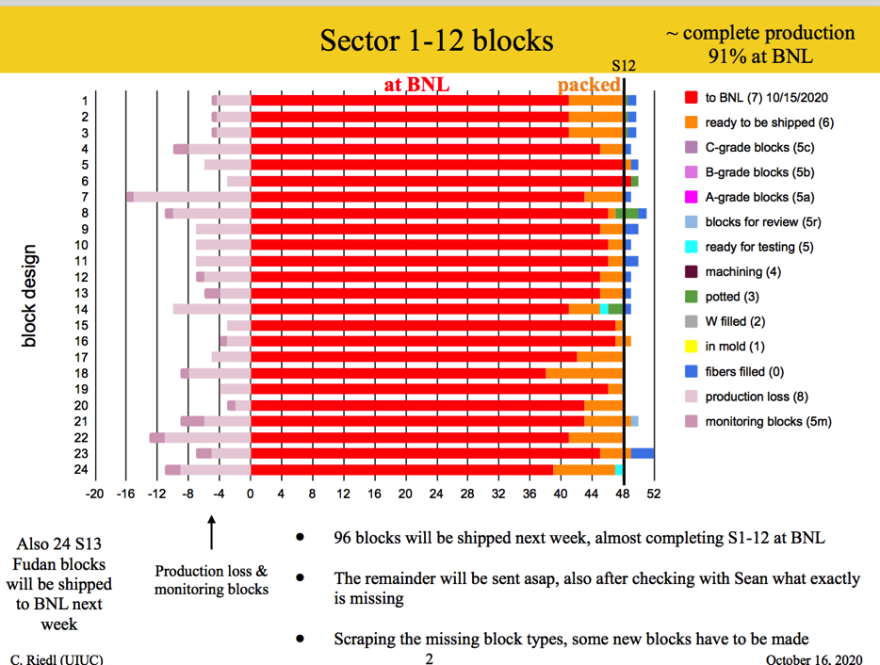
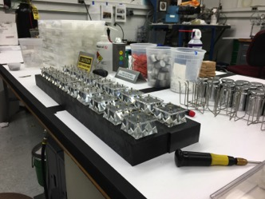
EMCal Block Assembly at UIUC
Just a few blocks remaining for Sectors 1-12 to be complete
Prepping light guides at BNL.

Slide 6
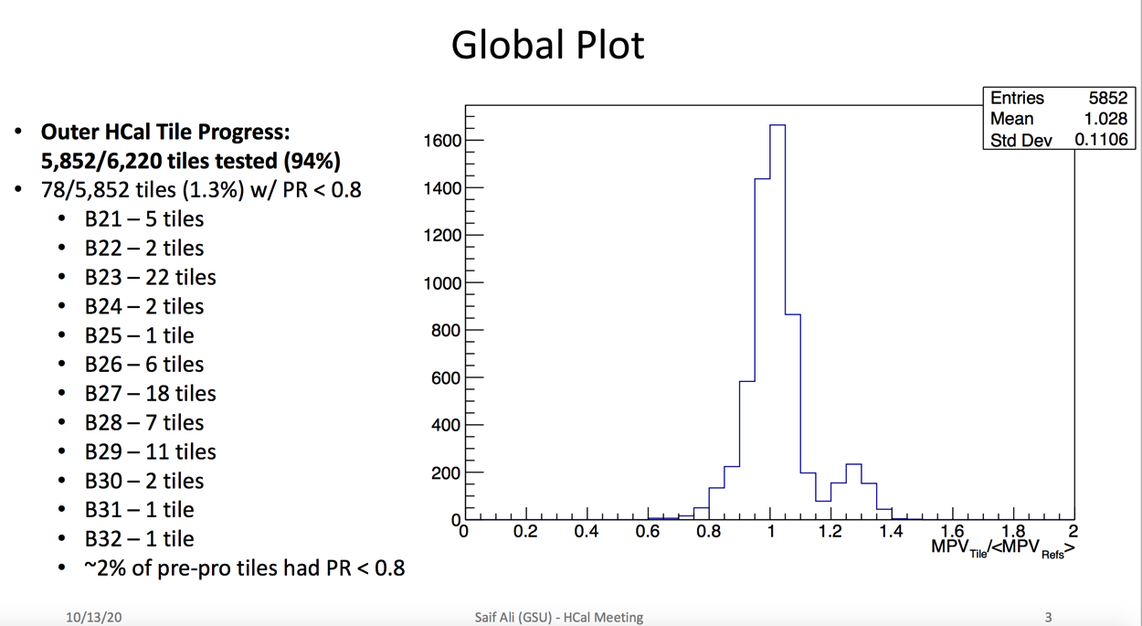
HCal Tiles testing at GSU
All OHCal tiles from Uniplast have been tested at GSU

Slide 7
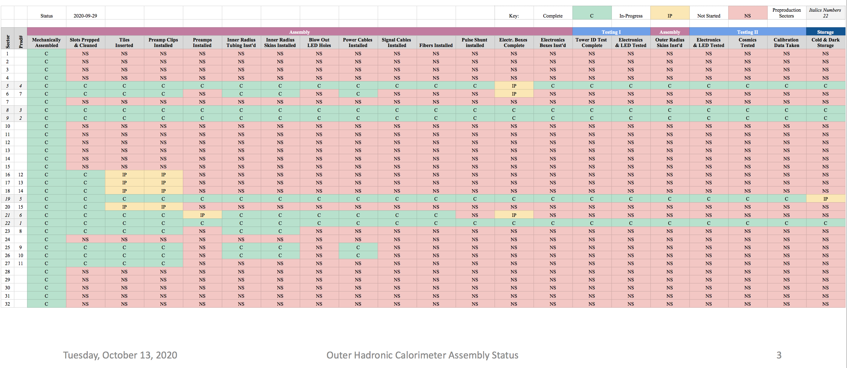
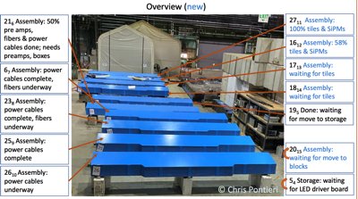
HCal Sector Assembly at BNL
5 sectors assembled. Additional 10 at various states of construction

Slide 8
Internal Labor Needs
Two Electrical designers – hired and working
I-7 DAQ/Trigger position - hired and working
3 mechanical entry level techs (TW-2, term) 2 EMCal, 1 HCal
  To be hired through IO. Five candidates. Interviews schedule for next week.
1 electrical entry level techs (TW-2, term) 1008 racks
  Good candidate identified. To be hired through CAD (Paul Sampson)
Entry level electrical engineer (Safety PLC, Rack power and controls)
  To be hired by IO. MoU to sPHENIX for 1 year.
mid-Career IO mechanical engineer.
  Work has started under Russ Feder’s supervision.
1-2 postdocs for hardware testing
  Discussing options with Jamie and Dave Morrison
This is in addition to the entry level techs that we get from CAD (Paul Sampson) for EMCal (1.0 FTE) and HCal/1008 (0.5-1.0 FTE)

Slide 9
Track Reinforcement and Cryo Work
  2020 shutdown tasks:
  Installing the cryo deck
    Needed to install cryo spool in 1008 IR
    Deck arrives next week. Installed early November
  Adding track gussets in IR
    Waiting for the availability of welders
  Installing and welding cryo spools in the 1008 IR and 1008 B
    Installation in 1008B far advanced. Installation in 1008 IR waiting for Cryo deck
  Reinforcing the tracks in the assembly hall
    Complete drawings available. Can not go through BoA process. PPM tells us that we must do an RFQ solicitation. Work can be completed while Run 2021 is underway.
  Beginning track reinforcement in the IR
    Have started to remove unneeded section of tracks. Welding of new gussets by BNL part of this work. Contractor work will start as time allows after contract is awarded.

Slide 10
Status of Procurements
Procurement Process at PPM continues to be very slow. Important pending sPHENIX orders at PPM:
Items Vendor Cost
Track Reinforcement TBD $510k
EMCal Preamp production CEM $440k
sPHENIX Beam pipe Materion-Brush $290k
Cryo-LN2 piping TBD $250k
IHCal Frame ISU $950k
LV power supplies Vicor $160k
EMCal Blocks factory for 2021 UIUC $460k
We have > $3M in orders pending in PPM

Slide 11
sPHENIX Response to COVID Pandemic
BNL transitioned to Min Safe status toward the end of March. All sPHENIX activities on BNL site stopped. Work stopped at most universities and some vendors.
sPHENIX restarted work at BNL in Phase-1B restart with 5 FTEs on June 18
sPHENIX work at BNL reached 18 FTEs at Phase-2B (60% of our technical workforce) on Jul 22.
BNL authorized 5 visiting scientists, postdocs, grad students to begin testing and detector assembly at sPHENIX factories Aug 10 bringing us to 23 FTEs
We have received permission to increase our FTE threshold to 30 FTEs including BNL Visitors. That bring us to 80% of the BNL sPHENIX technical workforce.
sPHENIX has assigned a Task Coordinator to optimized the personnel on site and tasks performed each day.
We’re in regular communication with BNL safety personnel to make sure that all continues to go smoothly.
All institutions with sPHENIX fab responsibilities have reopened with low density labor practices implemented. Some never closed (Lund Univ) during the pandemic.
We’re working with collaborating institutions to get everyone back on schedule if practical. Amending contracts to add personnel or replace undergraduates with techs.
The early completion date for both the MIE and I&F has remained unchanged for the last 2 months.
Due to COVID we have experienced a 2.5 month delay in the MIE early completion date, and no delay in the I&F early completion date.
  We are hiring additional people to help mitigate the MIE and I&F delays and try to improve the MIE ECD.
  Additional shutdowns would cause additional loss to the schedule but we still have 11.5 months float to PD-4.

Slide 12
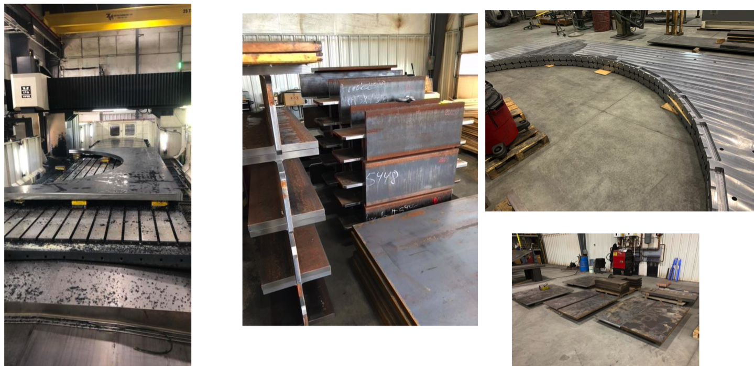
Carriage/Cradle Production at Manufacturer
Carriage/Cradle Work continues to be on schedule at Streck’s
Delivery due at BNL 3rd week in December
Plan to send BNL engineer in November to visit Streck’s in Watervliet, NY

Slide 13
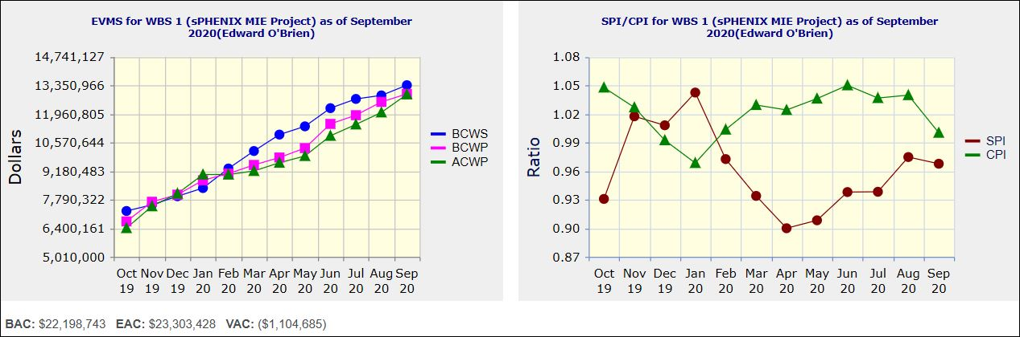
Performance Indices – sPHENIX MIE
Cumulative SPI | Cumulative CPI
0.97 | 1.00
Cumulative BCWS (Scheduled) | $13,357,837
Cumulative BCWP (Performed) | $12,931,617
Cumulative ACWP (Actual) | $12,909,861
DOE SPI or CPI Value Thresholds
0.90 to 1.15
0.85 to 0.89 or 1.16 to 1.25
<0.85 or >1.25

Slide 14
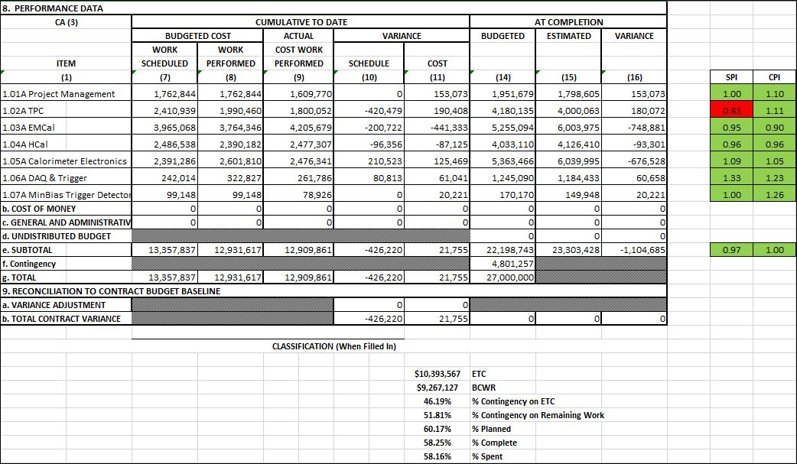
Cost Performance Report (CPR) – sPHENIX MIE
DOE SPI or CPI Value Thresholds
0.90 to 1.15
0.85 to 0.89 or 1.16 to 1.25
<0.85 or >1.25
*Highlights in table above takes variance $ into consideration, not just Indices

Slide 15
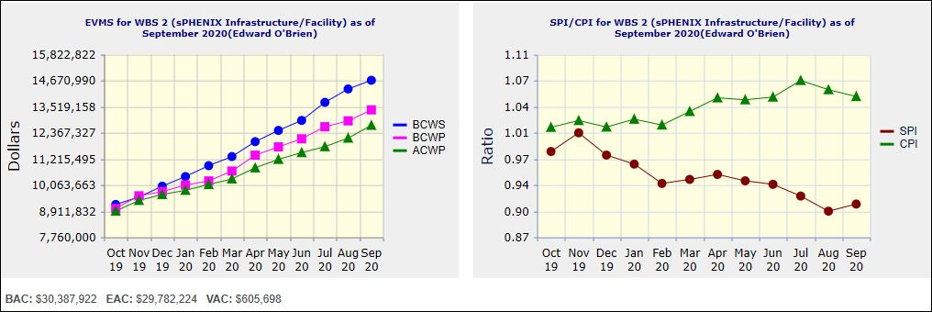
Performance Indices – 1008 Infra and Facility Upgrade
Cumulative SPI | Cumulative CPI
0.91 | 1.05
Cumulative BCWS (Scheduled) | $14,678,450
Cumulative BCWP (Performed) | $13,374,734
Cumulative ACWP (Actual) | $12,695,884
DOE SPI or CPI Value Thresholds
0.90 to 1.15
0.85 to 0.89 or 1.16 to 1.25
<0.85 or >1.25

Slide 16
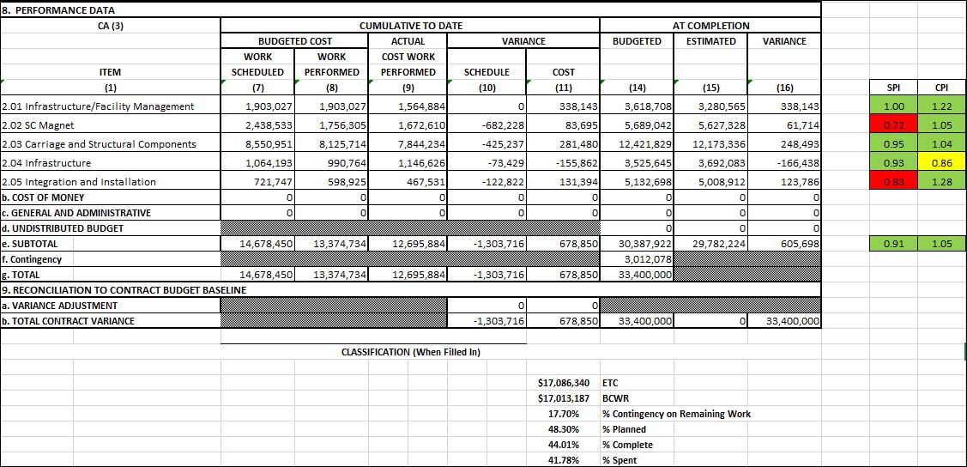
Cost Performance Report (CPR) – 1008 Infra and Facility Upgrade
DOE SPI or CPI Value Thresholds
0.90 to 1.15
0.85 to 0.89 or 1.16 to 1.25
<0.85 or >1.25
*Highlights in table above takes variance $ into consideration, not just Indices

Slide 17
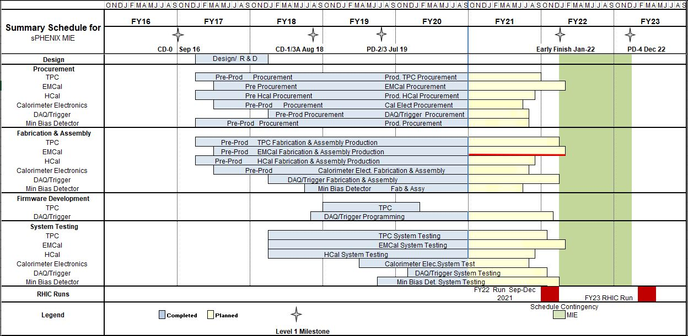
Summary Schedule – sPHENIX MIE

Slide 18
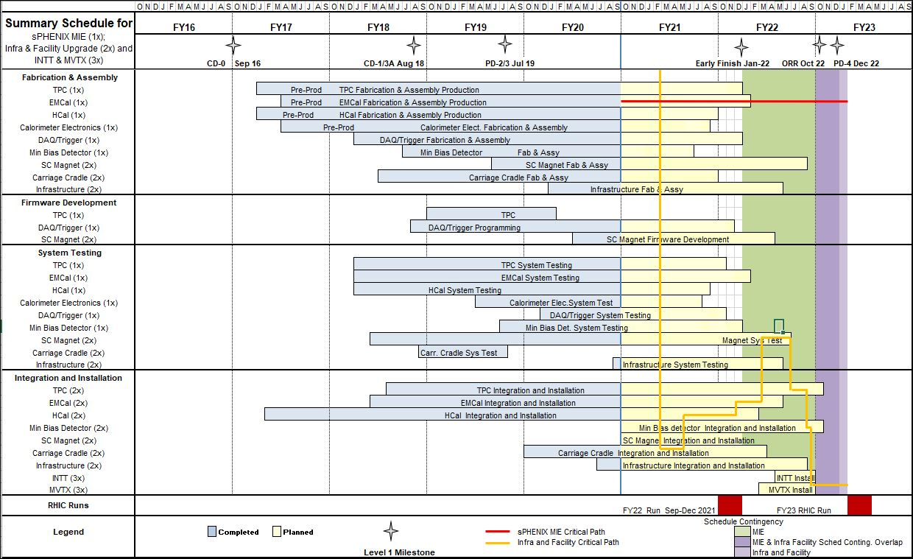
Summary Schedule – sPHENIX MIE and 1008 Infra and Facility Upgrade

Slide 19
Summary
Early completion date for MIE and 1008 I&F is unchanged for September. This is second month in a row.
Making good progress hiring labor for the big push in 2021.
It is critical to the project schedule that we break the procurement log jam soon.
30 sPHENIX FTEs approved to work at BNL in ROOP. This is 80% of technical staff.
  Remainder of staff is working remotely on engineering, design and management.
sPHENIX visitors also approved and are coming to BNL on a regular basis.
COVID mitigation plans continue to be implemented
sPHENIX factory work is progressing well. We are making progress on 1008 shutdown work, though Track Reinforcement contract has been delayed.

Slide 20
Back Up

Slide 21
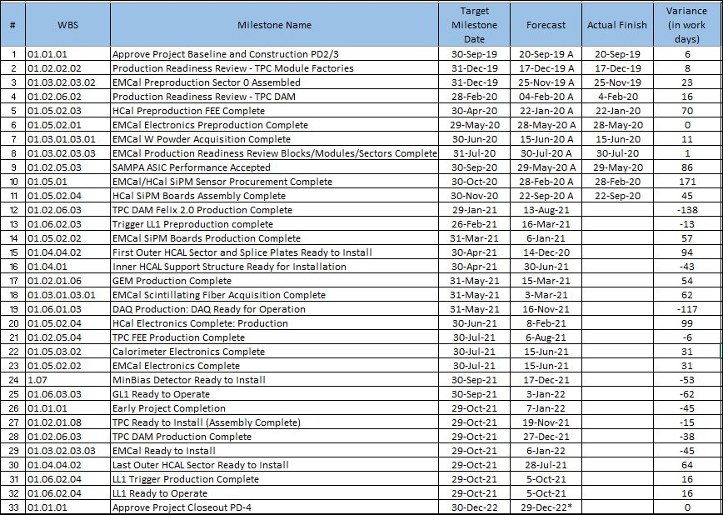
Milestones Status – sPHENIX MIE

Slide 22
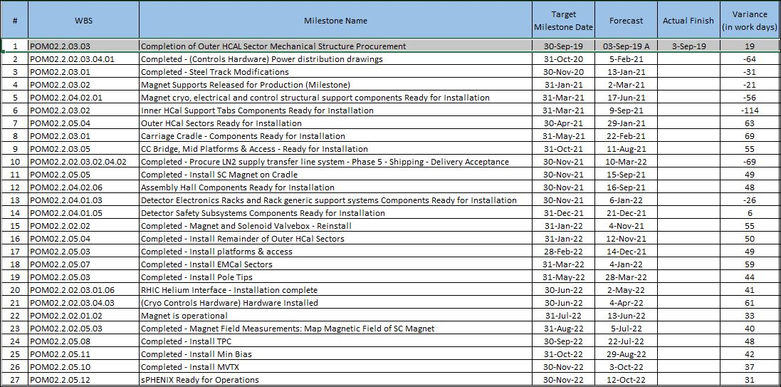
Milestones Status – 1008 Infra and Facility Upgrade

Slide 23
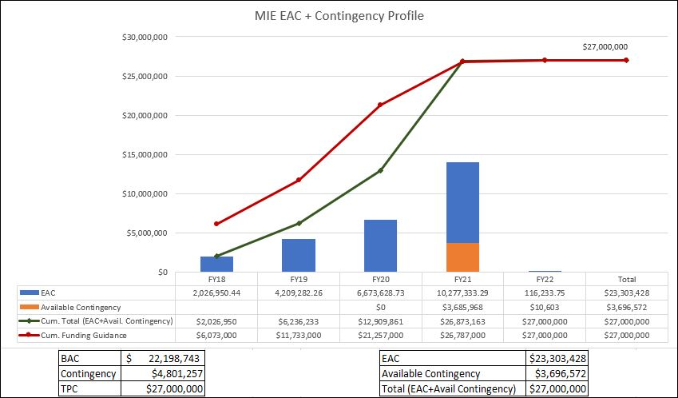
EAC and Contingency Profile – sPHENIX MIE

Slide 24
Baseline/Contingency Log - MIE

Slide 25
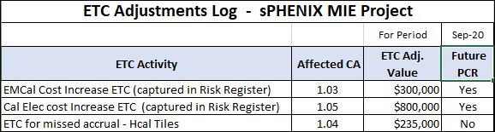
ETC Log - MIE

Slide 26
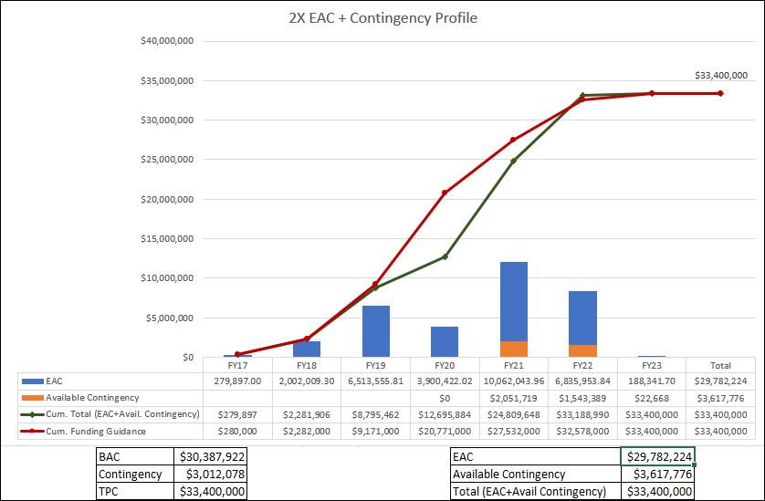
EAC and Contingency Profile – 1008 Infra and Facility Upgrade

Slide 27
Baseline/Contingency Log - 1008 Infra and Facility Upgrade

Slide 28
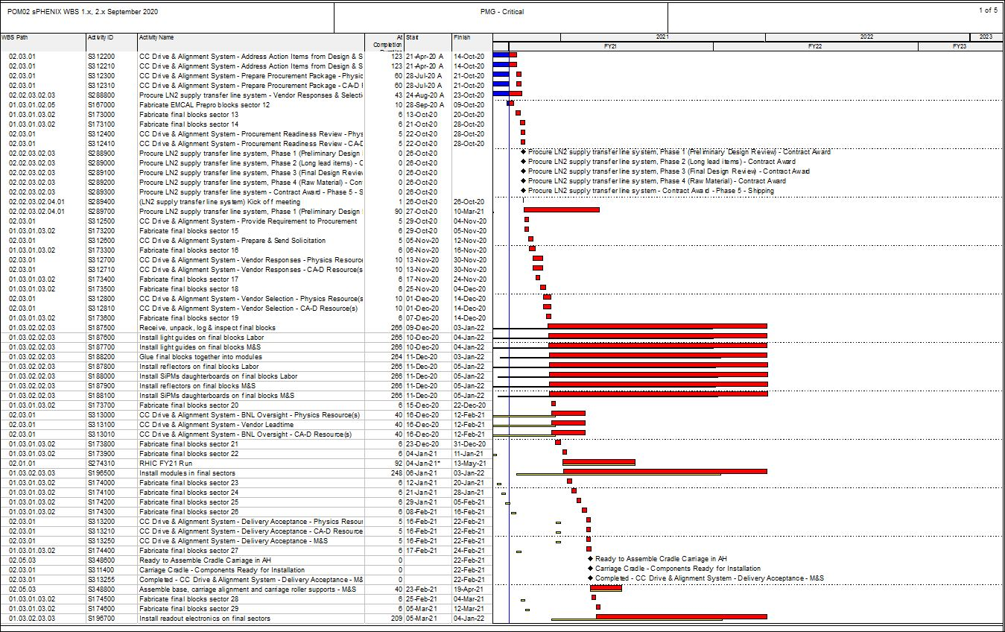
Critical Path (1x, 2x and 3x Combined)

Slide 29
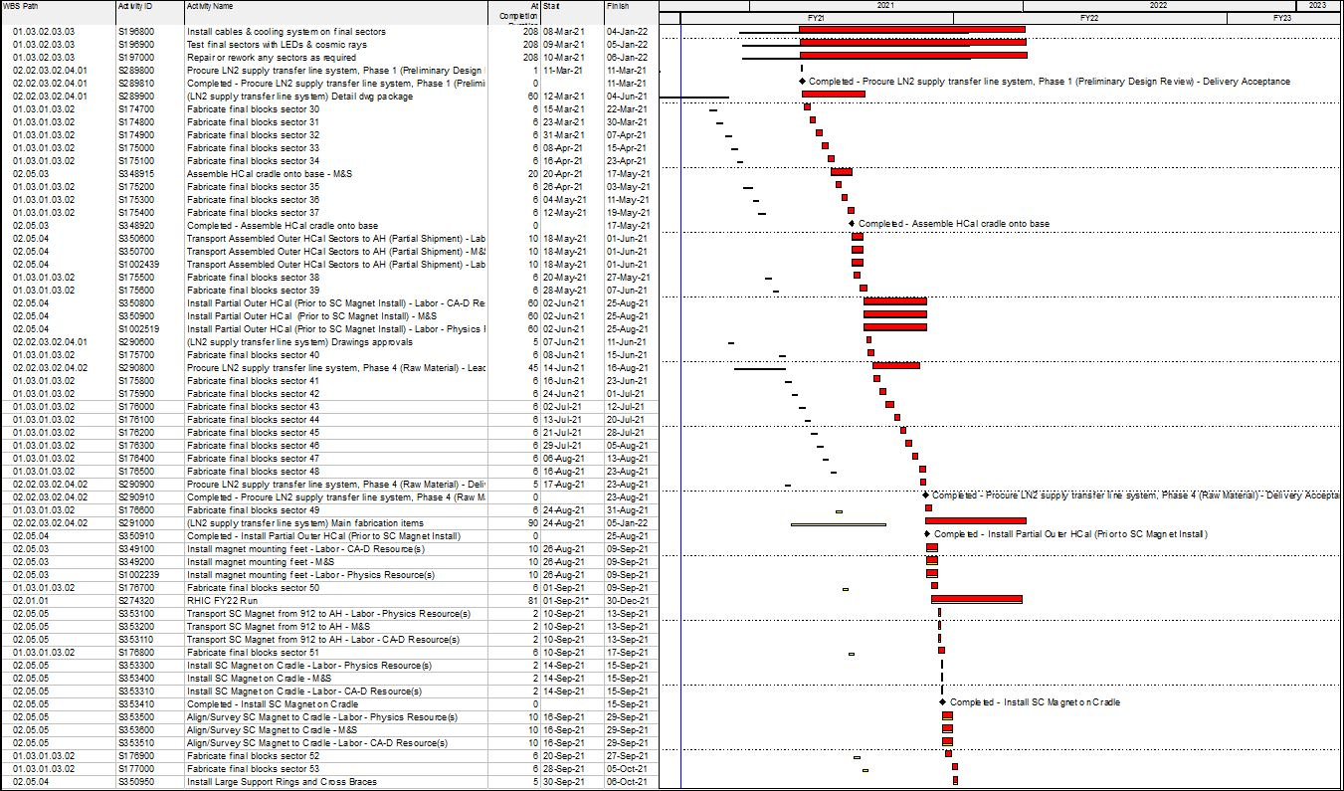
Critical Path (1x, 2x and 3x Combined)

Slide 30
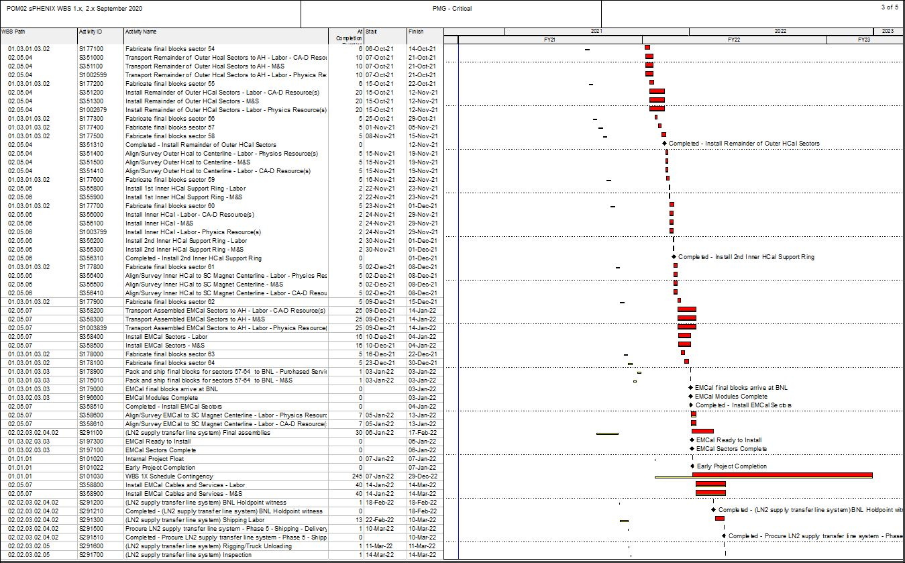
Critical Path (1x, 2x and 3x Combined)

Slide 31
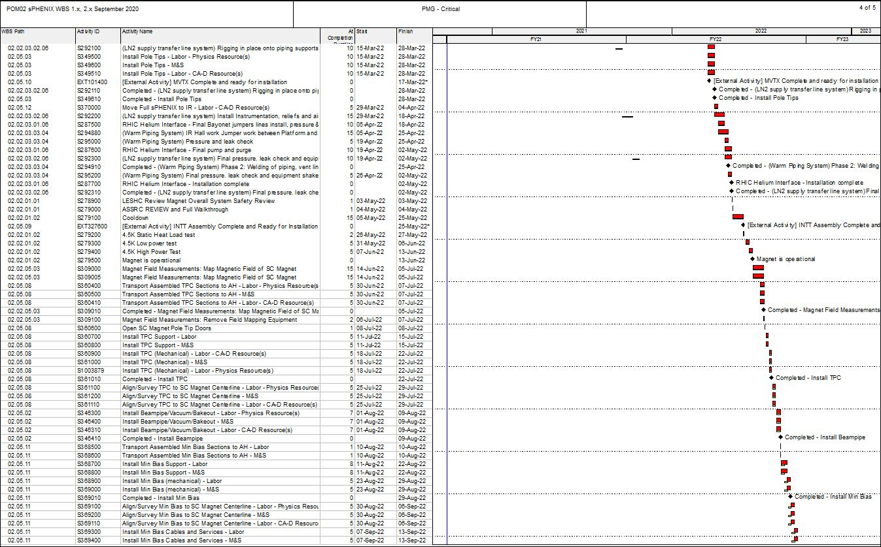
Critical Path (1x, 2x and 3x Combined)

Slide 32
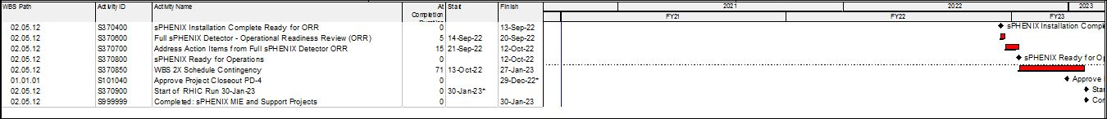
Critical Path (1x, 2x and 3x Combined)

