Slide 1
BNL Update
Weekly EMCal Meeting
Oct. 16, 2020

Slide 2
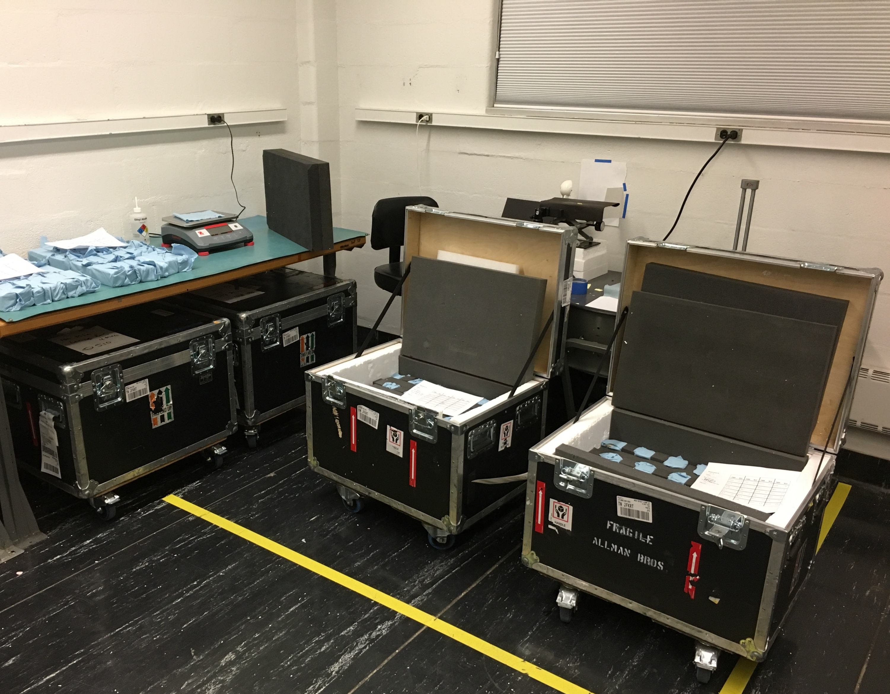
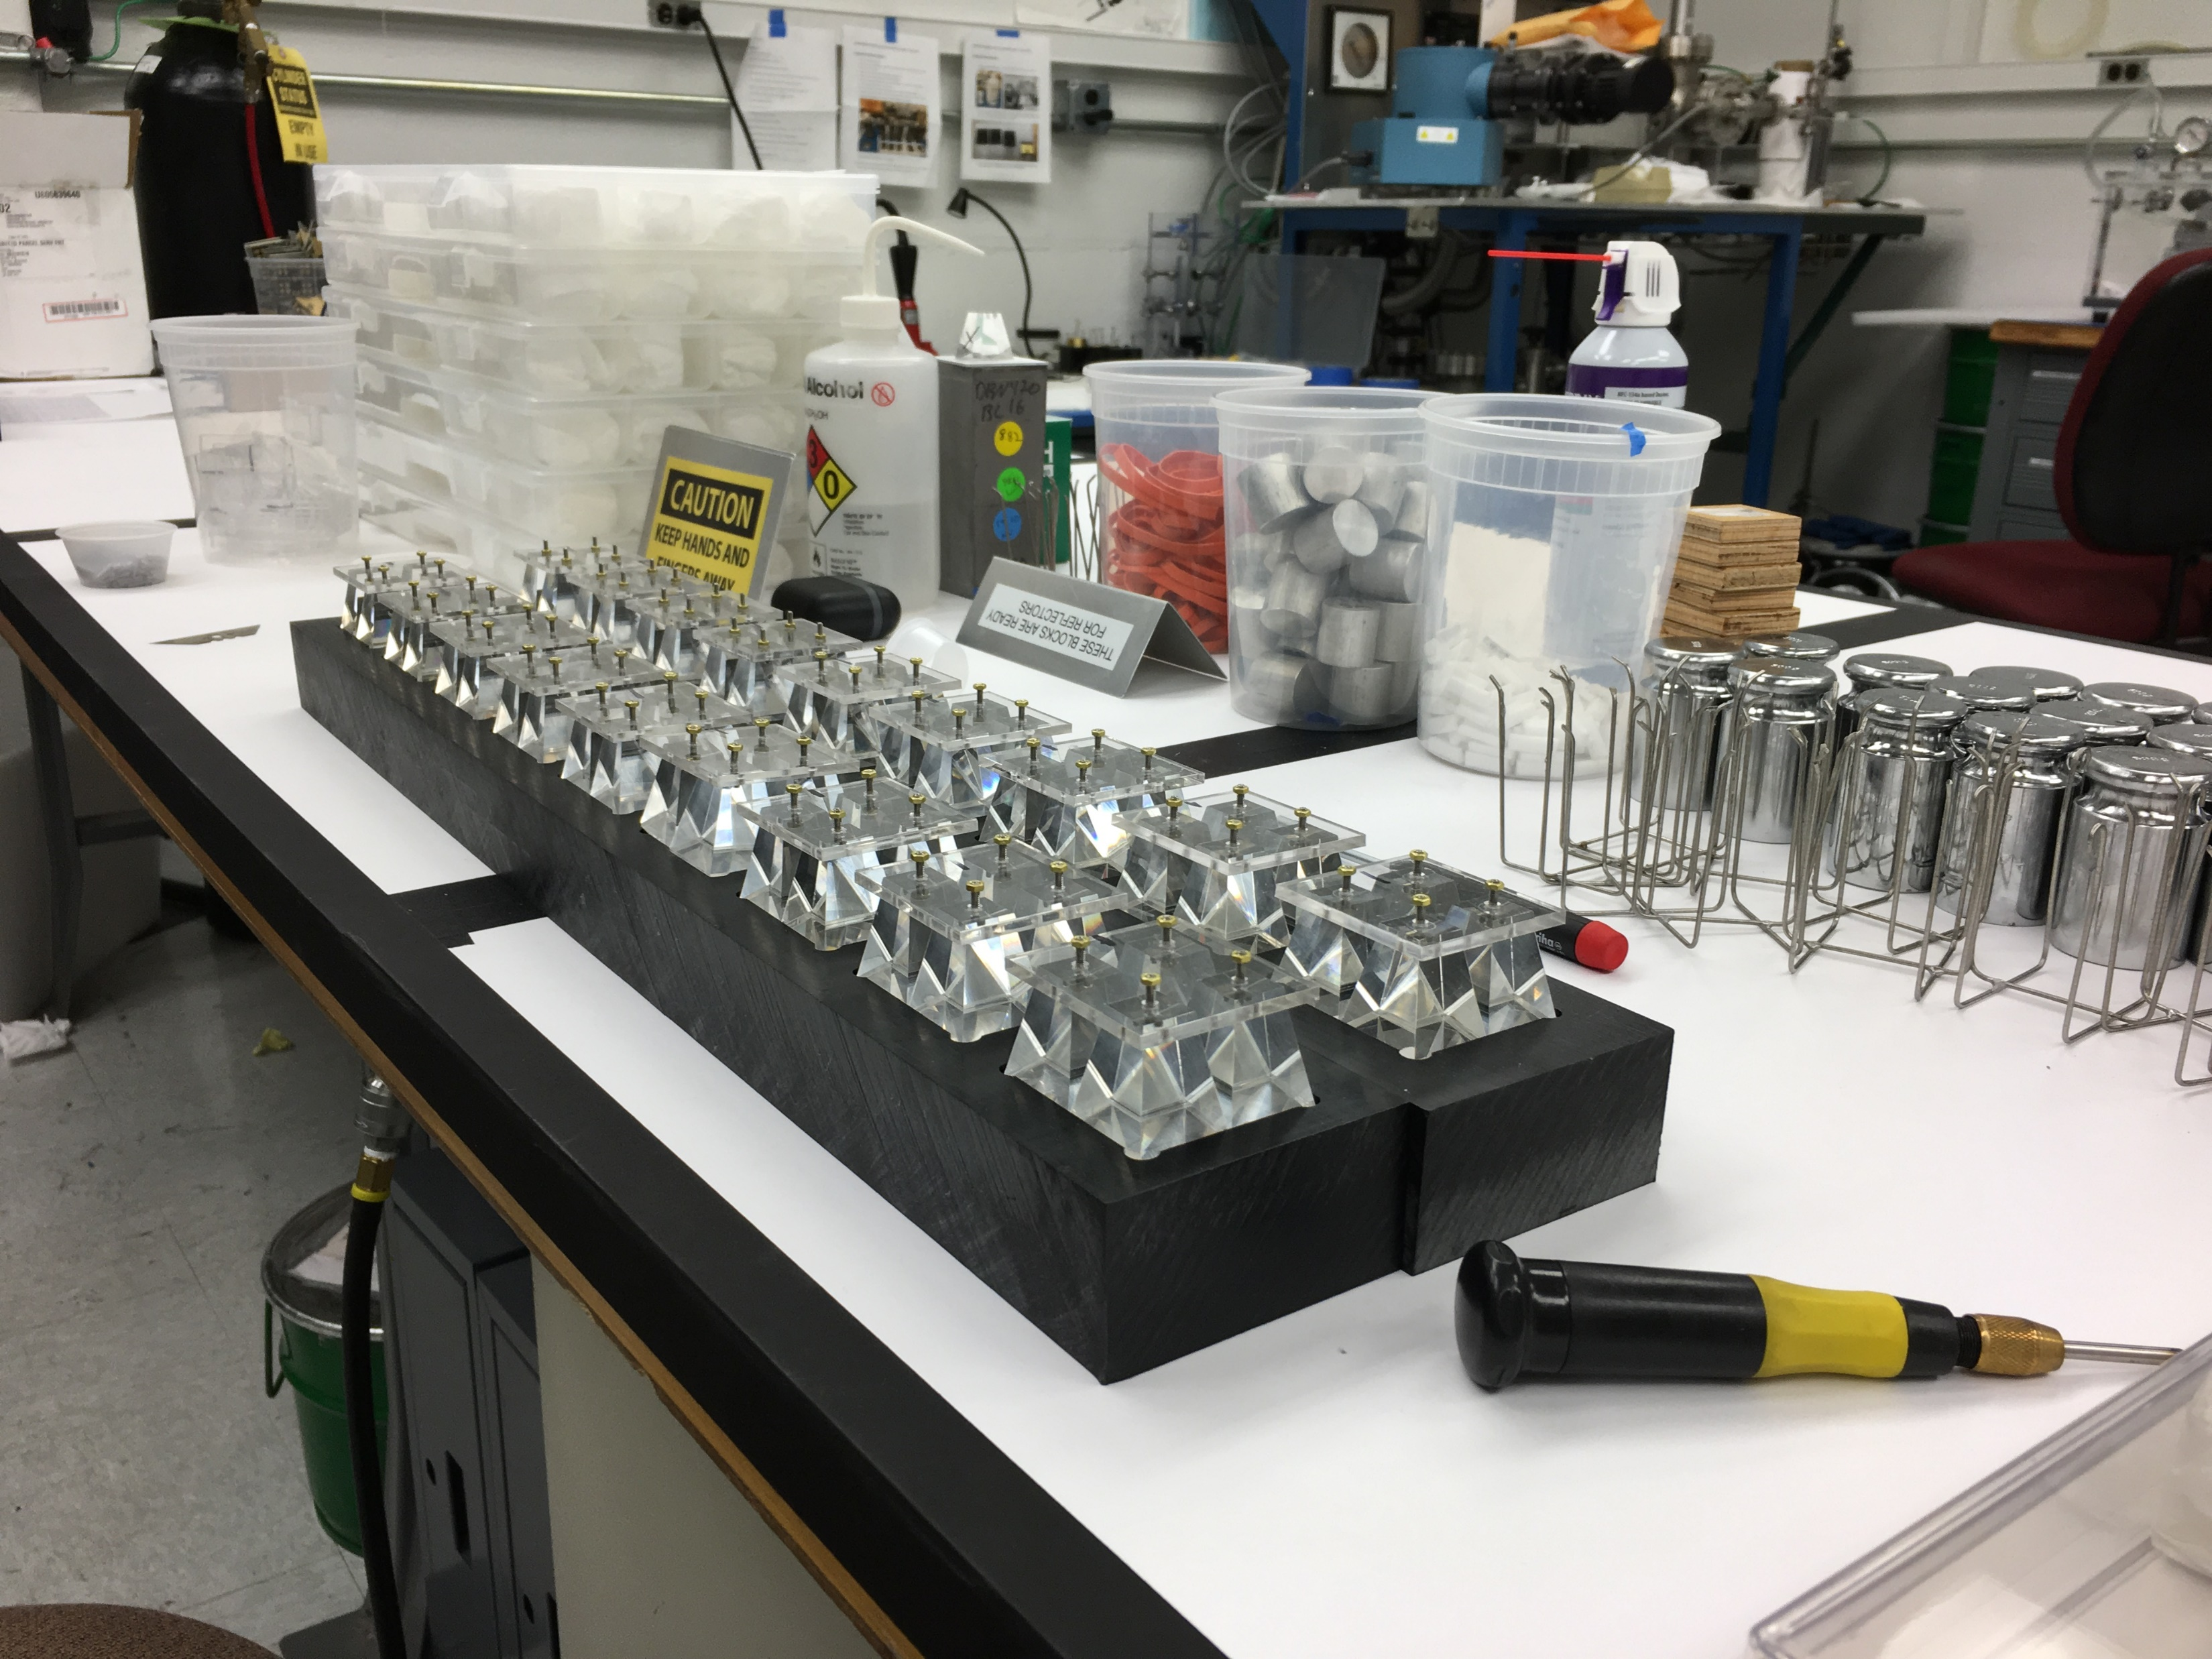
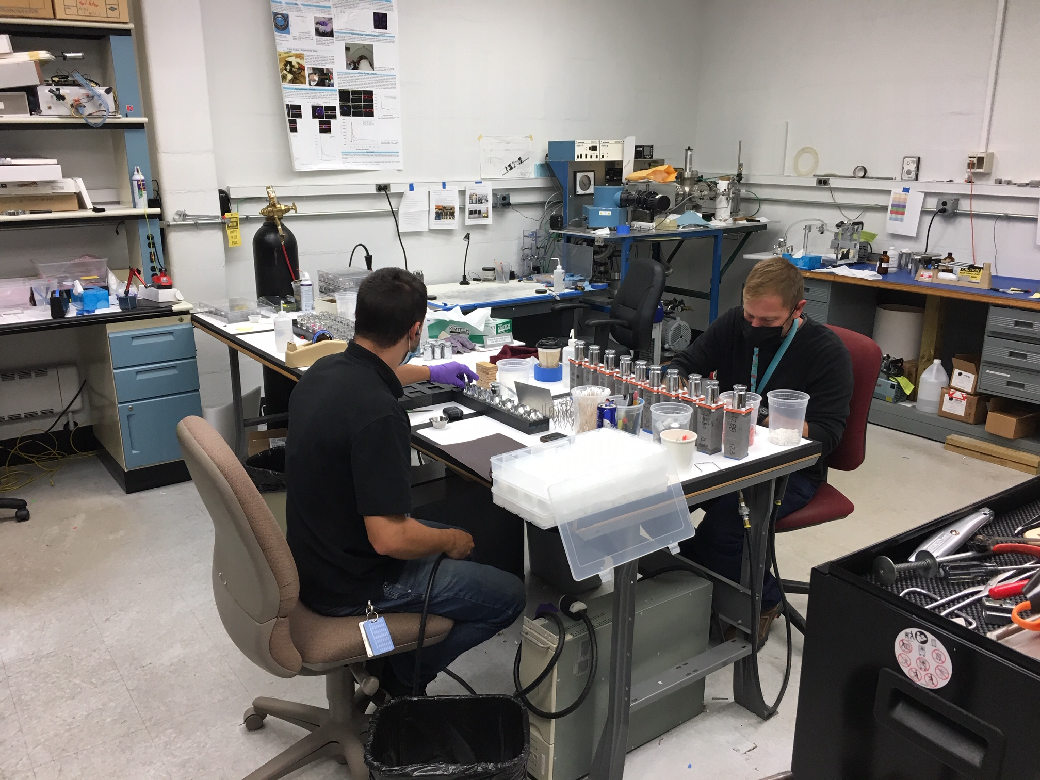
Sectors 1-12 Module Assembly
Shipment #23 of 96 blocks received and inspected.
Completed modules for Sectors 2-7.
Currently attaching lightguides to Sector 8 blocks and working on modules for Sectors 8 +
Light guides – Prepping lightguides rec’d last week. Enough on hand to finish sectors 7,8, part of 9.
Focused on lightguide prep this week.
Received sample lightguides for approval.
Next week:
Glue up sector 7
Final shipment of sectors 1-12 blocks?
Shipment 23 – blocks for Sector #11
Prepping lightguides.
Preparing lightguides and modules for Sectors 8 +

Slide 3
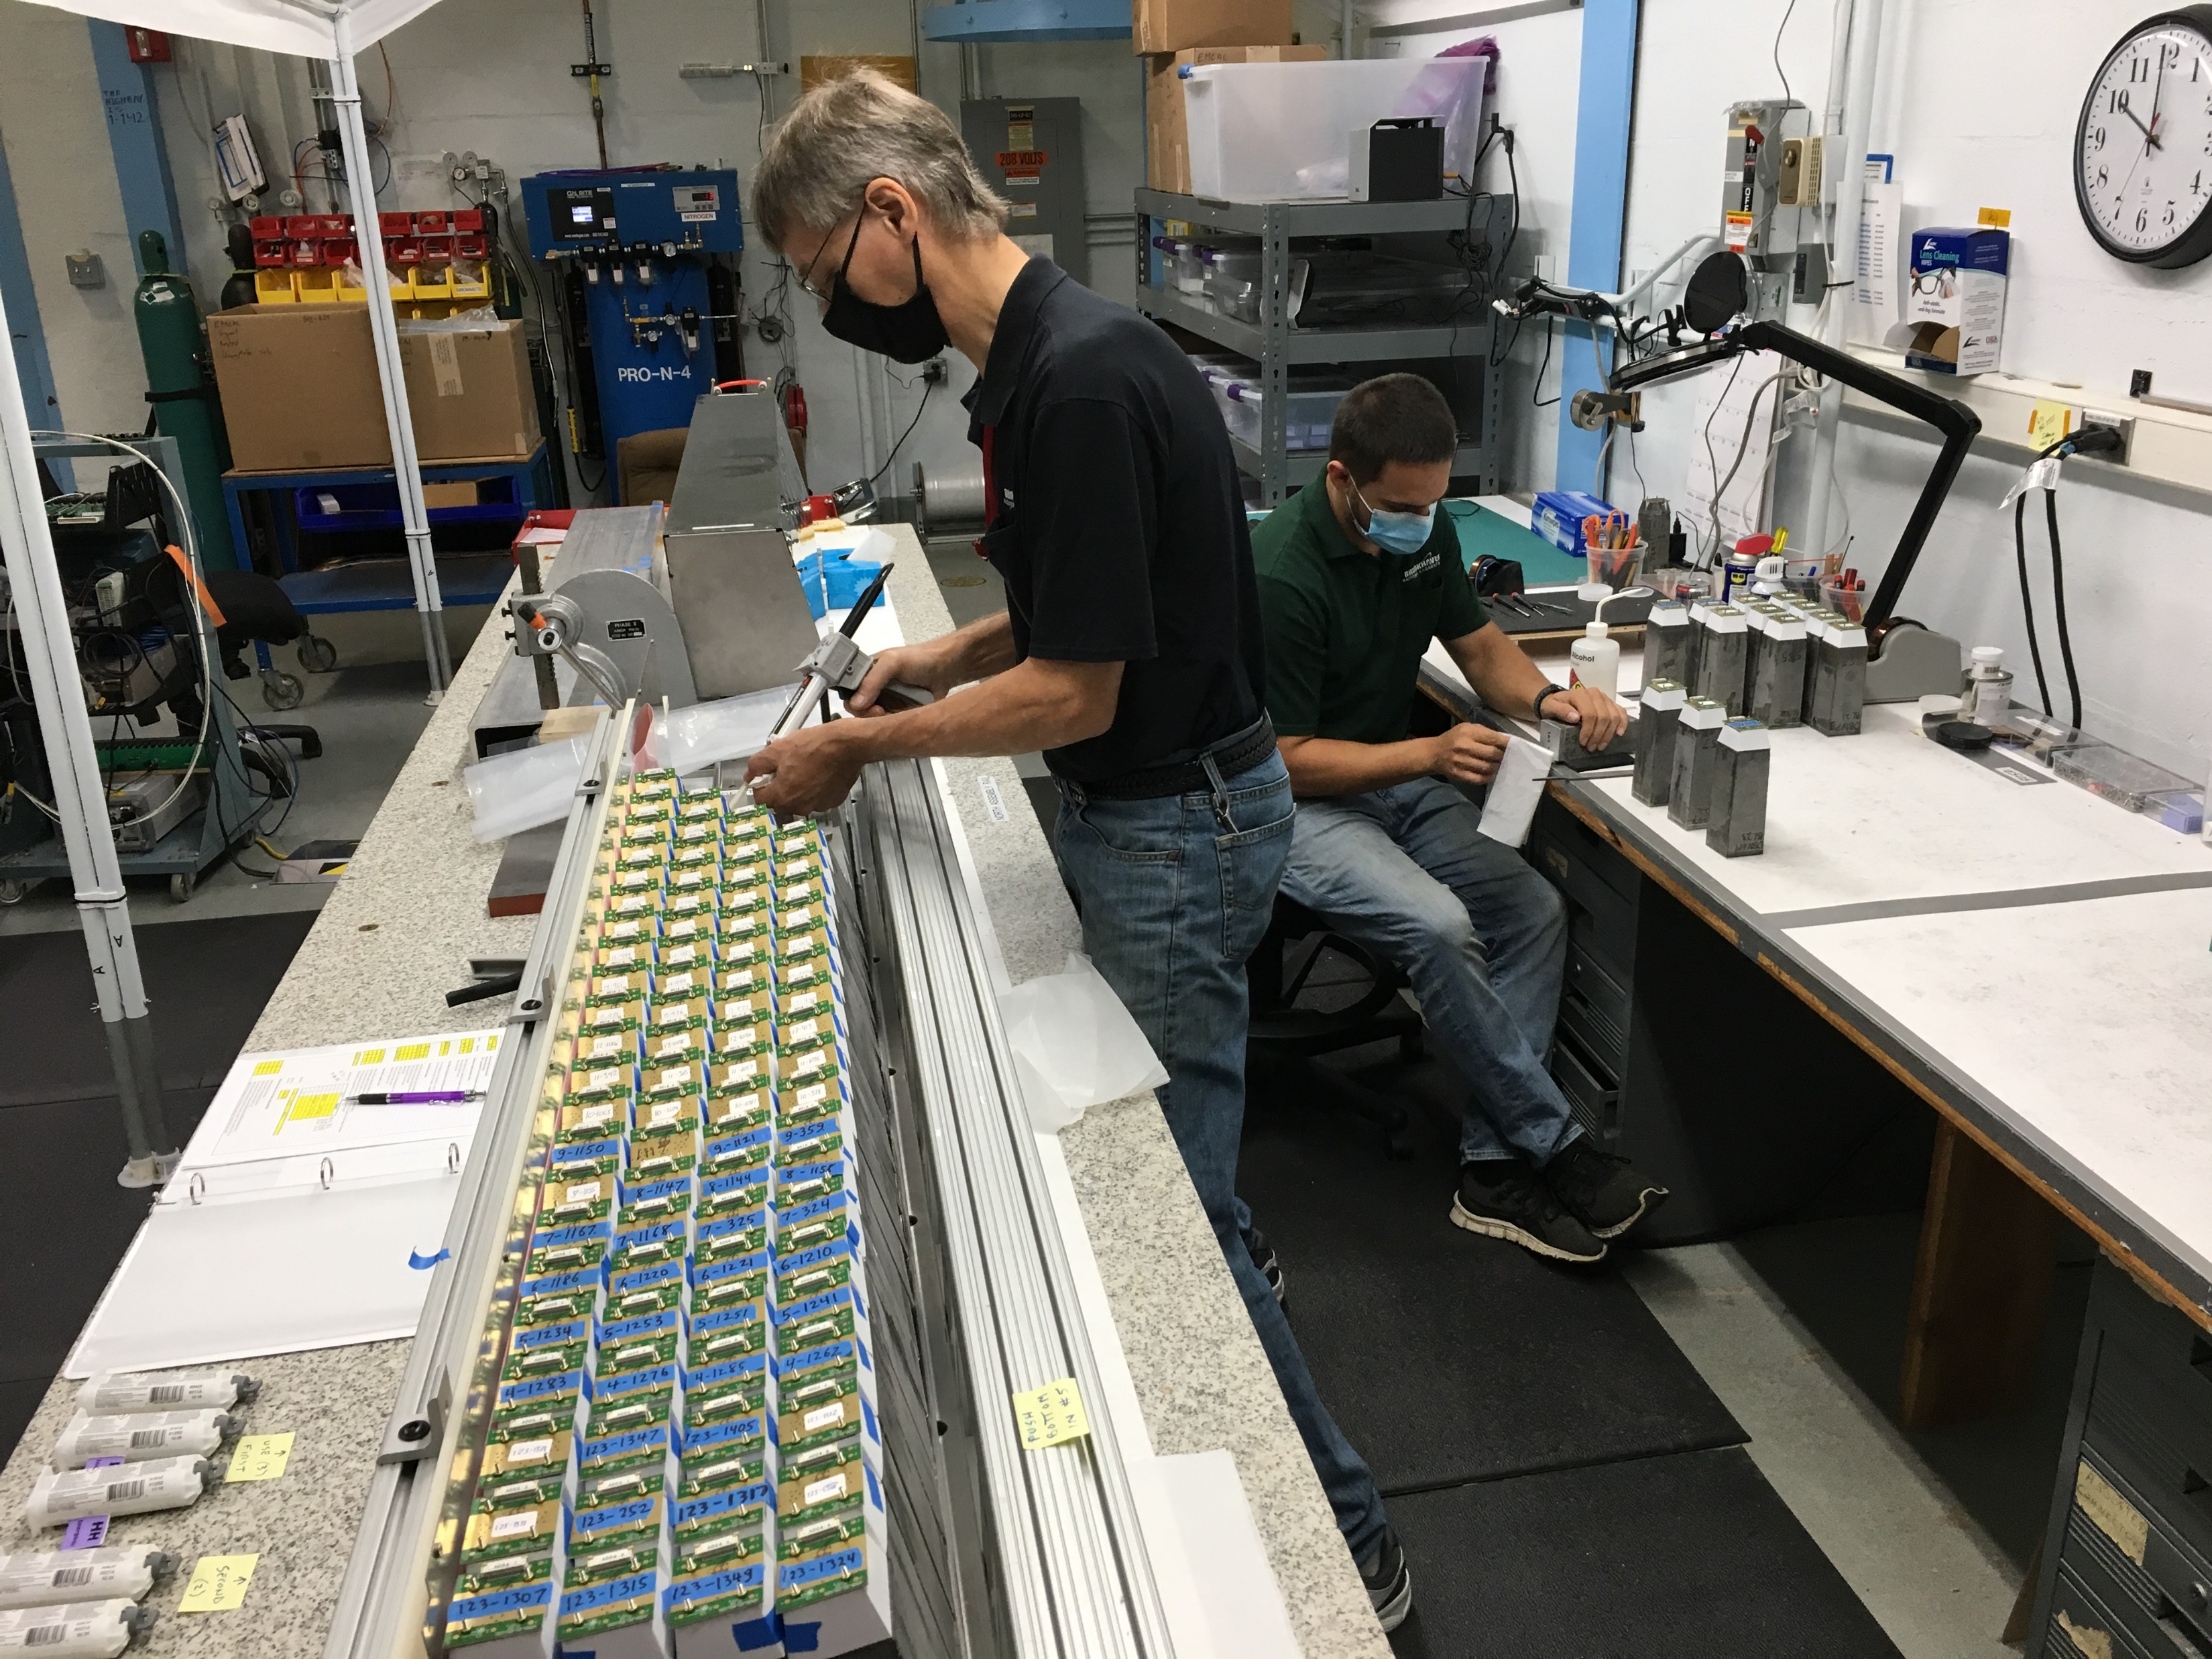
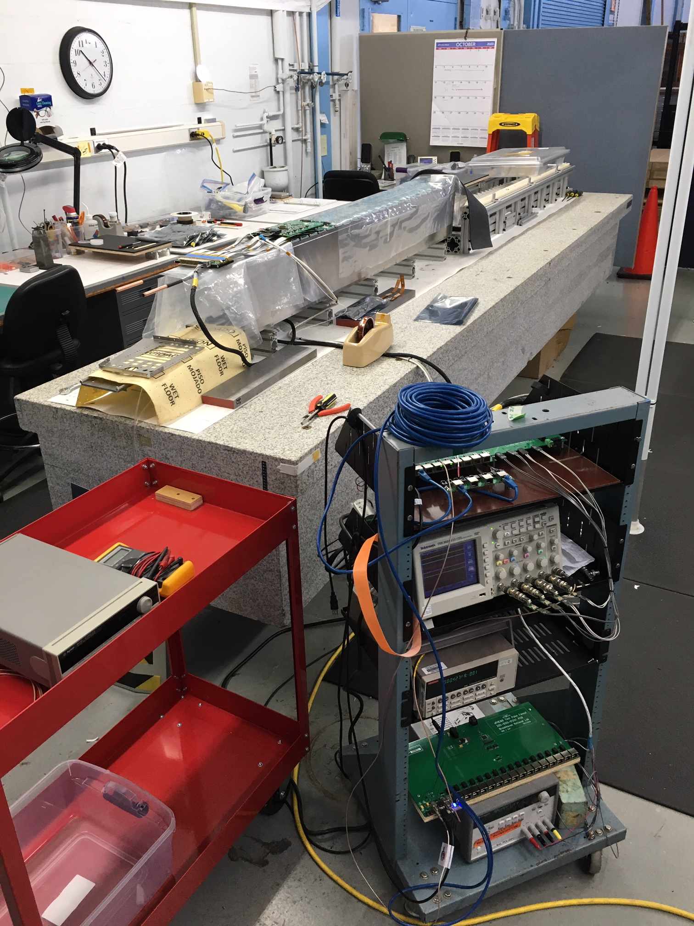
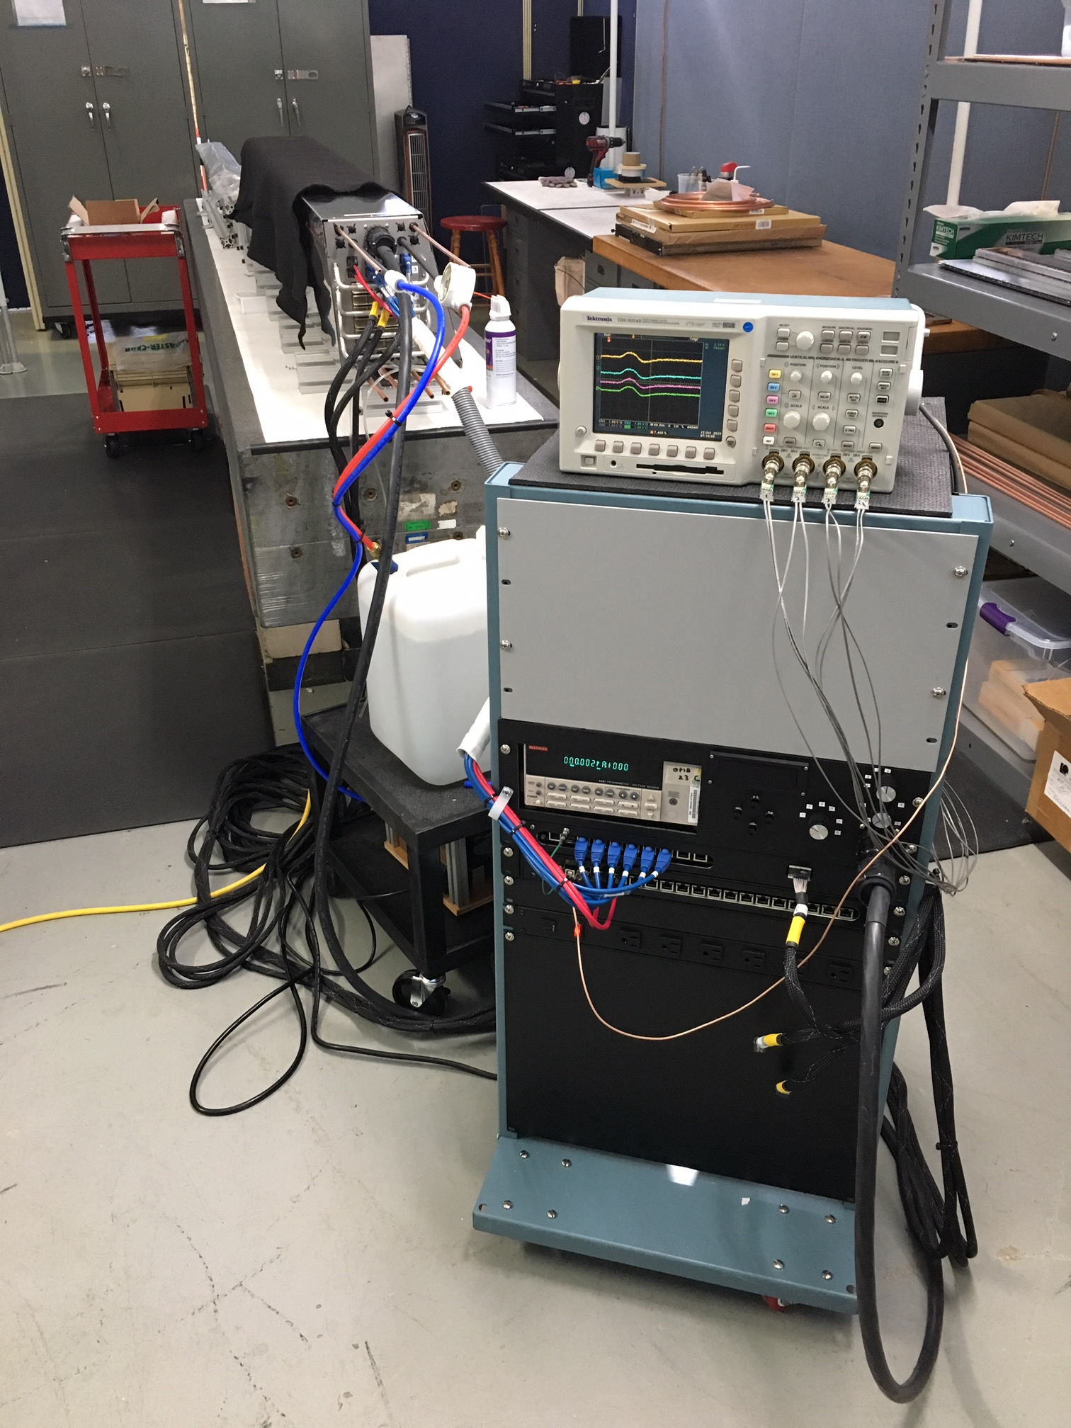
Sectors 1-12 Sector Assembly
Sector 2 – under test
Sectors 2,3,4,5 – 100% of LEDs & TPs working, ready for further testing
Sector 6 – under assembly.
Sector 7 – modules ready for gluing next week.
Sector 8 – preparing modules, possibly ready for gluing next week.
Sal made a new test stand for sector assembly testing.
Gluing up Sector 6 blocks
Sector 6 – preamps installed, ready for signal cables.
New test stand for sector assembly/testing.

Slide 4
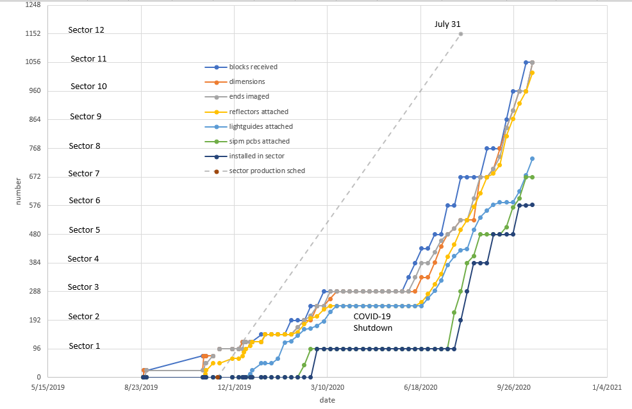
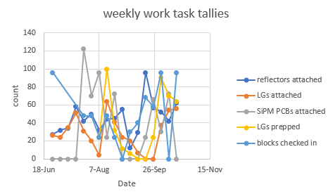
Progress Tracking – Module Production

Slide 5
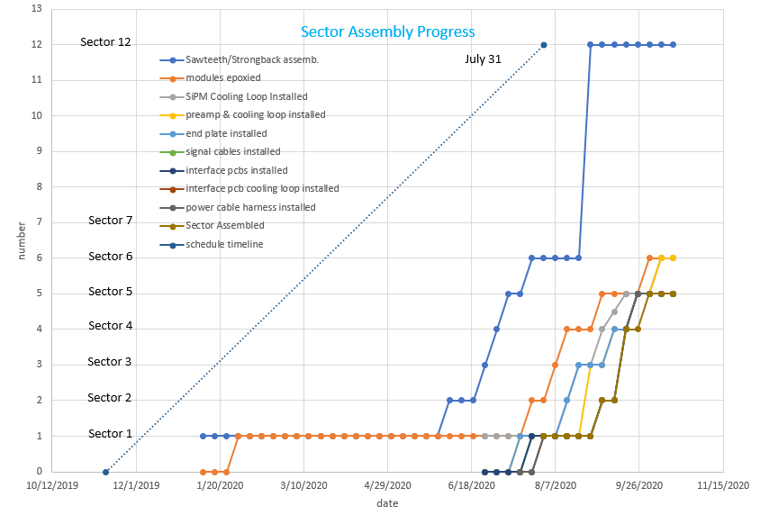
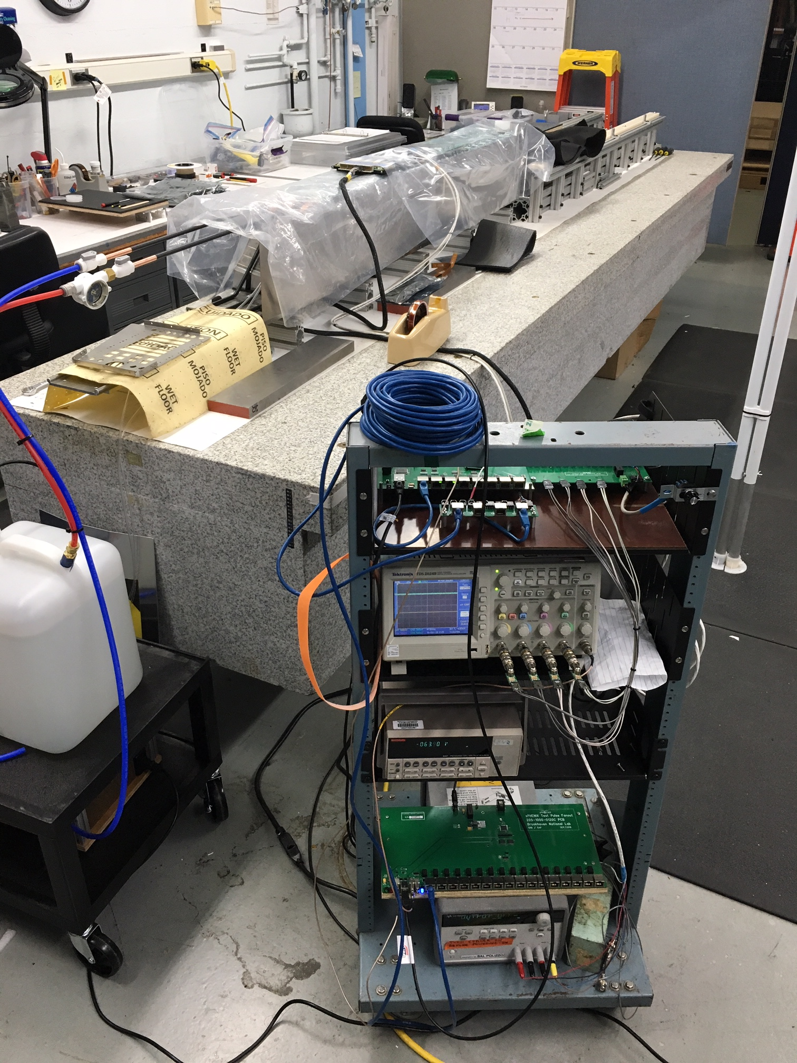
Progress Tracking – Sector Assembly
Sector 6 – under assembly/testing.

