Slide 1
PMG Agenda
Brief Status including COVID impact
Oversight of carriage cradle production construction
PEMP
Update on hiring of new personnel
Status of procurements
Status of the track reinforcement, cryo orders
October Cost and Schedule EV, Schedule w.r.t. critical path

Slide 2
sPHENIX MIE, 1008 I&F, Si Detector Status
sPHENIX MIE, I&F early completion date unchanged. 11.5 months of float for MIE. 3.5 months of float for 1008 I&F Upgrade.
  Proposed Run-22 schedule has not yet been included in P6 schedule. Expect no effect on MIE schedule but sPHENIX installation schedule will likely be delayed a minimum of one month.
  COVID impact on schedule stable for last 3 months.
30 sPHENIX FTEs approved to work at BNL in ROOP. This is 80% of technical staff.
  Remainder of staff is working remotely on engineering, design and management.
sPHENIX visitors also approved and are coming to BNL on a regular basis.
COVID mitigation plans continue to be implemented
Long lead procurements: 100% of SiPMs, 100% of tungsten powder, 100% of scintillator tiles, 75% of scintillating fibers
All SAMPA v5 chips fabbed, packaged and tested. Lund tests show 70% yield consistent with ALICE SAMPA v4 results.
EMCal blocks for 14 sectors complete. Sectors 1-7 assembled. Assembly of EMCal sectors 8-9 underway.
5 OHCal sectors complete. Assembly begun on OHCal Sectors 6-15.
All MVTX Readout Units at ORNL for testing. 37% of staves complete at CERN and ready to ship to LBNL
LHe cryo lines installation is 80% complete.
Orders for LN2 piping and Be beam pipe have been placed.
Carriage/Cradle continues to be on schedule for December delivery to BNL.

Slide 3
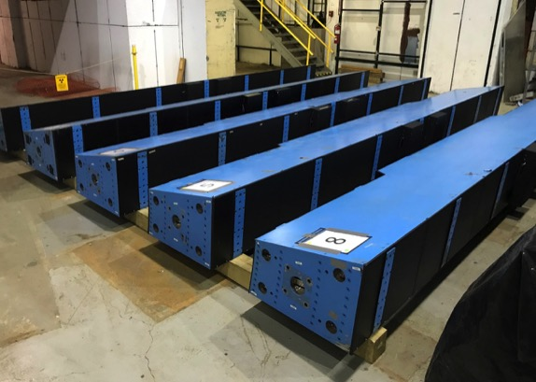
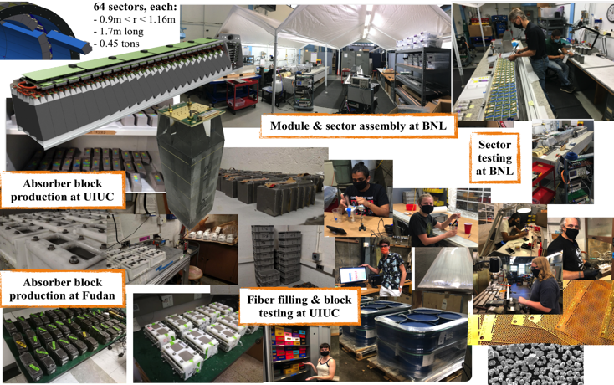
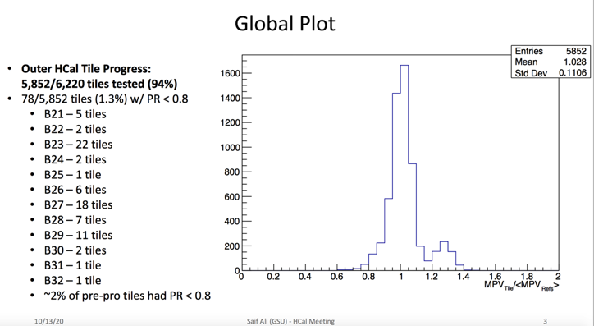
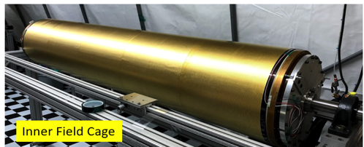
sPHENIX Progress in Pictures
HCal Factory at BNL
EMCal Factories: UIUC, BNL
TPC Inner Field Cage, SBU
5 OHCal Sectors complete @ BNL
EMCal Sectors at BNL
100% scintillating tiles at GSU from Uniplast
SBU

Slide 4
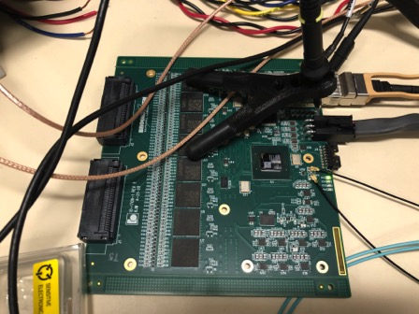
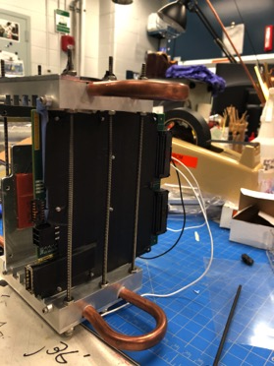
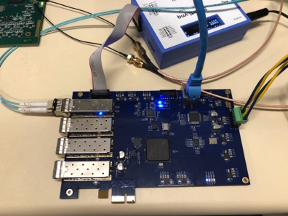
TPC FEE status
Two new boards assembled at IO are under test
  Most of the changes made for this version have been tested working fine
    New JTAG (over fiber), new SAMPA power-on-reset, new EEPROM, new FPGA, and new optical transceiver.
    Test of new cooling structure is being performed
    Environmental tests (radiation, magnetic field and HV discharge) are being prepared
  One-sector (26 FEEs) integrated readout test are being setup, and will start in Jan 2021
    Additional 32 boards are being fabricated and will be used for this test
All SAMPA v5 chips have been tested at 160nsec shaping time and the yield was obtained as 70%
  Test performed at Lund Univ.
  80nsec shaping test in progress
  Evaluation of SAMPA v5 mounted on FEE board is in progress
Plan is to start production of final version PCB by the end of this year.
  Procurement of key components have started
Pre-production FEE board in test
Test board for JTAG control over fiber (ala, Kai Chen of ATLAS)
FEE plugged into prototype cooling

Slide 5
EMCal Block production at UIUC ( as of 11/5)
All blocks for Sectors 1-12 have been completed and delivered to BNL
Fabrication of blocks for Sectors 13-64 has begun
  230 blocks produced
  2.2 sectors shipped to BNL
  Production loss 1.3 % (3 blocks)
Average production rate has exceeded full production rate of 60 blocks/week for several weeks

Slide 6
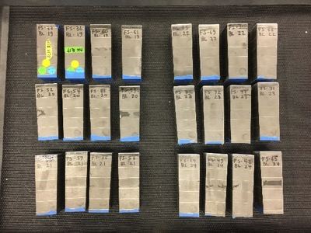
Block production at Fudan
Fudan blocks at BNL
The first 24 high rapidity blocks were sent to UIUC and tested. All passed QA but 3 were slightly damaged in shipping. The blocks were then sent to BNL where they will be installed in one of our sectors.
More than 120 additional blocks have now been produced and are being prepared for shipment directly to BNL in mid Nov.
PKU is now also planning to begin block production and will produce ~ 30% of the high η blocks.
A plan is being developed to deliver all the high η blocks needed for Sectors 13-64 in line with our production schedule.

Slide 7
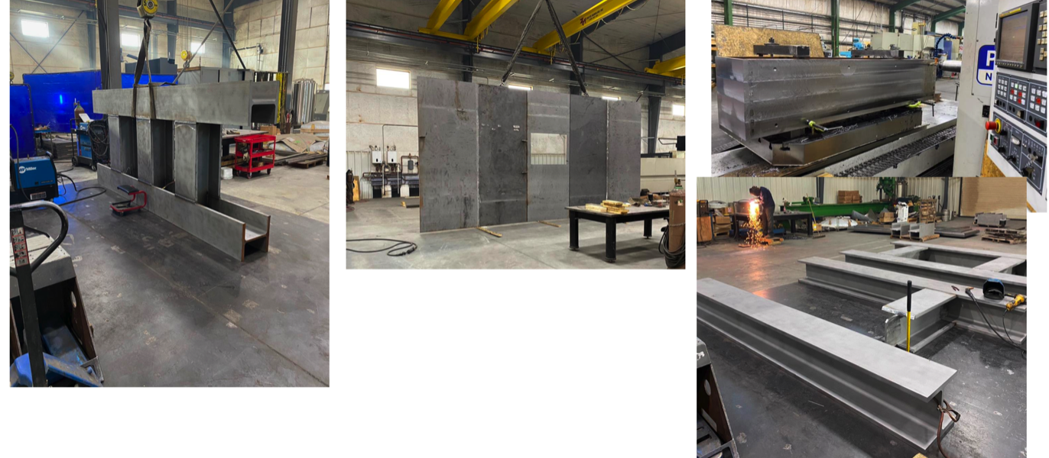
Carriage/Cradle at Manufacturer
Carriage/Cradle on Schedule for sPHENIX delivery end of December 2020
BNL engineers, surveyors will visit Streck’s mid-December

Slide 8
sPHENIX 2 PEMP Notables in 2021
NP: Complete infrastructure and facility upgrades in Building 1008 to enable the planned start of installation of the sPHENIX calorimeters. (Objective 2.3)
  Requires completion of 1008 Assembly Hall track reinforcement by the end of May 2021.
BHSO/SC: Effectively plan, execute, and successfully deliver SC projects equal to or less than $50 million that have been delegated to the Laboratory Director by SC under DOE O 413.3B [Super Pioneering High Energy Nuclear Interaction (sPHENIX)]. Clearly demonstrate successful accomplishment of key milestones in FY 2021 (adjusted for schedule impacts created by the COVID-19 pandemic) in accordance with SC guidance. (Objective 7.1)
  EMCal Preproduction Blocks complete 1-Dec -2020 ✔ Complete
  1st OHCal Sector ready to install 15-Apr-2021
  EMCal Scintillating Fiber Acquisition complete 31-May-2021
  EMCal Sector Assembly 50% Complete 15- Aug-2021

Slide 9
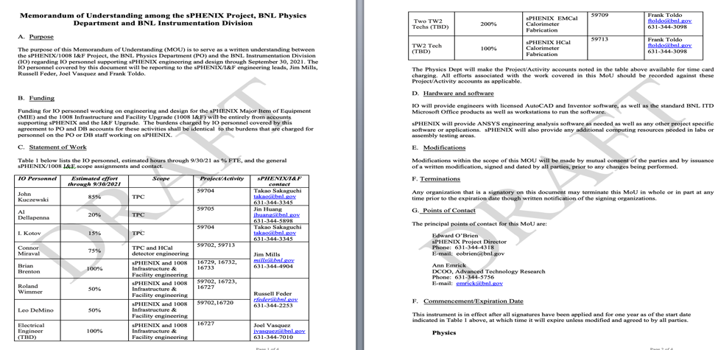
New Hires/Additional Personnel
FY2021 MoU Ready to sign with IO. Waiting for comments from Gabriella Carini
Two TW-2 mech techs accepted job offers this week. Will start work in EMCal factory in ~ 2 weeks.
IO EE’s and ME’s working on TPC, HCal and 1008 I&F
One TW-2 position to fill for HCal factory
One EE position to fill for 1008 I&F PLC design and programming
Borrow a TW-2 from CAD during RHIC 2021 run for rack set up work with senior tech.
8 FTEs from IO working for sPHENIX in 2021.

Slide 10
Major Procurement To Go
TPC Fee (submitted)
FELIX Cards (submitted)
EMCal block fab FY21 (submitted)
LV power systems, TPC, EMCal, HCal, MBD (submitted)
IHCal Frames (submitted)
Track modification (submitted)
IHCal Rings (submitted)
XY tables (submitted)
Large Rings
Magnet supports
Magnet Mapping contract w/ CERN
EMCal installation fixture
Platform
End Caps/Pole Tips
Calorimeter cables (MIE)
TPC Cooling and Laser systems (MIE)
DAQ LL1 Boards, crates, SEBs, EDBCs, JSEBs, ATPs, Buffer boxes (MIE)
IHCal installation fixture, TPC installation tools
Seismic restraints
2021 MVTX contracts (MIT, LBNL, LANL, ORNL)
Likely we will need one additional contract each w/ UIUC, SBU, GSU, WSU

Slide 11
Major Procurement To Go
TPC Fee (submitted)
FELIX Cards (submitted)
EMCal block fab FY21 (submitted)
LV power systems, TPC, EMCal, HCal, MBD (submitted)
IHCal Frames (submitted)
Track modification (submitted)
IHCal Rings (submitted)
XY tables (submitted)
Large Rings
Magnet supports
Magnet Mapping contract w/ CERN
EMCal installation fixture
Platform
End Caps/Pole Tips
Calorimeter cables (MIE)
TPC Cooling and Laser systems (MIE)
DAQ LL1 Boards, crates, SEBs, EDBCs, JSEBs, ATPs, Buffer boxes (MIE)
IHCal installation fixture, TPC installation tools
Seismic restraints
2021 MVTX contracts (MIT, LBNL, LANL, ORNL(submitted))
Likely we will need one additional contract each w/ UIUC, SBU, GSU, WSU

Slide 12
2020 Shutdown Tasks
RHIC 2020 shutdown will be Sept 14 – ~ Feb 1
  Tasks to complete during the 2020 shutdown include:
  Clean services off west wall (Done)
  Installing the cryo deck (Done)
  Adding track gussets in IR (Nearly complete)
  Remove excess tracks (Started)
  Installing and welding cryo spools in the 1008 IR and 1008 B (4/5 complete. Final cryo spool installation starting this week)
  Reinforcing the tracks in the 1008 (Contract with PPM. Two week solicitation starts this week)

Slide 13
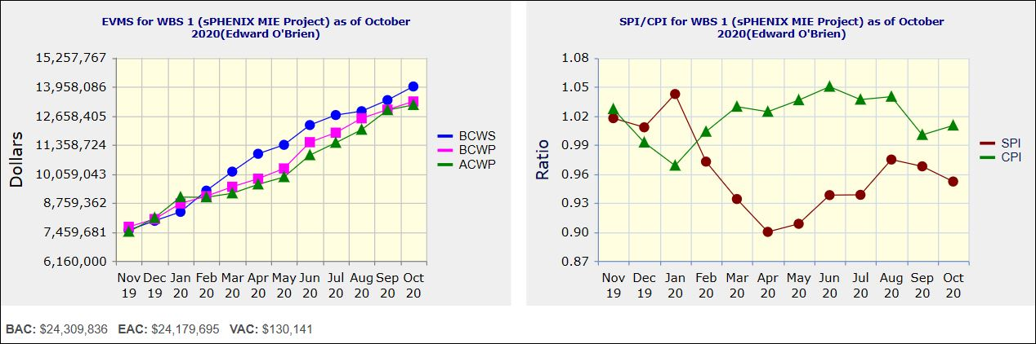
Performance Indices – sPHENIX MIE
Cumulative SPI | Cumulative CPI
0.95 | 1.01
Cumulative BCWS (Scheduled) | $13,967,154
Cumulative BCWP (Performed) | $13,295,231
Cumulative ACWP (Actual) | $13,141,543
DOE SPI or CPI Value Thresholds
0.90 to 1.15
0.85 to 0.89 or 1.16 to 1.25
<0.85 or >1.25

Slide 14
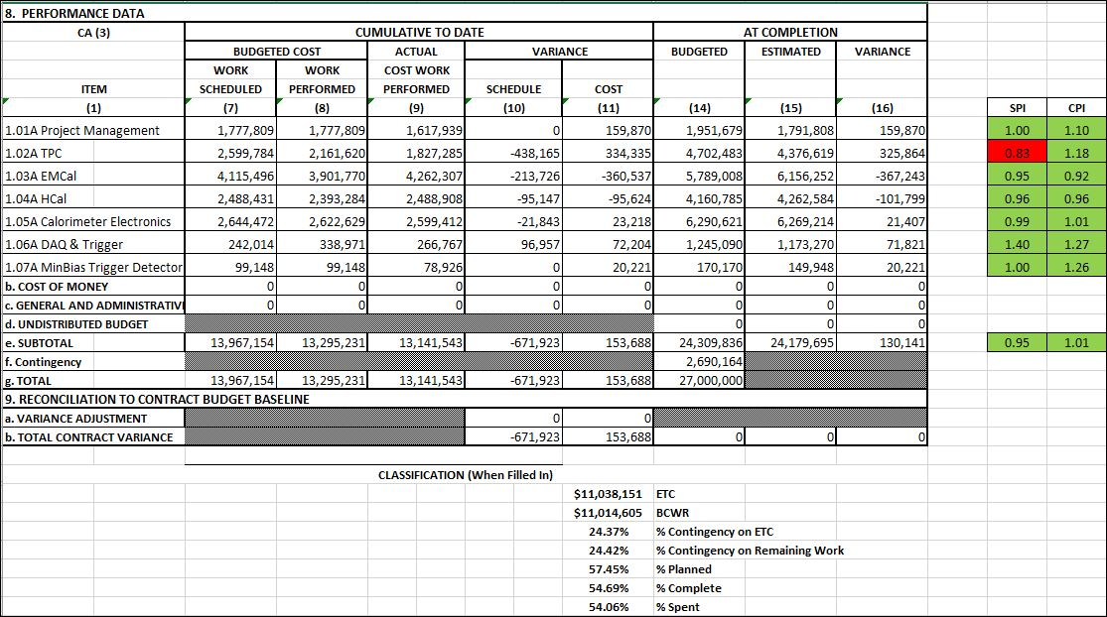
Cost Performance Report (CPR) – sPHENIX MIE
DOE SPI or CPI Value Thresholds
0.90 to 1.15
0.85 to 0.89 or 1.16 to 1.25
<0.85 or >1.25
*Highlights in table above takes variance $ into consideration, not just Indices

Slide 15
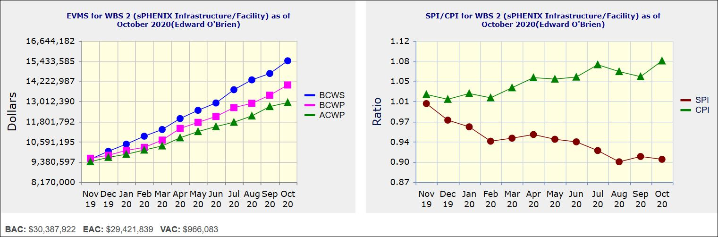
Performance Indices – 1008 Infra and Facility Upgrade
Cumulative SPI | Cumulative CPI
0.91 | 1.08
Cumulative BCWS (Scheduled) | $15,439,395
Cumulative BCWP (Performed) | $13,990,967
Cumulative ACWP (Actual) | $12,935,936
DOE SPI or CPI Value Thresholds
0.90 to 1.15
0.85 to 0.89 or 1.16 to 1.25
<0.85 or >1.25

Slide 16
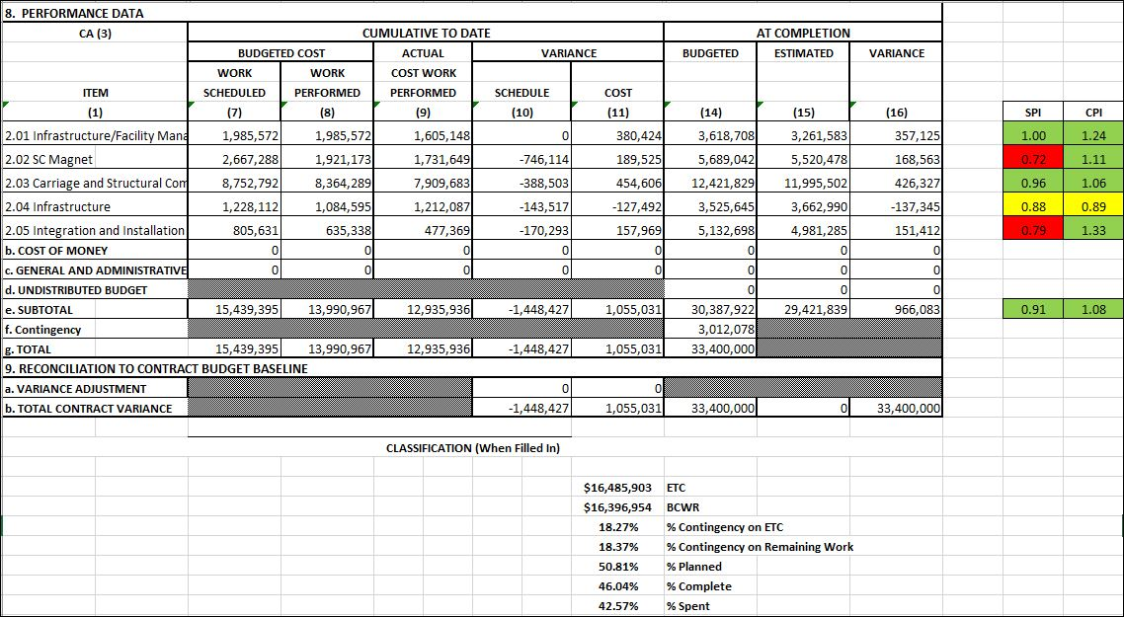
Cost Performance Report (CPR) – 1008 Infra and Facility Upgrade
DOE SPI or CPI Value Thresholds
0.90 to 1.15
0.85 to 0.89 or 1.16 to 1.25
<0.85 or >1.25
*Highlights in table above takes variance $ into consideration, not just Indices

Slide 17
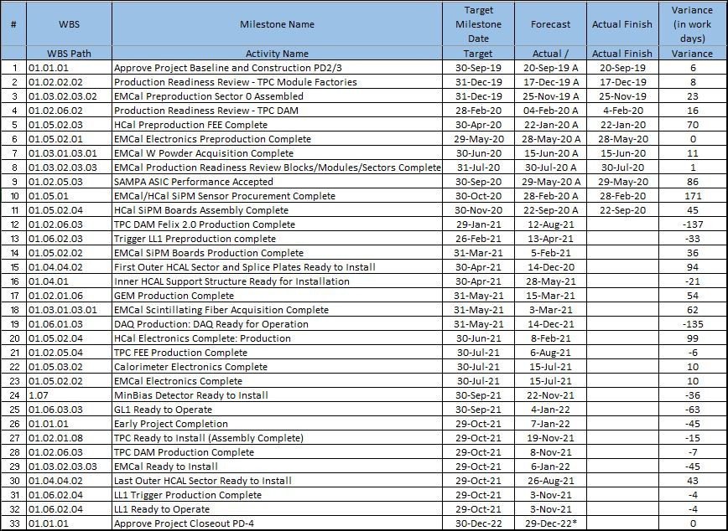
Milestones Status – sPHENIX MIE

Slide 18
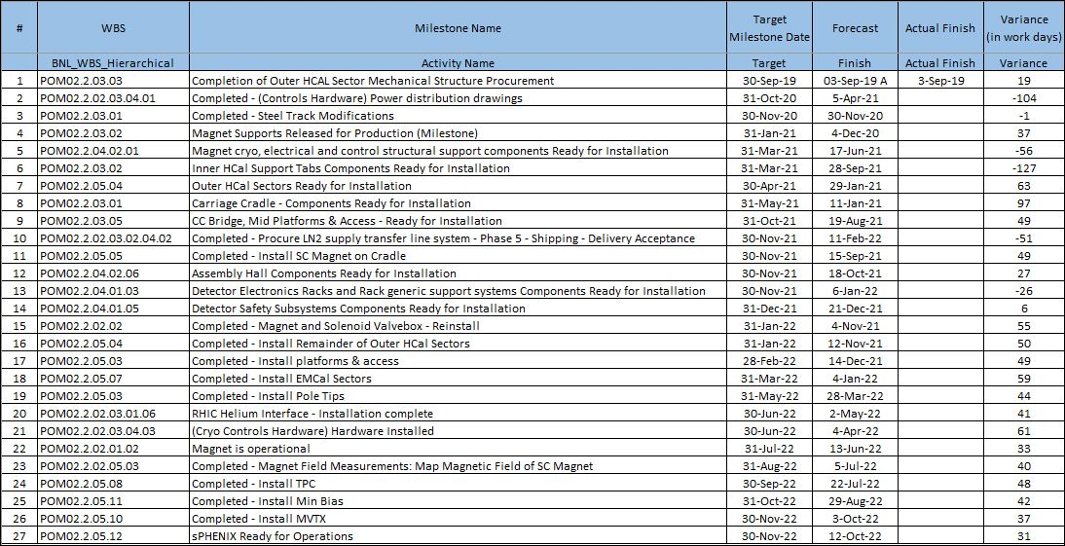
Milestones Status – 1008 Infra and Facility Upgrade

Slide 19
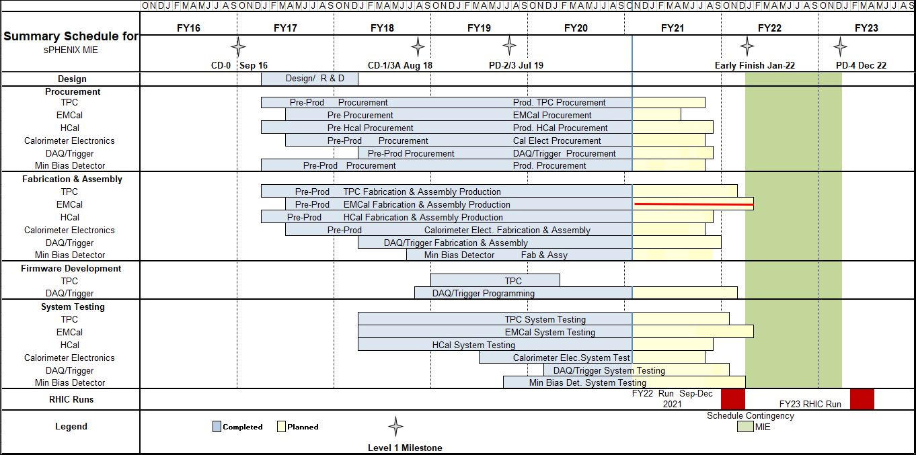
Summary Schedule – sPHENIX MIE

Slide 20
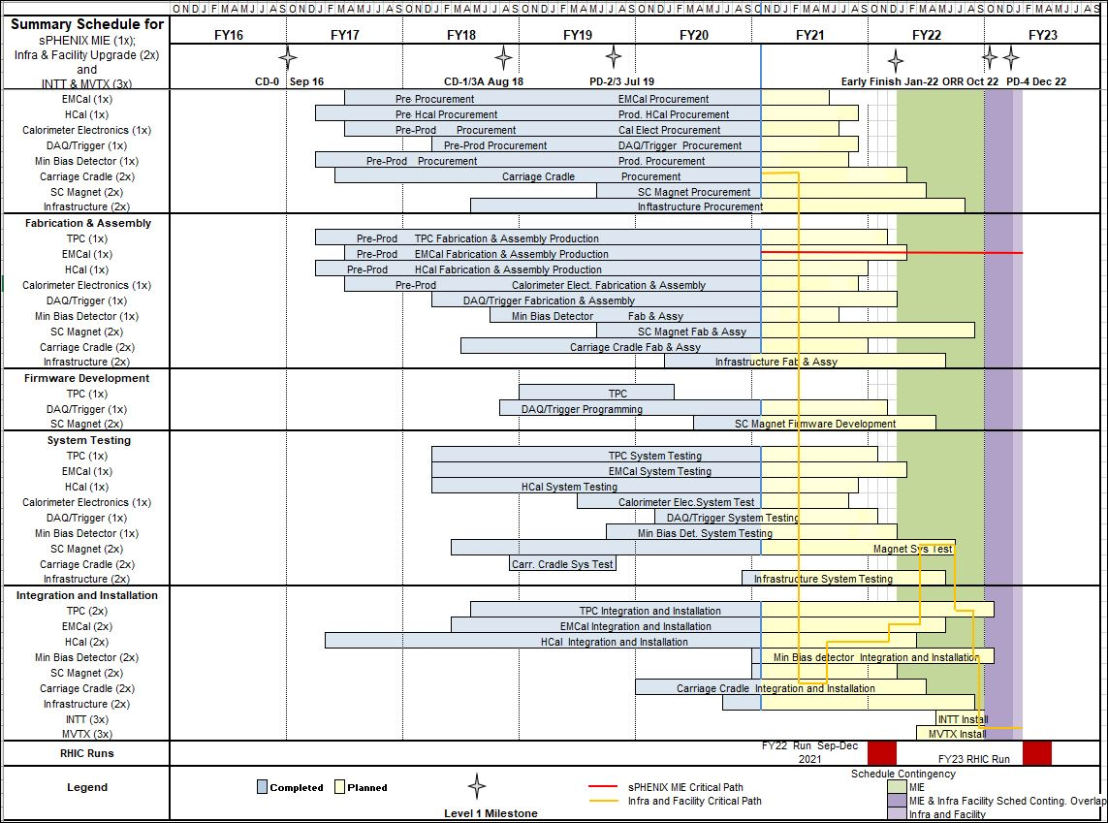
Summary Schedule – sPHENIX MIE and 1008 Infra and Facility Upgrade

Slide 21
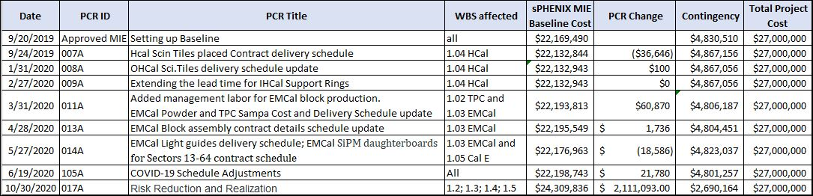
Baseline/Contingency Log - MIE
MIE PCR 017 just approved. Call on $2.11M in contingency. $2.7M in contingency remaining. More labor for universities (COVID impact), cables, electronics and TPC laser cost increase.

Slide 22
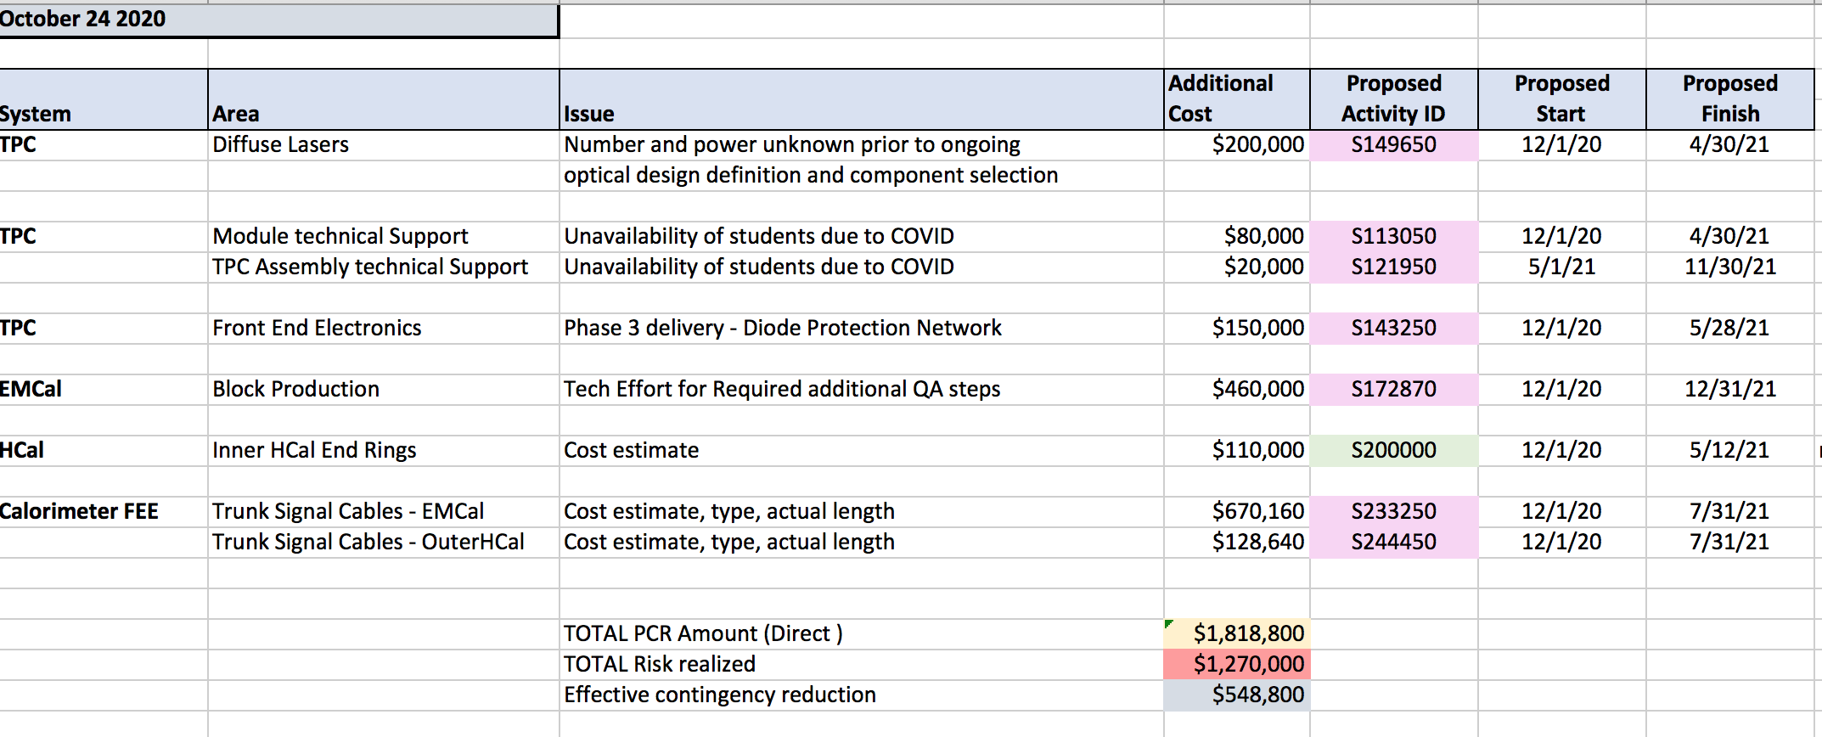
Details of Project Change Request 017
Fully burdened call on contingency is $2.11M

Slide 23
Summary
BNL is open and sPHENIX work is progressing on site. We have BNL authorization for 80% of our technical staff on site and working. sPHENIX Visitors from NYC metropolitan area also approved to be on site on case by case basis (SBU, Baruch, Rutgers, Lehigh)
We have a large team of engineers, designers and techs working on 1008 I&F Upgrade activities (design, reviews, procurement) remotely.
Significant progress on design and fab of sPHENIX components
The 1008 I&F early completion date is driven by vendor activities and is unchanged throughout the pandemic.
Issues:
Additional impact of COVID on schedule if there is a second shutdown.
Time available in 1008 IR to complete all work prior to sPHENIX roll-in.

Slide 24
Back Up

Slide 25
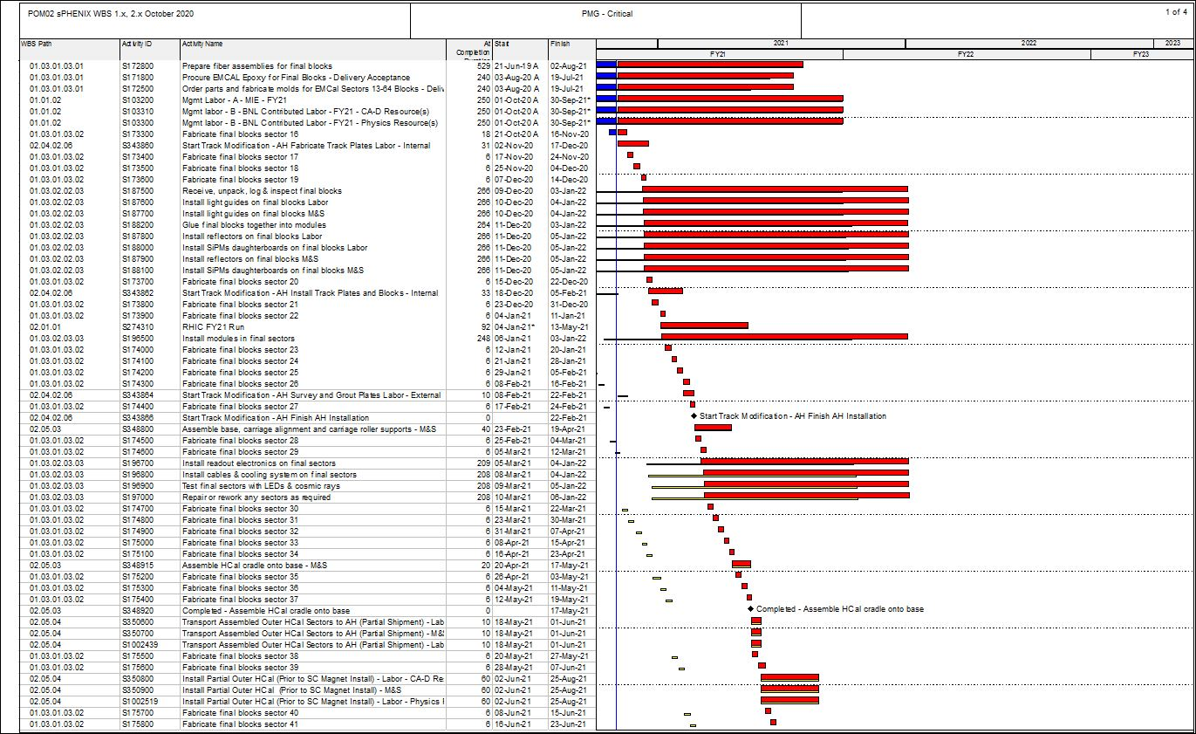
Critical Path (1x, 2x and 3x Combined)

Slide 26
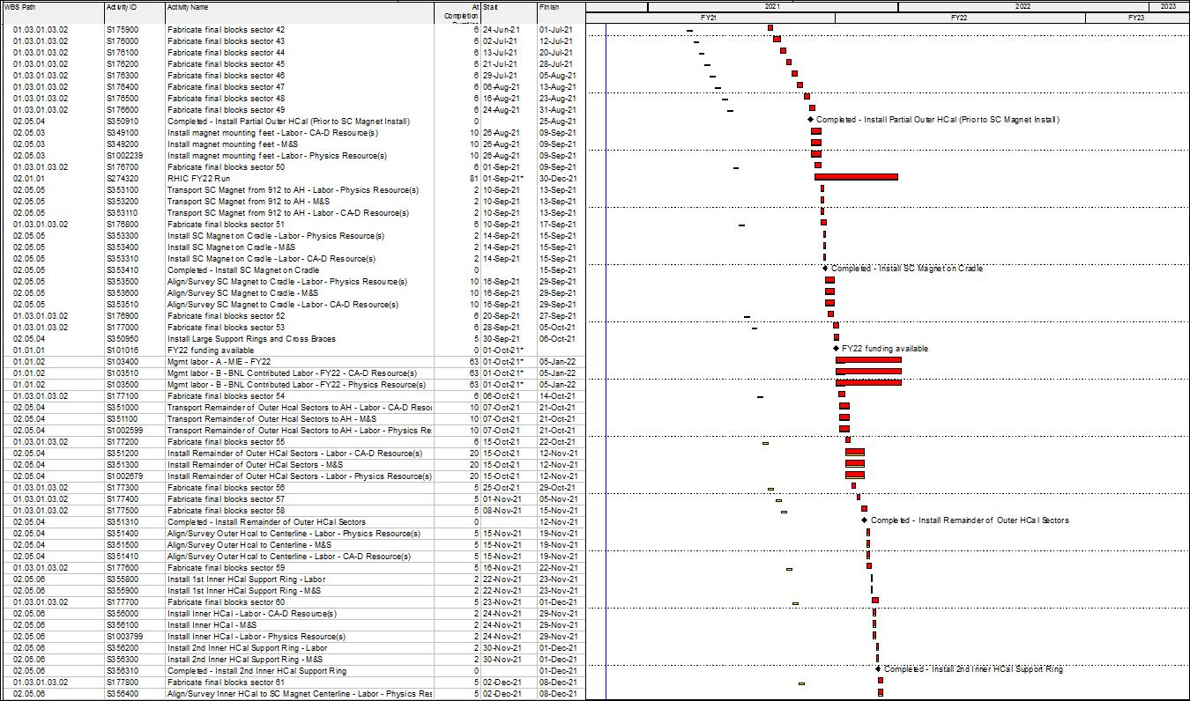
Critical Path (1x, 2x and 3x Combined)

Slide 27
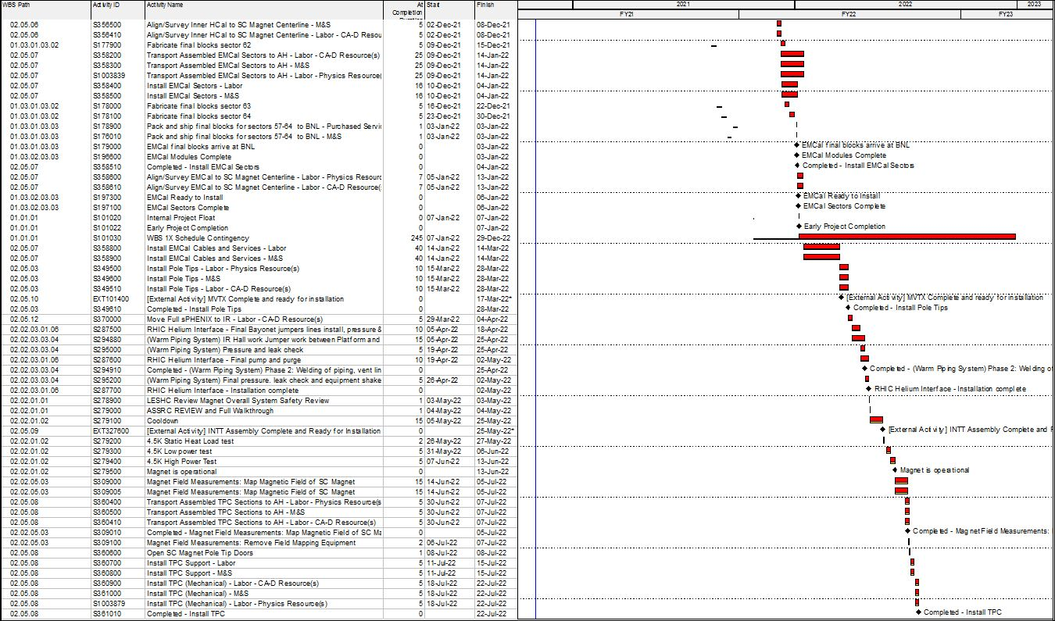
Critical Path (1x, 2x and 3x Combined)

Slide 28
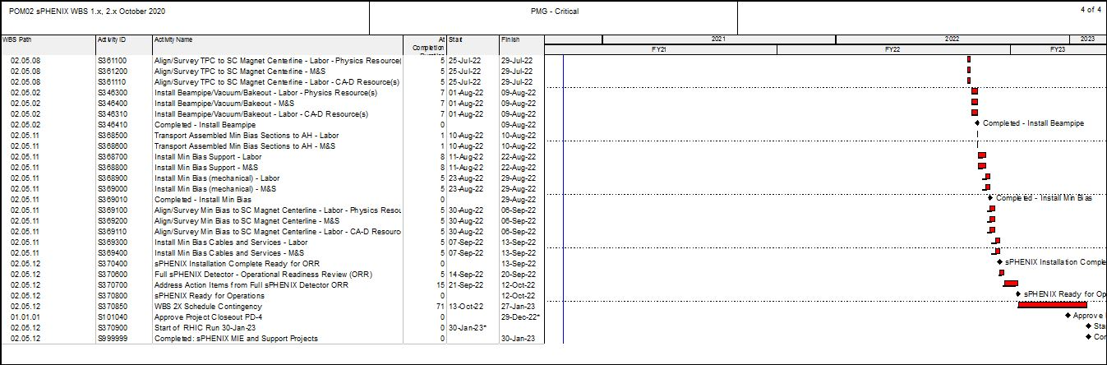
Critical Path (1x, 2x and 3x Combined)

Slide 29
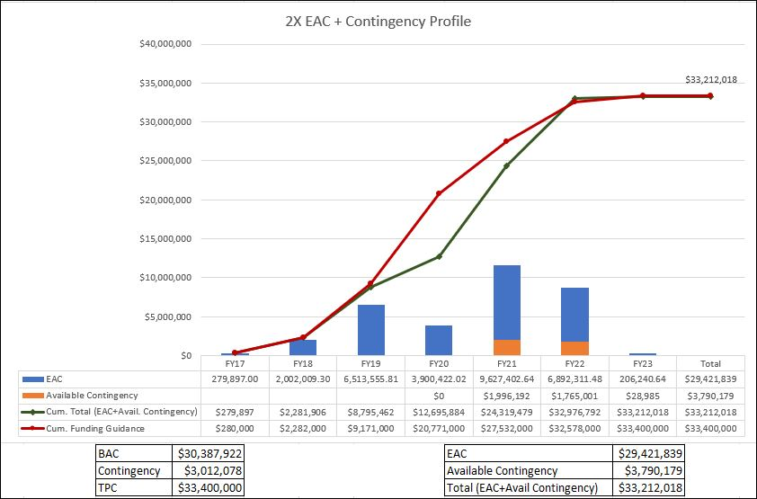
EAC and Contingency Profile – 1008 Infra and Facility Upgrade

Slide 30
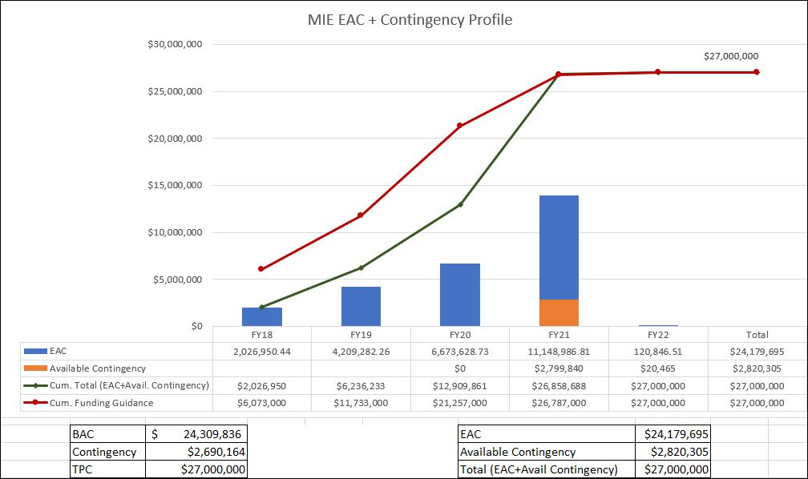
EAC and Contingency Profile – sPHENIX MIE

Slide 31
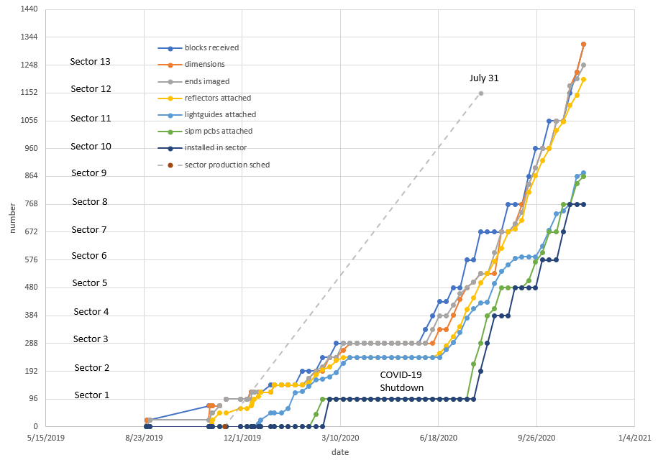
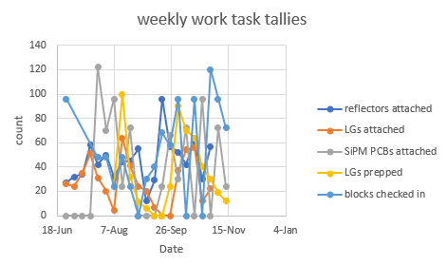
Progress Tracking – Module Production

Slide 32
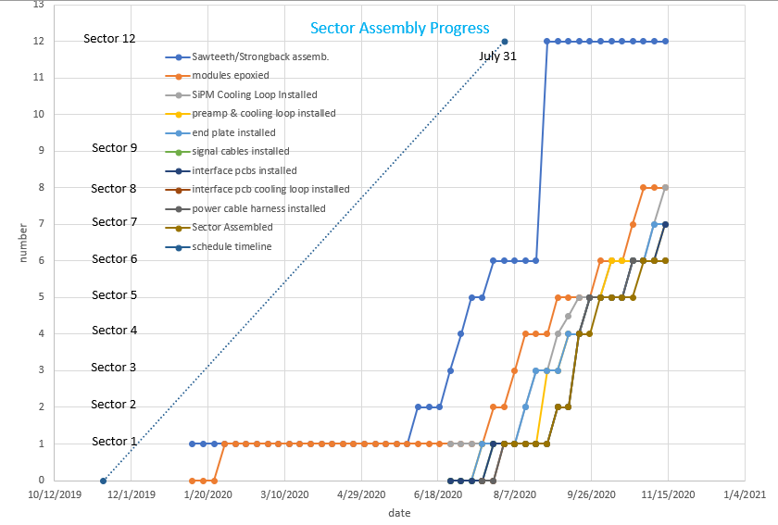
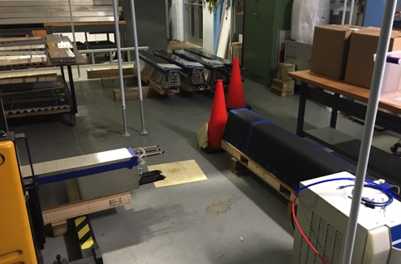
Progress Tracking – Sector Assembly
4,3,2,1
6
0
5

