Slide 1
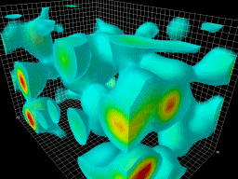
A novel compact detector concept for the Electron-Ion Collider (EIC)
Pawel Nadel-Turonski
Stony Brook University
Charles Hyde
Old Dominion University
The QCD vacuum
EIC PID consortium meeting, September 21, 2020

Slide 2
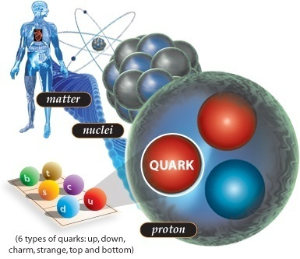
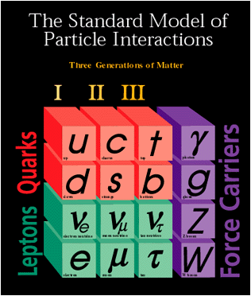
Visible matter according to the standard model
Almost all mass is dynamically generated by the strong interaction (QCD). The Higgs mechanism contributes a few percent.
Fermions (matter)
Bosons
(force)

Slide 3
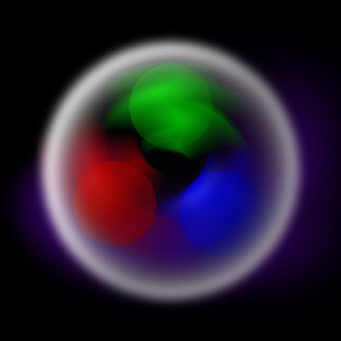
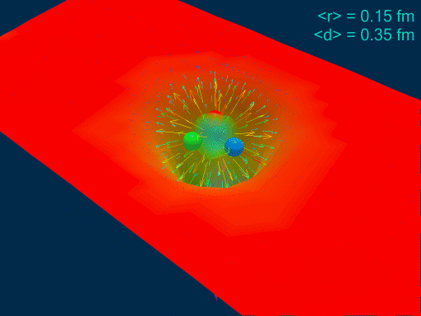
Understanding the glue that binds us all
300 MeV constituent quarks
EIC white paper
Few-MeV QCD current quarks
What is the spatial distribution of gluons and sea quarks in the proton?
How do the quarks and gluons make up the proton spin?
What happens at high gluon densities? Do gluons recombine and saturate?

Slide 4
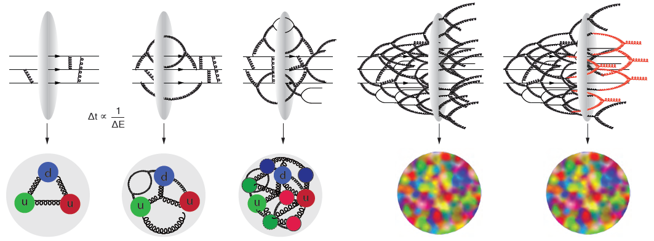
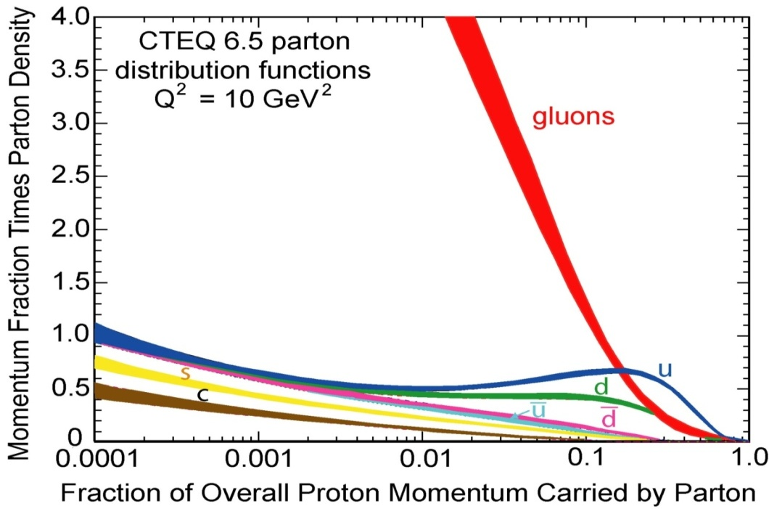
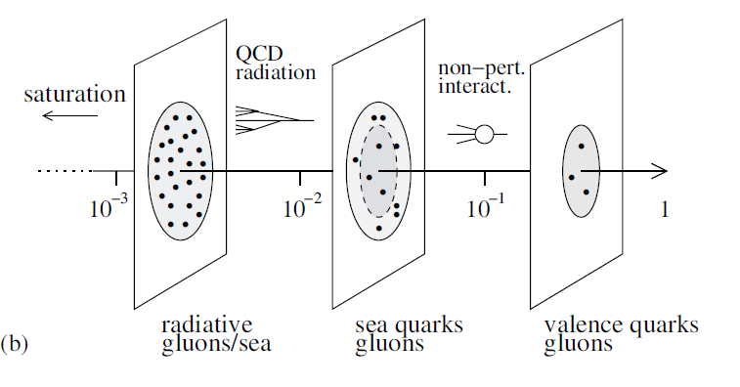
The changing nature of the proton
gluon momentum x
Detector frame
Rest frame
=
>>
EIC
(virtual sea)
JLab
(valence)

Slide 5
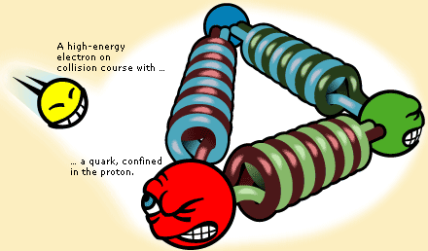
Electron scattering: x, t, and Q²
Q² is the (four-)momentum transfer from the electron, and is a measure of the resolving power of the probe.
t is the (four-)momentum transfer to the nucleon.
In elastic scattering, t and Q² are equivalent.
photon
x is the fraction of the nucleon momentum carried by the struck quark in a frame where the nucleon is moving quickly. With 3 quarks, one would naively expect x = 1/3.
photon
1
p
2
3
Reaching smaller values of x requires a higher collision energy!
x = p₁ / p_{proton}
x = Q² / 2 m_{proton} E_{photon}

Slide 6
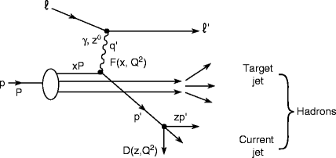
What do we detect?
Current jet (or hadron)
Scattered electron
Lepton scattering on a proton
p/A
e
Target jet (or hadron)
Inclusive DIS: only electron is detected
Semi-Inclusive DIS (SIDIS): electron and current jet (hadron) are detected.
Exclusive reactions: all particles are detected

Slide 7
Momentum distributions of quarks and gluons
Gluons saturate?
Accessed through inclusive reactions
photon
1
Parton Distribution Functions (PDFs) tell us about the densities of quarks and gluons inside the proton as function of their momentum (fraction) x.
p
2
3
x = p₁ / p_{proton}

Slide 8
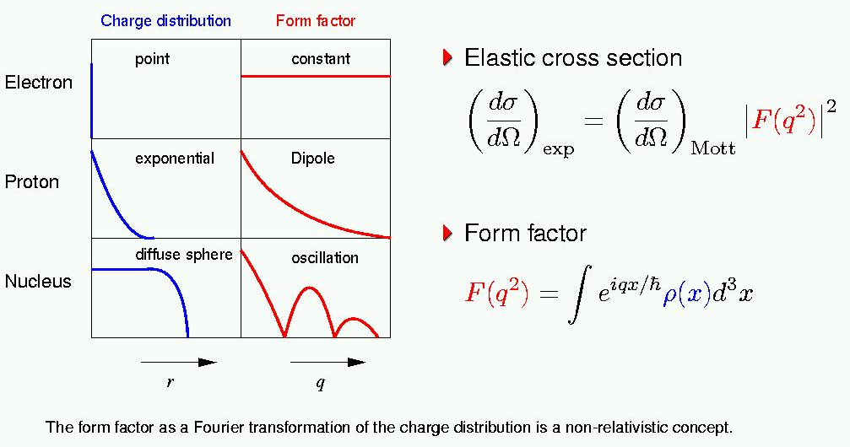
Spatial charge distributions (form factors)
Form Factors characterize internal spatial structure of particles
(diffraction)

Slide 9
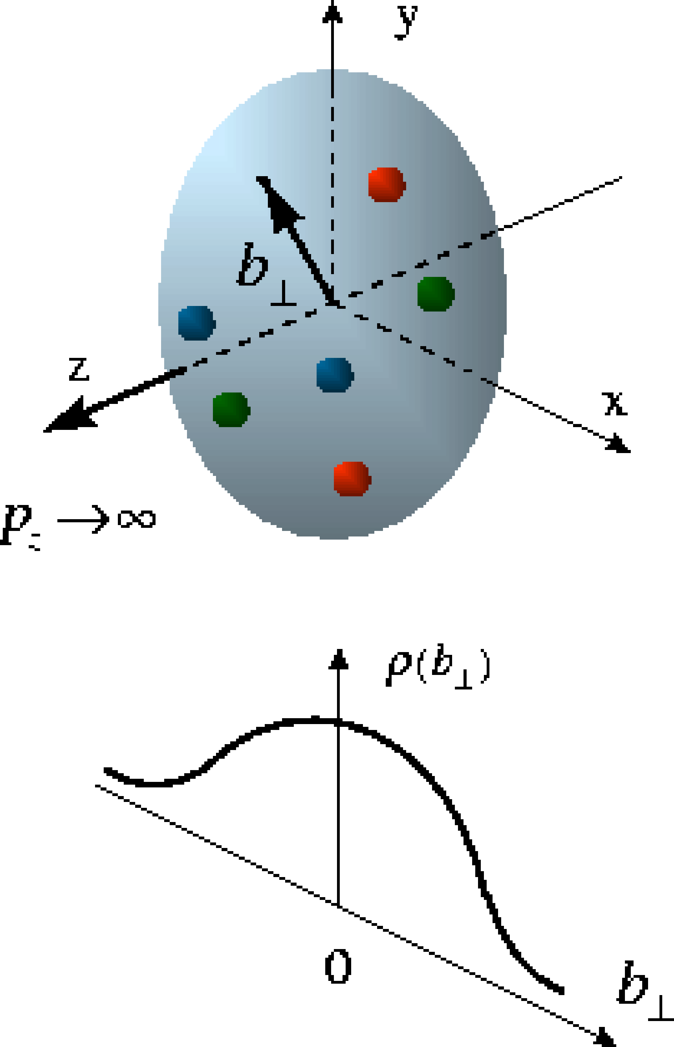
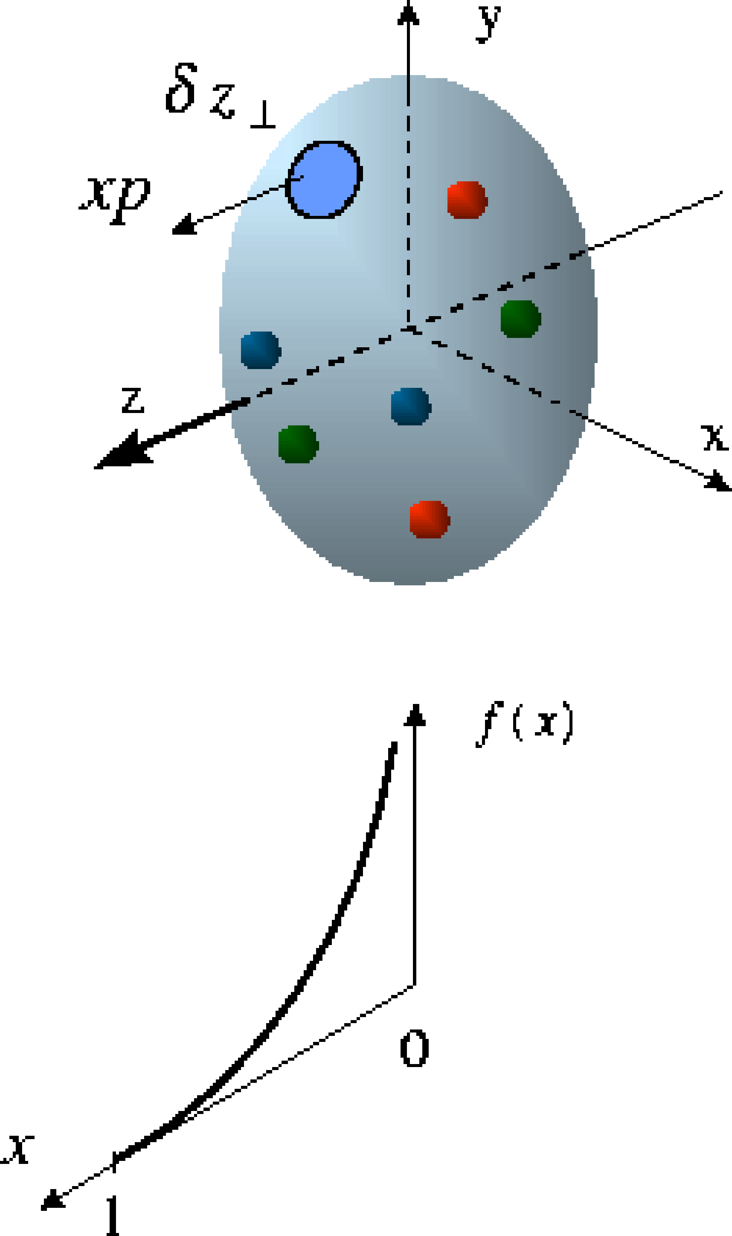
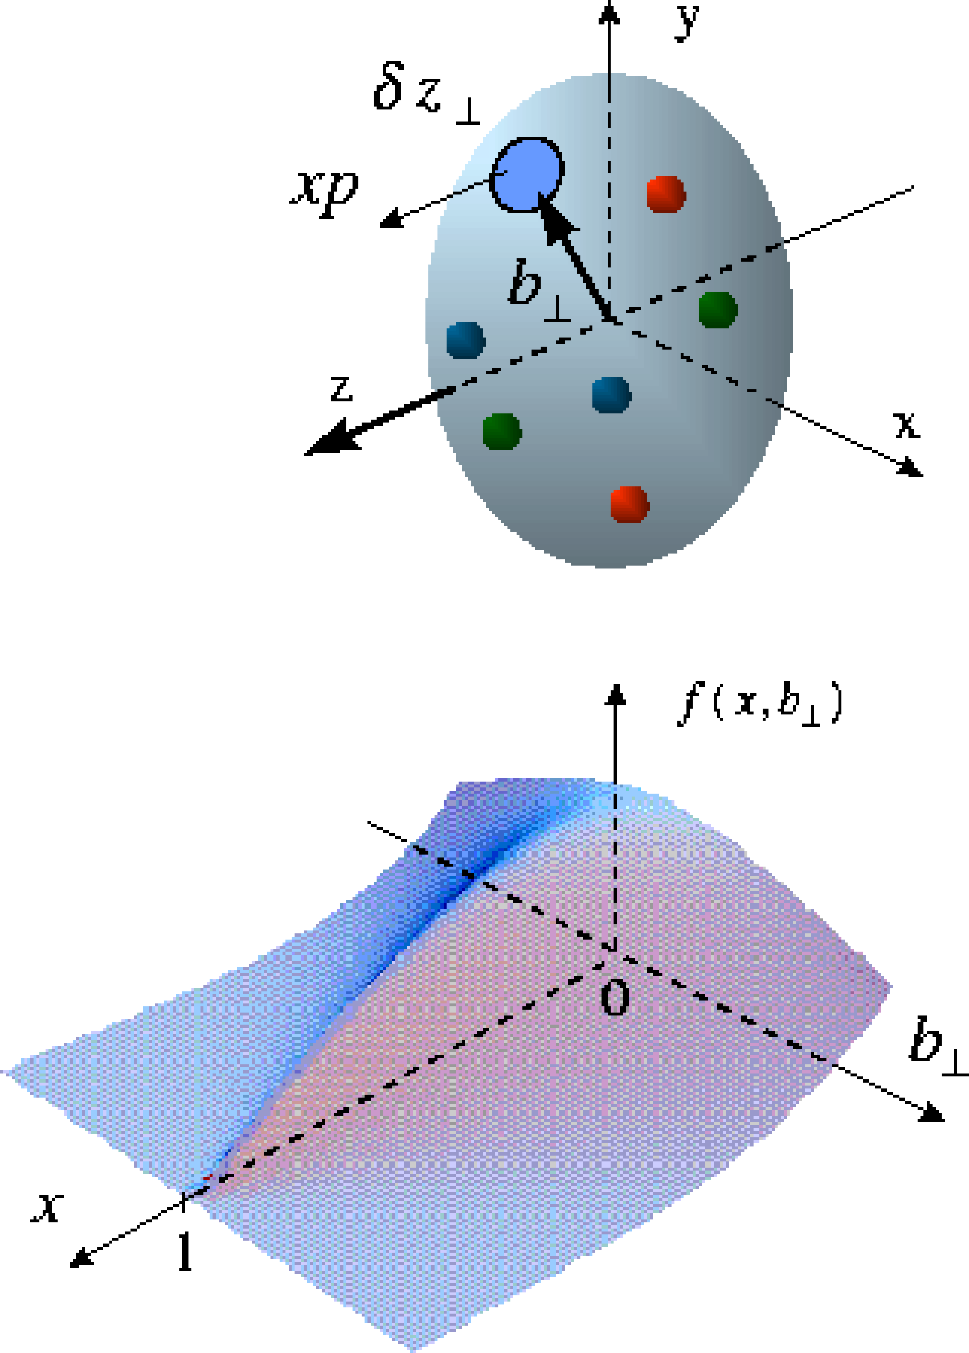
Tomography of the nucleon (and nuclei)
X. Ji, D. Mueller, A. Radyushkin (1994-1997)
Transverse charge & current densities (Form Factors)
Correlated quark momentum
and transverse spatial
distributions (Generalized
Parton Distributions)
Longitudinal momentum
distributions (Parton
Distribution Functions)

Slide 10
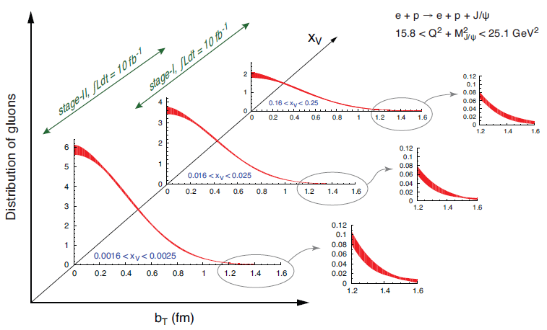
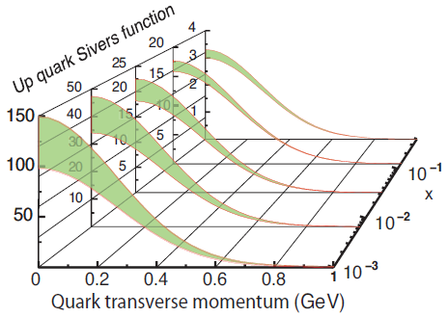
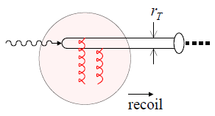
Transverse imaging in coordinate and momentum space
GPDs
TMDs
2+1 D picture in impact-parameter space
2+1 D picture in momentum space
Accessed through exclusive reactions
Accessed through semi-inclusive reactions
Transverse gluon distribution from J/ψ production
γ
Projections from EIC white paper
J/ψ

Slide 11
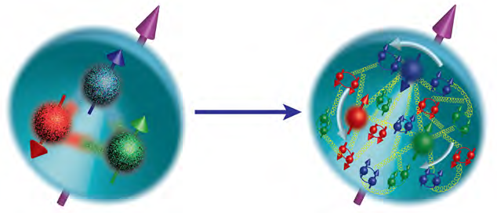
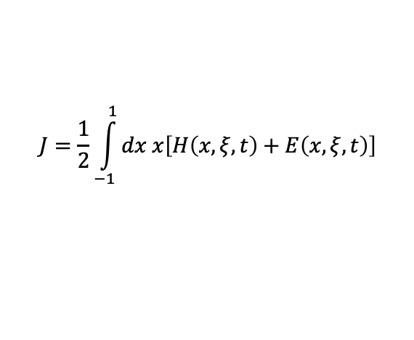
The spin of the proton
The nucleon spin reflects both the polarization of quarks and gluons, and their orbital motion.
½
polarization
orbit
polarization
orbit
quarks
gluons
Two complementary approaches needed to resolve proton spin puzzle
Measure ΔG - gluon polarization
Measure GPDs and TMDs - orbital motion
$$J=\frac{1}{2}\int_{−1}^{1}{dx x\left[H\left(x,ξ,t\right)+E\left(x,ξ,t\right)\right]}$$
Ji sum rule for GPDs H and E

Slide 12
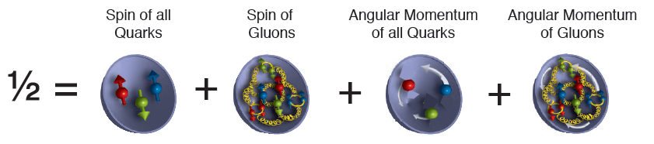
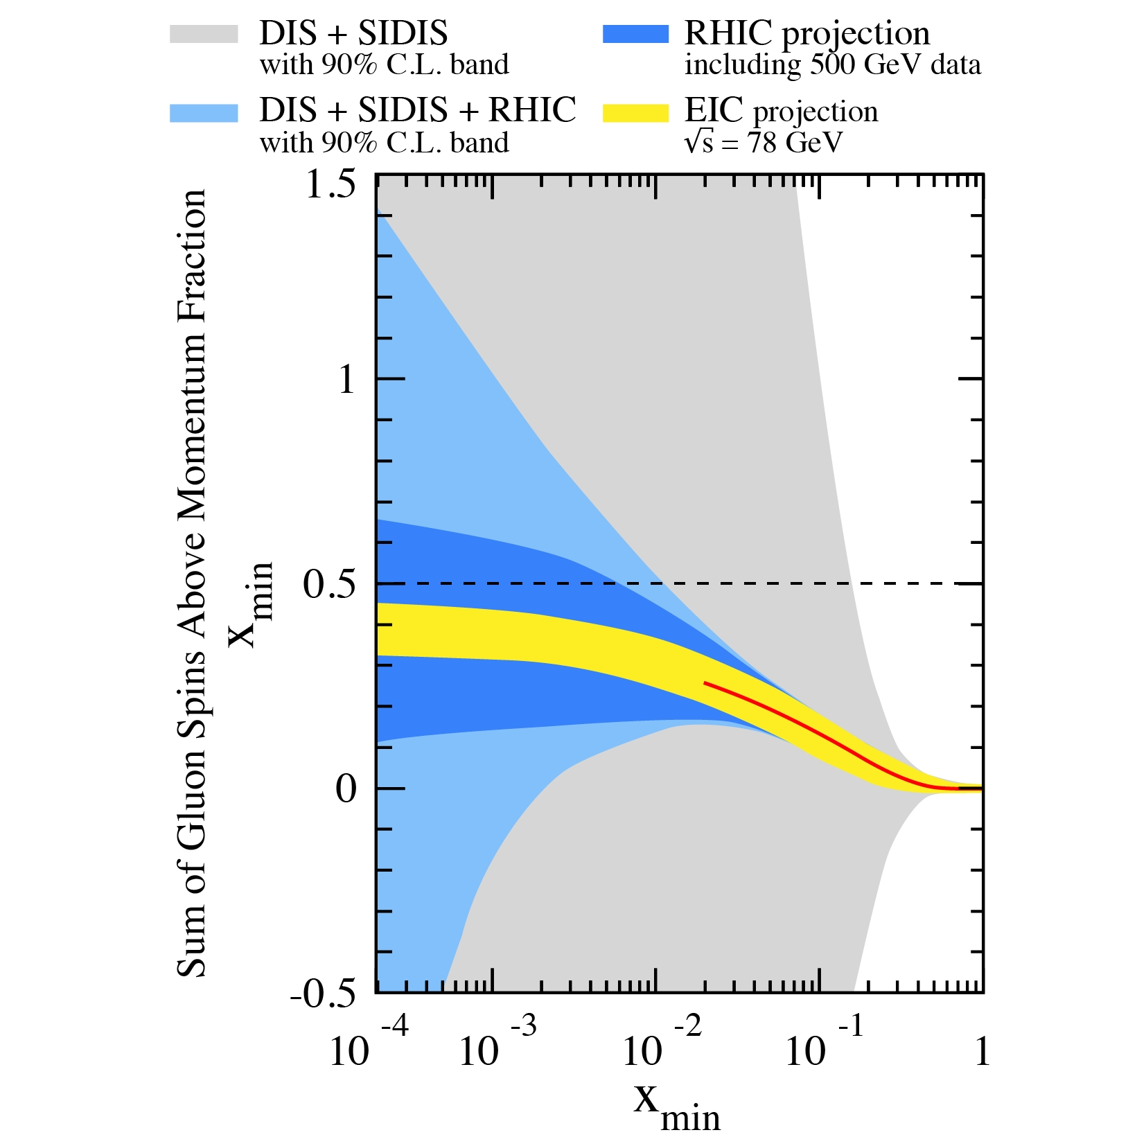
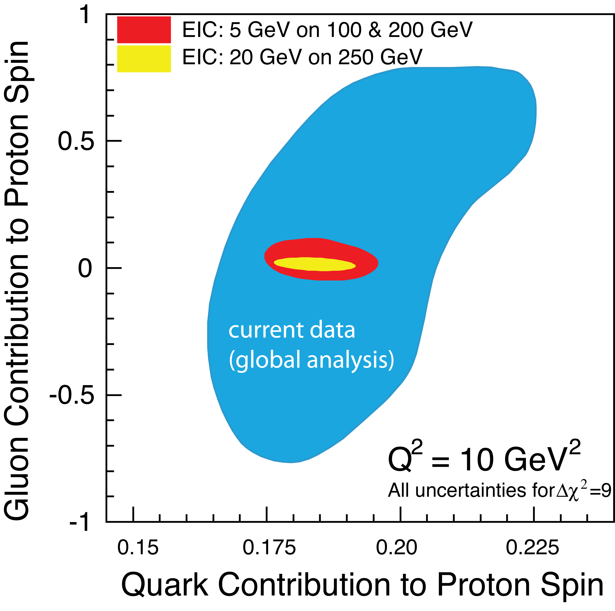
Gluon polarization
(ΔΣ/2)
(ΔG)
(ΔG)
Uncertainty
(ΔΣ/2)
Large uncertainties at low x require input from the EIC in addition to RHIC spin

Slide 13
Gluon saturation in the proton
small probe
large probe
many gluons
few gluons

Slide 14
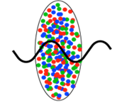
Detector frame: the nucleus is compressed into a pancake
Gluon saturation in nuclei
At low x the coherence length of the photon is larger than the nucleus
(rest frame).
JLEIC
.. but the visible matter is us!

Slide 15
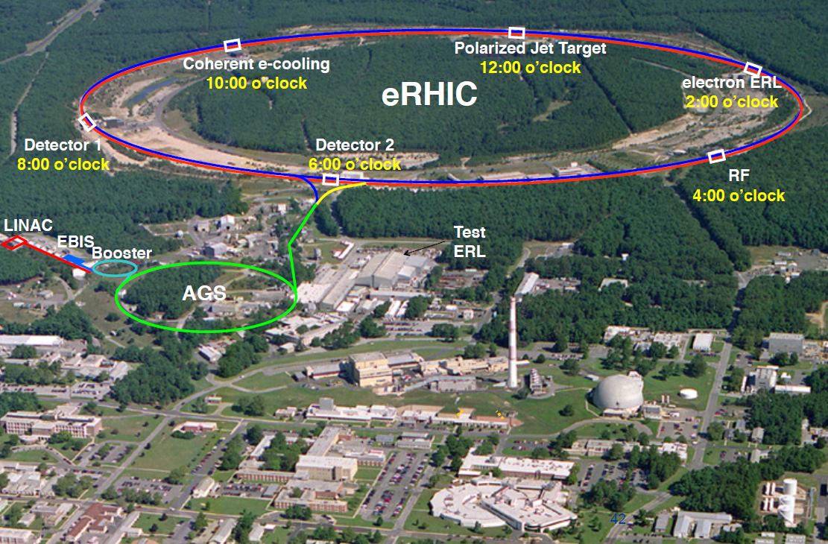
The Electron-Ion Collider at BNL
5-18 GeV polarized e- beams
  10 GeV luminosity maximum.
41-275 GeV polarized p beams
  Luminosity max at top energy
Ion beams up to 110 GeV/A
  Any ion species in principle possible from d to U
One detector is included in the project, but two would be desirable if funding permits

Slide 16
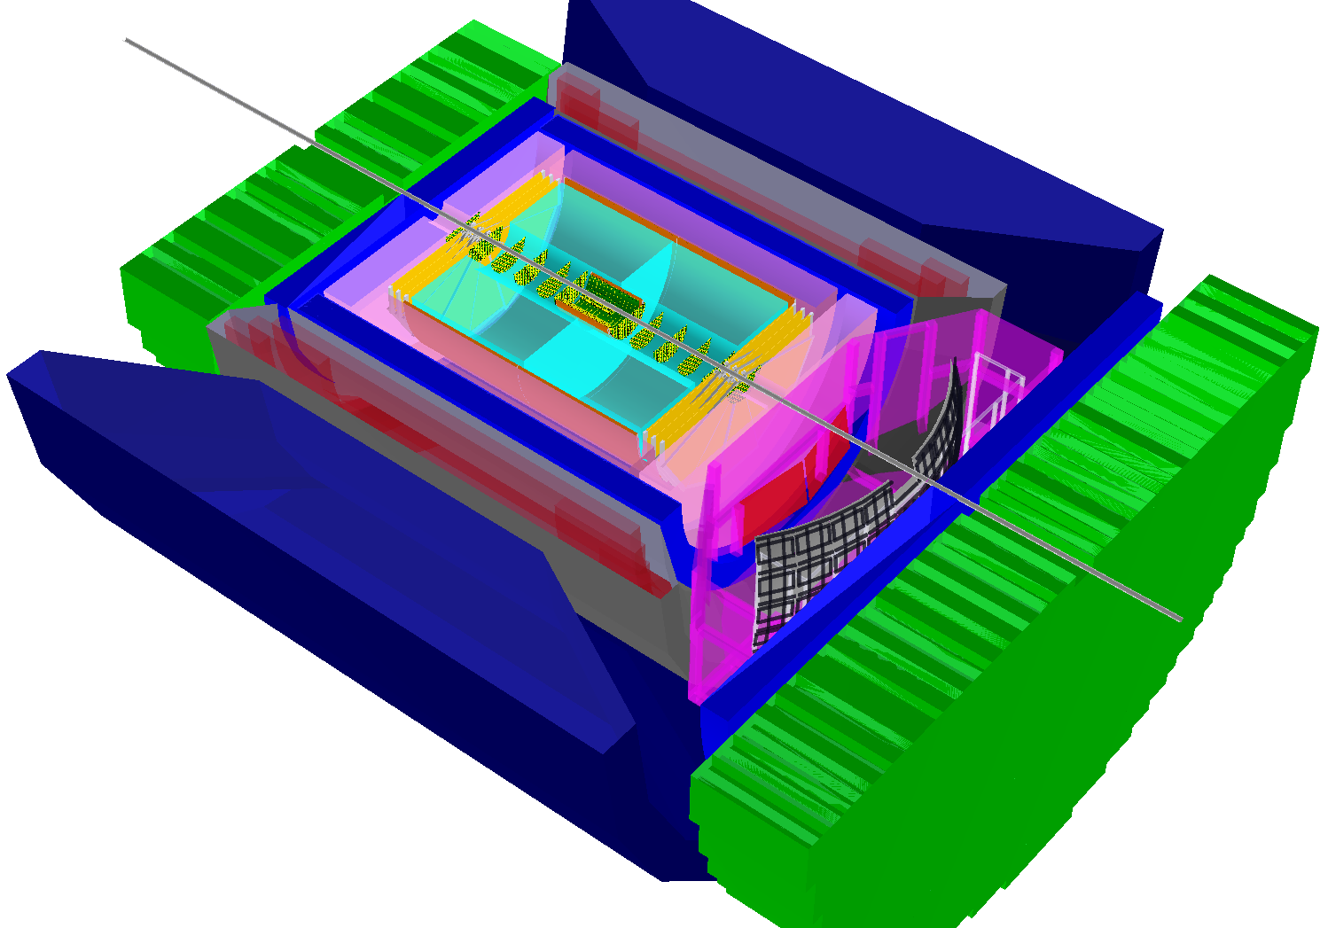
EIC detector requirements are diverse and demanding
ALICE
EIC detector
9 m
In order to reach the luminosity goal, the EIC detector is limited to a length of 9 m.
The physics require a hermetic detector with a full suite of subsystems allowing for precise measurement and identification of anything from single photons and mesons to jets
The collision kinematics are very asymmetric, requiring different technologies in different parts of the detector

Slide 17
A two detector scenario?
2020 Yellow Report “Reference Detector”
EIC-sPHENIX from 2018 LOI
To realize a two-detector scenario, we need three ingredients
  A primary detector that can satisfy the key EIC physics goals within a moderate budget
  A second detector that save costs by re-using suitable existing components (e.g., magnet, barrel Hcal, and TPC from sPHENIX).
  A complementarity between the two focusing on function rather than just technology
The Yellow Report “reference detector” is, however, generally similar in size and layout to the “EIC-sPHENIX” proposal from 2018.
  The main differences are that the ”reference detector” has less space for PID, may have an electron-side Hcal, and envisions using more expensive subsystems.

Slide 18
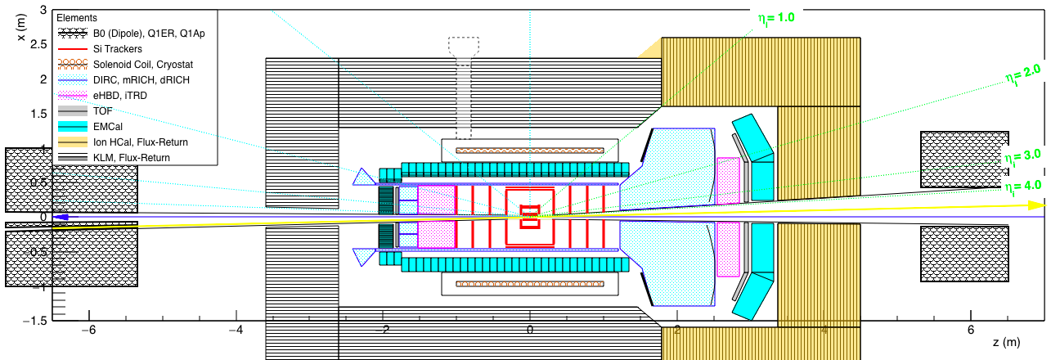
The compact EIC detector
Compact EIC detector
EIC-sPHENIX from 2018 LOI
A hermetic general-purpose detector that fulfills all physics requirements. It saves cost by reducing the size, but not performance of its subsystems:
  Risk minimized by utilizing components from Generic EIC R&D program
Key concepts:
  A small (ALICE-inspired) central Si-tracker and ultra-compact DIRC barrel Cherenkov
  An inexpensive barrel muon ID system integrated with the flux return of a new, small solenoid that can also provide a neutral particle veto for jets (like the Belle II KLM)
  A high-resolution Hcal (yellow) and a dual-radiator RICH (with outward-reflecting mirrors) at forward rapidities (to the right, in the ion beam direction)

Slide 19
Complementarity
Compact EIC detector
EIC-sPHENIX from 2018 LOI
The compact detector can support all aspects of the EIC physics program, but the concept is naturally complementary with an EIC upgrade of sPHENIX.
Key areas of complementarity :
  Barrel: KLM for muon ID and low-energy jets vs Hcal for high-energy jets
  Hadron endcap: dual-radiator RICH for optimal momentum coverage vs gas-only RICH, which could cover larger angles (if the inner Hcal was removed from sPHENIX) and more easily deal with higher-multiplicity jets
  Technological complementarities include tracking (Si vs TPC). Different choices EM calorimetry in the barrel and both EMcal and Hcal in the hadron endcap are also possible.

Slide 20
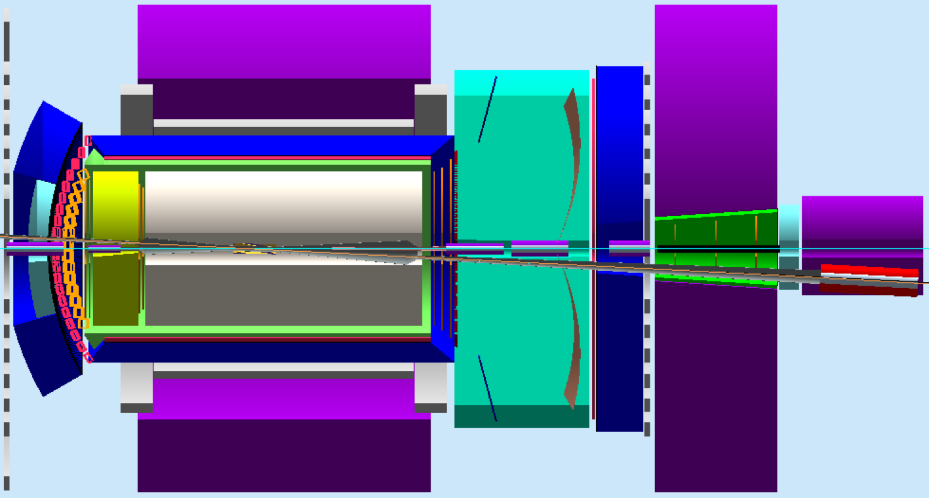
Integration
Compact EIC detector
Yellow Report “Reference Detector”
Two options for “B0” dipole integration
Integration of all subsystems of the detector within the limited space provided by the 9 m long interaction region can be challenging
The compact detector provides a simple solution to this problem
An alternative approach, making maximum use of the available space, was chosen for the JLab detector concept
  But the larger size would likely increase cost
2015 JLab EIC detector

Slide 21
Why not an “all-silicon” detector?
Compact EIC detector
ANL “TOPSiDE” detector
In the compact detector, the main benefit provided by the central Si-tracker is a smaller size, which in turn reduces the cost of the outer systems.
Since Cherenkov detectors do not rely on a long flight path, they are a natural choice for high-performance PID in any EIC detector, but in particular a compact one.
Replacing the Cherenkov-based PID with high-resolution (10 ps) timing, would require a much larger and more expensive detector, which would still not reach the same level of performance.

Slide 22

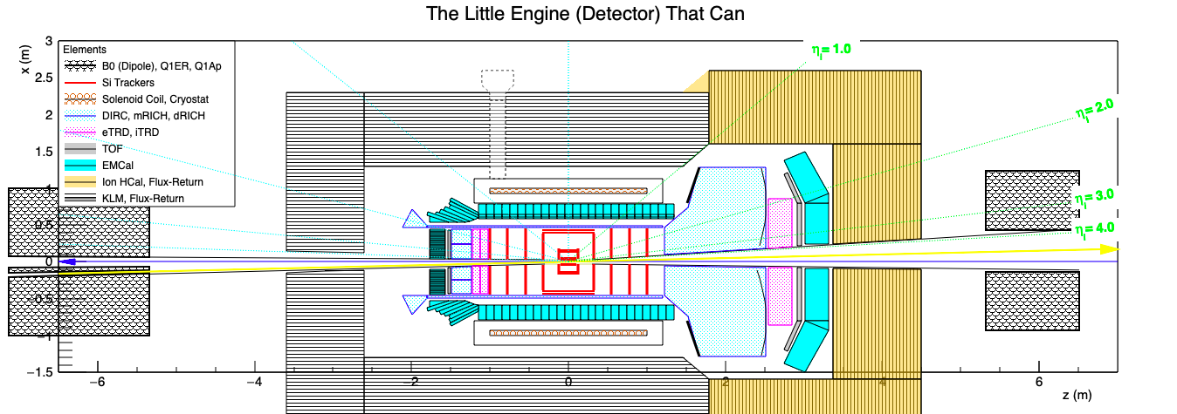
The compact EIC detector – overview
The picture shows an HBD in front of the mRICH and a TRD behind the dRICH. A more ideal configuration would likely be a TRD behind the mRICH but none behind the dRICH.
  This is still a concept detector that can be optimized in many ways!

Slide 23
The compact EIC detector – solenoid
New 2 T solenoid with a magnetic volume of about 2𝜋 m³ compared with 7.8𝜋 m³ in BaBar.
  The Si-tracker does not require a flat field, which thus can be optimized for the Cherenkovs.
The KLM can be integrated with the flux return at a moderate cost.

Slide 24
Hadronic calorimetry
Brian Page
At mid-rapidity, an Hcal does not reconstruct the jet energy as well as tracking and PID.
  Both jet energies and multiplicities are low
A high-resolution Hcal is needed in the hadron endcap.
  In addition to jets, it is also needed for kinematic reconstruction (hadronic method)

Slide 25
Hadronic calorimetry
Brian Page
Vetoing jets containing a K_{L} improves resolution
The veto efficiency can be determined precisely by comparing K_{L} and K_{s} yields.
The energy information from a traditional Hcal does not improve the resolution for jets with a missing few-GeV K_{L}
  Overall smearing remains comparable

Slide 26
The Belle (II) KLM
The KLM provides muon ID and K_{L} detection
  The muon momentum is determined by the central tracker
  The K_{L} gives an isolated hit in the KLM without an associated charged track
Mid-rapidity jets typically have low multiplicities and cover a large area in the detector
  The KLM is ideal for vetoing such jets with high efficiency

