Slide 1
ENDF/B-VII.1.x Decay Data Sublibrary
A.A. Sonzogni, T.D. Johnson, E.A. McCutchan,
National Nuclear Data Center
Brookhaven National Laboratory
Building 817
Upton, NY 11973-5000
www.nndc.bnl.gov

Slide 2
Will present work on:
Fixing bugs in ENDF/B-VII.1
New data for ENDF/B-VII.1.1
Related activities we are active on:
Beta-delayed neutron emitters CRP (IAEA).
Decay Heat Consultants meeting (IAEA).
Reactor antineutrinos
ORNL and Jyvaskyla experiments

Slide 3
ENDF/B-VII.1 decay data sub-library
Errors in ENDF/B-VII.1:
98mY Pn value, should be 0.034 but its is given as 0.00331.
90Kr, 2nd decay should have rfs=1.
Minor bugs in ENDF/B-VII.1:
Nuclides that are known to be 2β- or 2EC, but no half-life is known, much less the beta spectra.
Serious Issue:
ENDF/B-VII.1 is out of synch with ENDF/B fission yields

Slide 4
What we’ve done since the last release
Improve antineutrino spectra calculations by including Iβ from TAGS experiments
and Iβ following fit to Tengblad 1990 data
92Rb Use the 2006LH01 gamma normalization
137I Run LOGFT , Added 2 E2 gammas, run BRICC
135sb Run LOGFT , Added 2 E2 gammas, run BRICC
95Sr,140Cs,95Y,143La,145La,141Cs,143Ba,91Rb,93Rb,94Rb,144La use IB TAGS
82Ge Use ENSDF assuming IB(GS)=0
83Ge Use ENSDF assuming IB(GS)=1
90Br,96Rb,98Y,138I,88B,99Y,89br,134sb,95rb,82As Adjust the beta feeding to match Rudstam's data
91Br Use Woehr beta feeding, neutron have to be added

Slide 5
We have participated in experiments in ORNL and Jyvaskyla that measured new TAGS data for about 30 nuclides, which will be added to the library (IB, EEM, ELP).
The next release may also include antineutrino spectra for some nuclides.
Comparison between different Decay data sub-libraries can be found at www.nndc.bnl.gov/nudat2/ddsl/

Slide 6
An important drawback of the sub-library is the absence of level information. As a result, it can not be used to obtain coincidences.
If a new XML format is approved, the next major release will include these level data.
Next slides, some applications

Slide 7
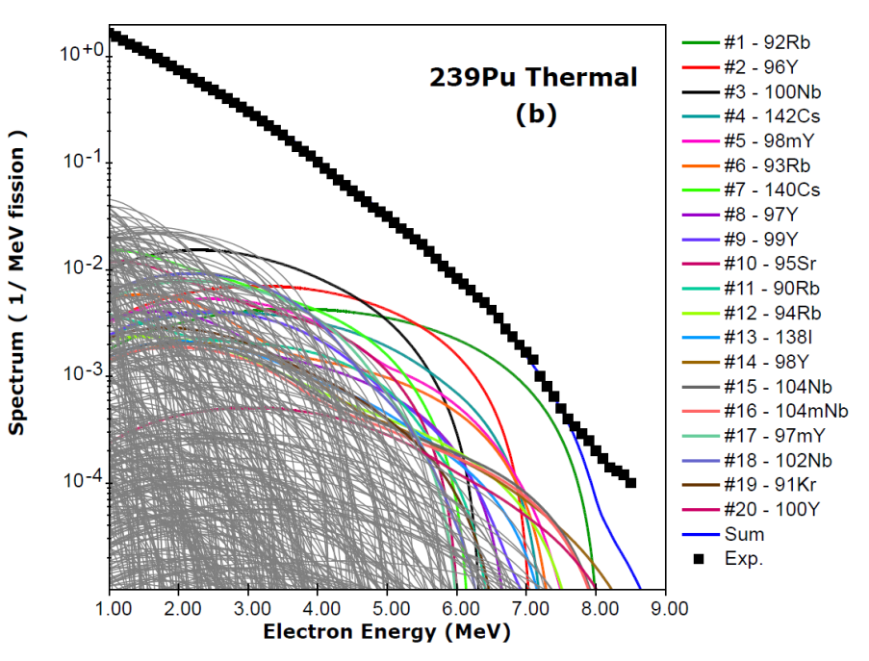
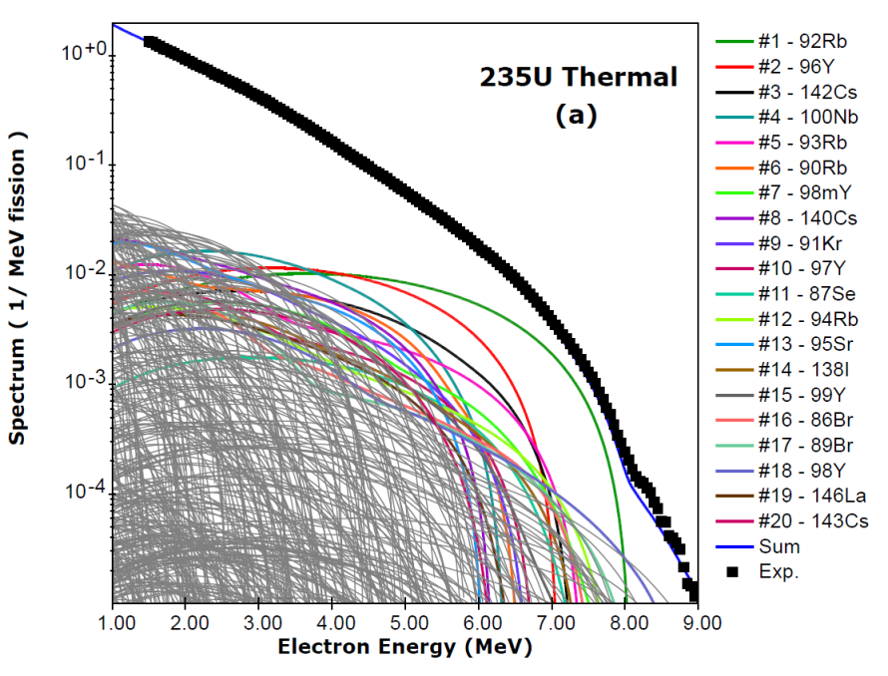
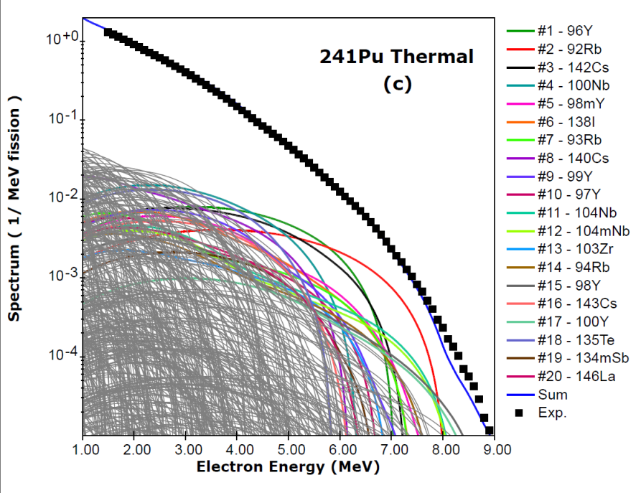
Recent (n,fission) Beta Spectra Calculations
No adjustable parameters
Phys. Rev. C 91, 011301(R) (2015)
For energies > 5 MeV, the electron and antineutrino spectra are mainly due to about 20 nuclides
The decay of these nuclides is of great interest

Slide 8
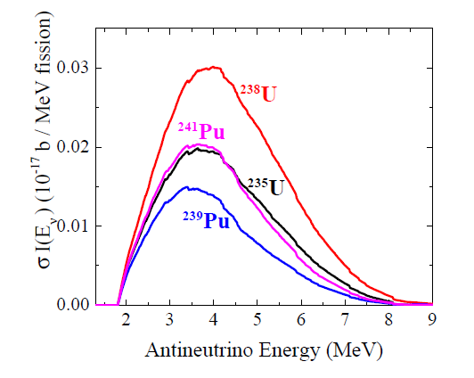
ν + p → n + e⁺ cross section integrated spectra
Target | Delayed neutron multiplicity/fission
238U | 4.4E-2
235U | 1.59E-2
241Pu | 1.62E-2
239Pu | 6.45E-3
The integral of antineutrino multiplicity has a similar behavior as the delayed neutron multiplicity.

Slide 9
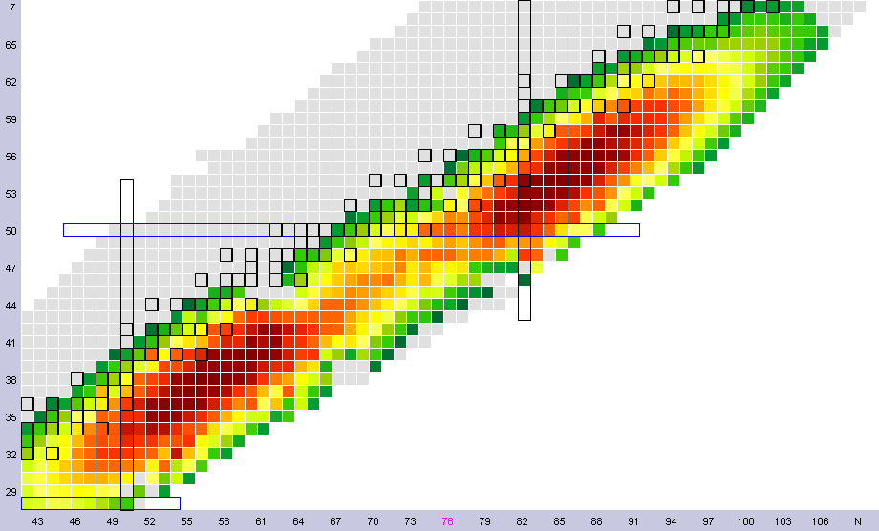
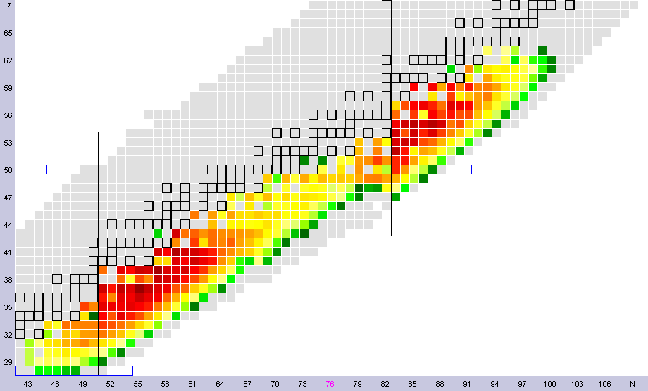
235U thermal fission yields
235U thermal Y_{i}/<σI>
Y_{i}=CFY_{i}∫σ(e)Iνi(e)
<σI>=ΣYi

Slide 10
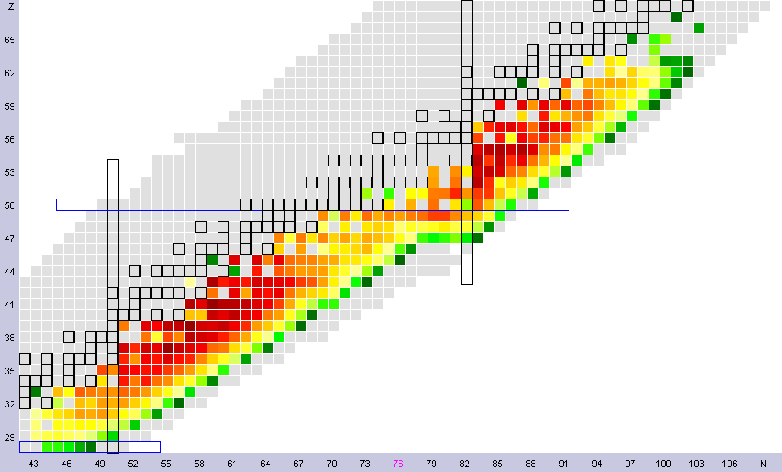
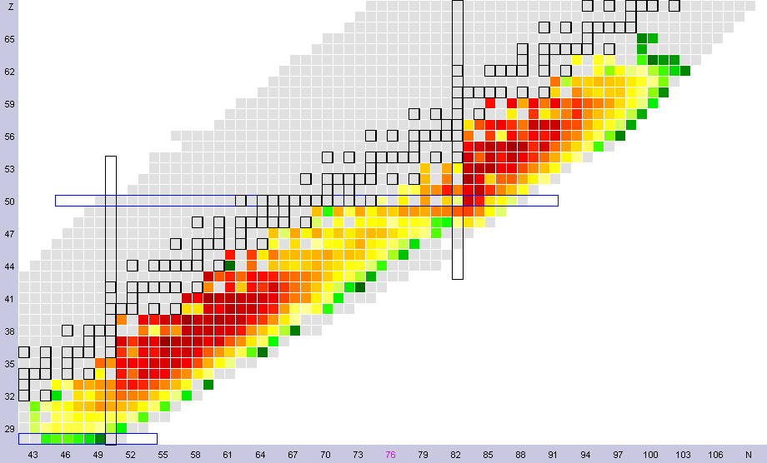
239Pu thermal Y_{i}/<σI>
238U fast Y_{i}/<σI>

Slide 11
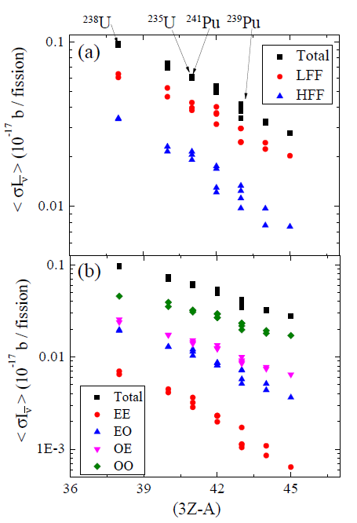
Systematics of <σI> with (3Z-A)
LFF: Light fission fragments ( Z<47)
HFF: Heavy Fission Fragments (Z >= 47)
EE: Even-Z, Even-N
EO: Even-Z, Odd-N
OE: Odd-Z, Even-N
OO: Odd-Z, Odd-N

Slide 12
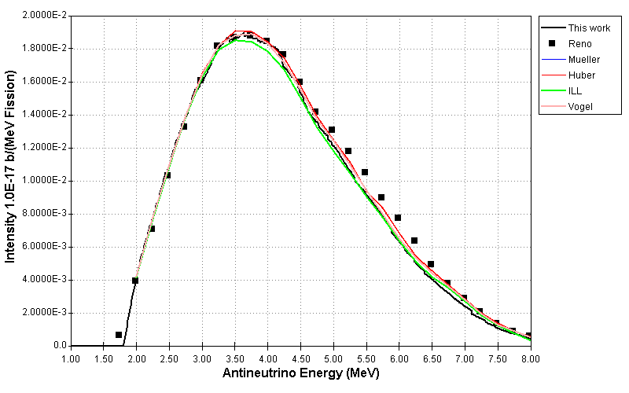
Comparison with preliminary RENO data
Excess of antineutrinos

Slide 13
Next workshop on
Modeling of Antineutrino Flux from Nuclear Reactors
June 2016
Port Jefferson or BNL
Tentatively Tuesday 6/14 – Thursday 6/16, 2016
1st workshop took place at the INT, Seattle, 11/2013
2nd workshop SUBATECH, Nantes, 01/2015

Slide 14
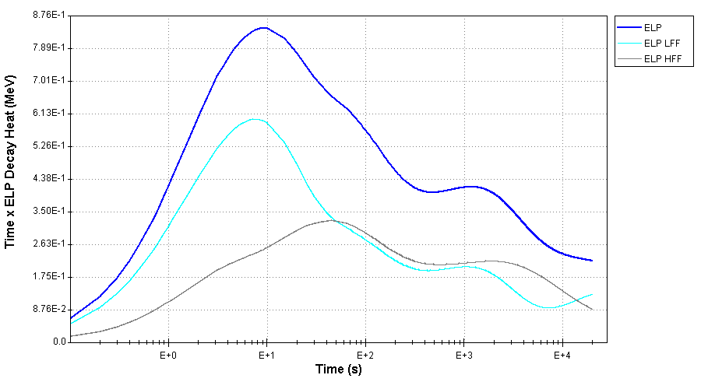
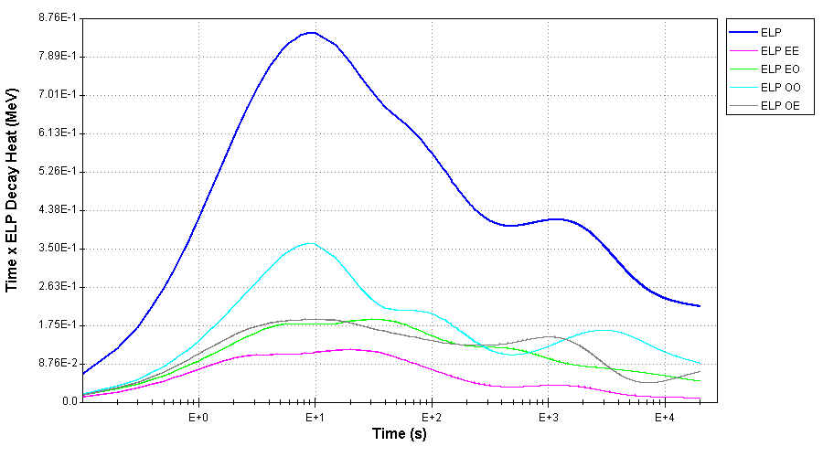
Relation to decay heat
235U Thermal

Slide 15
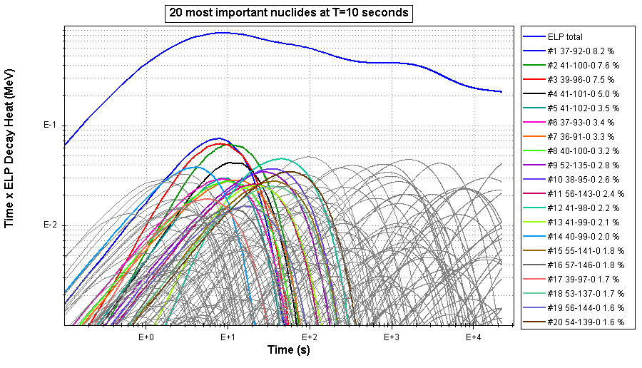
235U Thermal
92Rb, 100Nb, 96Y, 101Nb,102Nb

Slide 16
IAEA CRP on Beta delayed neutron emitters
Will result in newly evaluated values of Pn and T_{1/2} for delayed neutron emitters, ex, 88Br. These data will be incorporated in ENSDF as well as the sub-library.
ν_{d}: Delayed nu-bar, number of neutrons for single fission event. It can be calculated as:
ν_{d} =Σ CFY_{i} Pn_{i} , about 0.015/fission for 235U
CFY: cumulative fission yield.
Pn: beta-delayed neutron probability.

Slide 17
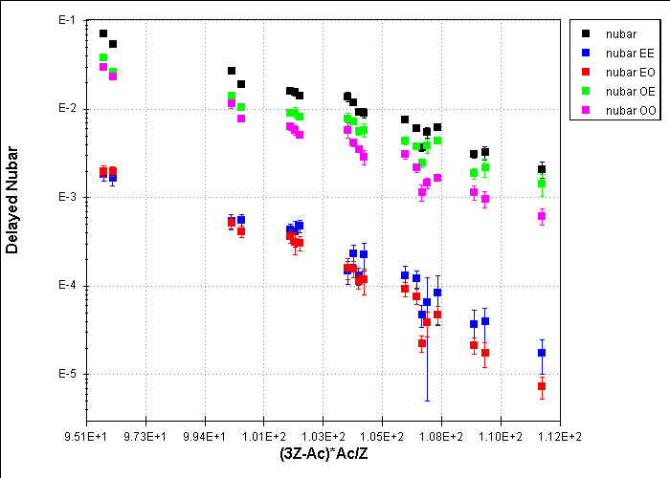
Delayed nu-bars calculated using Pn and CFY
232Th
238U
235U
238Np
241Pu
233U
239Pu
252Cf

Slide 18
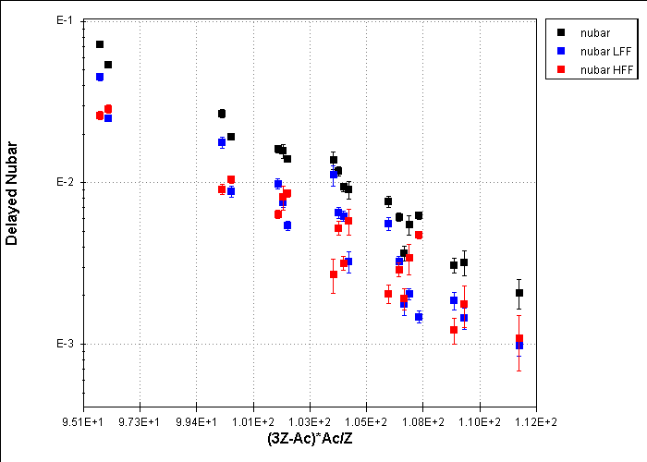
As before, but plotting lighter and heavier fission fragments contributions
232Th
238U

Slide 19
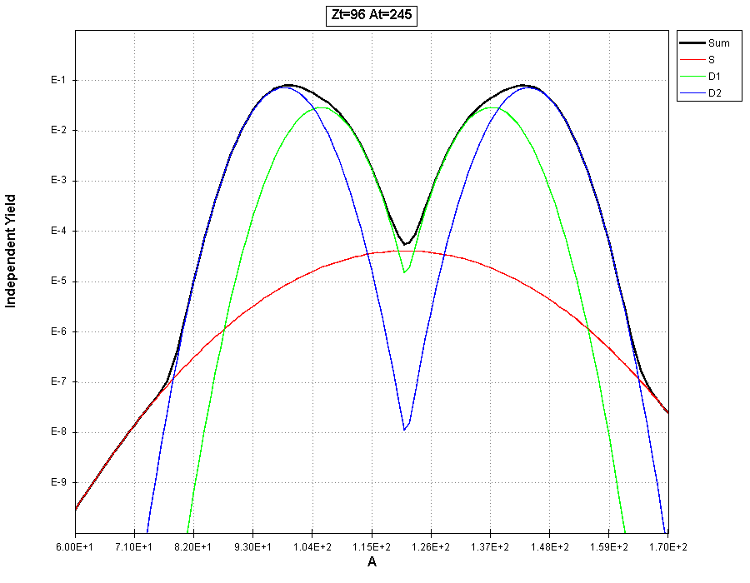
Now looking at the contributions of the different fission modes.
Using Katakura’s 5-Gaussian parametrization (IAEA CRP)

Slide 20
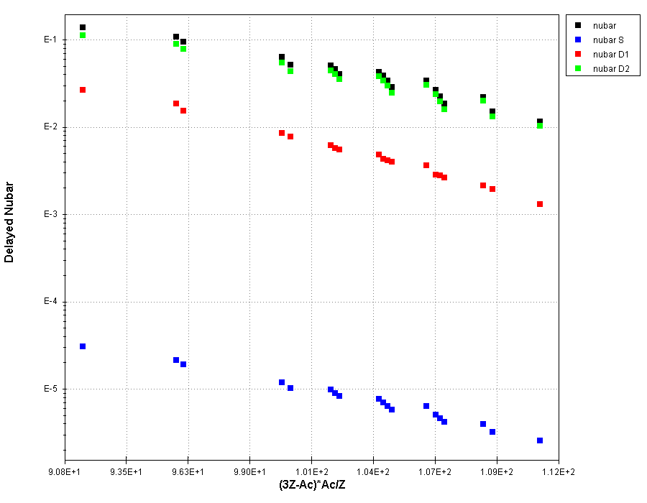
D2, most asymetric fission are the main (90%) contributors to delayed nubars

