Slide 1
Improved Neutron Capture Gamma-Ray Data for Li and F ENDF Libraries
Mini-CSEWG-2015 Brookhaven National Lab
Brad Sleaford
May 7, 2015

Slide 2
Collaborators
LLNL – B. W. Sleaford, C. Mattoon
LBNL – R.B. Firestone, A. Hurst, S. Basunia, L. Bernstein
Budapest Reactor –T. Belgya, L. Szentmiklósi
Charles University (Prague) – M. Krticka, F. Becvar
FRM II Reactor (Munich)- Zs. Revay, C. Genreith
IAEA – R. Capote
Large International Experimental and Theory Effort

Slide 3
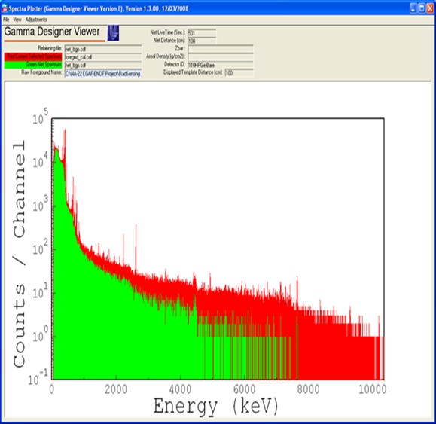
Why: Capture Gamma Application-Non Proliferation- ~26 Isotopes tested at LLNL
- Gammas are 6-12 MeV (σ!)
  Clear of competing lines
  More difficult to shield
  Fingerprint of capturing isotope
-Neutrons from spontaneous fission Actinides present
-Neutrons coupled to gammas
-Passive or active neutron sources
-Thermal Capture Dominates-
Cross section larger,
Thermalization time vs HPGe
Measurement of gamma spectra from Pu mass
Used in ANY spectroscopy application, Emergency response, Nonproliferation, etc.
Notes:
Application centric, ~26 libraries in use at LLNL ENDFB6,

Slide 4
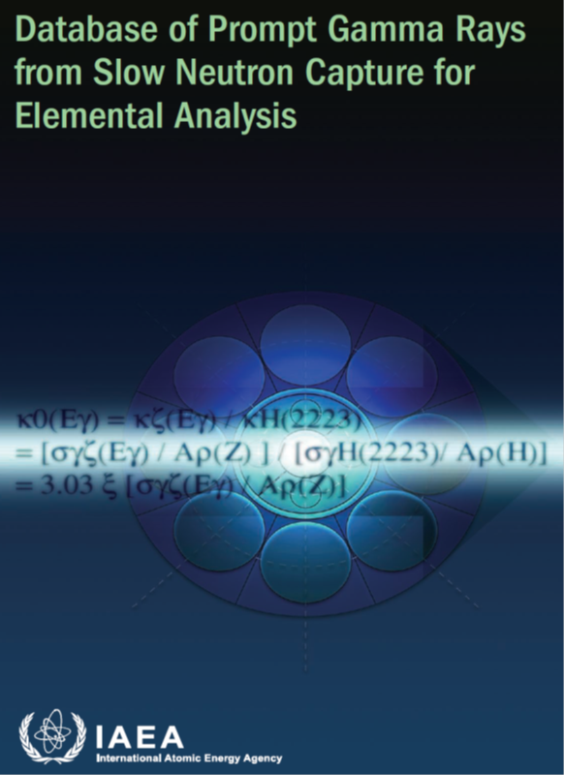
IAEA CRP Capture Gamma Spectra for ~260 Isotopes 36K lines ~ Budapest Reactor Measurements + FRMII

Slide 5
Li & F changes:
-MT 102 File 12 Yields ->EGAF σ’s Thermal Region
-Matched-Total Capture Cross section & Q value
-Cascades are complete-no quasi continuum
-Tested with NJOY, FUDGE at LLNL+ applications
3.00600E+3 5.96340E+0 1 0 3 0 32512102 2982
0.000000+0 0.000000+0 0 0 1 2 32512102 2983
2 2 32512102 2984
1.000000-5 1.776633+0 2.000000+7 1.390000+0 32512102 2985
7.245909+6 0.000000+0 2 2 1 2 32512102 2986
2 2 32512102 2987
1.000000-5 7.964218-1 2.000000+7 6.100000-1 32512102 2988
6.768811+6 0.000000+0 2 2 1 2 32512102 2989
2 2 32512102 2990
1.000000-5 4.868814-1 2.000000+7 3.900000-1 32512102 2991
4.775945+5 0.000000+0 1 2 1 2 32512102 2992
2 2 32512102 2993
1.000000-5 4.933301-1 2.000000+7 3.900000-1 32512102 2994
32512 0 2995

Slide 6
Li6-Significant line intensity changes and minor energy differences

Slide 7
F had few changes

Slide 8
26 beta Libraries have been in testing
Z |  | A | %NA | barns | number of Gammas
1 | H | 1 | 99.9844 | 0.33260 | 1
1 | D | 2 | 0.01557 | 0.00052 | 1
3 | Li | 6 | 7.589 | 0.04000 | 3
3 | Li | 7 | 92.411 | 0.05000 | 3
4 | Be | 9 | 100 | 0.01000 | 12
5 | B | 10 | 19.82 | 0.50000 | 9
5 | B | 11 | 80.18 | 0.01000 | 9
6 | C | 12 | 98.892 | 0.00353 | 6
7 | N | 14 | 99.6337 | 0.08000 | 60
8 | O | 16 | 99.7628 | 0.00019 | 4
9 | F | 19 | 100 | 0.00960 | 165
11 | Na | 23 | 100 | 0.53000 | 233
12 | Mg | 24 |  | 0.06000 | 283
13 | Al | 27 | 100 | 0.23000 | 291
14 | Si | 28 | 92.2297 | 0.18000 | 54
15 | P | 31 | 100 | 0.17000 | 202
16 | S | 32 |  | 0.53000 | 470
17 | Cl | 35 | 75.771 | 45.55000 | 383
17 | Cl | 37 | 24.229 | 0.43000 | 77
26 | Fe | 56 | 91.75 | 2.59000 | 193
46 | Pd | 104 | 11.14 | 0.60000 | 13
74 | W | 182 | 26.4985 | 19.90000 | 126
74 | W | 183 | 14.3136 | 10.30000 | 212
74 | W | 184 | 30.6422 | 1.70000 | 64
74 | W | 186 | 28.4259 | 38.50000 | 152
82 | Pb | 207 | 22.0827 | 0.62500 | 25

