Slide 1
Cross Section Evaluations … for ENDF/B-VIII
(with CIELO nuclei omitted)
Mark B. Chadwick (LANL), P. Talou, T. Kawano,
Fredrik Tovesson, G. Hale (LANL)
Kawano talk
Ni, V, Cu, … photonuclear data ….
This talk:
Prompt fission gamma-rays (PFGS) (not a focus in CIELO)
PFNS (beyond the big three, using a generalized model with data)
C, H related to standards
Fission product yields, informed by new measurements from TUNL, LANL
Notes:
1) We have extended the Los Alamos (Madland-Nix) model of PFNS in various ways by introducing an anisotropy parameter to model the emission of neutrons from rotating fragments; different temperature distributions in the light and heavy fragments; modified the optical model potentials used to calculate the inverse cross-sections of neutron emissions from the fragments; etc.
2) We have performed an extensive and thorough analysis of experimental PFNS data, including MCNP simulations of several past experimental setups, often leading to significantly increased error bars and significantly more realistic correlation matrices.
3) Items 1) and 2) led to a much more robust evaluation of PFNS data for Pu239 at 0.5 MeV incident neutron energy.
4) This work is done in collaboration with Chi-Nu at LANSCE, and the IAEA (Roberto Capote)

Slide 2
Summary and Outlook – Standards Work
NN analysis progressing; more p-p elastic scattering data needed in the 30-50 MeV range. Low-energy parameters retain their earlier (correct) values. Need to extend analysis above 200 MeV.
New data for n+⁶Li fit in well with the existing data set, and cause no problems with the R-matrix fitting.
n+^{12,13}C analyses in good shape below 2 MeV. Could produce a natural C standards file in this energy region now. More work is needed on both evaluations at higher energies, however.
Problem with unrealistically small uncertainties on standards cross sections may be solved by using parameter confidence intervals.
MC: we await TPC precision data on 239Pu/235U and ratio to 1H.

Slide 3
Recent Work on Light-Element Standards
G. Hale and M. Paris
T-2, LANL
n-p scattering up to 50 MeV
n+^{12,13}C up to 5-6 MeV

Slide 4
n-p Differential Cross Sections

Slide 5
n-p Polarizations

Slide 6
n+¹²C Total Cross Section
Notes:
Need to plot revised cross sections from soln 10e

Slide 7
n+¹²C Inelastic Cross Section
(thanks to R. Nelson)

Slide 8
n+¹³C Total Cross Section

Slide 9
Prompt Fission γ Rays Talou et al.
Recent experimental efforts
  IRMM, Geel, Belgium
    R. Billnert et al., Phys. Rev. C 87, 024601 (2013); A. Oberstedt et al., Phys. Rev. C 87, 051602(R) (2013); S. Oberstedt et al., Phys. Rev. C 90, 024618 (2014)
  DANCE, LANL+LLNL
    M. Jandel et al., references
    J. Ullmann et al., Phys. Rev. C 87, 044607 (2013)
    A. Chyzh et al., Phys. Rev. C 90, 014602 (2014), Phys. Rev. C 87, 034620 (2013)
Recent model calculations
  Monte Carlo simulations of the decay of fission fragments
    I. Stetcu et al., Phys. Rev. C 90, 024617 (2014)
    R. Vogt and J. Randrup, Phys. Rev. C 87, 044602 (2013)
    O. Litaize and O. Serot, Phys. Rev. C 82, 054616 (2010)
New evaluations in the works

Slide 10
Experiments and calculations for thermal-neutron-induced fission and spontaneous fission
  n+²³⁵U, n+^{239,241}Pu
  ²⁵²Cf (sf)
Higher energies?
  Recent experimental efforts: n(1.5 MeV)+²³⁵U, Oberstedt et al., FIESTA’2014
  Extension of Monte Carlo simulations up to 20 MeV, including multiple-chance fission and pre-equilibrium emissions, Stetcu et al., in progress
Nuclear Data Files
  PFG spectra produced in ENDF form (MF5, MT18) for ²³⁵U and ²³⁹Pu for thermal neutrons
  Plan to extend evaluations to all energies up to 20 MeV, and more isotopes for ENDF/B-VIII.

Slide 11
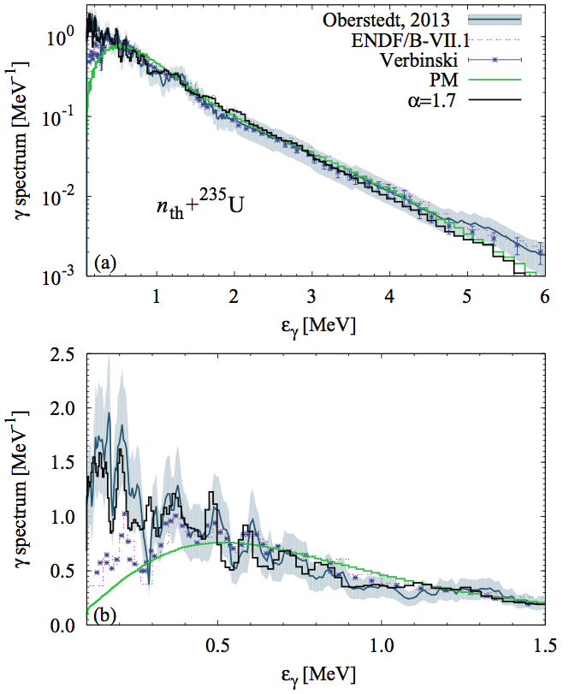
Results for n_{th}+²³⁵U
Strong fluctuations of PFGS below 1 MeV, due to γ transitions in fission fragments
Seen in IRMM experiments with LaBr detectors, but not at DANCE due to poor energy resolution
Well reproduced by Monte Carlo simulations

Slide 12
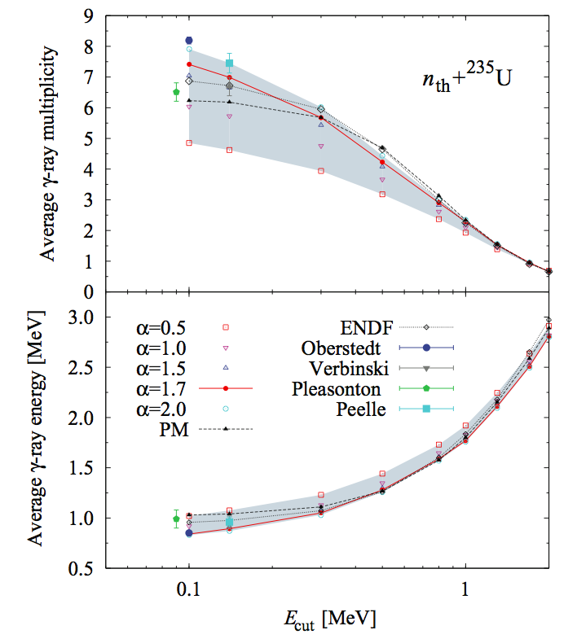
Results
on average multiplicity <M_{γ}> and average γ-ray energy <ε_{γ}> very sensitive to energy threshold (E_{cut}) and time-coincidence window used in experiments
Inconsistent experimental data
Model calculations provide a range of possible values; not discriminating enough yet

Slide 13
Average Prompt Fission Gamma Multiplicity <ν_{γ}> and Total Energy <E_{γ}^{tot}>
Isotope | Quantity | ENDF/B-VII | Oberstedt | DANCE (LANL) | DANCE (LLNL) | CGMF (LANL)
Pu239T | <E_{γ}^{tot}> (MeV) | 6.741 | - | 8.07 | 7.94 | 6.66
 | <ν_{γ}> (γ/f) | 7.78 | - | 7.08 | 7.93 | 7.48
U235T | <E_{γ}^{tot}> (MeV) | 6.600 | 6.96 | 6.42 | 8.35 | 6.45
 | <ν_{γ}> (γ/f) | 7.04 | 8.19 | 6.23 | 7.35 | 7.41
Cf252 (sf) | <E_{γ}^{tot}> (MeV) |  | 6.64 | 7.22 | 8.52 | 6.85
 | <ν_{γ}> (γ/f) |  | 8.30 | 8.02 | 8.75 | 8.15
Caution when comparing data and models…
Threshold γ energies (E_{th}=100 keV; 300 keV) and time-coincidence window (6ns; 100ns) [Oberstedt; Jandel]

Slide 14
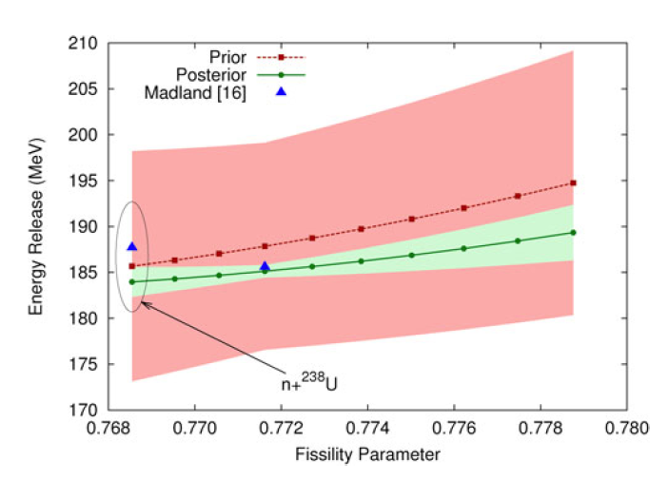
²³⁵U PFNS Evaluations
Rising-Talou, 2013
  M. E. Rising, P. Talou, T. Kawano, and A. K. Prinja, Nucl. Sci. Eng. 175, 81 (2013)
  Los Alamos model calculations + Bayesian analysis of experimental data
  Cross-isotope PFNS evaluations across suite of uranium and plutonium isotopes
  Cross-isotope correlations included
  Fix problem in B-VII.0 at 2-3 MeV.
Plan to extend evaluations up to 20 MeV with tools developed for ²³⁹Pu

Slide 15
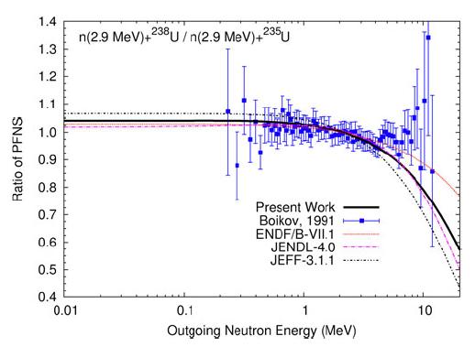
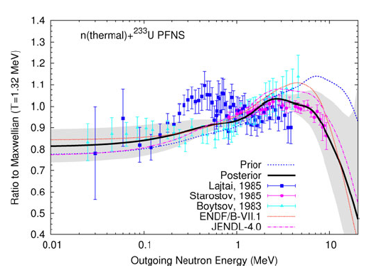
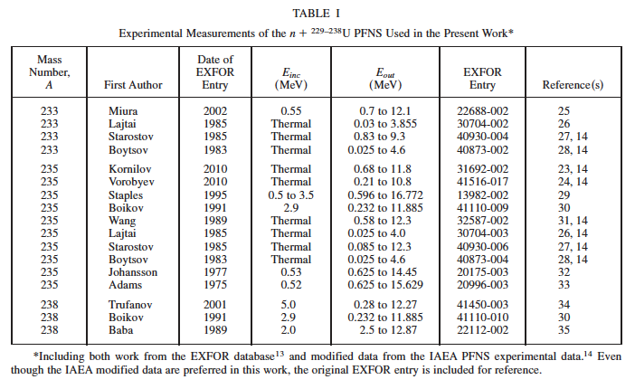
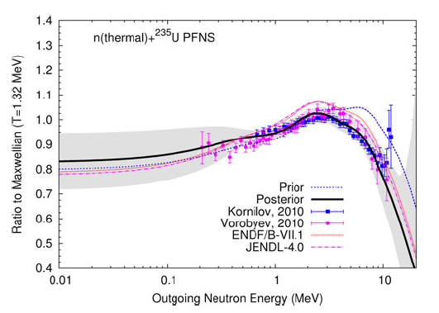

Slide 16
Multiplicity-dependent PFNS
Different spectra for
different values of ν
Scheme
  Calculate with CGMF
  Fit with xªexp(-x/b) functions
  Format in ENDF with P(ν)
ENDF Format extension proposed to store P(ν,E_{inc}) and χ_{i=1,ν}(E_{inc},E_{out})
New ENDF files for ²³⁹Pu and ²³⁵U
CGMF calculations + fit

Slide 17
Neutron Multiplicity
Distribution P(ν)
Experiment:
  very little data, esp. at higher energies
Modeling:
  new capabilities with Monte Carlo codes: CGMF, FREYA, FIFRELIN, GEF, …
  Systematics based on Terrell’s formula, and compared to limited data by Frehaut

Slide 18
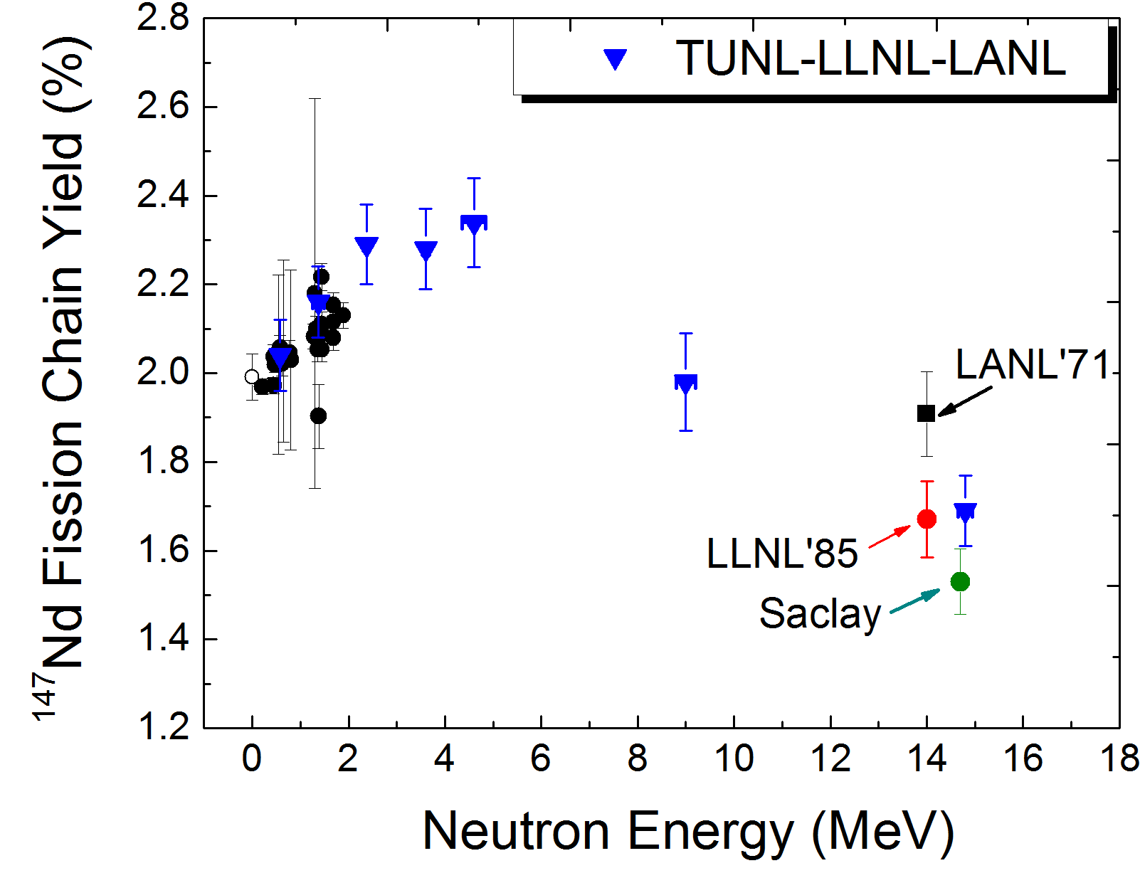
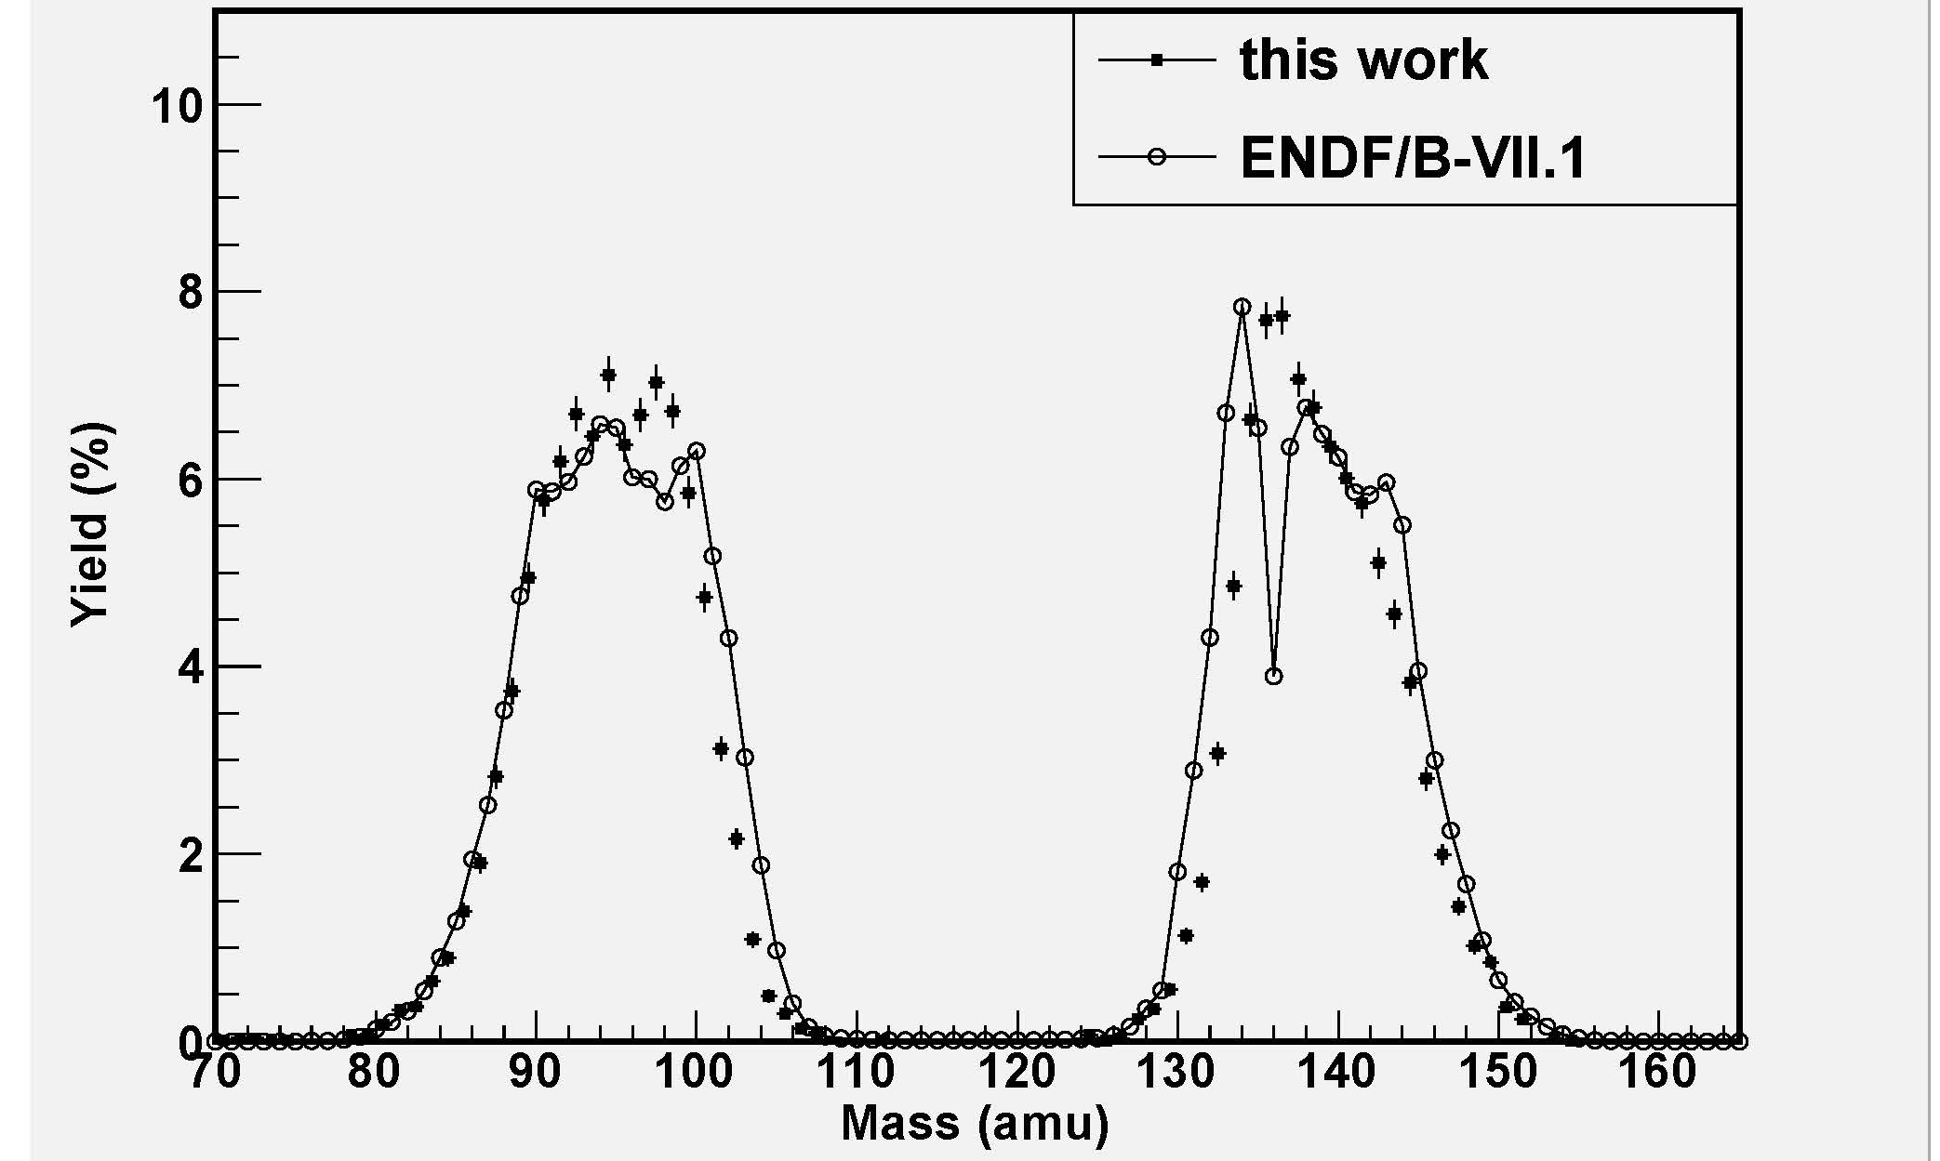
LANL-LLNL Fission Product Yield Measurements at LANSCE & TUNL for Stewardship (Fission Basis) & Forensics
Measured FPY at TUNL using quasi-monoenergetic neutrons
  Results support fission basis assessments of primary yields, from ~ 2010, although they may motivate some future small corrections
  Puzzles in ⁹⁹Mo data (SPIDER will address)
SPIDER measurements at LANSCE progressing well, for energy-dependence trends
    fission theory interpretation in T, X-CP
MIT reactor will provide a thermal ²³⁵U irradiation, for validation of the magnitude of the TUNL data (using radiochemistry & Ge detection)
FPYs are also an essential component in our post-detonation forensics assessments
²³⁵U(n,f_{th}) with SPIDER at Lujan
Notes:
This slope is larger than the one determined from previous data by Chadwick and Thompson, but given the large uncertainties of the previous data, they are not statistically inconsistent.
The FPY value presented by MacInnes [8] is 2.3s above the present 14.8 MeV value, while the value of Laurec [9] is 2s lower. Our new measurement helps resolve the long-standing discrepancy between these measurements. Compared to the FPY at 2.4 MeV, the FPY has decreased by 26% at 14.8 MeV. This general trend is expected since the FPYs for fission products in the valley region (A~110-128) and the high-/low-mass wings increase with increasing excitation energy in the fissioning system. In order to maintain the sum of all fission products to be 200%/fission, it is necessary for the higher yield “peak” products such as ¹⁴⁷Nd to decrease in relative yield.

Slide 19
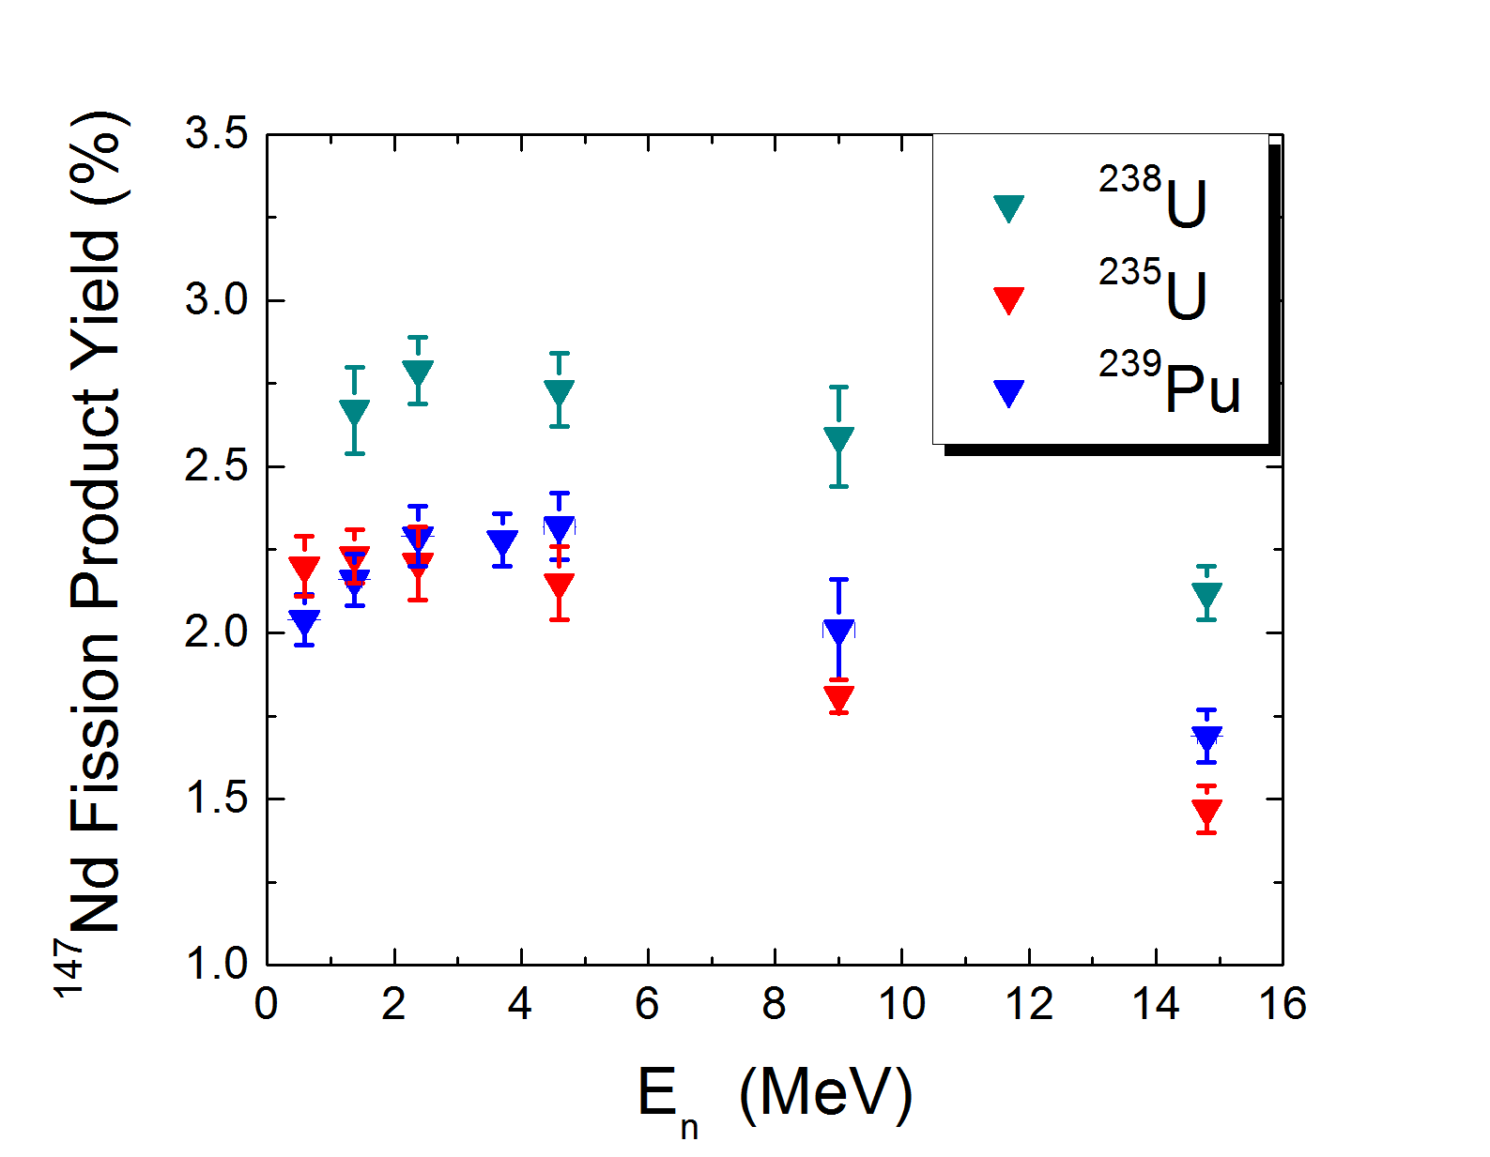
¹⁴⁷Nd Absolute Fission Product Yield from ²³⁹Pu and ^{235,238}U:
Challenge the Theory to Help Explain Data
The slope of ¹⁴⁷Nd FPY is positive from 0.5 to 2.6 MeV in all three fissile actinides
The slope of ¹⁴⁷Nd FPY from 4.6 to 14.8 MeV is negative in all three fissile actinides
Joint LLNL/LANL theoretical teams, using this data, are spearheading a renaissance in fission theory resulting in expanded capabilities to understand detailed fission properties
Notes:
This is due to the different type of potential energy surface for the fissioning system of 238,235U and 239Pu.
TUNL/LLNL/LANL measurements are providing an unprecedented level of self consistent, high precision fission product yield data

Slide 20
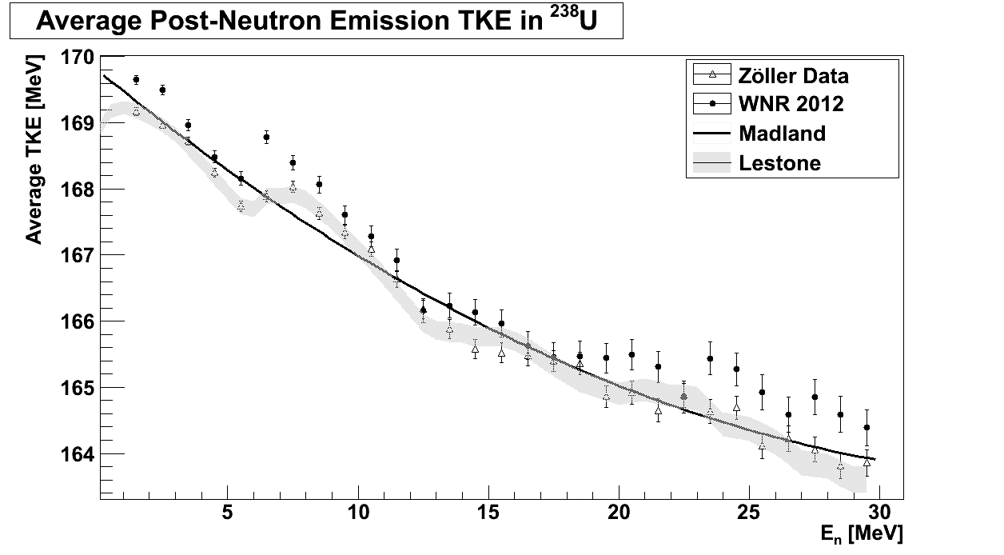
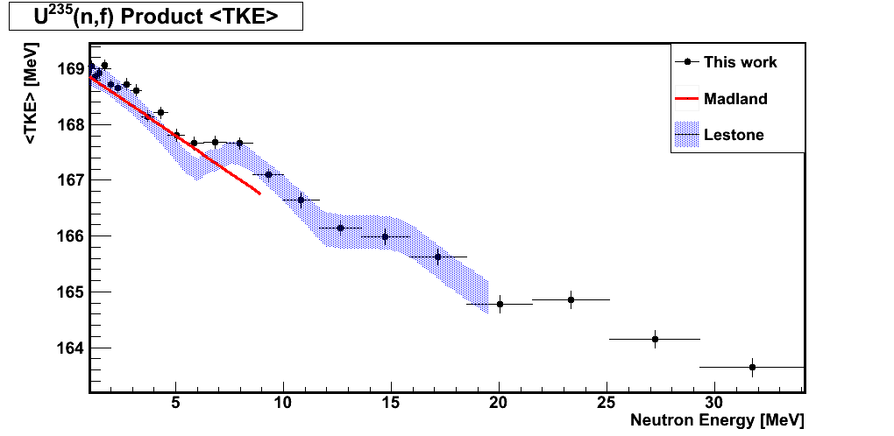
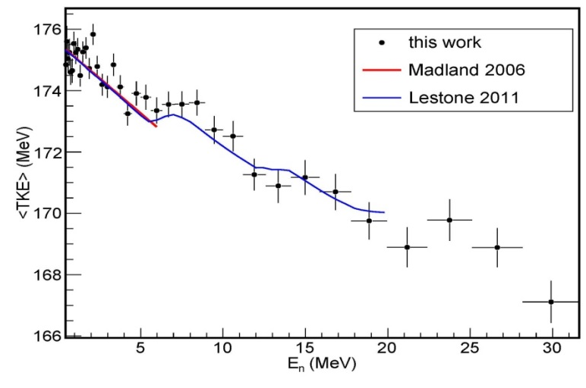
Total Kinetic Energy (TKE) results – New Data from Tovesson Motivates ENDF Changes
²³⁸U(n,f)
²³⁵U(n,f)
Zöller et al. data for U-238 extends beyond 30 MeV
  For U-235 no previous data above 9 MeV
  For Pu-239 no data beyond 5 MeV
Madland evaluation is fit to experimental data
  Not intended for extrapolation
  ENDF values for 14 MeV never the less are extrapolations
Semi-empirical modeling by Lestone et al. in close agreement with new data
  J.P. Lestone, T.T. Strother, Nuclear Data Sheets 118, 208 (2014)
ENDF ²³⁹Pu fission energy deposition ‎needs to be increased by 2 MeV
²³⁹Pu(n,f)

Slide 21
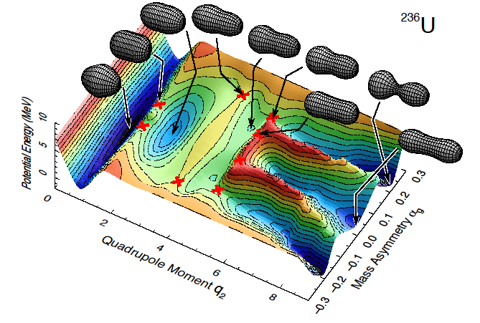
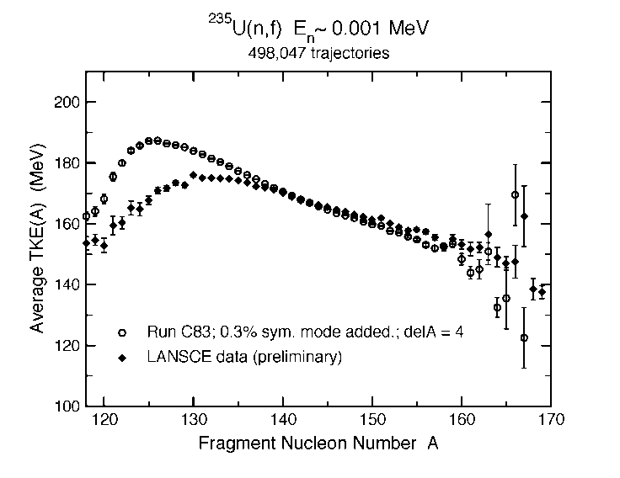
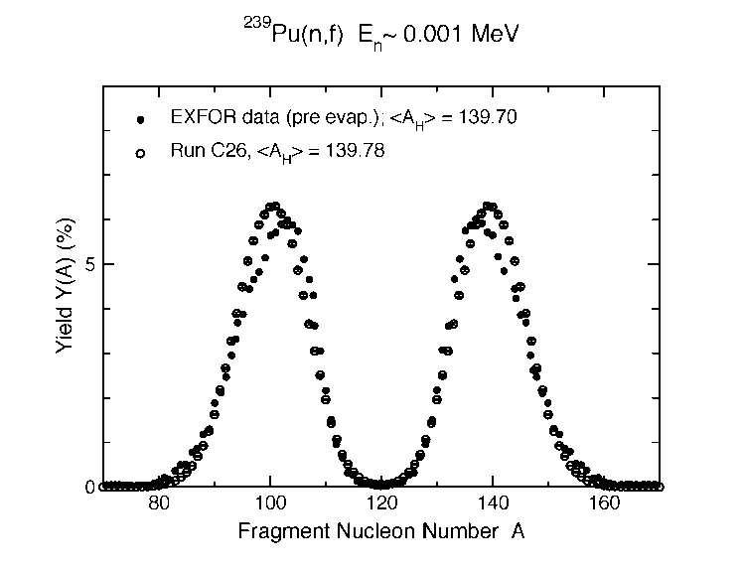
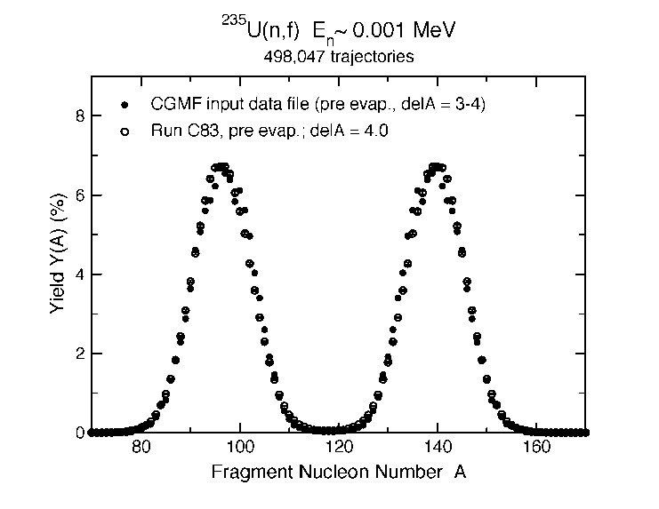
Theoretical calculations of fission fragment properties
Macroscopic-microscopic description of fission successfully models potential energy of nuclei
New advanced calculations of nuclei advancing through the potential predicts mass, charge and kinetic energy of fission fragments
Theory will provide nuclear data for isotopes that are challenging to measure
Measurements of fission correlation helps constrain theoretical models
From A. Sierk, LANL

