Slide 1
Fission Product Yields of ²³⁵U,²³⁸U and ²³⁹Pu
&
Neutron Induced Reactions on Specific Nuclei
Presenter: Werner Tornow (PI)
Duke University & TUNL
Co-PI: C.R. Howell, Duke University & TUNL
Co-authors: M. Bhike, Krishichayan, B. Fallin, M. Gooden
Duke University & TUNL
&
C. Arnold, T. Bredeweg, M. Fowler, G. Rusev, D. Vieira,
J. Wilhelmy
LANL
&
J. Becker, M. Stoyer, A. Tonchev
LLNL

Slide 2
Outline
1. 235,238U(n,f) and 239Pu(n,f) product yields between E_{n}=0.5 and 15 MeV
(124Xe(n,γ)125Xe cross-section data between E_{n}= 0.5 and 15MeV)
(124Xe(n,2n)123Xe cross-section data between E_{n}=10 and 15 MeV)
(see poster of Megha Bhike)
3. 86Kr(n,γ)87Kr cross-section data between E_{n}= 0.5 and 15 MeV
86Kr(n,2n)85Krm cross-section data between E_{n}=11 and 15 MeV
(see poster by Megha Bhike)
(Other NIF related experiments)
5. 238U(n,2n)237U cross section measurements
6. Future work

Slide 3
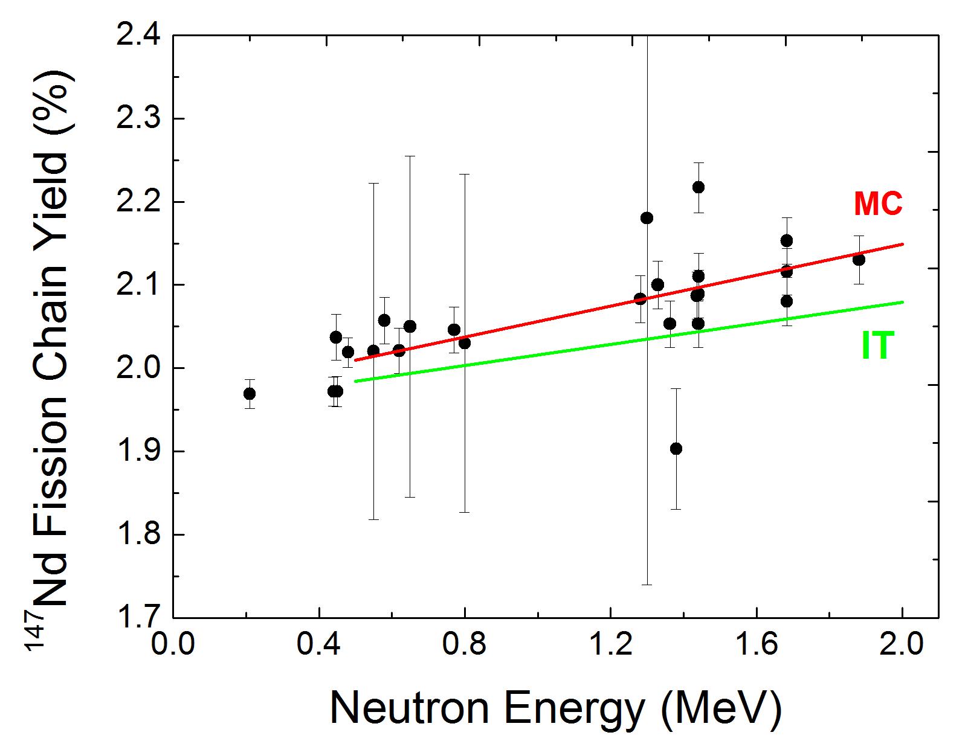
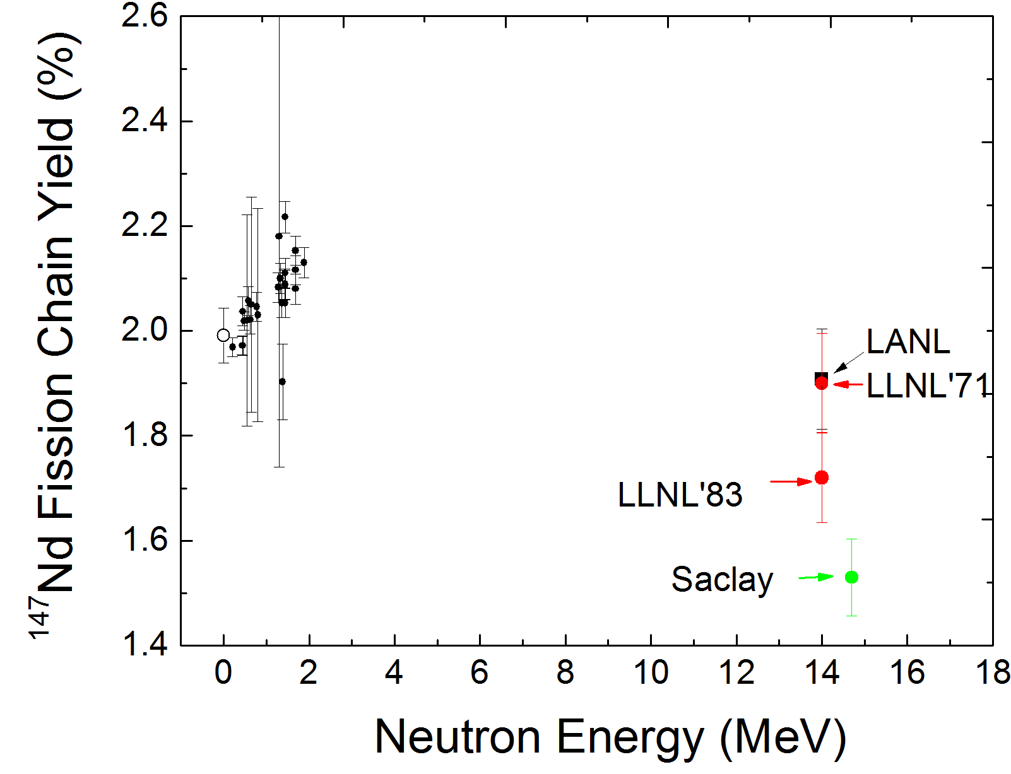
Motivation
Resolve the long-standing difference between LLNL and LANL with respect to selected fission product data
Joint LANL/LLNL fission product review panel suggested the possible energy dependence 239Pu(n,f)147Nd fission product yield:
4.7%/MeV from 0.2 to 1.9 MeV (M. Chadwick)
3.2%/MeV from 0.2 to 1.9 MeV (I. Thompson)1
Relative slope (%) = 100* [(FPY(E2)-FPY(E1)) / (E2-E1)] / FPY(E1)
Mostly low energy data from critical assemblies or fast reactors
239Pu(n,f)147Nd
There are no 147Nd data between 1.9 and 14 MeV
239Pu(n,f)147Nd
Not many data exist in the MeV range
Large discrepancy (~20%) at 14 MeV
M.B. Chadwick et al. Nuclear Data Sheets 111 (2010) 2923; H.D Selby et al. Nuclear Data Sheets 111 (2010) 2891.
P. Baisden et al, LLNL-TR-426165, 2010; R. Henderson et al. LLNL-TR-418425-DRAFT; I. Thompson et al. Nucl. Sci. Eng. 171, 85 (2012)

Slide 4
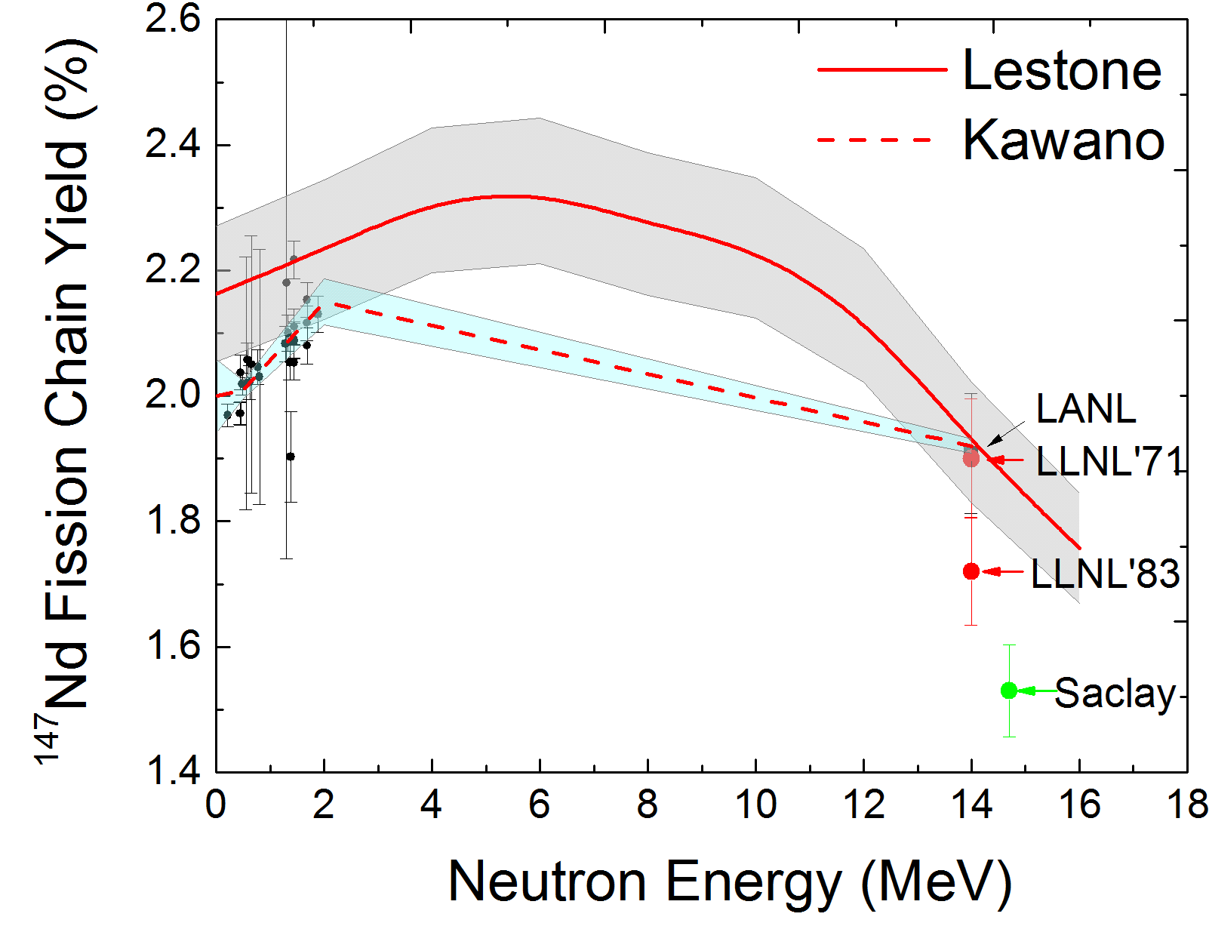
Theory Prediction
J. Lestone. Nuclear Data Sheets 112 (2011) 3120
T. Kawano et al. J. Nucl. Sci. Technol. 50 (2013) 1034

Slide 5
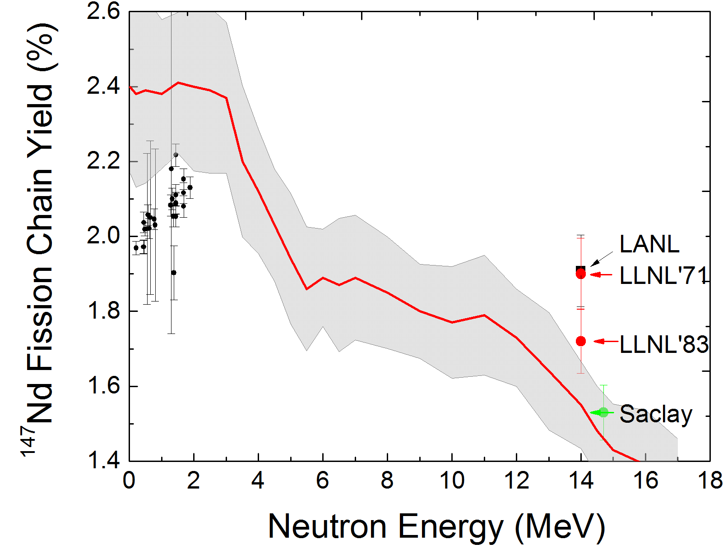
Theory Prediction
GEF Code, Version 2.2, 2013

Slide 6
Approach
Mono-energetic neutron beams
Dual fission chambers → to get absolute yields
High-resolution γ-ray spectroscopy

Slide 7
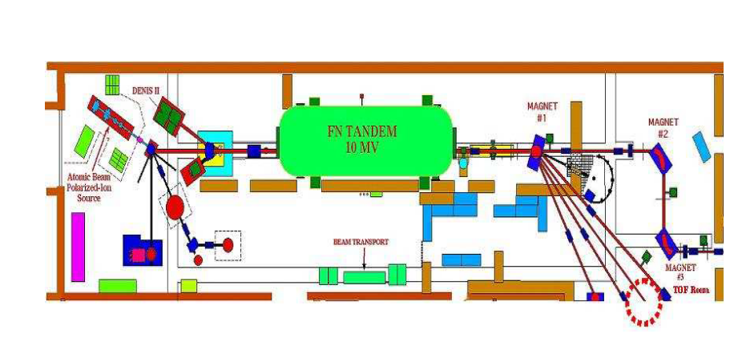
Floor Plan of TUNL (Triangle Universities Nuclear Laboratory)
For neutron energies below E_{n}=0.6 MeV: 7Li(p,n)7Be
For neutron energies below E_{n}=4 MeV: 3H(p,n)3He
For neutron energies above E_{n}=4 MeV: 2H(d,n)3He
For neutron energies above E_{n}=14.5 MeV and below 30 MeV: 3H(d,n)4He

Slide 8
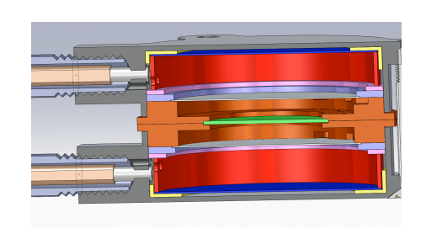
Dual Fission Chamber
Thick Target
Thin Monitor Foils
Gas Inflow
Fission Chambers

Slide 9
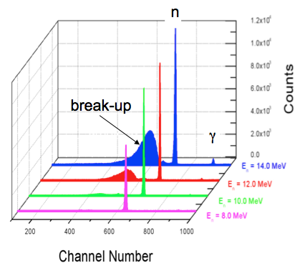
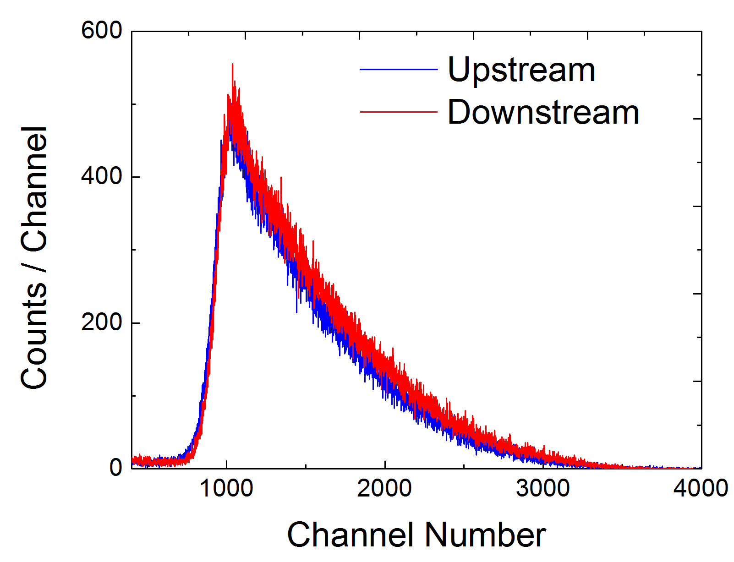
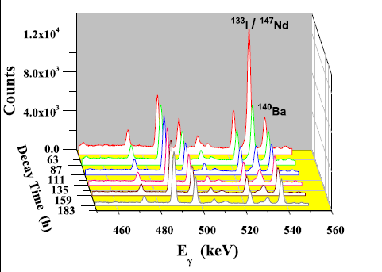
Monoenergetic Neutron Irradiation
2H gas
Dual fission chamber
n-detector
n
p or d
From VdG accelerator
One thick target ~0.2 g/cm2
Two thin targets ~10 μg/cm2
(Gamma_count / Fission_count) = (m_{thick} / m_{thin}) * FPY * C
Notes:
9

Slide 10
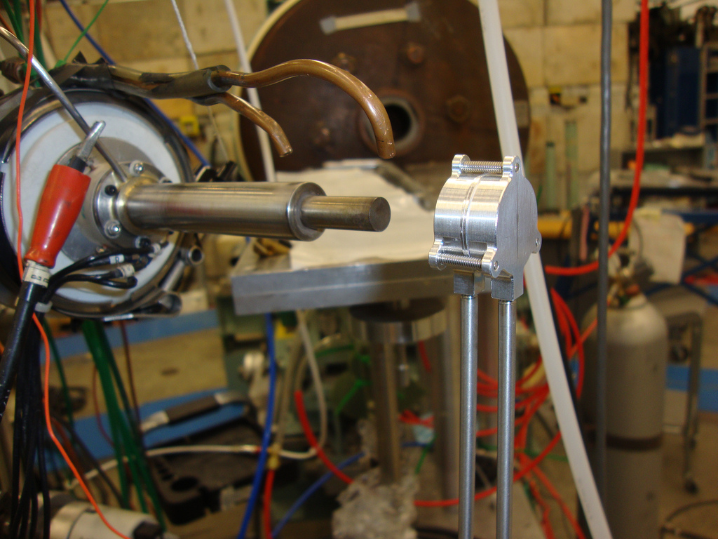

Slide 11
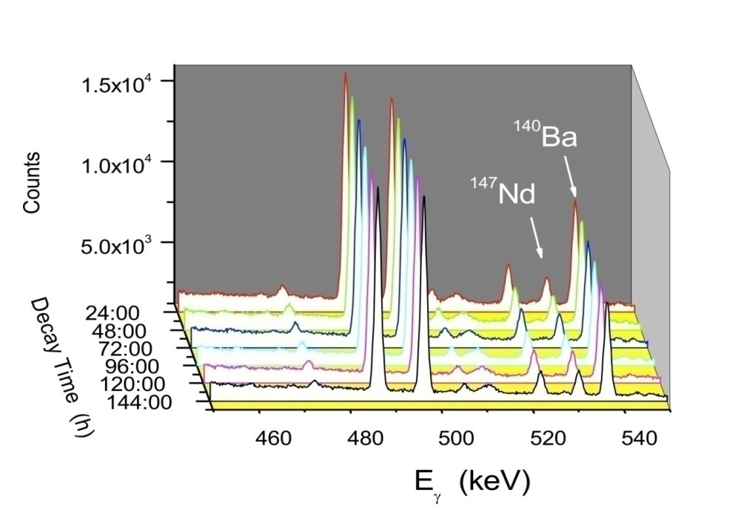

Slide 12
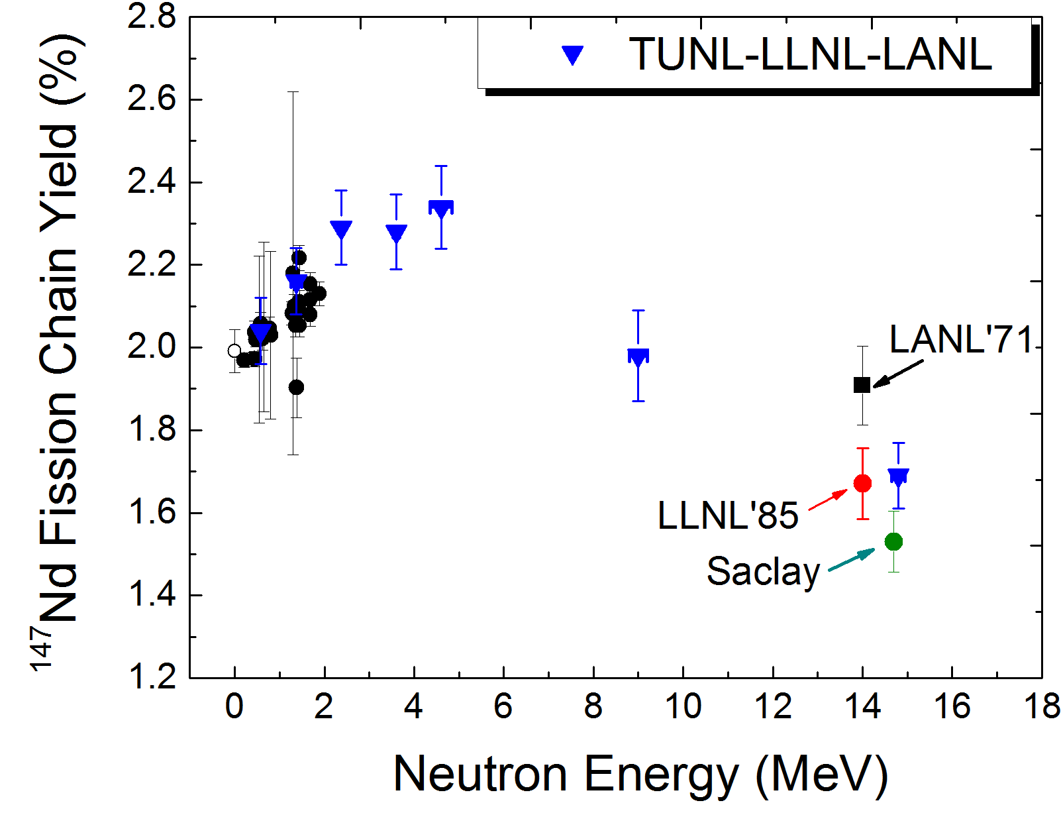
239Pu
At higher energies the FPY for 147Nd turns over and decreases
The TUNL measurements at 14.8 MeV is in a very good agreement with LLNL value
Compared to the FPY at 4.6 MeV, the FPY has decreased by 37% at 14.8 MeV
Our new measurement helps resolve the long-standing discrepancy at 14.8 MeV !

Slide 13
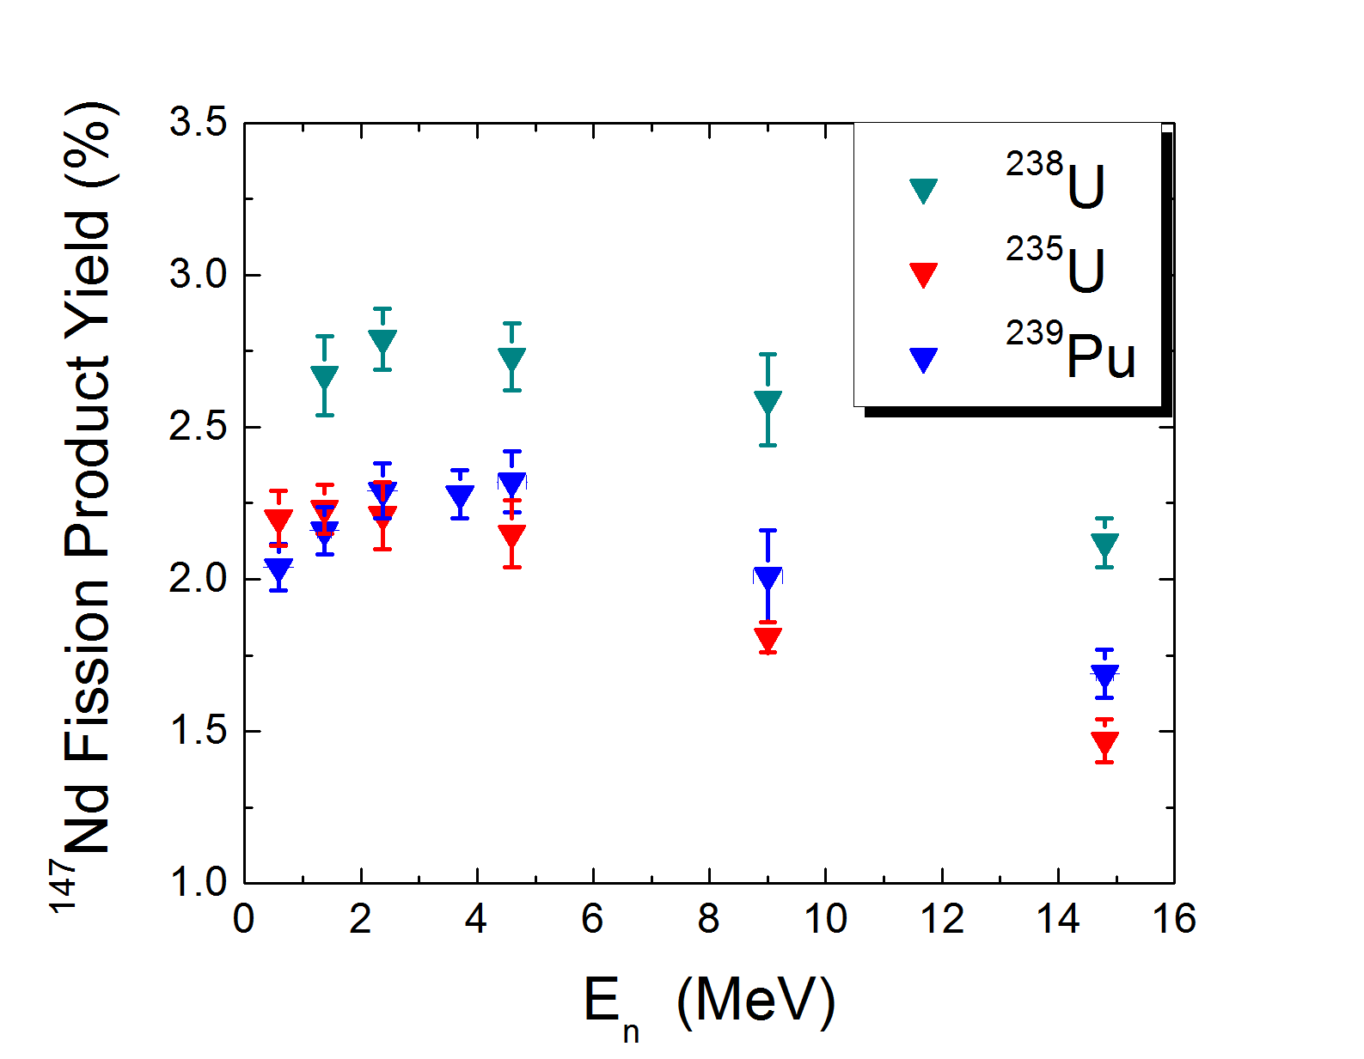
For 239Pu the slope of the 147Nd FPY is positive from 0.5 to 2.6 MeV
The slope of 147Nd FPY from 4.6 to 14.8 MeV is negative in all three fissile actinides
Joint LLNL/LANL theoretical teams, using this data, are spearheading a renaissance in fission theory resulting in expanded capabilities to understand detailed fission properties
M. Gooden Thesis, Sept. 2014
SSAP Annual p.58

Slide 14
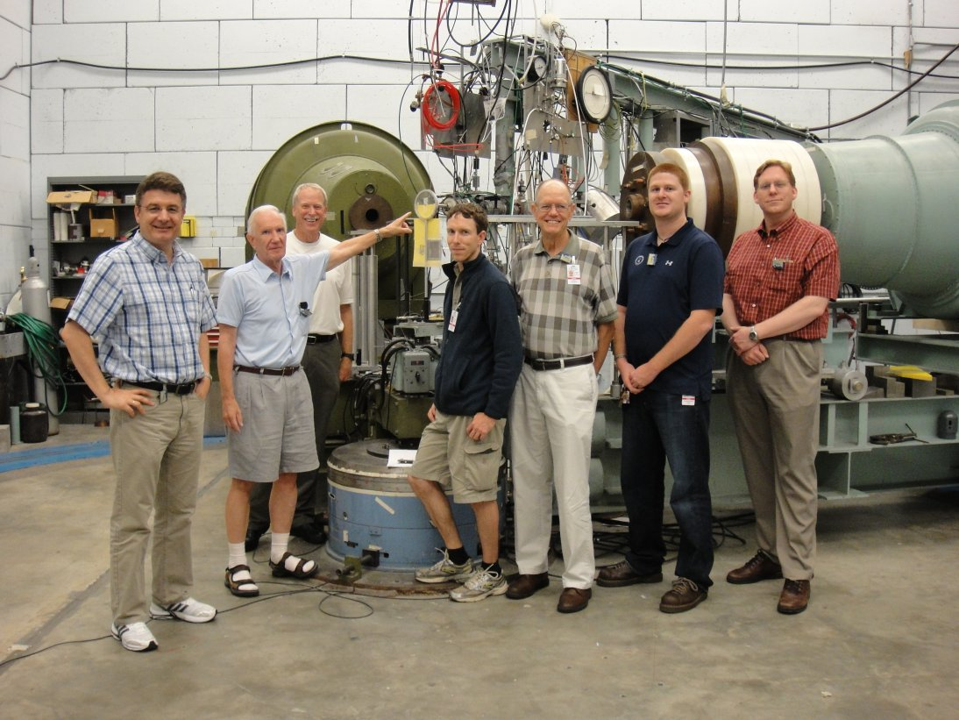

Slide 15
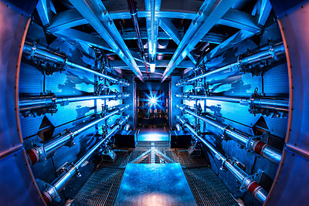
124Xe(n,2n)123Xe & 124Xe(n,γ)125Xe
86Kr(n,2n)85Krm & 86Kr(n,γ)87Kr
National Ignition Facility (NIF)
at LLNL
Inertial Confined Fusion, 192 laser beams, DT capsule in hohlraum

Slide 16
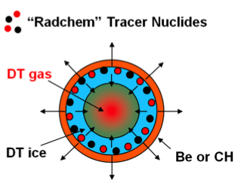
or SiO₂
(ablator)
Use a mixture of 124Xe and 136Xe or Kr as tracer nuclei
The (n,γ) reaction with Q=0 MeV probes the low-energy neutron
component
The (n,2n) reaction with Q>9 MeV probes the high-energy neutron
component

Slide 17
Editors’ Suggestion

Slide 18
Flange
Ceramic
insulator
High-pressure
Kr-86 sphere
Havar foil
d
n
D₂
Activation
foils
D₂ gas inlet
Aperture
Suppressor

Slide 19
86Kr(n,γ)87Kr
5/2+
0
T_{1/2}=76.3 m
87Kr
β−
50%
5/2−
402.587
3/2−
0
87Rb
stable

Slide 20
86Kr(n,γ)87Kr

Slide 21
86Kr(n,2n)85Krm
1/2−
304.871
T_{1/2}=4.480 h
21.2%
IT
9/2+
0
85Kr
β−
75.2%
T_{1/2}=10.752 y
3/2−
151.161
5/2−
0
85Rb
stable

Slide 22
86Kr(n,2n)85Krm

Slide 23
Production runs at TUNL during the past 12 months
Feb. 21 - 25, 2014: FPY @ 4.6 MeV on 235U
Mar. 21 - 31, 2014: FPY @ 14.8 MeV on 239Pu
Apr. 22 - 27, 2014: FPY @ 4.6 MeV on 238U
May 29 - Jun. 3, 2014: FPY @ 4.6 MeV on 239Pu
Jul. 28 - Aug. 6, 2014: FPY @ 3.6 MeV on 239Pu & 235U
Sep. 22 - 28, 2014: Activation @ 17.5 -21.5 MeV of 169Tm (RIF)
LLNL/LBNL (A. Tonchev, E. Norman)
Oct. 27 - Nov. 2, 2014: NIF NTOF Detector Tests @ 1 – 29.5 MeV
LANL/LLNL (J. Wilhelmy, J. Caggiano)
Dec. 16 - 22, 2014 : FPY @ 3.6 MeV on 238U
Total 58 days: $350,000
In addition: Many short runs throughout the year for (n,γ) and (n,2n)
on 86Kr and 238U(n,2n)237U

Slide 24
What are the plans for the future?
Fission Product Yield at 5.5 MeV for 239Pu, 235U, 238U
Fission Product Yield at 7.5 MeV for 239Pu, 235U, 238U
Fission Product Yield at thermal energy on 239Pu, 235U and 238U
at the MIT reactor
Fission Product Yield at 11.5 MeV on 239Pu, 235U, 238U

Slide 25
Publications during the reporting period:
[1] Dual-Fission Chamber and Neutron Beam Characterization for Fission Product Yields Using Monoenergetic Beams, C. Bhatia, B. Fallin, M.E. Gooden, C.R. Howell, J.H. Kelley, W. Tornow, C. W. Arnold, E. Bond, T.A. Bredeweg, M.M. Fowler, W. Moody, R.S. Rundberg, G. Rusev, D.J. Vieira, J.B. Wilhelmy, J. A. Becker, R. Macri, C. Ryan, S. A. Sheets, M.A. Stoyer, A.P. Tonchev, Nucl. Instr. and Methods in Physics Research, A 757, 7 (2014).
[2] Neutron-capture cross-section measurements of 136Xe between 0.4 and 14.8 MeV, M. Bhike and W. Tornow, Phys. Rev. C 89, 031602 (Rapid Communication), (2014).
[3] Comprehensive Sets of 124Xe(n,γ)125Xe and 124Xe(n,2n)123Xe Cross-Section Data for Assessment of Inertial Confinement Deuterium-Tritium Fusion Plasma, Megha Bhike, B.Fallin, M.E. Gooden, N. Ludin, and W. Tornow, Phys. Rev. C 91, 011601 (Rapid Communication), (2015).
[4] Exploratory study of fission product yields of neutron-induced fission of 235U, 238U and 239Pu at 9 MeV, C. Bhatia, B. Fallin, M.E. Gooden, C.R. Howell, J.H. Kelley, W. Tornow, C.W. Arnold, E. Bond, T. Bredeweg, M. Fowler, W. Moody, R. Rundberg, G. Rusev, D. Vieira, J. Wilhelmy, J. Becker, R. Macri, C. Ryan, S. Sheets, M. Stoyer, A.P. Tonchev, submitted to PRC.

Slide 26
Acknowledgements
TUNL
Duke
C. BHATIA (PD)
M. BHIKE (PD)
KRISHICHAYAN (PD)
B. FALLIN (GS)
C. HOWELL (Co-PI)
N.C. State Univ.
M. GOODEN (GS)
J. KELLEY
LLNL
J. BECKER
R. HENDERSON
J. KENNEALLY
R. MACRI
D. REGNIER
C. RYAN
S. SHEETS
N. SCHUNCK
M. STOYER
A. TONCHEV
LANL
C. ARNOLD
E. BOND
T. BREDEWEG
M. CHADWICK
M. FOWLER
W. MOODY
P. MOOLER
R. RUNDBERG
G. RUSEV
A. SIERK
D. VIEIRA
J. WILHEMY

