Slide 1
Nuclear Data Evaluations for Tungsten ^{182-184,186}W and ^{63,65}Cu isotopes
L.C. Leal, M.T. Pigni, and V. Sobes
Oak Ridge National Laboratory
Oak Ridge, TN
CSEWG
Brookhaven National Laboratory
May 7-8, 2015

Slide 2
Presentation Road Map
Nuclear Data Evaluation Overview at ORNL not including CIELO activities
Evaluation Procedure with SAMMY
  Differential data evaluation process
  Connection to integral data (benchmark)
Evaluation work on ¹⁸³W (Pigni)
Evaluation work on ^{182,184,186}Tungsten (Leal)
Evaluation work on ^{63,65}Cu (Sobes)
Concluding Remarks

Slide 3
General Information: R-Matrix Limited Format
R-matrix Limited (RML) Format, ENDF option LRF=7, was developed for allowing including more channels in the evaluation process;
Identical assumption as in the Reich-Moore formalism, i.e., gamma channels are eliminated using the Teichmann-Wigner channel elimination approach;
Channel Matrix Elements are still of the form:

Slide 4
General Information: Blatt and Biedenharn formalism
Angular Distribution
where
Legendre polynomial of degree L
Angle of the outgoing particle relative to the incoming particle in the CM system
Includes all the ingredients for determining the cross sections.
It contains the collision matrix U_{cc’}.

Slide 5
calculated from resonance parameters
General Information: ENDF Representation

Slide 6
Nuclear Data Evaluation Status Overview
Resolved Resonance Region (RRR) Cross Section Evaluations
No. | Nucleus ( I^{π} ) |  | Method | No. Levels^{(*)} | s-wave | p-wave | Evaluator
^{1 ✓} | ¹⁸²W ( 0⁺ ) | 10⁻⁵ eV–10 (5.0) keV | RM | 306 | 171 | 135 | L. C. Leal
^{2 ✓} | ¹⁸³W ( 1/2⁻ ) | 10⁻⁵ eV–5 (2.2) keV | RM | 387 | 346 | 21 | M. T. Pigni
^{3 ✓} | ¹⁸⁴W ( 0⁺ ) | 10⁻⁵ eV–10 (4.0) keV | RM | 178 | 94 | 84 | L. C. Leal
^{4 ✓} | ¹⁸⁶W ( 0⁺ ) | 10⁻⁵ eV–10 (8.3) keV | RM | 169 | 95 | 74 | L. C. Leal
^{5 ✓} | ⁶³Cu ( 3/2⁻ ) | 10⁻⁵ eV-300 (100) keV | RM | 527 | 323 | 204 | V. Sobes
^{6 ✓} | ⁶⁵Cu ( 3/2⁻ ) | 10⁻⁵ eV-300 (100) keV | RM | 762 | 525 | 237 | V. Sobes
RM – Reich-Moore Approximation (*) bound and external levels not included

Slide 7
SAMMY Evaluation Procedure
All experimental data have been reasonably represented by a set of resonance parameters and covariance (uncertainty) is obtained
  SAMMY resonance parameter and covariance are converted into the ENDF/B format - file 2 (parameter) and 32 (covariance matrix)
Process ENDF/B file with NJOY or AMPX in order to generate cross section in pointwise and/or group representation
Find in the ICSBEP database integral benchmark experiments sensitive to the data of the evaluated isotope(s)
Run MCNP and/or KENO codes
  sensitivity analysis using TSUNAMI and TSURFER in order to improve agreement with benchmark experiments
  Goal: improve results of integral data calculations and, at the same time, have reasonable description of differential data
SAMMY analysis together with TSUNAMI/TSURFER is the way to go
Notes:
ICSBEP – integral criticality safety experiments

Slide 8
Integral quantities helping in the SAMMY Evaluation Procedure
Differential and Integral
σ
σ(E_{p})
E_{a}
E_{p}
E_{b}
E
σ(E) as a function of energy
R is the reaction rate
(measured quantity)
Differential
Integral

Slide 9
External Levels and Database
External levels: bound levels (negative resonances) and levels above the resonance region
  Careful determination of the external levels is needed before starting a SAMMY evaluation
  It provides a good understanding of the scattering potential cross section
  Indicates whether background effects a properly calculated
  (Effective) nuclear scattering radii are well defined once the external levels have been determined
  Provides an insight whether a direct reaction component is present
Consistency of the database
  Resolution function (ORELA, GELINA, …)
  Data normalization
  …

Slide 10
External Levels Evaluation
Contribution from the external levels - bound levels (negative resonances) and levels above the resonance region - and potential scattering cross section
At low energies the effective radius is well defined and the potential scattering cross section is depending by the channel radius, a, and distant-level parameter, R∞, as
R∞(E) is essentially the difference between the contribution to the R-matrix from the resonances below and above E
External levels important to avoid troublesome edge effects near the boundaries of the internal region

Slide 11
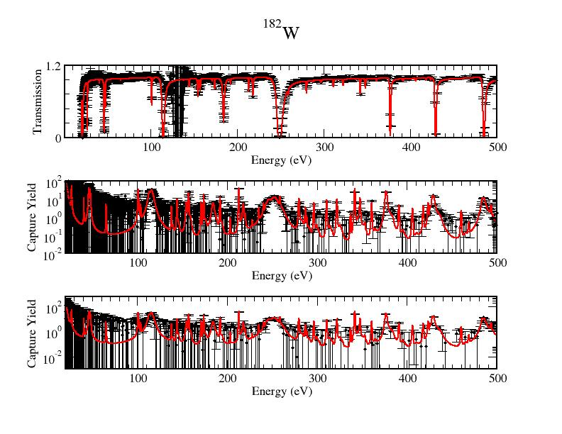
¹⁸²W cross section evaluation

Slide 12
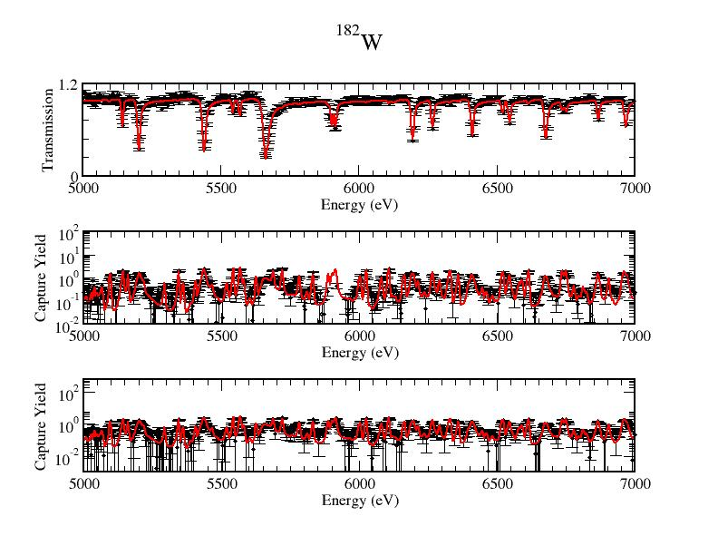
¹⁸²W cross section evaluation

Slide 13
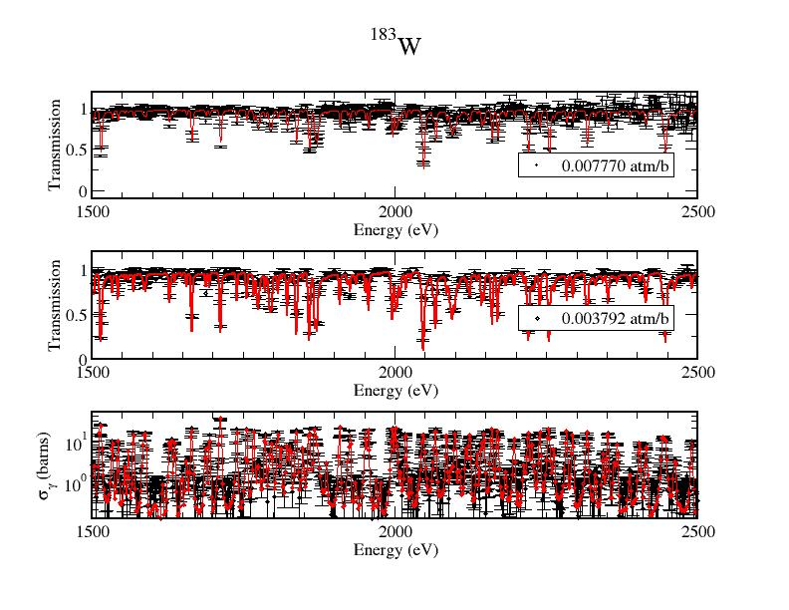
¹⁸³W cross section evaluation (Pigni)

Slide 14
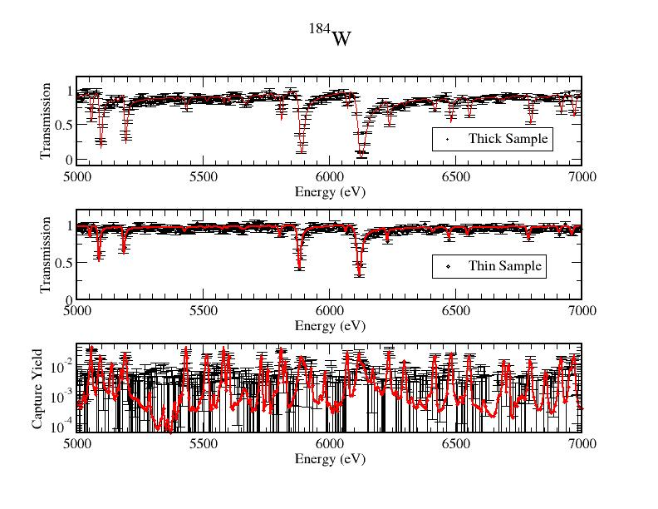
¹⁸⁴W cross section evaluation

Slide 15
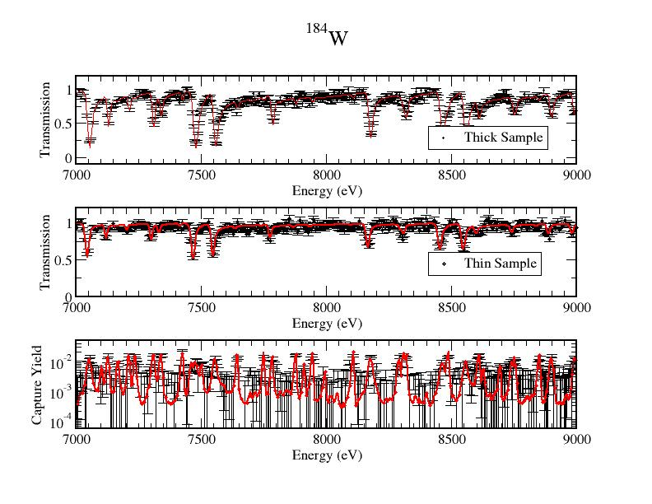
¹⁸⁴W cross section evaluation

Slide 16
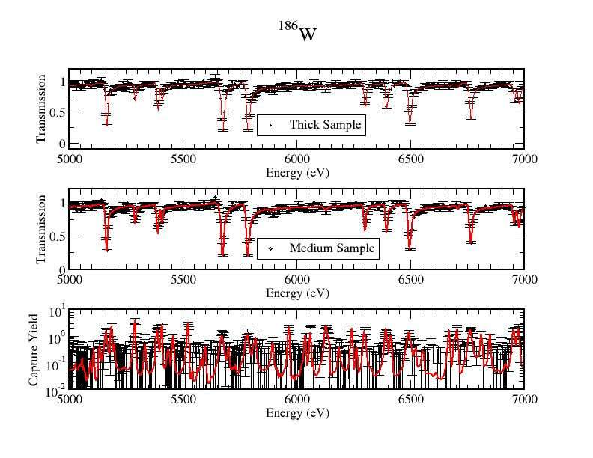
¹⁸⁶W cross section evaluation

Slide 17
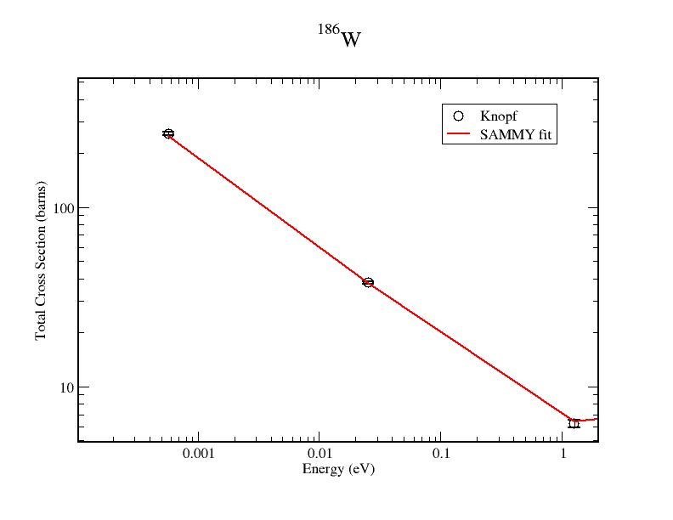
¹⁸⁶W cross section evaluation

Slide 18
¹⁸⁶W cross section evaluation
 |  | σt (barns) | σγ (barns) | σs (barns) | R’ _{(fm)} | b_{coh} _{(fm)} | b_{inc} _{(fm)}
¹⁸²W | ORNL | 28.18±0.40 | 20.31±0.64 | 8.87±0.28 | 7.6 | 7.11 | -
 | ATLAS | - | 19.90±0.30 | 8.84±0.30 | 8.1 | 7.04 | -
¹⁸³W | ORNL | 15.56±0.50 | 9.87±0.53 | 5.69±0.11 | 7.9 | 6.47 | -0.43
 | ATLAS | - | 10.40±0.20 | 2.40±0.60 | 8.1 | 6.59 | -
¹⁸⁴W | ORNL | 8.98±0.40 | 1.63±0.13 | 7.35±0.10 | 7.6 | 7.41 | -
 | ATLAS | - | 1.70±0.10 | 7.35±0.10 | 8.0 | 7.55 | -
¹⁸⁶W | ORNL | 37.97±0.40 | 37.88±0.59 | 0.09±0.02 | 7.7 | -0.76 | -
 | ATLAS | - | 38.10±0.50 | 0.09±0.01 | 7.6 | -0.73 | -

Slide 19
Covariance Evaluations (Total)

Slide 20
Covariance Evaluations (Total)

Slide 21
Covariance Evaluations (Total)

Slide 22
Covariance Evaluations (Total)

Slide 23
Cu Cross Section Evaluations Thermal (Sobes)
  Motivation
  Nuclear Data Advisory Group (NDAG) identified ⁶³Cu and
  ⁶⁵Cu important for criticality safety applications
  Purpose of Differential Measurements:
  Thermal Cross Section Shape
  Thermal Cross Section Uncertainty
  SAMMY Resolved Resonance Analysis
23

Slide 24
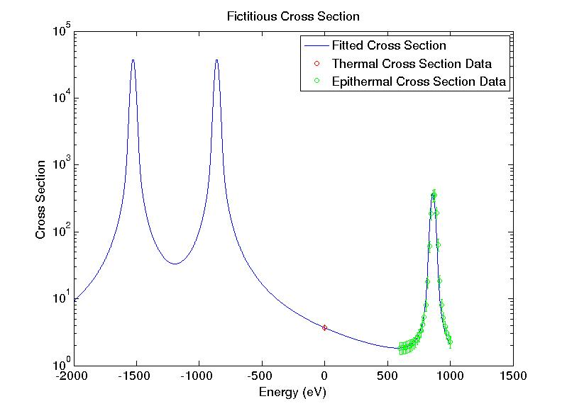
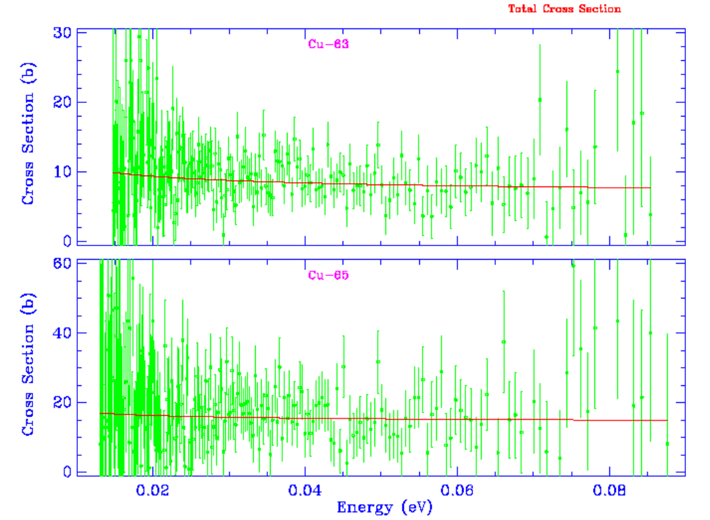
Cu Cross-section Evaluations Thermal (Sobes)
Measurements Performed
at the MIT Nuclear Reactor (MITR-II)
Bound Levels
A better definition of the negative external levels if we fit a differential cross section
A better definition of the uncertainty and correlations at the thermal energy

Slide 25
Cu Cross-section Evaluations (Sobes)
SAMMY Evaluation of the Transmission Data
  SAMMY analysis of transmission data for Cu-63 and Cu-65
  Measurements made at the Oak Ridge Electron Linear Accelerator (ORELA) by M. S. Pandey, J. B. Garg, and
  J. A. Harvey (1977)
  Flight-path length: 80 meters
  Thicknesses:
  Cu-63 0.07895 at/barns
  Cu-65 0.07437 at/barns
  Energy Range: 0.0001 eV to 300 keV
25

Slide 26
Updated ^{63,65}Cu Evaluations (Sobes)
Three major improvements of consequence to the Zeus benchmarks:
  Resolved resonance region expanded
  three-fold
  Capture cross section evaluated based on experimental measurements
  Detailed angular distributions generated for elastic scattering
26

Slide 27
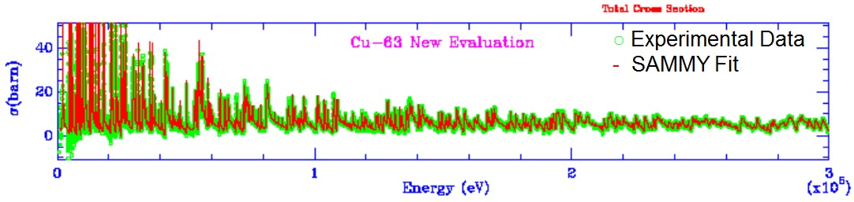
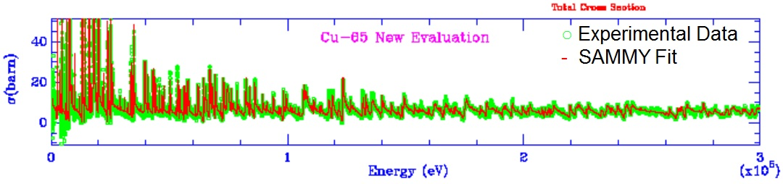
Cu cross section evaluations (Sobes)
SAMMY Fit of the transmission data of ⁶³Cu and ⁶⁵Cu in the energy range 30 eV–300 keV

Slide 28
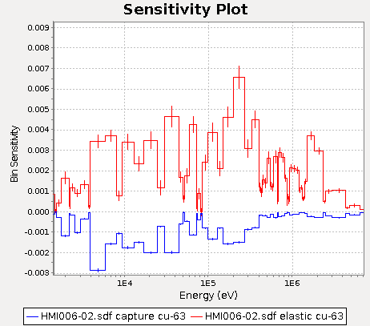
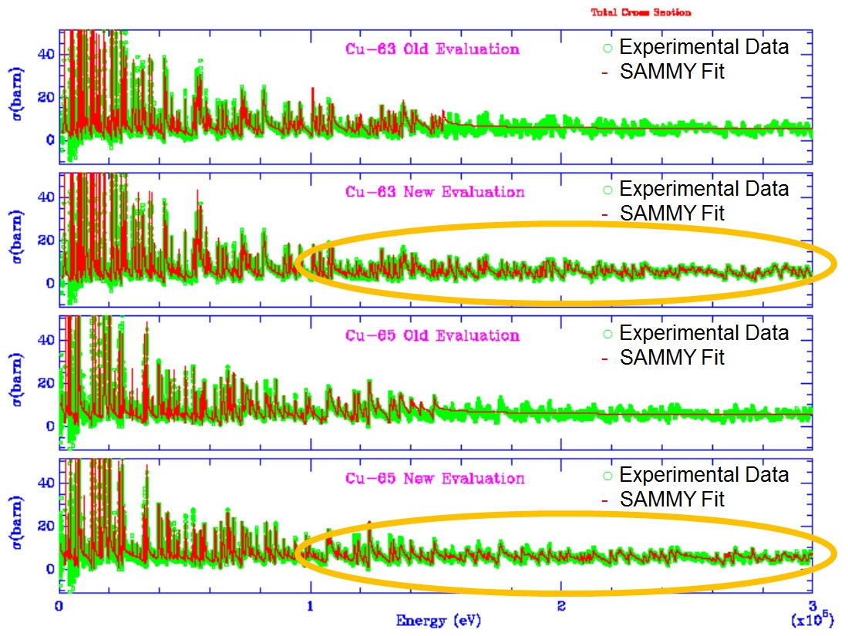
Extending the Resolved Resonance Region
Resolved resonance region of both copper isotopes, has been extended from 99.5 keV to 300 keV.

Slide 29
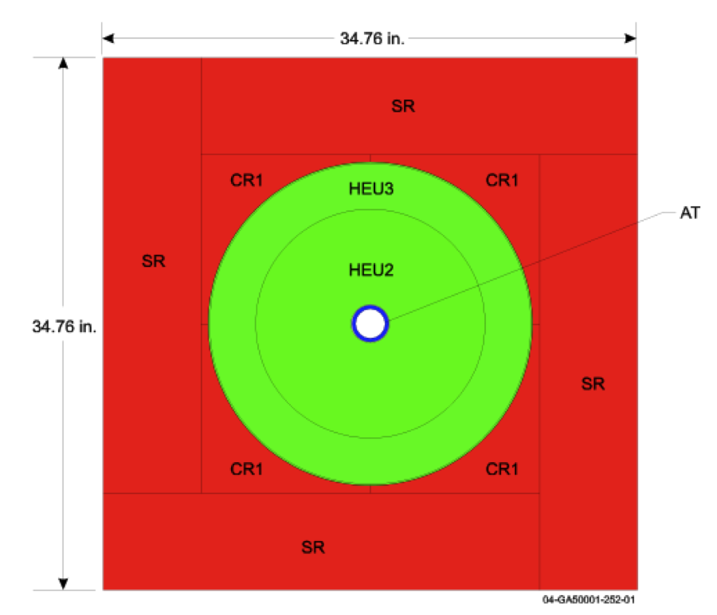
Detailed Angular Distributions
For the Zeus cases, system k_{eff} is most sensitive to the elastic scattering reaction in copper
Previous angular distributions came from model calculations
New angular distributions generated from resonance parameters using Blatt-Biedenharn formalism.
  Self-consistent with the angle-integrated elastic scattering
  Display resonance behavior.
For heavily reflected systems, such as the Zeus cases, the forward/backward component of the angular distribution of elastic scattering determines whether scattered neutrons leak out of the system or return back into the fuel region.

Slide 30
Detailed Angular Distribution

Slide 31
Benchmarking Results: k_{eff}
Case | Model Benchmark | Cu Res. (File 2) | VII.1 | ORNL | VII.1 | ORNL | ORNL
 |  | Cu Ang. Dist. (File 4-2) | VII.1 | VII.1 | ORNL | ORNL | ORNL
 |  | ²³⁵U | VII.1 | VII.1 | VII.1 | VII.1 | ORNL
 |  | All other isotopes | VII.1 | VII.1 | VII.1 | VII.1 | VII.1
1 | 0.99770 +/- 0.00080 |  | 0.99370 | 0.99663 | 0.98864 | 0.99236 | 0.99562
2 | 1.00010 +/- 0.00080 |  | 0.99640 | 1.00097 | 0.99239 | 0.99622 | 0.99903
3 | 1.00150 +/- 0.00090 |  | 1.00120 | 1.00556 | 0.99570 | 1.00001 | 1.00136
4 | 1.00160 +/-0.00080 |  | 1.00670 | 1.01355 | 1.00071 | 1.00697 | 1.00423
VII.1 = ENDF/B-VII.1

Slide 32
Full Results

Slide 33
Concluding Remarks
Resolved resonance evaluations were done for ¹⁸²W, ¹⁸³W, ¹⁸⁴W, ¹⁸⁶W, ⁶³Cu and ⁶⁵Cu;
Thermal data, coherent and incoherent data were used in the evaluation;
Resonance parameter covariance generated;
Resonance ranges extended with the help of high-resolution differential data;
RML Format (LRF=7) were used;
Blatt and Biedenharn methodology used for angular data representation;

