Slide 1
Criticality Data Testing with Revised ^{63,65}Cu, ^{182,3,4,6}W and H-H₂O Data Files
A.C. (Skip) Kahler
Los Alamos National Laboratory
Cross Section Evaluation Working Group
May 7-8, 2015

Slide 2
ABSTRACT We summarize criticality calculations with ICSBEP benchmarks performed with a revised Copper, Tungsten and Hydrogen-bound-in-water scattering kernel data files.

Slide 3
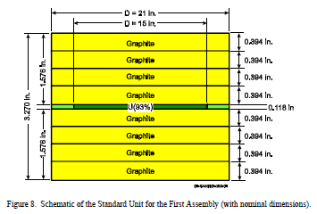
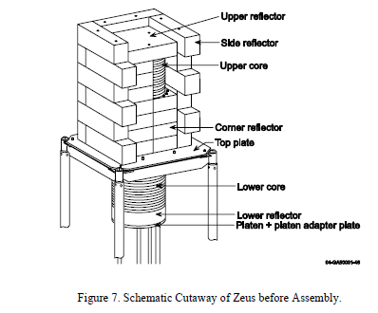
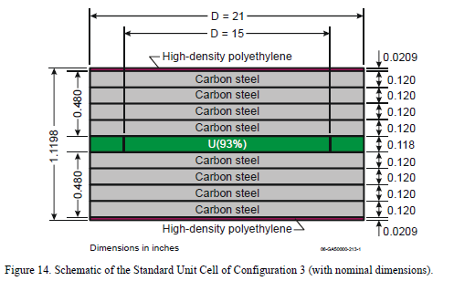
ZEUS Critical Benchmarks …
HMI6.x – Copper reflected Graphite-HEU core.
HMF72.x – Copper reflected Iron-HEU or Iron-CH₂-HEU core.

Slide 4
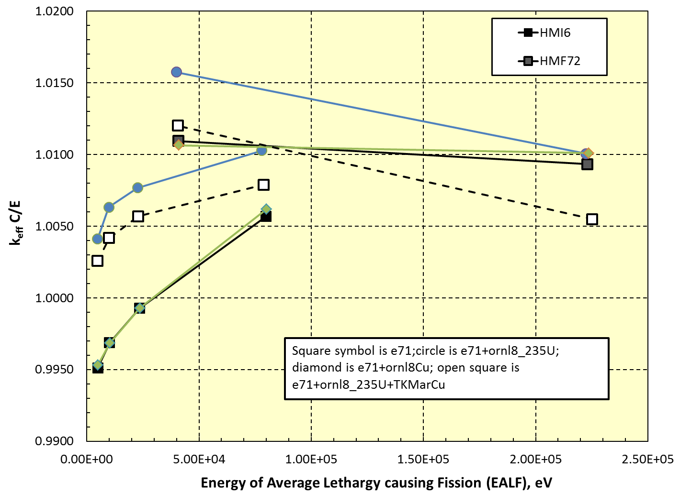
ZEUS Benchmarks (HMF72, HMI6)
^{63,65}Cu data sets from Kawano.
Latest results (open squares) show reduced bias in k_{eff}, but still have work to do.

Slide 5
ICSBEP Benchmarks with W …
HMF3.x – reflected spherical HEU assemblies (1.9”, 2.9”, 4.5” and 6.5” W reflector).
HMF49.x – axially reflected HEU cylinders (1,3 & 8 cm thick).
HMF50 – HEU cylinder with interstitial W.
HMM17 – HEU cylinder with interstitial W & CH₂; also axial and radial CH₂.
PMF5 – Pu sphere with 4.7 cm thick W reflector.
UMF4.x – ²³³U spheres with 2.4 cm or 5.8 cm thick W reflector.

Slide 6
… and Calculated Eigenvalues
Compare calculated eigenvalues for E71 versus the new ORNL ^{182,183,184,186}W evaluations
Benchmark | E71 k_{calc} | E71 EALF | E71 + revised ^{iso}W (BNL Sourceforge, v633-v636)
HMF3.8 HMF3.9 HMF3.10 HMF3.11 | 1.00211(7) 1.00223(7) 1.00505(7) 1.00881(6) | 638 keV 579 keV 531 keV 514 keV | 1.00141(9) 1.00180(9) 1.00558(9) 1.01089(9)
HMF49.1 HMF49.2 HMF49.3 | 0.99799(6) 0.99974(6) 0.99869(6) | 803 keV 765 keV 726 keV | 0.99781(9) 0.99946(9) 0.99849(9)
HMF50 | 0.99810(6) | 647 keV | 0.99793(9)
HMM17 | 0.99540(8) | 176 eV | 0.99654(12)
PMF5 | 1.00112(6) | 1.008 MeV | 1.00063(9)
UMF4.1 UMF4.2 | 0.99866(6) 0.99559(6) | 985 keV 893 keV | 0.99857(9) 0.99528(9)

Slide 7
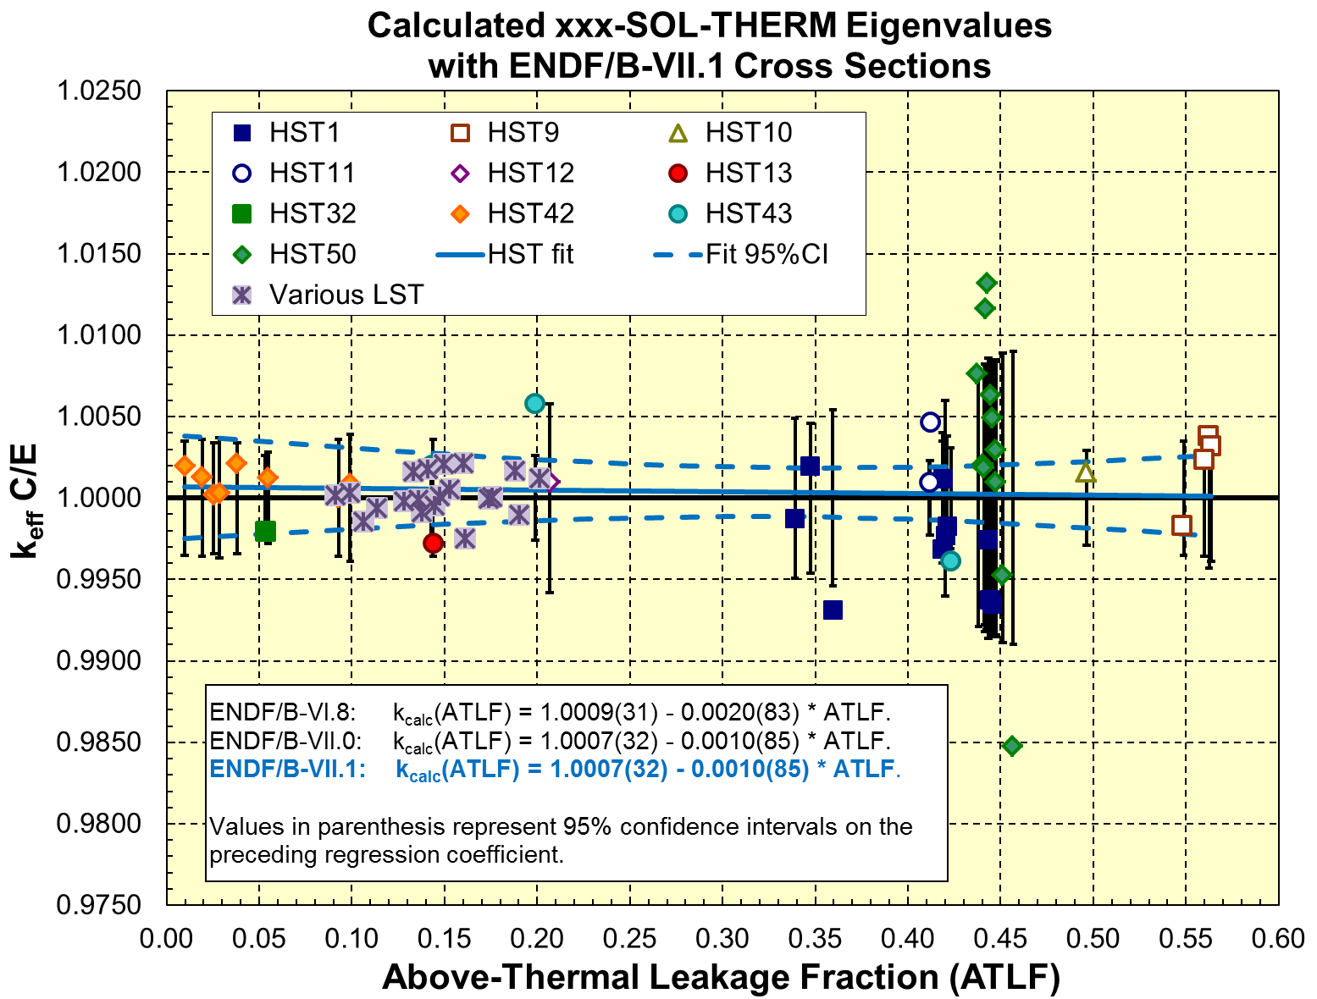
HST Benchmarks and H-H₂O
WPEC Sub-Group 42 will examine scattering kernel data …
Already have a h-h₂o file submitted by Ignacio Marquez from the Comisión Nacional de Energía Atómica (CNEA)
b = 1.0003(33)
m = -0.0005(54)

