Slide 1
A Covariance Methodology for ENDF File 7 S(α,β) and Thermal Neutron Inelastic Scattering Cross Section Data
Jesse C. Holmes ¹ Ayman I. Hawari ² Michael L. Zerkle ¹
mini-CSEWG
Brookhaven National Laboratory Upton, NY May 7th – 8th, 2015
¹ Bechtel Marine Propulsion Corporation
Bettis Atomic Power Laboratory
West Mifflin, PA
² North Carolina State University
Department of Nuclear Engineering
Raleigh, NC

Slide 2
Motivation
For systems with a significant thermal neutron population, calculated system response parameters can be very sensitive to the supplied thermal neutron scattering cross section data.
In these situations, any assessment of the impact of nuclear data uncertainties on system response parameter uncertainties is incomplete without accounting for uncertainties and correlations in the supplied thermal scattering cross section data.
For inelastic scattering, differential and integral thermal scattering cross sections are typically calculated by numerical integration of the double-differential thermal scattering law, S(α,β), tabulated in ENDF File 7.
Published ENDF File 7 S(α,β) data is calculated theoretically based on fundamental scattering physics models. In particular, S(α,β) is conventionally calculated based on a supplied excitation mode energy spectrum for the material’s interatomic structure.
Currently, no published ENDF File 7 libraries contain covariance data. Furthermore, no accepted procedure exists for quantifying or representing covariances for theoretically generated S(α,β) or for handling the associated differential and integral cross section covariances.

Slide 3
Objectives
Assess the (future) requirements for thermal neutron scattering covariance information in nuclear system simulation uncertainty and sensitivity analysis codes.
In many solids, interaction with phonons (or vibrational modes) is the only consequential mechanism for energy exchange in the neutron scattering process at thermal energies. In this case, the material phonon energy spectrum, ρ(ε), is typically the fundamental parameter determining S(α,β).
Establish a general mathematical formalism for expressing and calculating uncertainties in ρ(ε), which is a probability density function of the available phonon mode population. These uncertainties must reflect the particular methodology and physics models employed in generating ρ(ε).
Demonstrate the Monte Carlo production of a covariance matrix for S(α,β), as well as for associated differential and integral scattering cross sections, by sampling perturbed phonon spectra. Hexagonal graphite is used as an example material for demonstrating the methodology.

Slide 4
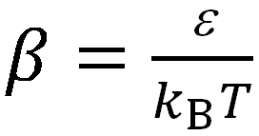
Requirements for Thermal Scattering Covariance Data
ρ(ε)
Various internal nuclear data library formats are utilized by nuclear system simulation and/or sensitivity and uncertainty analysis codes.
Regardless of the data format or structure, the differential and integral thermal inelastic scattering cross sections employed are generally determined by some method of integration over ENDF File 7 S(α,β).
In principle, uncertainties and correlations among all tabulated differential and integral cross sections at all incident energies are required for completeness.
Differential cross sections are coupled in energy and angle. However, for many nuclear engineering applications, dσ(E)/dE′ is of much greater importance than the angular distribution of scattered neutrons.
double-differential cross section
momentum transfer factor
energy transfer factor
differential cross section in energy
integrated inelastic cross section

Slide 5
Utility of the S(α,β) Covariance Matrix
S(α,β) is tabulated over discrete evaluator-defined α and β grids for specified T.
Let the vector y represent the set of all calculated differential and integral cross sections, and let the vector x represent the set of all tabulated S(α,β) for specified T. Therefore,
The summation limits are determined by the α and β grids and by the physical limits of α and β for particular j. The intervals Δα_{a} and Δβ_{b} are defined by the grids. Linear interpolation is applied as required. For differential cross sections, the summation is over one variable with the appropriate Δ.
Since the terms of M can be calculated as needed, it is not necessary to store M for specific cross section library formats. Consequently, V_{x} is the only information required to determine covariances for any set of differential and integral thermal scattering cross section data.
defines the covariance matrix for y in terms of the covariance matrix for
x with the terms of the sensitivity matrix M given by the constant factors
(Terms of M for non-physical or unused α and β combinations are ZERO.)

Slide 6
Thermal Scattering Theory
The double-differential thermal neutron scattering cross section may be written in general form as:
Randomly oriented polycrystalline structure applies for most nuclear engineering applications:
The impact of coherent interference on integral scattering cross sections is negligible for many
materials at temperatures of concern, and the incoherent approximation is traditionally applied:
S_{s} is a function of only ρ(ω) and T. Since thermal displacements of atoms from their equilibrium positions are
generally small, S(α,β) may be calculated by a harmonic phonon expansion in terms of ρ(ε) = ρ(ω)/ħ.
In this case, the uncertainty in theoretically calculated S(α,β) depends directly on the uncertainty in the supplied
phonon energy spectrum ρ(ε).
If desired, the coherent interference term may be calculated using dispersion relations and added to S(α,β) to
adjust for the bias. This has been done successfully for graphite in other works [Hawari et al., PHYSOR-2008].

Slide 7
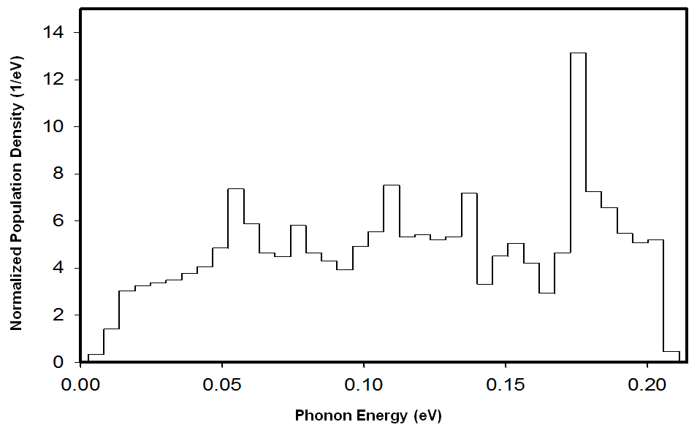
Example Phonon Energy Spectrum
The bins are represented by p_{d=1,2,3,…,D}
d = 11
d = 20
This is the phonon energy spectrum incorporated in the currently published ENDF/B-VII thermal scattering law evaluation for graphite. It is based on Young et al., “Phonon Spectrum of Graphite,” Journal of Chemical Physics, 42 (1965).
The spectrum is calculated using a lattice dynamics model with four force constants for perfect hexagonal graphite fitted to thermodynamic data for porous reactor grade graphite.

Slide 8
Properties of the Phonon Energy Spectrum
Probability density function of the available vibrational mode population in a given material structure.
Generally defined as a normalized piecewise step function over uniformly distributed energy bins.
In this case, ρ(ε) may be described by a set of parameters (or random variables) p_{d}, where d = 1 … D, or by the vector p.
For any method of arriving at the phonon energy spectrum (whether based on theory, experiment, or some combination), the features of the spectrum will be distorted to some extent in energy and magnitude with respect to the ideal phonon spectrum.
In principle, these spectral shape uncertainties may be described by a joint probability density function (which must be estimated by the evaluator) for the parameters p_{d} .
Uncertainties in the phonon spectrum will depend on the particular material structure and temperature as well as the physics models and methodology employed to generate it.

Slide 9
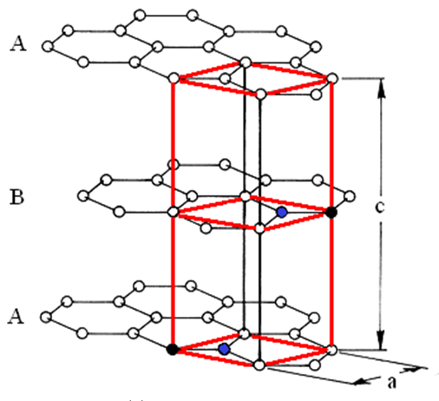
Hexagonal Graphite as a Demonstration Material
Graphite is a layered material with highly
anisotropic interatomic forces.
In the parallel (in-plane) and perpendicular
(out-of-plane) directions, graphite has distinct
material properties and distinct partial phonon
spectra, where .
In this work, the phonon spectrum for graphite is
produced using the ab initio density functional
theory code VASP and the lattice dynamics code
PHONON.
The material, method of producing the phonon
spectrum, and the associated uncertainty analysis in this
work are selected to demonstrate the application of a
generalized methodology for thermal neutron scattering
covariance data.
It is not the intent of this work to produce a full evaluation for
graphite with covariance data for ENDF publication.

Slide 10
Directional Properties of the Phonon Spectrum for Graphite
The total phonon energy spectrum for graphite (left) and each directional partial phonon energy spectrum
for graphite (right) calculated with VASP/PHONON in this work.
For the partial spectra on the right, the in-plane parallel spectrum (blue) is normalized to 2/3 and the out-
of-plane perpendicular spectrum (black) is normalized to 1/3.
In the low-energy region, phonon modes perpendicular to the plane are highly dominant. The low-energy
perpendicular mode population is heavily influenced by the weak interplanar forces in graphite.
Total Phonon Energy Spectrum
Directional Partial Phonon Energy Spectra

Slide 11
Phonon Scattering Probability
The phonon energy spectrum maps the distribution of
available phonon modes as a function of energy. It
does not provide information about the likelihood that a
particular phonon mode will interact with a scattering
neutron (independent of the population density).
For a phonon mode with energy ε, the thermal average
of the phonon occupation number is
.
P(ε) = C < n > ρ(ε) gives an estimate of the relative
probability that a neutron with incident energy E will
absorb a phonon with energy ε in a thermal scattering
event. This is plotted to the right in red as a function of
temperature.
P(ε) provides a view of the regions of the phonon
spectrum that thermal cross sections are expected to
be sensitive to and informs an uncertainty analysis that
focuses on the physics of the sensitive regions.
Phonon spectrum (black) for
hexagonal graphite vs. P(ε) (red).

Slide 12
Phonon Scattering Probability
The phonon energy spectrum maps the distribution of
available phonon modes as a function of energy. It
does not provide information about the likelihood that a
particular phonon mode will interact with a scattering
neutron (independent of the population density).
For a phonon mode with energy ε, the thermal average
of the phonon occupation number is
.
P(ε) = C < n > ρ(ε) gives an estimate of the relative
probability that a neutron with incident energy E will
absorb a phonon with energy ε in a thermal scattering
event. This is plotted to the right in red as a function of
temperature.
P(ε) provides a view of the regions of the phonon
spectrum that thermal cross sections are expected to
be sensitive to and informs an uncertainty analysis that
focuses on the physics of the sensitive regions.
Phonon spectrum (black) for
hexagonal graphite vs. P(ε) (red).

Slide 13
Phonon Scattering Probability
The phonon energy spectrum maps the distribution of
available phonon modes as a function of energy. It
does not provide information about the likelihood that a
particular phonon mode will interact with a scattering
neutron (independent of the population density).
For a phonon mode with energy ε, the thermal average
of the phonon occupation number is
.
P(ε) = C < n > ρ(ε) gives an estimate of the relative
probability that a neutron with incident energy E will
absorb a phonon with energy ε in a thermal scattering
event. This is plotted to the right in red as a function of
temperature.
P(ε) provides a view of the regions of the phonon
spectrum that thermal cross sections are expected to
be sensitive to and informs an uncertainty analysis that
focuses on the physics of the sensitive regions.
Phonon spectrum (black) for
hexagonal graphite vs. P(ε) (red).

Slide 14
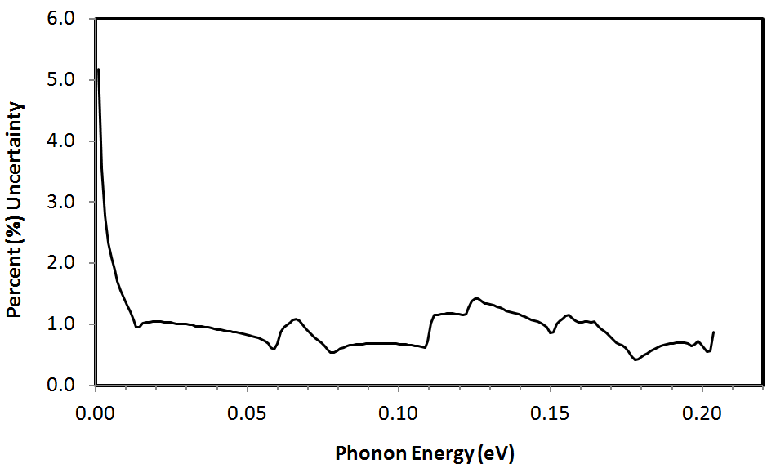
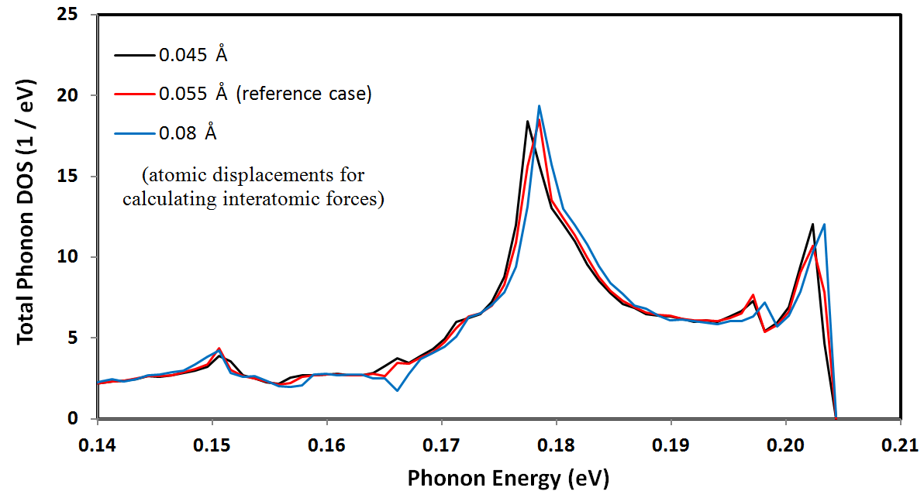
Modeled Sources of Uncertainty in the Graphite Phonon Spectrum
Statistical uncertainty from 10⁶
random samples of phonon wave
vectors in the reciprocal space
of the first Brillouin zone.
(top graph)
Selected parameter-based physics
model uncertainty within the VASP/
PHONON simulation process.
(bottom graph)
Low-energy region uncertainty
based on incomplete modeling of
interplanar forces.
(next slide)

Slide 15
Uncertainty in the Low-Energy Region of the Phonon Spectrum for Graphite
The phonon dispersion relations for graphite predicted by VASP using density functional theory match experimental
dispersion relations data very well except for very low energy phonons propagating in the out-of-plane direction.
Density functional theory does not account for Van der Waals forces, and low-energy perpendicular phonon modes
are influenced significantly by Van der Waals forces.
To assess the uncertainty in the low-energy phonon mode population, different sets of experimental dispersion
relations data were examined, and the range of low-energy phonon spectra resulting from this experimental data
was calculated geometrically and compared to the reference VASP/PHONON result.
Comparison of Phonon Energy Spectra
Calculated by Different Methodologies
Range of Possible Phonon Mode Population Densities
(Including Experimental Uncertainty)

Slide 16
Describing a Joint-PDF for the Phonon Spectrum Parameters by Monte Carlo Sampling
Specific aspects of uncertainties in the shape of ρ(ε) may be described by one or more reshaping functions
that operate, independently or dependently, on any number of the parameters p_{d} .
For example, statistical uncertainties could be described by randomly revaluing each p_{d} according to
Gaussian distributions with known standard deviations.
Bounds may be established for the possible shift of features in energy. This shift may be energy-dependent
(e.g., for modeling the effect of uncertainty in lattice constants).
Alternatively, bounds may be established for the possible variation in magnitude of the phonon spectrum in a
particular energy region while maintaining features coupled (e.g., when a comparison is made to other
calculated spectra or experimental data).
In general, any number of non-redundant reshaping functions may be defined which operate on p. Any
appropriate sampling scheme (e.g., Gaussian or flat) may be used to randomly revalue p according to each
reshaping function.
After the sequential application of all reshaping functions, the perturbed p must be renormalized. This entire
process constitutes one Monte Carlo trial.
Applying reshaping functions to a parameterized phonon spectrum allows a geometric description of statistical
and systematic uncertainties in ρ(ε) in the physical context of phonon mode density regardless of the
methodology employed in generating ρ(ε).

Slide 17
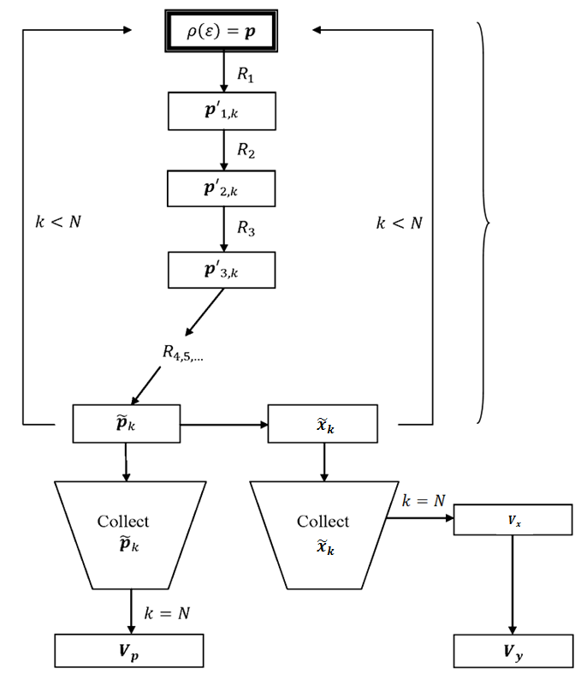
Uncertainty Calculation Methodology
Flowchart demonstrating the
methodology for calculating
uncertainties and covariances
in the phonon energy spectrum
and in differential and integral
scattering cross sections.
Calculations for the phonon
spectrum are on the left side
and calculations for cross
sections are on the right side.

Slide 18
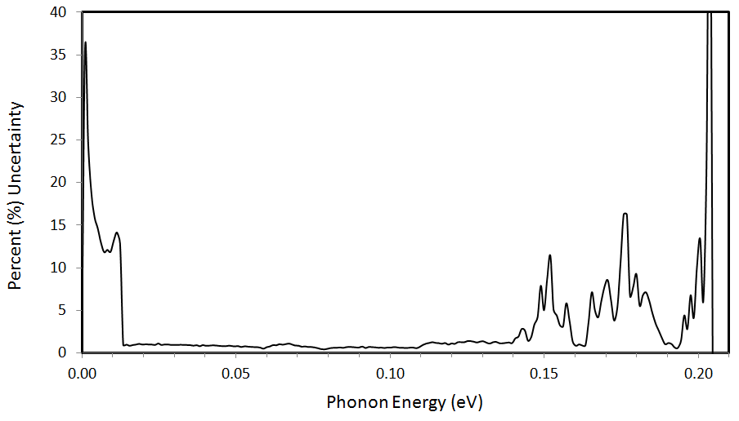
Uncertainty Results in the Phonon Spectrum for Graphite
Reshaping functions are applied to p to
account for statistical uncertainties,
selected VASP/PHONON parameter
uncertainties, and uncertainties in the
low-energy region of the spectrum
resulting primarily from an incomplete
description of interplanar forces.
500 Monte Carlo trials were carried out,
resulting in 500 normalized phonon
spectra representing the expected
range and probable distribution of
spectral shapes for the phonon energy
spectrum of graphite.

Slide 19
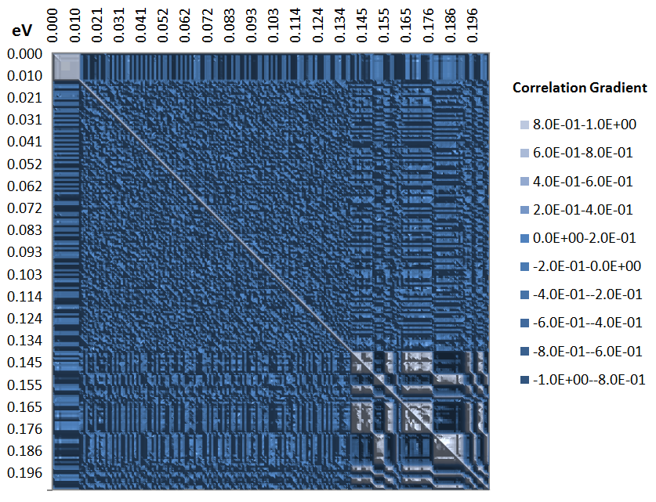
Correlation Matrix for the Graphite Phonon Spectrum

Slide 20
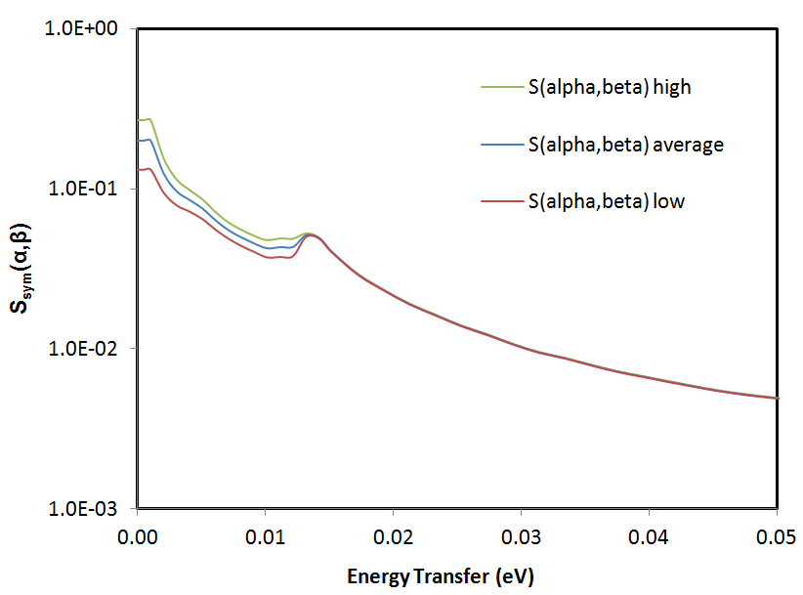
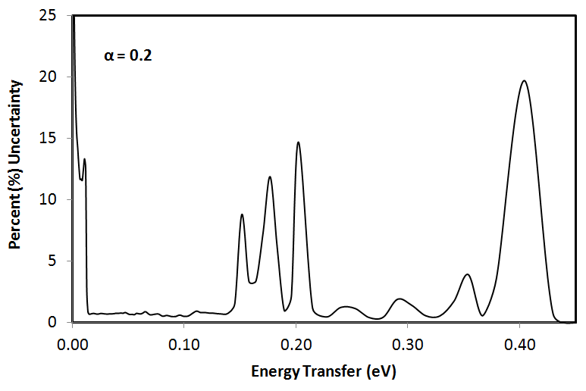
Uncertainty in S_{sym}(α,β) for α = 0.2
All results are for the symmetric scattering
law, S_{sym}(α,β), conventionally tabulated
in ENDF File 7.
For most materials, the principle of
detailed balance implies the relationship
between upscattering and downscattering
processes.
Therefore, a symmetric scattering law can
be defined such that
This allows the full thermal scattering law
to be tabulated in terms of positive β only.
All plots are at 293.6 K and in terms of
energy transfer (eV), instead of β, for
more intuitive comparison to ρ(ε).

Slide 21
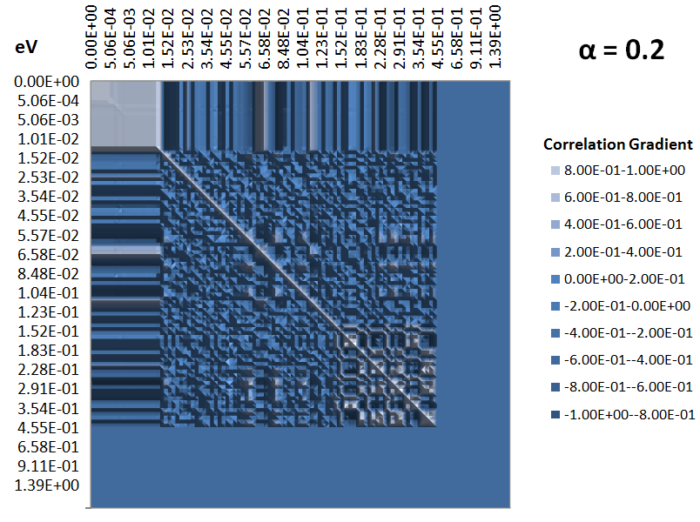
Correlation Matrix for S_{sym}(α,β) for α = 0.2
The zero-correlation region
for high energy transfer (or
for high β) is manually set to
zero for S_{sym}(α,β) < 1*10⁻¹⁰ to
highlight the extremely low
sensitivity of differential and
integral cross sections to
this region.
This also demonstrates one
method for greatly reducing
the S_{sym}(α,β) covariance data
required for storage. The
1*10⁻¹⁰ threshold can be set
much higher without
significant loss of information.

Slide 22
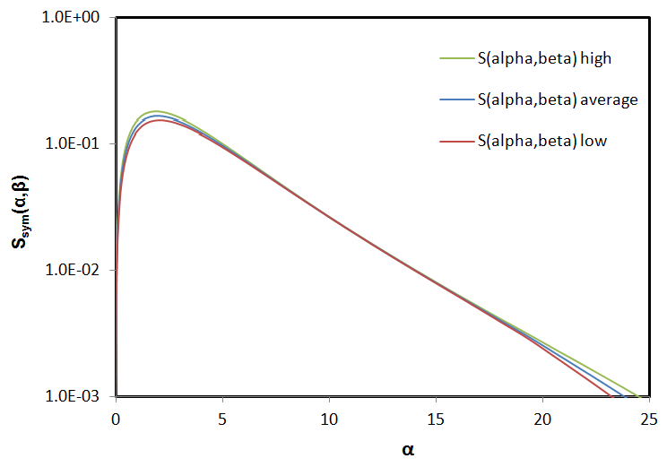
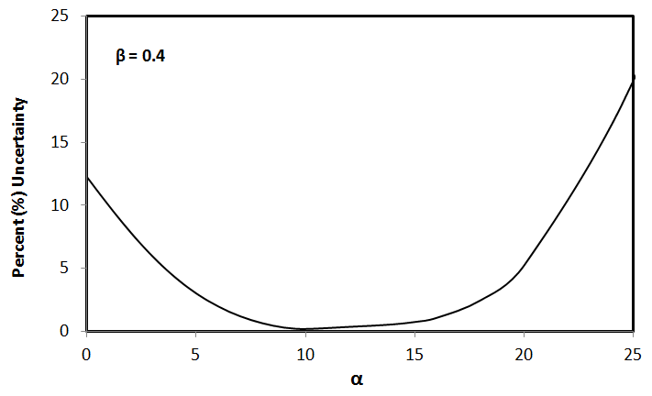
Uncertainty in S_{sym}(α,β) for β = 0.4

Slide 23
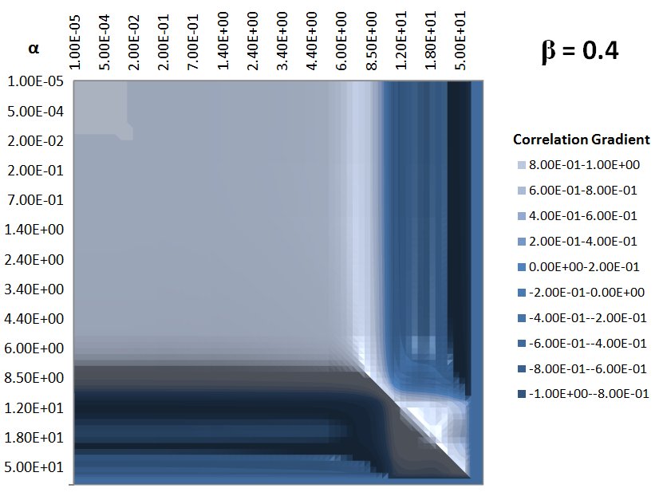
Correlation Matrix for S_{sym}(α,β) for β = 0.4

Slide 24
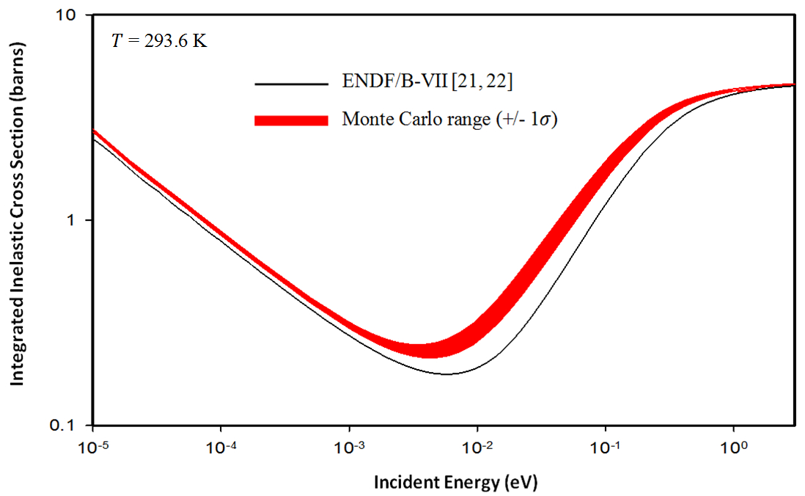
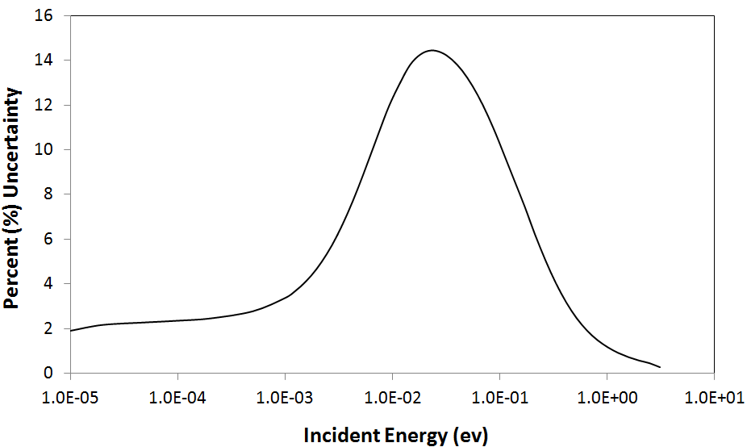
Uncertainties in Integral Inelastic Scattering Cross Sections
Theoretically calculated integral inelastic
thermal scattering cross sections are always
very highly correlated.
Any perturbations in the phonon energy
spectrum tend to adjust all integral cross
sections in the same direction.
Uncertainties in the integral inelastic cross
sections (due to phonon spectrum
uncertainties) will always go to zero in the
limit of high incident energy.
Integral cross sections always converge to
the free cross section in the high-energy limit
regardless of the features of the phonon
spectrum.
In this case, uncertainty in the nuclear cross
section is the only significant remaining
uncertainty (typically on the order of 1%).
Almost all of the integral uncertainty (in this
example) is the result of uncertainties in the
low-energy region of the phonon spectrum due
to the modeling of weak interplanar forces.

Slide 25
Storage Issues for an S_{sym}(α,β) Covariance Matrix
For a 100 × 100 α and β grid, the number of elements in the covariance matrix is 10⁸. This is likely to be
too large to be of any practical use.
There are several possible methods for massively reducing the quantity of stored data without suffering
significant loss of uncertainty information fidelity at the differential and integral cross section level. Three
general approaches will be listed.
1. Similar to the procedure for collapsing fine energy-group covariance data to a coarse-group structure
in the resonance energy region, a group averaging procedure may be applied where the S_{sym}(α,β)
covariance matrix is subdivided into a coarse block structure with resolution based on magnitude and
variation of S_{sym}(α,β). For example, collapsing to a 20 α and 40 β point covariance grid structure
would reduce storage requirements by more than 99%. The S_{sym}(α,β) matrix itself is not affected.
2. A low-threshold cutoff for the magnitude of S_{sym}(α,β) could be defined, below which all covariances
are set to be zero and not stored. Integral cross sections have significant sensitivity to only a
narrow range of S_{sym}(α,β) points and are quite insensitive to the majority of S_{sym}(α,β) points. The
full S_{sym}(α,β) matrix is needed only for full convergence of the integrated cross sections.
3. The covariance data for S_{sym}(α,β) may be supplied as a covariance matrix for the phonon spectrum,
which may then be propagated with a temperature and grid-dependent sensitivity matrix. Additionally,
a coarse phonon spectrum bin structure could be used accounting for the magnitude and variation of
ρ(ε) as well as the varying sensitivity to different energy regions.

Slide 26
Summary / Conclusions
An S(α,β) covariance matrix allows the calculation of uncertainties and correlations (or corvariances) for all secondary neutron energy distributions, coupled energy-angle distributions and integral inelastic cross sections (for any data structure).
Published ENDF File 7 libraries, by convention, contain S(α,β) generated theoretically in the incoherent approximation. In this case, for most materials, the phonon energy spectrum is the fundamental parameter describing the S(α,β) scattering law.
The phonon spectrum is a probability density function that can be described by a set of random variables p_{d} . A Monte Carlo process of generating perturbed phonon spectra by operating on p_{d} with reshaping functions allows a geometric description of particular aspects of uncertainty in the phonon spectrum. This allows the calculation of an S(α,β) covariance matrix.
The reshaping function and Monte Carlo processes are general and may be applied to describe any source of uncertainties in the phonon spectrum, regardless of how the spectrum was generated (theoretically or experimentally).
The success of the procedure will be limited only by how well reshaping functions can be defined to accurately capture the systematic and statistical uncertainties in the spectrum. These will depend on the particular physics of the material structure and on the physics models and methodology utilized to arrive at the spectrum.

