Slide 1
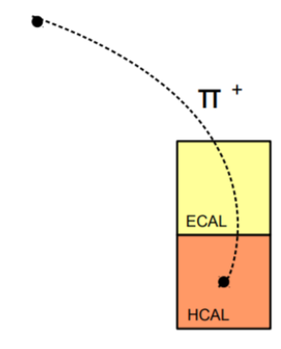

Effects of Eflow Neutral Hadrons on Jet Energy Resolution
Sean Preins
9/28/2020

Slide 2
Motivation
The purpose of this is to determine the potential of the barrel hadronic calorimeter, and to study the general HCAL impact on energy flow performance.
By filtering out jets with neutral hadron energy flow objects, the jet energy resolution can be improved, but with certain tradeoffs.
Studying where these tradeoffs outweigh the potential benefits will help determine the appropriate HCAL design most beneficial to jet physics.

Slide 3
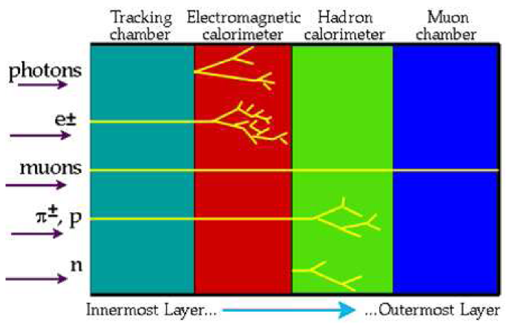
Energy Flow Objects
The three detectors being used are the tracking detector, electromagnetic calorimeter (ECAL), and the hadronic calorimeter (HCAL).
There are four categories of Eflow objects; Eflow tracks, Eflow electrons, Eflow photons, and Eflow neutral hadrons, each corresponding to a certain type of signal.
A detection is only noted if E/sigma(E) is above a certain threshold, usually 1.0.
As it is not a perfect reconstruction, Eflow objects may contain multiple particles, or one particle may produce multiple Eflow objects.

Slide 4
Electron/Track Energy Flow Objects
If there is an ECAL detection with a track pointing to it and is isolated, then create an ‘Eflow electron’ with an energy equal to the detection with the best resolution.
After an ‘Eflow electron’ is created, remove the track and subtract the track energy from the ECAL energy, and keep the remainder if it is positive and above the threshold.
For any track not associated with an Eflow electron, create an ‘Eflow track’ with an energy equal to the detection with the best resolution.
If it is pointing to an ECAL/HCAL detection, subtract the track energy from the ECAL/HCAL detection energy (ECAL taking precedent) and leave the remainder in the event. Only keep the remainder if it is positive and above the threshold.

Slide 5
Photon/Neutral Hadron Energy Flow Objects
If there is an ECAL detection with no track pointing to it, then create an ‘Eflow photon’ with an energy equal to the ECAL detection.
After an ‘Eflow photon’ is created, remove the ECAL detection from the event.
For each remaining HCAL detection, create an ‘Eflow neutral hadron (NH)’ with an energy equal to the remaining HCAL energy.

Slide 6
Example 1
Electron Eflow Object Check:
There is no isolated ECAL detection with a track pointing to it.
Eflow track with E = 3 GeV
Eflow photon with E = 2 GeV
Eflow NH with E = 1 GeV
Assume that sigma(E) << 1.0
and threshold = 1.0
Track Eflow Object Check:
There is a track not associated with an Eflow electron. Create an Eflow track with E = 3 and remove the track. Subtract 3 from HCAL 2 and discard the result as it is negative. This implies that it does not overlap with a neutral hadron.
E_{HCAL 1} = 1 GeV
HCAL 1
E_{HCAL 2} = 2 GeV
HCAL 2
Photon Eflow Object Check:
There is an ECAL detection, and no track is pointing towards it. A photon Eflow object is created with E = 2. Remove the ECAL detection.
ECAL
E_{ECAL} = 2 GeV
Neutral Hadron Eflow Object Check:
There is a remaining HCAL detection. A neutral hadron Eflow object is created with E = 1.
E_{Track} = 3 GeV
Track

Slide 7
Example 2
Eflow track with E = 2
Electron/Photon Eflow Object Check:
There are no more tracks or ECAL detections, so no Eflow electrons or photons are created.
Eflow track with E = 3
Eflow neutral hadron with E = 2
Assume that sigma(E) = 1.0
and threshold = 1.0
Track Eflow Object Check:
Track 1 is not associated with an Eflow electron, so an Eflow track is made with E = 2. It points to HCAL 1, so subtract 2 from 2.5 in HCAL 1, leaving 0.5. Because 0.5/1 < 1, the remainder is discarded.
Track 2 is not associated with an Eflow electron, so an Eflow track is made with E = 3. It points to HCAL 2, so subtract 3 from 5 in HCAL 2, leaving 2. Because 2/1 > 1, the remainder is kept. This means it overlaps with a neutral hadron.
E_{HCAL 1} = 2.5
HCAL 1
E_{HCAL 2} = 5
E_{HCAL 2} = 2
HCAL 2
Track 1
Neutral Hadron Eflow Object Check:
There is a remaining HCAL detection. A neutral hadron Eflow object is created with E = 2. This may be a “false NH Object” as an upward energy fluctuation from the track particle.
E_{Track 1} = 2
Track 2
E_{Track 2} = 3

Slide 8
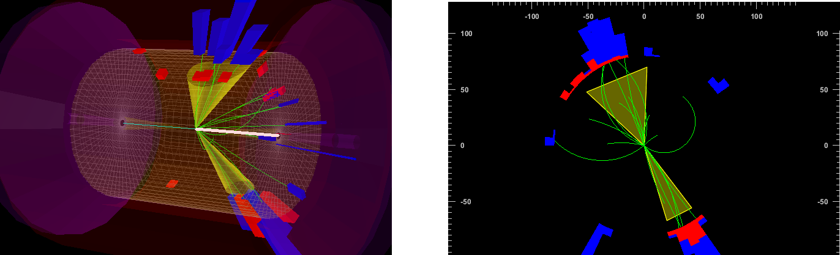
dELPHES Simulation Parameters
Proton energy: 275 GeV
Electron energy: 10 GeV
Neutral current deep inelastic scatter
Minimum Q2 of 100
Anti kt algorithm with R=1.0
HCAL resolution of 100%/sqrt(E) + 10% in barrel, 50%/sqrt(E) + 10% in endcap
Minimum PT of a jet was 5 GeV/c
Minimum GenJet energy of 10 GeV
No tracking beyond Eta = 3.0
Cells are larger to mimic energy deposits in adjacent cells
HCAL granularity of 0.25 x 0.25 in barrel, 0.2 x 0.2 in endcap
400,000 events generated
Electron

Slide 9
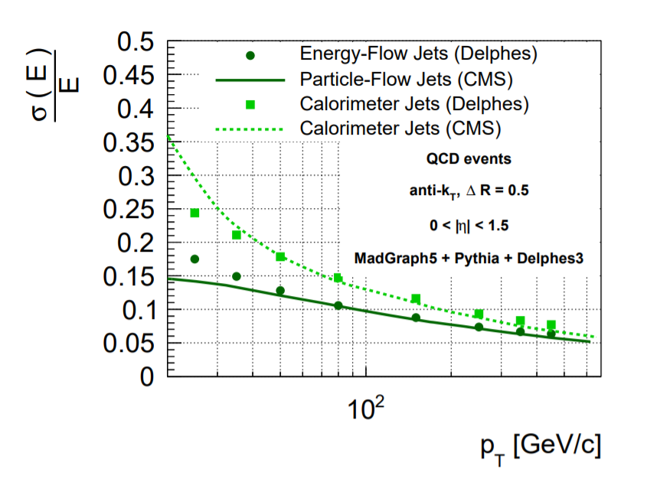
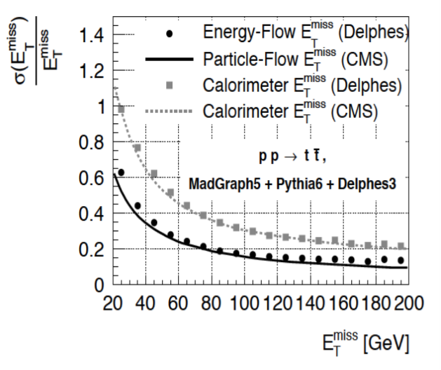
A comparison of dELPHES and full simulation Geant4 based for the CMS detector.
An analysis of missing energy, which is related to jet performance.
https://arxiv.org/pdf/1307.6346.pdf

Slide 10
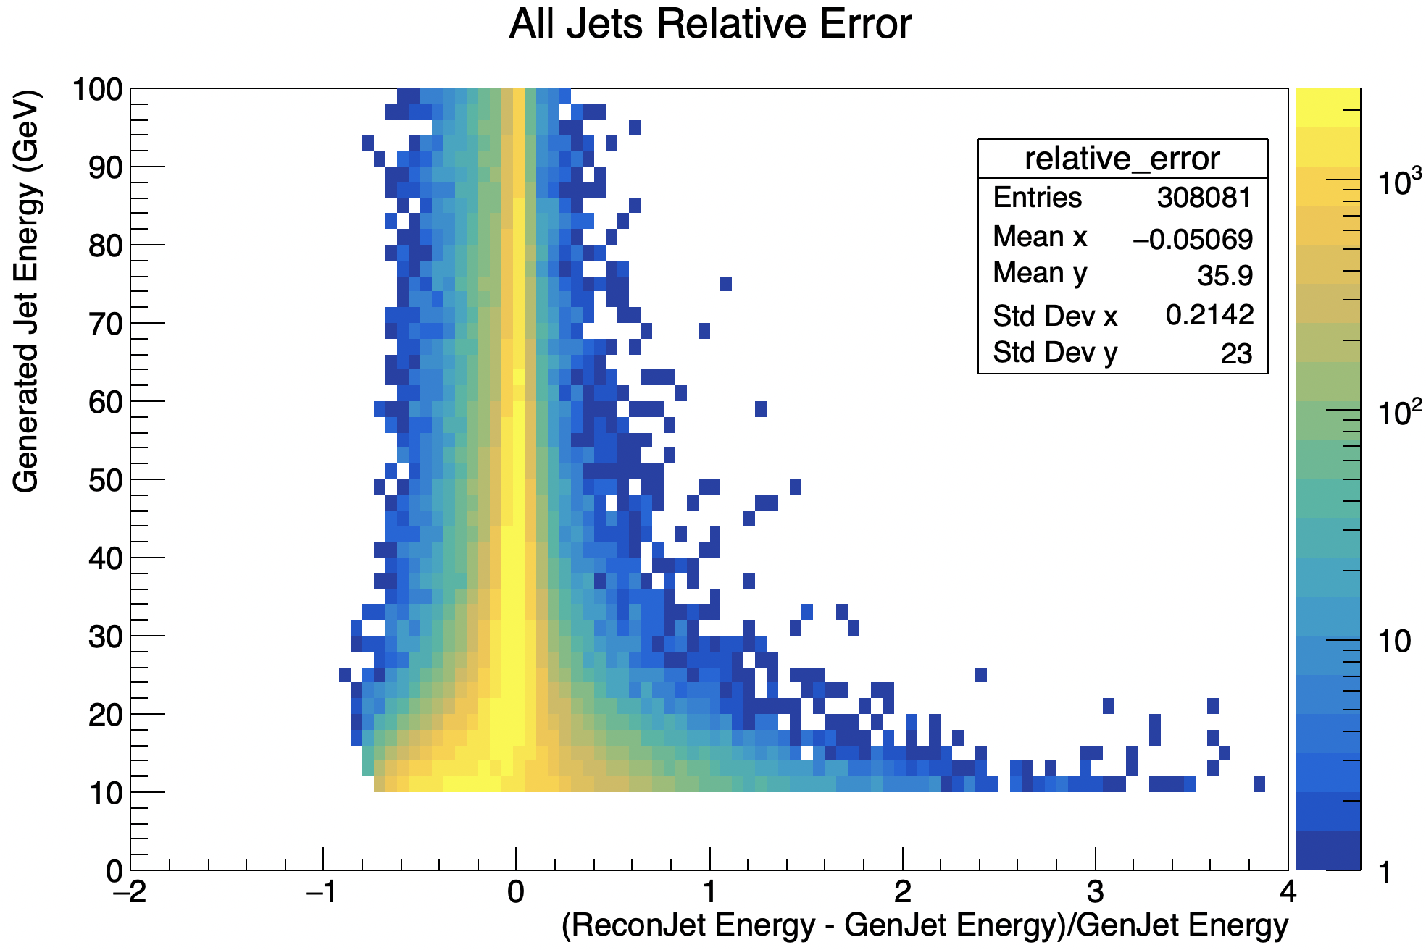
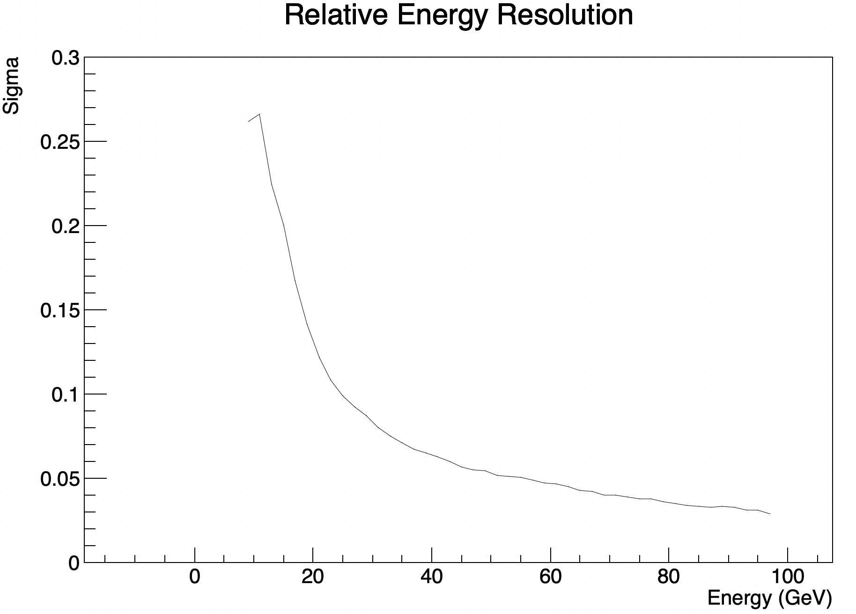
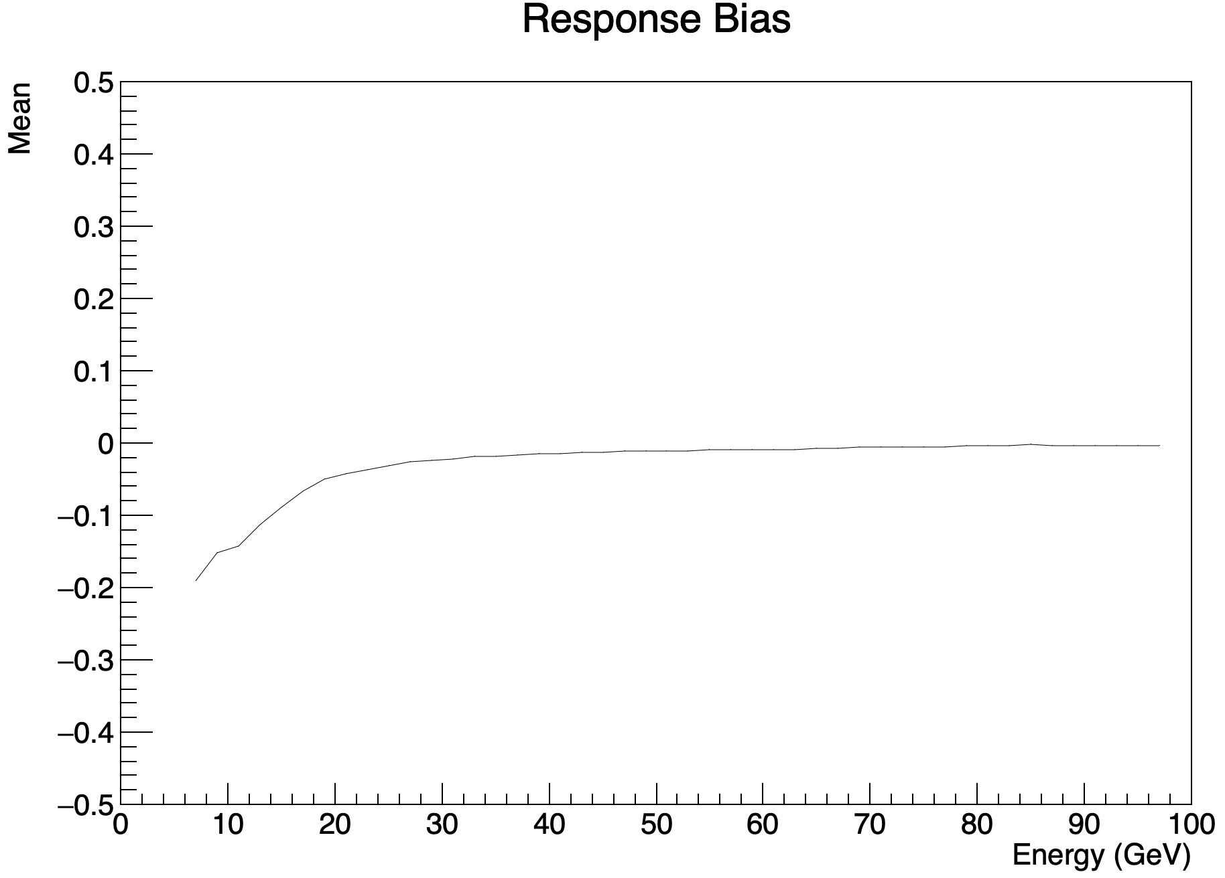
Jet Energy Resolution and Bias
True jets and reconstructed jets are paired together based on how well their angular “Delta R” distance matches. This does leave some unmatched.

Slide 11
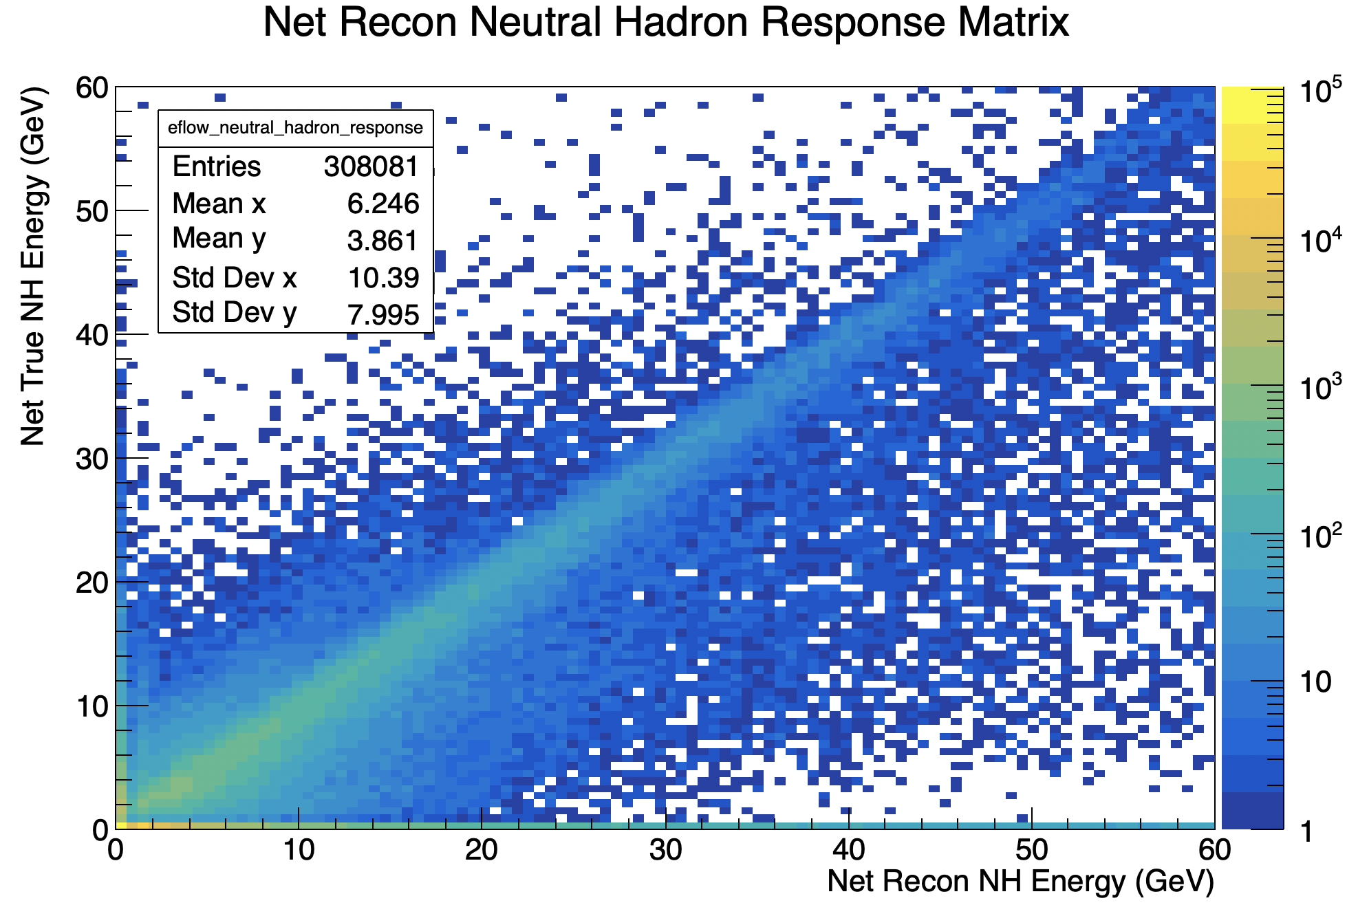
Eflow Neutral Hadron Response
For every matching jet pair, the total reconstructed neutral hadron energy (given from NH Eflow objects) was compared with the true neutral hadron energy content.
The diagonal line corresponds to accurate NH energy reconstructions.
The bottom line corresponds to jets that contain only false NH Eflow objects and no true NH energy.

Slide 12
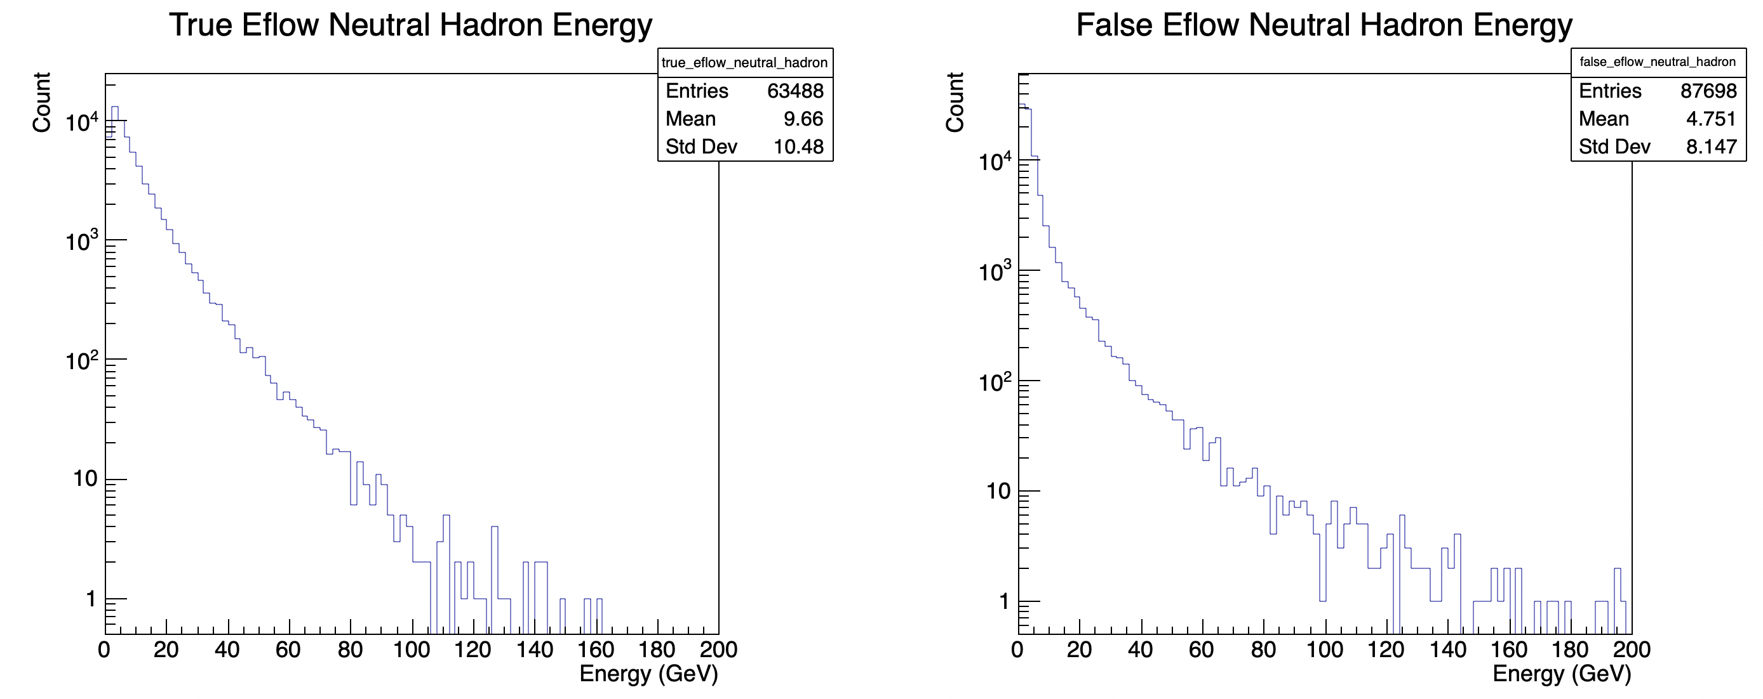
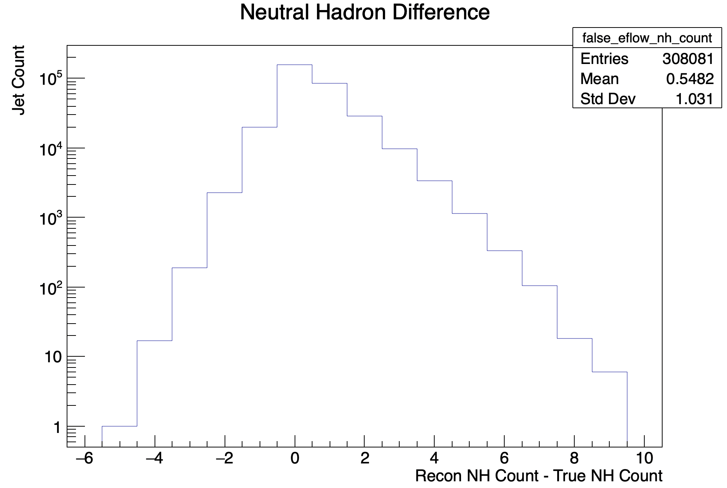
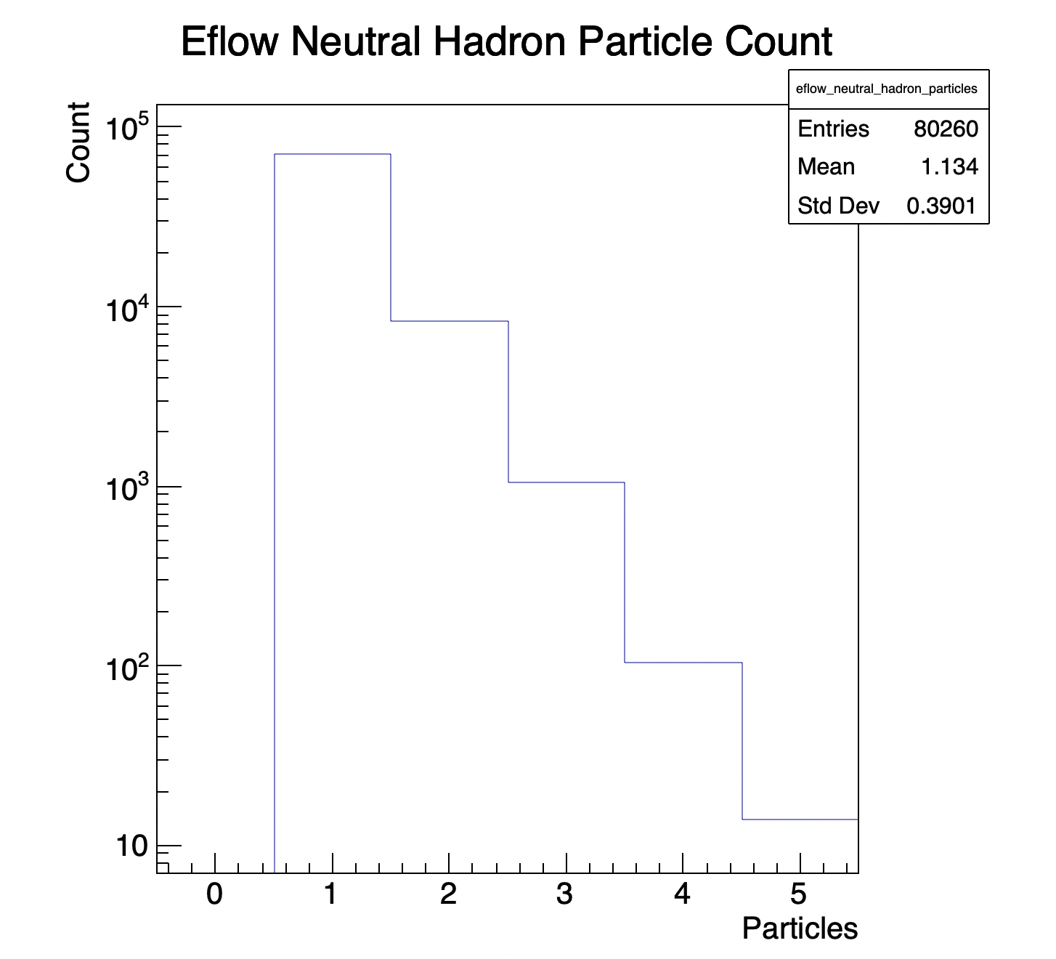
False / Missed Neutral Hadrons
Neutral hadrons will be missed from the detector if their energy goes below the threshold E/sigma(E) = 1.
A charged particle may produce a false Eflow neutral hadron if its energy in the HCAL has a significant upwards fluctuation.
As a result, false Eflow neutral hadrons are likely to be produced at lower energies.
A single NH Eflow object may also contain multiple particles due to large granularity.

Slide 13
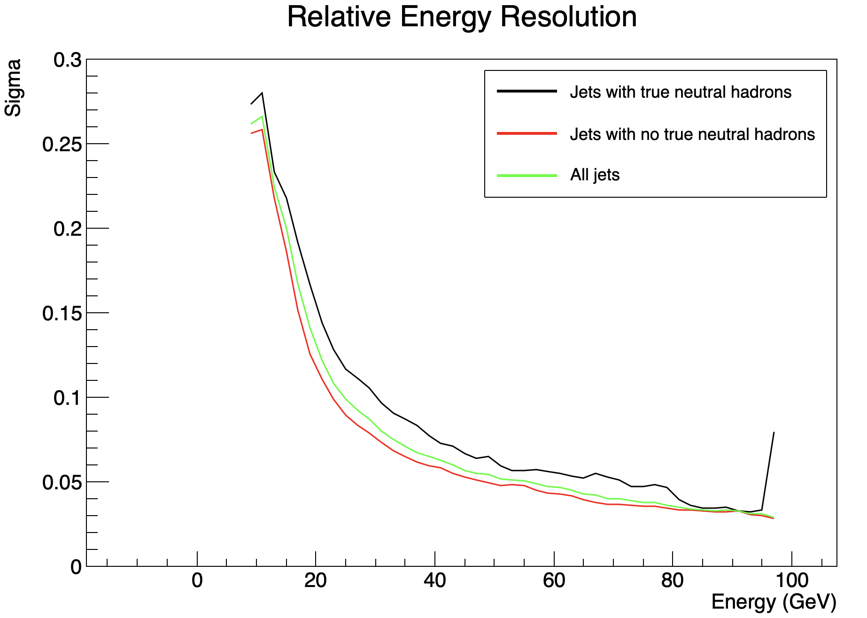
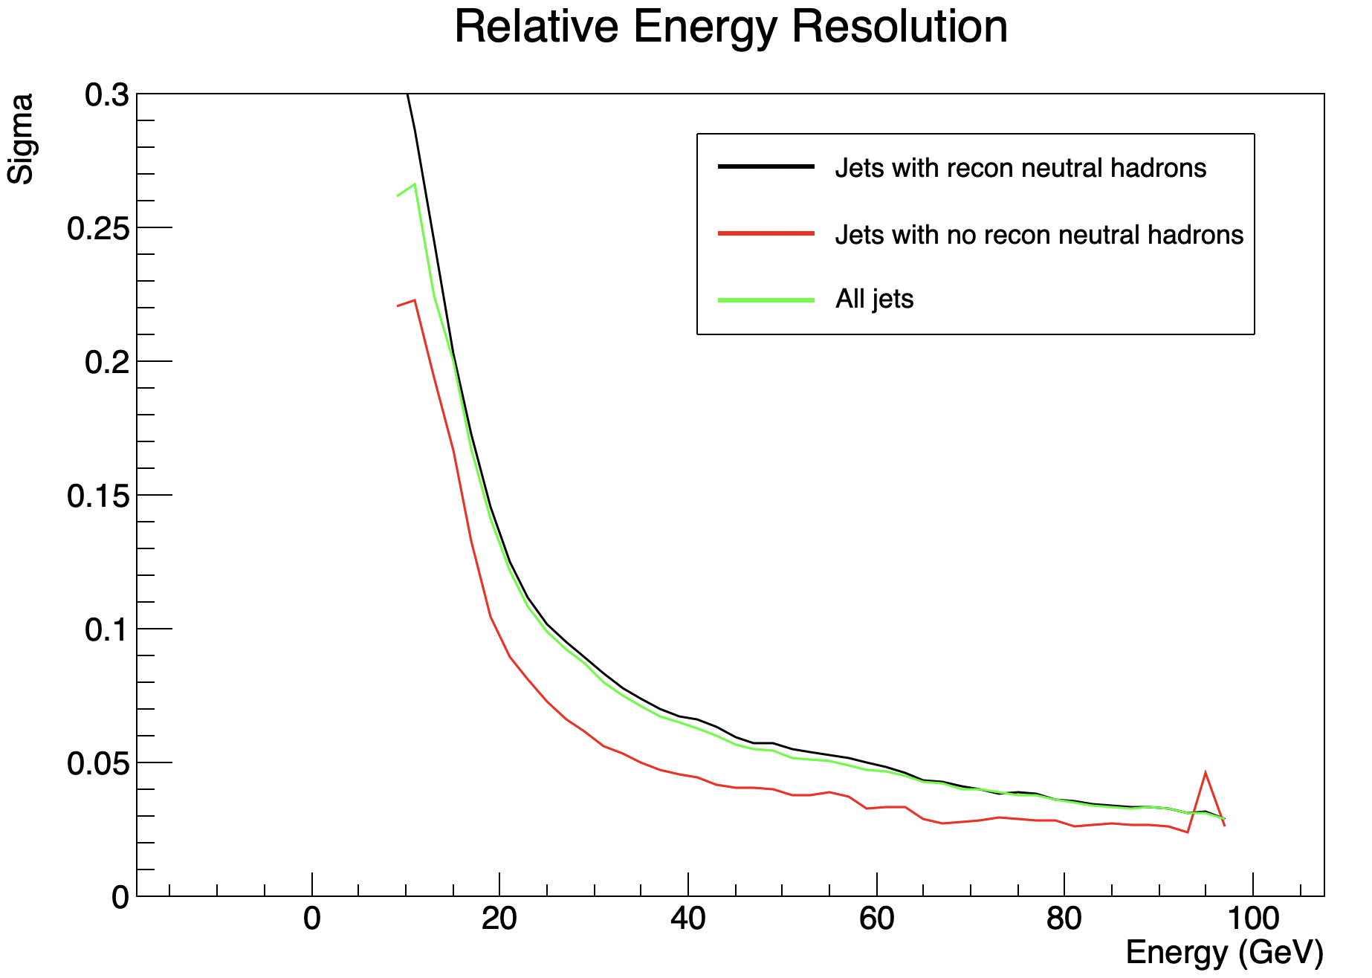
Effects on Jet Energy Resolution
The jet energy resolution does significantly improve when jets with NH Eflow objects are filtered out.
However, this improvement is not as dramatic when jets with true neutral hadrons are filtered out instead.
This shows that a large portion of the improvement does not come from filtering true neutral hadrons

Slide 14
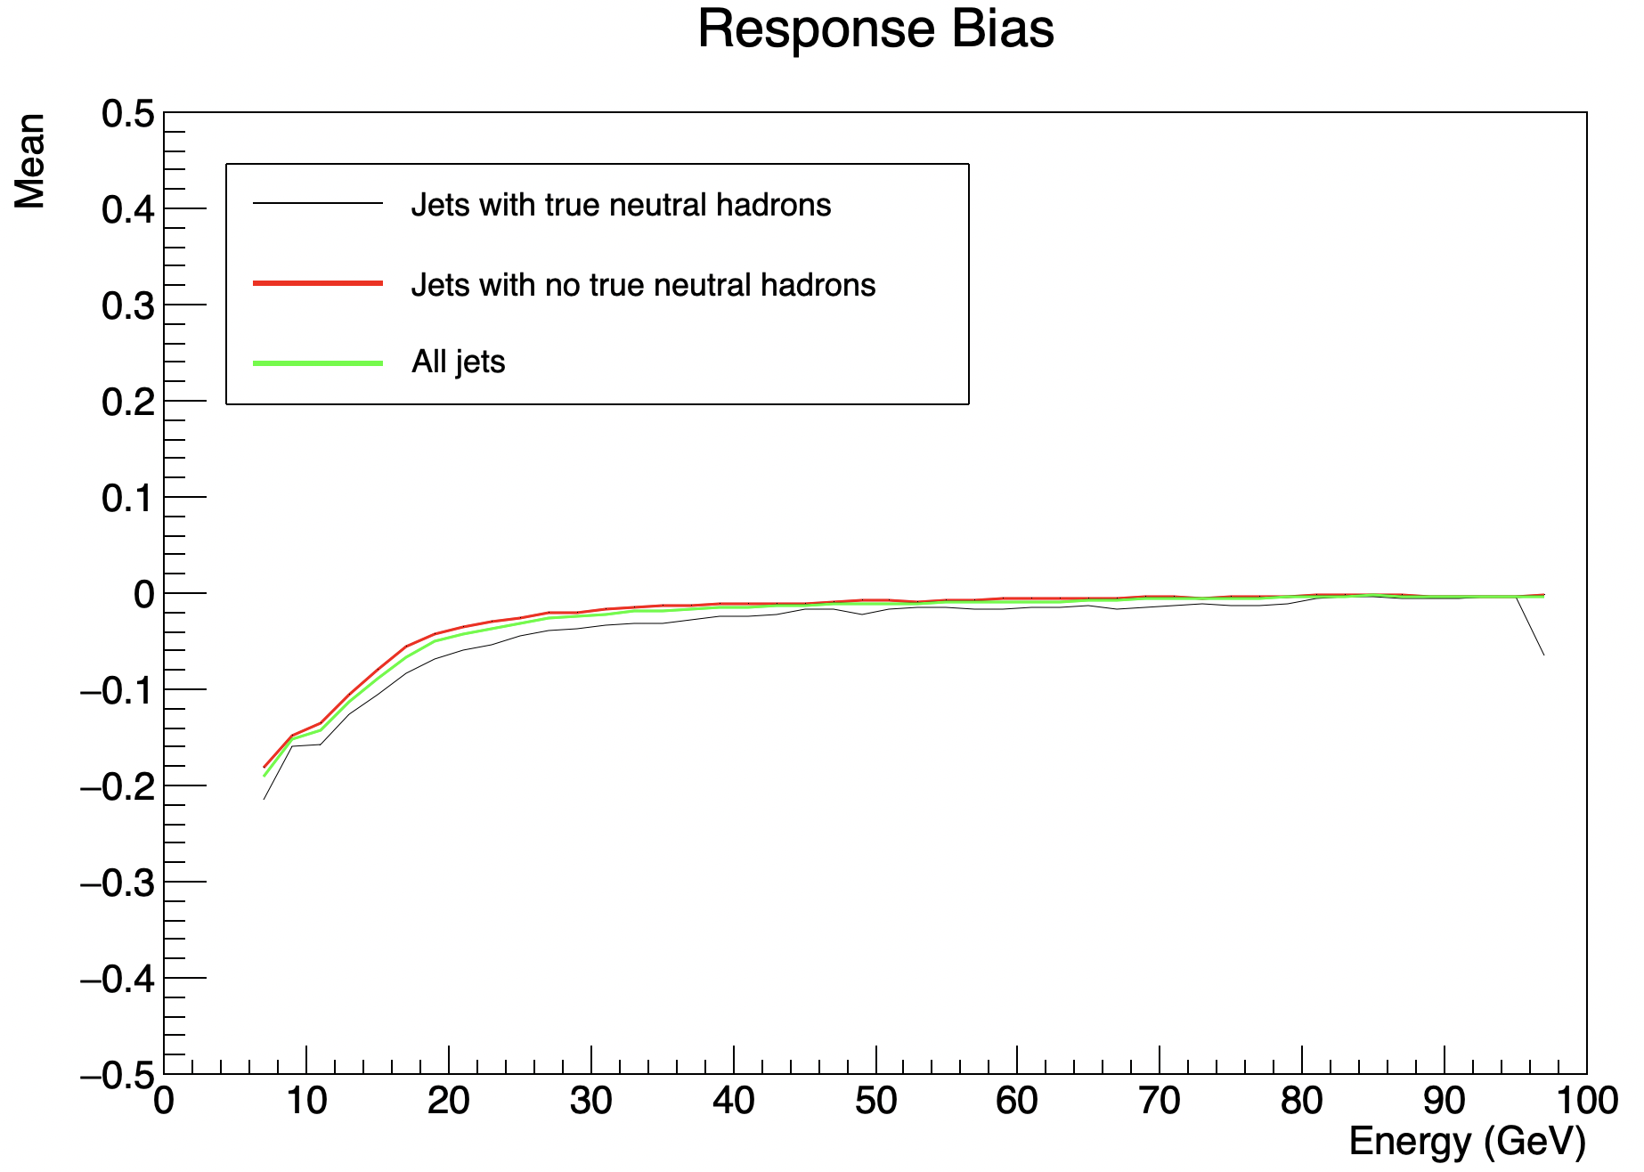
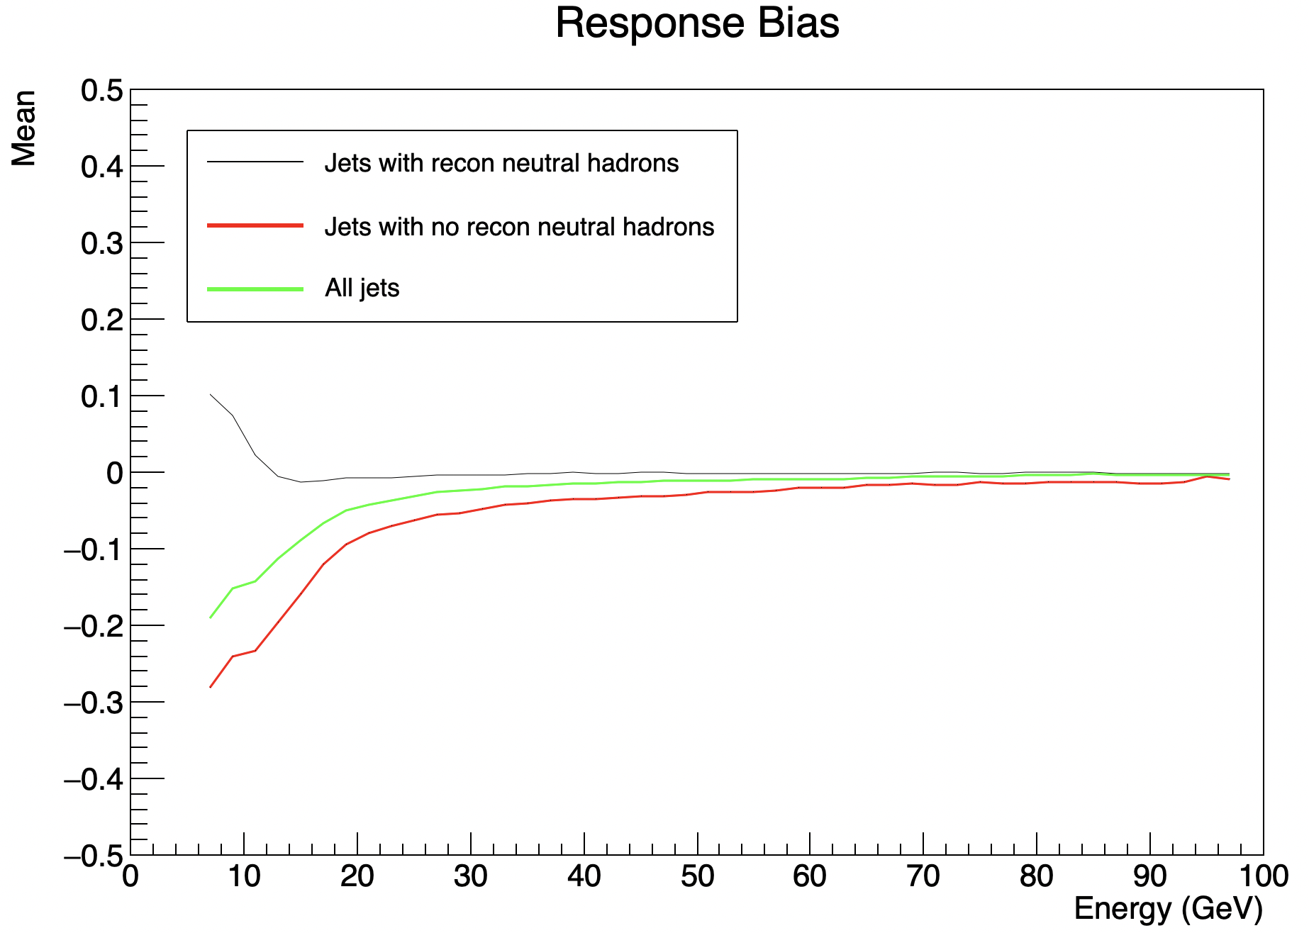
Effects on Jet Energy Bias
Filtering NH Eflow objects introduces a greater energy bias at low energies.
Jets with false NH Eflow objects will tend to have a positive bias as energy is double counted.
Jets without false NH Eflow objects will tend to have a negative bias as energy is occasionally missed.
By removing jets with NH Eflow objects, you remove the positive bias from false NH Eflow objects, but keep the negative bias from missed particles.
When filtering jets with no true neutral hadrons, this change in bias nearly vanishes.

Slide 15
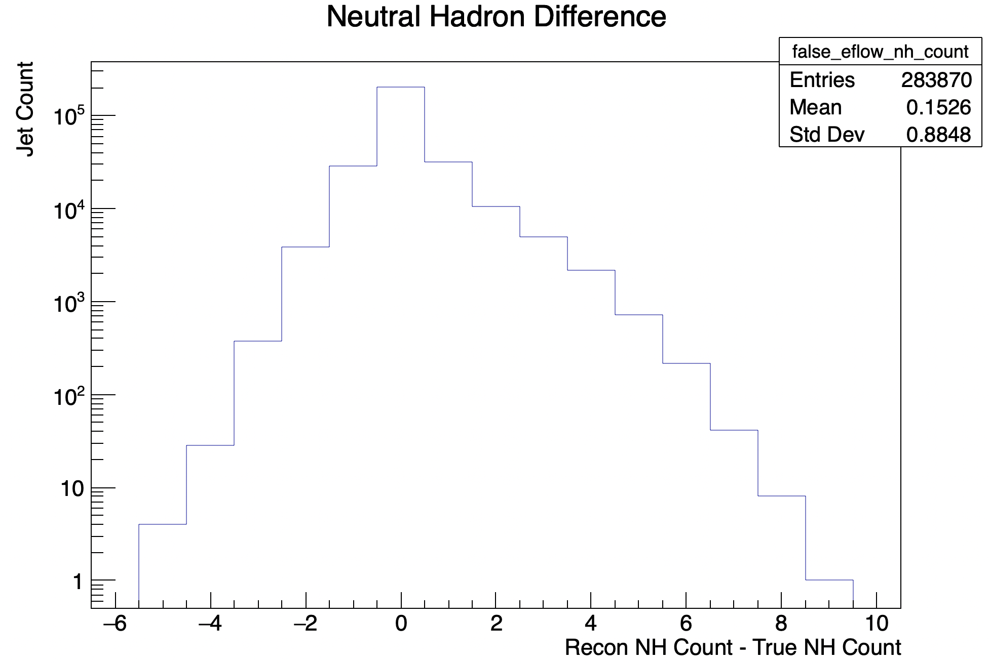
Increasing the threshold
By increasing the threshold of detection from 1.0 to 2.5, we may prevent the creation of many false Eflow NH objects.
In terms of the neutral hadron number difference, the mean improves from 0.55 to 0.15, and the Std Dev improves from 1.03 to 0.88.
This increased threshold has a tradeoff of introducing a greater negative bias as more true neutral hadrons are missed.
The rate at which these biases interact is nontrivial, and energy/angle dependent.

Slide 16
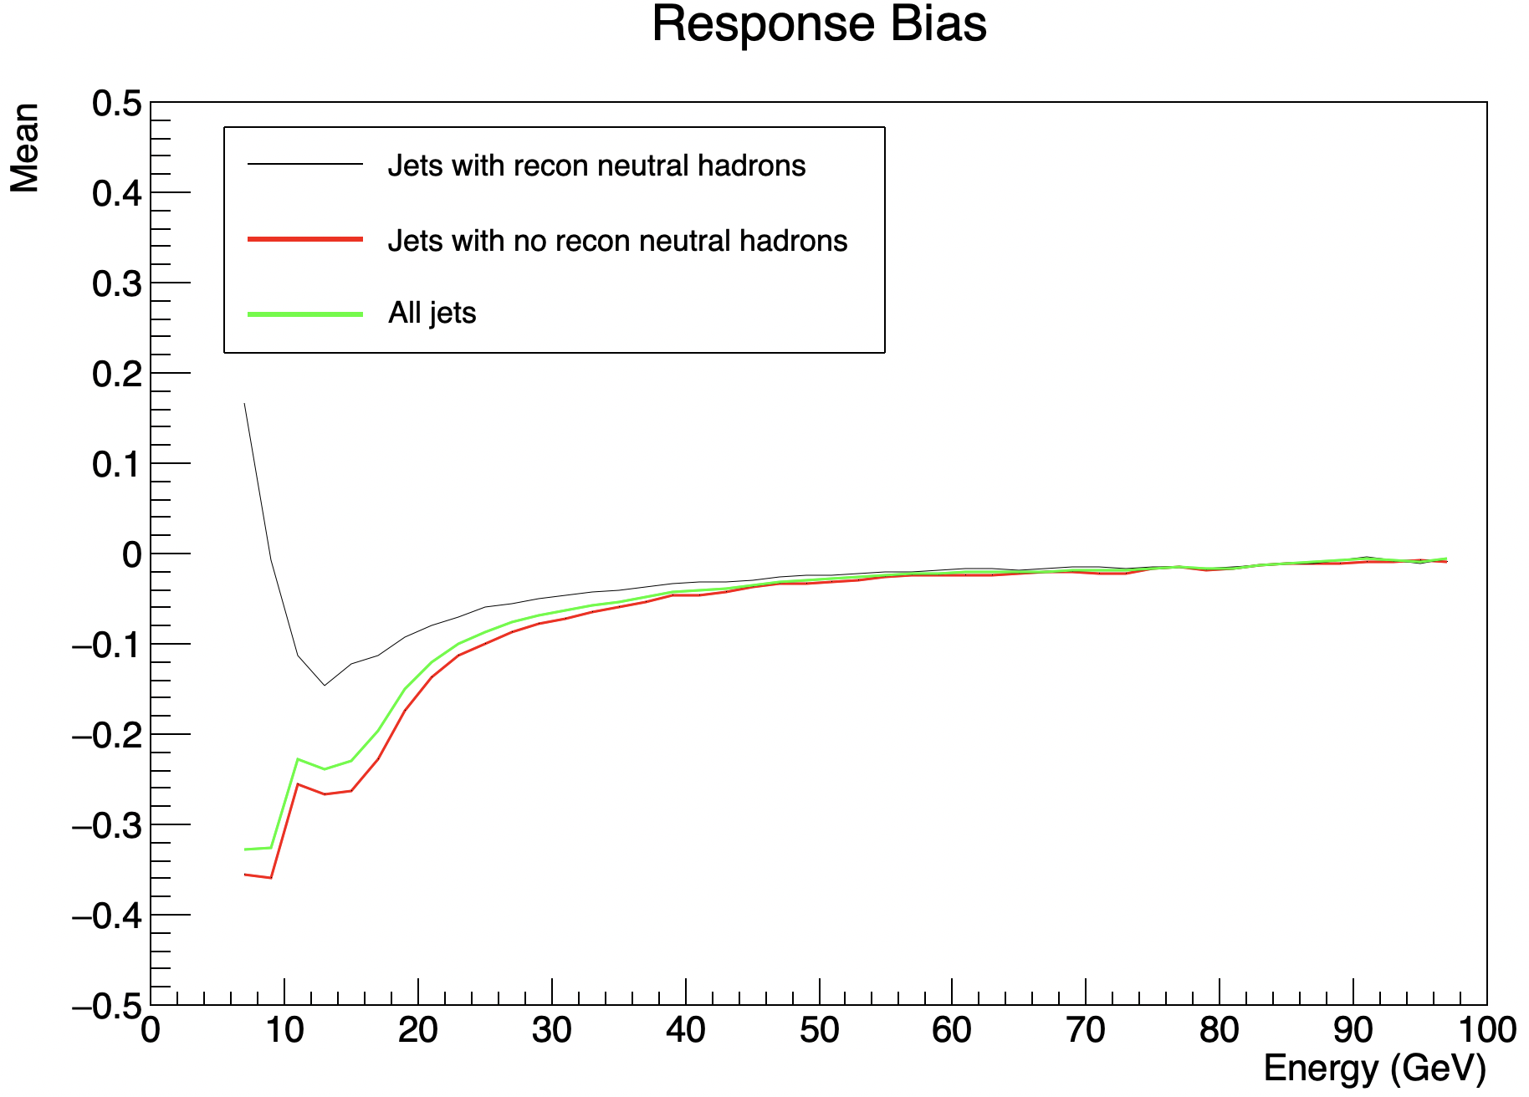
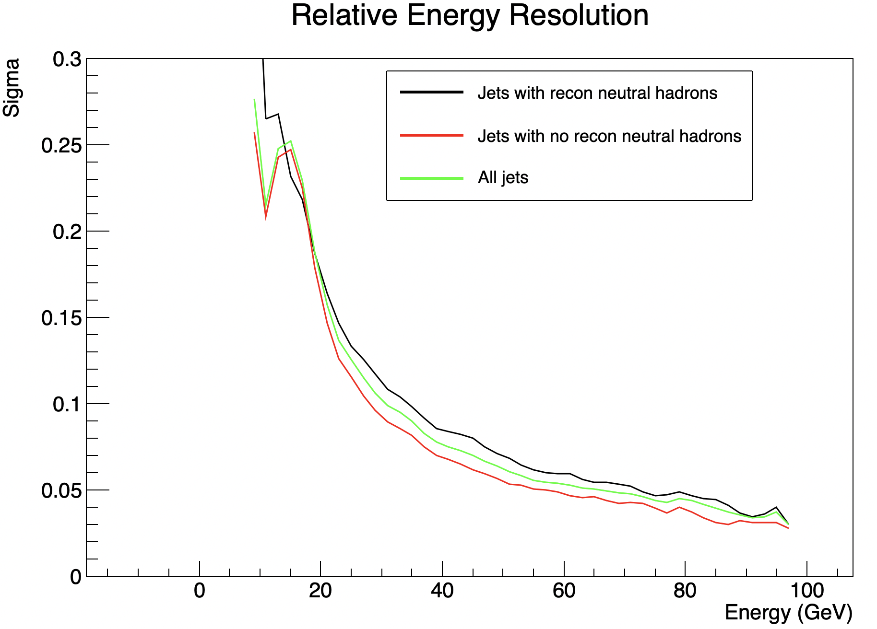
Bias / Resolution Comparison
Threshold = 1.0
Threshold = 2.5

Slide 17
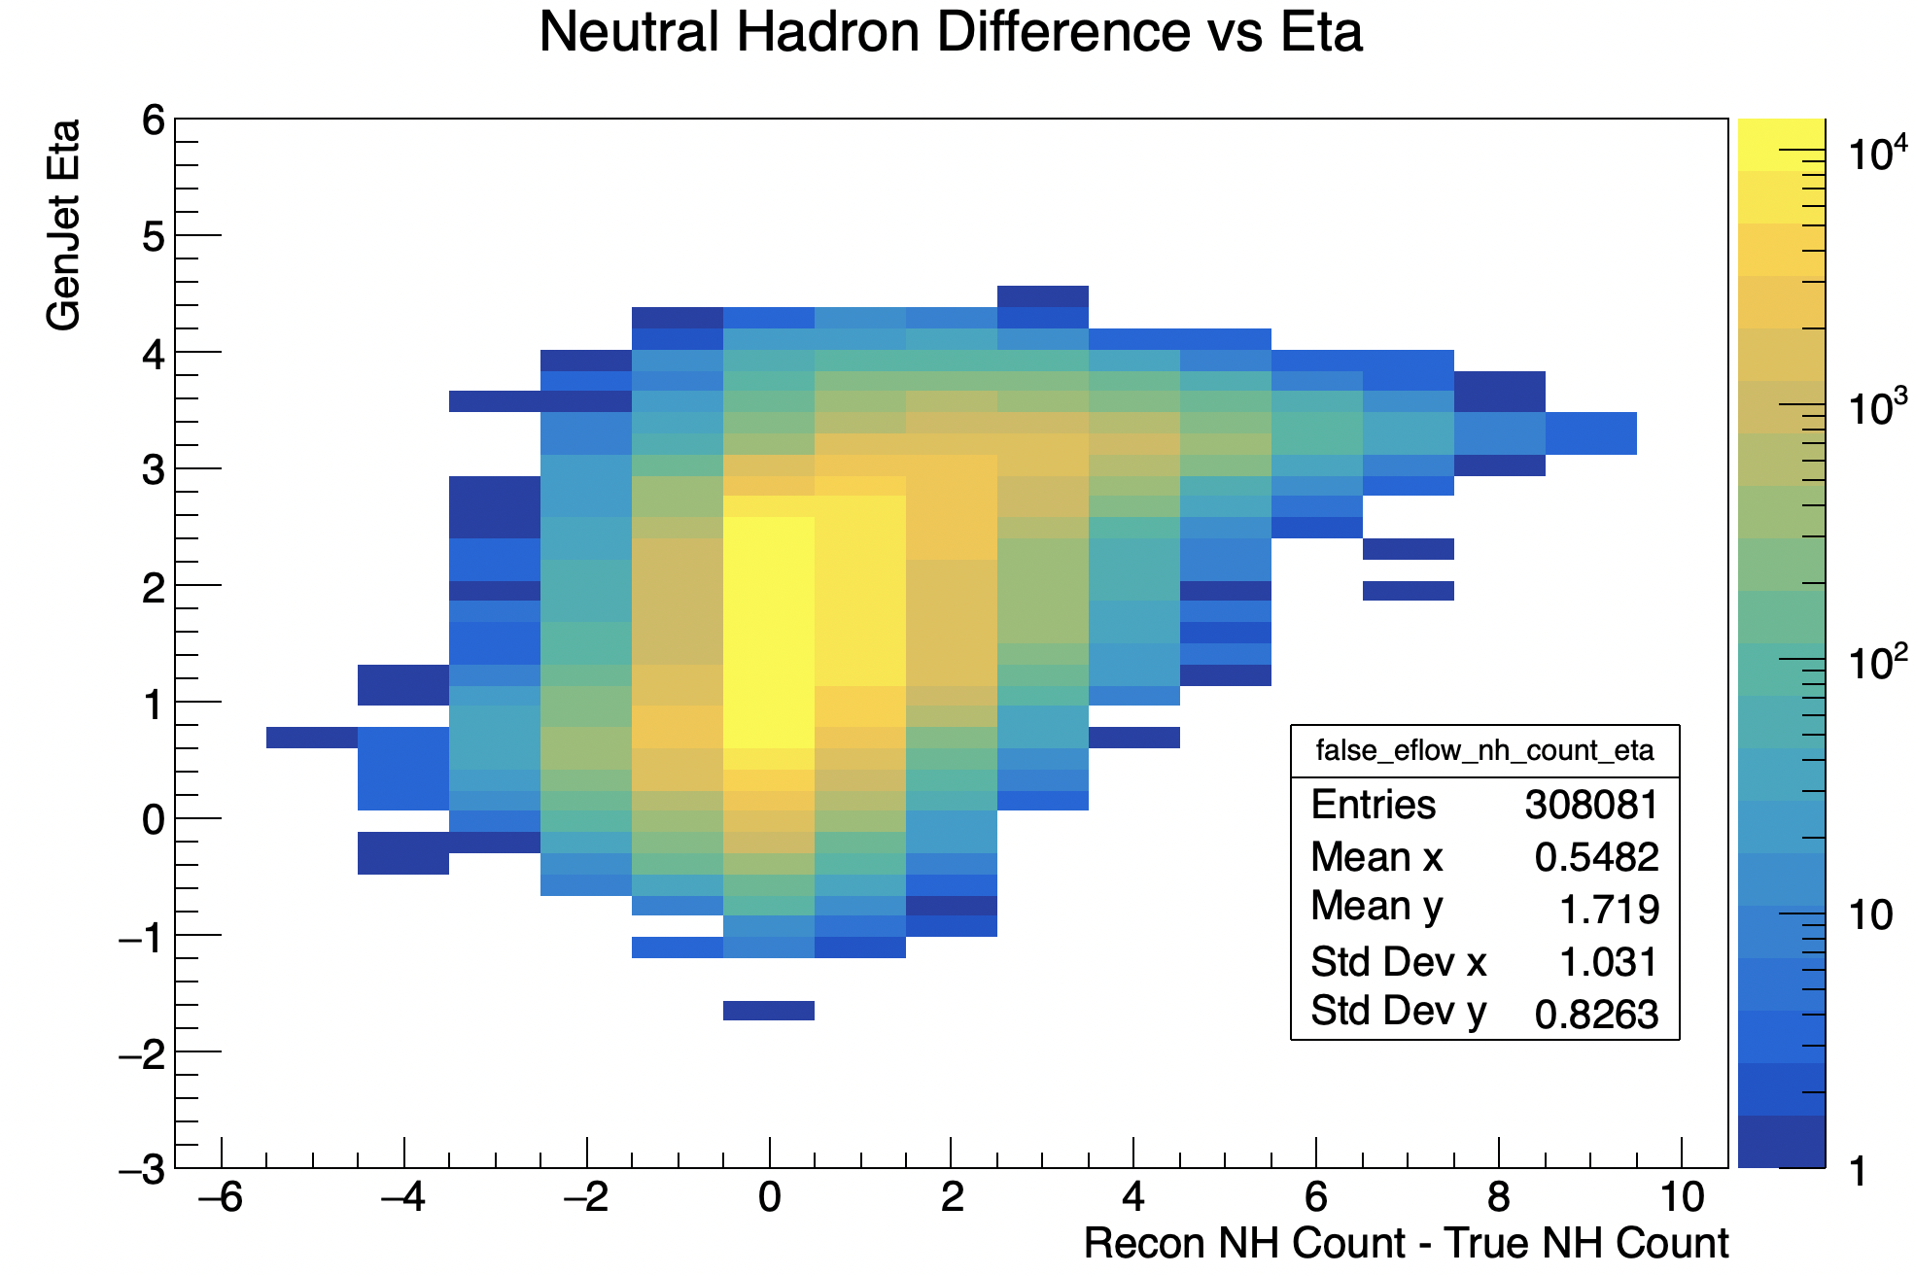
Potential Solutions
Optimize the threshold of detection for the HCAL.
Develop a new Eflow algorithm less likely to produce false NH Eflow objects (e.g. more skeptical of HCAL detections with tracks/ECAL detections at the same angle).
Find angular regions in the detector where this method is more/less likely to be effective.
Consider different HCAL designs, e.g. no endcap, cheap barrel, no barrel, or a better barrel.
Some combination of the above methods.

