Slide 1
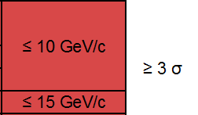
EIC Barrel RICH
Goal: Investigate the feasibility of a Barrel RICH detector for pi/k separation beyond 10 GeV/c, as well as eID up to 4 GeV/c.
Henry Klest and Tom Hemmick
DISCLAIMER: Many things in this talk are speculative and depend on further R&D.

Slide 2
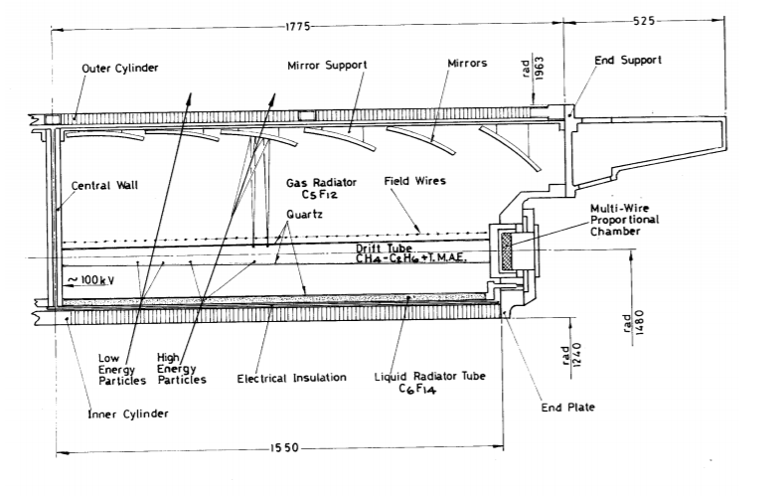
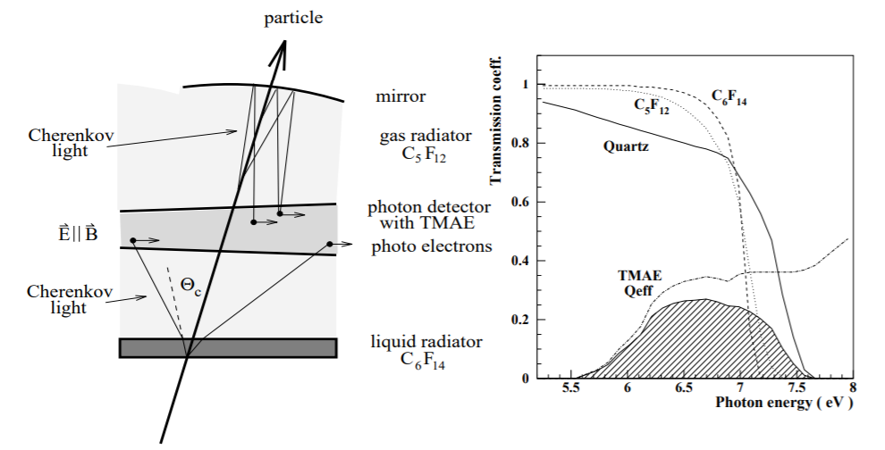
DELPHI Barrel RICH
DELPHI had a dual-radiator RICH w/ C6F14 liquid and C5F12 gas in a 1.2T solenoid and it provided a modest level of probabilistic pi/k separation up to ~12 GeV/c or so. Gas radiator used focusing, liquid did not.
Designed in the early ‘80s before many modern detector technologies. Their RICH was readout by a 4.2 cm thick TPC laced with TMAE gas. Gas radiator was 42 cm.
It was a very complicated design and had many engineering issues that impacted the performance.
This detector had: 3 separate fluid control systems, heating elements to keep C5F12 at 40 degrees C, two field cages, a MWPC with blinders, a 150 kV cathode, nine quartz windows, and TMAE mixed in the TPC drift gas.
DELPHI serves only as a proof of principle that a Barrel RICH can be a feasible detector, nothing from this design other than geometry would be wanted at EIC

Slide 3
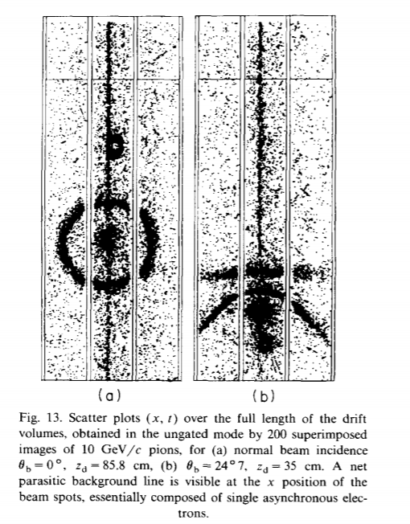
DELPHI Barrel RICH
TPC readout introduced a lot of issues.
Hard to reconstruct Z-position precisely due to large time binning w.r.t drift velocity.
Lost electrons and resolution at large drift distance to field non-uniformities and diffusion.
Conversion point of photon arbitrary in R.
Only phi coordinate of a photon could be measured precisely, but rings smeared in phi due to bending in B-field.
Ionization trail, delta rays, electronic noise, crosstalk, after-pulses, photon feedback, all easily confused with ring photons signal/background ratio only .34
Photodetection and pattern recognition have improved significantly since LEP.

Slide 4
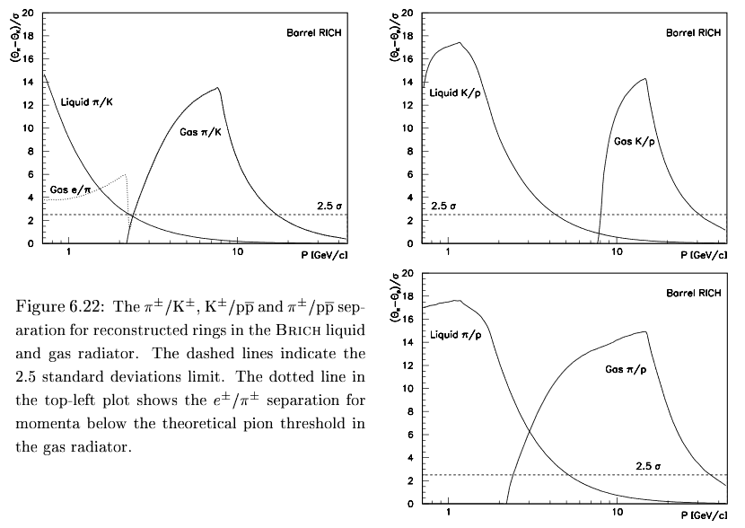
Note the dotted line is at 2.5σ, but we want 3.
Would prefer to make something simpler to analyze, if possible. Impetus for a barrel RICH is high Q² events, which require high statistics. The sooner the detector is understood and ready for physics the better.
“PID with the DELPHI RICH” Dissertation, Emile Schyns

Slide 5
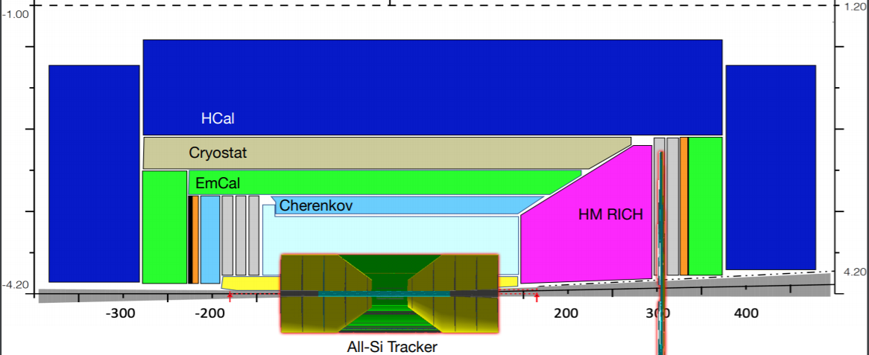
Detector cartoon from Rey Cruz-Torres (LBNL)
Free Real Estate?
The compact all-silicon design has enough space for a RICH in the barrel. The question is what kind of a design can accomplish > 15 GeV/c pi/k separation with the tracks bending in the magnetic field. In principle, a short O(40 cm) RICH could also be shoehorned into sPHENIX-like design if inner HCal is removed and EMCal is backed up to magnet.

Slide 6
Ingredients/Considerations for a Barrel RICH*
Ingredient | DELPHI | EIC, as considered in this presentation
1. Magnetic Field | 1.2T | 1.5T or 3T
2. Space | 42 cm (gas) | ~40-50 cm
3. Photodetector | TMAE TPC + MWPC | CsI MPGD or SiPM
4. Dark Rate/Background | Ionization trail from particle tracks in TPC | SiPM dark rate
5. Radiator | C5F12 @ 40°C | C4F10 or C3F8, pressurized and/or cooled.
*Not an exhaustive list. These represent only the considerations currently implemented in our fast simulation.

Slide 7
Limitations
Ingredient | Known limitations | Possible solution
1. Magnetic Field | Larger bending of tracks in larger field means greater smearing of a ring. Strongly affects many photodetectors. | Decrease length of radiator
2. Space | Short radiator will produce fewer photons | Pressurize gas
3. Photodetector | B-field tolerance, SiPM Dark rate, crosstalk, and rad hardness | Change temperature/voltage, Needs further R&D
4. Radiator | Needs to have high momentum reach and produce enough photons | Heavy gas, pressurized
5. Dark Rate/Background | SiPM dark rate is large, scintillation spectra in the visible unknown | Needs further R&D
6. Low momentum | Needs to be supplemented by low momentum PID | DIRC, dE/dx, ToF? DIRC preferable to minimize gaps in positive pi/k separation

Slide 8
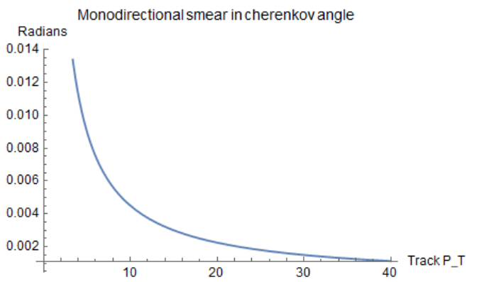
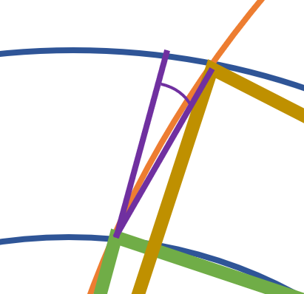
Bending Geometry
1. Magnetic Field
Toy model of how Cherenkov rings will look on the detector plane.
Approximated in MC as a uniform distribution ranging from 0 to $∆φ/2,$ multiplied by cos($θ_{c}$)
Need to find the change in angle of a particle as it passes through the RICH
Particle Trajectory in
x-y plane
RICH boundaries
r₂
$$R=\frac{P_{T}(GeV/c)}{.3∗B(T)}$$
Momentum (GeV) | Smear over 20 cm radiator length in 1.5 T (mrad)
1.5 | 30
3 | 15
5 | 9
7 | 6.4
10 | 4.5
15 | 3
20 | 2.25
25 | 1.8
r₁
Vertex
$∆φ=\cos^{−1}\left[\frac{{2R}^{2}−r_{2}^{2}}{{2R}^{2}}\right]−$ $\cos^{−1}\left[\frac{2R^{2}−r_{1}^{2}}{2R^{2}}\right]$
Angle made between chord and tangent is $∆φ$/2
Note that this smear is applied only to one axis of the ring. Simulation assumes P_{T} = P. $θ_{c}$ at saturation in 3 Bar C3F8 is 80 mrad.

Slide 9
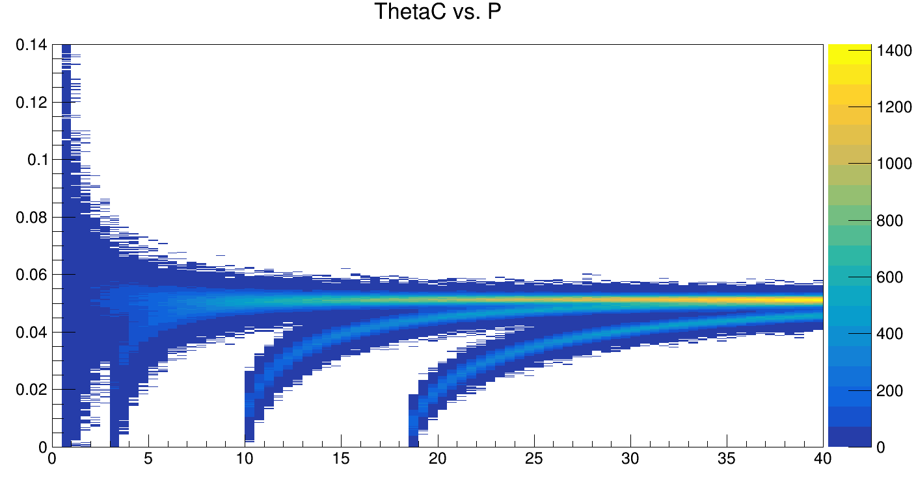
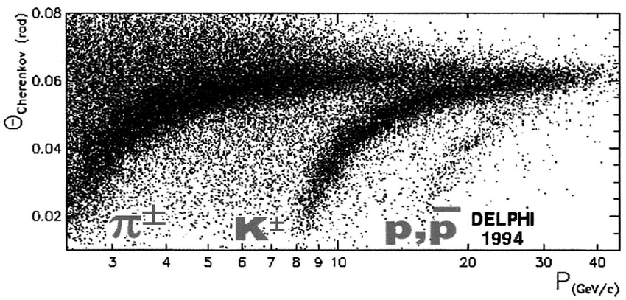
1. Magnetic Field
Large spread at low momentum from bending. Inputting specs similar to DELPHI’s into our simulation matches qualitatively what they saw (note log scale)

Slide 10
Nominal design in Simulation
1. Magnetic Field/2. Space
= Photodetector
Need to make best possible use of radial space, need to know how compact this can be and still get enough photons.
Greater length means greater bending of a track.
Thus the “Normal” RICH strategy of increasing radiator length is less efficient
Pressurizing a heavy gas is a good option
Note that this is necessary both to get enough photons, as well as getting the kaon threshold close to the DIRC 3-sigma k/pi separation momentum of ~6 GeV/c to provide consistent positive PID at all momenta up to 15 GeV/c
Also note that radiator length increases slightly with increasing |η|, all lengths quoted for η = 0.
Silicon tracker gives excellent pointing resolution into RICH
Lower B-field and length is better, decreased $\int{B∙dl}$
This brings about a radical idea from Tom

Slide 11
Two of them!
1. Magnetic Field/2. Space
Cutting length in half improves bending resolution contribution by a factor of 2.
Can share a gas volume, provide 2 independent measurements of radius if you can get enough photons.
With pressurized gas, could get enough photons in ~20 cm.
Downside: more mirrors and more photodetectors = more $$$
Impact of having 2 layers not in simulation, all results shown are for a single layer only.
= Photodetector

Slide 12
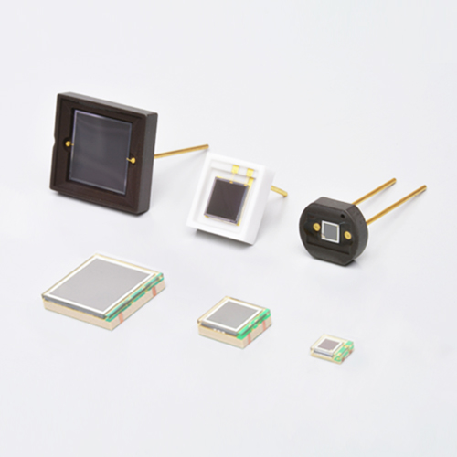
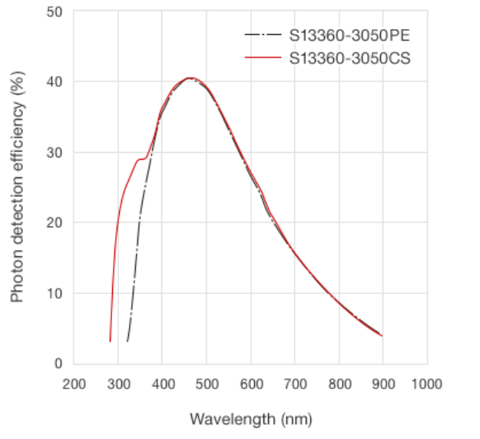
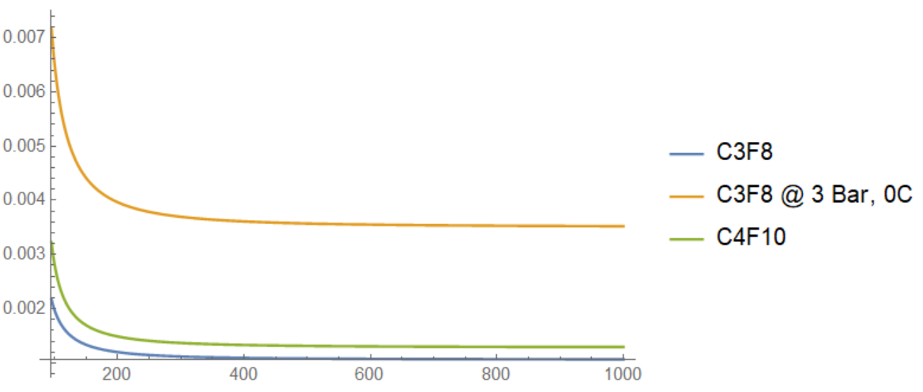
Photodetectors
3. Photodetectors
Only B-resistant technologies will operate in an optimal geometry (spherical mirrors w/ sensors pointed outwards) in the barrel.
SiPMs are the primary choice considered here, but photocathode-coated MPGDs are a possible alternative if SiPMs are deemed infeasible.
SiPMs benefit hugely from operating in the visible range, all gases are transparent and have negligible chromatic dispersion, less perfluorocarbon scintillation.
Beating down dark counts in SiPMs will be a formidable task.
Temperature, time resolution
UV photocathode coated MPGDs are also possible, but aren’t considered yet because of lack of accessible data on C3F8 gas.
In C4F10, transparency of gas in UV is too low. Needs to be measured for C3F8.
Low total photon yield, will need to reject track ionization as much as possible.
Pressurizing heavy gases exacerbates chromaticity, likely to be leading resolution term.
Sample SiPM Photon detection efficiency
Index of refraction, n-1
Photon Wavelength (nm)

Slide 13
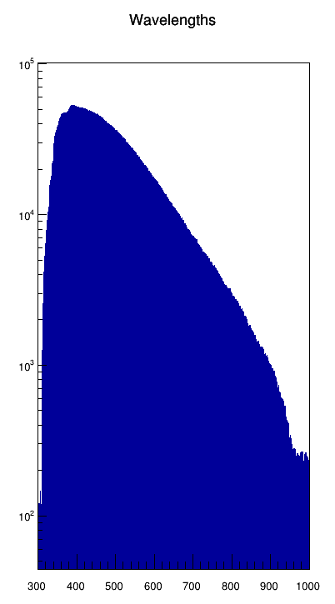
Perflourocarbon gas parameters from “VUV Absorbing Vapours in n-Perfluorocarbons.” publication, https://cds.cern.ch/record/600182/files/ep-2002-099.pdf
SiPM detected photon wavelength (note log scale)
Index of Refraction, n-1
CsI Wavelength Window
SiPM Wavelength Window
Photon Wavelength (nm)
Chromatic dispersion increases with pressure, mainly affecting the UV. Pressurizing to increase N_{pe} in the VUV region therefore degrades resolution, especially in heavy gases. C4F10 becomes opaque around 150 nm, CsI has QE out beyond 150, but not enough photons in this region in 50 cm or less of radiator. If pressurized C3F8 has transparency out to 130 nm or so, could be viable.

Slide 14
Perflourocarbon gas parameters from “VUV Absorbing Vapours in n-Perfluorocarbons.” publication, https://cds.cern.ch/record/600182/files/ep-2002-099.pdf
Note that SiPM detected wavelengths are peaked near 400 nm, chromaticity in pressurized heavy gases is non-zero but small compared to the VUV.
Index of Refraction,
n-1
CsI Wavelength Window
SiPM Wavelength Window
Photon Wavelength (nm)

Slide 15
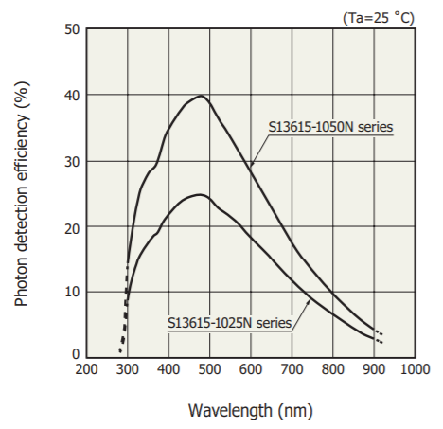
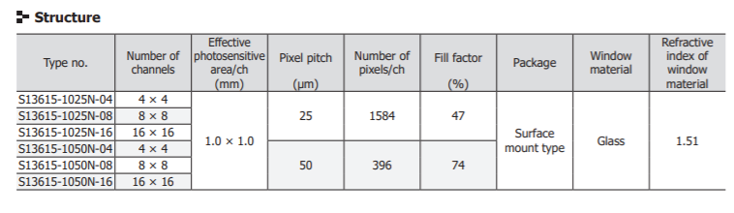
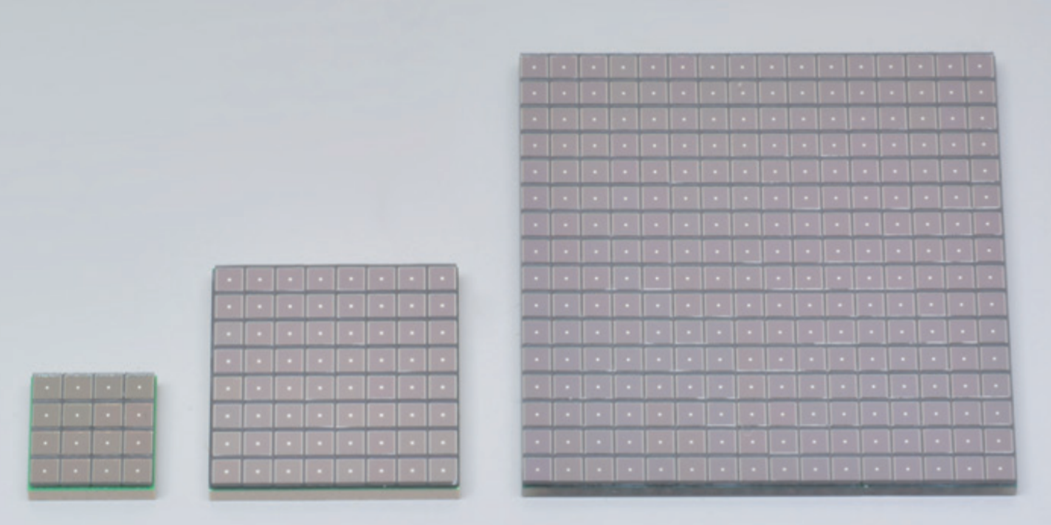
Hamamatsu SiPM Info
3. Photodetectors
Latest and greatest is the new TSV (Through-Silicon Via) S13615 series.
1x1 mm channels with a high fill factor and PDE, also a dark rate that’s very low compared to predecessors at STP.
High packing efficiency is also possible.
PDE of this model assumed in simulation.

Slide 16
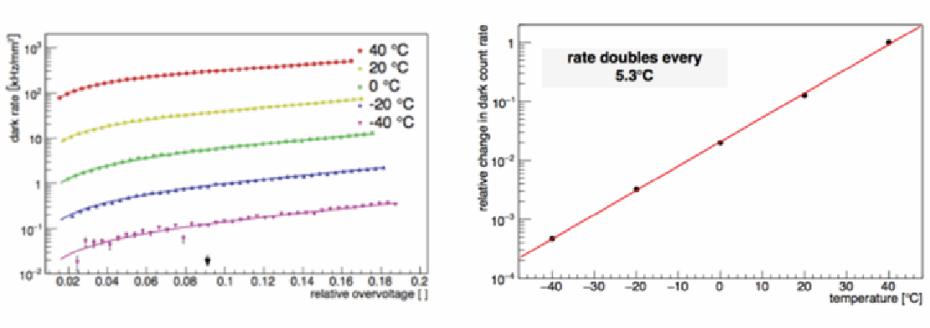
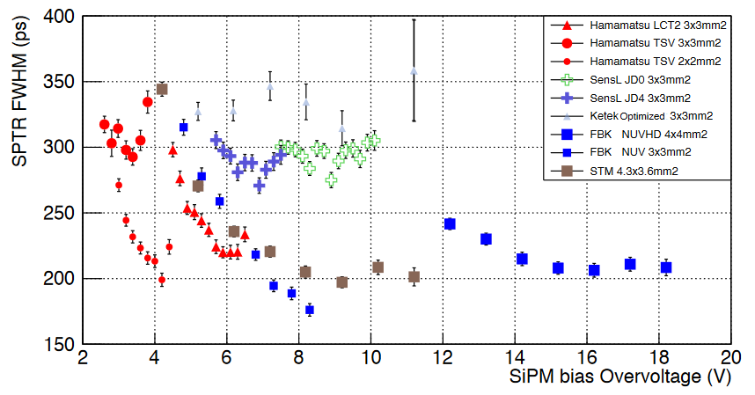
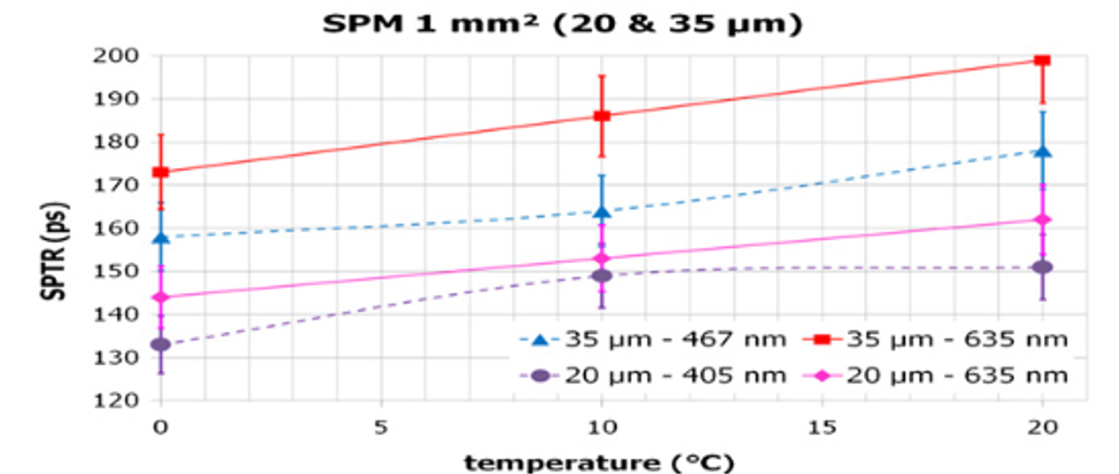
Timing
4. Dark Rate
Dark rate decreases and time resolution improves at lower temperatures, so having the ability to cool the SiPMs is a must. At 0° C, DCR of S13615 could be as low as 6 kHz when new. 100 kHz is assumed in baseline simulation.
Fast, time-digitizing electronics are a must to beat DCR.
By shrinking the time window during which hits are accepted, one can reject most dark hits.
In literature, time resolution of 80 ps has been achieved, Hamamatsu TSV has been tested and shown 100 ps performance

Slide 17
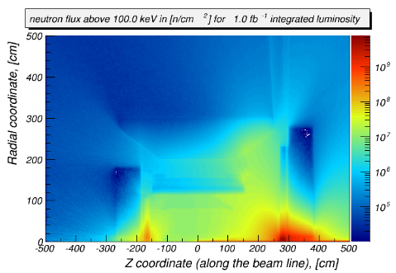
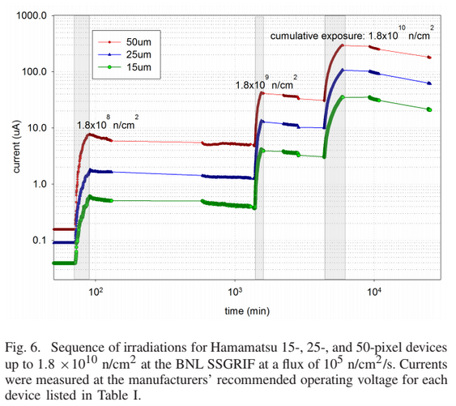
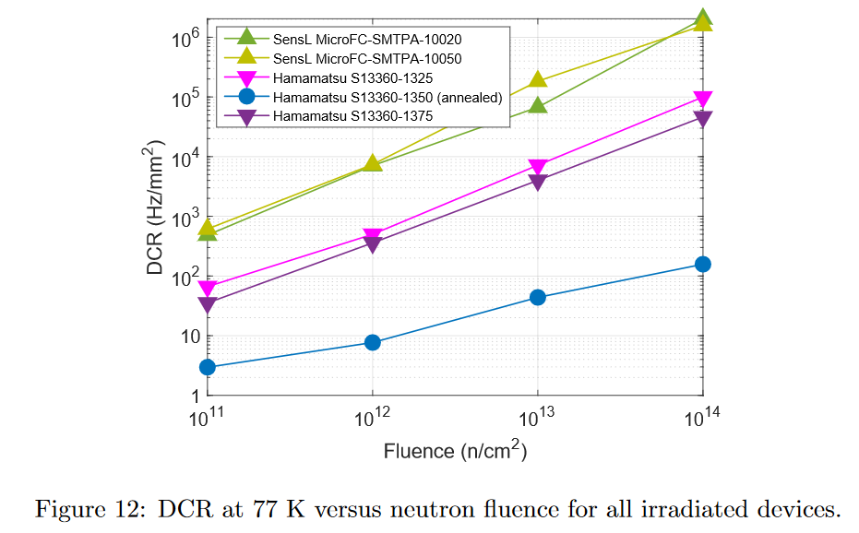
Radiation Damage
Location of BRICH SiPMs
Irradiation with neutrons and protons introduces defects in the silicon that can produce energy levels in the band gap.
Dark current increases roughly proportional to neutron dose.
At possible location of SiPMs, ~3 to ~5x10⁷ n/cm² per fb⁻¹ according to preliminary studies.
Annealing has shown promise in reducing DCR, changing temperature and voltage reactively can also help combat increases in DCR due to irradiation.
A large R&D effort from the world community is underway.

Slide 18
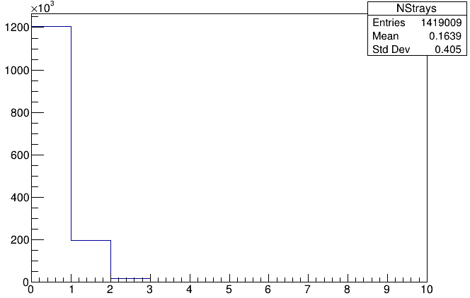
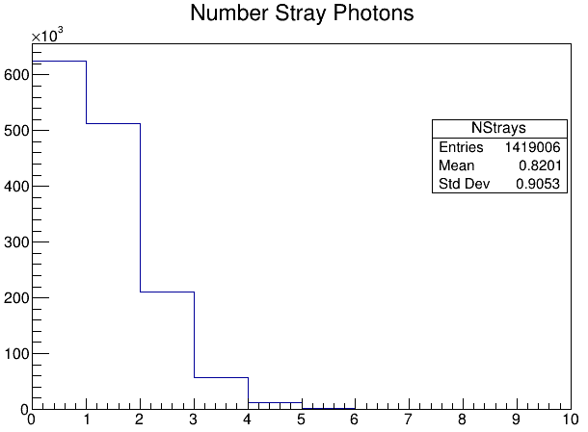
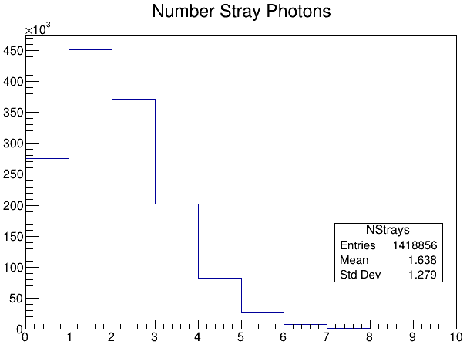
Dark Rate in Simulation
4. Dark Rate
Assuming a time cut on any hit pixel of$±2σ_{t}$ The amount of dark hits in the active area on average is
$DCR\left(Hz/mm^{2}\right)∗Active Area \left(mm^{2}\right)∗4∗Time Resolution(s)$
which follows a Poisson distribution.
Factor of 4 comes from a 2-sigma cut in incidence time, 2 sigma above and 2 sigma below the truth time.
Dark hits with θ_{C Noise Hit} < 1.2*θ_{C max} are taken to be confused with true hits as a quick approximation of some pattern recognition.
Prevents dark hits far away from the true ring having large pull and ruining results
This should be taken as a “worst case”, better fitting techniques will improve the noise rejection.
100 kHz
500 kHz
1 MHz
Number of dark counts inside of active area within a $±2σ_{t}$ time window for $σ_{t}$ = 100 ps

Slide 19
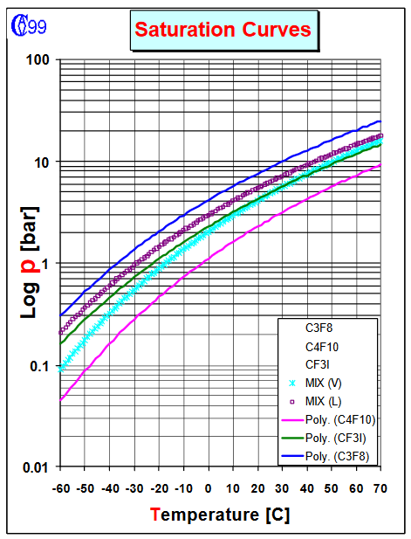
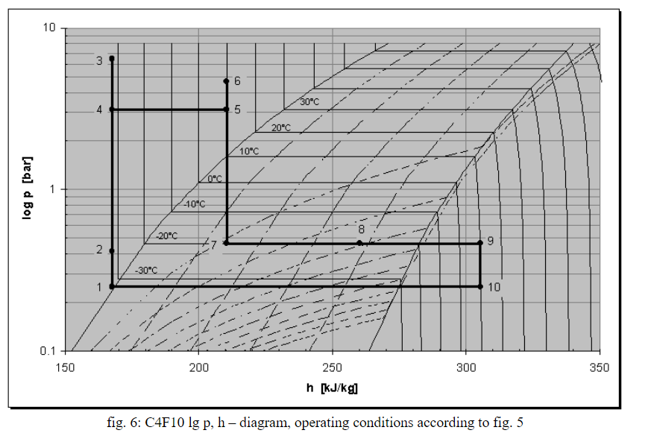
Gas Radiator Choice
5. Radiator
https://tel.archives-ouvertes.fr/tel-00592091/file/Greg_memoire-version-for-final-printing-April-2011.pdf Great resource on refrigerants.
Need relatively high index to get an appreciable amount of photons.
However, heavy fluorocarbons are good refrigerants for a reason.
At room temperature, C4F10 cannot reach 3 bar without condensing.
Acquisition of C4F10 is also an issue
C3F8 can be gaseous at 4 bar and 0° C, still widely produced for medical procedures.

Slide 20
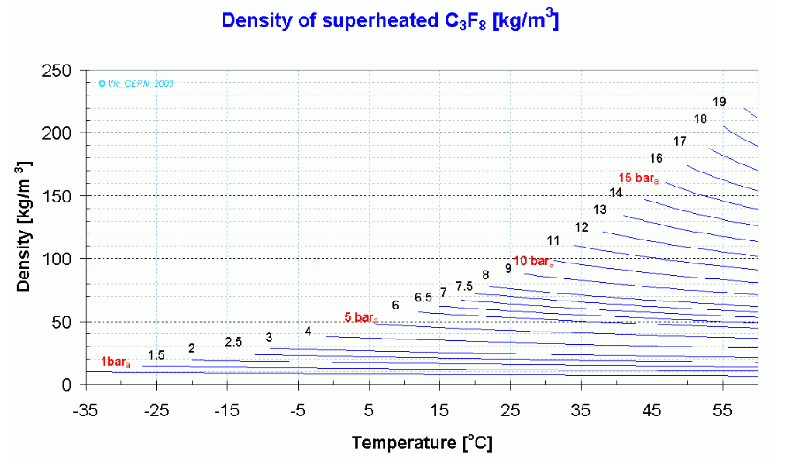
Gas Radiator Choice
5. Radiator
https://tel.archives-ouvertes.fr/tel-00592091/file/Greg_memoire-version-for-final-printing-April-2011.pdf
https://detector-cooling.web.cern.ch/fluidmaterial.html
Great resources on refrigerants.
Index of 1.004 can provide ~15 photons in 20 cm at β=1. DELPHI gas had n = 1.00172
How does index depend on temperature near the condensation point? Scales as density, not pressure.
Can gain a bit of index by cooling. Not beyond 20-30% though at reasonable pressures and temp. differences.
If PFCs are banned, Xenon or a greener refrigerant may be an option.
Gas characterization is part of the R&D that a detector like this would require.
Large phase space of similar heavy gases such as C4F8, C3F8O. Optical and thermodynamic properties need to be studied and optimized.

Slide 21
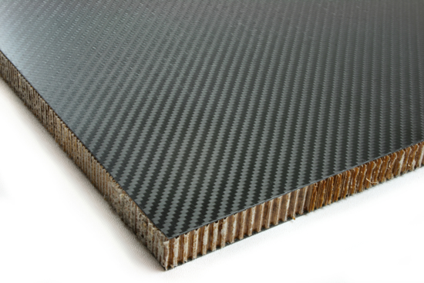
Is 3 bar possible with low material budget?
5. Radiator
Maybe, with a honeycomb/carbon-fiber gas volume.
Such a structure has been proposed for use in car bodies to increase strength and decrease weight compared to aluminum.
Excellent thermally insulating properties compared to metals.
Cylinders are inherently strong, although the seams may be an issue.
The volume from 50 cm to 90 cm in radius would be ~ 5m³ of gas
Need to find out what the maximum pressure the SiPM windows can hold.

Slide 22
Smearing in simulation
Current status is $σ^{2}=σ_{Pixel}^{2}+σ_{Chrom.}^{2}+$ ${"σ"}_{Bend}^{2}$+ $σ_{Extra}^{2}$
$σ_{Pixel}^{2}$ is $\frac{Pixel size in mm}{L∗\sqrt{12}}$ where L is radiator length, pixels assumed square
$"{σ"}_{Bend}^{2}$ is applied as a uniform distribution along one ring axis as described earlier.
$σ_{Extra}^{2}$ is a 3 mrad smear to compensate for inevitable tracking and emission point errors. Tracking error will be small in Si-tracker design. Emission point? Shorter radiator but more mirrors. Can a track that goes between mirrors be reconstructed? Depends on N_{pe}.
$σ_{Chrom.}^{2}$ is inherent in the MC, photons are generated at wavelengths according to the efficiencies and that photons θ_{C obs.} is determined accordingly. Due to operating in the VIS, this term is subleading.

Slide 23
Efficiencies in Simulation
Efficiency | % of photons surviving (approx.)
SiPM PDE (25° C) | ~40% at peak (475 nm)
Timing cuts | 90%
Mirror reflectivity | 92%
Glass window transparency | 89%
PDE loss to a possible temperature/voltage operating point (0° C) | 80%
Total @ PDE peak | ~25%
Baseline Detector Design in the following plots, parameters unless otherwise mentioned are:
C3F8 gas at 3 bar with n = 1.0033 1x1 mm SiPM, 100 kHz of dark rate,
20 cm length,
1.5T magnetic field
Species | Threshold P @ n = 1.0033 (GeV)
e | .06
pi | 1.7
ka | 6.1
p | 11.6

Slide 24
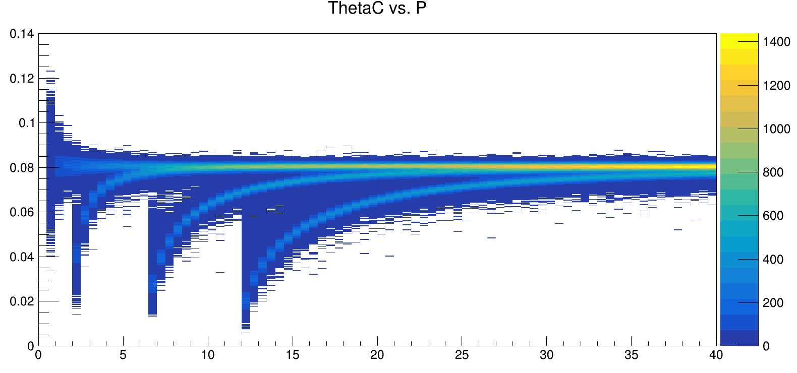
For baseline configuration
C3F8 gas at 3 bar, 20 cm long 1x1 mm SiPM, 100 kHz of dark rate,
1.5T magnetic field
Note that since the saturation angle has increased, a smear of 1 mrad has less effect than it did when the saturation angle was lower. The GEM-RICH using STP CF4 had a saturation angle of ~35 mrad. In a short radiator with pixelized readout, one wants to have a larger saturation angle so the physical size of a ring on the detector plane isn’t too small.
Also note the large tails of the bands, due to larger relative pull of noise hits that can be reduced with better fitting procedure

Slide 25
Preliminary Results
All the following results are still a work in progress and are subject to change.
Also note that N_{sigma} in the following plots is calculated using average of the two peaks, not the wider peak as is sometimes done.
The fast simulation assumes track incidence on a spherical mirror with no aberrations, a more detailed study on possible mirror geometries will be necessary eventually.

Slide 26
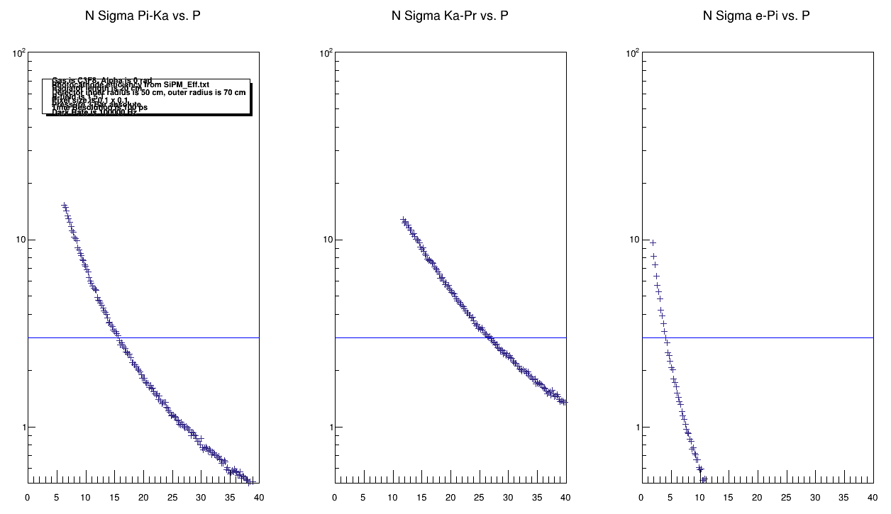
For baseline configuration
Datapoints begin at heavier species threshold.
Should also be able to operate as a threshold detector.
Note, lengths are quoted for midrapidity.
Performance should improve at higher pseudorapidities due to increasing radiator length and decreased bending.
C3F8 gas at 3 bar, 20 cm long 1x1 mm SiPM, 100 kHz of dark rate,
1.5T magnetic field

Slide 27
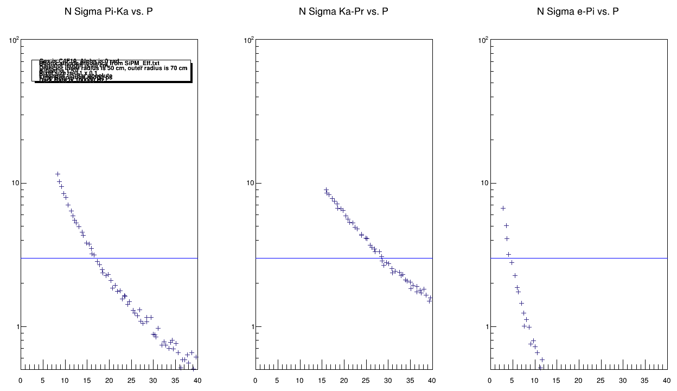
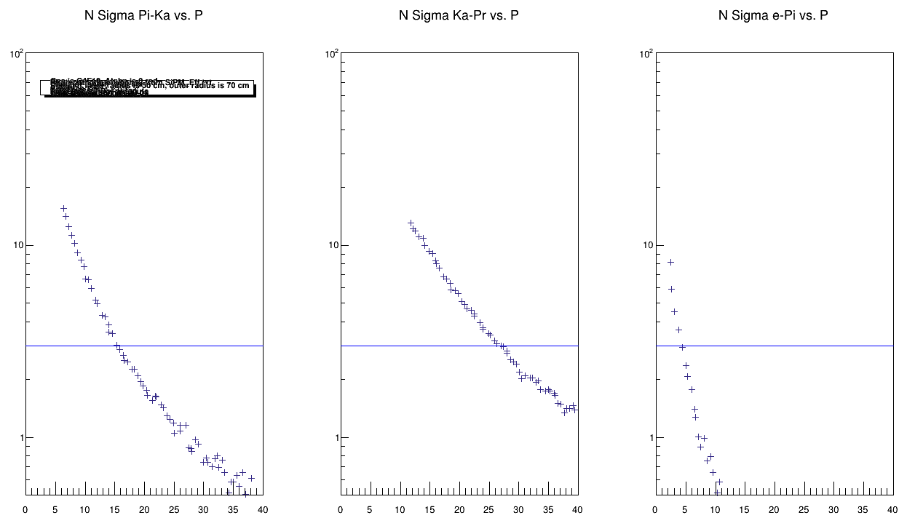
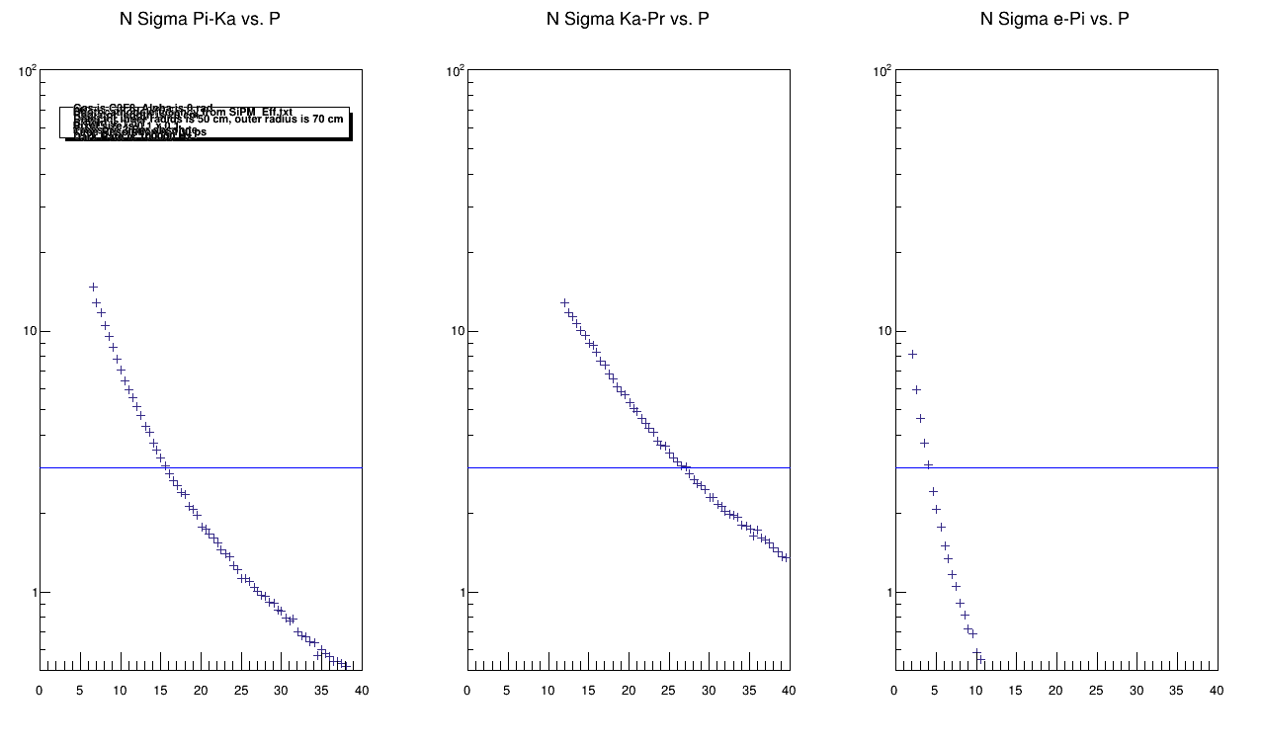
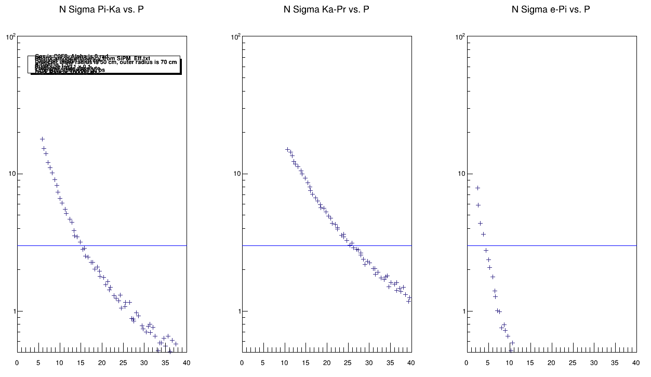
Gas Options Comparison
Gold = C3F8 4 Bar abs. (16.1 N_{pe}) n = 1.0043
Blue = C3F8 3 Bar abs. (12.1 N_{pe}) n = 1.00328
Orange = C4F10 1.5 Bar abs. (7.4 N_{pe})
n = 1.002
Grey = C4F10 2.7 Bar Abs. (13.3 N_{pe}) n = 1.0036
Npe values quoted at β = 1
Higher pressure = higher index, roughly equal 3-sigma threshold,
N_{pe} ∝ pressure
1x1 mm SiPM, 100 kHz of dark rate,
20 cm length,
1.5T magnetic field
Main tradeoff is engineering difficulty (holding high pressure) and tunability of temperature vs. N_{pe} and kaon threshold

Slide 28
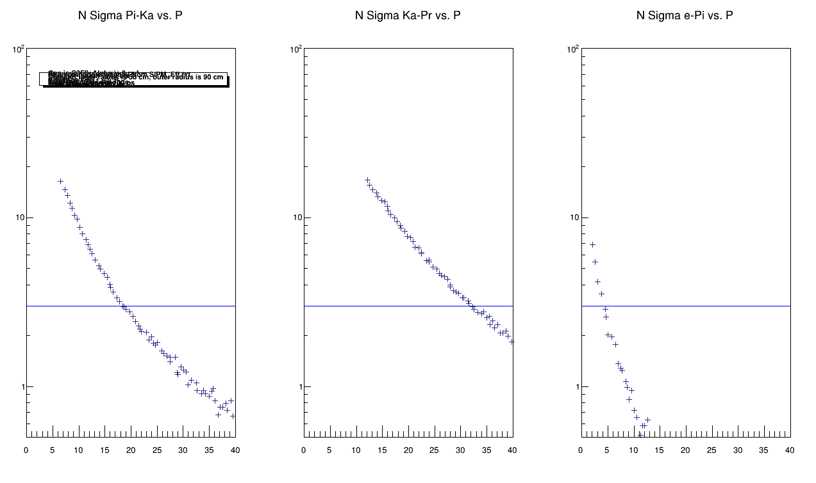
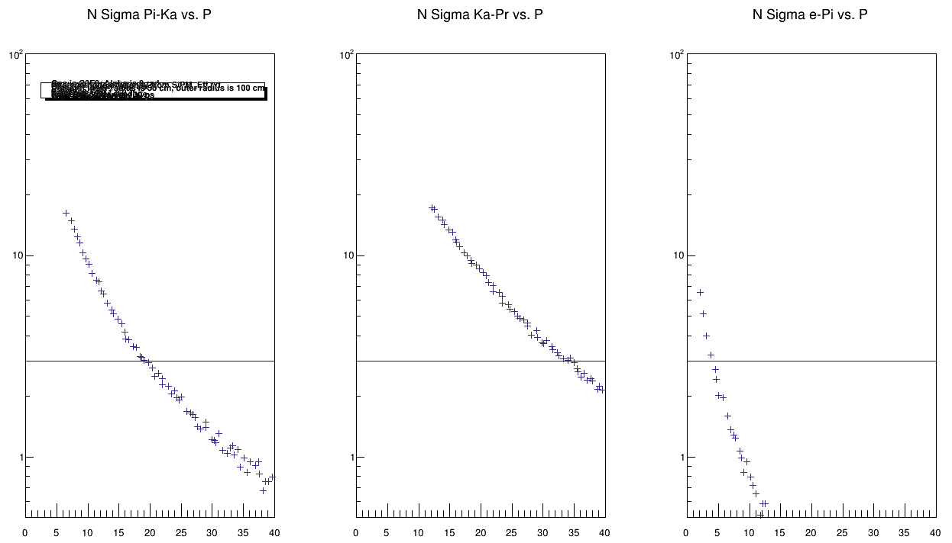
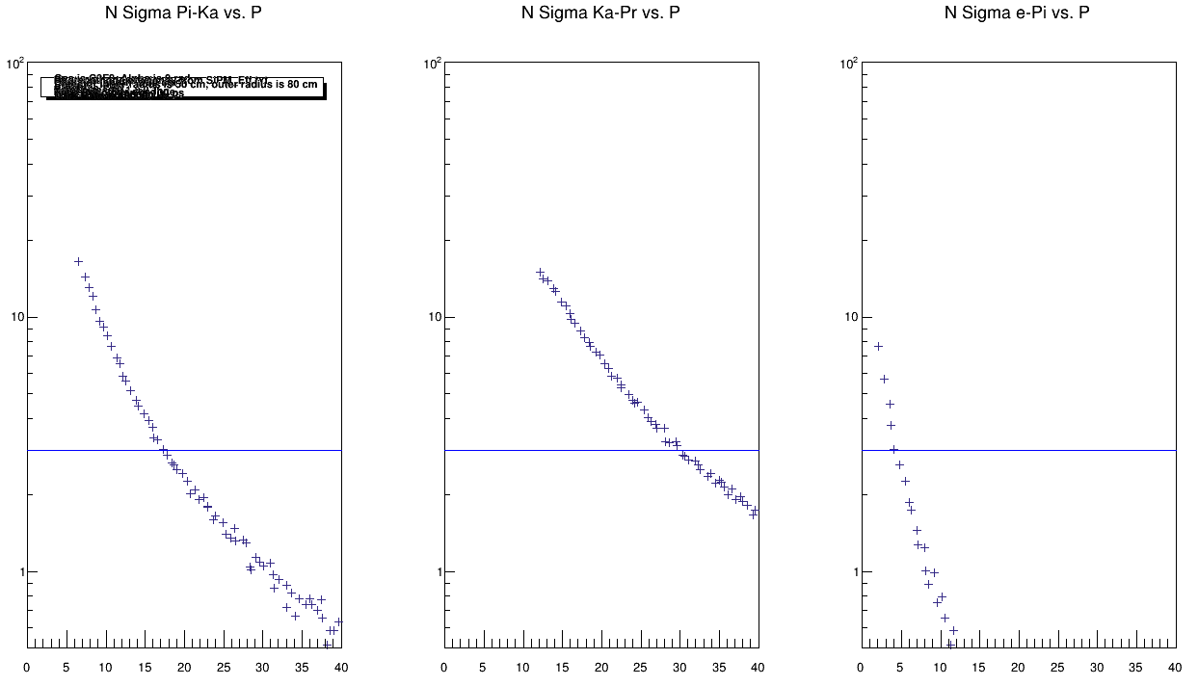
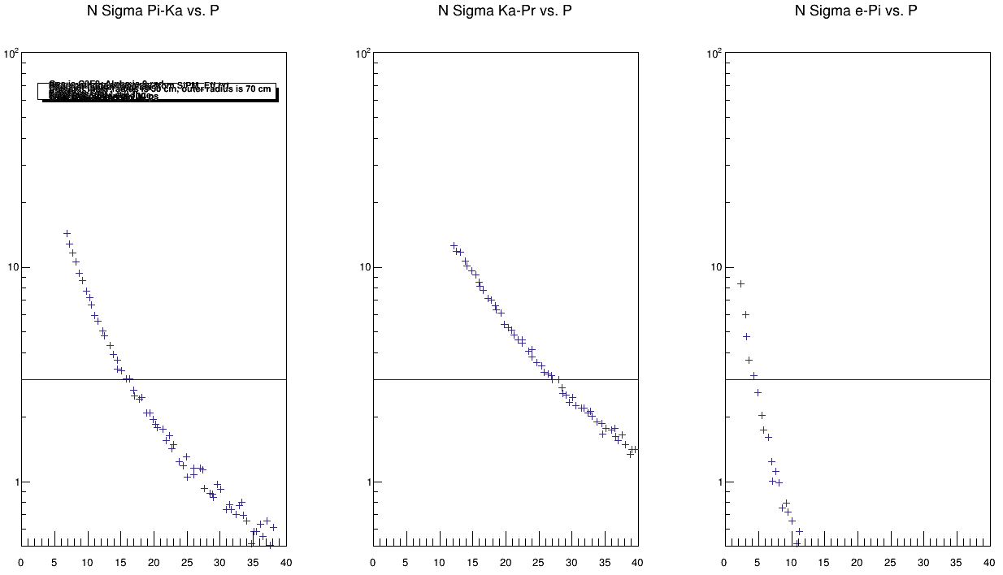
Length Comparison
Blue = 20 cm (12.1 Npe)
Green = 30 cm (18.2 Npe)
Gold = 40 cm (24.2 Npe)
Orange = 50 cm (30.3 Npe)
Momentum dependent smear along one axis of the ring due to bending
Longer detector sees diminishing returns
C3F8 gas at 3 bar, 1x1 mm SiPM, 100 kHz of dark rate,
1.5T magnetic field

Slide 29
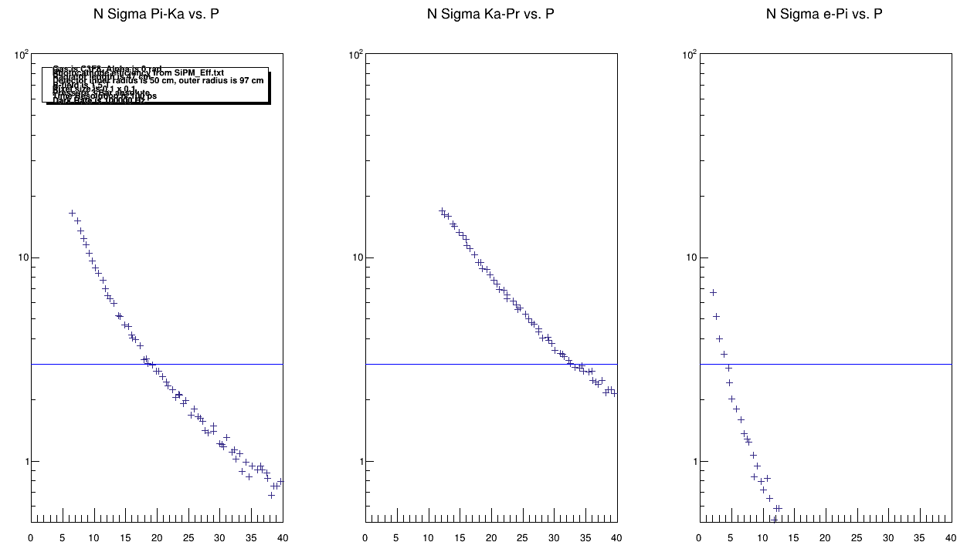
Rapidity Comparison
Blue = Midrapidity (12.1 N_{pe})
Green = Max. Path Length through detector @ η ≅ .7
47 cm (28 N_{pe})
Bending slightly overestimated at non-zero rapidity in simulation
Assuming a rectangular geometry, want to have overlap between barrel RICH and forward RICH
C3F8 gas at 3 bar, 1x1 mm SiPM, 100 kHz of dark rate,
20 cm length,
1.5T magnetic field

Slide 30
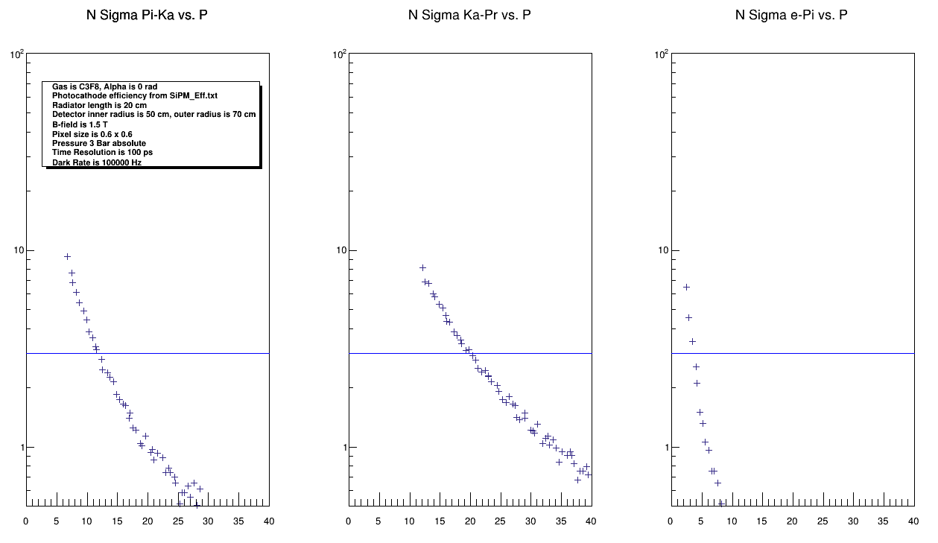
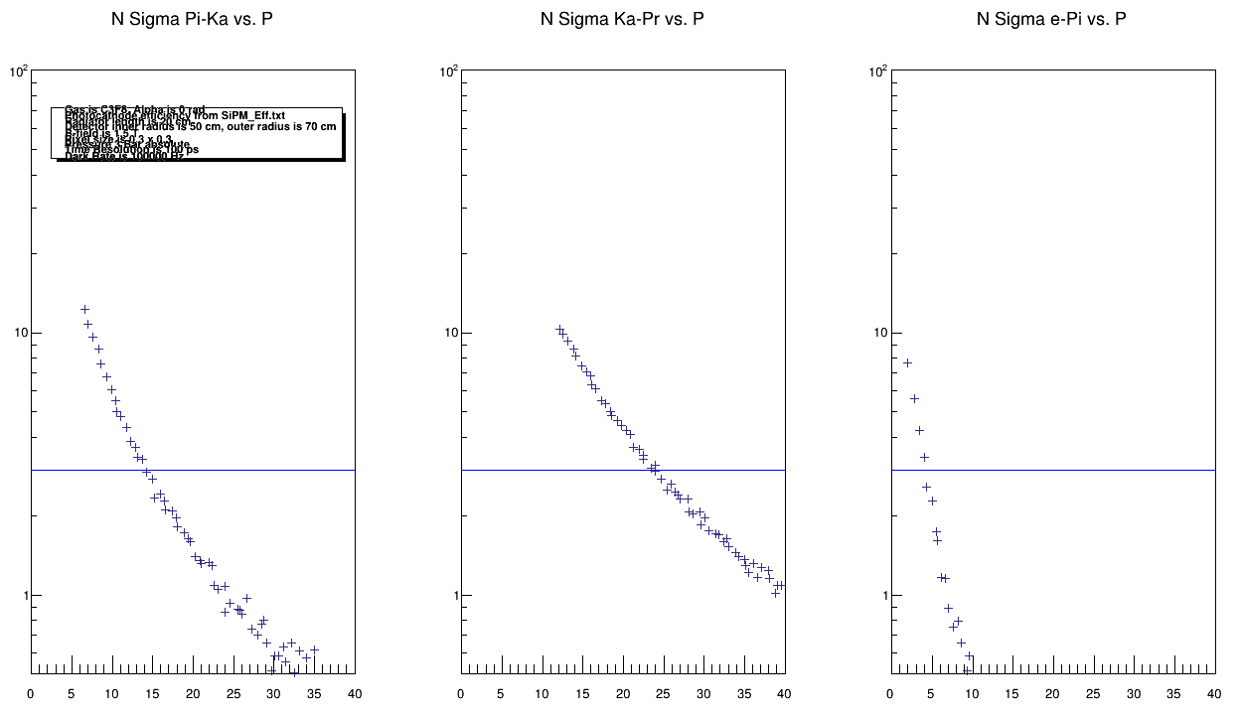
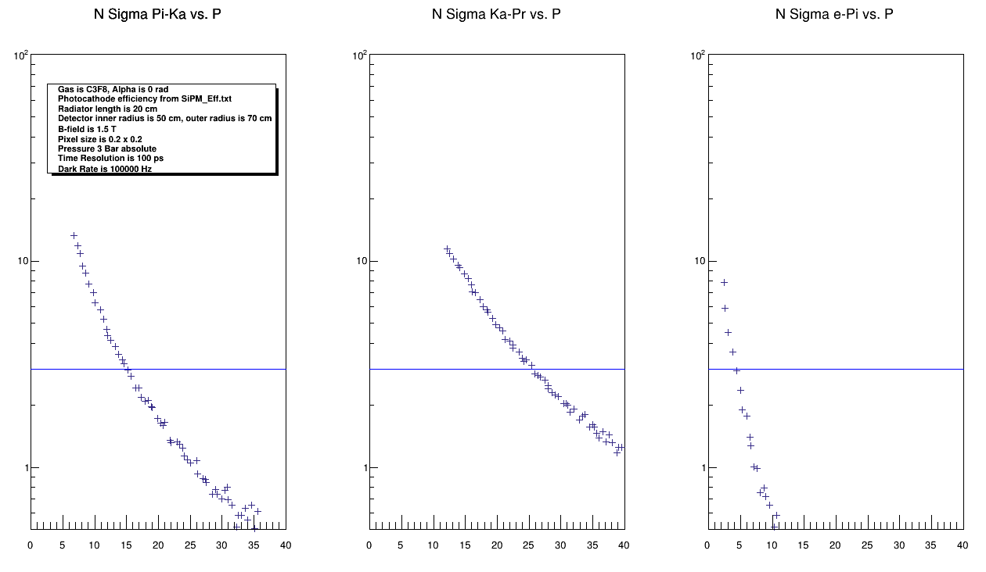
Pixel Size Comparison
Blue = 1x1 mm
Gold = 2x2 mm
Orange = 3 x 3 mm
Green = 6x6mm
Pixel size is a substantial factor in resolution in a short radiator.
Smallest channel size available is typically 1x1 mm.
C3F8 gas at 3 bar, 1x1 mm SiPM, 100 kHz of dark rate,
20 cm length
1.5T magnetic field
C3F8 gas at 3 bar, 0 kHz of dark rate,
20 cm length,
1.5T magnetic field

Slide 31
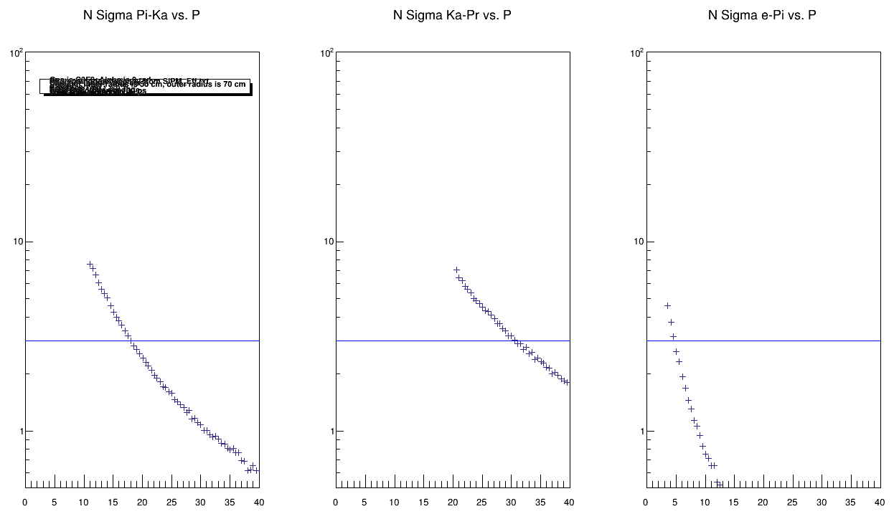
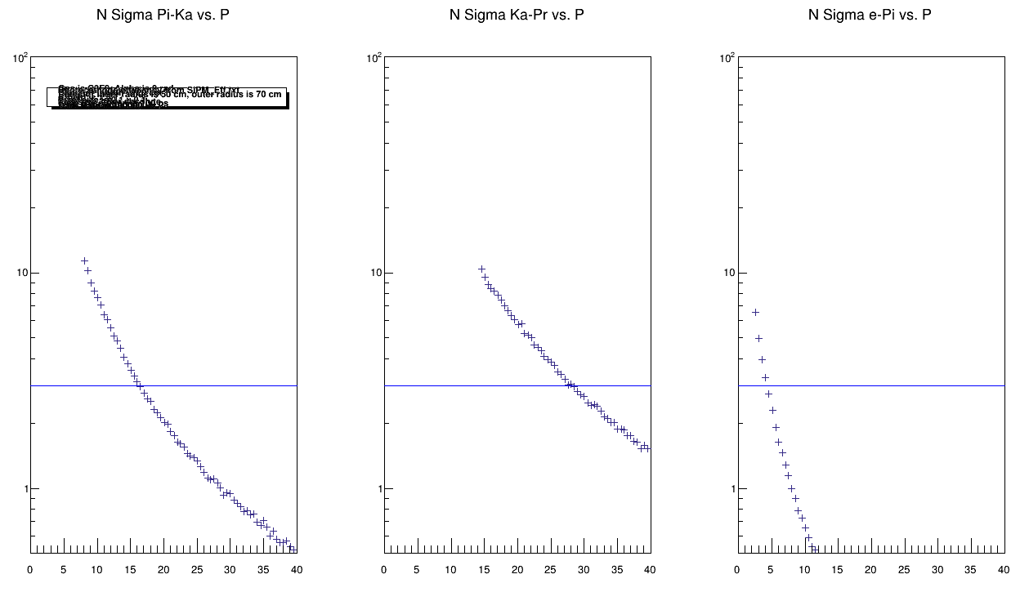
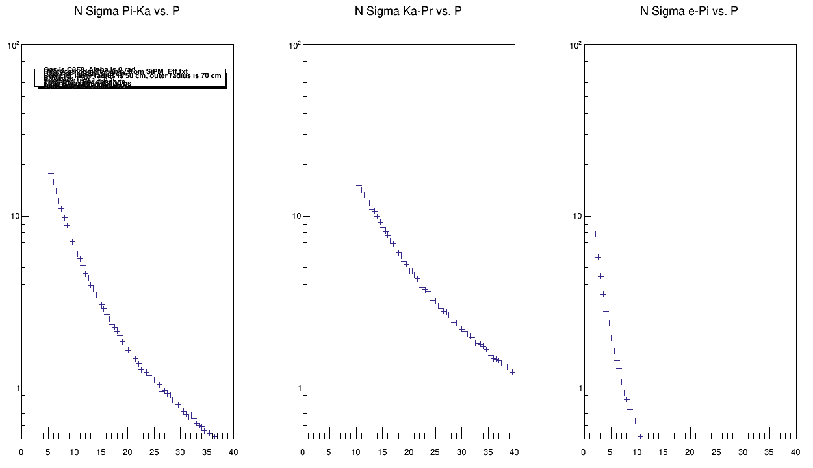
Pressure Comparison
Green = 1 Bar abs. (4.1 N_{pe}) n = 1.00109
Orange = 2 Bar abs. (8.2 Npe) n = 1.00218
Blue = 3 Bar abs. (12.3 N_{pe})
n = 1.00327
Gold = 4 Bar abs. (16.4 N_{pe}) n = 1.00436
Npe values quoted at β = 1
Higher pressure = higher index & higher chromaticity Roughly equal 3-sigma thresholds,
N_{pe} ∝ pressure
C3F8, 1x1 mm SiPM, 100 kHz of dark rate,
20 cm length,
1.5T magnetic field
Note, DIRC 3-σ pi/k threshold at ~6 GeV. 3 Bar looks ok. In situ control of pressure and temperature would be nice.

Slide 32
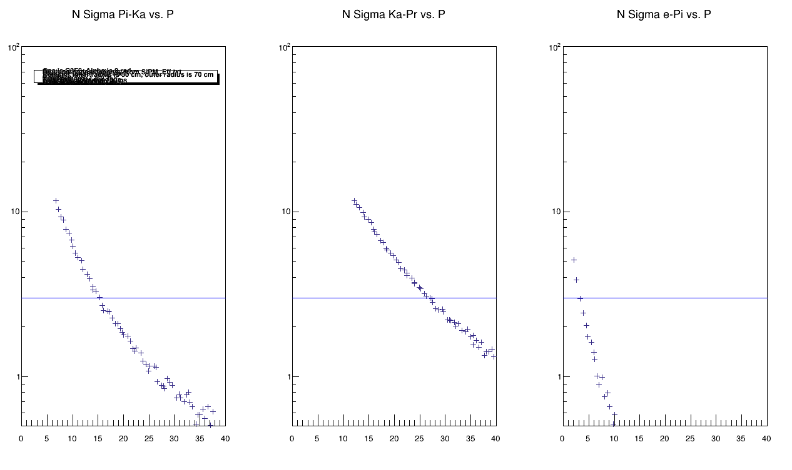
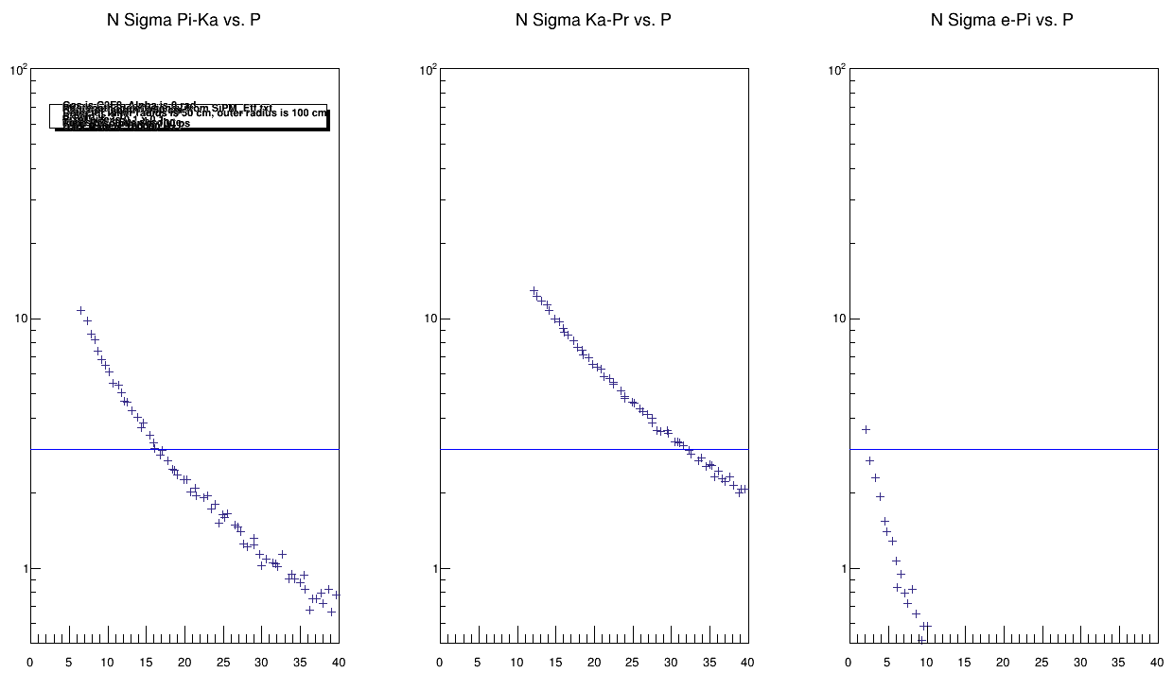
B-Field Comparison
Blue = 1.5T, 20 cm
Green = 3T, 20 cm
All ~12 N_{pe}
Gold = 3T, 50 cm
~30 N_{pe}
Angular resolution scales ~linearly in B and L since bending is $\int{B∙dl}$
Higher field and longer radiator hurts e/pi separation the most.
C3F8 gas at 3 bar, 1x1 mm SiPM, 100 kHz of dark rate,

Slide 33
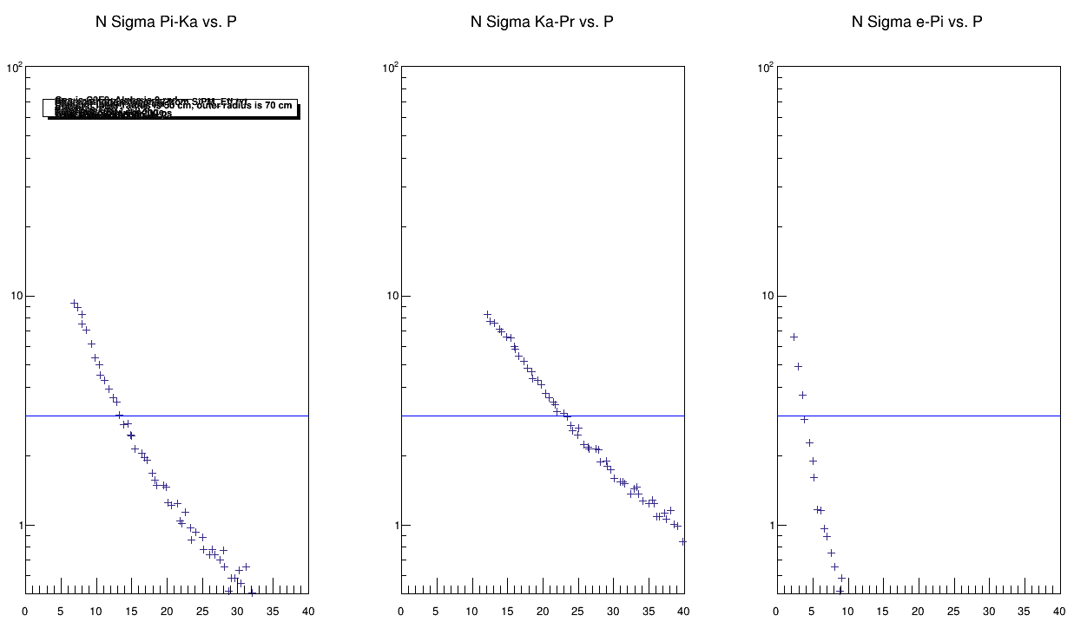
SiPM Time Res. Comparison @ 100 kHz Dark Rate
Blue: 100 ps
Orange: 50ps
Gold:
150 ps
Green: 200 ps
Dark hits beyond 1.2*θ_{C} are ignored.
C3F8 gas at 3 bar, 1x1 mm SiPM, 0 kHz of dark rate,
20 cm length,
1.5T magnetic field

Slide 34
Dark Rate Comparison @ 100 ps Time Resolution
Orange: 0 Hz
Blue: 100 kHz
Green: 500 kHz
Gold: 1 MHz
Nothing too unexpected here, 100 kHz is tolerable, but lower is preferred. 500 kHz+ is problematic.
Note that a proper fitting algorithm will improve these results
Noise hits beyond 1.2*θ_{C} are ignored.
C3F8 gas at 3 bar, 1x1 mm SiPM, 0 kHz of dark rate,
20 cm length,
1.5T magnetic field

Slide 35
Impacts
Factor | Relative Impact on 3-Sigma thresholds | Relative Impact on N_{pe}
Length | Large but saturates | Large, Linear
Pressure | Small | Large, Linear
Gas | Small | Large
Pixel Size | Large for short length | Small, Packing efficiency can vary based on pixel size
Dark Rate (SiPM) | Very large | 10% N_{pe} loss to timing cut may be able to be relaxed if dark rate is low
Timing Resolution (SiPM) | Very Large | 10% N_{pe} loss to timing cut may be able to be relaxed if timing resolution is good
Magnetic Field | Large for long radiator, small for short radiator | None

Slide 36
In Summary
Obviously SiPM R&D is a huge undertaking, if it succeeds and the dark counts can be controlled through the life of the experiment, then a detector design like this appears viable.
N_{pe} needs to be high in a short radiator.
If one wants to reconstruct rings on top of SiPM dark counts, or rings split between two mirrors.
Photocathode-coated MPGDs also need investigation as a back-up option in case the SiPMs cannot be made radiation hard or improved through annealing.
Preliminarily, a pi/k separation of 3 sigma up to ~15 GeV/c or more seems realistic IF background can be tamed. This complemented with low momentum PID could provide consistent positive PID up through 15 GeV/c.
e/pi separation may supplement the low momentum eID. But no definitive statement can be made until these results are double and triple-checked.

Slide 37
In Conclusion
To-Do
Further background investigation and implementation into the MC is ongoing.
Material budget also needs consideration.
Need to think about possible mirror configurations.
Study gas characteristics.
Need more info about alternative gases
Need to see if MPGDs are viable in C3F8
Please suggest ways to improve the design and realism of the simulation! We’re all ears.
As we all know, the devil is in the details.

Slide 38
Backups

Slide 40
Dark Rates
20C of cooling gives factor of ~16 reduction in dark count, ~5.6 kHz typical, ~16.9 kHz max for S13615
How well can we control the overvoltage, what is the effect on PDE?
For S13360-3050CS
Would want to see if this is a generic scaling or is dependent on the model number

