Slide 1
Far-Forward Complementarity
Alex Jentsch, Julia Furletova, Michael Murray
9/30/2020

Slide 2
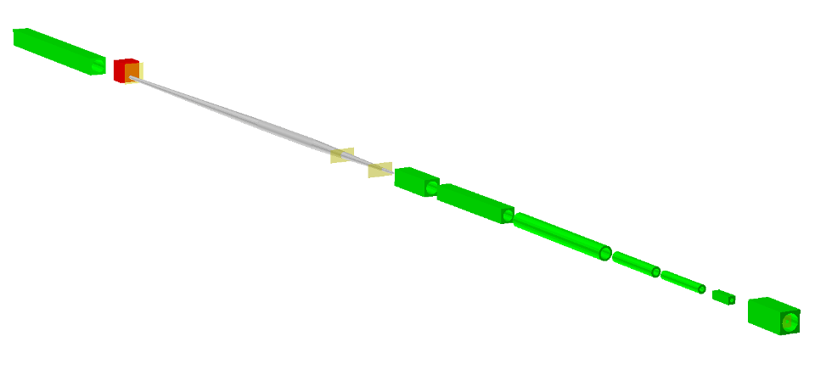
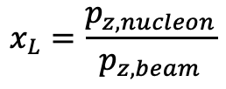
What is your current baseline thinking?
Detector | Detector Position (x,z) | Angular Acceptance | Notes
ZDC | (0.96m, 37.5m) | 𝜽 < 5.5 mrad | About 4.0 mrad at ϕ ~ 𝜋
Roman Pots (2 stations) | (0.845m, 26m) & (0.936m, 28m) | 0.0* < 𝜽 < 5.0 mrad | 0.65 < x_{L} < 1.0 10σ cut
Off-Momentum Detectors | (0.8, 22.5m) & (0.85m, 24.5m) | 0.0 < 𝜽 < 5.0 mrad | Roughly 0.4 < x_{L} < 0.6
B0 Sensors (4 layers, evenly spaced) | x = 0.19m, 5.4m < z < 6.4m | 5.5 < 𝜽 < 20.0 mrad | Could change a bit depending on pipe and electron quad.
B2pf dipole
ZDC
Roman pots (inside pipe)
B1apf dipole
$$x_{L}=\frac{p_{z, nucleon}}{p_{z, beam}}$$
B1pf dipole
Off-Momentum Detectors
Q2pf quadrupole
Q1bpf quadrupole
Q1apf quadrupole
B0apf dipole
Hadron beam coming from IP
B0pf dipole
Meets general physics requirements.
B0 Silicon Detector

Slide 3
How might a second detector differ in technology choices and what (dis)advantages might that bring in terms of kinematic coverage, resolution on reconstructed variables, radiation hardness, dominating systematics etc?
Kinematic coverage
Secondary focus to allow proton coverage to pt ~ 0 GeV/c.
Alter beam pipe size in IR #2 “B0” detector to change the kinematic gap between B0 and RP coverage (currently stands at theta ~ 5mrad). Should not affect apertures for smaller pipe in the first dipole.
Neutron cone (currently baseline IR covers theta < 4.5mrad.
Technology
Different ZDC technologies to better emphasize photon vs. neutron resolution.
Potentially different technology for EM calorimetry in “B0” region.

Slide 4
- Are there wider implications for other parts of the detector - eg due to material budgets?
At this point, we do not believe so.

Slide 5
- Would the complementary designs naturally be associated with different choices of solenoid field, center of mass energy, luminosity or beam polarization?
One possible goal for the Far-forward area could be “optimization” for lower center-of-mass energies.

Slide 6
Are there any limitations in the performance of your sub detector technologies for very small bunch spacing < 9ns?
Not so much of a concern for us. All of our detectors are being pitched with very fast (tens of ps) timing (i.e. LGADs), or to be integrated with fast timing layers (e.g. for the B0).

Slide 7
Are there any rate limitations?
Mostly a concern for beam+beam, beam+gas, and beam+machine/detector backgrounds – especially in the B0 region which is very close to the IR.
This is being studied by an EIC R&D effort.

Slide 8
Is +/- 4.5 m enough longitudinal space to fit the detector?
In principle, yes. But having more space in the FF area to add detector components and access the detectors for IR #2 would be a good consideration.
Potentially a CMS+LHCb combo detector (for lack of a better description).

Slide 9
Are there any issues we should be aware of in terms of cost, technology readiness, or time required to construct the detector?
Designing and building the B0 spectrometer is going be a real challenge that we have not really been able to address in detail in our Yellow Report efforts (i.e. engineering constraints, backgrounds, access to the detectors in shut down).
From a complementarity perspective, choice of different technologies and engineering constraints could help to lower the overall risk to the physics program in the baseline IR.
ZDC EM calorimetry has to be cutting edge to deliver the low energy photon measurements needed for coherent e+(heavy)A physics.

Slide 10
Might it be possible to combine more than one function into your detector(s)?
This has been a major push for the FF studies as a whole.
Off-momentum detectors being designed similar to that of the Forward Silicon tracker in the barrel – surrounding the beam pipe to cover both the spectator protons and negative pions, etc.
Need to consider impact on the ZDC (detector material effect on photons, for example)
B0 combining silicon tracking and EMCAL.
ZDC having both HCAL and EMCAL components.
Potential need for PID in the FF region (pion, kaon, proton).
Needs more study.

Slide 11
Do your detector technologies have any impact on the design of the interaction region?
***Things other than detector technology.
Could have impact beam pipe size, and material (near the off-momentum detectors), exit window for the ZDC.
More study and iteration with machine group needed.
B0 magnet design.
Size of the bore, presence of electron pipe+shielding, size of the hadron beam pipe.
Some of this has already been considered. Further iterations on the horizon.

Slide 12
What studies need to be done (or have been done already) to make fully quantitative statements?
Many done – many needed.
Really needs to be thought through.
Very limited people-power available for simulations and studies (essentially 2-3 people total).
Collaboration with software people and engineers needed to develop the detailed simulations needed to look into these additional details.
Studied so far…
e+p DVCS events with proton tagging.
e+d exclusive J/Psi events with proton or neutron tagging.
e+Au events with neutron tagging to veto breakup and photon acceptance.
Meson structure with neutron tagging (ep$→\left(π\right)→$e’ n X) .
Currently in progress
e+He3 with spectator proton tagging
Meson structure with Lambda decays ($Λ→$p$π−$ and $Λ→nπ0$)
e+He4 coherent He4 tagging.
Backgrounds and rates.

