Slide 1
ATF Operations Status
23rd Annual ATF Users’ Meeting (virtual)
Mark Palmer
December 7, 2020

Slide 2
A Special Thanks...
Program Advisory Committee:
  Sandra Biedron (Chair), University of New Mexico
  Jianming Cao, Florida State University
  Jean-Pierre Delahaye, CERN
  Louis DiMauro, Ohio State University
  Ernest Fontes, Cornell University
  Bjorn Manuel Hegelich, University of Texas at Austin
  Patric Muggli, Max Planck Institute for Physics & CERN
  Carl Schroeder*, Lawrence Berkeley National Lab
  Craig Siders, Lawrence Livermore National Lab
  * Final year

Slide 3
Outline
FY20 Recap
Availability
User Activities
Operations Summary
Facility Updates
COVID-19
Operations Status: What is available in 2021
Capability Operational Status Update
Available Parameters
Available Facilities
Recap of User Resources and Responsibilities
Time Requests
Beam Scheduling
Run Reports

Slide 4
FY20 Operations Recap

Slide 5
Availability
Resource | Planned Hours | Delivered Hours | % of Planned Hours
Electron Beam | 790 | 823 | 104%
Laser (NIR + LWIR) | 760 | 777 | 102%
UED | 950 | 741 | 78%
Total | 2500 | 2341 | 94%
2020
2021
Resource | Planned Hours
Electron Beam | 750
Laser (NIR + LWIR) | 750
UED | 750
Total | 2250

Slide 6
User Activities Breakdown
UED set up for turn-key materials science operations
Accelerator focused experiments have the largest amount of setup time
Advanced accelerator experiments have a wide range of complex requirements.

Slide 7
FY20 Hours Summary
New Capability
Being Brought Online

Slide 8
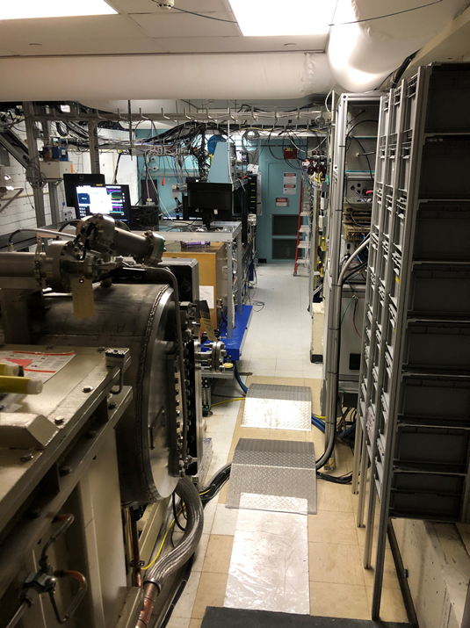
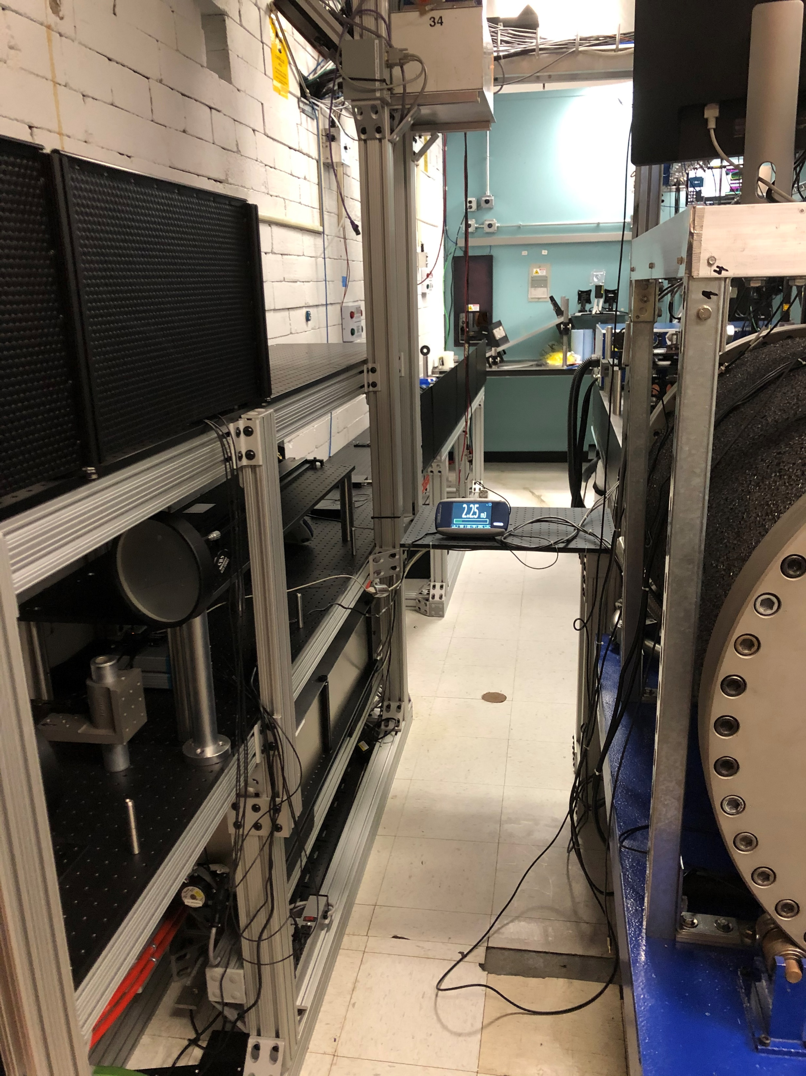
FY20 Facility Updates
Shielding wall
Final amplifier
LWIR path

Slide 9
COVID-19 Impacts
User Operations interrupted in March
  Prevented key experimental starts after last year’s Users’ Meeting
  User hour impact mitigated by 3 effects:
    Significant amount of user time provided at B820 during FY20Q1 and Q2 to allow for a major upgrade down planned for Q3-Q4
    Change in laser hour accounting (to include NIR user operations)
    UED impacted by being on a complementary schedule to work at B820 – loss of single largest run period in the March-May timeframe
Laboratory in Min Safe for ~3 months
  ATF returned to limited operations on June 18th
  Rapidly returned UED to operations through end of year
  Executed modifications to the CO2 room in preparation for deploying the full in-vacuum transport upgrade to deliver high-power (5TW) pulses to users a full upgrade not possible before summer 2021
NOTE: Status report request includes COVID-19 impacts on users

Slide 10
Operations Status

Slide 11
Operational Status: Available User Time
This plan is subject to considerable uncertainty depending on COVID-19 impacts
BNL presently in a “Limited Operations” state. ATF has managed to bring the first few non-local
users on-site during FY21 Q1.

Slide 12
Current Operational Status
Electron Beam
  Operational in 15-75 MeV energy range
    Replacement gun and linac klystrons performing well
  X-band klystron repair funding has been received – long-lead repair, however
    Significant impact on experiments needing the TCAV diagnostic
UED
  Observed stable operation through summer 2020
    Validates improvements implemented in FY10
  Operation up to 48 Hz delivered
  Installation of OPA pump system delayed due to COVID-19
CO₂ Laser
  >5 TW, 2ps operation demonstrated at output of CPA
    Presently certified for 2 TW delivery to user IPs
    Higher powers require in-vacuum transport
  Polarization rotator and circular polarization capability
    Power limits observed for circular polarization
  Major R&D program will continue to impact user operations next year
NIR Systems
  Ti:Sapphire laser system has been commissioned and operation verified to highest specified power
  In-air transport of Stage I parameters to users operational

Slide 13
Capability Updates Planned in 2021
Planned Updates:
  Laser Capability
    LWIR (CO₂) Laser System
      In-Vacuum CPA and transport slated for deployment in summer 2021
        November Technical Review completed successfully – now preparing long-lead procurements
        Expect user operations with >5TW and <2ps by late 2021
      Vacuum Transport updates will lay the foundation for further pulse compression upgrades in subsequent years
    NIR Laser Systems
      Nd:YAG
        Second stage amplification to be added in 2021
      Ti:Sapphire
        In-vacuum transport and vacuum compressor will enable Stage I and Stage II operating parameters in 2021
  UED (with UEM support)
    OPA system to enable pump wavelengths in the mid- to long-wave IR
    Scheduled for installation next week
Continued updates to the ATF pages and PASS system to reflect our current suite of capabilities
Further Discussion During Friday Afternoon’s “Next Steps” Session

Slide 14
Recap of User Resources and Responsibilities

Slide 15
Electron Beam Requirements
Parameter | Units | Typical Values | Comments | Requested Values
Beam Energy | MeV | 50-65 | Full range is ~15-75 MeV with highest beam quality at nominal values
Bunch Charge | nC | 0.1-2.0 | Bunch length & emittance vary with charge
Compression | fs | Down to 100 fs (up to 1 kA peak current) | A magnetic bunch compressor available to compress bunch down to ~100 fs. Beam quality is variable depending on charge and amount of compression required. NOTE: Further compression options are being developed to provide bunch lengths down to the ~10 fs level
Transverse size at IP (σ) | μm | 30 – 100 (dependent on IP position) | It is possible to achieve transverse sizes below 10 um with special permanent magnet optics.
Normalized Emittance | μm | 1 (at 0.3 nC) | Variable with bunch charge
Rep. Rate (Hz) | Hz | 1.5 | 3 Hz also available if needed
Trains mode | --- | Single bunch | Multi-bunch mode available. Trains of 24 or 48 ns spaced bunches.

Slide 16
CO₂ Laser Requirements
Configuration | Parameter | Units | Typical Values | Comments | Requested Values
CO₂ Regenerative Amplifier Beam | Wavelength | μm | 9.2 | Wavelength determined by mixed isotope gain media
 | Peak Power | GW | ~3
 | Pulse Mode | --- | Single
 | Pulse Length | ps | 2
 | Pulse Energy | mJ | 6
 | M² | --- | ~1.5
 | Repetition Rate | Hz | 1.5 | 3 Hz also available if needed
 | Polarization | --- | Linear | Circular polarization available at slightly reduced power
CO₂ CPA Beam | Wavelength | μm | 9.2 | Wavelength determined by mixed isotope gain media
Note that delivery of full power pulses to the Experimental Hall is presently limited to Beamline #1 only. | Peak Power | TW | 2 | ~5 TW operation is planned for FY21 (requires further in-vacuum transport upgrade). A 3-year development effort to achieve >10 TW and deliver to users is in progress.
 | Pulse Mode | --- | Single
 | Pulse Length | ps | 2
 | Pulse Energy | J | ~5 | Maximum pulse energies of >10 J will become available in FY20
 | M² | --- | ~2
 | Repetition Rate | Hz | 0.05
 | Polarization |  | Linear | Adjustable linear polarization along with circular polarization will become available in FY20

Slide 17
Near IR Experimental Laser Requirements
Ti:Sapphire Laser System | Units | Stage I Values | Stage II Values | Comments | Requested Values
Central Wavelength | nm | 800 | 800 | Stage I parameters have been delivered, while Stage II parameters will be available for user experiments once our vacuum transport installation is complete (now planned for FY21 after COVID-19 delays)
FWHM Bandwidth | nm | 20 | 13
Compressed FWHM Pulse Width | fs | <55 | <75 | Transport of compressed pulses will initially include a very limited number of experimental interaction points. Please consult with the ATF Team if you need this capability.
Chirped FWHM Pulse Width | ps | ≥50 | ≥50
Chirped Energy | mJ | >30 | 200
Compressed Energy | mJ | >14 | 100
Energy to Experiments | mJ | >10 | >80
Power to Experiments | GW | >250 | >1067
Nd:YAG Laser System | Units | Typical Values | 2021 Modifications | Comments | Requested Values
Wavelength | nm | 1064 | 1064 | Single pulse
Energy | mJ | 5 | 100
Pulse Width | ps | 14 | <20
Wavelength | nm | 532 |  | Frequency doubled
Energy | mJ | 0.5
Pulse Width | ps | 10

Slide 18
Special Equipment Requirements and Hazards
Electron Beam
  Please indicate any special equipment that you expect to need, including (but not limited to) the transverse deflecting cavity, shaped bunch using mask technique, plasma capillary discharge system, bolometer/interferometer setup etc.:
CO₂ Laser
  Please note any specialty laser configurations required here:
Ti:Sapphire and Nd:YAG Lasers
  Please note any specialty non-CO₂ laser configurations required here:
Hazards & Special Installation Requirements
  Large installation (chamber, insertion device, etc.):
  Cryogens:
  Introducing new magnetic elements:
  Introducing new materials into the beam path:
  Any other foreseeable beam line modifications:

Slide 19
Six Available IPs
FEL room – high power CO₂ delivered to ion chamber with gas jet capability
BL1 – 3 chambers.
  IGS chamber for electron beam-only experiments
  LWFA chamber for laser–ebeam experiments plus gas jet capability
  Compton chamber for laser-ebeam interaction
BL2 – 1 chamber + 1 insertion device IP
  Plasma chamber with capillary discharge capability and laser delivery
  Designated area for wiggler structures etc. with laser interaction capability
  Laser delivery to both IPs at reduced power – vacuum transport does not extend beyond BL1
  Deflecting cavity diagnostic

Slide 20
UED Special Equipment Requirements and Hazards
Indicate whether your experiment requires UED or UEM beams
User Sample and Setup
  Please indicate any special equipment that you expect to need bolometer/interferometer setup etc.:
Pump Laser Requirements
  Please note any special pump laser requirements here:
Hazards & Special Installation Requirements
  Large installation (chamber, insertion device, etc.):
  Cryogens:
  Introducing new magnetic elements:
  Introducing new materials into the beam path:
  Any other foreseeable beam line modifications:

Slide 21
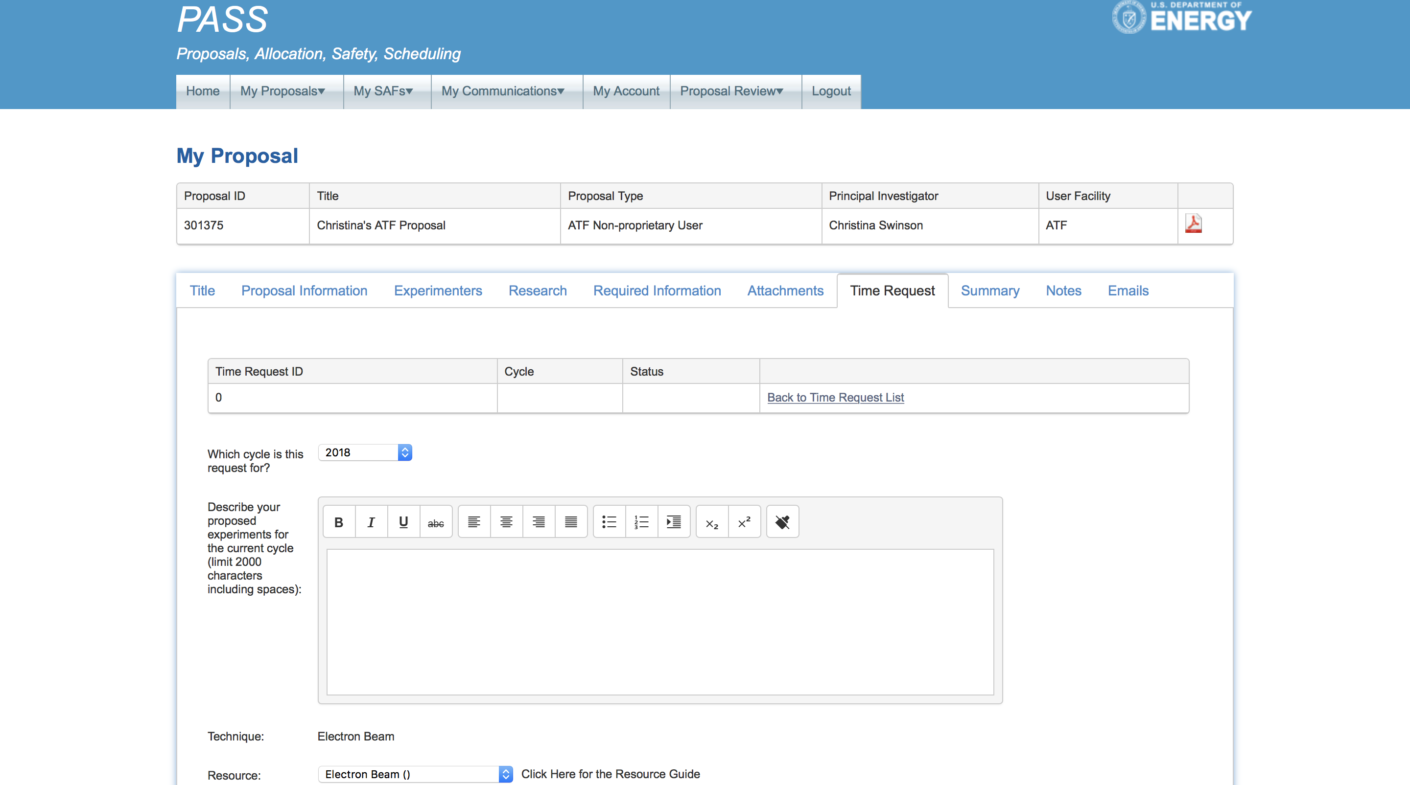
Time Request
For new experiments and experiments continuing into 2020, a time request must be submitted at pass.bnl.gov
ATF Proposal
PI Name

Slide 22
Beam Scheduling and Planning
Check the online schedule from the Operations tab on the ATF homepage
Submit a beam time request https://surveys.external.bnl.gov/n/ATFShiftRequest.aspx
Check that your experimental safety review is in place, email Karl Kusche (kusche@bnl.gov)
Submit installation and run plans to atf@bnl.gov
Read the Users’ Place section of the ATF website
Attend the 9 am Monday planning meeting, during your run, to coordinate technical support and experiment requirements

Slide 23
Run Reports
The lead experimenter should attend the ATF weekly meeting at 4 pm each Friday, during their run, to report that week’s progress.
  PI’s should inform the ATF if they wish to designate a second person to be the main point-of-contact or lead experimenter
Submit an end-of-run survey form after finishing run at https://surveys.external.bnl.gov/n/ATFUsersRunReport.aspx

Slide 24

Questions?

Slide 25


