Slide 1
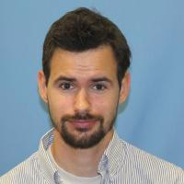
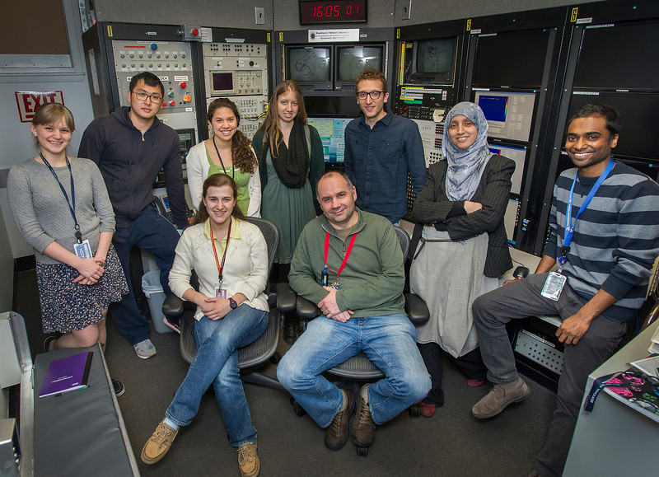
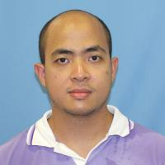
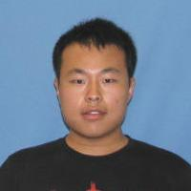
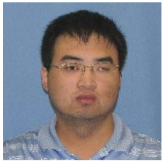
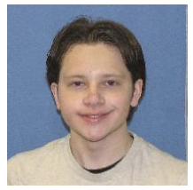
AE63 – [PHY542]
Advanced Accelerator Lab
by Mikhail Fedurin
and Dmitry Kayran
2016
2017
2015
2016
2017
2017
2016
2016
2019
2019
2020
December 7, 2020 ATF User Meeting
2020

Slide 2
Goals of the course
Introduce students to the field of experimental Accelerator Physics
Demonstrate e-beam techniques and diagnostics used in Advanced Accelerator Concept experiments at Accelerator Test Facility
Teach students to model experiments, compare model results with measurements.

Slide 3
Syllabus (plan for spring 2021)
Course overview, administrative issues.
Introduction to photo-injectors
Modeling photo-injectors
Transport of particle beams, Beam Acceleration
Beam Diagnostics, emittance measurement techniques
Dispersion and Masking Techniques
Computer Lab
Wakefields and THz generation by corrugated pipe
Coherent Synchrotron Radiation (CSR). Experimental demonstration of CSR; magnetic bunch compression
Finishing Simulation in Comp. Lab
PHY542 web page (example):
http://case.physics.stonybrook.edu/index.php/PHY542_spring_2019

Slide 4
Evaluation (plan for spring 2021)
Student’s performance was evaluated based on:
  active involvement in the laboratory (25% of final grade);
  lab report (60% of final grade);
  presentation of a project topic (20% of final grade).
Students did prepare Report and one Presentation during semester
  Report and Presentation from one of lab class (see syllabus)
  Content should include: 1) theory of the experiment and explain the objectives; 2) technique used to obtain data; 3) detailed data analysis; 4) conclusion remarks
Presentation was made at the end of semester. Required better preparation. Presentation was performed at front of the class. To avoid the overlap topics was distributed at beginning of semester among students
PHY542 web page (example):
http://case.physics.stonybrook.edu/index.php/PHY542_spring_2019

Slide 5

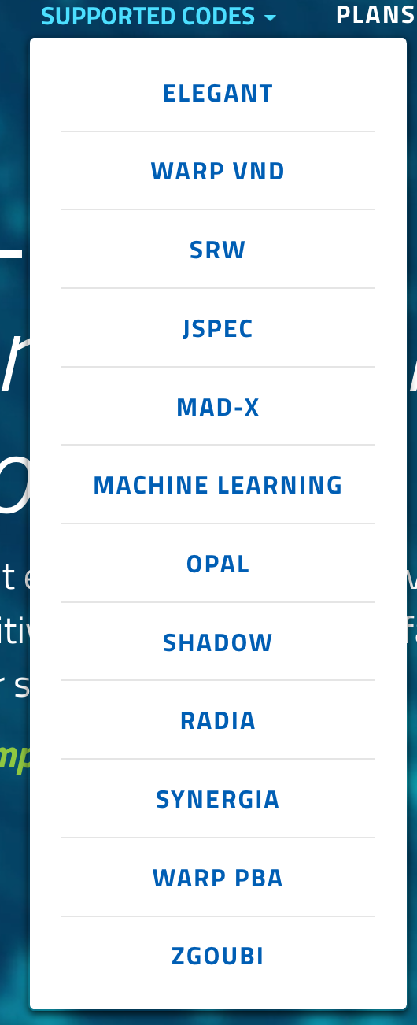
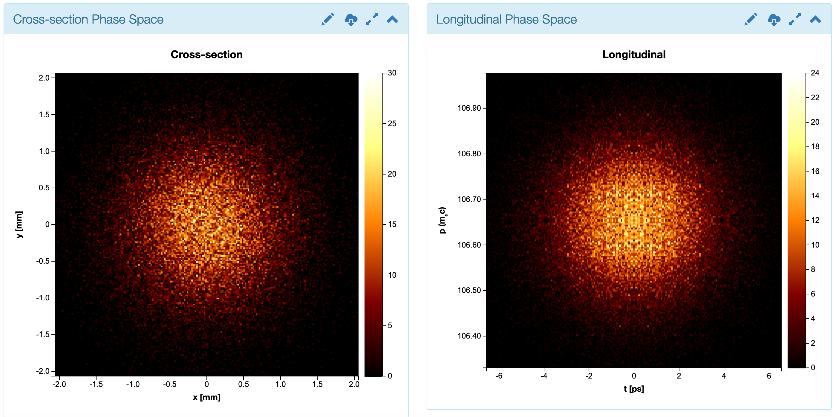
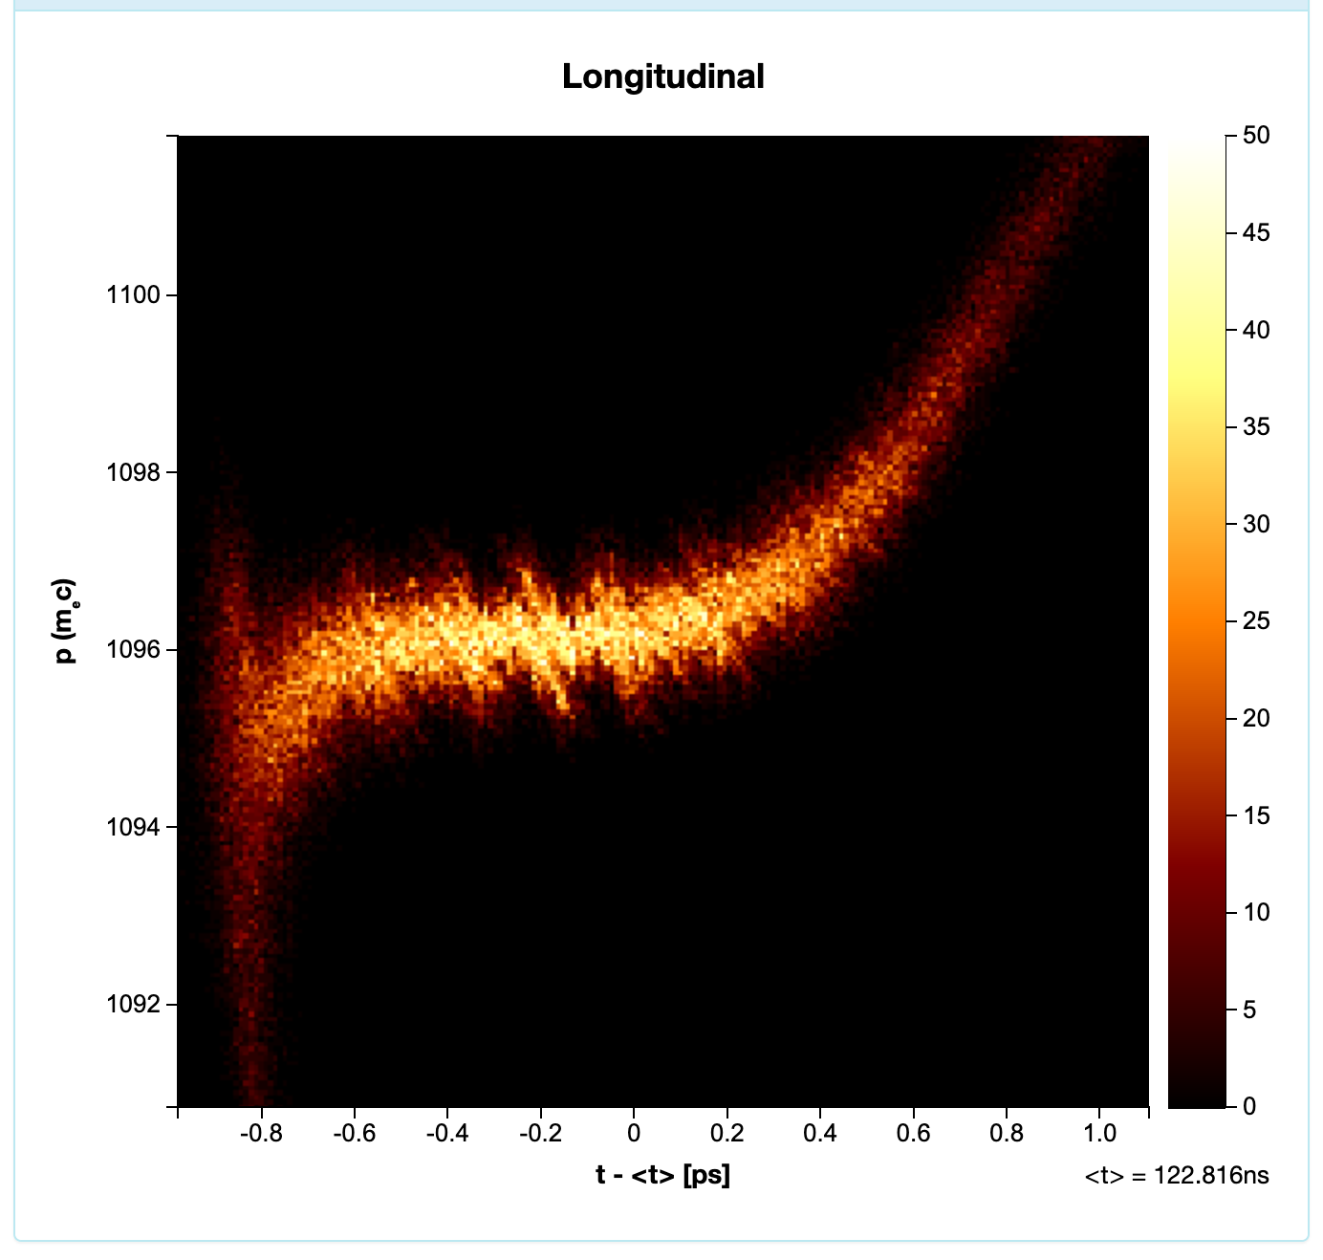
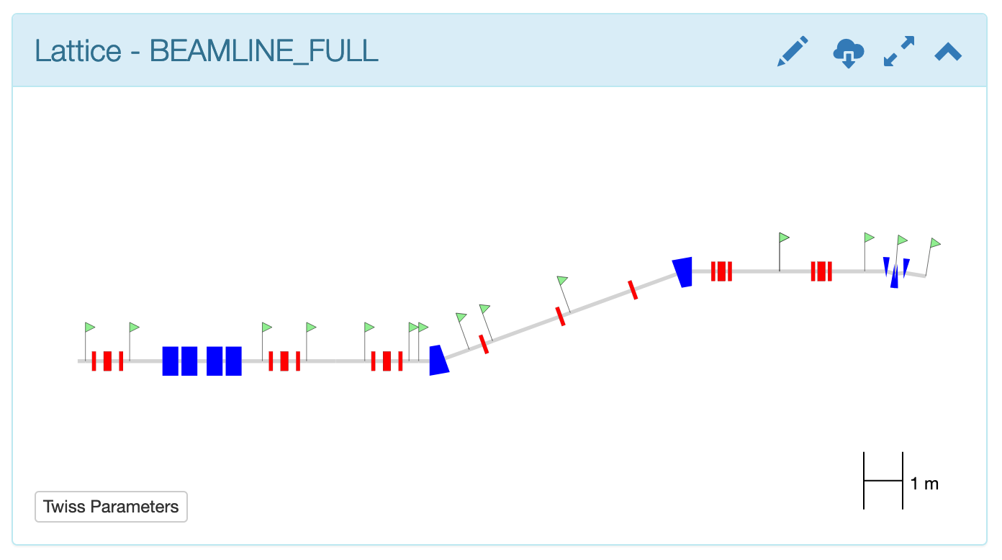
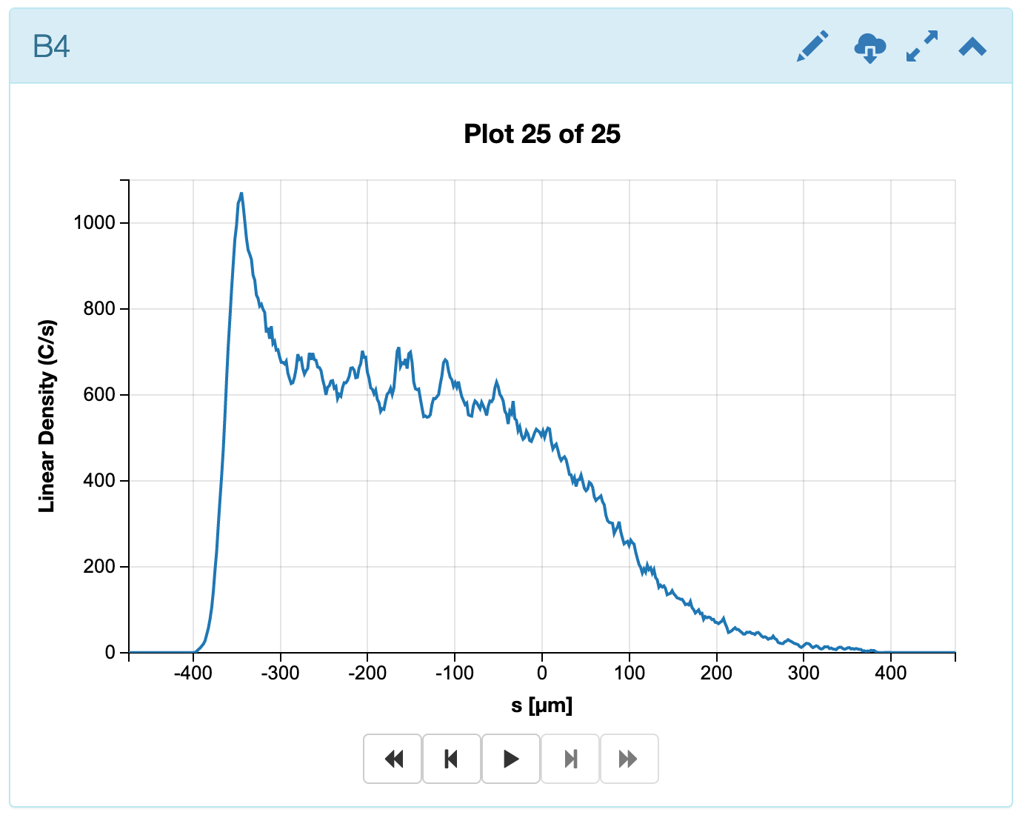
Sirepo for Beam Simulations
Web browser based
Free
Easy to catch
Amazing visualization
http://www.sirepo.com/

Slide 6
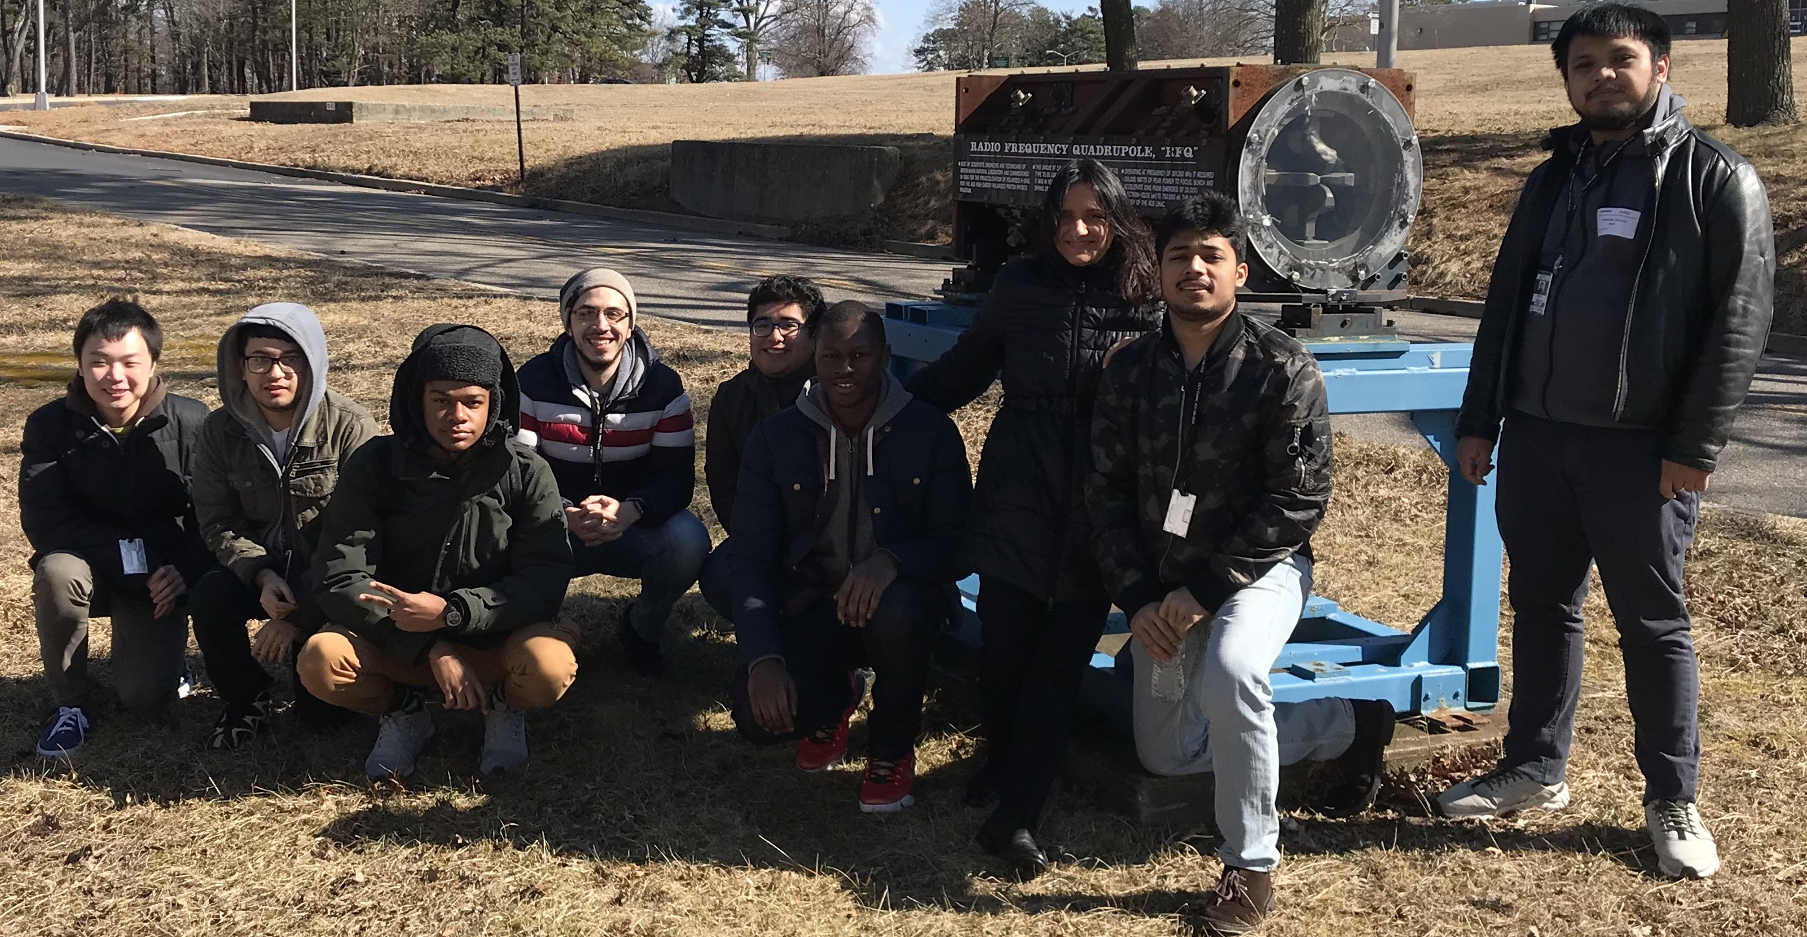
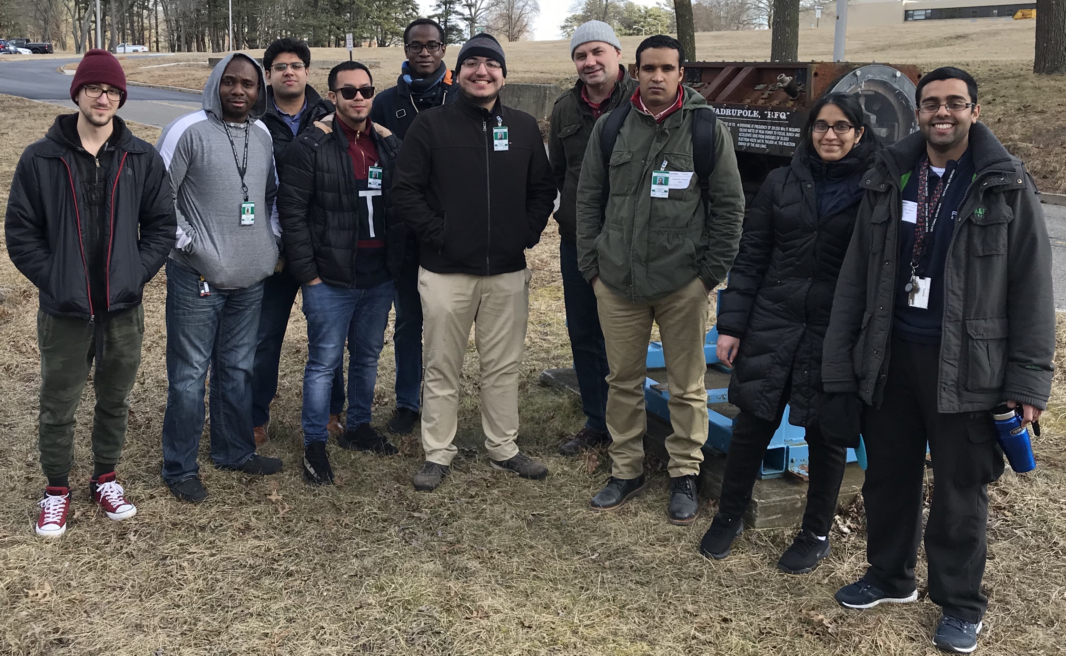
Extended class for
City University New York
In Spring and Fall of 2020 AE63 was extended to give introductory Accelerator Laboratory course for CUNY students
AE63 extension was supported by BNL diversity program:
  Round trip travel from NYC to BNL was planned to covered for 18 students
  16 hours presentations dedicated accelerator and laser physics by M.Fedurin and M.Polyansky
CUNY 2020 Spring
on BlueJeans
CUNY
2019
CUNY 2020 Fall
on Zoom

Slide 7
Electron Beam
Parameter | Nominal | Requested
Beam Energy (MeV) | 30-65 | From 30 MeV to 60 MeV for Linac capability demonstration
Bunch Charge (nC) | 0.1-2.0 | From 0 to Max at gun (gun demonstration)
Compression | Down to 100 fs (up to 1 kA peak current) | Any compression up to CSR breakup to demonstrate bunch compression principal
Transverse size at IP (sigma, um) | 30 – 100 (dependent on IP position) | Any size. Possibility to vary quads in tunnel for emittance measurements.
Normalized Emittance (um) | 1 (at 0.3 nC) | Any emittance. Possibility to vary emittance by charge and gun solenoid
Rep. Rate (Hz) | 1.5 | 1.5
Trains mode | Single bunch | Not required

Slide 8
2021 Experiment Time Estimates
Run Hours (include setup time in hours estimate): 40hrs
Number of electron beam only hours: 40hrs
Number of CO₂ laser hours delivered to laser experiment hall (”FEL room”): 0
Number of CO₂ laser hours, + ebeam, delivered to electron beam experiment hall: 0
Overall % setup time: 0%
Hazards & installation requirements: None
40 hours total of e-beam time distributed over:
  every Monday from 3pm to 7pm
  except national holidays, spring break and snow storm impact
Estimate start date – end of January
Estimate finish – end of April

Slide 9
Experimental Time Request
CY2021 Time Request
Capability | Setup Hours | Running Hours
Electron Beam Only | 0 | 40 (SBU) + 20 (CUNY) in spring + 40 (ECTAST) in summer
Laser* Only (in FEL Room) | 0 | 20 (CUNY)
Laser* + Electron Beam
Time Estimate for Remaining Years of Experiment (including CY2021)
Capability | Setup Hours | Running Hours
Electron Beam Only |  | 300
Laser* Only (in FEL Room) |  | 60
Laser* + Electron Beam
* Laser = Near-IR or LWIR (CO₂) Laser

Slide 10
2015-2019 Advanced Accelerator Lab students:
2017
2016
2015
2017
2016
2016
2017
2019
2016
2019
2020
2020

Slide 11
Support materials

Slide 12
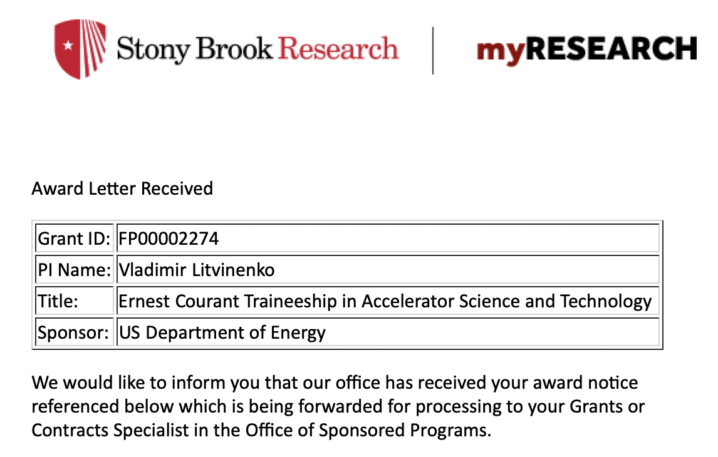
Ernest Courant Traineeship in Accelerator Science and Technology
$2.9M over 5 years
Collaboration of BNL, FNL, Cornell and
Stony Brook Universities

Slide 13
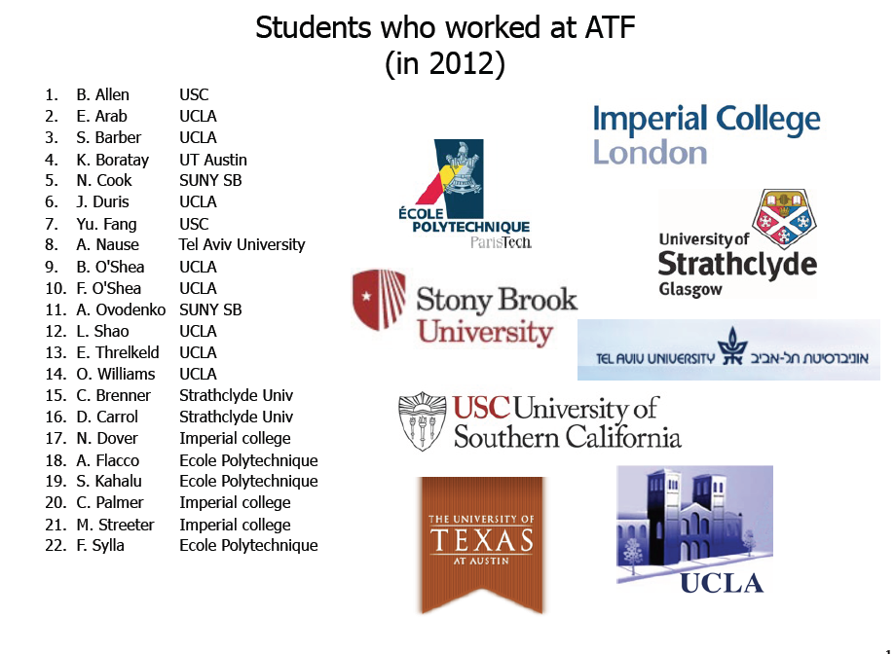
Accelerator Stewardship program

