Slide 1
UED-301650: UF82
Direct detection of dynamic pathways during photoinduced phase transition in VO₂
PI: Junjie Li¹, Yimei Zhu¹
Collaborator: Jing Tao¹, Lijun Wu¹, Weiguo Yin, Olivier Delaire³
1. Condensed Matter and Material Science Division, BNL
2. Duke University
Sponsored by the U. S. DOE, BES,
(Received)
22nd ATF Users Meeting: Application for Continuation

Slide 2
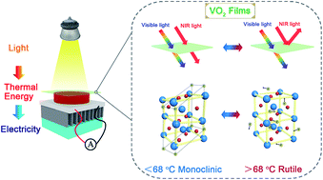
Unique optical/electric properties across phase transition in VO₂
K_{tot} Total thermal conductivity
K_{e} electronic thermal conductivity.
VO₂ as thermosensitive switch in light-driven thermoelectric conversion system
Thermal conductivity across the metal-insulator transition
Zhang, Y., J. Mater. Chem. A 7, 8521 (2019)
Lee, S., Science 355, 371 (2017)

Slide 3
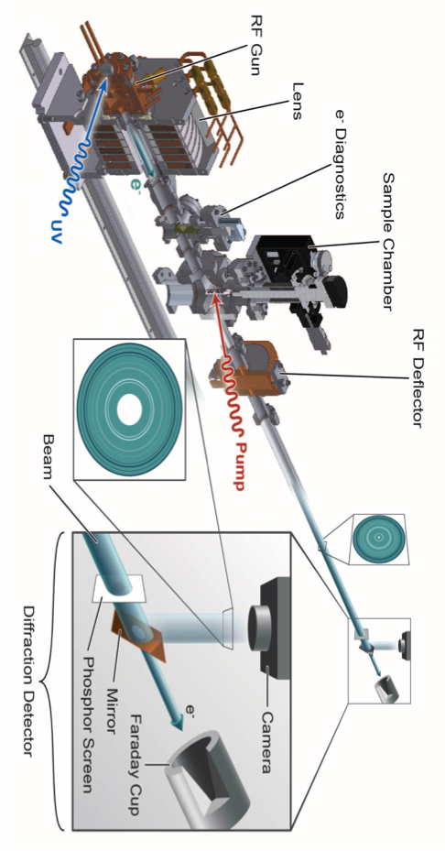
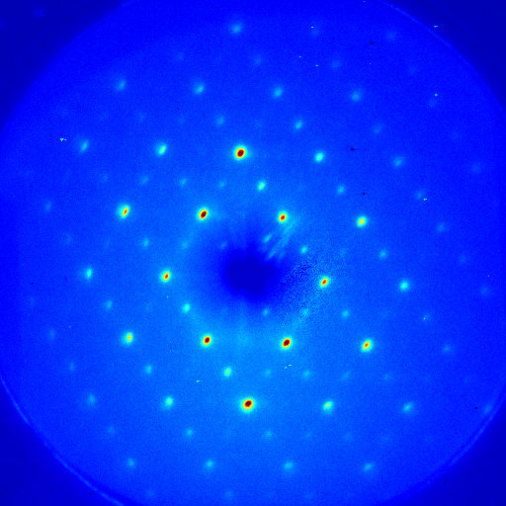
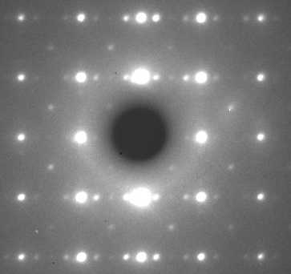
BNL MeV-Ultrafast Electron Diffraction
Acceleration voltage = 2.8 MeV
10⁶ electrons per pulse
Temporal resolution ~ 180 fs
Notes:
Here shows a typical optical pump probe measurement. The pump pulse will arrive first to initiate a dynamical process, This involves the interaction between laser and sample. Also it set the time-zero or the beginning of the whole process. Then after a short time-delay, at t1, the probe pulse arrives to measure the reflectivity. By adjusting the time delay, we finally can get a whole curve of how the optical properties change during the dynamic process initiated by the pump pulse.
Nowadays, there are many kinds of pump probe technique. They all use laser pulse to pump, but probe varies a lot.

Slide 4
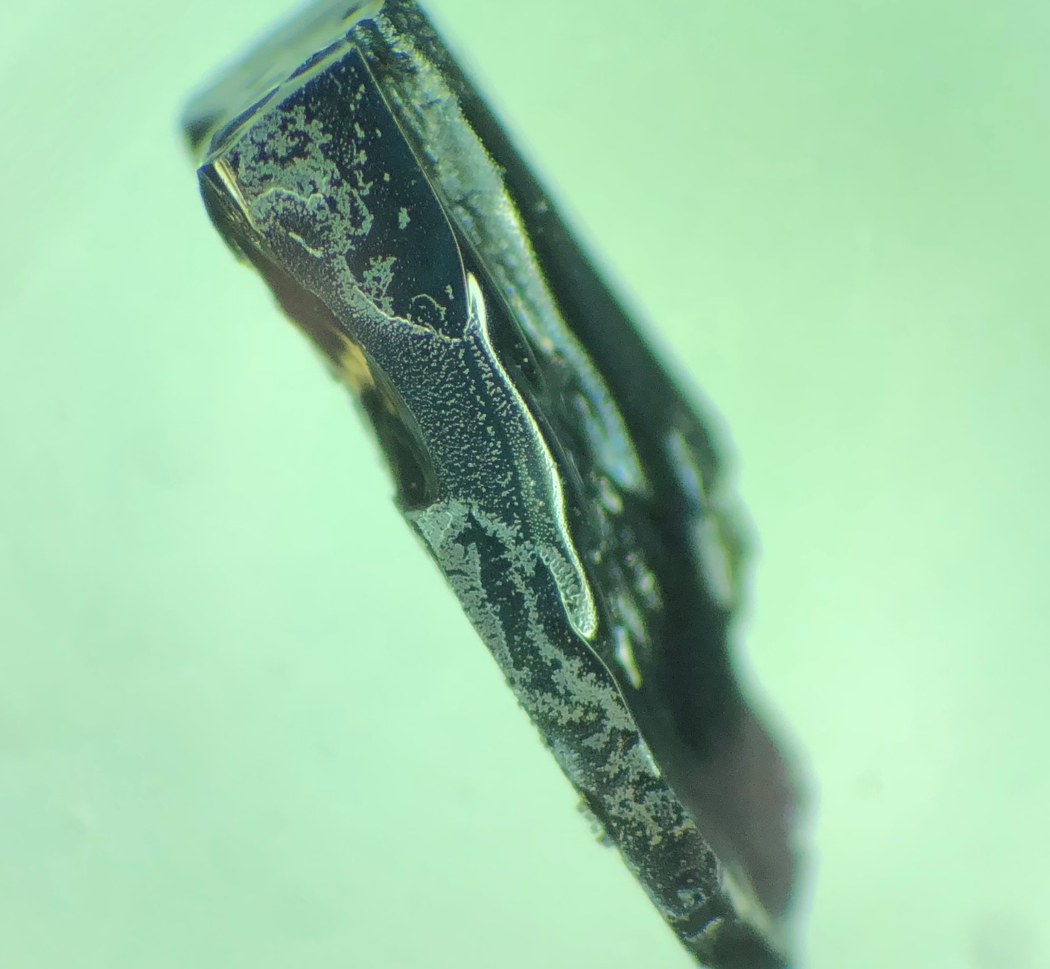
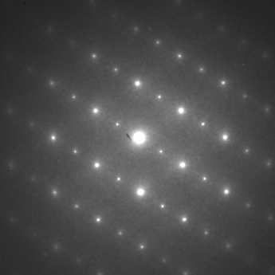
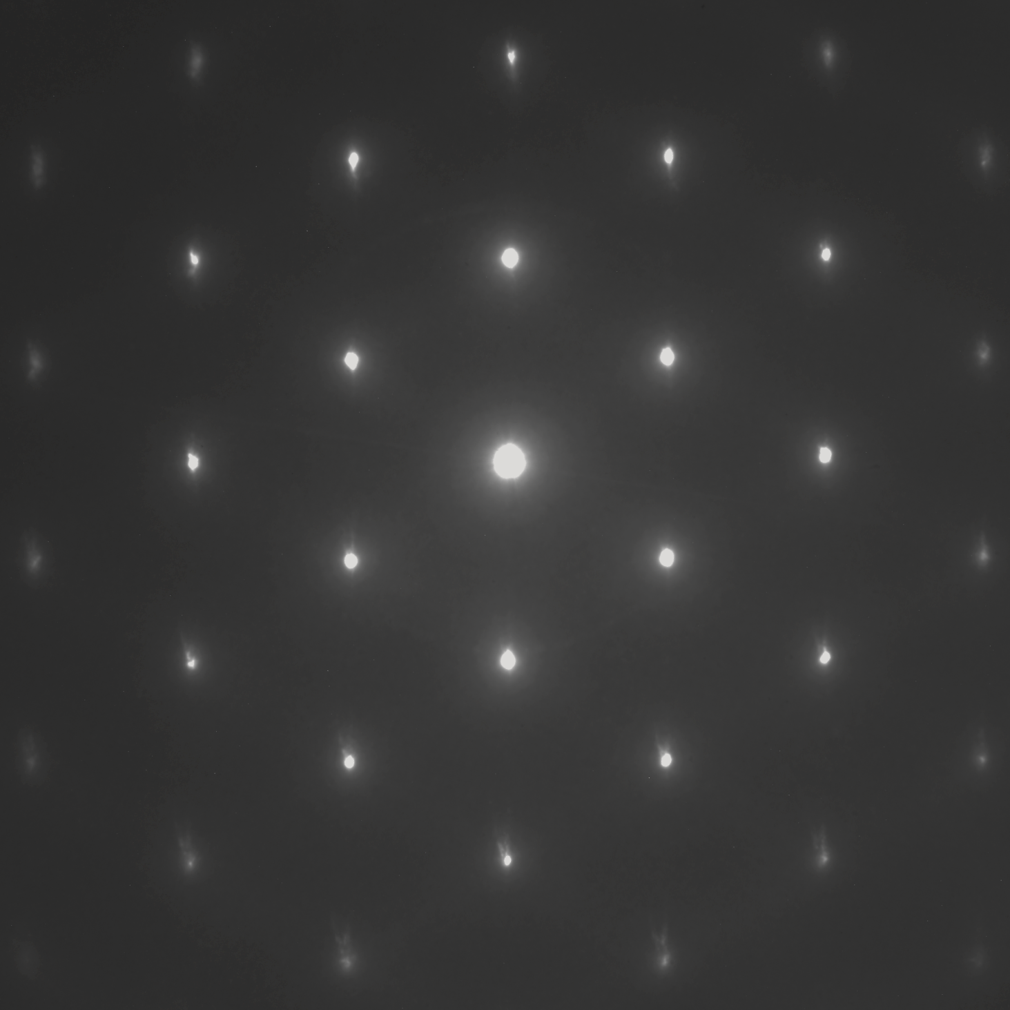
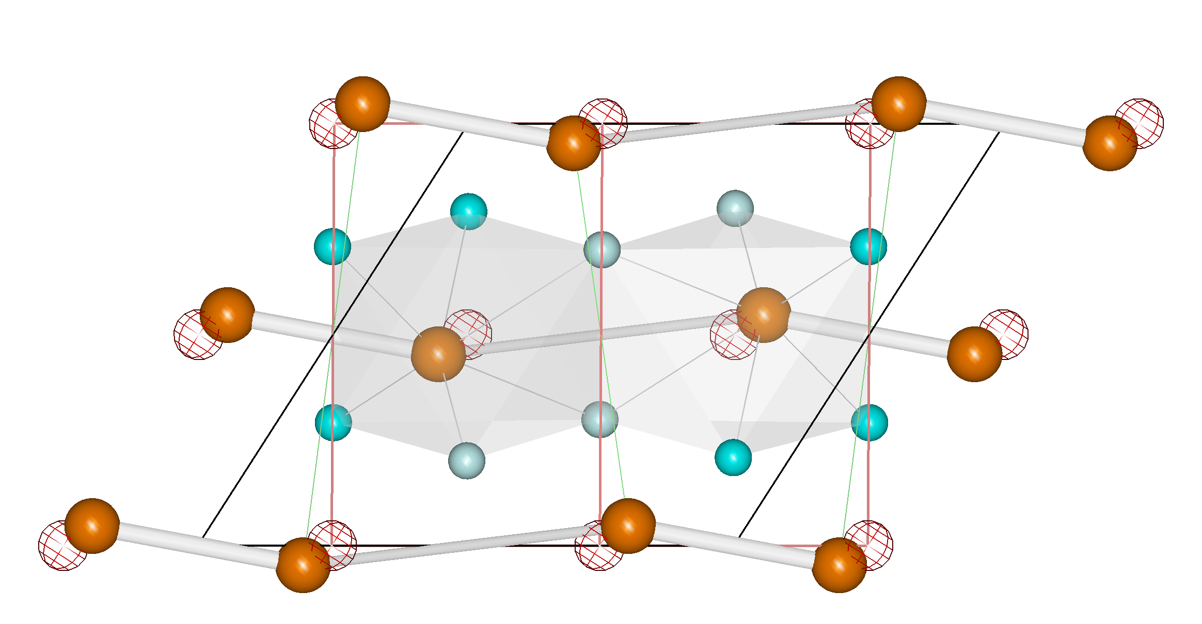
Sample preparation/TEM characterization
bulk VO₂
Monoclinic (300 K)
Rutile (350 K)
FIB
Vanadium (Monoclinic)
Vanadium (Rutile)
Oxygen

Slide 5

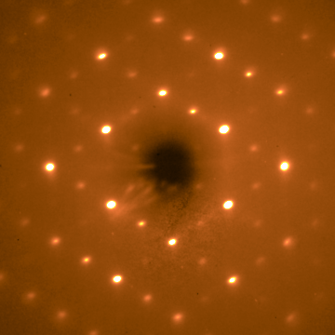
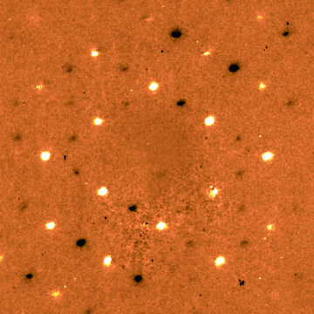
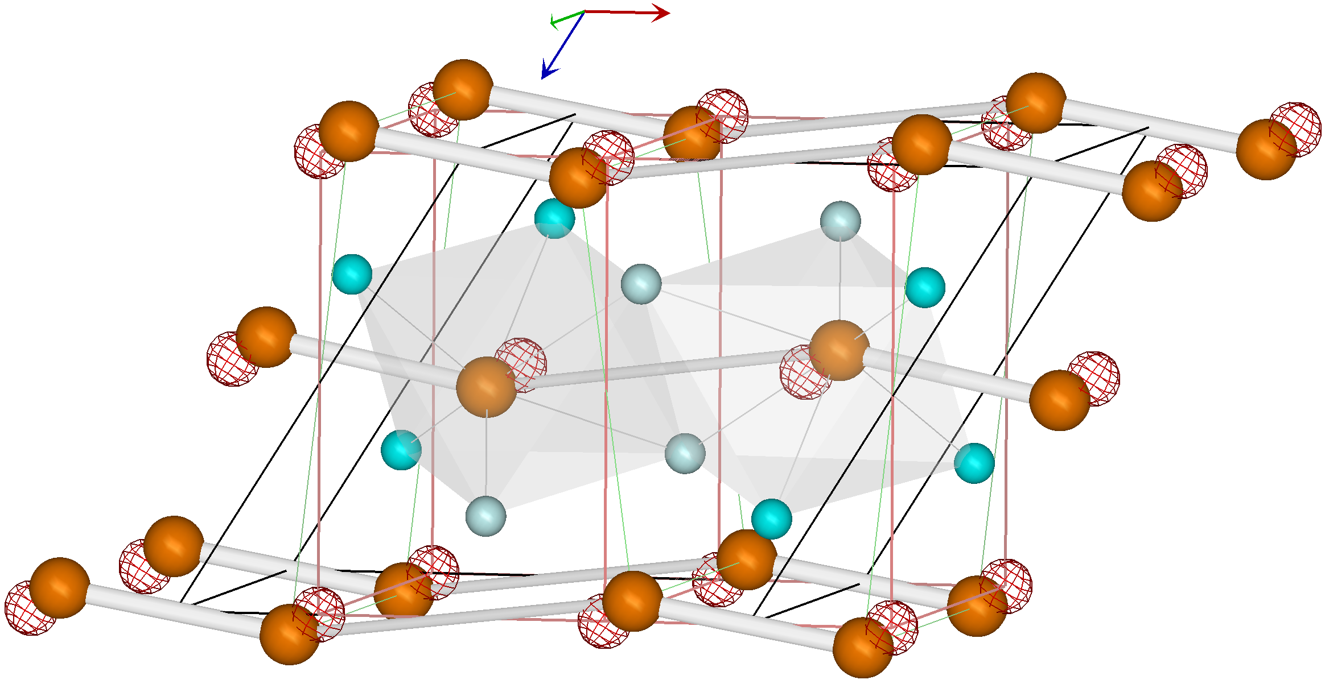
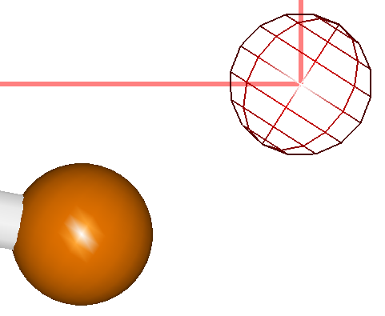
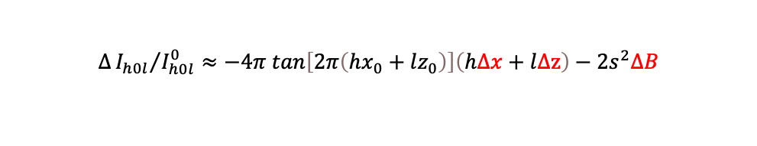
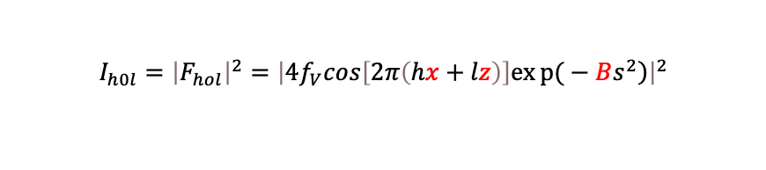
UED study of photoinduced phase transition
MeV-UED pattern
before time zero, at 314 K
Differentiate the electron diffraction
at 730 ps
b_{M1}
a_{M1}
(d)
c_{M1}
20-2
-302
200
40-2
-504
-102
300
002
0
2000 a. u.
-150 a.u.
200 a.u.
Monoclinic and Rutile phase
h0l with h=2n,
only Monoclinic phase
h0l with h=2n+1,
z
$$I_{h0l}={\left|F_{hol}\right|}^{2}={\left|\left.4f_{V}cos\left[2π\left(hx+lz\right)\right]exp{(}−Bs^{2}\right)\right|}^{2}$$
$$∆{I_{h0l}}/{I_{h0l}^{0}}≈−4π tan\left[2π\left(hx_{0}+lz_{0}\right)\right]\left(h∆x+l∆z\right)−{2s}^{2}∆B$$
x

Slide 6
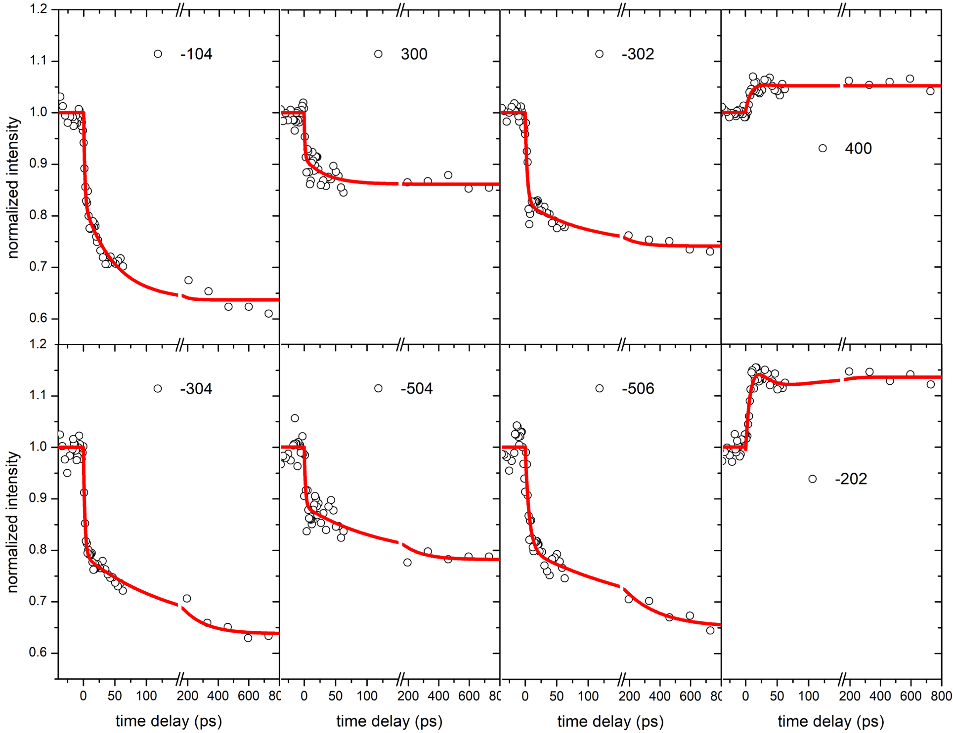
Evolution of Individual Bragg Peak intensity
20 Monoclinic peaks
20 Rutile peaks
20 independent equations

Slide 7
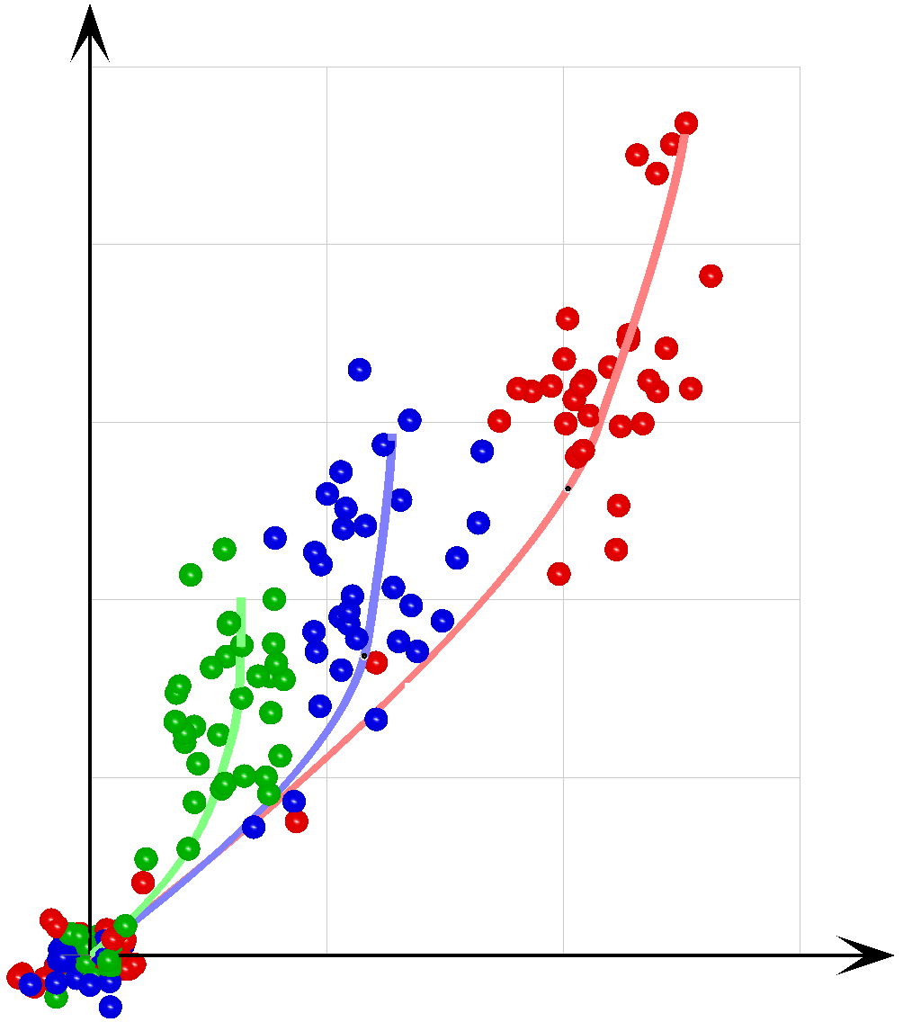
Atomic pathway of photoinduced phase transition in VO₂
b_{M1}
a_{M1}
c_{M1}
Vanadium motion pathway
16 mJ/cm²
0.1
10 mJ/cm²
8 mJ/cm²
Normal. displ. |Δz/Δz₀|
z
0.05
4 ps
4 ps
4 ps
4 ps
x
0.025
0.05
|Δx/Δx₀|

Slide 8
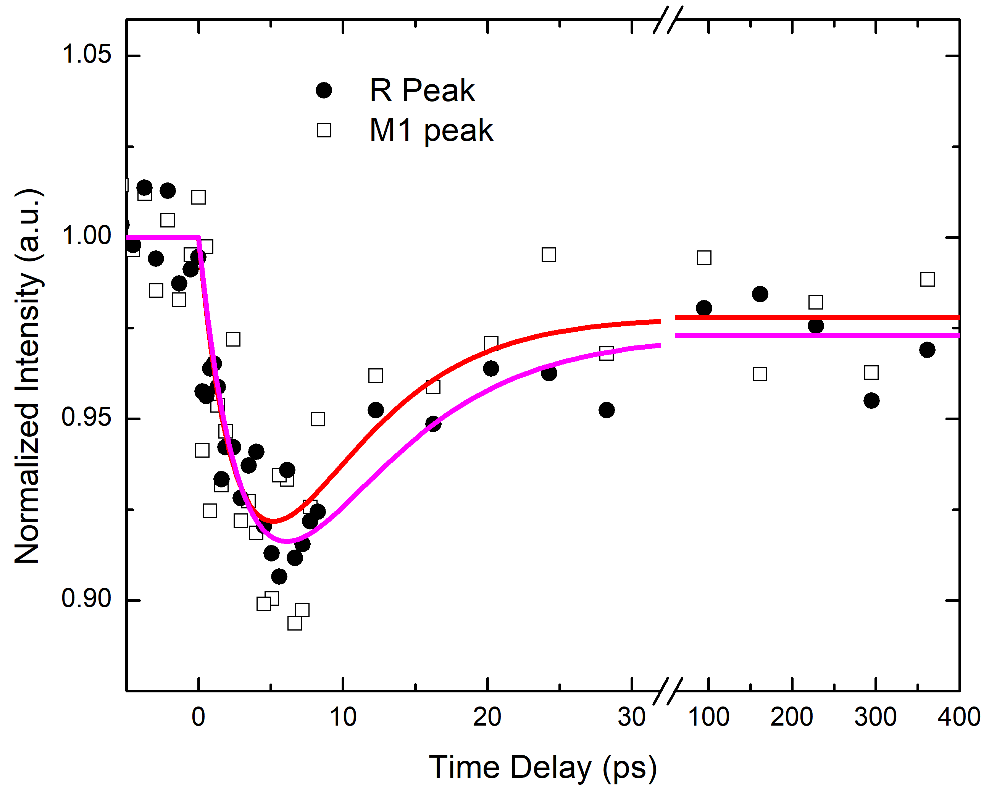
UED measurement, 77K
No phase transition is found
until pump fluence of 16 mJ/cm²
Thermal heating matters

Slide 9
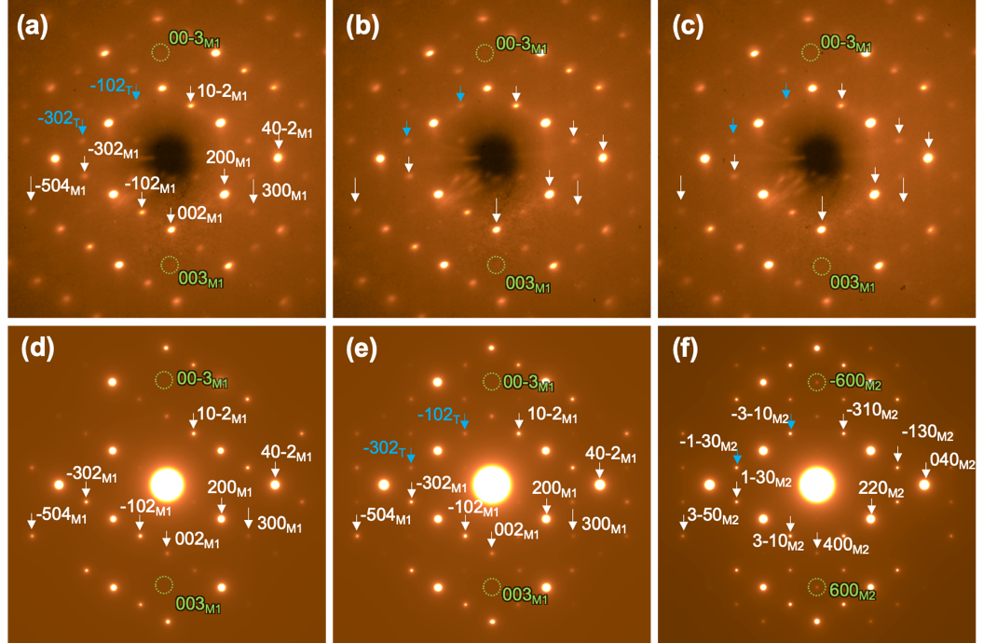
No evidence for M2 in phase transition
Electron diffraction pattern by UED
Shao et al. NPG Asia Materials (2018) 10: 581-605

Slide 10
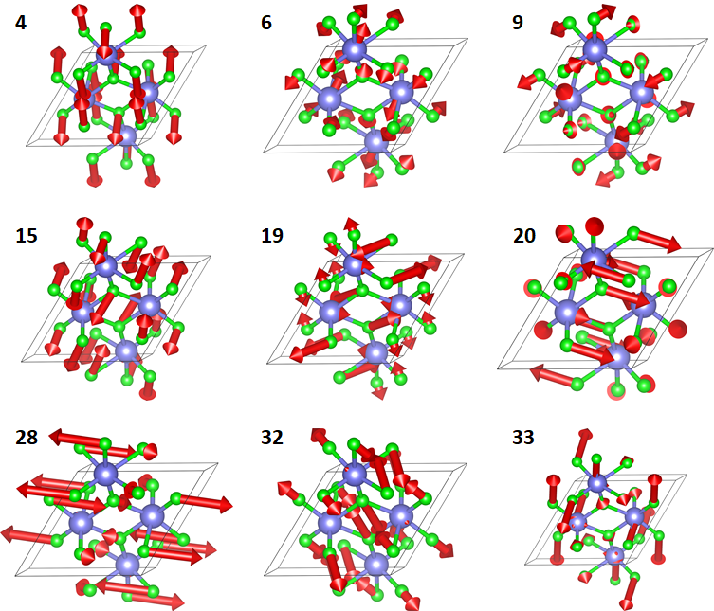
Density-functional theory (DFT)
Harmonic phonon dispersion calculations

Slide 11
Summary
Confirm the photoinduced Monoclinic/insulator to Rutile/metal transition in single crystal VO₂.
Discover the atomic path of structure phase transition in VO2
  A diagonal linear motion toward Rutile phase, ~ a few picosecond
  A V-V twisting dominant motion, deviating from diagonal direction, in ~100 ps
Find no evidence for existence of intermediate M2 in the phase transition
Thermal heating play an important role in the phase transition

Slide 12
Thank You!

Slide 13
Thermal transport at nanometer
Thermoelectric materials: MFP is too short
Nanometer scale materials: theory and regular measurement don’t work
Zeng, L., Scientific Reports 5, 17131 (2015)

Slide 14
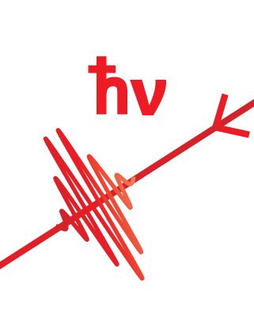
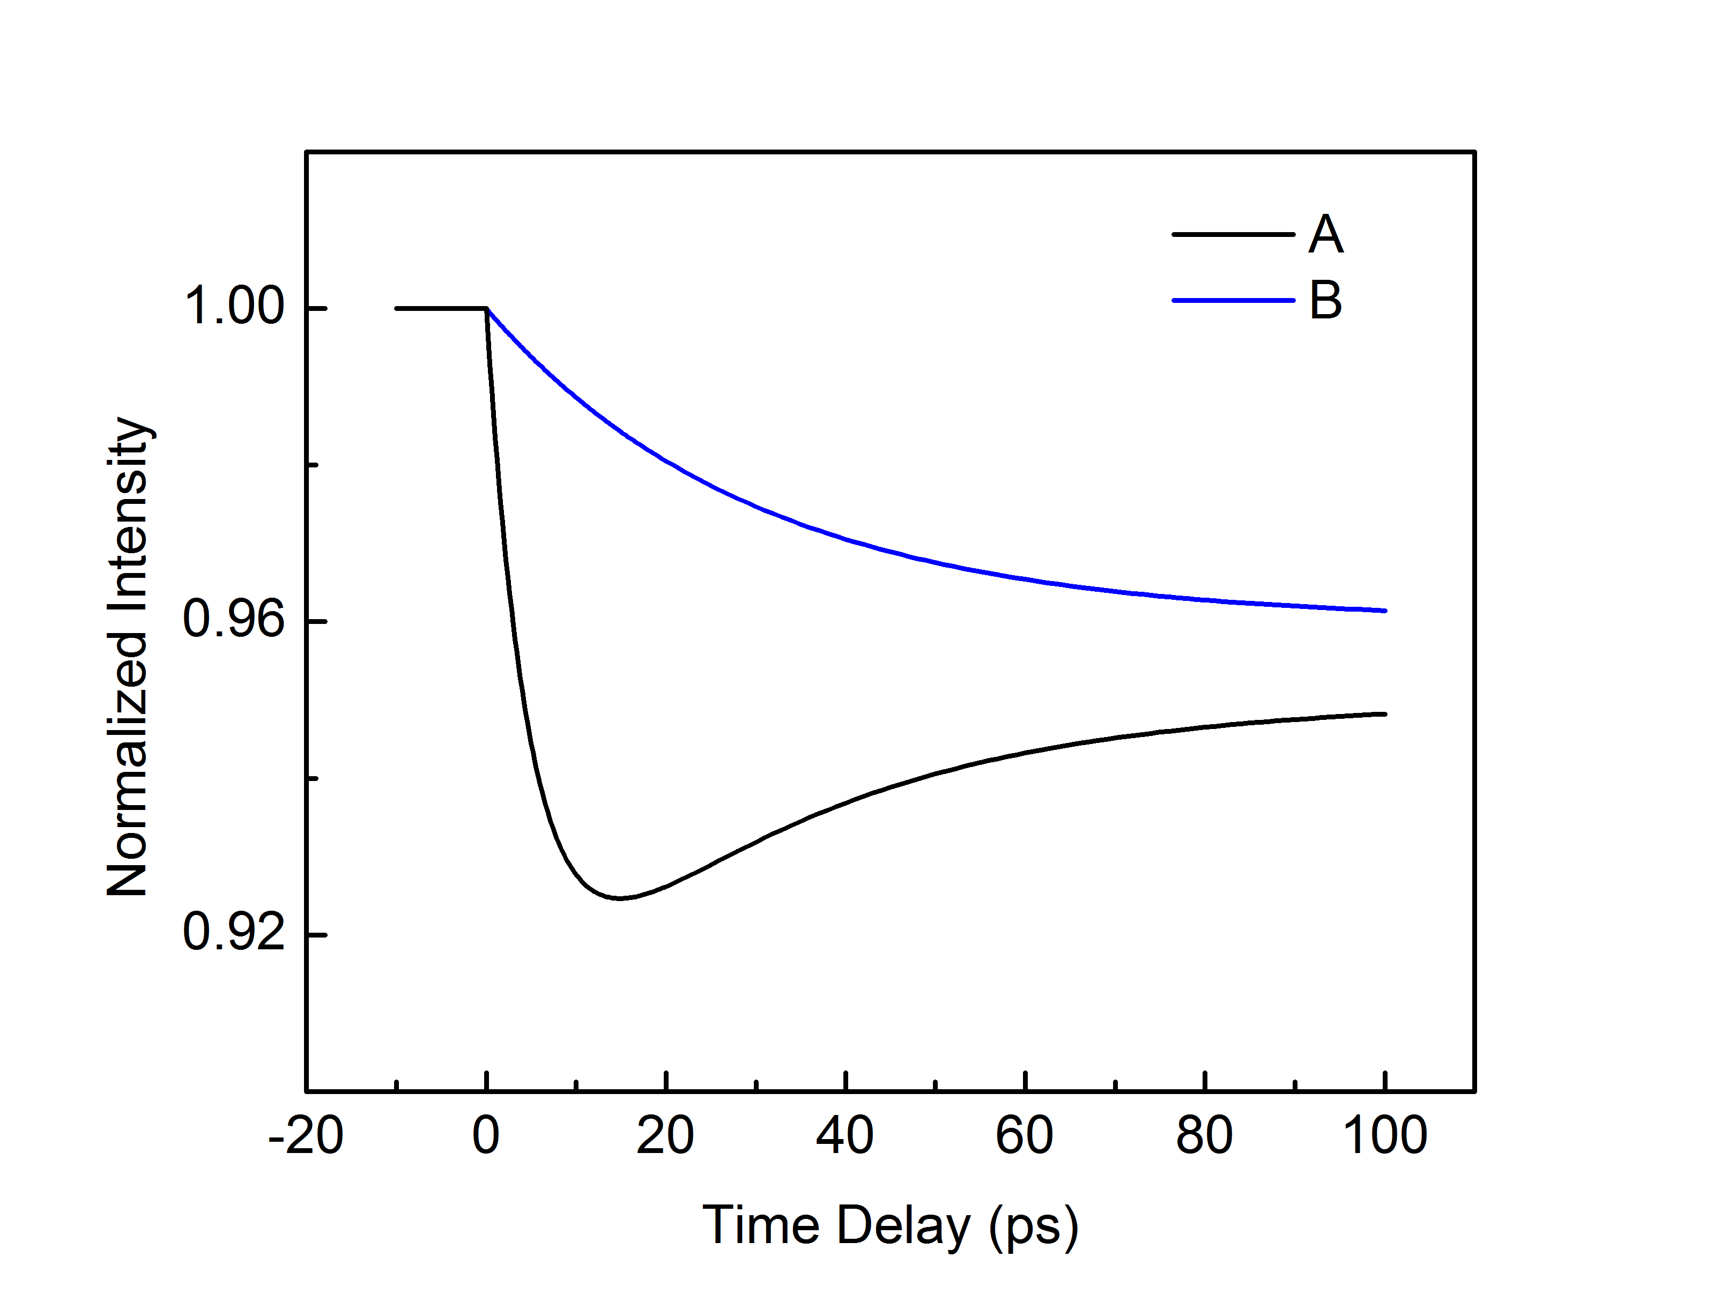
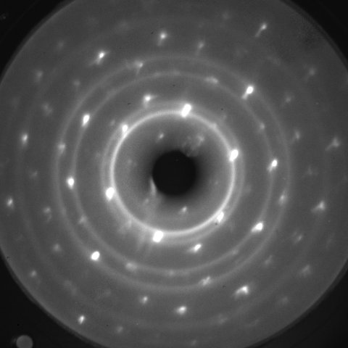
thermal transport in thermoelectric material Bi₂Te₃
e⁻
Au
Bi₂Te₃
Phonon scattering and
Thermal transport at interface
1120
e-p coupling and
phonon coupling within A
3030
Stuck by difficulty in the sample preparation

