Slide 1
ATF Science Planning Report Overview
Navid Vafaei-Najafabadi
December 11, 2020

Slide 2
Synthesis
ATF Science Planning Workshop was conducted on October 15-17 2019
The resulting report has been organized around a set of Priority Research Directions (PRDs) corresponding to three research areas:
Long-Wave Infrared (LWIR) Driven Science.
Electron-Beam-Driven Science
Laser Electron Beam Interactions
Experiments within each PRD led to the creation of a set of facility requirement that will be needed to enable each PRD
Together, the topics represent a significant and robust collection of cutting-edge accelerator and technology research. We believe that the urgent completion of this future research is crucial to support continued progress on our national and international advanced accelerator thrusts.

Slide 3
Outline
Introduction to the content and structure of the report
Research Areas
Long-Wave Infrared (LWIR) Driven Science.
Electron-Beam-Driven Science
Laser Electron Beam Interactions

Slide 4
Outline
Introduction to the content and structure of the report
Research Areas
Long-Wave Infrared (LWIR) Driven Science.
Electron-Beam-Driven Science
Laser Electron Beam Interactions

Slide 5
2019 ATF Science Planning Workshop
Goals:
Determine or reaffirm (from 2017 report) the set of parameters that will support the currently planned program and enable the exploration of new Physics
Determine the priority research directions that can be leveraged to establish a priority based upgrade path.
Strategy
Synthesize the summary of scientific needs for the parameters of ATF facilities to enable the exploration of new physics based on community input (October 15-17 2019 workshop)
Synthesize a summary of capability upgrades required for enabling new key research
Editors:
Navid Vafaei-Najafabadi (Stony Brook University)
Michael Downer (University of Texas at Austin)
David Sutter (University of Maryland)
Gerard Andonian (University of California, Los Angeles)
Aakash Sahai (University of Colorado)

Slide 6
Comparison to the Previous ATF Workshop
2017: ATF Scientific Needs Workshop
Focused on ATF II (building 912)
Focused on science driven by Laser/Laser+e-beam
2019: ATF Science Planning Workshop
Focused on continuing operations in ATF (building 820)
Expanded the topics to include science driven by Laser/e-beam/Laser+e-beam

Slide 7
Summary of Current Capabilities & Potential Upgrade Paths
Long-wave IR (LWIR) High Power Laser at ~ 9.2 μm
Current: 5 TW, 2 ps CO₂ laser pulses at the output of the final amplifier, up to 2.5 TW delivered to users
1 Year Goal: 5 TW delivered to users
3 Year Goal: 10-20 TW of CO₂ laser power with sub-ps pulse length delivered to users
Electron Beam
Current: 50-65 MeV, 0.1-2 nC, pulse length down to ~100 fs, normalized emittance of ~1 mm-mrad, repetition rate of 1.5 Hz
3 Year Goal: Bunch compression down to 30 fs, potential energy upgrade up to 125 MeV, T-CAV on both user beam lines
Near-IR Lasers
Nd:YAG: 1-5 mJ, 1-15 ps pulse length delivered to users
Ti:Sapphire: ≤100 fs, terawatt-class pulses delivered to users
Green: Critical for the proposed science program
Orange: Highly Desirable
Notes:
Upgrades: mJ seed pulse, NLPC, gain profile modification to reach 1 ps.

Slide 8
Structure of the Report
Organized around a set of Priority Research Directions (PRDs) corresponding to three research areas A, B, and C:
Long-Wave Infrared (LWIR) Driven Science.
Electron-Beam-Driven Science
Laser Electron Beam Interactions
Information regarding each PRD is organized as follows:
Introduction: The context of the PRD at ATF and any related prior R&D.
Status of the current research and future directions: status of the ATF R&D, proposed experiments that will pursued in each PRD, and a summary of the specific research thrusts
Enabling technologies: beam requirements and upgrades needed to enable the research thrusts, including the required supporting diagnostic, instrumentation, and simulation or other software support as appropriate.
Notes:
PRDs: Research Areas enabled by the present research infrastructure and near-term upgrade plans at building 820.

Slide 9
Priority Research Directions
Long-Wave Infrared (LWIR) Driven Science.
LWIR Laser-Driven Plasma Ion Acceleration
LWIR Laser-Driven Plasma Electron Acceleration
Basic Plasma Physics Research in Novel Regimes
LWIR Laser Technology Development
Electron-Beam-Driven Science
Advanced Acceleration Research
Beam Phase Space Optimization
Low Emittance Source Development
Novel and Efficient Terahertz Radiation Generation
Laser Electron Beam Interactions
Basic Research of Laser-Plasma Charged-Lepton-Beam Production
Electron Acceleration Techniques Driven by the Combination of Electron Beam and LWIR Laser
Radiation Generation

Slide 10
Outline
Introduction to the content and structure of the report
Research Areas
Long-Wave Infrared (LWIR) Driven Science.
LWIR Laser-Driven Plasma Ion Acceleration
LWIR Laser-Driven Plasma Electron Acceleration
Basic Plasma Physics Research in Novel Regimes
LWIR Laser Technology Development
Electron-Beam-Driven Science
Laser Electron Beam Interactions

Slide 11
A.1. LWIR Laser-Driven Plasma Ion Acceleration
Interaction of intense laser pulse with near-critical-density plasma results in coupling of significant amount of laser energy to forward motion of large population of electrons and ions
ATF Advantages:
Hot electron yield is significantly higher with an LWIR laser (vs NIR), which plays a critical role in creating the space charge that will accelerate ions.
The critical density for an LWIR laser pulse (n_{e} ~ 10¹⁹ cm⁻³ for λ = 10 μm) can be achieved by using supersonic gas targets as opposed to a solid target:
Gas target is a clean source of protons and ions; it can be run at a high-pulse repetition rate, and the density of the plasma can be changed easily near critical plasma density
Notes:
Advantage of gas target: clean source of protons and ions; it can be run at a high-pulse repetition rate, and the density of the plasma can be changed easily in the neighborhood of the critical plasma density

Slide 12
A.1. LWIR Laser-Driven Plasma Ion Acceleration
Research Thrusts:
Achieving higher energy ions using collisionless electrostatic shock acceleration (CESA): CESA has been an ongoing experiment at ATF with very promising results. These results should be extended to higher energies. Achieving 200 MeV at $a_{0}$ ~ 10 should be pursued as the primary goal.
Investigate the potential benefits of using LWIR laser ion acceleration mechanisms other than CESA, particularly in RPA and RITA: Both RPA and RITA are examples of so-called coherent techniques, where thin plasma surfaces are directly driven by the high-intensity laser to co-propagate with it. The exploration of radiation pressure acceleration (RPA) requires the development of ultrathin gaseous targets and controlling the laser pre-pulse energy. The relativistically induced transparency acceleration (RITA) mechanism requires further investigation of mixed-Z gas targets apart from shaping of gas targets. Other acceleration mechanisms, such as Magnetic Vortex Enabled Acceleration (MVEA) also remain largely unexplored in the LWIR regime.

Slide 13
A.1. LWIR Laser-Driven Plasma Ion Acceleration
Beam Parameters
Diagnostics
Plasma Diagnostics (interferometry, shadowgraphy,etc)
Prepulse contrast diagnostics better than 4 orders of magnitude
Experiment | LWIR Laser | e-beam
PRD A.1: Ion Acceleration | 10 TW: ~ 10 MeV ions 25 TW: ~ 100 MeV ions Circ. Pol. For advanced methods (RPA, etc)
PRD A.2 e- Acceleration | 10 TW, 1ps: Blowout regime 20 TW, 0.5 ps: Bubble regime Integrated intense NIR: two color injection
PRD A.3 Weibel | 1 TW, ~3 ps, circ. Pol.

Slide 14
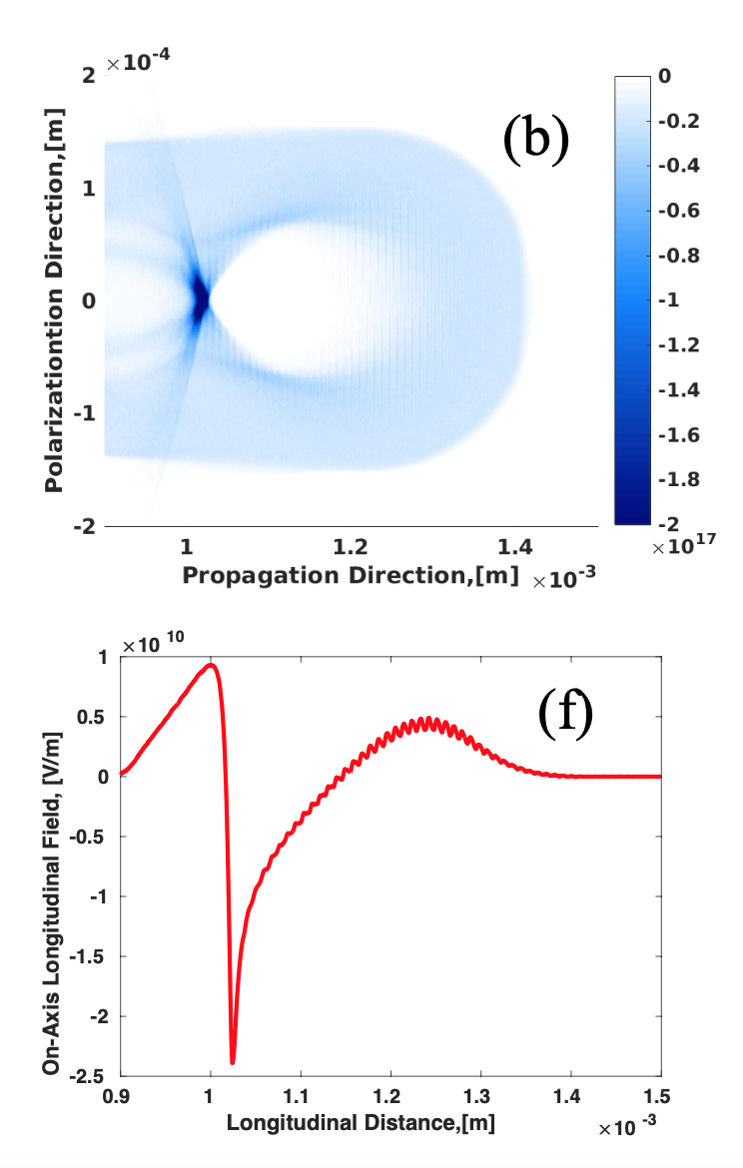
A.2. LWIR Laser-Driven Plasma Electron Acceleration
Figure 2.1: LWIR driven blowout regime (SPACE)
The ponderomotive force of the laser expels the plasma electrons out of its path. The space charge between the expelled electrons and the remaining ions, which are much heavier than the electrons, creates a plasma wave in the wake of the laser pulse with a gradient of tens of GV/m.
ATF Advantages:
LWIR laser is ideal for operating the LWFA in the blowout regime at low densities of 10¹⁶-10¹⁷ cm-3. The bubbles in this regime have a radius of hundreds of microns
Low dark current (no self injection observed in simulations even at $a_{0}≽4$)
ATF-based opportunities for pinpoint external injection/ionization injection: open new pathways for acceleration of high-brightness electron bunches with sub-% energy spread
$a_{0}=3.8$,
P=20 TW,
𝜏=0.5 ps,
$n_{e}=2×{10}^{16}$cm⁻³
Notes:
External injection: e-beam; Ionization injection: 2 lasers

Slide 15
A.2. LWIR Laser-Driven Plasma Electron Acceleration
Research Thrusts
Accessing highly non-linear wakefield regime ($a_{0}>4$): Verify unique features of LWIR-driven LWFA in this regime, such as lack of dark current
High quality electron beams from controlled two-color injection: Use the short-pulse higher intensity NIR laser to ionize impurity elements within the fully formed wake driven by the lower-intensity, longer wavelength CO₂ laser. Electron bunches created using this two-color scheme are expected to be of FEL-quality.
High quality electron beams from controlled external injection: The injection of the ATF-linac e-beam into the large bubble driven by the LWIR laser is a primary research thrust for ATF (See C.1 for detailed discussion).
Probing of large wake structure: Probing of the wake structure generated by an LWIR laser pulse at an unprecedented level of detail and resolution will be possible using longitudinal and transverse probes including Thomson scattering, or via transverse probing using an electron beam (See C.1 for detailed discussion)

Slide 16
A.2. LWIR Laser-Driven Plasma Electron Acceleration
Beam Parameters
Diagnostics
Plasma Diagnostics
Prepulse contrast diagnostics better than 4 orders of magnitude
Accurate synchronization and alignment diagnostics for the two-color optical injection experiments (more on this later)
Experiment | LWIR Laser | e-beam
PRD A.1: Ion Acceleration | 10 TW: ~ 10 MeV ions 25 TW: ~ 100 MeV ions Circ. Pol. For advanced methods (RPA, etc)
PRD A.2 e- Acceleration | 10 TW, 1ps: Blowout regime 20 TW, 0.5 ps: Bubble regime Integrated intense NIR: two color injection
PRD A.3 Weibel | 1 TW, ~3 ps, circ. Pol.

Slide 17
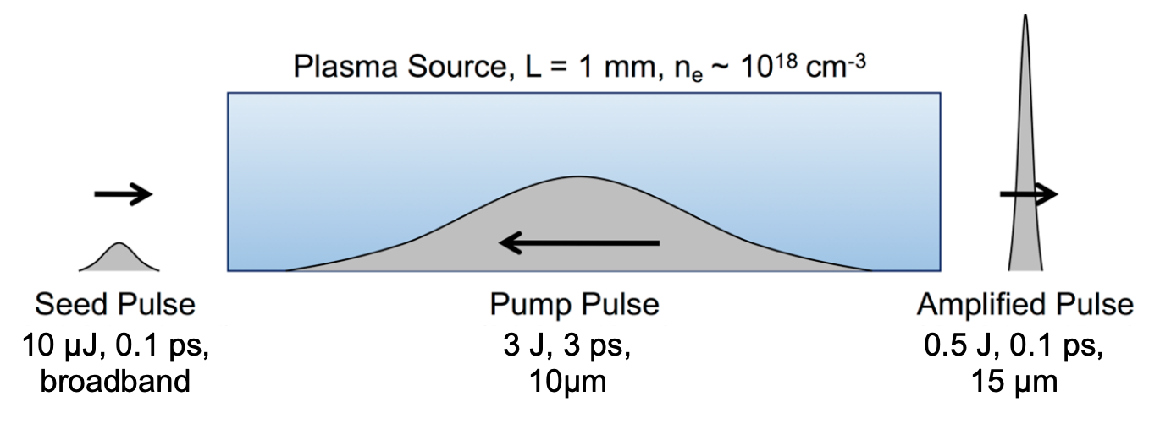
A.3. Basic Plasma Physics Research in Novel Regimes
Experiments:
Weibel instability: The anisotropy of a plasma generated via optical field ionization with an LWIR laser enables the study of the electron Weibel instability, an important mechanism for self-generating magnetic fields in both laboratory and space plasmas.
Plasma Optics: Entails the use of plasma medium to manipulate the state of a laser pulse, including focusing, guiding, and compression. It avoids material damage, e.g. representing an important alternative for a final-focus optic
Backward Raman Amplification (BRA): consists of a low-energy, femtosecond seed pulse and a high-energy, long-duration, counter-propagating pump pulse in the plasma. Energy is transferred from pump to seed when ω_{pump} – ω_{seed} = ω_{p},
ATF Perspective:
Unique aspects of the LWIR laser allows for the exploration of the basic physics of laser plasma interactions (LPI) in this region of the electromagnetic spectrum.
Application-driven basic plasma physics research is another important component of this PRD, where the investigation of the basic physics of LPI can lead to improved capabilities of the LWIR lasers, which will then benefit a wide array of experiments in return.

Slide 18
A.3. Basic Plasma Physics Research in Novel Regimes
Research Thrusts:
Weibel Instability: Using the ATF CO2 laser, carry out the first detailed measurements on the growth rate and k-spectrum evolution of electron Weibel instability.
Plasma Optics: Develop the physics of plasma focusing optics and investigate the possibility of implementation as a final focusing optics.
Backward Raman LWIR Amplification: Investigate the potential application of the backward Raman amplification technique to ATF laser

Slide 19
A.3. Basic Plasma Physics Research in Novel Regimes
Beam Parameters
Diagnostics
Ultrafast electron radiography (See C.1 for more discussion) using ATF’s linac-produced electron beam to measure the growth of the magnetic fields in Weibel Instability
Experiment | LWIR Laser | e-beam
PRD A.1: Ion Acceleration | 10 TW: ~ 10 MeV ions 25 TW: ~ 100 MeV ions Circ. Pol. For advanced methods (RPA, etc)
PRD A.2 e- Acceleration | 10 TW, 1ps: Blowout regime 20 TW, 0.5 ps: Bubble regime Integrated intense NIR: two color injection
PRD A.3 Weibel | 1 TW, ~3 ps, circ. Pol.
Notes:
For the plasma lens and backward Raman amplification, no facility upgrades specifically were requested. Rather, it was emphasized that the development of these technologies at ATF creates an opportunity for developing such novel approaches to focusing and amplification of a high-power LWIR laser, which in turn can only be tested at the ATF CO2.

Slide 20
A.4. LWIR Laser Technologies Development
Majority of the research directions highlighted in this report require an LWIR laser pulse with high power (>10 TW) and a short pulse (≤ 1 ps).
New Technologies are needed to bridge the gap between the existing capabilities and those demanded by the experiments
Therefore, research in this area merits designation as a PRD at ATF.
ATF Advantage: The unique LWIR infrastructure as well as the significant institutional experience and memory in CO₂ technology development
Two categories of LWIR technologies were discussed at this workshop:
(1) CO₂ beam manipulation technology, including laser micro-fabricated components
(2) Advanced optical pumping of the CO₂ laser-amplifier, aimed at improving the rep-rate, efficiency and compactness of terawatt CO₂ lasers

Slide 21
A.4. LWIR Laser Technologies Development
Research Thrusts
Advanced CO2 beam manipulation: Characterize optics developed via femtosecond laser micromachining and determine their utility as a replacement for conventional optical components
Advanced laser amplifier technology: Investigate issues surrounding the transition from electrical discharge sources to optical pumping, including the development of more energetic 4.3 μm pump sources, understanding the physics of excitation and relaxation, and gain tailoring via isotope mixing.

Slide 22
Research Area A Facility Needs
Experiment | LWIR Laser | e-beam
PRD A.1: Ion Acceleration | 10 TW: ~ 10 MeV ions 25 TW: ~ 100 MeV ions Circ. Pol. For advanced methods (RPA, etc)
PRD A.2 e- Acceleration | 10 TW, 1ps: Blowout regime 20 TW, 0.5 ps: Bubble regime Integrated intense NIR: two color injection
PRD A.3 Weibel | 1 TW, ~3 ps, circ. Pol.
Expanded Diagnostic Capabilities
Plasma Diagnostics (interferometry, shadowgraphy,etc)
Prepulse contrast diagnostics better than 4 orders of magnitude
Ultrafast electron radiography (See research area C for more discussion)
Accurate synchronization and alignment diagnostics for multiple beams (See research area C for more discussion)

Slide 23
Outline
Introduction to the content and structure of the report
Research Areas
Long-Wave Infrared (LWIR) Driven Science.
Electron-Beam-Driven Science
Advanced Acceleration Research
Beam Phase Space Optimization
Low Emittance Source Development
Novel and Efficient Terahertz Radiation Generation
Laser Electron Beam Interactions

Slide 24
B.1. Advanced Acceleration Research
The aim in this PRD is to develop novel, high-gradient, beam-driven acceleration methods
Experiments
Dielectric wakefield accelerator (DWA): a relativistic drive beam traverses a dielectric-lined waveguide establishing a wakefield, which is then sampled by a trailing witness beam. ATF has played a major role in the history of experimental demonstration of key components of DWA research
Metallic-structure-based wakefield acceleration: develop a class of novel cavity designs with unconventional spatiotemporal distributions using multi-harmonic mode superposition (e.g. TM010 and TM012) to suppress pulsed heating and RF breakdown.
ATF Advantages
Possessing high-quality electron beams
Capability of delivering single bunch and multi-bunch configurations
State-of-the-art diagnostics

Slide 25
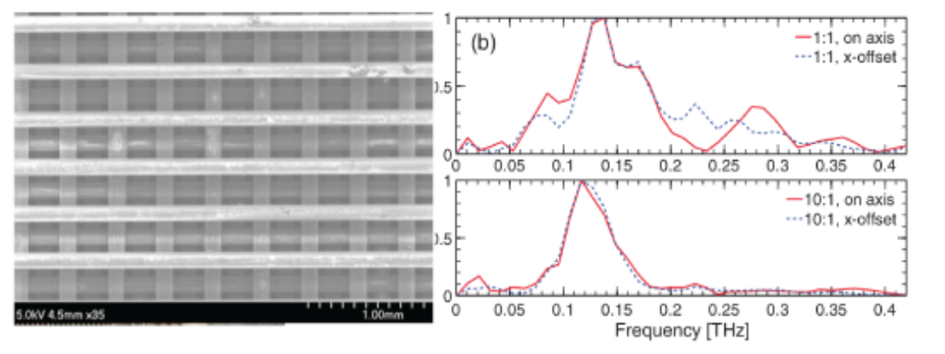
B.1. Advanced Acceleration Research
Research Thrusts:
Dielectric wakefield acceleration: The continued programs on dielectric wakefield acceleration (DWA) are aimed at extending interaction lengths by measuring the effects of beam breakup due to transverse forces, investigation of high transformer ratios by beam phase space tailoring, and material and geometry advances to combat structure breakdown limitations.
Exploration of Multi-mode Harmonic Cavities (MHCs): the goal is to incorporate the MHC concepts for the realization of a beam-driven high gradient two-beam accelerator (TBA) with low breakdown probability and a reliable acceleration gradient in an X-band structure to reach 200 MV/m. The transformer ratio for this scheme and for an inductively detuned structure is expected to be larger than 10, resulting in the high beam-to- beam efficiency of energy transfer.
Figure 3.1 DWA based on woodpile geometry
Figure 3.2 Two Beam Structures

Slide 26
B.1. Advanced Acceleration Research
Beam Parameters
Diagnostics
Beam characterization: Transverse deflective cavity (T- CAV), 2 THz interferometry from coherent transition radiation (CTR), coherent diffraction/edge/Cerenkov radiation (CDR/CER/CCR)
Experiment | LWIR Laser | e-beam
PRD B.1 Dielectric Wakefield Acceleration (DWA) |  | $ε_{n}∼ 1−2 μm$, $Q>300$ pC, $σ_{z}<200 μm, σ_{r}<50 μm$ r.m.s
PRD B.1 Two Beam Acceleration (TBA) |  | $Q\sim 1$nC, $σ_{z}, σ_{r}<2 mm$, total peak power> 60 MW
PRD B.2 Structure-based phase space manipulation |  | $ε_{n}∼ 1−2 μm$.
PRD B.2 fs beam manipulation | TEM_10 mode
PRD B.4 THZ Generation |  | $ε_{n}≤2 μm$, $Q>400$pC, $σ_{z}<120 μm$, 6.4 cm period undulator: 1.5 mJ THz pulse
Notes:
A number of these diagnostics have been pioneered at ATF.

Slide 27
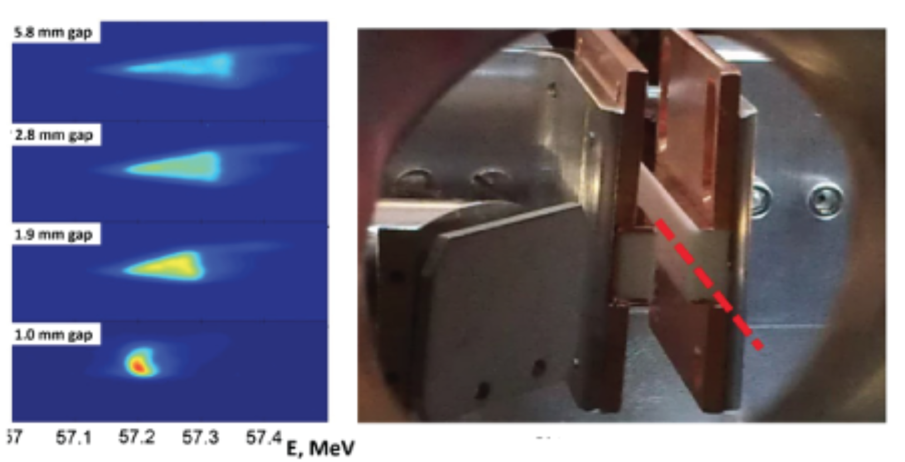
B.2. Beam Phase Space Optimization
Precision control of the beam longitudinal phase space is important for many applications (current profile tailoring for high transformer ratio experiments, coherent synchrotron radiation (CSR) suppression, etc)
ATF Advantages:
Extensive control over the parameters of the ATF electron beam
Ready availability of the state-of-the-art diagnostics for measuring beam properties
Experiments/Research Thrusts:
Dechirpers and shapers: Continued exploration of broadband, multimode structures (e.g. DWA and corrugated metallic structures), in conjunction with compression element such as a chicane, to remove a beam energy-chirp, e.g. inherent in beam compression stages.
Sub-fs modulator: a higher-order IFEL interaction in conjunction with the x-band deflecting cavity creates beam angular modulations correlated to the longitudinal beam coordinate. These (sub-fs) modulations in turn can be used as a high-resolution beam diagnostic.
Figure 3.1 Energy Dechirper with variable-gap DWA

Slide 28
B.3. Low Emittance Source Development
Experimental efforts at ATF will either benefit greatly by having access to ultralow emittance electron beams, or their aim is to develop new sources of ultralow emittance beams.
Experiments/Research Thrusts:
Field Emission Cathodes: a laser beam is directed across the tip of the cathode rather than illuminating the cathode as done in laser-driven photocathodes. This scheme is conducive to using non-traditional cathode materials, e.g. carbon nanotubes (CNTs). The development of this method with novel materials can lead to developing ultralow emittance beams.
Diamond Electron Amplifiers (DEAs): In a DEA, the primary electrons from, say, a thermionic cathode impinge upon a diamond wafer, which generates >200 secondary electrons for every primary one. These secondary electrons emerge from the backside of the diamond wafer, forming a bunch with low emittance and low energy spread.
Optical Bessel Beams (OBBs): Could be used to help guide a counterpropagating electron bunch emitted from advanced electron sources in the place of a solenoid magnet. This guiding process requires no magnetic hardware, thus avoiding the problem of magnetic field leakage onto the cathode, which can spoil the emittance.

Slide 29
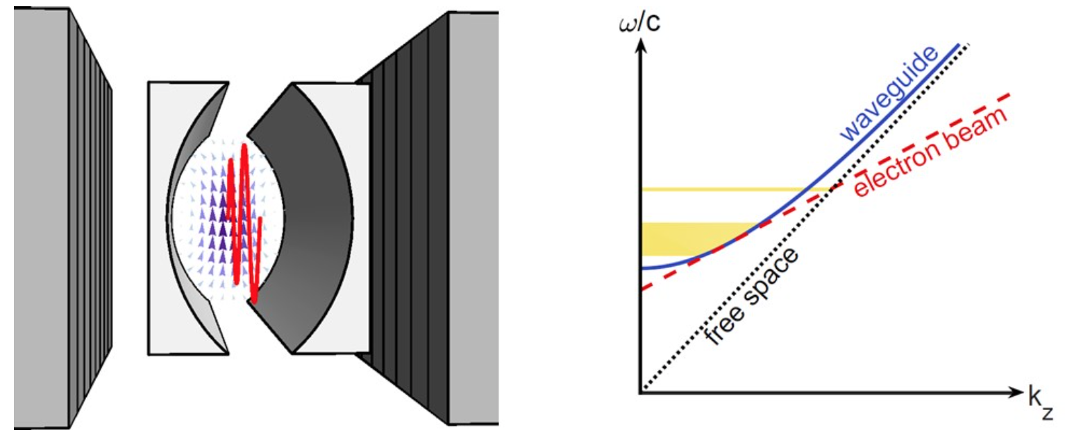
B.4. Novel and Efficient Terahertz Radiation Generation
The THz range is one of the regions in the electromagnetic spectrum where FELs are particularly attractive both because solid-state-based sources are scarce and because electron beam and undulator parameters needed are relatively easily achievable.
By controlling the dispersion properties of the wave in a long wavelength free-electron laser operated in a waveguide, it is possible to obtain simultaneously group and phase velocity matching, enabling a very long interaction region.
The parameters at ATF are particularly well suited to explore the 1-10 THz range, which are of interest to a variety of applications
Figure 3.4: left) Cartoon of curved parallel plate waveguide FEL. right) Dispersion relation for EM waves in vacuum and in waveguide. Coupling with e-beam occurs at intersection points. For tangential intersection the zero slippage condition is satisfied.

Slide 30
B.4. Novel and Efficient Terahertz Radiation Generation
Research Thrust:
The first test of the physics of the zero-slippage FEL in a tapered undulator with high gain.
Verify that a record-high 10% conversion efficiency, mJ-level THz pulse energy and GV/m THz fields are achievable with the ATF beam.
In the waveguide zero-slippage configuration, the interaction can be prolonged until the limit of electron beam energy depletion, achieving record high efficiencies in the conversion of the e-beam energy into THz pulse energy in a single-pass system

Slide 31
B.4. Novel and Efficient Terahertz Radiation Generation
Beam Parameters
Experiment | LWIR Laser | e-beam
PRD B.1 Dielectric Wakefield Acceleration (DWA) |  | $ε_{n}∼ 1−2 μm$, $Q>300$ pC, $σ_{z}<200 μm, σ_{r}<50 μm$ r.m.s
PRD B.1 Two Beam Acceleration (TBA) |  | $Q\sim 1$nC, $σ_{z}, σ_{r}<2 mm$, total peak power> 60 MW
PRD B.2 Structure-based phase space manipulation |  | $ε_{n}∼ 1−2 μm$.
PRD B.2 fs beam manipulation | TEM_10 mode
PRD B.4 THZ Generation |  | $ε_{n}≤2 μm$, $Q>400$pC, $σ_{z}<120 μm$, 6.4 cm period undulator: 1.5 mJ THz pulse
Notes:
A number of these diagnostics have been pioneered at ATF.

Slide 32
Research Area B Facility Needs
Experiment | LWIR Laser | e-beam
PRD B.1 Dielectric Wakefield Acceleration (DWA) |  | $ε_{n}∼ 1−2 μm$, $Q>300$ pC, $σ_{z}<200 μm, σ_{r}<50 μm$ r.m.s
PRD B.1 Two Beam Acceleration (TBA) |  | $Q\sim 1$nC, $σ_{z}, σ_{r}<2 mm$, total peak power> 60 MW
PRD B.2 Structure-based phase space manipulation |  | $ε_{n}∼ 1−2 μm$.
PRD B.2 fs beam manipulation | TEM_10 mode
PRD B.4 THZ Generation |  | $ε_{n}≤2 μm$, $Q>400$pC, $σ_{z}<120 μm$, 6.4 cm period undulator: 1.5 mJ THz pulse
Required Diagnostic Capabilities
Beam characterization: Transverse deflective cavity (T- CAV), 2 THz interferometry from coherent transition radiation (CTR), coherent diffraction/edge/Cerenkov radiation (CDR/CER/CCR)

Slide 33
Outline
Introduction to the content and structure of the report
Research Areas
Long-Wave Infrared (LWIR) Driven Science.
Electron-Beam-Driven Science
Laser Electron Beam Interactions
Basic Research of Laser-Plasma Charged-Lepton-Beam Production
Electron Acceleration Techniques Driven by the Combination of Electron Beam and LWIR Laser
Radiation Generation

Slide 34
C.1 Basic Research of Laser-Plasma Charged-Lepton-Beam Production
Physics of e-beam Generation
One significant milestone, which is required for achieving high beam quality in an LWFA, is the accurate understanding of the fields and the interaction of the electron beams with these fields.
Because of the stability, high-quality, and the flexibility in properties of the linac e-beam at ATF, the injection and acceleration of this beam in an LWIR-driven LWFA allows for the investigation of the impact of the plasma wakefield on the quality of the electron beam.
The electron beam propagated perpendicular to the plasma wakefield provides a probe for direct measurement of LWFA’s field structures.
Physics of e+ beam generation
BNL-ATF’s unique combination of linac-produced, sub-picosecond, nanocoulomb e-beam tightly synchronized with sub-picosecond multi-TW CO₂ laser pulse can enable breakthrough experiments in producing ultra-short positron beams of tunable properties using laser wakefield acceleration.
First, the electron beam enables the controlled production of positron-electron showers or jets.
Second, these positrons are captured in a quasi-nonlinear CO₂ LWFA.

Slide 35
C.1 Basic Research of Laser-Plasma Charged-Lepton-Beam Production
Research Thrusts
Electron beam injection experiments: injecting the electron beam longitudinally in a wakefield will enable the following objectives: (a) Acceleration of the injected beam at high efficiency, while preserving a low energy spread and emittance (b) Investigating the physics of transverse instabilities, including transverse instability growth and mitigation strategies; e.g. impact of ion motion
Transverse electron probe development: The transverse probing of the plasma wakefield should be developed for direct measurement of the fields in linear and nonlinear plasma wakes, particularly at densities <10¹⁷cm⁻³.
Confirm the scaling of positron generation physics for LWIR driver through simulations and preliminary experiments: The properties of the electron positron showers generated by the ATF e-beam and high-Z target as well the the ability of the LWFA to capture and accelerate these positrons will need to be investigated and verified in simulations first and then in experiments.

Slide 36
C.1 Basic Research of Laser-Plasma Charged-Lepton-Beam Production
Experiment | LWIR Laser | e-beam
PRD C.1 e- injection into LWFA in blowout | 20 TW, 0.5 ps: Bubble regime | $σ_{r},σ_{z}≪R_{b}\sim 100 μm$, $γ>$200: 100 MeV beam injection $σ_{r}≫λ_{p}$: ultrafast electron radiography
PRD C.1 e+ beam generation | 0.5-5 TW, ~2 ps, spot size w₀~50-100 µm | >60 MeV, $ΔE/E$ <1%, $σ_{r}$<50 µm, Q>250 pC, $ε_{n}$<10 µm, bunch length $σ_{z}/c$<0.2 ps
PRD C.2 Dielectric Laser Acceleration | 20 mJ, 2 ps, 10 Hz rep rate | 50 MeV, $Q\sim$1 pC, $ε_{n}\sim 20 nm$, $σ_{r}\sim 5 μ$m
PRD C.2 Direct Laser Acceleration | 20 TW, 0.5 ps: Bubble regime | $σ_{z}/c\sim$0.5 ps, $Q\sim 1$nC: Drive beam $σ_{z}/c\sim 30$ fs, $Q\sim 10$pC: Trailing beam
PRD C.3 Inverse Compton Scattering | $a_{0}=1.5,$ Circular polarization: nonlinear ICS $a_{0}=2$, linear polarization: harmonic radiation $a_{0}=10$, any polarization: higher order multiphoton Thomson scattering | 50-75 MeV, $ε_{n}\sim 1 μm, σ_{r}\sim 10−30 μ$m, $Q\sim 300−500p$C, rep rate 3Hz

Slide 37
C.1 Basic Research of Laser-Plasma Charged-Lepton-Beam Production
Alignment and Synchronization Requirements
Laser and e-bam beams must be synchronized with the jitter much less than the size of the bubble.
Computer-based optimization technologies will likely be required to achieve repeatable and high-precision synchronization.
Thus, a focus at ATF on building capabilities to increase the repetition rate of the TW CO₂ laser as well as implementing computer optimization and machine learning into the beam line, electron sources, RF and laser sources are essential to the practical realization of tightly synchronized electron and laser beams as required by the experiments.

Slide 38
C.1 Basic Research of Laser-Plasma Charged-Lepton-Beam Production
Diagnostics Requirements
The ultrafast electron radiography experiments, which profile internal electric fields of wakes using transverse fs e-bunches, are needed for visualizing low-density wakes.
To characterize plasma accelerated e-beams with the expected fractional percent energy spread and spin- polarization,
Full e-trajectory recovery within the spectrometer’s energy-dispersion plane (e.g. using tandem screen detection or fiducial grids) will be essential.
E-beam polarimeters based on Møller e-e scattering from polarized ferromagnetic targets, which are standard equipment at conventional accelerators, will have to be adapted for the first time to the unique challenges of LWFA beams.
To ascertain the low-emittance of generated e-bunches, coherent transition radiation (CTR) methods — including multi-octave spectroscopy, imaging, and interferometry — show promise for high-resolution 6D profiling of e- bunches. However, computational advances in reconstructing e-bunch profiles from CTR data are also needed.

Slide 39
C.1 Basic Research of Laser-Plasma Charged-Lepton-Beam Production
Computational Requirements
Particle-in-cell (PIC) codes such as WarpX, FBPIC, OSIRIS, VSim, and SPACE: for modeling fields and charged particles self-consistently;
Magnetohydrodynamic codes (e.g. FLASH): for modeling plasma evolution e.g. in plasma lenses, ionized gas jets and discharge capillaries;
Machine-learning tools: for beam diagnostics and steering;
Parallel codes: for computing Lienard- Wiechert fields from particle trajectories (LW3D), to model e.g. undulator or betatron radiation
Commercial codes with user friendly interface (e.g. VSim): for researchers who are not simulation experts to get started quickly.
ATF initial conditions, such as laser pulse profiles and electron phase space distributions, could be built into simulation codes as selectable configurations

Slide 40
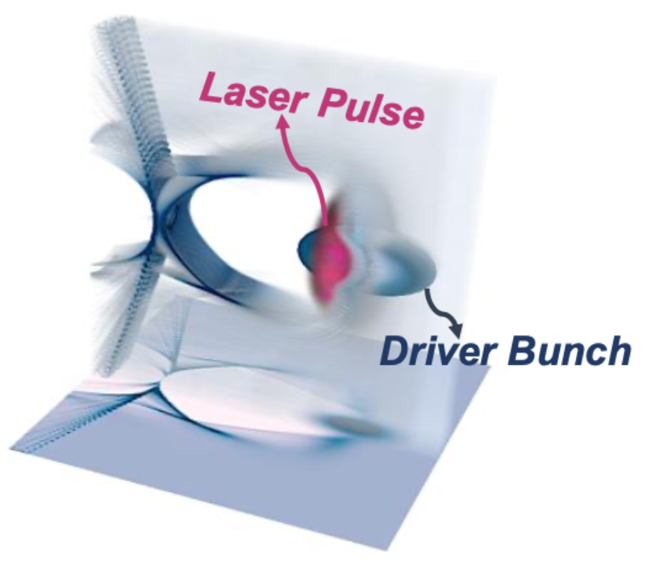
C.2. Electron Acceleration Techniques Driven by the Combination of Electron Beam and LWIR Laser
New acceleration mechanisms that use a laser and an electron beam to accelerate electrons at higher gradients than conventional accelerators:
Dielectric Laser Acceleration (DLA1): compact accelerator for charged particles based on micron scale photonic structures driven with laser light
Direct Laser Acceleration (DLA2): a process where electrons inside an ion column gain energy from a co-propagating laser pulse.
This method is proposed as a way to replenish the energy of an electron beam driving a plasma wakefield in a synergistic Electron-bunch/Laser-pulse Wakefield Acceleration (ELWA). i.e. Driver Beam (DB) electrons can gain energy from the laser at a rate that is the same or higher than the rate they lose energy to the wakefield.
Notes:
Development of these methods may in turn give rise to fundamentally new technological approaches with potentially transformative ramifications.

Slide 41
C.2. Electron Acceleration Techniques Driven by the Combination of Electron Beam and LWIR Laser
Research Thrusts:
Dielectric laser acceleration (DLA1):
Proof of principle demonstration of GeV/m acceleration in specialized structures
Key demonstrations to study beam dynamics, wakefield effects, and acceleration over centimeter-scale distances with multi-MeV energy gains.
Direct laser acceleration (DLA2): Demonstration of the synergistic increase of acceleration length under the combined effect of the ATF electron beam and LWIR laser:
In single-bunch, high charge configuration, the electron beam will extend the propagation length of laser in plasma.
In two-bunch configuration, the trailing electron beam will experience higher energy gain due to the synergistic increase in acceleration length.
Notes:
Development of these methods may in turn give rise to fundamentally new technological approaches with potentially transformative ramifications.

Slide 42
C.2. Electron Acceleration Techniques Driven by the Combination of Electron Beam and LWIR Laser
Experiment | LWIR Laser | e-beam
PRD C.1 e- injection into LWFA in blowout | 20 TW, 0.5 ps: Bubble regime | $σ_{r},σ_{z}≪R_{b}\sim 100 μm$, $γ>$200: 100 MeV beam injection $σ_{r}≫λ_{p}$: ultrafast electron radiography
PRD C.1 e+ beam generation | 0.5-5 TW, ~2 ps, spot size w₀~50-100 µm | >60 MeV, $ΔE/E$ <1%, $σ_{r}$<50 µm, Q>250 pC, $ε_{n}$<10 µm, bunch length $σ_{z}/c$<0.2 ps
PRD C.2 Dielectric Laser Acceleration | 20 mJ, 2 ps, 10 Hz rep rate | 50 MeV, $Q\sim$1 pC, $ε_{n}\sim 20 nm$, $σ_{r}\sim 5 μ$m
PRD C.2 Direct Laser Acceleration | 20 TW, 0.5 ps: Bubble regime | $σ_{z}/c\sim$0.5 ps, $Q\sim 1$nC: Drive beam $σ_{z}/c\sim 30$ fs, $Q\sim 10$pC: Trailing beam
PRD C.3 Inverse Compton Scattering | $a_{0}=1.5,$ Circular polarization: nonlinear ICS $a_{0}=2$, linear polarization: harmonic radiation $a_{0}=10$, any polarization: higher order multiphoton Thomson scattering | 50-75 MeV, $ε_{n}\sim 1 μm, σ_{r}\sim 10−30 μ$m, $Q\sim 300−500p$C, rep rate 3Hz
Notes:
Development of these methods may in turn give rise to fundamentally new technological approaches with potentially transformative ramifications.

Slide 43
C.3. Radiation Generation
Generating short, intense x-rays is one of the primary applications of particle accelerators
This requires the transverse oscillation of electrons, which here is provided by an intense LWIR laser pulse. This coupling can occur either in vacuum (Inverse Compton Scattering, ICS) or in the presence of a plasma wave (Direct Laser Acceleration, DLA2).
ATF Advantages (ICS):
LWIR laser at ATF enables the study of ICS in unique regimes: nonlinear/narrowband ICS sources with high photon flux, which enables studies such as nuclear resonance experiments for eventual gamma-ray applications in the emergent nuclear photonics community
A dedicated, tunable, high quality electron beam source such as the one provided by ATF is another great advantage because it increases the flexibility of the experimental parameter space, which allows for the exploration of novel methods such as polarized x-ray generation
The presence of two high power laser sources at different wavelengths at ATF (1μm and 10μm), allows for novel hybrid schemes to investigate bi-harmonic energy production and modulation of ICS x-ray pulses at the sub-femtosecond scale.
Generating an x-ray bunch-train from the recirculation of the laser and multiple interaction with the electron beam: a unique capability enabled by ATF’s independent control over laser and electron beam source, which enables control over the bandwidth of the radiation.
ATF Advantages (DLA):
Electrons have a larger transverse momentum and a higher radius of oscillation compared to oscillating in a small bubble generated by NIR laser. This is expected to significantly increase the gamma-ray yield of electrons in the plasma.
Off- axis external injection enables whole beam betatron oscillations of the bunch, and the eventual demonstration of an ion channel laser.

Slide 44
C.3. Radiation Generation
Research Thrusts:
Developing ICS sources in novel regimes
Developing high flux ICS spectral radiation on a single shot basis
Bi-harmonic (dual wavelength mixing) ICS Experiment, using the NIR lasers (Nd:YAG/Ti:S lasers) in conjunction with the multi-TW CO2 laser
Linear ICS Source <100 keV for certain medical applications and hard x-ray optics development
The combination of an ICS source driven by an inverse free-electron laser accelerator enables an all-optical system for high average flux photons.
Investigating the radiation generated from LWFA
Injecting the electron beam longitudinally in the SM-LWFA and investigating the resulting radiation
Characterizing the betatron radiation from an injected electron in an LWFA driven in the blowout regime
Exploring novel radiation mechanisms such as ion channel laser.

Slide 45
C.3. Radiation Generation
Experiment | LWIR Laser | e-beam
PRD C.1 e- injection into LWFA in blowout | 20 TW, 0.5 ps: Bubble regime | $σ_{r},σ_{z}≪R_{b}\sim 100 μm$, $γ>$200: 100 MeV beam injection $σ_{r}≫λ_{p}$: ultrafast electron radiography
PRD C.1 e+ beam generation | 0.5-5 TW, ~2 ps, spot size w₀~50-100 µm | >60 MeV, $ΔE/E$ <1%, $σ_{r}$<50 µm, Q>250 pC, $ε_{n}$<10 µm, bunch length $σ_{z}/c$<0.2 ps
PRD C.2 Dielectric Laser Acceleration | 20 mJ, 2 ps, 10 Hz rep rate | 50 MeV, $Q\sim$1 pC, $ε_{n}\sim 20 nm$, $σ_{r}\sim 5 μ$m
PRD C.2 Direct Laser Acceleration | 20 TW, 0.5 ps: Bubble regime | $σ_{z}/c\sim$0.5 ps, $Q\sim 1$nC: Drive beam $σ_{z}/c\sim 30$ fs, $Q\sim 10$pC: Trailing beam
PRD C.3 Inverse Compton Scattering | $a_{0}=1.5,$ Circular polarization: nonlinear ICS $a_{0}=2$, linear polarization: harmonic radiation $a_{0}=10$, any polarization: higher order multiphoton Thomson scattering | 50-75 MeV, $ε_{n}\sim 1 μm, σ_{r}\sim 10−30 μ$m, $Q\sim 300−500p$C, rep rate 3Hz

Slide 46
C.3 Radiation Generation
Diagnostics:
General area detectors, including KBr, MCPs, x-ray CCDs, and CsI scintillators with CCD
Flux measurements with CdTe of Si based photodetectors
Crystal Si or CdTe (optional channeling) average flux energy spectrometer.
Single Shot Double differential diagnostic, Curved bent multi layer or Si & Quartz spectrometer
Potential gamma-ray detection: liquid scintillator detector in combination with single photon count PMT, and Compton magnet spectrometer

Slide 47
Research Area C Facility Needs
Experiment | LWIR Laser | e-beam
PRD C.1 e- injection into LWFA in blowout | 20 TW, 0.5 ps: Bubble regime | $σ_{r},σ_{z}≪R_{b}\sim 100 μm$, $γ>$200: 100 MeV beam injection $σ_{r}≫λ_{p}$: ultrafast electron radiography
PRD C.1 e+ beam generation | 0.5-5 TW, ~2 ps, spot size w₀~50-100 µm | >60 MeV, $ΔE/E$ <1%, $σ_{r}$<50 µm, Q>250 pC, $ε_{n}$<10 µm, bunch length $σ_{z}/c$<0.2 ps
PRD C.2 Dielectric Laser Acceleration | 20 mJ, 2 ps, 10 Hz rep rate | 50 MeV, $Q\sim$1 pC, $ε_{n}\sim 20 nm$, $σ_{r}\sim 5 μ$m
PRD C.2 Direct Laser Acceleration | 20 TW, 0.5 ps: Bubble regime | $σ_{z}/c\sim$0.5 ps, $Q\sim 1$nC: Drive beam $σ_{z}/c\sim 30$ fs, $Q\sim 10$pC: Trailing beam
PRD C.3 Inverse Compton Scattering | $a_{0}=1.5,$ Circular polarization: nonlinear ICS $a_{0}=2$, linear polarization: harmonic radiation $a_{0}=10$, any polarization: higher order multiphoton Thomson scattering | 50-75 MeV, $ε_{n}\sim 1 μm, σ_{r}\sim 10−30 μ$m, $Q\sim 300−500p$C, rep rate 3Hz

Slide 48
Research Area C Facility Needs
Alignment and Synchronization Requirements
Implementation of computer-based optimization technologies and accompanying high repetition rate are needed for achieving and maintaining high precision alignment and synchronization between the beams
Expanded Diagnostic Capabilities
The ultrafast electron radiography to profile internal electric fields of plasma wakes using transverse fs e-bunches
To characterize plasma accelerated high quality e-beams requires full e-trajectory recovery within a magnetic spectrometer’s energy-dispersion plane, e-beam polarimeters based on Møller e-e scattering from polarized ferromagnetic targets, and CTR-based 6D profiling of e- bunches.
Radiation detectors, including KBr, MCPs, x-ray CCDs, and CsI scintillators with CCD, flux measurements, Crystal Si or CdTe average flux energy spectrometer, Single Shot Double differential diagnostic, Curved bent multi layer or Si & Quartz spectrometer, liquid scintillator detector in combination with single photon count PMT, and Compton magnet spectrometer
Expanded Computational Capabilities
Availability of user-friendly simulation codes for modelling short/long-term plasma dynamics, radiation production, and machine-learning tools for beam diagnostics and steering will be a great asset for users

Slide 49
Conclusions
The report for the ATF Science Planning Workshop, which was conducted on October 15-17 2019, attempts to meet the following goals:
Determine the priority research directions that can be leveraged to establish a priority based upgrade path.
Determine or reaffirm (from 2017 report) the set of parameters that will support the currently planned program and enable the exploration of new Physics
The report has been organized around a set of Priority Research Directions (PRDs) corresponding to three research areas:
Long-Wave Infrared (LWIR) Driven Science.
Electron-Beam-Driven Science
Laser Electron Beam Interactions
Experiments within each PRD led to the creation of a set of facility requirement that will be needed to enable each PRD
Together, the topics represent a significant and robust collection of cutting-edge accelerator and technology research. We believe that the urgent completion of this future research is crucial to support continued progress on our national and international advanced accelerator thrusts.

Slide 50
Summary of the Research Area Facility Needs

Slide 51
Research Area A Facility Needs
Experiment | LWIR Laser | e-beam
PRD A.1: Ion Acceleration | 10 TW: ~ 10 MeV ions 25 TW: ~ 100 MeV ions Circ. Pol. For advanced methods (RPA, etc)
PRD A.2 e- Acceleration | 10 TW, 1ps: Blowout regime 20 TW, 0.5 ps: Bubble regime Integrated intense NIR: two color injection
PRD A.3 Weibel | 1 TW, ~3 ps, circ. Pol.
Expanded Diagnostic Capabilities
Plasma Diagnostics (interferometry, shadowgraphy,etc)
Prepulse contrast diagnostics better than 4 orders of magnitude
Ultrafast electron radiography (See research area C for more discussion)
Accurate synchronization and alignment diagnostics for multiple beams (See research area C for more discussion)

Slide 52
Research Area B Facility Needs
Experiment | LWIR Laser | e-beam
PRD B.1 Dielectric Wakefield Acceleration (DWA) |  | $ε_{n}∼ 1−2 μm$, $Q>300$ pC, $σ_{z}<200 μm, σ_{r}<50 μm$ r.m.s
PRD B.1 Two Beam Acceleration (TBA) |  | $Q\sim 1$nC, $σ_{z}, σ_{r}<2 mm$, total peak power> 60 MW
PRD B.2 Structure-based phase space manipulation |  | $ε_{n}∼ 1−2 μm$.
PRD B.2 fs beam manipulation | TEM_10 mode
PRD B.4 THZ Generation |  | $ε_{n}≤2 μm$, $Q>400$pC, $σ_{z}<120 μm$, 6.4 cm period undulator: 1.5 mJ THz pulse
Required Diagnostic Capabilities
Beam characterization: Transverse deflective cavity (T- CAV), 2 THz interferometry from coherent transition radiation (CTR), coherent diffraction/edge/Cerenkov radiation (CDR/CER/CCR)

Slide 53
Research Area C Facility Needs
Experiment | LWIR Laser | e-beam
PRD C.1 e- injection into LWFA in blowout | 20 TW, 0.5 ps: Bubble regime | $σ_{r},σ_{z}≪R_{b}\sim 100 μm$, $γ>$200: 100 MeV beam injection $σ_{r}≫λ_{p}$: ultrafast electron radiography
PRD C.1 e+ beam generation | 0.5-5 TW, ~2 ps, spot size w₀~50-100 µm | >60 MeV, $ΔE/E$ <1%, $σ_{r}$<50 µm, Q>250 pC, $ε_{n}$<10 µm, bunch length $σ_{z}/c$<0.2 ps
PRD C.2 Dielectric Laser Acceleration | 20 mJ, 2 ps, 10 Hz rep rate | 50 MeV, $Q\sim$1 pC, $ε_{n}\sim 20 nm$, $σ_{r}\sim 5 μ$m
PRD C.2 Direct Laser Acceleration | 20 TW, 0.5 ps: Bubble regime | $σ_{z}/c\sim$0.5 ps, $Q\sim 1$nC: Drive beam $σ_{z}/c\sim 30$ fs, $Q\sim 10$pC: Trailing beam
PRD C.3 Inverse Compton Scattering | $a_{0}=1.5,$ Circular polarization: nonlinear ICS $a_{0}=2$, linear polarization: harmonic radiation $a_{0}=10$, any polarization: higher order multiphoton Thomson scattering | 50-75 MeV, $ε_{n}\sim 1 μm, σ_{r}\sim 10−30 μ$m, $Q\sim 300−500p$C, rep rate 3Hz

Slide 54
Research Area C Facility Needs
Alignment and Synchronization Requirements
Implementation of computer-based optimization technologies and accompanying high repetition rate are needed for achieving and maintaining high precision alignment and synchronization between the beams
Expanded Diagnostic Capabilities
The ultrafast electron radiography to profile internal electric fields of plasma wakes using transverse fs e-bunches
To characterize plasma accelerated high quality e-beams requires full e-trajectory recovery within a magnetic spectrometer’s energy-dispersion plane, e-beam polarimeters based on Møller e-e scattering from polarized ferromagnetic targets, and CTR-based 6D profiling of e- bunches.
Radiation detectors, including KBr, MCPs, x-ray CCDs, and CsI scintillators with CCD, flux measurements, Crystal Si or CdTe average flux energy spectrometer, Single Shot Double differential diagnostic, Curved bent multi layer or Si & Quartz spectrometer, liquid scintillator detector in combination with single photon count PMT, and Compton magnet spectrometer
Expanded Computational Capabilities
Availability of user-friendly simulation codes for modelling short/long-term plasma dynamics, radiation production, and machine-learning tools for beam diagnostics and steering will be a great asset for users

Slide 55
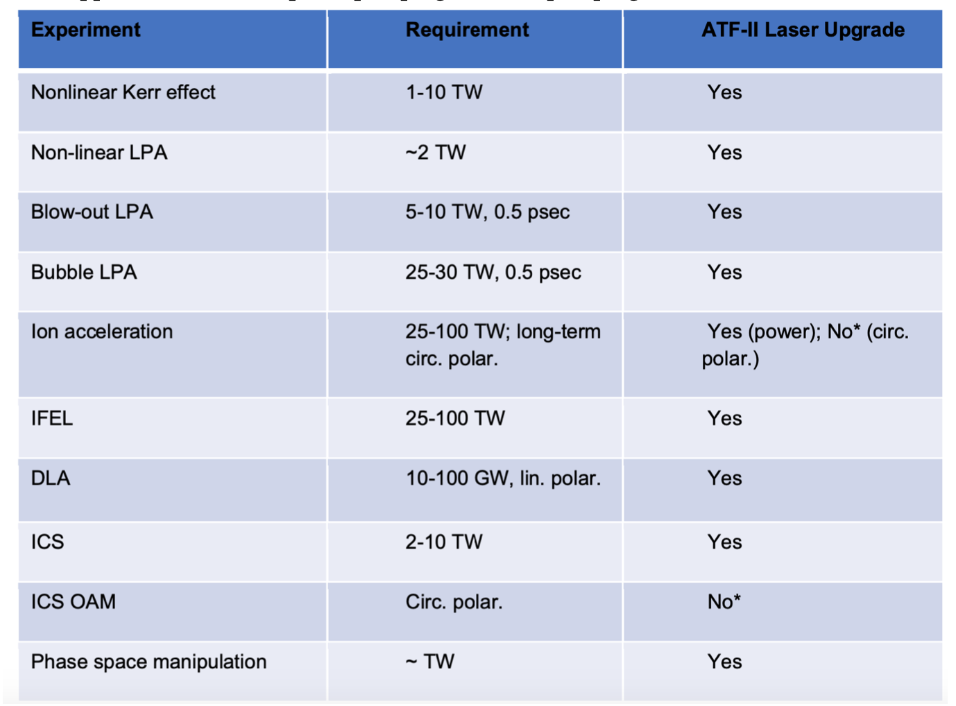
Overview of experimental requirements by topical area, reproduced from the “report of the accelerator test facility scientific needs workshop 2017”. Page 48

