Slide 1
ATF Electron Beam and UED plans
Mikhail Fedurin
ATF User meeting
December 7 – 11, 2020

Slide 2
Outline
ATF main beam parameters
ATF beam diagnostic and manipulation capabilities
FY20 e-beam improvements and plans
Electron beam upgrade perspectives
UED facility improvements
UED plans

Slide 3
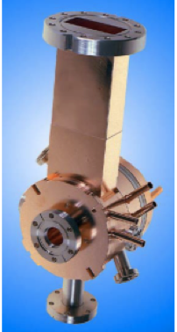
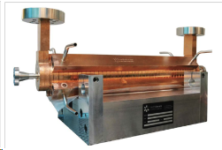
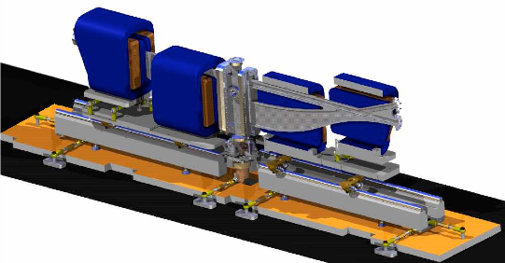
ATF linac main beam parameters
Parameter | Typical value / range | Best value
Energy | 50-65 MeV | 75 MeV
Charge | 0.1 – 2 nC | 2.5 nC
Repetition rate | 1.5 Hz | 3 Hz
Electron spot size on cathode | 2.86 mm | 0.2 – 4 mm
Bunch length | 1-8 ps | 100 fs with compression
Average bunch current | 100 A | 1.2 kA with compression
Emittance | 1 – 3 mm mrad | 0.8 mm mrad @ 0.5 nC

Slide 4
Facility Overview (Bldg. 820)
CO₂ Laser Area
Beamline 1:
Experimental stations:
1) Inverse Compton,
2) LWFA with gas jet cell,
3) IGS (big in vacuum space)
Differential pumping (2 stages)
CO2/YAG & e-beam IP
Electron Accelerator Area
Beamline 2:
Experimental station with
plasma cell capillary
Insertion device section
Differential pumping (1 stage)
CO2 & e-beam IP
X-band Deflector cavity (TDC)

Slide 5
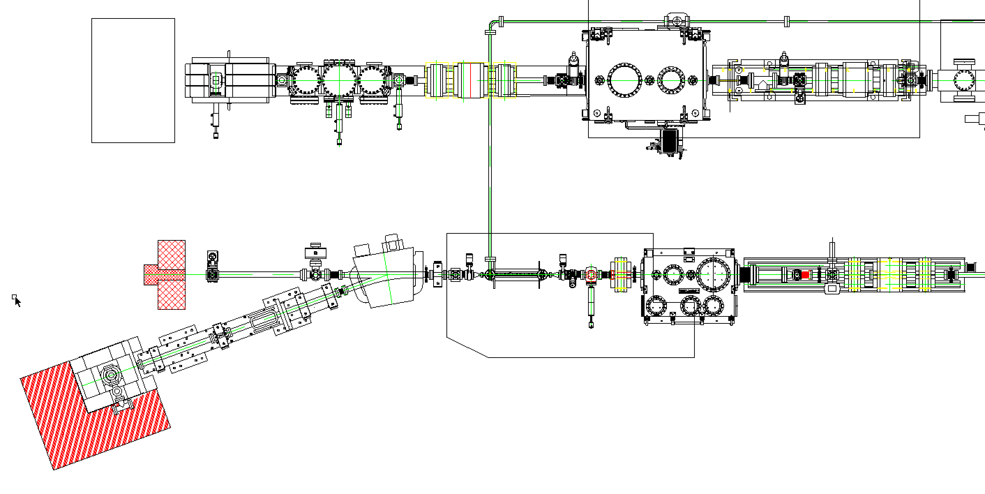
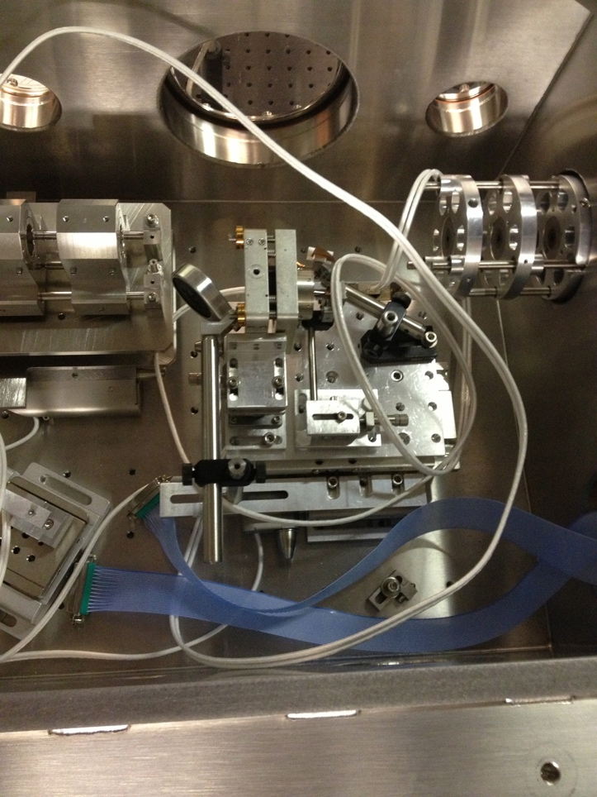
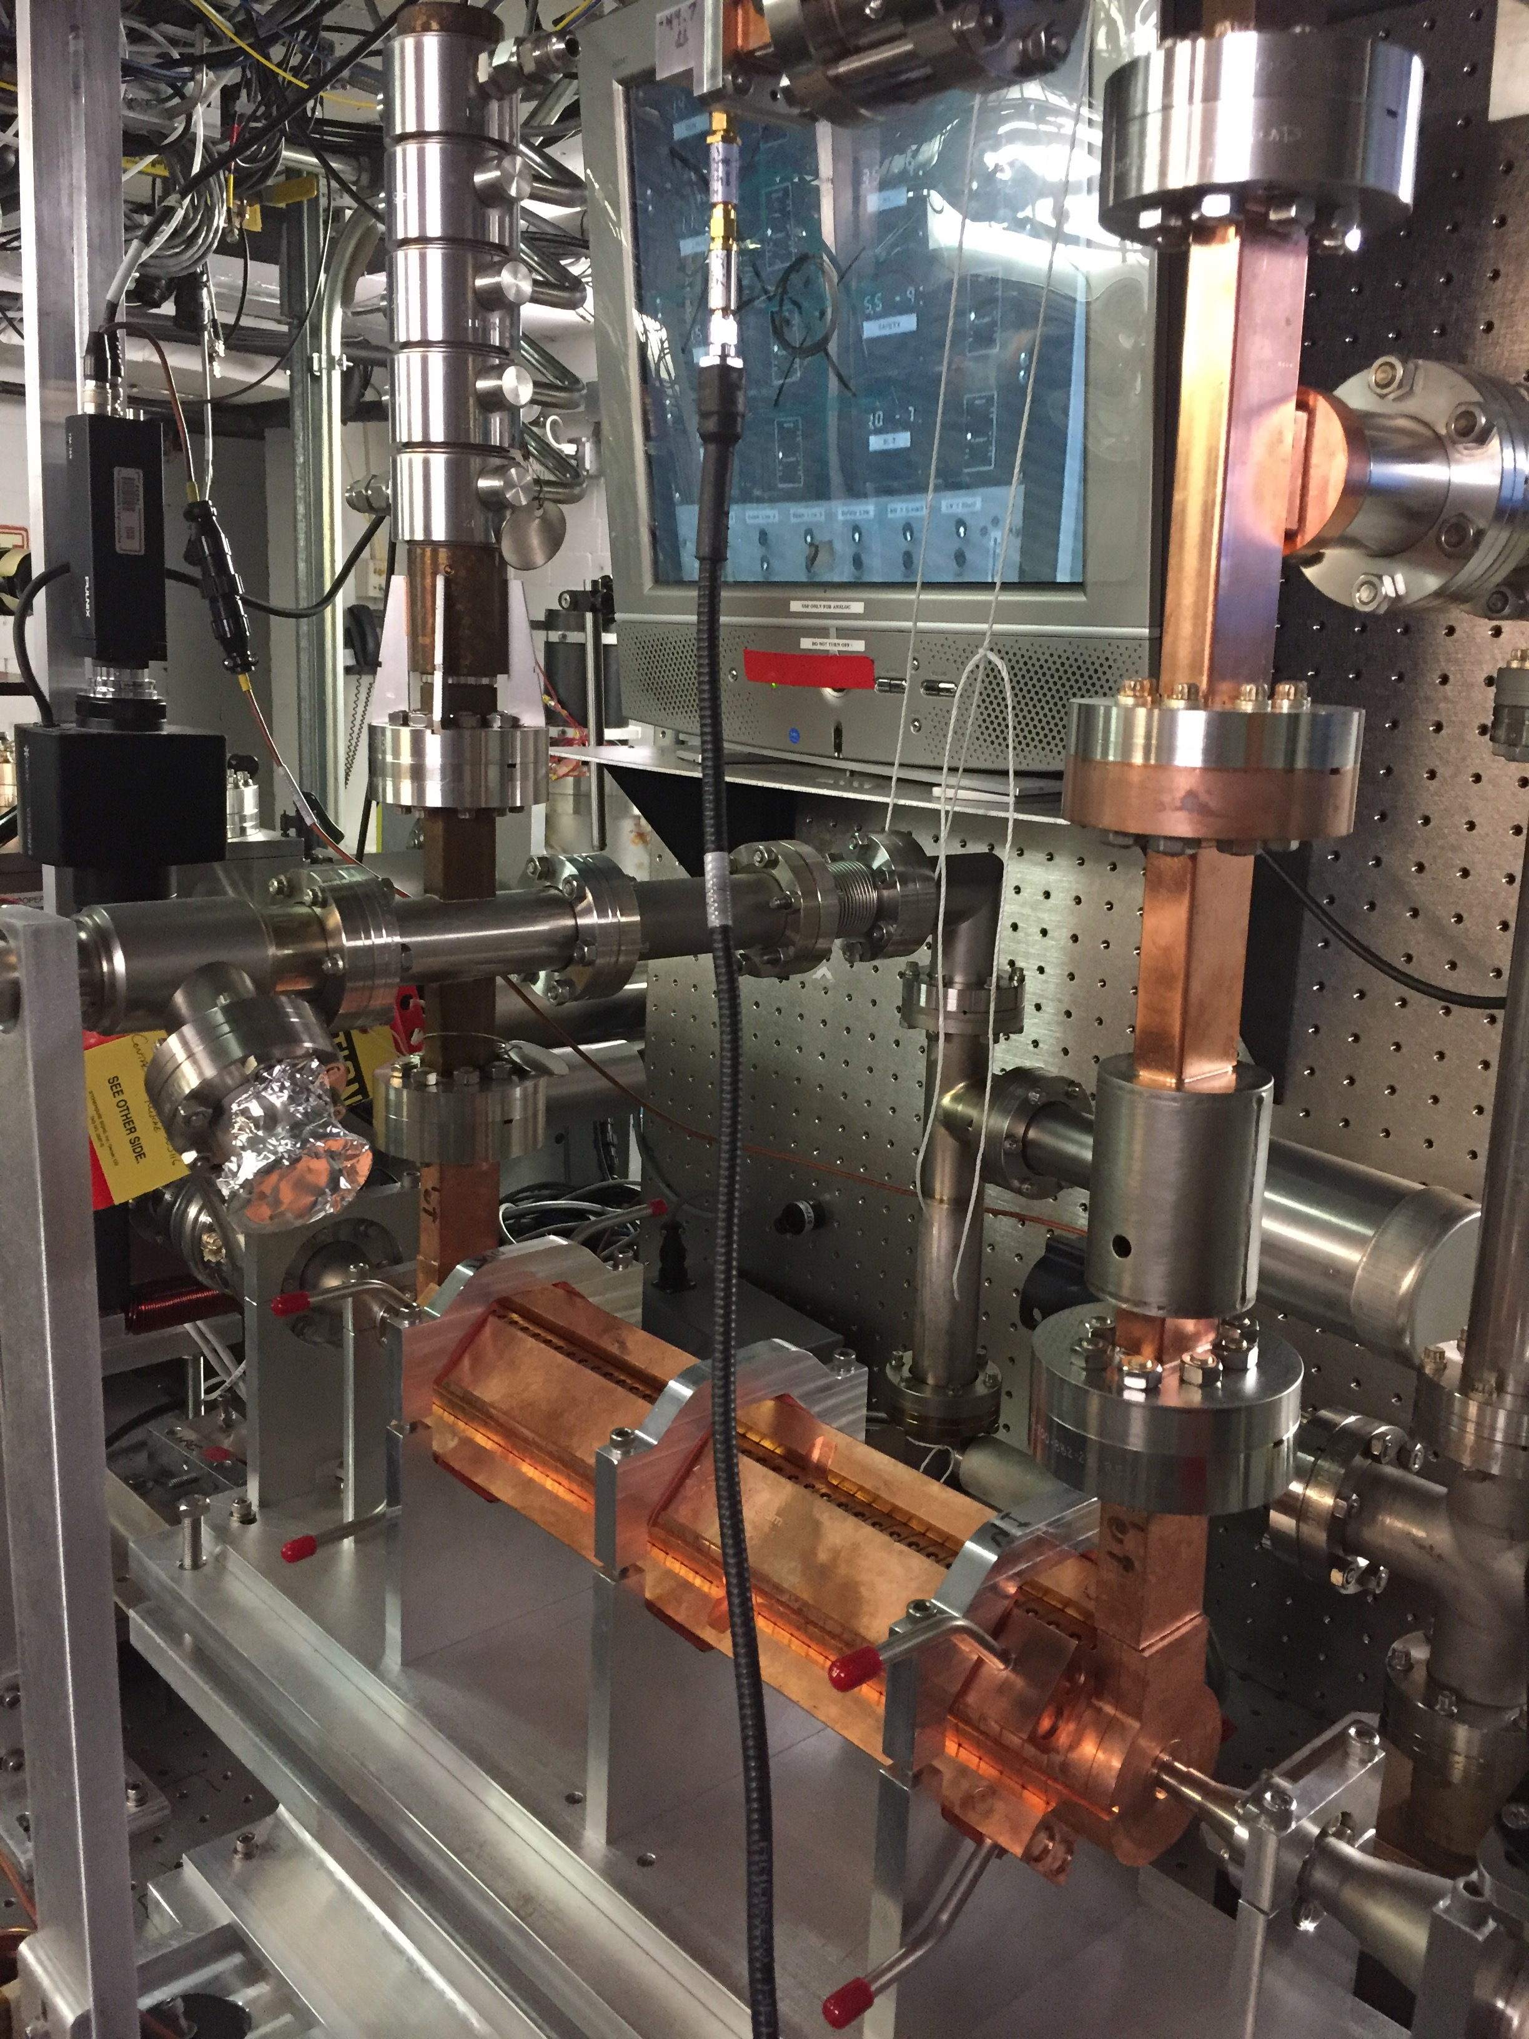
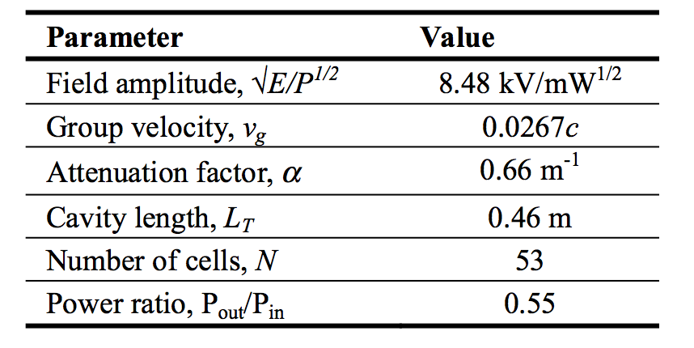
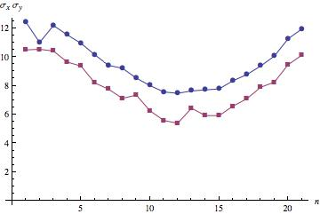
ATF beam diagnostics
  Beam profile measurements
  Bunch length measurements
PMQ triplet assemblies:
G=50 T/m, focal length ~20 cm
G=500 T/m, focal length ~8 cm
Microscope (25-0506 X15 Reflecting Objective NA 0.28, F~13 mm)
Basler Gigabit camera (scA 1400-17gm, F=135 mm).

Slide 6
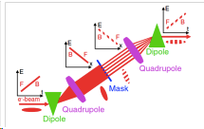
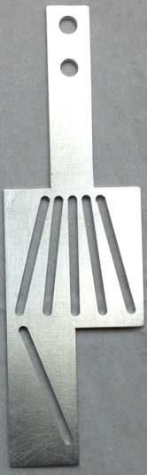
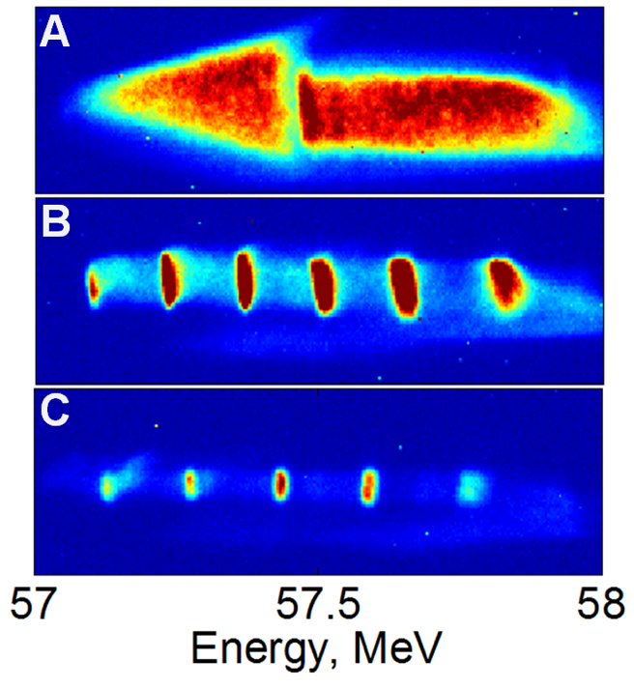
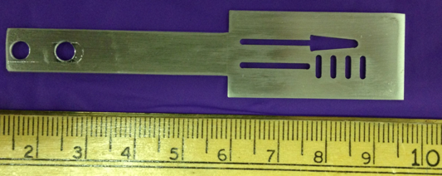
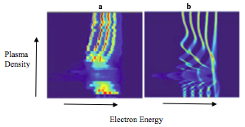
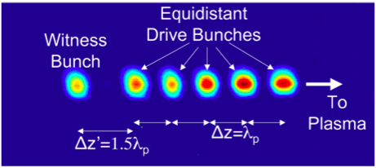
ATF beam manipulation and diagnostics
e-beam mask technique
Images on the screen
after deflector
Image at mask
e-beam spectrometer

Slide 7
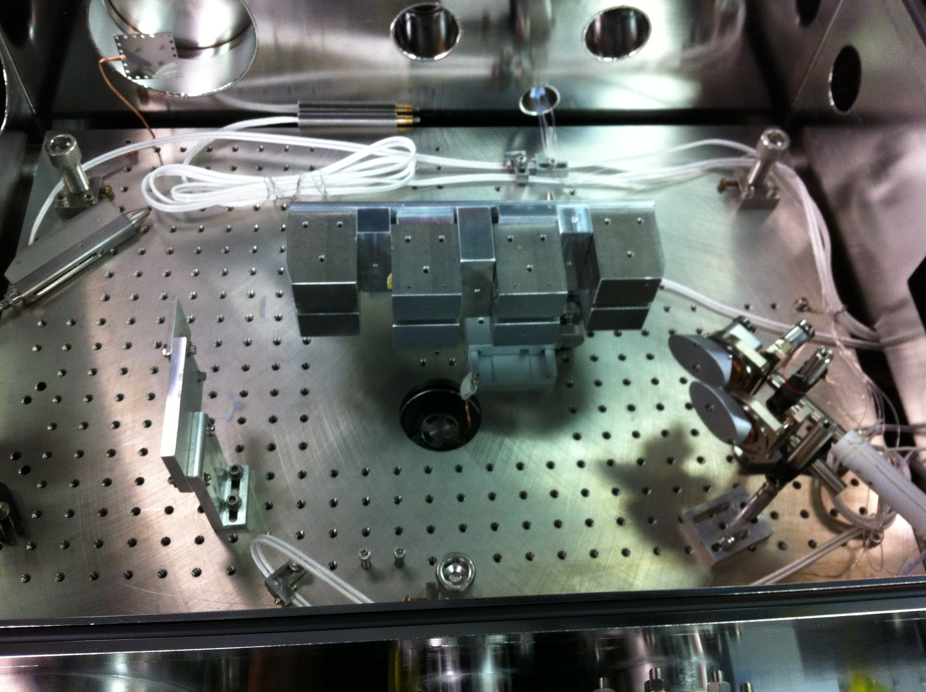
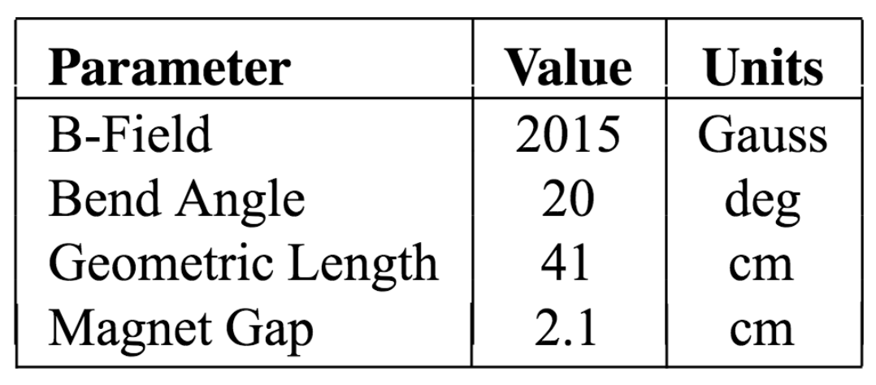
ATF beam manipulation capabilities
  Bunch compression
Permanent Magnet Chicane
Electromagnet chicane
~1 Tesla magnetic field
50 mm magnetic length

Slide 8
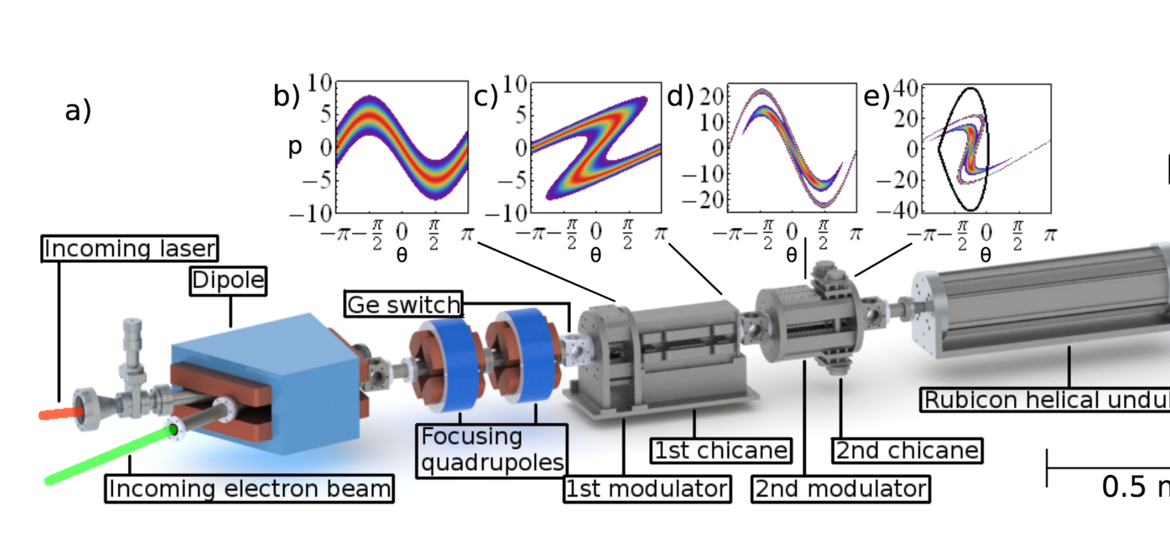
ATF beam manipulation capabilities
  10 um microbunching with CO2 laser
N. Sudar, P. Musumeci, I. Gadjev, et al., PRL 120, 114802 (2018)

Slide 9
FY20 e-beam improvements and plans
Replacement of ATF old gun klystron in January significantly improved beam stability
X-band klystron refurbish was arranged and may happen after FY21 (>1year repair due to present constraints)
Control system continues upgrade
Bunch compression design for LWFA experiments at beamline #1
ATF received funding from BNL for maintenance work (crane replacement, YAG room air handlers)

Slide 10
Electron beam bunch compression design
  e-beam compression with permanent magnet chicane (simulations by Yichao Jing)
FWHM bunch length < 20 fs is achievable for higher charge (100 pC in this case) with the combination of the zigzag chicane together with CSR shielding

Slide 11
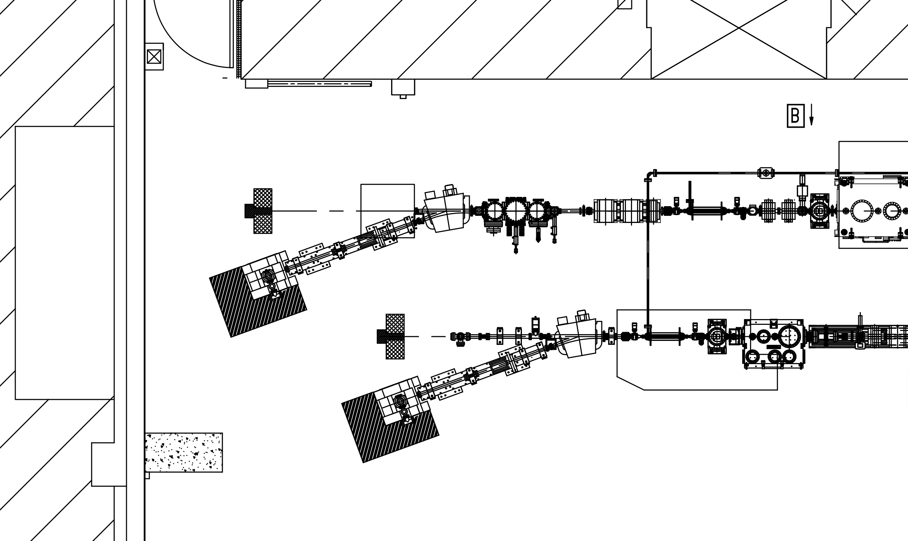
Electron beam upgrade perspectives
  Deflector cavity for BL1
TDC BL1
TDC BL2
Beamline #1 design with TDC diagnostics capabilities after completion of laser transport

Slide 12
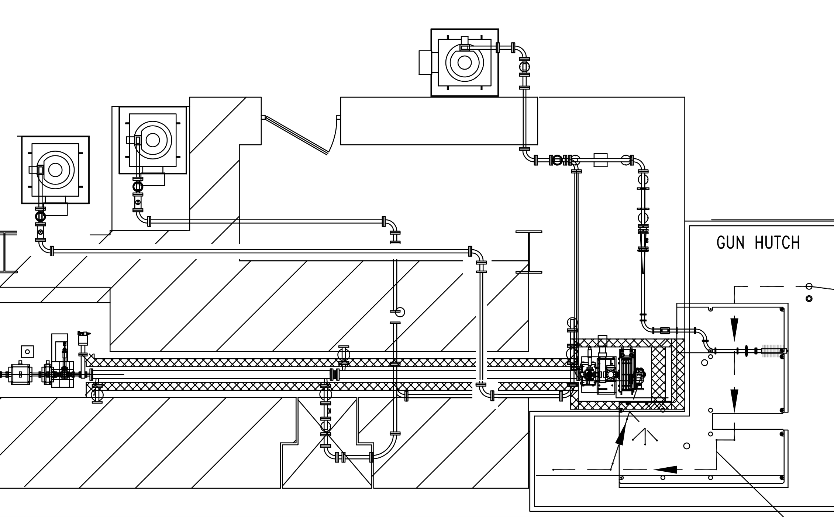
Electron beam upgrade perspectives
  Linac energy upgrade
Gun klystron
Linac
klystron #1
Plan to feed linac acceleration sections with separated klystrons to push maximum operational energy to 110-120 MeV
Linac klystron #2

Slide 13
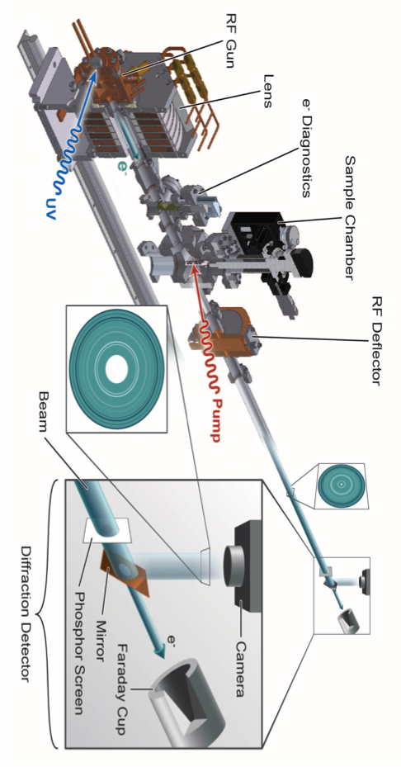
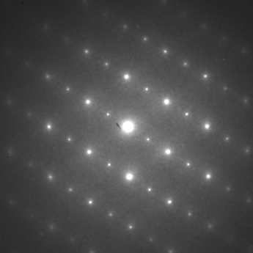
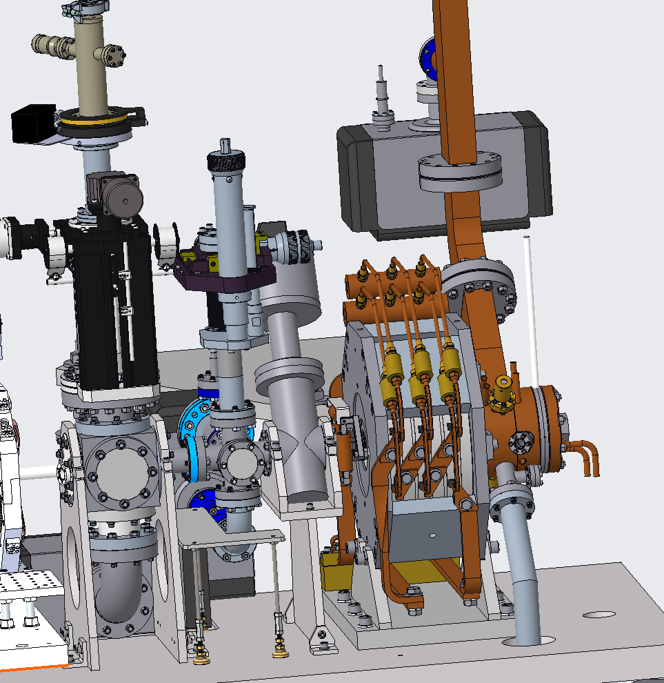
ATF UED main beam parameters
 | BNL | SLAC | MSU
Beam energy, MeV | 3 | 3.68 | 0.03
N e⁻ per pulse | 1.25 E+6 | 3.8E+5 | 500
Temporal resolution, fs | 180 | 102 | 300
Beam size diameter, μm | 300 (100 best) | 400 (10 best) | 20-40
Max repetition rate | 48 | 120 (180 best) | 1,000
N e⁻ per sec per μm² | 880 | 360 | 400
Advantage | short bright pulse | short bright pulse | DC (no jitter)

Slide 14
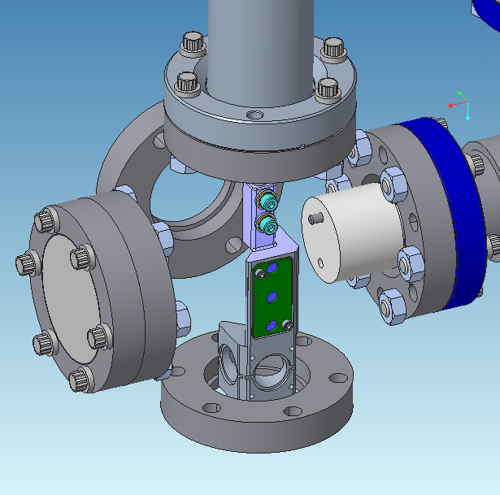
FY20 UED facility improvements
Repetition rate upgrade from 5Hz to 48Hz obviously speed up user scan rate and decrease systematic drifts influence
Stable performance during last summer
e-beam collimator was replaced with new design

Slide 15
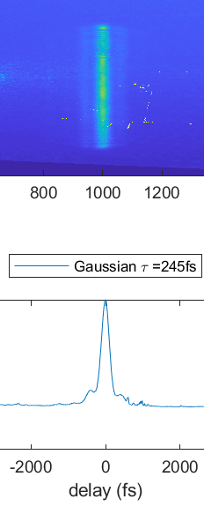
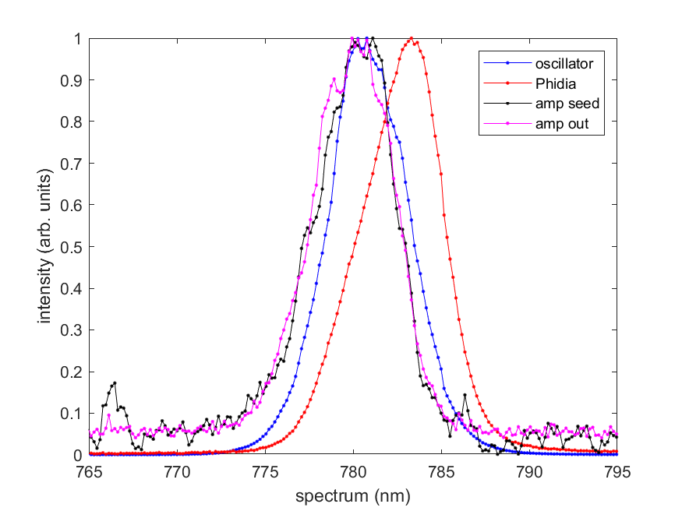
UED plans: Support Tunable Pump Wavelength
mid-IR pump-probe materials science requires an Optical Parametric Amplifier to access the full range of wavelengths
To reach the needed OPA output energy levels of ~100 μJ at λ=10-11 μm, a more energetic pump pulse from a new Ti:sapphire booster amplifier is needed
“Topas HE” OPA from SpectraPhysics installation starts next week

Slide 16
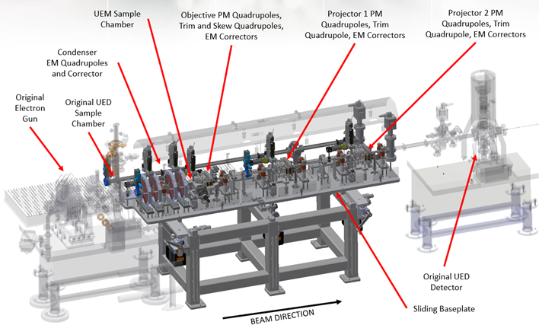
UED plans: Flexible UED-UEM translation table
Quick change design to switch between UEM and UED baseline drift tube configuration

Slide 17
UED plans: beam diagnostic beamline extension
Beamline extension for real-time beam diagnostic at the end of beamline will include spectrometer magnet for shot-to-shot energy fluctuations, Faraday cup for charge fluctuations

Slide 18
Thank you!

