Slide 1
LWIR Laser Plans
Misha Polyanskiy
2020-12-11

Slide 2
Outline
2021 Upgrades
Timing system upgrade
Vacuum compressor chamber and transport line
  Motivation for vacuum upgrade
  Configuration of the system after upgrade
  Commissioning plan
Ongoing R&D
Towards 25 TW, ≤0.5 ps
  Millijoule solid-state seed
  Post-compression
R&D for long perspective
  Optical pumping

Slide 3
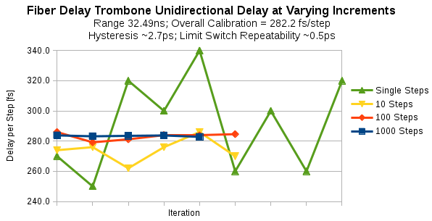
LWIR Optical Delay Line Overview
Goal: Provide user-friendly CO₂ system synchronization with e-beam
Approach: Multiplex critical signals in single long-range optical delay line
Current synchronization of CO₂ system involves step-wise, in phase adjustment of a number timing mechanisms:
  Clock/RF signals at 2856, 81.6, 40.8, 10.2 MHz
  Precision triggers at 240 Hz, 1.5 Hz, single-shot at few- to sub-ns resolution
  Optical path internal to CO₂ laser via roof reflector/trombone
Complex manual adjustment system requiring laser expertise
Convert various signals from RF/electrical domain to optical
Requires updates to facility timing architecture
  New model of optical clock distribution and synchronization of laser systems
Single software controlled, user-accessible delay for experiments
3

Slide 4
Why vacuum?
5 TW
Experimental
chamber
~ ~ ~ ~ ~ ~ ~ ~ ~ ~ ~ ~ ~ ~ ~ ~ ~ ~ ~ ~ ~ ~ ~ ~
~ ~ ~ ~ ~ ~ ~ ~ ~ ~ ~ ~ ~ ~ ~ ~ ~ ~ ~ ~ ~ ~ ~
~ ~ ~ ~ ~ ~ ~ ~ ~ ~ ~ ~ ~ ~ ~ ~ ~ ~ ~ ~ ~ ~ ~ ~
~ ~ ~ ~ ~ ~ ~ ~ ~ ~ ~ ~ ~ ~ ~ ~ ~ ~ ~ ~ ~ ~ ~
~ ~ ~ ~ ~ ~ ~ ~ ~ ~ ~ ~ ~ ~ ~ ~ ~ ~ ~ ~ ~ ~ ~ ~
~ ~ ~ ~ ~ ~ ~ ~ ~ ~ ~ ~ ~ ~ ~ ~ ~ ~ ~ ~ ~ ~ ~
~ ~ ~ ~ ~ ~ ~ ~ ~ ~ ~ ~ ~ ~ ~ ~ ~ ~ ~ ~ ~ ~ ~ ~
~ ~ ~ ~ ~ ~ ~ ~ ~ ~ ~ ~ ~ ~ ~ ~ ~ ~ ~ ~ ~ ~ ~
~ ~ ~ ~ ~ ~ ~ ~ ~ ~ ~ ~ ~ ~ ~ ~ ~ ~ ~ ~ ~ ~ ~ ~
~ ~ ~ ~ ~ ~ ~ ~ ~ ~ ~ ~ ~ ~ ~ ~ ~ ~ ~ ~ ~ ~ ~
~ ~ ~ ~ ~ ~ ~ ~ ~ ~ ~ ~ ~ ~ ~ ~ ~ ~ ~ ~ ~ ~ ~ ~
~ ~ ~ ~ ~ ~ ~ ~ ~ ~ ~ ~ ~ ~ ~ ~ ~ ~ ~ ~ ~ ~ ~ ~ ~ ~ ~ ~ ~ ~ ~ ~ ~ ~ ~ ~ ~ ~ ~ ~ ~ ~ ~ ~ ~ ~ ~
~ ~ ~ ~ ~ ~ ~ ~ ~ ~ ~ ~ ~ ~ ~ ~ ~ ~ ~ ~ ~ ~ ~
Compressor
14 J, 2 ps
Vacuum
NaCl
Air
20 J
70 ps
10 mJ
70 ps
Regenerative
CO₂ amplifier
[2 μJ]
[140 ps]
Ti:Sapphire
amplifier
Ge
Coupler
Shutter
Isolator
Nd:YAG
OPA
Osc
Final CO₂
amplifier
15 μJ
350 fs
Stretcher

Slide 5
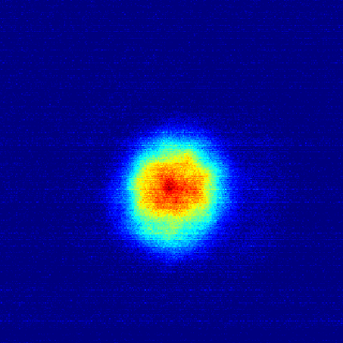
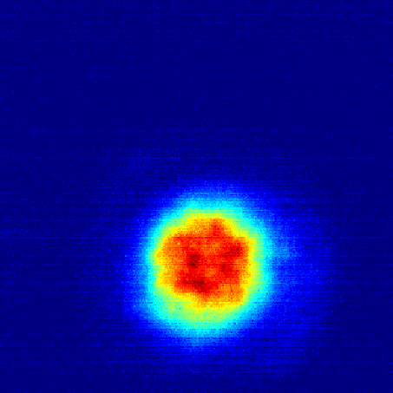
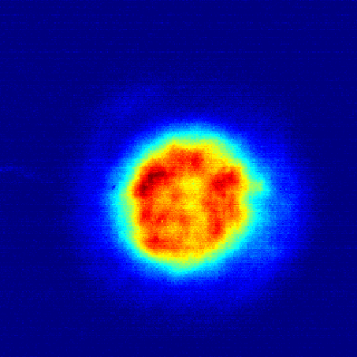
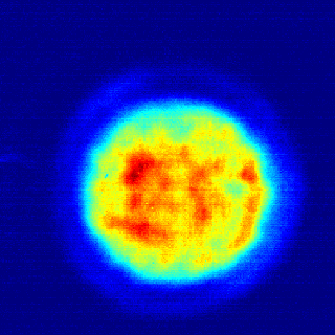
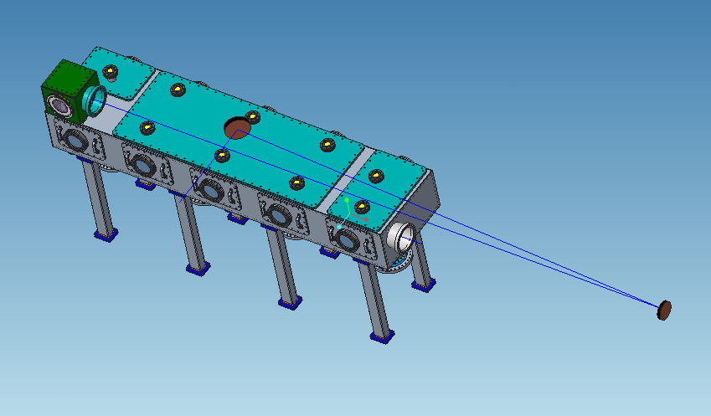
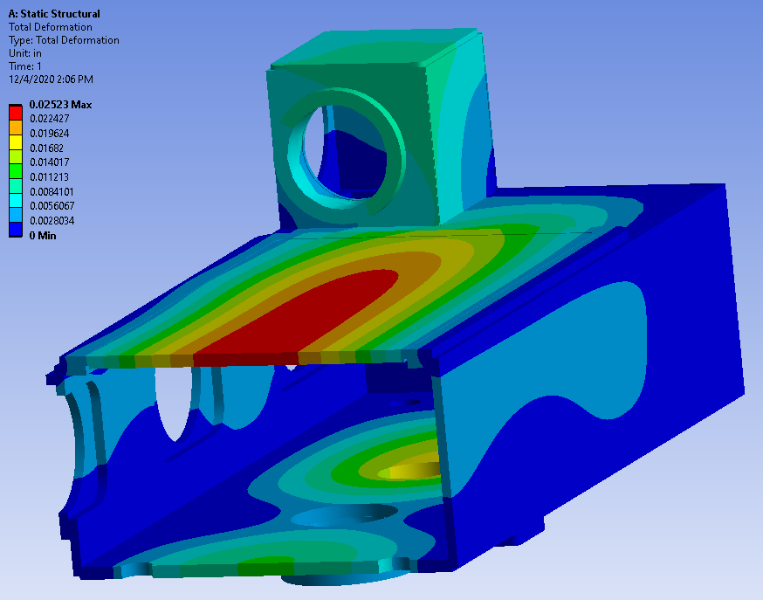
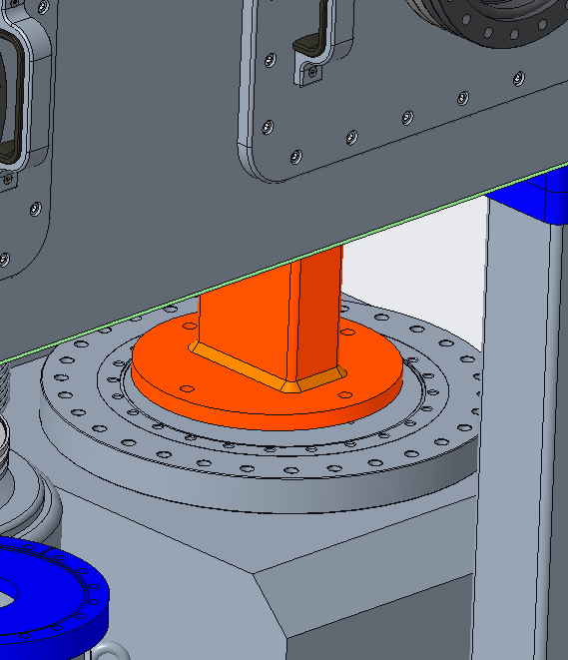
Vacuum transport
1.3 J
2.4 J
4.7 J
8.1 J
97.5 mm
≤ 1 J/cm² (design spec)
5 TW (2 ps): ≤ 0.4 TW/cm²
25 TW (100s fs) ≤ 2.0 TW/cm²
Standard requirement: B < 1
 | Air (12 m) | NaCl (40 mm) | Air + NaCl
n2 | 3.0e-19 cm²/W | 3.0e-16 cm²/W
B-integral @ 5 TW | 1.0 | 3.3 | 4.3
B-integral @ 25 TW | 4.9 | 16.4 | 20.3

Slide 6
Vacuum transport
Experimental
chamber
Compressor
~ ~ ~ ~ ~ ~ ~ ~ ~ ~ ~ ~ ~ ~ ~ ~ ~ ~ ~ ~ ~ ~ ~ ~
~ ~ ~ ~ ~ ~ ~ ~ ~ ~ ~ ~ ~ ~ ~ ~ ~ ~ ~ ~ ~ ~ ~
~ ~ ~ ~ ~ ~ ~ ~ ~ ~ ~ ~ ~ ~ ~ ~ ~ ~ ~ ~ ~ ~ ~ ~
~ ~ ~ ~ ~ ~ ~ ~ ~ ~ ~ ~ ~ ~ ~ ~ ~ ~ ~ ~ ~ ~ ~
~ ~ ~ ~ ~ ~ ~ ~ ~ ~ ~ ~ ~ ~ ~ ~ ~ ~ ~ ~ ~ ~ ~ ~
~ ~ ~ ~ ~ ~ ~ ~ ~ ~ ~ ~ ~ ~ ~ ~ ~ ~ ~ ~ ~ ~ ~
~ ~ ~ ~ ~ ~ ~ ~ ~ ~ ~ ~ ~ ~ ~ ~ ~ ~ ~ ~ ~ ~ ~ ~
~ ~ ~ ~ ~ ~ ~ ~ ~ ~ ~ ~ ~ ~ ~ ~ ~ ~ ~ ~ ~ ~ ~
~ ~ ~ ~ ~ ~ ~ ~ ~ ~ ~ ~ ~ ~ ~ ~ ~ ~ ~ ~ ~ ~ ~ ~
~ ~ ~ ~ ~ ~ ~ ~ ~ ~ ~ ~ ~ ~ ~ ~ ~ ~ ~ ~ ~ ~ ~
~ ~ ~ ~ ~ ~ ~ ~ ~ ~ ~ ~ ~ ~ ~ ~ ~ ~ ~ ~ ~ ~ ~ ~
~ ~ ~ ~ ~ ~ ~ ~ ~ ~ ~ ~ ~ ~ ~ ~ ~ ~ ~ ~ ~ ~ ~ ~ ~ ~ ~ ~ ~ ~ ~ ~ ~ ~ ~ ~ ~ ~ ~ ~ ~ ~ ~ ~ ~ ~ ~
~ ~ ~ ~ ~ ~ ~ ~ ~ ~ ~ ~ ~ ~ ~ ~ ~ ~ ~ ~ ~ ~ ~
2 ps
Vacuum
70 ps
NaCl
Air
Experimental
chamber
NaCl
Compressor
Vacuum
≤ 2 ps
Vacuum
≥ 70 ps
Compressed pulse: B ≈ 0 (vacuum)
Stretched pulse: B < 1
(by CPA design)

Slide 7
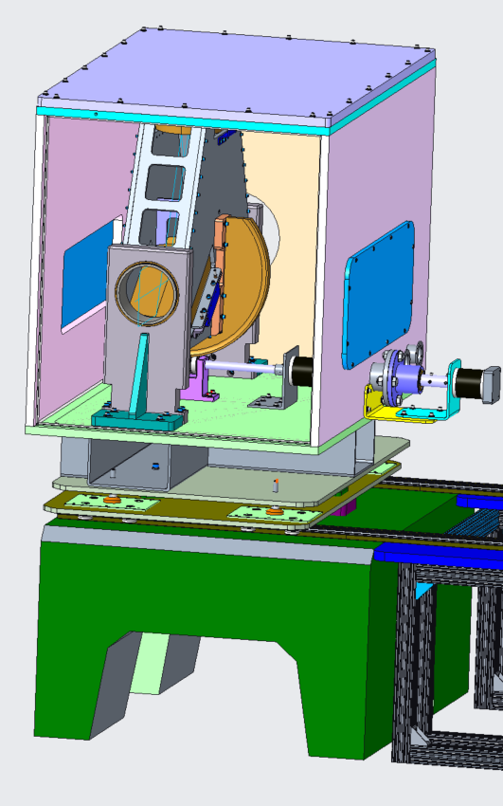
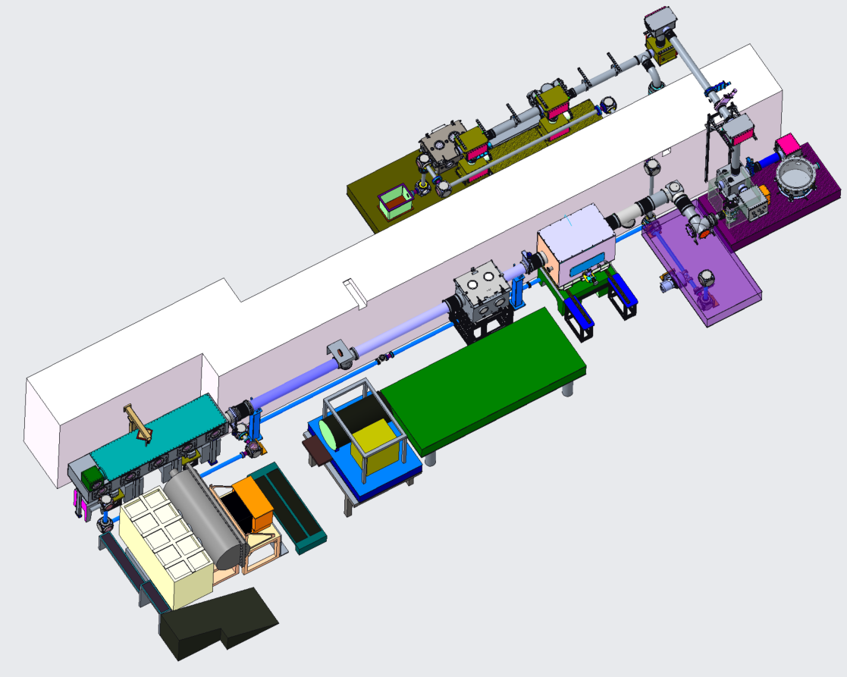
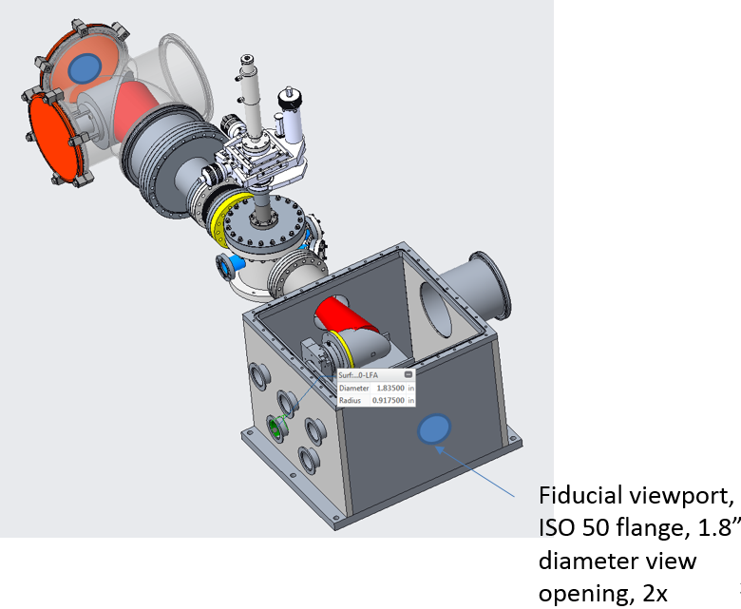
LWIR laser infrastructure after upgrade
Flexible polarization rotator (FPR)
Nonlinear pulse compressor
Test chamber
Experimental Hall
FEL Room
Compressor
Shielding wall
CO₂
Seed Laser Table
YAG
YAG
CO₂
plasma
Final amplifier
CO2 Room
Plasma shutter
7

Slide 8
Vacuum upgrade: Implementation plan
Now-Summer 2021:Preparations
  Long-lead and other procurements
  Continued evaluation of system components in view of handling higher pulse energy
Summer 2021: Installation
Fall 2021: Commissioning and Return to User Operations
  Initial demonstration of 2TW operation in vacuum
    Basic system optimization at presently available power levels
    Enables interleaved user operations at 2 TW while power upgrade is characterized during machine development time
  Gradual power increase: 2 TW a ~5 TW
    Characterization of component performance at each power level
    Detailed optimization and trouble-shooting
Late 2021: Delivery of higher power user operations

Slide 9
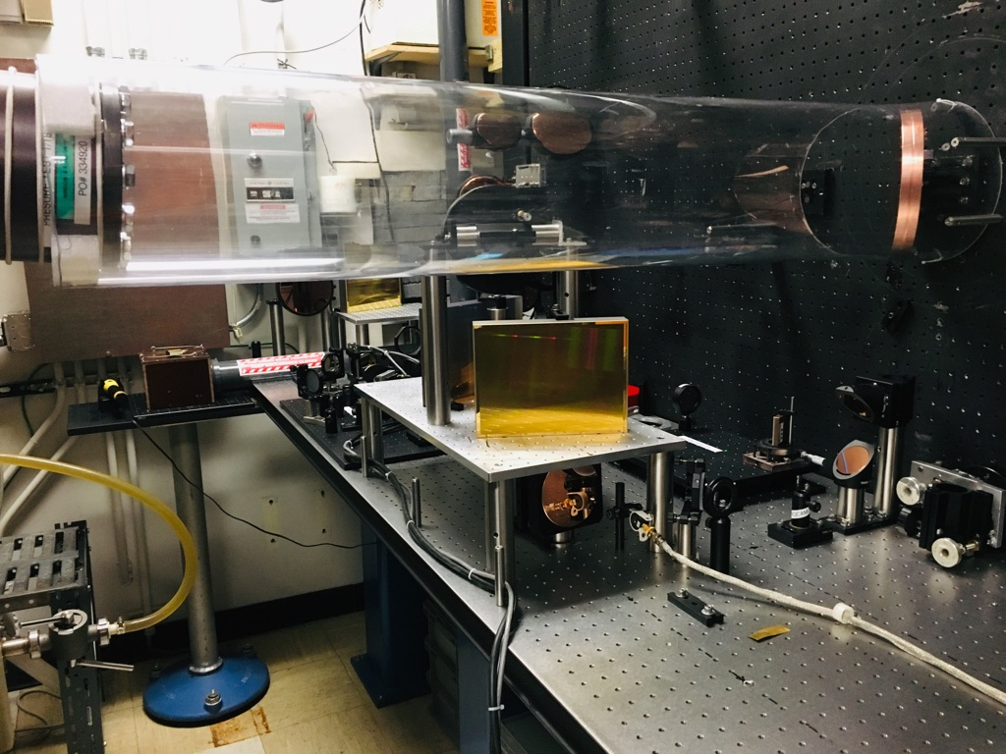
Compressor gratings
Damage test protocol 2018-11-28
Shot # | Sample | mV | mJ | ω (µm) | Ф₀ (J/cm²) | Damage size (pix) | Damage size (µm) | Damage threshold (J/cm²) | comments
Compressed pulse (~2 ps) @ 9.2 um
1 | Au on Cu replica 100/mm, 9 um Richardson | 63.6 | 3.63 | 140 | 11.79 | 255 | 234 | 2.91 | strong damage
2 |  | 21.2 | 0.82 | 140 | 2.67 | 56 | 51 | 2.49 | some darkening
3 |  | 13.2 | 0.47 | 140 | 1.51 |  |  |  | darkening hardly visible
4 | Au on Zerodur replica 100/mm, 9 um Richardson | 56.2 | 3.03 | 140 | 9.84 | 252 | 231 | 2.51
5 |  | 45.2 | 2.22 | 140 | 7.21 | 204 | 187 | 2.95
6 |  | 12.4 | 0.43 | 140 | 1.41 |  |  |  | no visible damage
7 |  | 33.8 | 1.49 | 140 | 4.85 | 156 | 143 | 2.88
8 | Inprintus test grating (bare Cu, low quality) | 54.0 | 2.86 | 140 | 9.28 | 274 | 252 | 1.85
9 |  | 29.2 | 1.23 | 140 | 4.00 | 203 | 186 | 1.65
10 |  | 6.6 | 0.21 | 140 | 0.70 |  |  |  | no visible damage
11 | Au on SS master 100/mm Bach | 60.0 | 3.33 | 140 | 10.82 | 240 | 220 | 3.14
12 |  | 14.6 | 0.52 | 140 | 1.70 |  |  |  | no visible damage
13 |  | 50.8 | 2.62 | 140 | 8.51 | 184 | 169 | 4.11
14 |  | 42.8 | 2.06 | 140 | 6.69 | 163 | 150 | 3.78
15 |  | 23.4 | 0.93 | 140 | 3.02 |  |  |  | hardly visible darkening
15
16 | Cu mirror lab grade, new SPAWR | 42.4 | 2.03 | 140 | 6.60 | 160 | 147 | 3.81
17 |  | 51.6 | 2.68 | 140 | 8.70 | 188 | 173 | 4.07
18 |  | 55.8 | 3.00 | 140 | 9.73 | 195 | 179 | 4.30
19 |  | 24.2 | 0.97 | 140 | 3.15 |  |  |  | no visible damage
Compressor gratings (4x)
Manufacturer | Richardson Gratings (Newport)
Catalog # | 53028ZD02-970R
Coating material | Au
Substrate | Zerodur
Type | replica
Line density | 100 mm⁻¹
Ruled area | 154 x 206 mm²
Blaze wavelength | 9.0 μm
Au Reflection Absorption
0.8 um 0.987 0.013
9.2 um 0.995 0.005
Calculated using optical constants from: Babar and Weaver. Optical constants of Cu, Ag, and Au revisited, Appl. Opt. 54, 477-481 (2015)
Mitigation options
Master gratings
Replica, regular replacement
Bigger beam

Slide 10
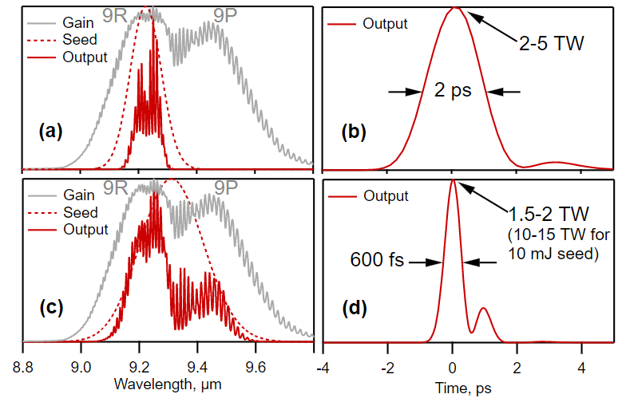
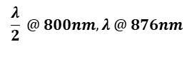


(10) Millijoule, femtosecond solid state seed
Proposal 308053
2 ps limit for pulse duration is defined by gain narrowing in CO₂ amplifiers
Main contributor to gain narrowing is the high-total-gain regenerative amplifier
Gain narrowing in the final amplifier is relatively small
If a 10 mJ sub-picosecond pulse is available from a solid-state laser system, CO₂ regen can be eliminated from the amplifier chain
This would allow achieving a sub-picosecond at present energy levels
800nm
20nm BW
200mJ
200ps
800nm
20nm BW
80mJ
200ps
$$\frac{λ}{2} @ 800nm, λ @ 876nm$$
Ge filter
9199.6nm
230nm BW
6mJ
200ps
CaCO₃
$$ω_{R}=1087cm^{−1}$$
BaGa₄S₇
$$θ=9.3, φ=0$$
876nm
20nm BW
80mJ
200ps
Current:
Regen x10¹²
Final x10³
Solid state seed:
Final only x10³

Slide 11
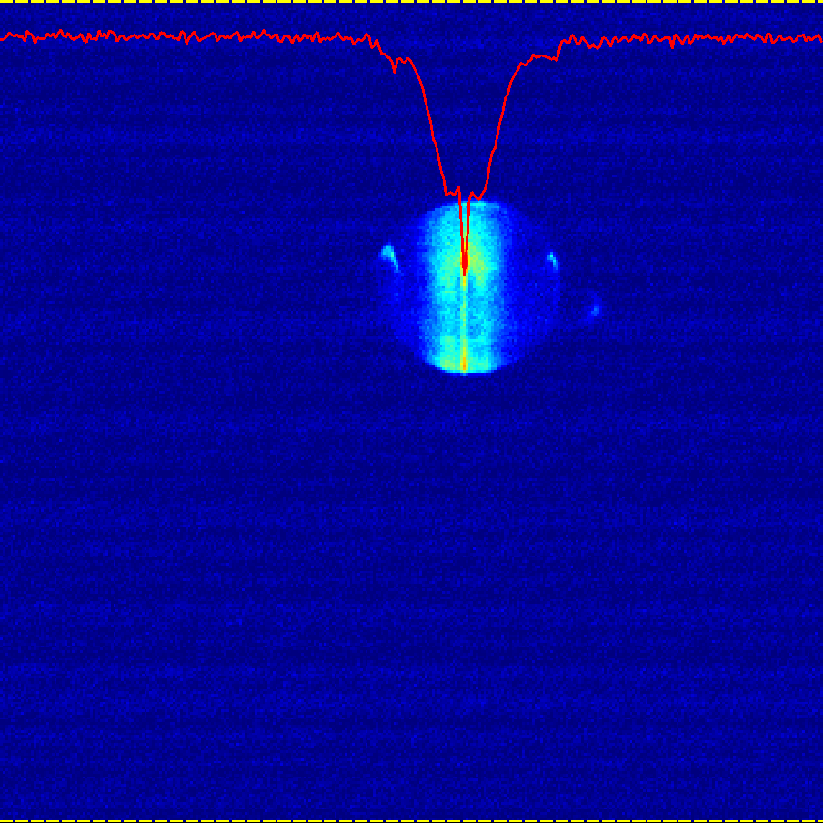
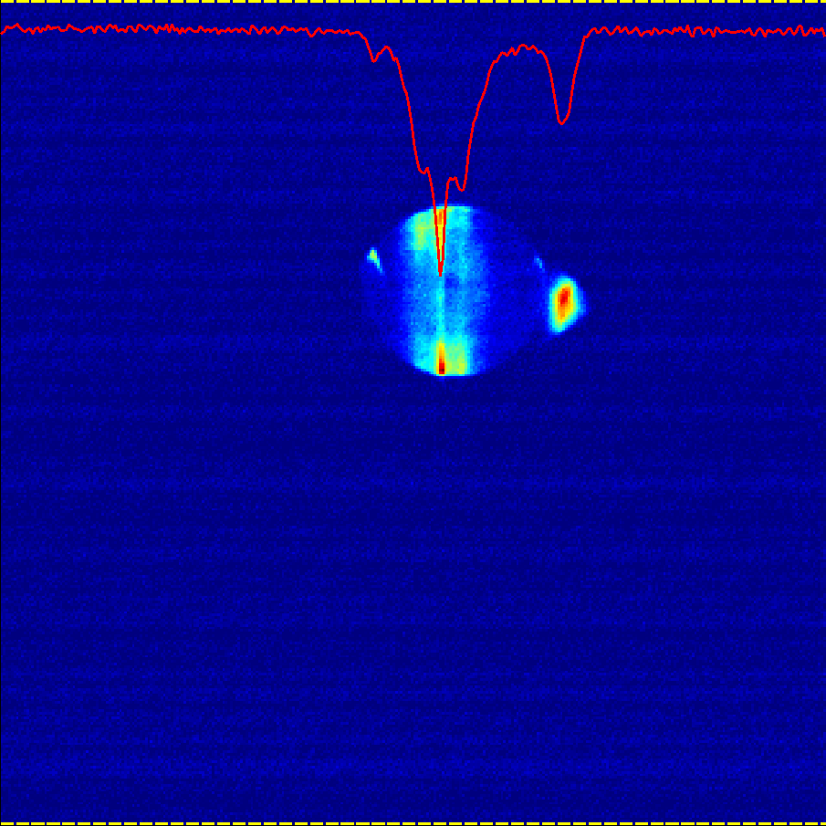
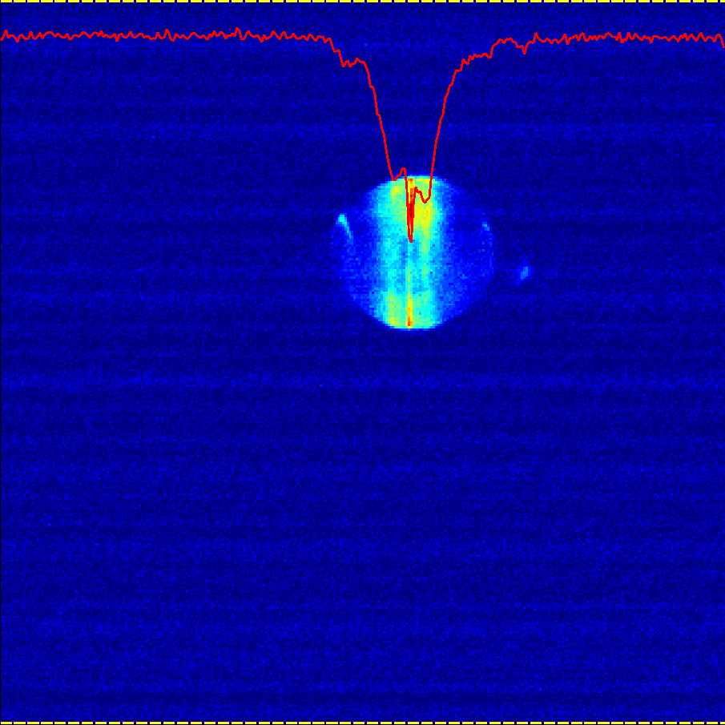
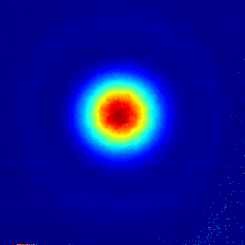
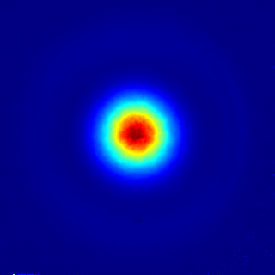
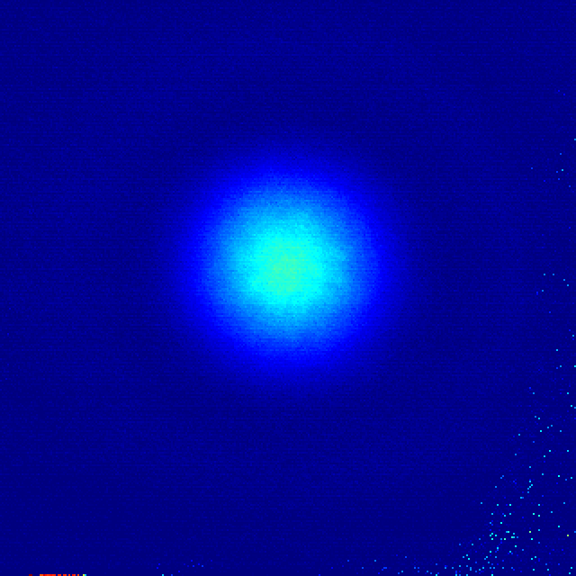
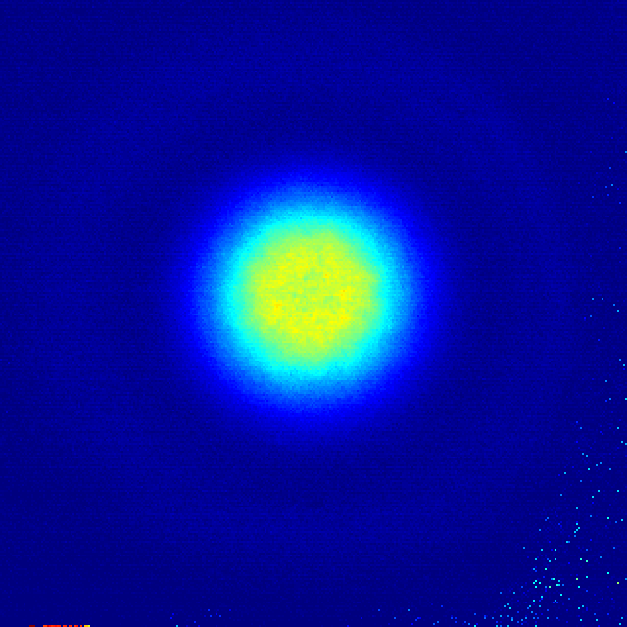
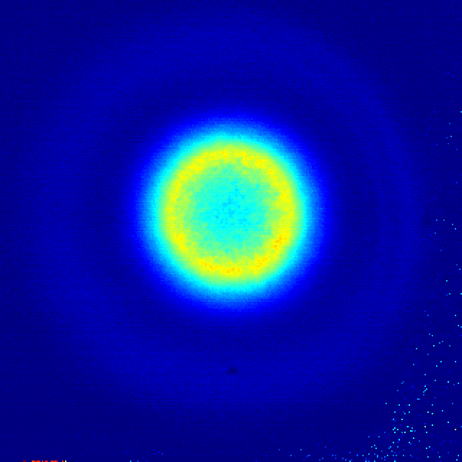
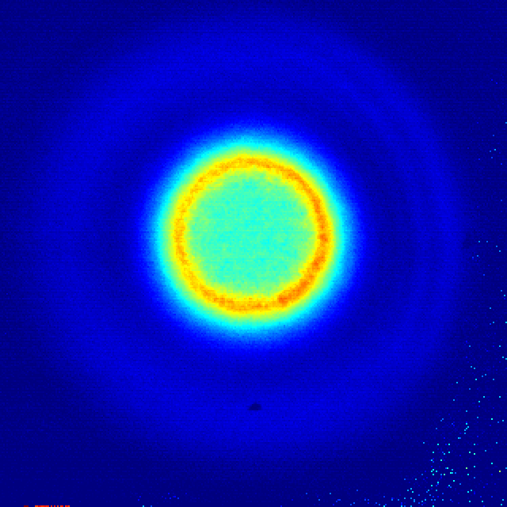
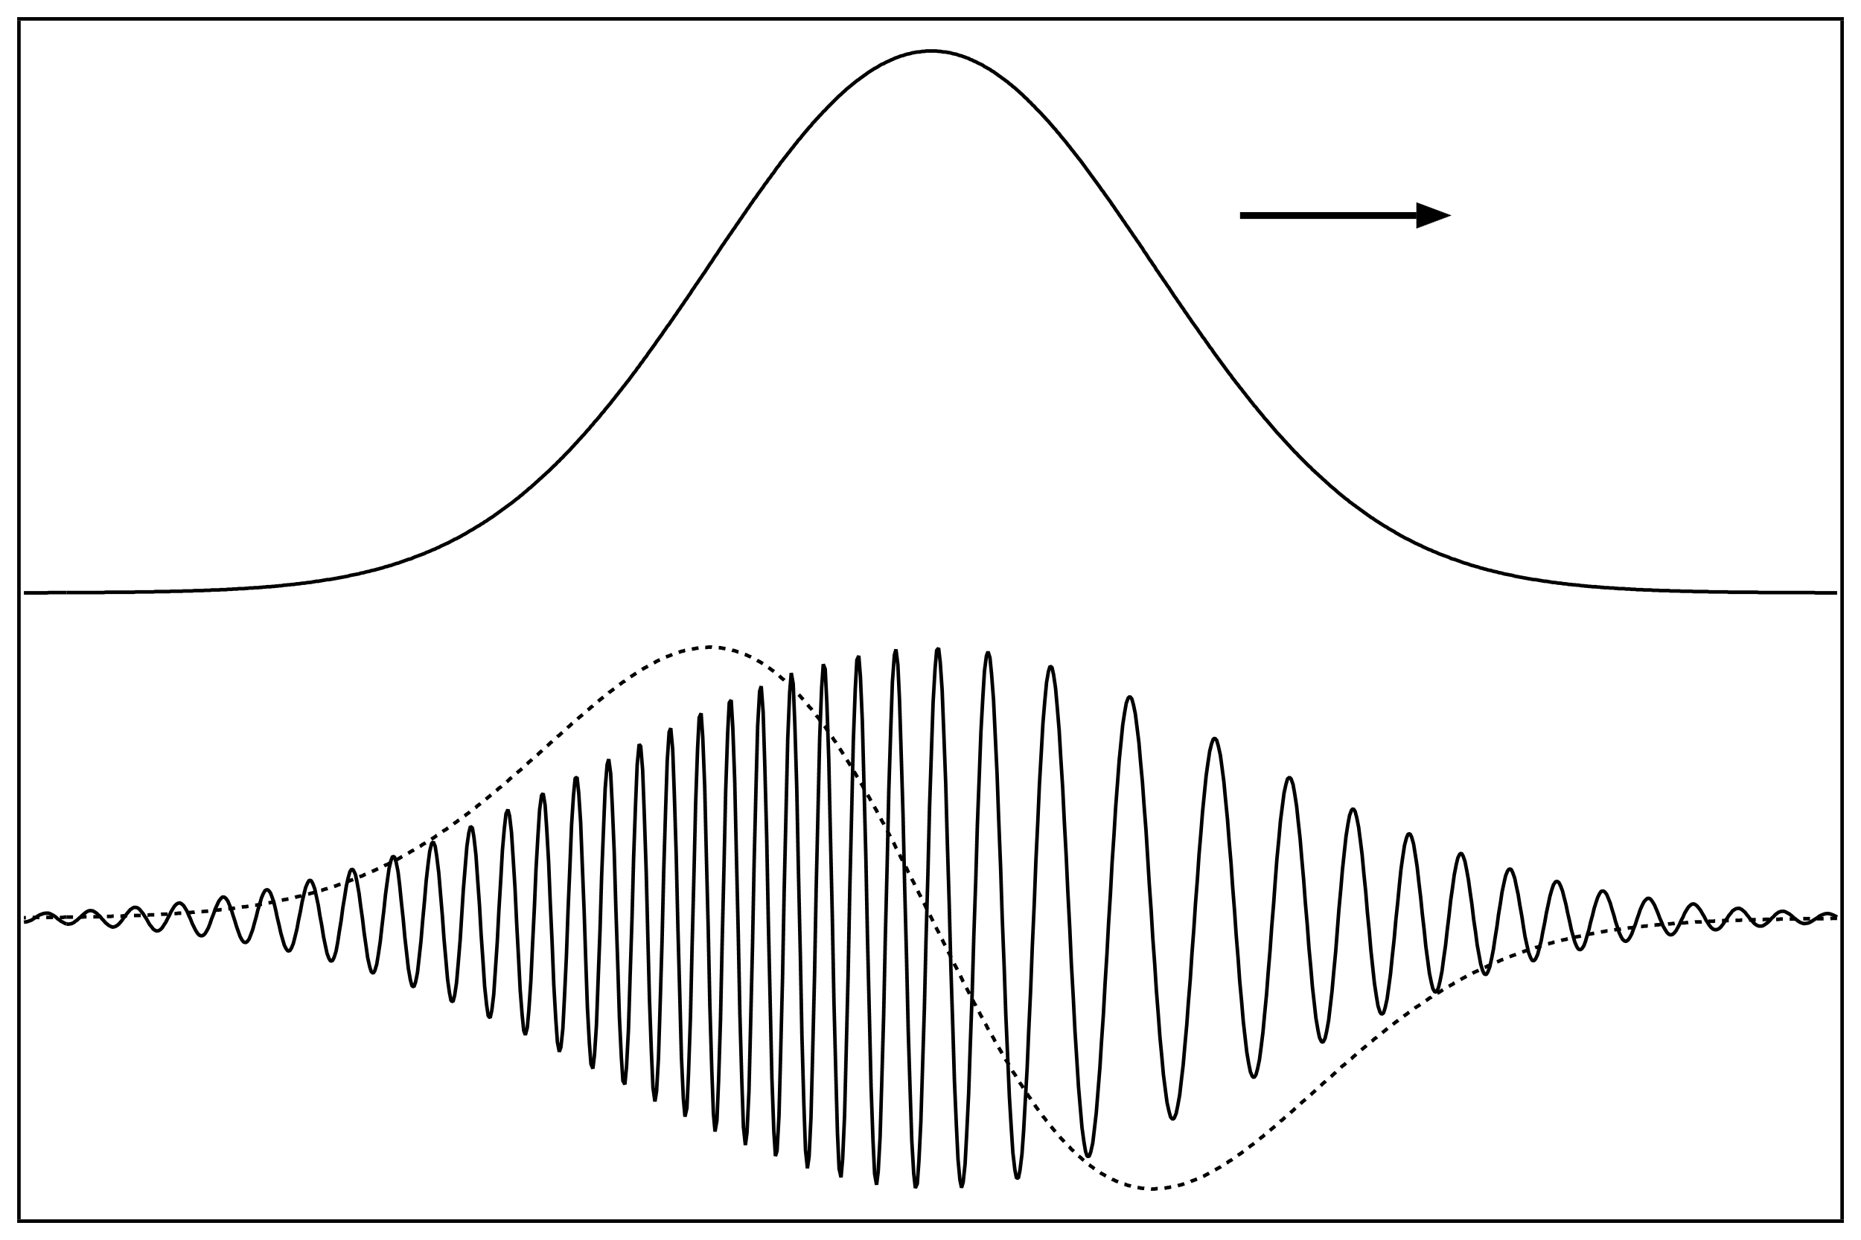
Nonlinear pulse compressor
Nonlinear properties of LWIR materials
AE-101
Nonlinear post-compressor
LDRD
14 m
Delivery of a proof-of-principle prototype: 2022
Sample
NaCl
Joulemeter
Beam
profiler
BK7
BK7
12.88 mm Dia.
Teflon aperture
BK7
140 mJ
560 mJ
[ Imaging lens ]
Materials with negligible nonlinear absorption
(NaCl, KCl, BaF2[?]..)
Materials with non-negligible nonlinear absorption
(ZnSe, ZnS, Ge, Si…)
ZnSe
NaCl
Self-phase modulation
Dispersive compression
85 mJ
150 mJ
300 mJ
500 mJ
n(t) = n₀ + n₂I(t)

Slide 12
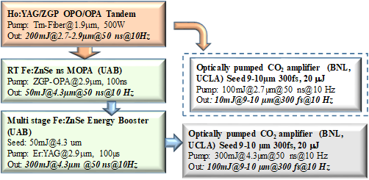
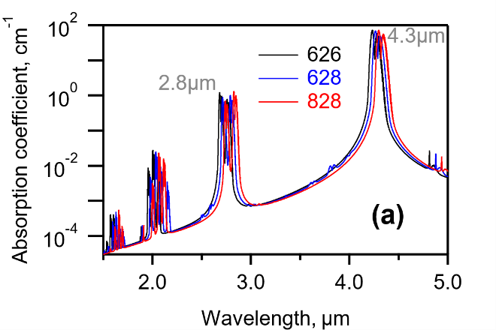
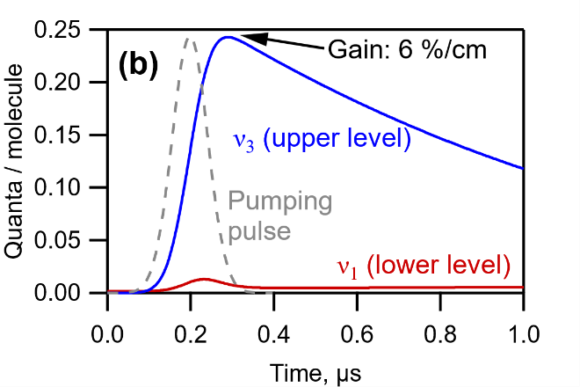
Optical pumping (long-long term)
AE-85
Advantage | Why important
High pressure possible | Smooth gain spectrum
No CO₂ dissociation | High rep. rate Compact gas cell Non-equilibrium mixed-isotope CO₂
N₂-free mixture | Efficient energy extraction in a single pass
High shot-to-shot stability | Real-life applications
[Potentially] high efficiency
Via a
combination
vibration
Direct to
upper level
Absorption spectra of a
1 bar CO₂ / 9 bar He mix
Population dynamics for a
100 ns, 500 mJ/cm², 2.8 μm pump

Slide 13
Summary
2021 upgrades
We are aiming at achieving a 5 TW peak power in IP via implementation of a vacuum compressor chamber and a vacuum beam transport
After implementing the upgrades, we will gradually ramp-up power staring at 2 TW where the system is known to perform reliably
The main risk is a long-term degradation of the compressor gratings at increased energy. Mitigation options are available
We will also upgrade the timing system
We keep working on increasing the repetition rate
R&D
An aggressive research program on 10 mJ solid-state seed aimed at 0.5 ps pulse duration via better use of CO₂ gain bandwidth
Nonlinear pulse compression will allow 100s of fs long pulse and up to 25 TW peak power. Prototype delivery scheduled in 2 years.
Experimental study of optical pumping is in progress

