Slide 1
2021 Facility Upgrade Plans
Chris Cullen
December 11, 2020

Slide 2
Topics
UED
Ultrafast Electron Microscope (UEM)
Optical Parametric Amplifier (OPA)
B820 laser rooms
Pre down configuration
Present configuration
Including laser room reconfiguration completed September, 2020
Scope of NIR upgrades
Scope of LWIR (CO2) upgrades
Schedule
Summary

Slide 3
Ultrafast Electron Microscope (UEM)
LDRD funded project: Demonstration of feasibility of sub-nm, picosecond electron microscope for the life sciences
NSLS-II with ATF personnel support
Objective is to obtain tissue sample images with minimal sample degradation due to high speed, short duration pulse
Quick change design to switch between UEM and UED baseline drift tube configuration

Slide 4
UED Sample Mid-IR Pump Source (OPA)
A commercial Optical Parametric Amplifier will be installed next week that will provide multi-μJ femtosecond pulses fully tunable from 2-11 microns
Diagnostics, controls, full Integration, and first beam delivery on samples expected in early 2021
ATF previously assembled and demonstrated the Ti:Sapphire booster amplifier required to achieve the higher NIR pulse energies necessary for pumping the OPA itself (below)
A DOE early career award (Jing Tao) has provided the opportunity to extend the wavelength range available for pumping UED samples
This will broaden the physical mechanisms that can be studied with the instrument and increase the scientific reach of the facility

Slide 5
B820 Laser Rooms

Slide 6
Configuration Prior to Summer, 2020
Experimental Hall
Jib Crane
Shielding wall
CPA
Seed Laser Table
Polarization rotator
Regen
Plasma shutter
Final amplifier
NIR
LWIR

Slide 7
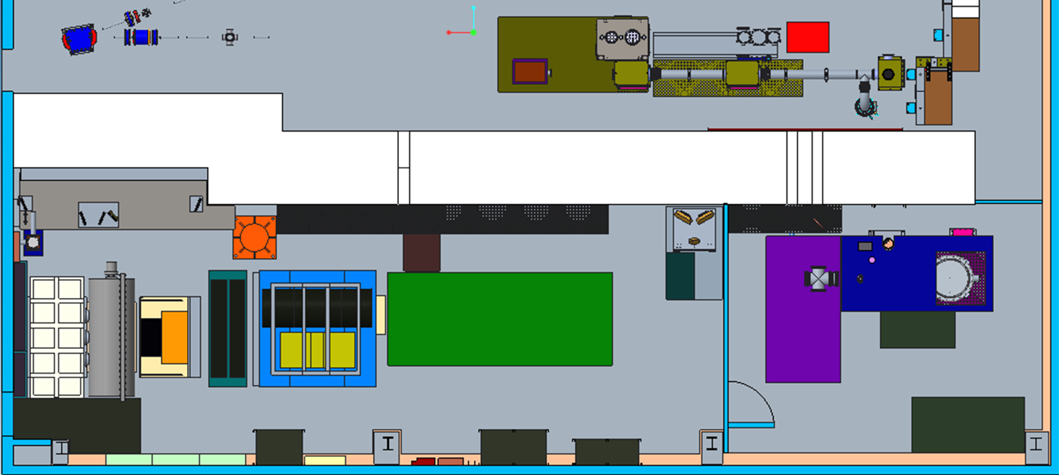
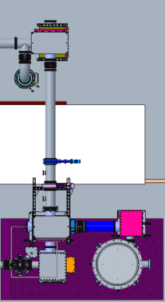
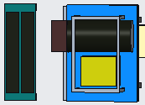
Present Configuration with Summer 2020 upgrades
Experimental Hall
Jib Crane
Shielding wall
CPA
Seed Laser Table
Polarization rotator
Plasma shutter
Final amplifier
Regen
Room upgrades:
Vestibule removed
Dividing wall removed
Seed laser table moved
Regen table moved
NIR
LWIR

Slide 8
Present Configuration with Summer 2020 upgrades
Shielding wall
Final amplifier
LWIR path

Slide 9
Modified Laser Transport Systems – Plan View
NIR
LWIR
Shielding wall
NLPC experimental chamber
CPA chamber
Seed Laser Table
Polarization rotator
chamber
Plasma shutter
Final amplifier
Regen

Slide 10
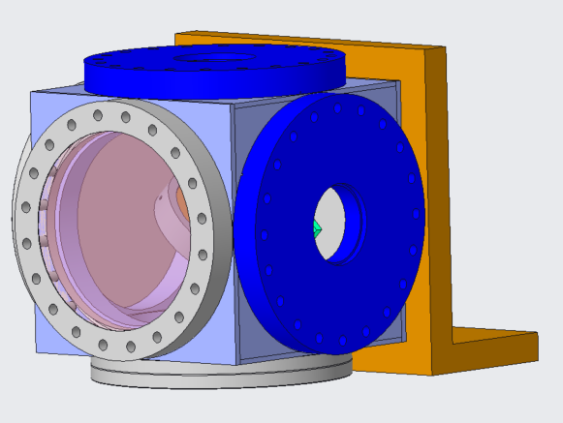
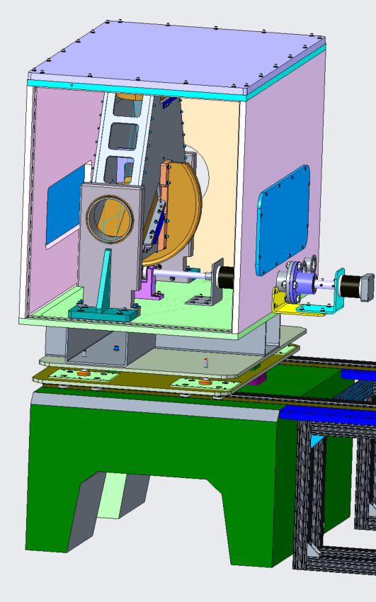
Modified Laser Transport Systems – Iso View
NIR Cube with mounting bracket
Experimental Hall
Shielding wall
Seed Laser Table
FPR chamber on steel frame with concrete base
Laser Rooms
Final amplifier
Room walls hidden for clarity

Slide 11
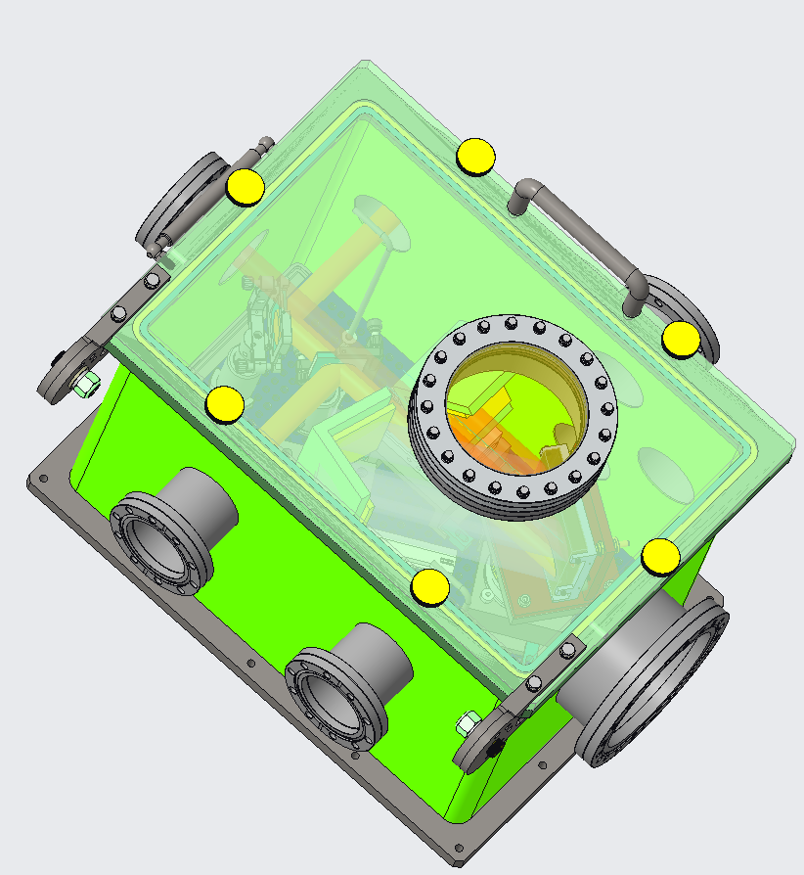
NIR Vacuum Transport Path Diagram - Isometric
NIR vacuum transport runs along the ceiling in the ebeam experimental hall
NIR
NIR compressor
NIR compressor
Alternate location for NIR compressor
NIR vacuum transport runs along the floor in the laser rooms
Beam enters laser room here
LWIR Components removed for clarity.

Slide 12
LWIR Vacuum Transport Installation – Plan View
Existing vacuum transport
Collimating mirror
Shielding wall
Circular polarization mirror
Future NLPC staging area
CPA
chamber
NLPC chamber
Seed Laser Table
Polarization rotator
chamber
Plasma shutter
Regen
Final amplifier
LWIR

Slide 13
LWIR Vacuum Transport Installation – Iso View
Experimental Hall
FPR
Shielding wall
Seed Laser Table
CPA
Laser Rooms
Final amplifier
Room walls hidden for clarity

Slide 14
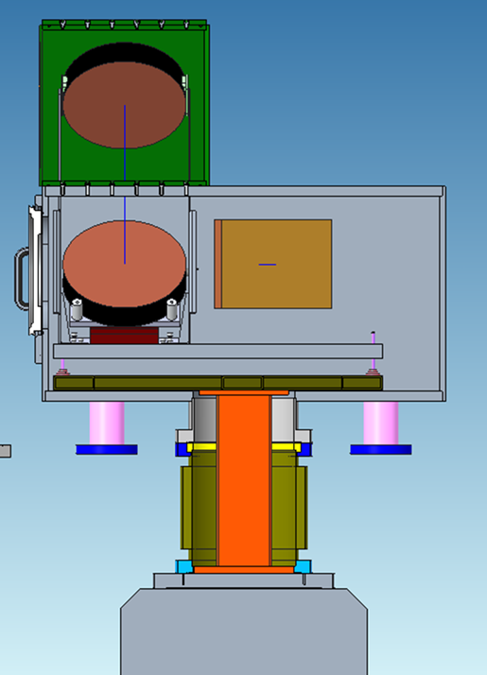
CPA Vacuum Chamber
Optics mounted to concrete pedestals for thermal stability and vibration isolation
Vacuum chamber supported by SS legs
Bellows is only mechanical connection
Breadboard
Stable frame
Bellows
Concrete

Slide 15
CPA Vacuum Chamber Optical Load Path
Concrete base
SS flange connects to concrete base
Structural tube columns
Rigid frame
Breadboards leveled on frame
Bellows connected to flange is the only physical connection between the chamber (and pumps) and the optical mounts

Slide 16
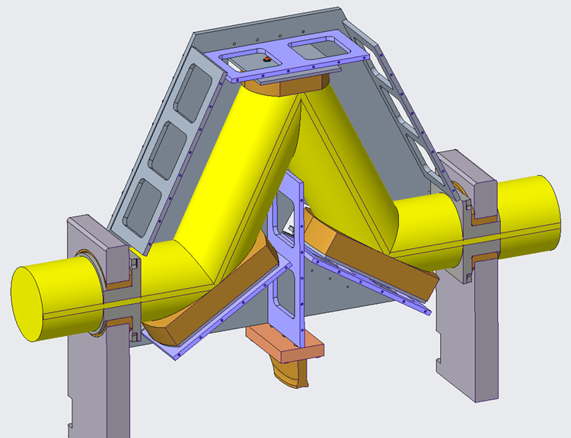
Flexible Polarization Rotator (FPR)
Concrete base
Vibration isolation
Thermal stability
FPR is on hand
Vacuum chamber designed
6” diameter clear aperture

Slide 17
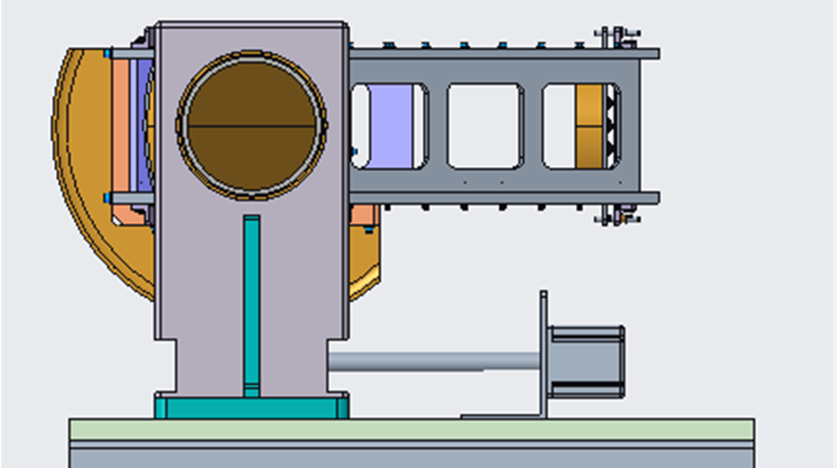
FPR Motion
Stepper motor drive
Brass worm gear drive
-2° to 92° range of rotation

Slide 18
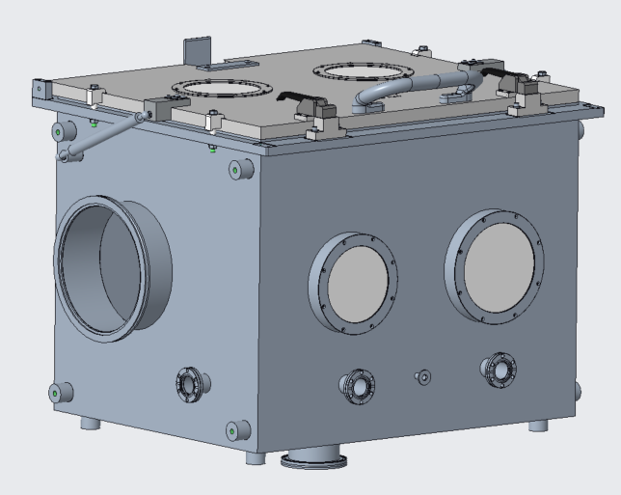
NLPC Experimental Chamber
Procurement in process
Intended for NLPC development
Initial vacuum transport does not include optics in this chamber

Slide 19
Schedule
UEM – March, 2021 installation
OPA – installation planned for next week
Vacuum laser transport
Proceed with major procurements
Major procurements are for the CPA, FPR & NIR chambers
Goal: Delivery of improved NIR and LWIR capabilities to users before the end of calendar 2021!
Goal: Installation commencing in August 2021
Major components must be received before installation commences

Slide 20
Upgrades Summary
UEM will obtain tissue sample images with minimal sample degradation.
UED OPA tunable wave converter will provide a range of wave lengths to study a wider range of physical effects on materials.
NIR vacuum transport & compressor will improve beam stability and optics reliability.
CO2 Vacuum transport will deliver high quality TW beam to experiments for increased particle acceleration.
Polarization rotator will provide infinitely adjustable polarity from horizontal to vertical to simplify viewing plasma waves.
Circular polarization is required for Radiation Pressure ion acceleration and the RUBICON experiment.

Slide 21
Thank you! Questions? Up next: User Discussion

