Slide 1

Progress on AE85
A Multiatmosphere CO₂ Amplifier Optically Pumped by a 4.3 μm Fe:ZnSe Laser
Funded by DOE HEP Accelerator Stewardship Program 2020-2023
SERGEI TOCHITSKY-PI, Dana Tovey, Jeremy Pigeon, Chan Joshi
Department of Electrical Engineering, UCLA
Igor Pogorelsky, Mikhail Polyanskiy
Brookhaven National Laboratory, USA
Sergei Mirov et al
University of Alabama at Birmingham

Slide 2

Motivation
  Long-wavelength Infrared range is attractive for particle acceleration and radiation generation. At present we experience a Renaissance of mid-IR ultrafast lasers mainly based on OPA and OPCPA in nonlinear crystals pumped at 1-2 μm.
  CO₂ laser is efficient and is able to store a great deal of energy within the active medium. The shortest pulse demonstrated so far is ~2 ps and all high-power picosecond systems operate in a single-shot regime limited by electrical discharge stability in a >10 atm molecular gas.
  In AE85 experiment funded by the DoE grant, we study potential of Optically Pumped CO₂ laser technology for production of ≤1 ps pulses at a high-repetition rate. A collaborative effort of UCLA/BNL (gas lasers) built around the state-of the art mid-IR solid-state lasers developed at UAB.
ATF User’s 2020

Slide 3
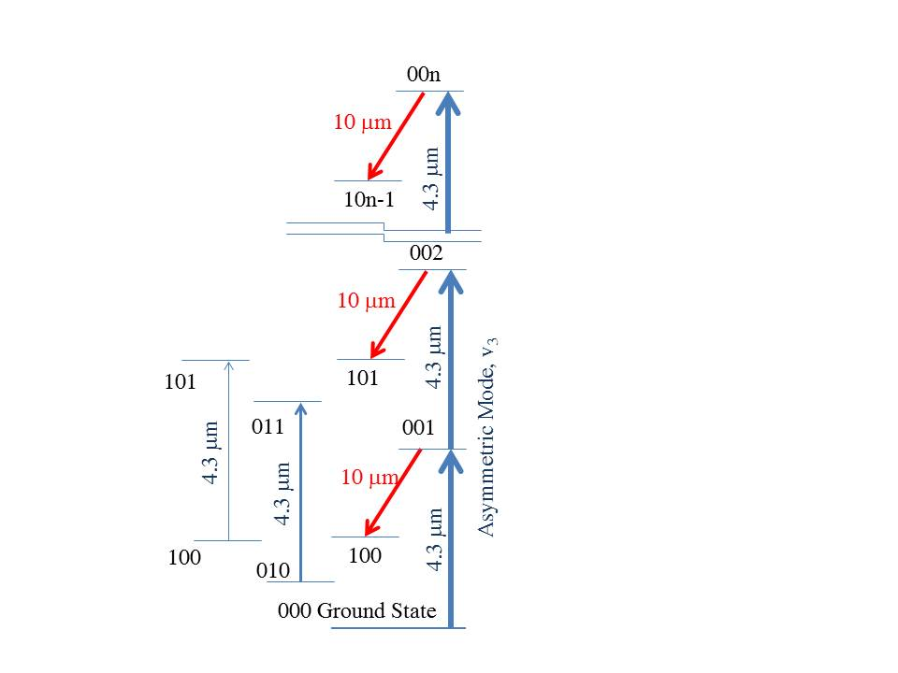
Optically Pumped CO₂ Laser
CO₂ Molecule
Recipe for success: High-gain CO₂ laser
Population of 001 level Maximized
Population of 100 level Minimized
CO
Gain Spectrum
2
1
0.8
1atm
10atm
20atm
Δν~1.2THz
0.6
Normalized Ampl..
Normalized Gain
0.4
0.2
0
10.4
10.6
10.8
11
10.4
10.6
10.8
11
10.4
10.6
10.8
11
μ
Wavelength (μm)
Wavelength (
m)
ATF User’s 2020

Slide 4
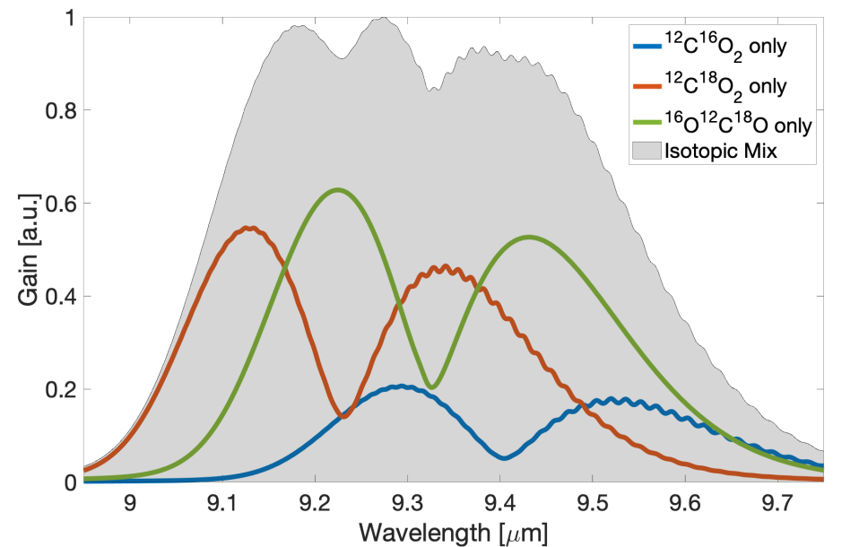
Modeling of Picosecond Pulse Amplification
4.3 μm
Fe:ZnSe
Laser
10 μm pulses
300-500 fs
10 GW
10 μm
300 fs
OPA
Seed
10-15 atm
Isotope CO₂
Amplifier
Feasibility study of a compact GW class CO₂ amplifier and gain dynamics.
D. Tovey et al. Appl. Opt., 58, 5756, 2019, J Appl. Phys. 128, 103103, 2020
ATF User’s 2020

Slide 5
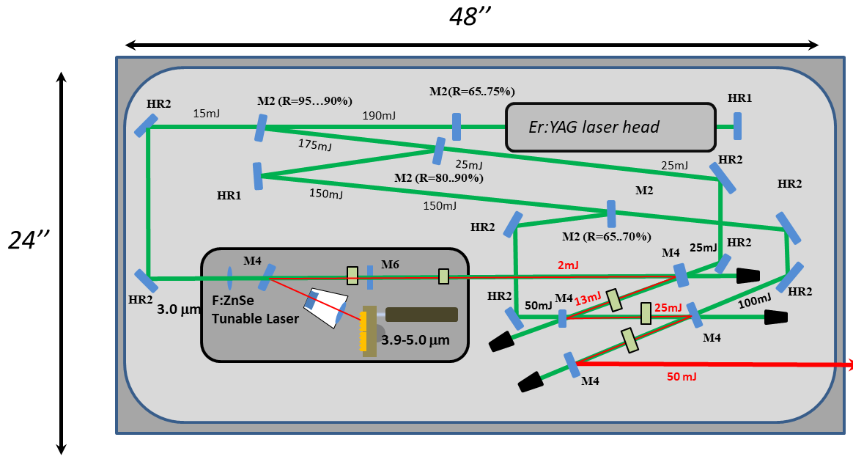
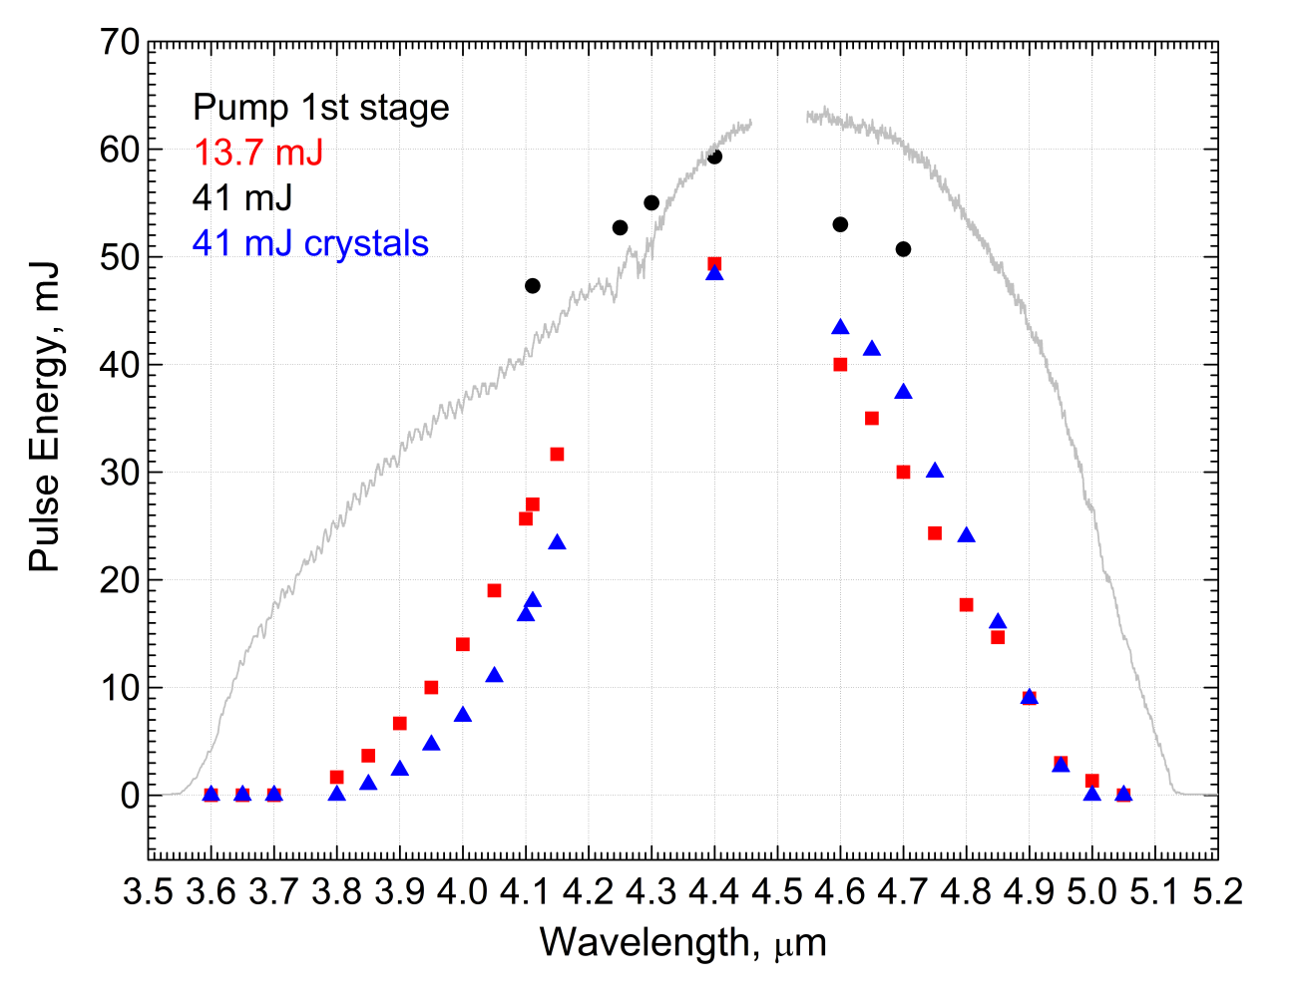

Tunable 3.9-5 μm Fe:ZnSe source for
Optical Pumping of the CO₂ laser
Group of Prof. S. Mirov
ATF User’s 2020

Slide 6
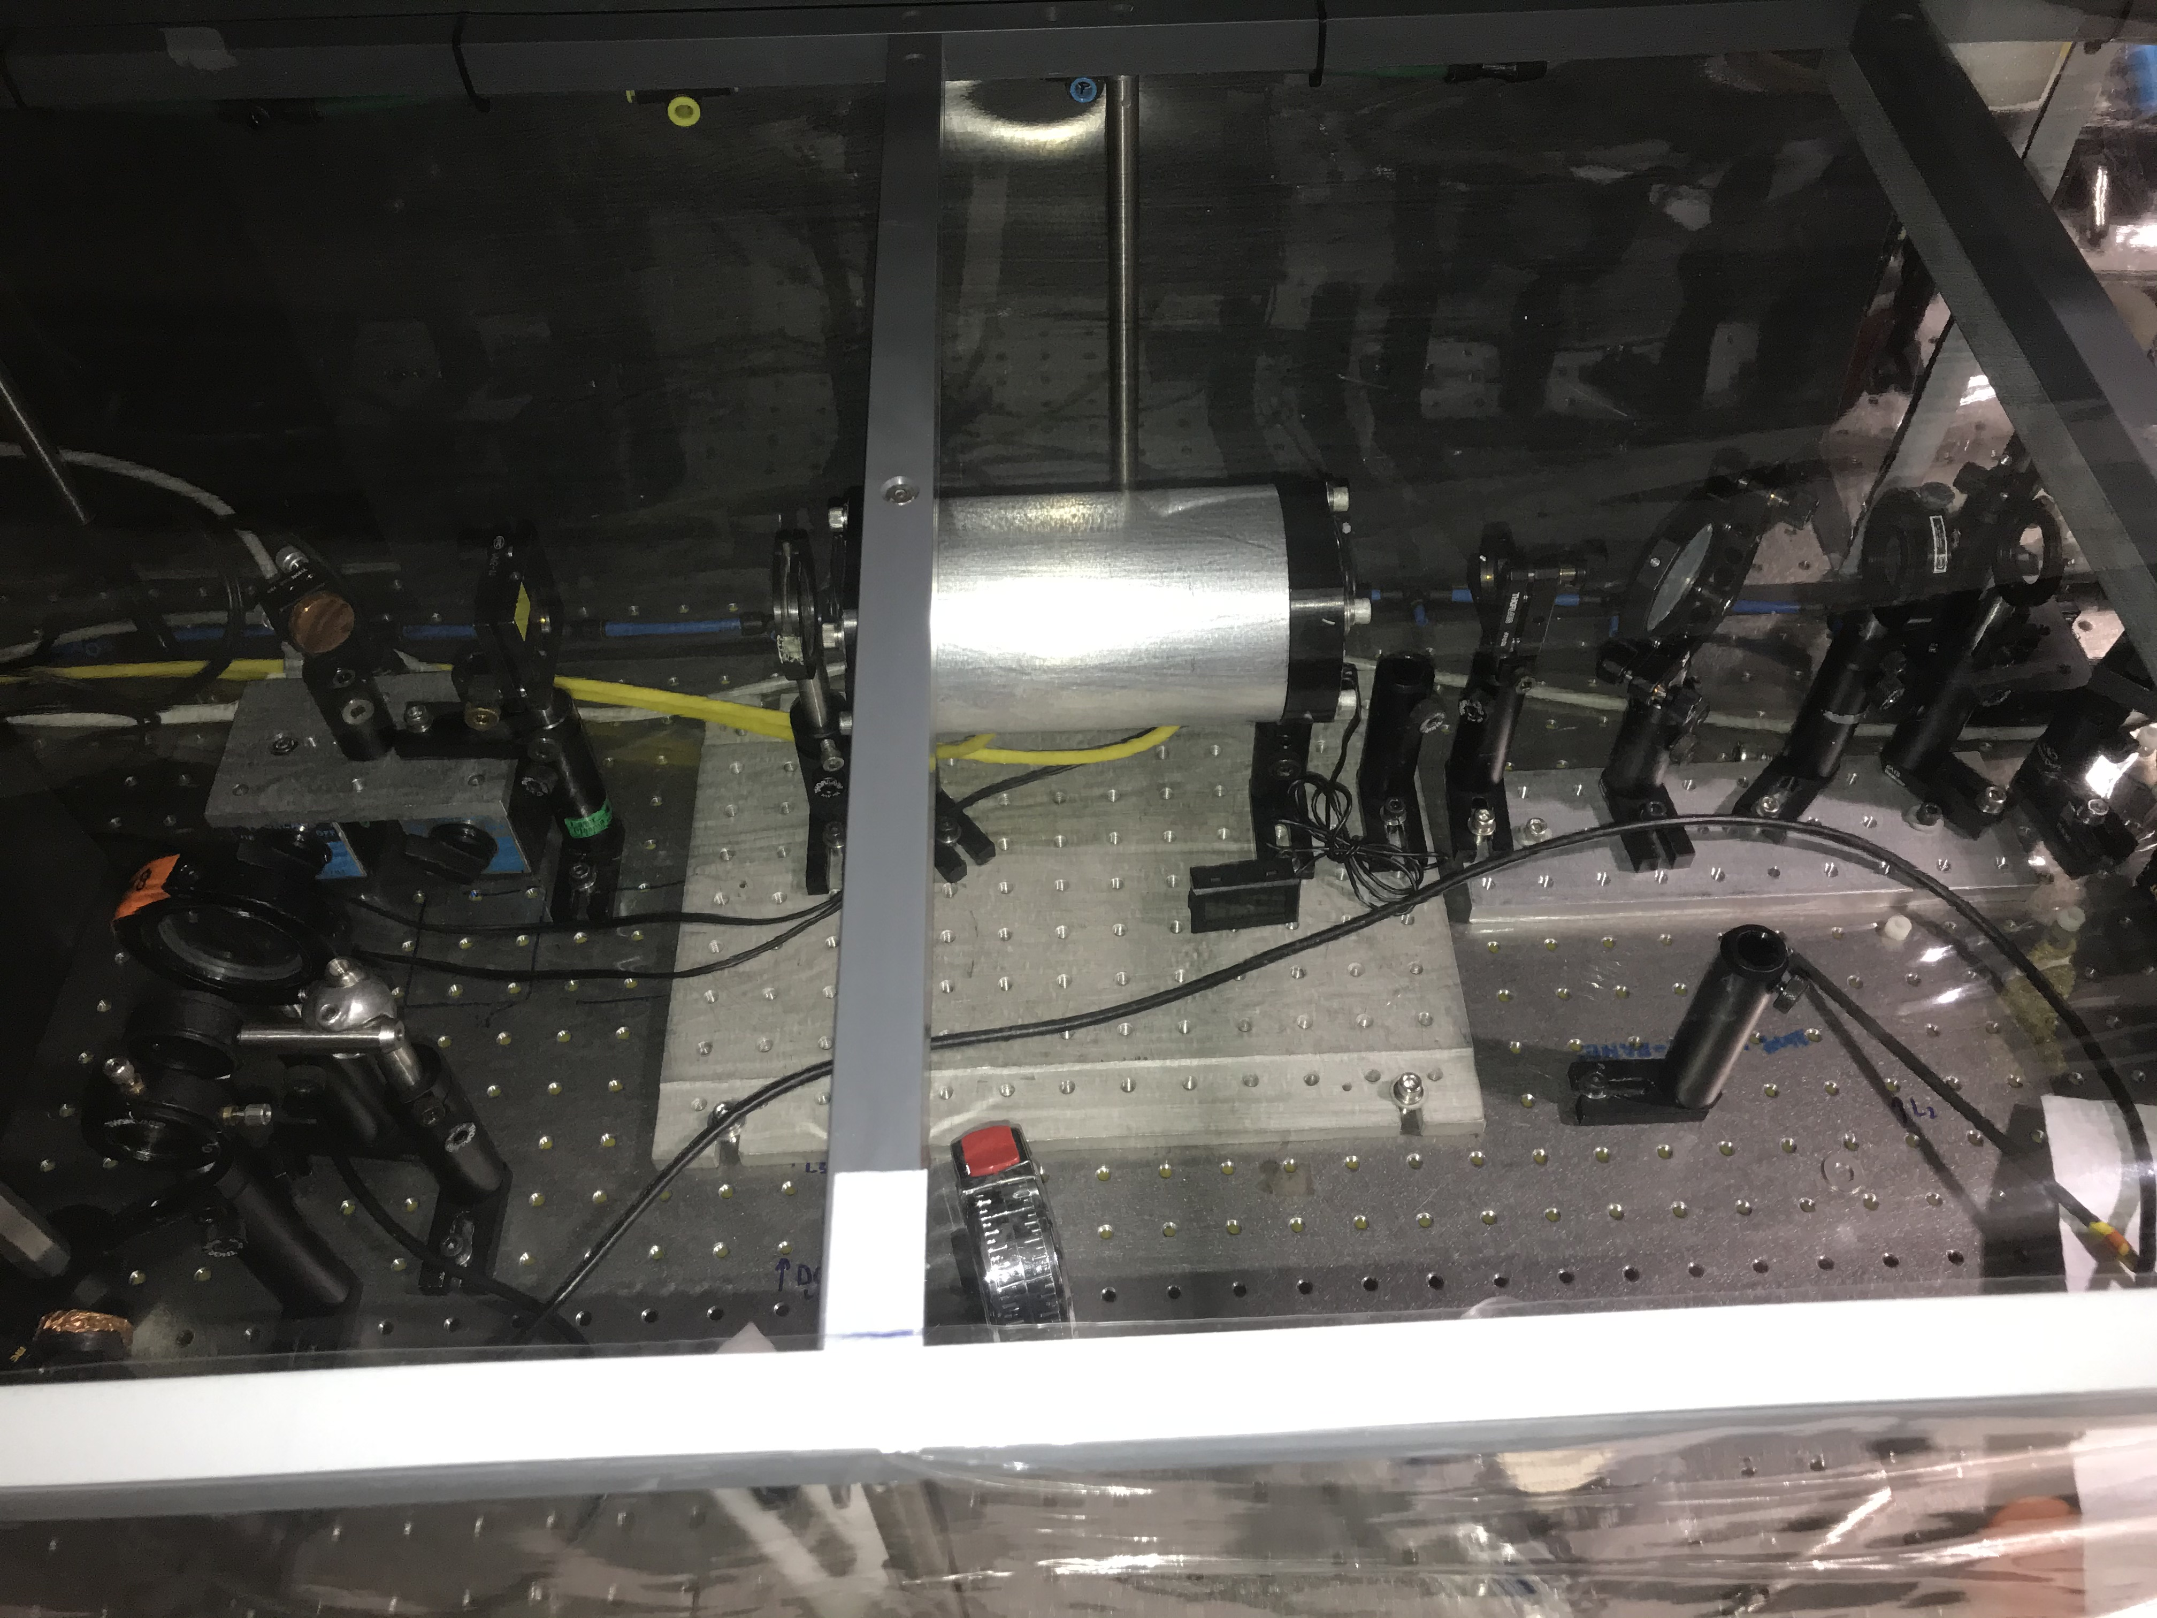
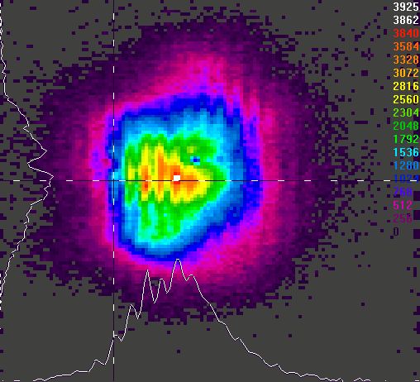
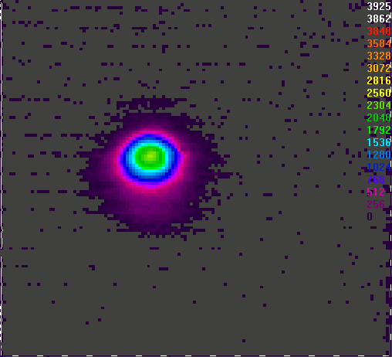
Optically Pumped High-pressure CO₂ Laser
4.3μm Pump Beam
4.3 μm pump pulse
Dichroic mirror
(T = 99% for 4 μm,
R = 99.5% for 10 μm)
High pressure CO₂ cell
Dichroic mirror
Focusing lens
2.5 mm
(beam magnified 5x)
10 μm cavity
10 μm filter
10μm Laser Beam
NaCl window
12.5 mm
Detector
ATF User’s 2020

Slide 7
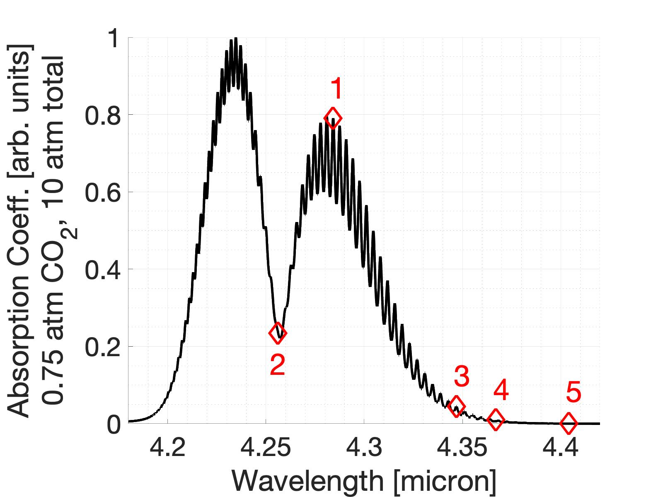
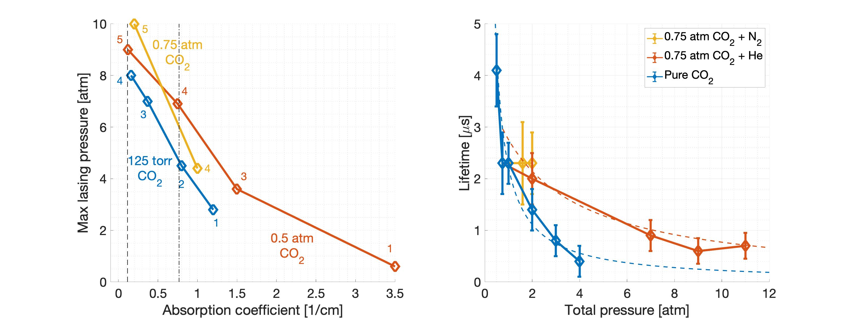
Lasing and Gain Dynamics in OP CO₂ cell
With >35 mJ absorbed in the multiatmosphere CO₂ cell.
ATF User’s 2020

Slide 8
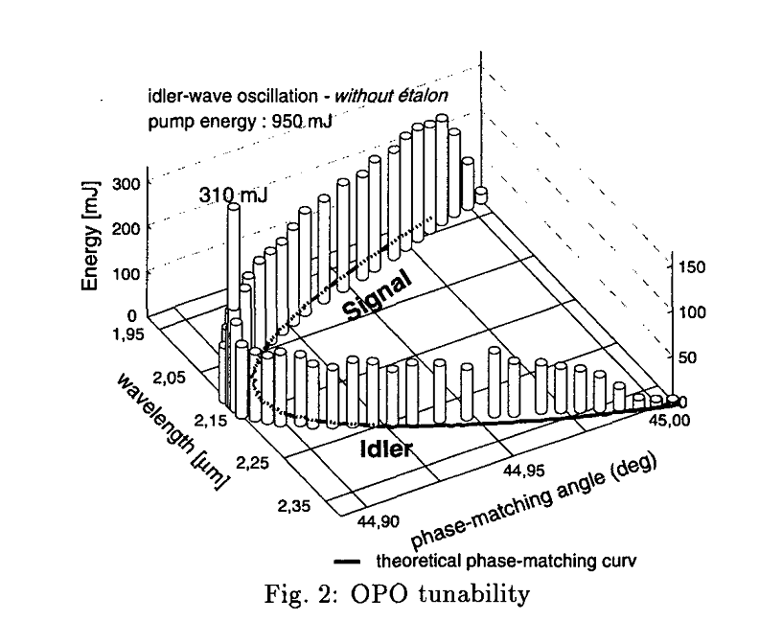
4.256 μm OPO Source Pumped by Nd:YAG
4 μm pulse:
~50-100 mJ, 10 ns
1064 nm
2128 nm
4.3 μm
Q-switched
Nd:YAG
CO₂ Cell
Amplification
OPO
OPO
Gabriel Mennerat and Philippe Kupecek, OSA TOPS Vol. 19 Advanced Solid State Lasers, 1998
ATF User’s 2020

Slide 9
4-μm OPO in ZnGeP₂ Modeling
2128 nm pump, 10 ns
2mm ZGP crystal
4256 nm half-harmonic
2 mm ZGP
50% output coupler
rear mirror
3 cm cavity
Dana Tovey, UCLA + Igor & Misha, BNL experimental verification.
ATF User’s 2020

Slide 10
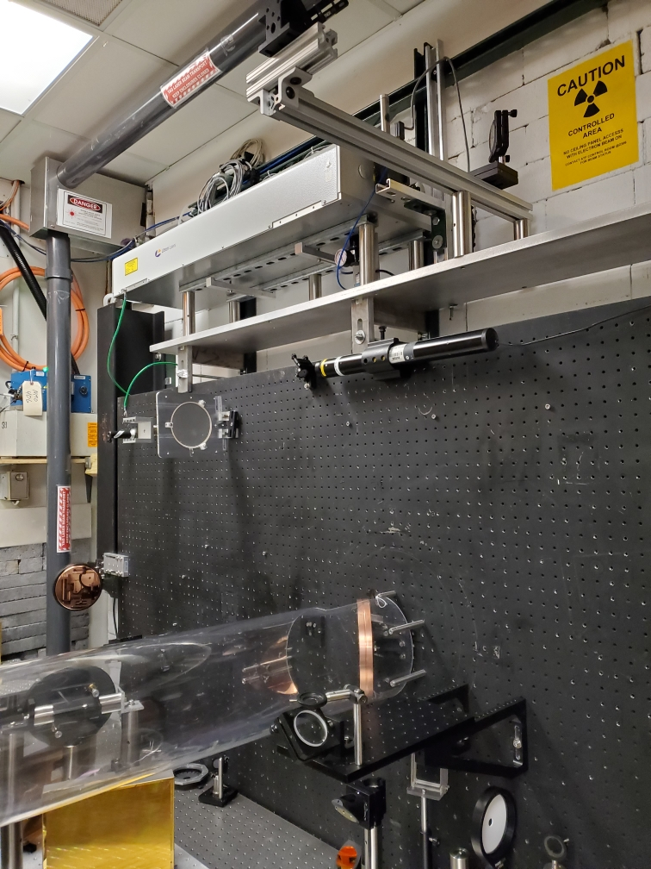
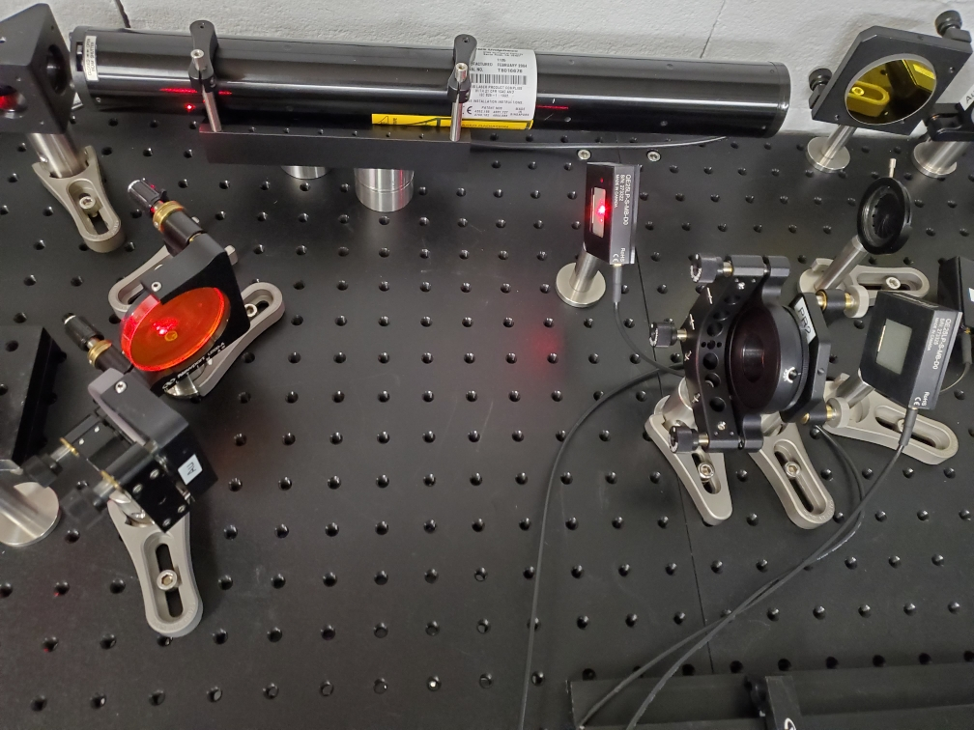
Status of the 4-μm OPO
YAG
ATF User’s 2020

Slide 11
Experimental Time Request
CY2021 Time Request
Capability | Setup Hours | Running Hours
Electron Beam Only
Laser* Only (in Laser Rooms) | 1-2 weeks | 2 weeks
Laser(s)* + Electron Beam
Time Estimate for Remaining Years of Experiment (including CY2021)
Capability | Setup Hours | Running Hours
Electron Beam Only
Laser* Only (in FEL Room) | 2021-2023 5-6 weeks | 5 weeks
Laser(s)* + Electron Beam
* Laser = Near-IR or LWIR (CO₂) Laser

Slide 12
Summary
We have made important and necessary steps in AE85 experiment, a CO₂ Laser only, funded by DOE Accelerator Stewardship Program
  Gain dynamics study in optically pumped CO₂ active medium pumped by a ~50 mJ Fe:ZnSe laser indicates that a) a short 1-10 cm long cell at >12 atm pressure and b) regenerative amplifier are durable.
  Next step in 2021 will be developing at BNL a 100 mJ, 4.3 um laser system based on NdYAG laser pumped OPO’s. Design and building a 1-10 cm long cell and start with lasing in the >10-12 atm CO₂-He medium followed by seeding and amplifying ~0.5 ps pulses using the CPA scheme.
  We request 3-4 weeks in 2021 using front end with the CPA capability and may be the 10 μm CO₂ regen.
ATF User’s 2020

