Slide 1
Electron Beam Formation via Ionization Injection ​Seeding for Next Generation Accelerator R&D R. Kupfer¹, M. Babzien¹, I Pogorzelski¹, M. Polyanskiy¹, M. Fedurin¹, K. Kusche¹, I. Petrushina², A. Cheng², R. Samulyak^{1,2}, N. Vafaei-Najafabadi^{1,2}, V. Litvinenko^{1,2}, R. Zgadzaj³, M. C. Downer ³, and M. Palmer ¹ ¹Brookhaven National Laboratory, ²Stony Brook University, ³The University of Texas at Austin *BNL-LDRD grant #18‐026
23nd ATF Users’ Meeting
December 7, 2020

Slide 2
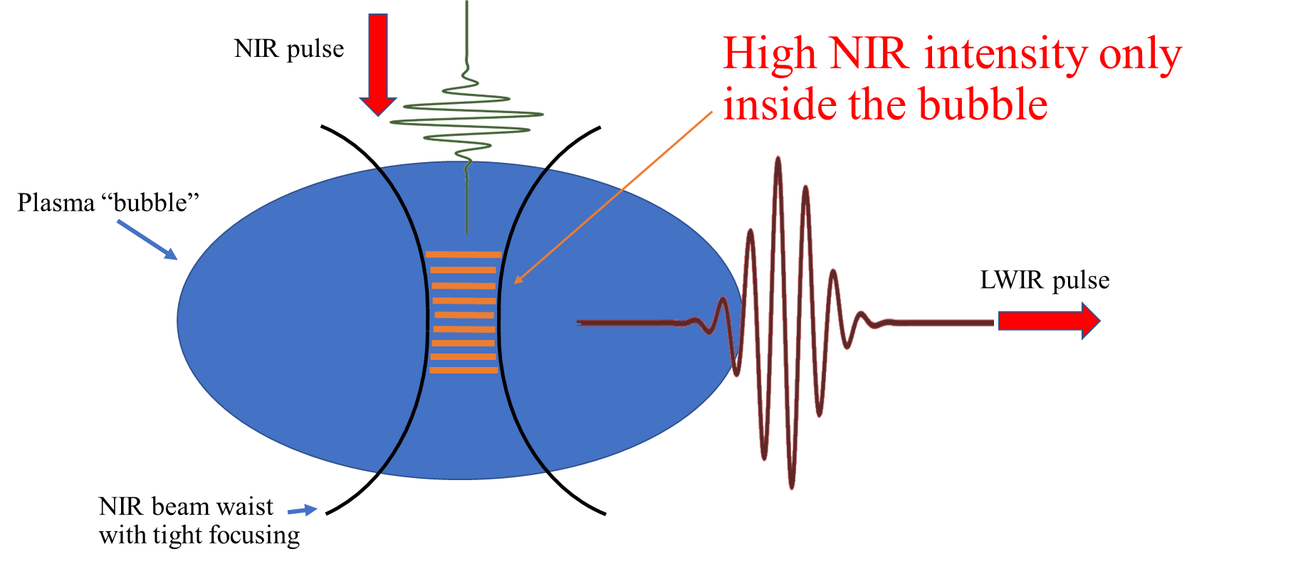
Electron Beam Formation via Ionization Injection ​Seeding for Next Generation Accelerator R&D
LWIR, high a₀, ‘low’ intensity, drive the bubble
NIR, low a₀, ‘high’ intensity, inject electrons through ionization inside the bubble
High acceleration gradient, high flux and low emittance
The intensity of the NIR pulse at the focus should be higher than the CO2 to allow higher ionization states on top of the LWIR
A suitable gas target with ionization threshold (for some higher ionization state) above that of the CO2’s field but below NIR intensity
Minimize NIR interaction with the plasma – we would like to reach high intensity only inside the bubble

Slide 3
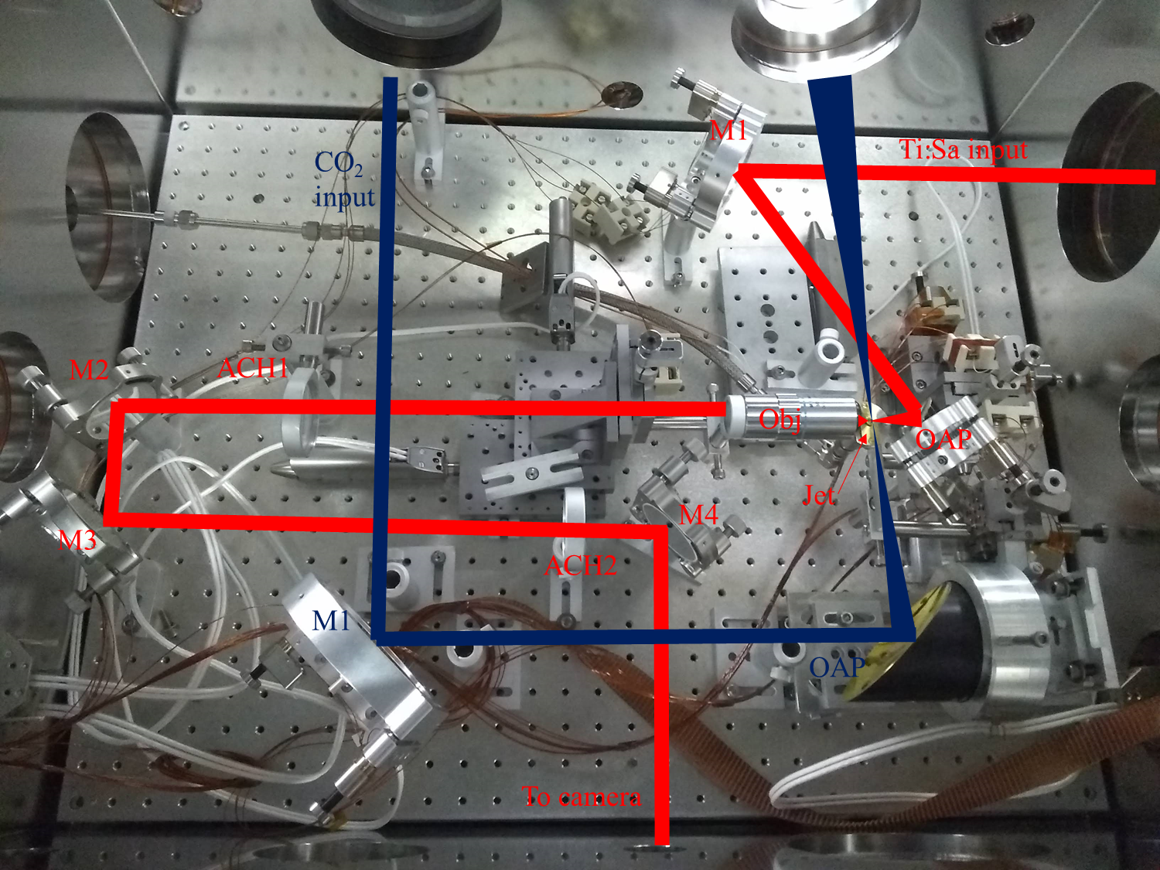
Electron Beam Formation via Ionization Injection ​Seeding for Next Generation Accelerator R&D

Slide 4
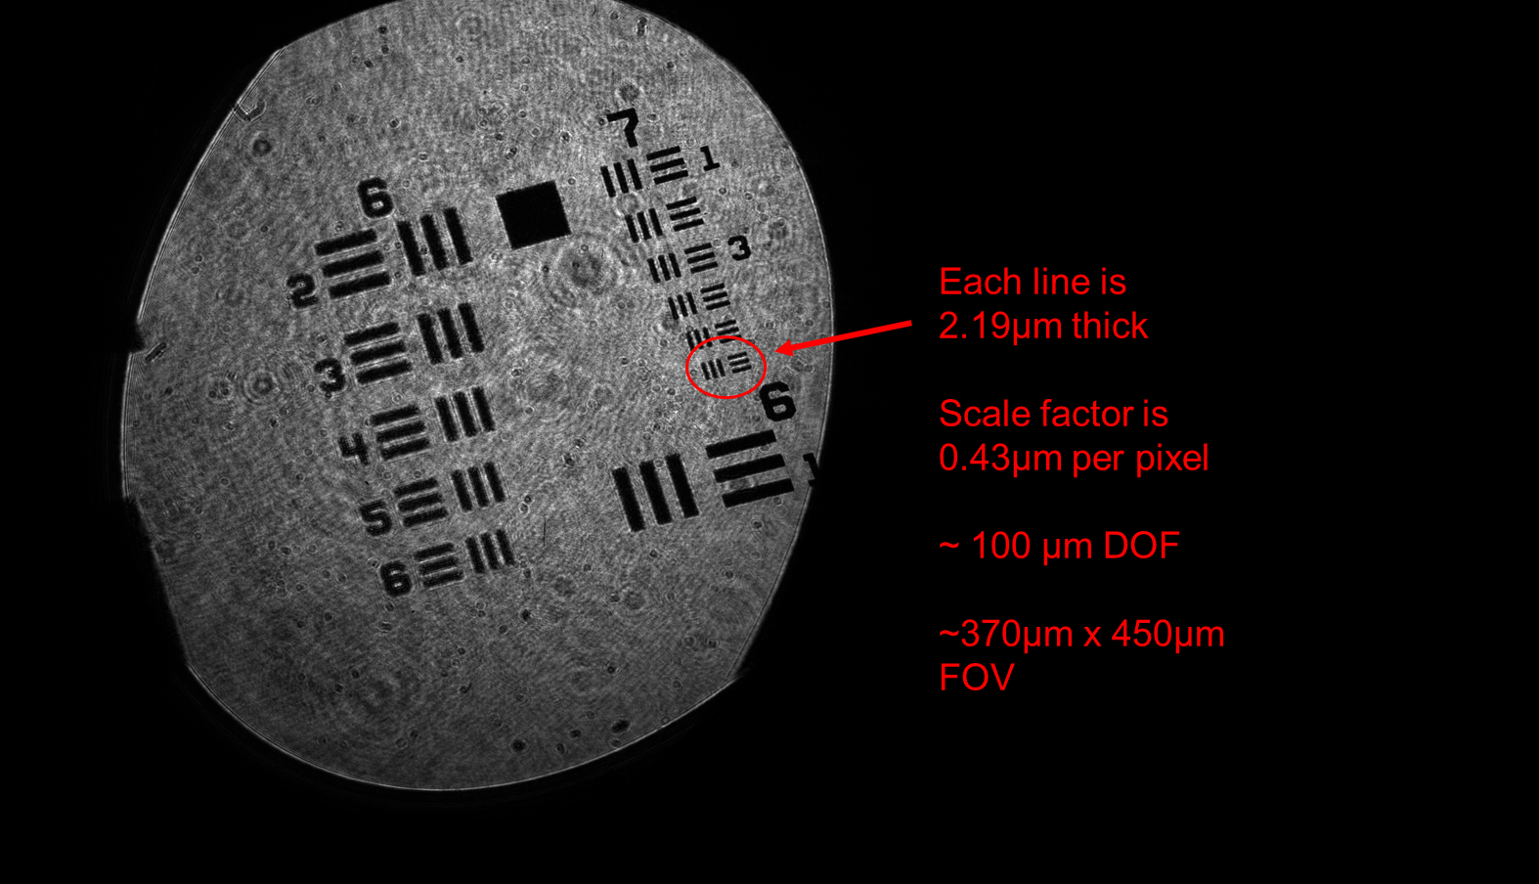
Electron Beam Formation via Ionization Injection ​Seeding for Next Generation Accelerator R&D

Slide 5
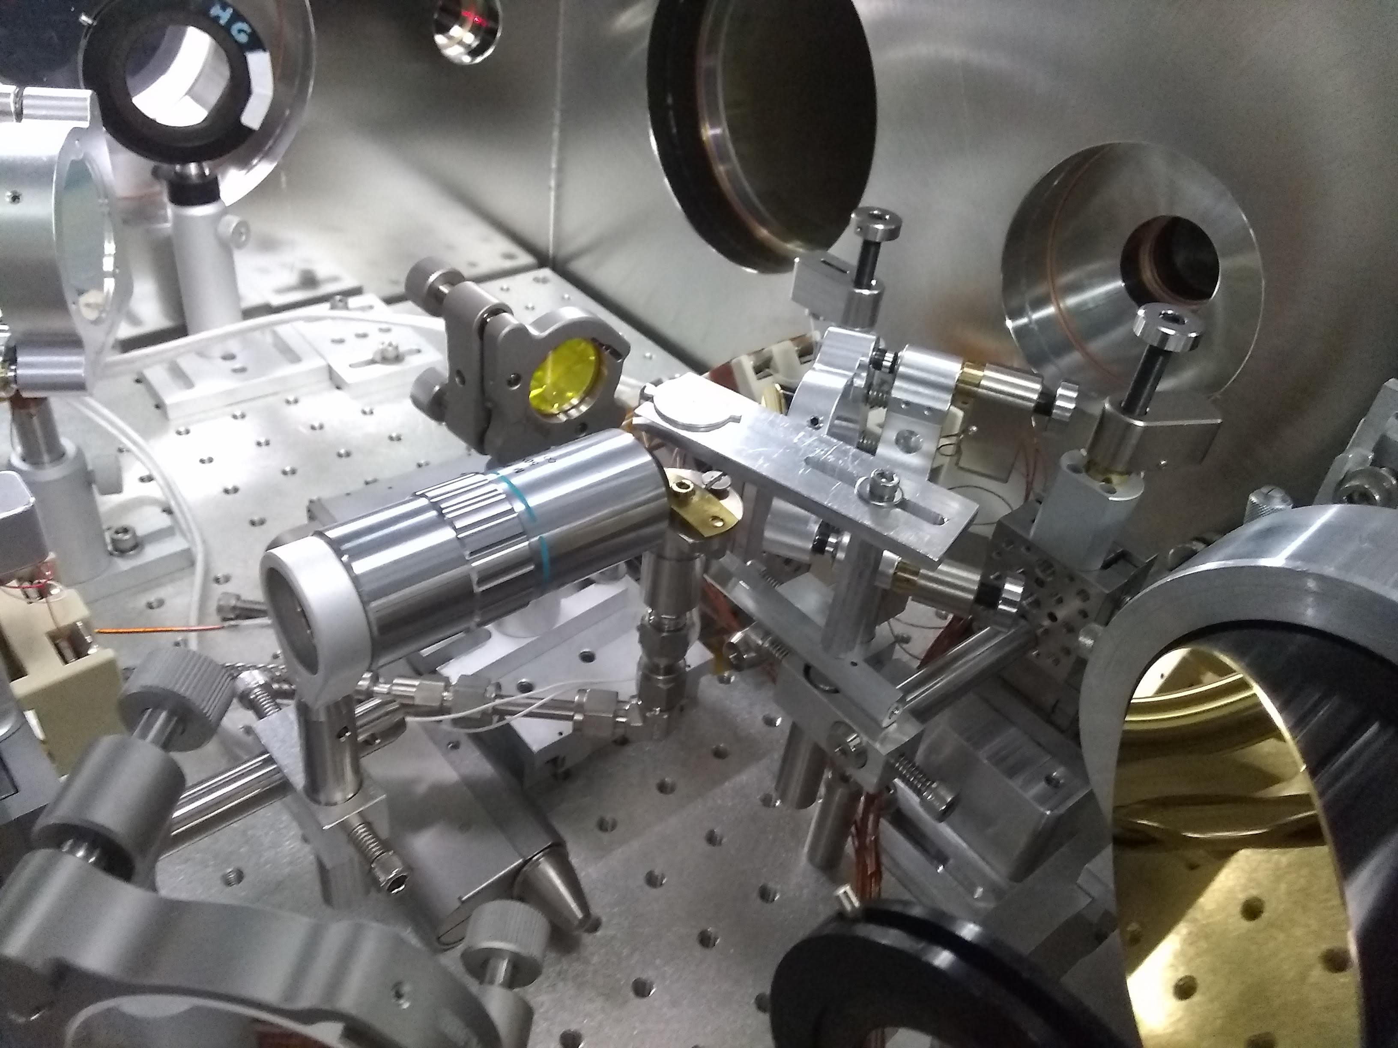
Electron Beam Formation via Ionization Injection ​Seeding for Next Generation Accelerator R&D
He:Ne backlighter
Overlapping and Timing Ti:Sa and CO2
Ti:Sa
Pin head ~60µm wide
Plasma emission
Pin
Ti:Sa arrives before CO₂ (osc delay 9512ps)
Ti:Sa arrives after CO₂ (osc delay 9515ps) – Blocked by overdense plasma
Timing within ~3ps

Slide 6
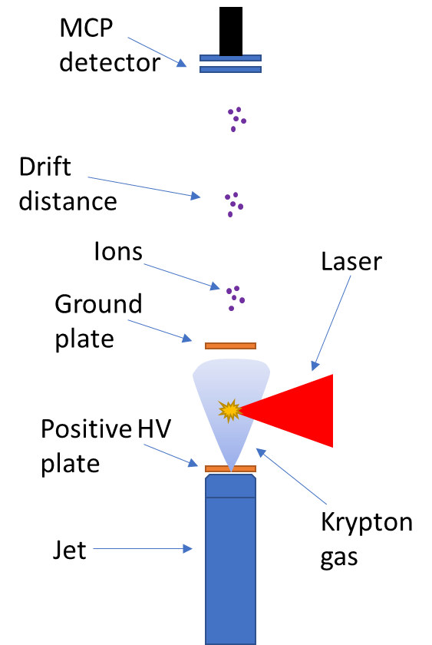
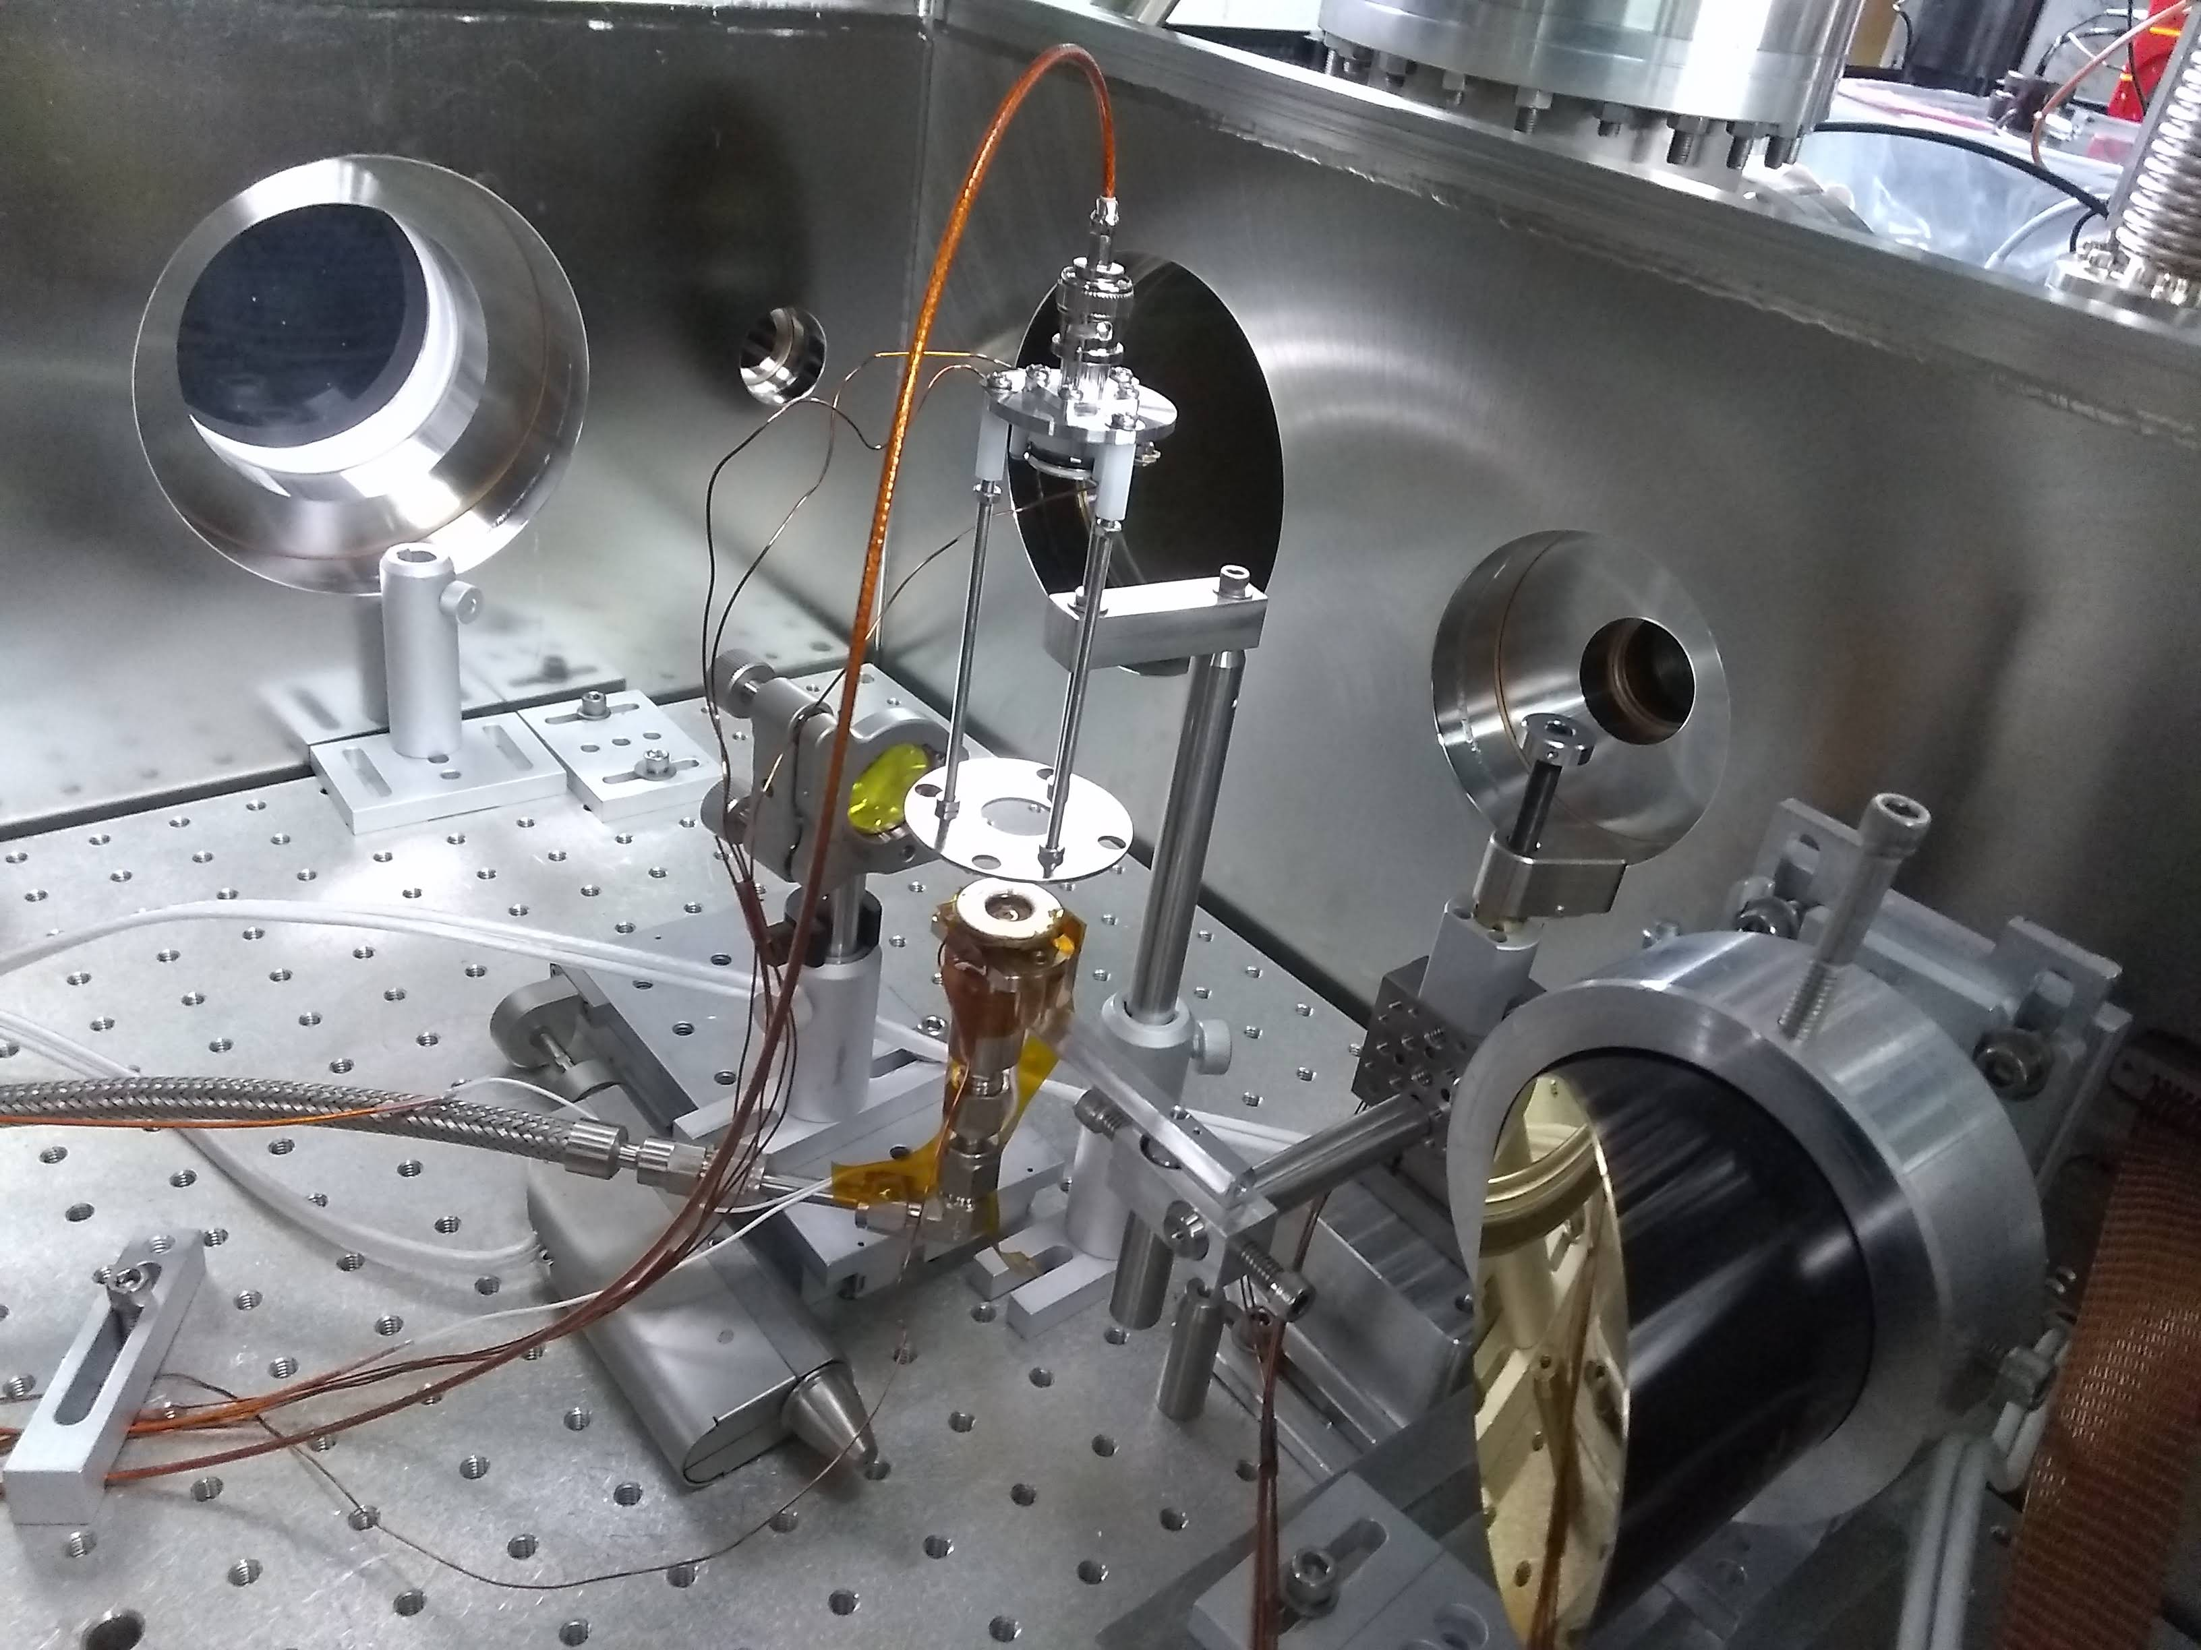
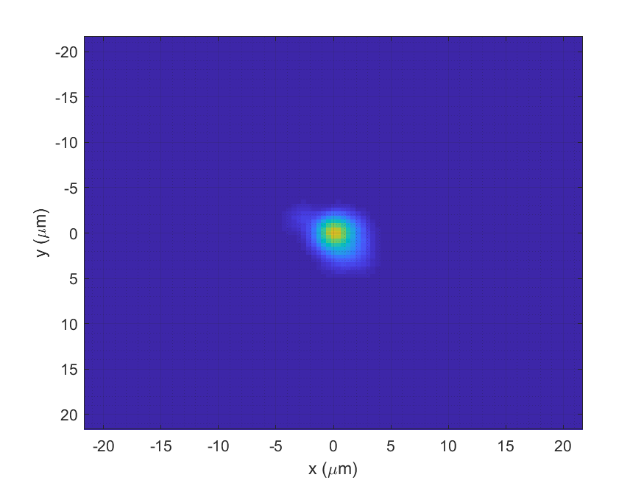
Electron Beam Formation via Ionization Injection ​Seeding for Next Generation Accelerator R&D
Jet backing pressure ~14PSI, jet window 70µs, chamber’s steady state pressure 4.5x10⁻⁵ Torr
Accelerator plate voltage 2kV, MCP voltage 1.9kV, accl distance 40mm, drift distance 90mm, measurement averaged over 10 shots
Laser duration ~60fs, energies 1mJ ~ 12mJ, 12Hz rep rate
Focal spot:

Slide 7
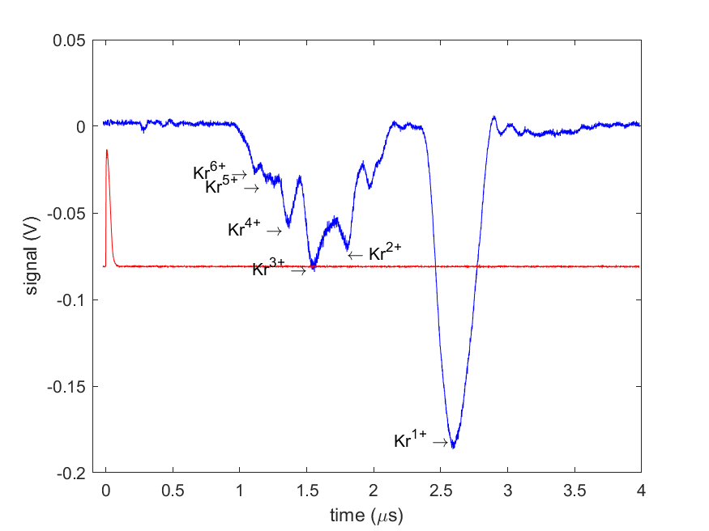
Electron Beam Formation via Ionization Injection ​Seeding for Next Generation Accelerator R&D
$$1.7±0.2mJ$$
Low intensity – good agreement with ‘Textbook theory’
d$elay=\frac{(2×accl dist. +drift distance)}{\sqrt{2∙V∙e}}×\sqrt{\frac{m}{Z}}\sim \sqrt{\frac{1}{z}}$

Slide 8
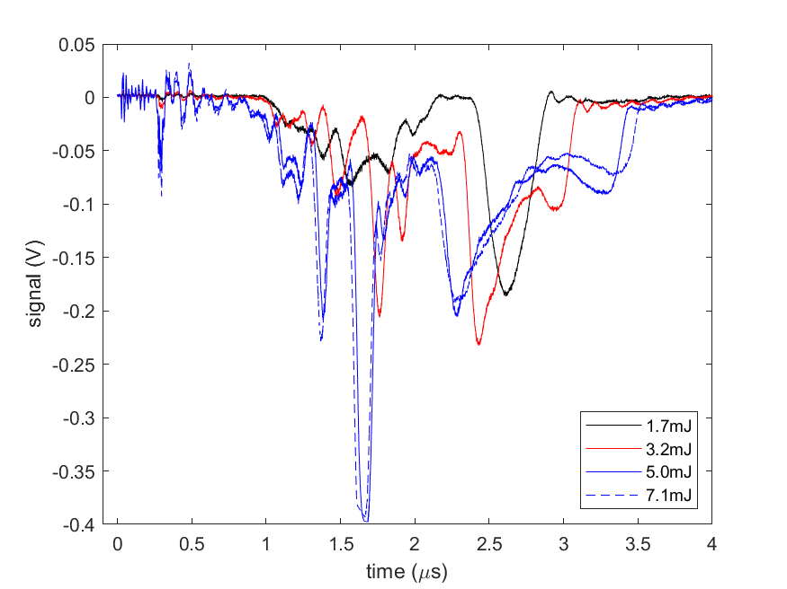
Electron Beam Formation via Ionization Injection ​Seeding for Next Generation Accelerator R&D
$$1.7 to 5mJ$$
Mid intensity – peak splitting
Peak splitting

Slide 9
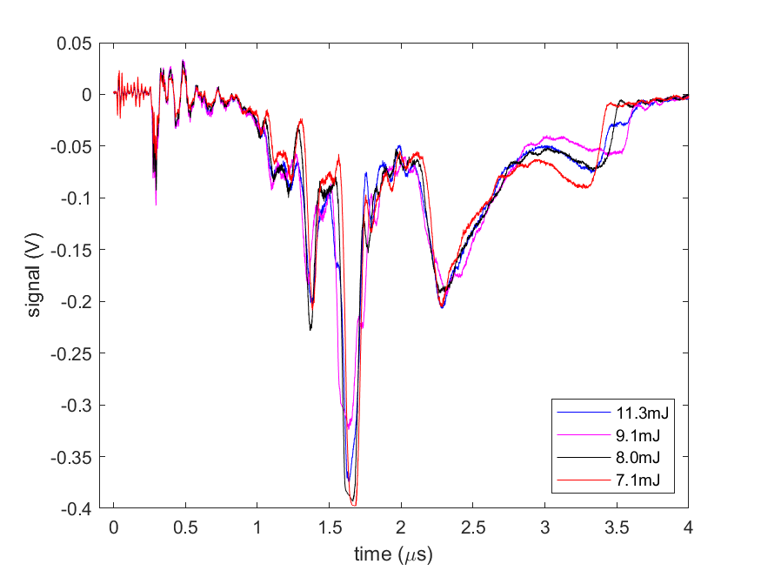
Electron Beam Formation via Ionization Injection ​Seeding for Next Generation Accelerator R&D
$$7.1mJ and above$$
Higher intensities – no additional splitting

Slide 10
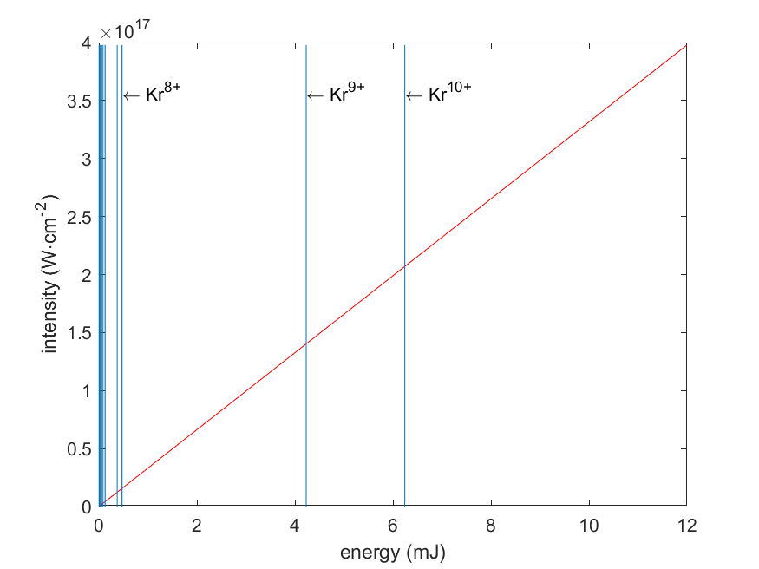
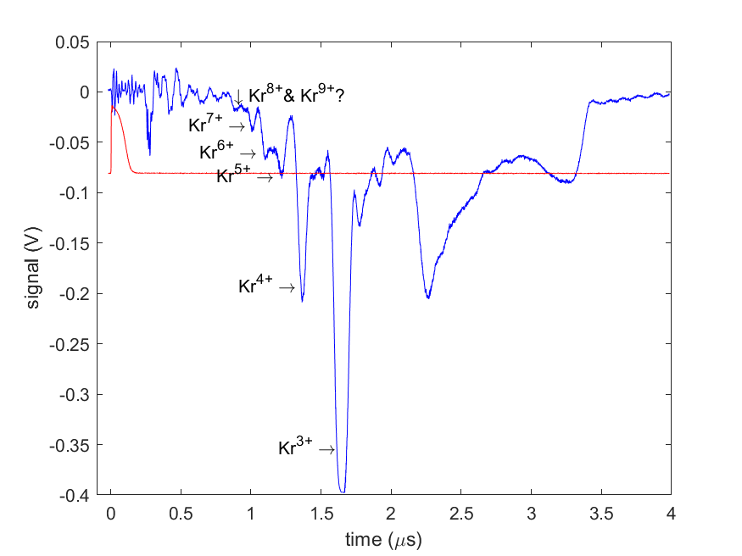
Electron Beam Formation via Ionization Injection ​Seeding for Next Generation Accelerator R&D
Barrier Suppression Model with $ω_{0}=4μm$ flat-top beam
High intensity – (optimistic interpretation) a shoulder appears at +8/+9 location

Slide 11
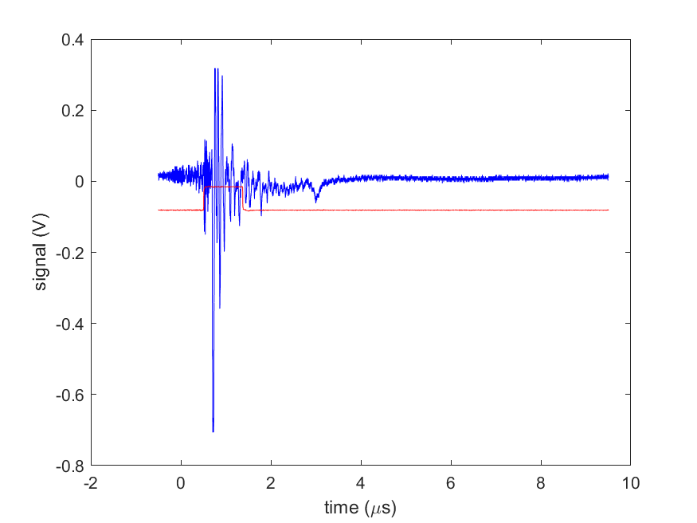
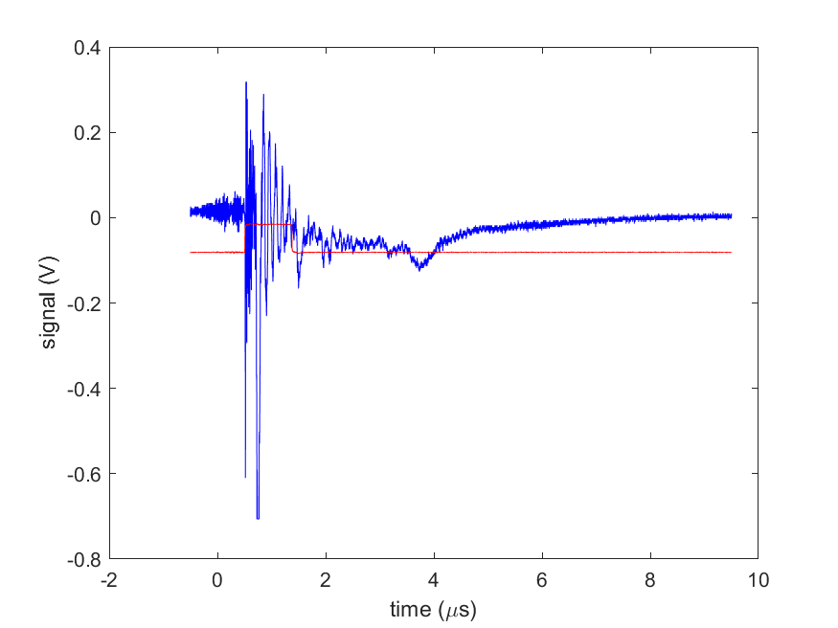
Electron Beam Formation via Ionization Injection ​Seeding for Next Generation Accelerator R&D
TOF with CO₂
1.2J
3J
Kr⁺¹
Kr⁺¹ splitting
Protons?

Slide 12
Electron Beam Formation via Ionization Injection ​Seeding for Next Generation Accelerator R&D
Next steps:
Repeat TOF measurements with improved spectrometer
Improve consistency of electron generation by CO2
Replace OAP mount
Install permanent CO2 focus diagnostic
Transition to vertically mounted jet
Remote controlled backing pressure control

Slide 13
Electron Beam Requirements
Parameter | Units | Typical Values | Comments | Requested Values
Beam Energy | MeV | 50-65 | Full range is ~15-75 MeV with highest beam quality at nominal values | N/A
Bunch Charge | nC | 0.1-2.0 | Bunch length & emittance vary with charge | N/A
Compression | fs | Down to 100 fs (up to 1 kA peak current) | A magnetic bunch compressor available to compress bunch down to ~100 fs. Beam quality is variable depending on charge and amount of compression required. NOTE: Further compression options are being developed to provide bunch lengths down to the ~10 fs level | N/A
Transverse size at IP (σ) | μm | 30 – 100 (dependent on IP position) | It is possible to achieve transverse sizes below 10 um with special permanent magnet optics. | N/A
Normalized Emittance | μm | 1 (at 0.3 nC) | Variable with bunch charge | N/A
Rep. Rate (Hz) | Hz | 1.5 | 3 Hz also available if needed | N/A
Trains mode | --- | Single bunch | Multi-bunch mode available. Trains of 24 or 48 ns spaced bunches. | N/A

Slide 14
CO₂ Laser Requirements
Configuration | Parameter | Units | Typical Values | Comments | Requested Values
CO₂ Regenerative Amplifier Beam | Wavelength | μm | 9.2 | Wavelength determined by mixed isotope gain media
 | Peak Power | GW | ~3
 | Pulse Mode | --- | Single
 | Pulse Length | ps | 2
 | Pulse Energy | mJ | 6
 | M² | --- | ~1.5
 | Repetition Rate | Hz | 1.5 | 3 Hz also available if needed
 | Polarization | --- | Linear | Circular polarization available at slightly reduced power
CO₂ CPA Beam | Wavelength | μm | 9.2 | Wavelength determined by mixed isotope gain media | 9.2
Note that delivery of full power pulses to the Experimental Hall is presently limited to Beamline #1 only. | Peak Power | TW | 2 | ~5 TW operation is planned for FY21 (requires further in-vacuum transport upgrade). A 3-year development effort to achieve >10 TW and deliver to users is in progress. | 2/5
 | Pulse Mode | --- | Single |  | single
 | Pulse Length | ps | 2 |  | 2
 | Pulse Energy | J | ~5 | Maximum pulse energies of >10 J will become available in FY20 | 2/10
 | M² | --- | ~2
 | Repetition Rate | Hz | 0.05
 | Polarization |  | Linear | Adjustable linear polarization along with circular polarization will become available in FY20

Slide 15
Near IR Experimental Laser Requirements
Ti:Sapphire Laser System | Units | Stage I Values | Stage II Values | Comments | Requested Values
Central Wavelength | nm | 800 | 800 | Stage I parameters have been delivered, while Stage II parameters will be available for user experiments once our vacuum transport installation is complete (now planned for FY21 after COVID-19 delays) | 800
FWHM Bandwidth | nm | 20 | 13
Compressed FWHM Pulse Width | fs | <55 | <75 | Transport of compressed pulses will initially include a very limited number of experimental interaction points. Please consult with the ATF Team if you need this capability. | 60
Chirped FWHM Pulse Width | ps | ≥50 | ≥50
Chirped Energy | mJ | >30 | 200
Compressed Energy | mJ | >14 | 100 |  | 15
Energy to Experiments | mJ | >10 | >80
Power to Experiments | GW | >250 | >1067
Nd:YAG Laser System | Units | Typical Values | 2021 Modifications | Comments | Requested Values
Wavelength | nm | 1064 | 1064 | Single pulse
Energy | mJ | 5 | 100
Pulse Width | ps | 14 | <20
Wavelength | nm | 532 |  | Frequency doubled
Energy | mJ | 0.5
Pulse Width | ps | 10

Slide 16
Special Equipment Requirements and Hazards
Electron Beam
N/A
CO₂ Laser
none
Ti:Sapphire and Nd:YAG Lasers
none
Hazards & Special Installation Requirements
none

Slide 17
COVID-19 Pandemic Impacts
Delay of beam time (from March to September 2020)

Slide 18
Experimental Time Request
CY2021 Time Request
Capability | Setup Hours | Running Hours
Electron Beam Only | N/A | N/A
Laser* Only (in Laser Rooms) | 80 | 120
Laser(s)* + Electron Beam
Time Estimate for Remaining Years of Experiment (including CY2021)
Capability | Setup Hours | Running Hours
Electron Beam Only | N/A | N/A
Laser* Only (in FEL Room) | 160 | 240
Laser(s)* + Electron Beam
* Laser = Near-IR or LWIR (CO₂) Laser

Slide 19
Electron Beam Formation via Ionization Injection ​Seeding for Next Generation Accelerator R&D

