Slide 1
AE89 : Plasma Compression for Terawatt Long Wavelength Lasers PI: Daniel Gordon, Naval Research Laboratory Funding: Office of Naval Research, Received
Yu-hsin Chen, Patrick Grugan, Antonio Ting, A. Mamonau
Plasma Physics Division, Naval Research Laboratory
R. Kupfer, M. Babzien, M. Polyanskiy, I. Pogorelsky, M. Palmer
Accelerator Test Facility, Brookhaven National Laboratory
December 7, 2020

Slide 2
Overview of Experimental Objective (updated)
Counter-propagate ATF CO₂ and an ultra-short seed pulse with slightly longer wavelength
Timing jitter must satisfy Δt << c/L, where L is the interaction length, L ~ 1 mm
Pump source
Seed source
9.2 micron, 3 J, 5 ps
ATF CO₂ Laser
Driven by ATF Ti:sapphire laser
Helium/Hydrogen
N_{e} = 5x10¹⁷ cm⁻³
L = 1.5 mm
Output:
0.5 J
11 micron
150 fs
100 nJ
11 micron
100 fs
Parameters have been updated for operation of BESTIA at 9 microns, and to reflect preference for somewhat shorter output wavelength, based on seed pulse results.

Slide 3
Progress in CY2020
Obtained seed pulse data March 2020
Primary enabler was DTGS sensor
Right before lockdowns!
Extensive simulation study of seed pulse experiments
Simulations of BRA with observed seed pulse parameters
Manuscript on experiments and simulation under review
Lessons learned pointed to a new seed pulse generator and diagnostic
Started building at NRL
Missing: no experiments with CO₂ laser

Slide 4
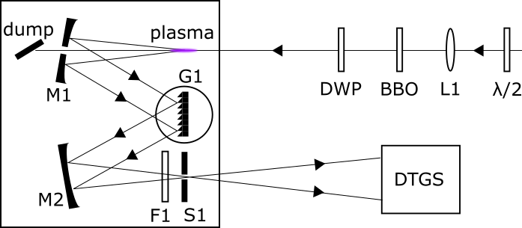
Experimental Setup for LWIR Seed Source
Workhorse was a specially built 4f grating spectrometer
(Also tried MCT)

Slide 5
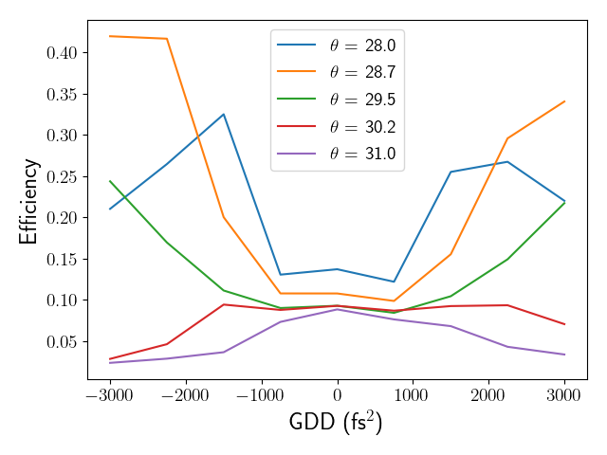
Second Harmonic Generation within the Seed Source
Efficiency was low, likely due to combination of third order effects and imperfect beam
Experimental Measurements
turboWAVE nonlinear optics model
(accounting for third order effects)
Efficiency
Duration

Slide 6
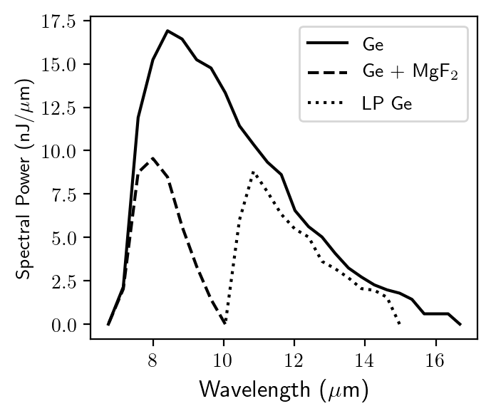
Experimental Data from LWIR Seed Source
Spectra due to shortest possible drive pulse (55 fs)
Drive pulse energy was 6.3 mJ
Various filters used for filter F1 as additional check

Slide 7
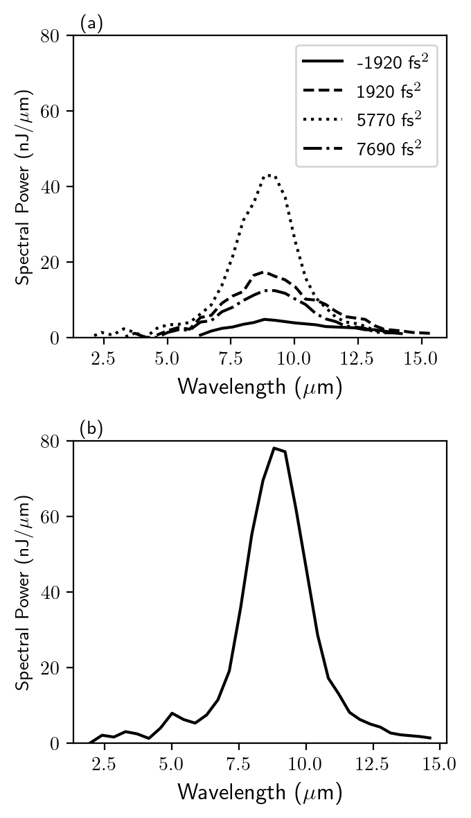
Effect of varying GDD and drive pulse energy
Dependence on GDD somewhat unexpected
A little more drive pulse energy goes a long way
6.3 mJ drive pulse
7.5 mJ drive pulse

Slide 8
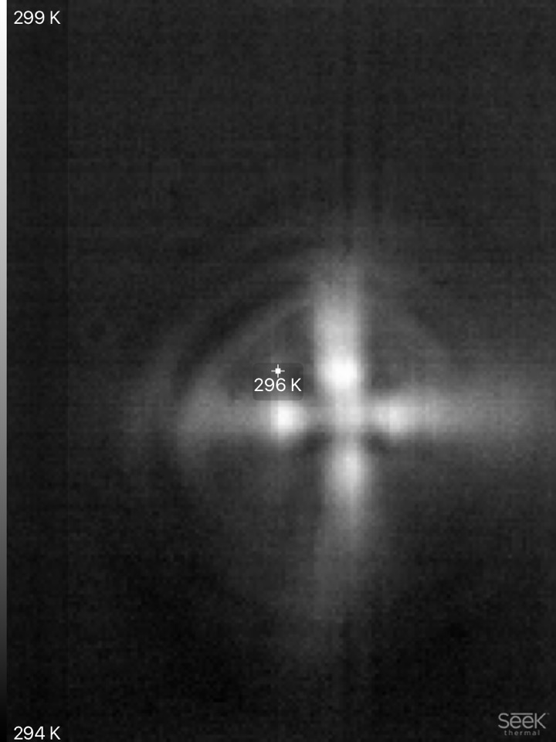
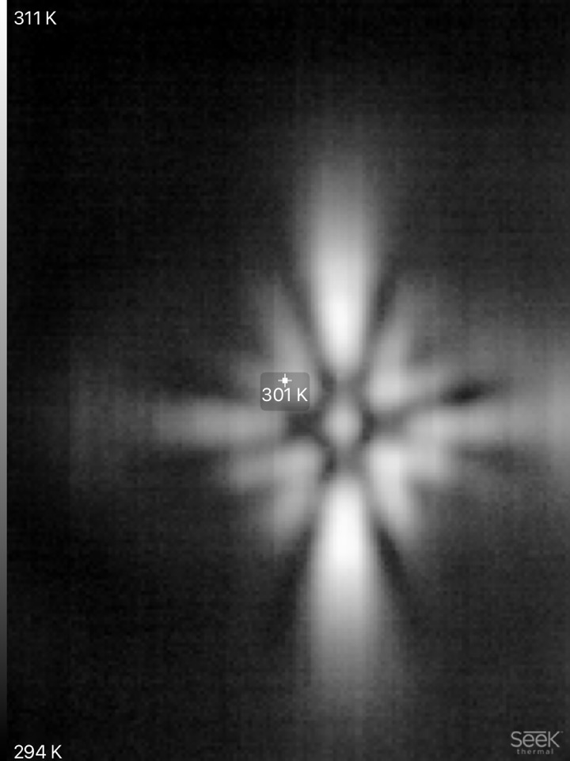
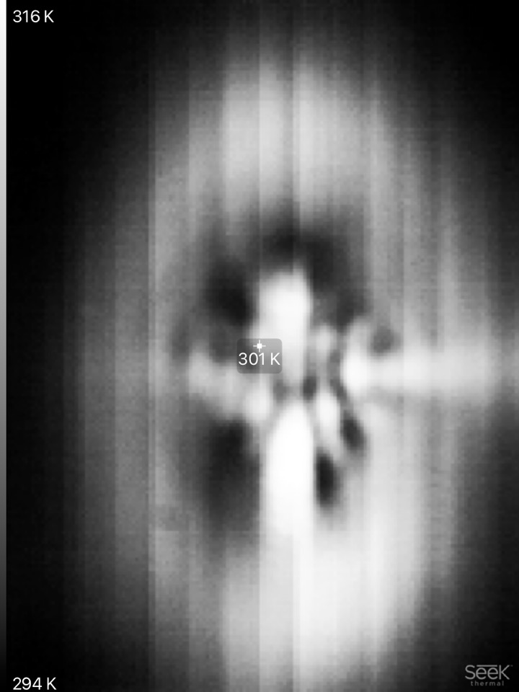
Spatial patterns were measured, but likely there is a systematic error
We noted at NRL that the SHG pattern has azimuthally varying hot spots which appear to be associated with iris leaf intersections.
Tuning up

Slide 9
Simulations using SeaRay Propagation Code
SeaRay is an NRL propagation code written in Python with GPGPU acceleration
https://github.com/USNavalResearchLaboratory/SeaRay, https://searay.readthedocs.io
Features include
Multiple propagation models with various levels of detail with hand-off procedure built-in
Ray tracing, paraxial, UPPE
Ray tracing through optical systems can be coupled into and out of physics models
Full humid air dispersion relation built in
UPPE model is most useful for this work
Arbitrarily broadband radiation, fully dispersive
Not as expensive computationally as PIC
Added during 2020
Various ionization models (PPT tunneling used in the following)
CO₂ gain media (translation of co2amp routines to Python)
CPA system elements for eikonal beamline models

Slide 10
Recovering the observed scaling with GDD
Variation of nonlinear index with pulse duration put in phenomenologically
Variation of SHG efficiency with pulse duration put in phenomenologically

Slide 11
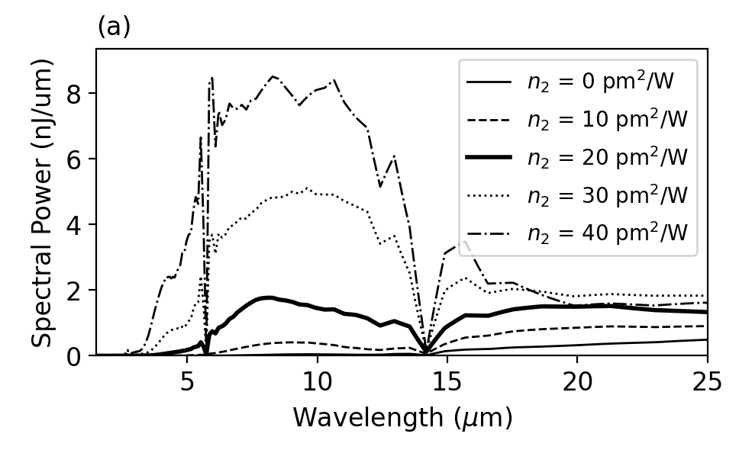
Effect of nonlinear index taken in isolation
The SHG efficiency figures into the LWIR yield as a linear factor
Less obvious conclusion is that variation of nonlinear index of air with pulse duration affects the LWIR yield
Holding SHG efficiency and drive pulse chirp (4000 fs²) fixed

Slide 12
LWIR seed pulse generator and in-situ diagnostic
In air, larger photocurrents are also shorter in time, leading to an unfavorable trade-off between wavelength and pulse energy.
Proposed solution is controlled gas environment, with gas that can be multiply ionized.
Noble gas environment
Gas inlet
Salt
Prism
Laser entrance and gas outlet

Slide 13
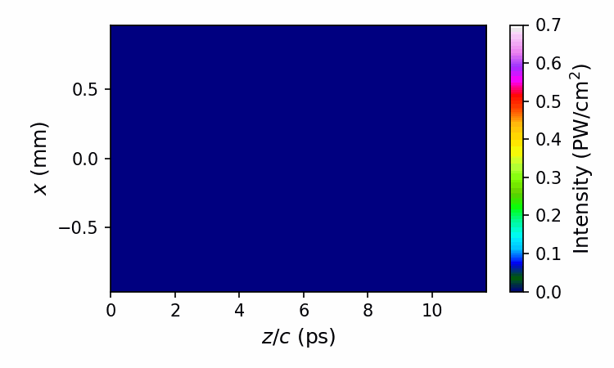
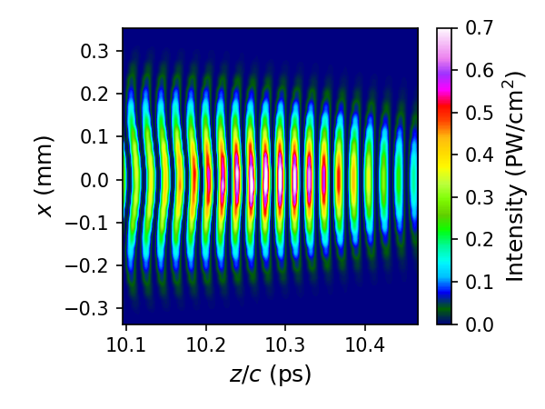
TurboWAVE Simulation of Revised BRA Parameters
Changes: Operate at 11 microns instead of 15 microns, use He/H₂ mixture

Slide 14
2020 Activities & Impacts Associated with this Experiment
Manuscript
D.F. Gordon et al., “Seed source for plasma compression in the long wavelength infrared,” submitted to Phys. Plasmas, under review
Patent
Patent disclosure (combined LWIR spectrometer and source) in preparation for the NRL patent evaluation board

Slide 15
COVID-19 Pandemic Impacts
Experiments mostly shut down
Limited access to CO₂ laser
NRL lasers are being restored

Slide 16
Summary
Generated up to 300 nJ ~50% bandwidth LWIR pulses for seeding
Effect of drive pulse chirp (for fixed energy) is due to combination of SHG efficiency and rotational contribution to nonlinear index of air
Updated simulations of both seed pulse generation and plasma compression
New combination seed source and broad range spectrometer under construction
Would like to start shooting gas jet plumes with CO₂ laser
Interferometry
Spontaneous backward Raman

Slide 17
Electron Beam Requirements
Parameter | Units | Typical Values | Comments | Requested Values
Beam Energy | MeV | 50-65 | Full range is ~15-75 MeV with highest beam quality at nominal values | 0
Bunch Charge | nC | 0.1-2.0 | Bunch length & emittance vary with charge | 0
Compression | fs | Down to 100 fs (up to 1 kA peak current) | A magnetic bunch compressor available to compress bunch down to ~100 fs. Beam quality is variable depending on charge and amount of compression required. NOTE: Further compression options are being developed to provide bunch lengths down to the ~10 fs level | -
Transverse size at IP (σ) | μm | 30 – 100 (dependent on IP position) | It is possible to achieve transverse sizes below 10 um with special permanent magnet optics. | -
Normalized Emittance | μm | 1 (at 0.3 nC) | Variable with bunch charge | -
Rep. Rate (Hz) | Hz | 1.5 | 3 Hz also available if needed | -
Trains mode | --- | Single bunch | Multi-bunch mode available. Trains of 24 or 48 ns spaced bunches. | -
EXPERIMENT DOES NOT USE ELECTRON BEAM

Slide 18
CO₂ Laser Requirements
Configuration | Parameter | Units | Typical Values | Comments | Requested Values
CO₂ Regenerative Amplifier Beam | Wavelength | μm | 9.2 | Wavelength determined by mixed isotope gain media | 9.2
 | Peak Power | GW | ~3 |  | >0.3
 | Pulse Mode | --- | Single |  | single
 | Pulse Length | ps | 2 |  | 1-3
 | Pulse Energy | mJ | 6 |  | >0.5
 | M² | --- | ~1.5 |  | <3
 | Repetition Rate | Hz | 1.5 | 3 Hz also available if needed | >1
 | Polarization | --- | Linear | Circular polarization available at slightly reduced power | linear
CO₂ CPA Beam | Wavelength | μm | 9.2 | Wavelength determined by mixed isotope gain media | 9.2
Note that delivery of full power pulses to the Experimental Hall is presently limited to Beamline #1 only. | Peak Power | TW | 2 | ~5 TW operation is planned for FY21 (requires further in-vacuum transport upgrade). A 3-year development effort to achieve >10 TW and deliver to users is in progress. | >1
 | Pulse Mode | --- | Single |  | single
 | Pulse Length | ps | 2 |  | 1-5
 | Pulse Energy | J | ~5 | Maximum pulse energies of >10 J will become available in FY20 | >1
 | M² | --- | ~2 |  | <3
 | Repetition Rate | Hz | 0.05 |  | 0.05
 | Polarization |  | Linear | Adjustable linear polarization along with circular polarization will become available in FY20 | linear

Slide 19
Other Experimental Laser Requirements
Ti:Sapphire Laser System | Units | Stage I Values | Stage II Values | Comments | Requested Values
Central Wavelength | nm | 800 | 800 | Stage I parameters should be achieved by mid-2020, while Stage II parameters are planned for late-2020. | 800
FWHM Bandwidth | nm | 20 | 13 |  | 20
Compressed FWHM Pulse Width | fs | <55 | <75 | May want slightly chirped pulse up to 200 fs | 50-200
Chirped FWHM Pulse Width | ps | ≥50 | ≥50 |  | -
Chirped Energy | mJ | >30 | 200 |  | -
Compressed Energy | mJ | >14 | 100 |  | -
Energy to Experiments | mJ | >10 | >80 |  | 10
Power to Experiments | GW | >250 | >1067 |  | 300
Nd:YAG Laser System | Units | Typical Values | Comments | Requested Values
Wavelength | nm | 1064 | Single pulse | -
Energy | mJ | 5 |  | -
Pulse Width | ps | 14 |  | -
Wavelength | nm | 532 | Frequency doubled | 532
Energy | mJ | 0.5 | Interferometry of gas jet | 0.5
Pulse Width | ps | 10 |  | 10

Slide 20
Special Equipment Requirements and Hazards
Electron Beam
none
CO₂ Laser
Vacuum waist size of ~ 0.5 mm
Ti:Sapphire and Nd:YAG Lasers
Synchronization with CO2 to within 1.5 ps
Spatial overlap with CO2 to within 250 microns
Hazards & Special Installation Requirements
Considering mixing hydrogen and helium
Ablation of beam dump used in seed generation
Eyewear/controls for ultra-broad spectral products

Slide 21
Experimental Time Request
CY2020 Time Request
Capability | Setup Hours | Running Hours
Electron Beam Only | 0 | 0
Laser* Only (in FEL Room) | 200 | 200
Laser* + Electron Beam | 0 | 0
Time Estimate for Remaining Years of Experiment (including CY2020)
Capability | Setup Hours | Running Hours
Electron Beam Only | 0 | 0
Laser* Only (in FEL Room) | 400 | 400
Laser* + Electron Beam | 0 | 0
* Laser = Near-IR or LWIR (CO₂) Laser

