Slide 1




AE95 - Optical diagnosis of self-modulated CO2-laser-driven plasma wakes
R. Zgadzaj, James R Welch, M. C. Downer - University of Texas at Austin
M. Babzien, M. Fedurin, P. Kaur, R. Kupfer, K.Kusche, M. Polyanskiy, C. Swinson,
I. Pogorelsky, M. Palmer - Brookhaven National Lab, Accelerator Test Facility
I. Petrushina, L. D. Pinto de Almeida Amorim, M. Flament, P. Iapozzuto, Y. Jing,J. Yan, S. Kongtawong, P. Kumar, R. Samulyak, N. Vafaei-Najafabadi, V. Litvinenko - Stony Brook University
C. Zhang, W.B. Mori, C. Joshi -
University of California Los Angeles
Work supported by: AFOSR-MURI* grant FA9550-16-1-0013 DoE grant DE-SC0011617 DoE grant DE-SC0014043
ATF USERS MEETING, DEC. 09, 2020

Slide 2
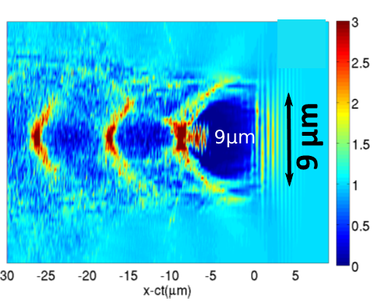
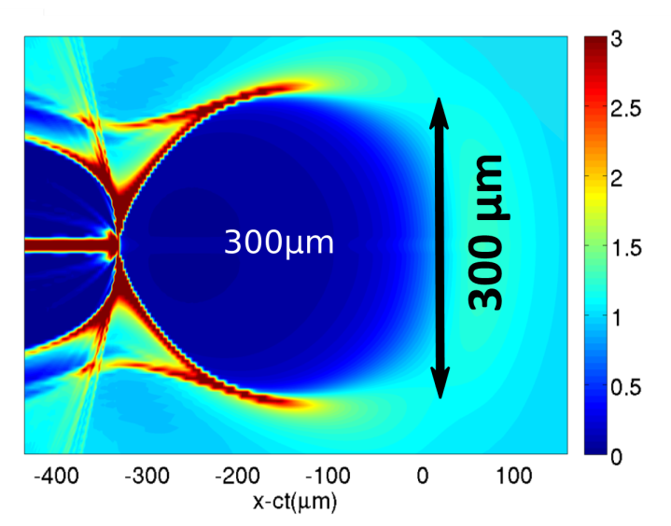

Vision: Quasi-mono-energetic LWFAs based on large, controlled mid-IR laser-driven bubbles
λ_{drive}= 0.8 µm (UT)
25 TW, 30 fs
λ_{drive}= 10 µm
25 TW, 500fs
n_{e}/n₀
n_{e}/n₀
n_{e} = 2 10¹⁹cm⁻³
n_{e} = 1 10¹⁶cm⁻³
simulations courtesy G. Shvets
The most intractable problems in LWFA science (16 years after 2004)
are ~ 10% energy spread (needed: 0.1%) & lack of e-spin-polarization.
Solution: 1) Increase Bubble size >>> a) driving it in lower plasma density 10¹⁶ < n_{e} < 10¹⁷ cm⁻³
    b) and efficiently using LWIR driver AE93/AE95/AE88
2) Control injection >>> a) self-injection absent for densities 10¹⁶ < n_{e} < 10¹⁷ cm⁻³
    b) inject micron sized, fs duration bunches from a linac AE93/AE95
    c) photo-inject electrons from high Z dopant into the bubble AE88
ATF USERS MEETING, DEC. 09, 2020

Slide 3
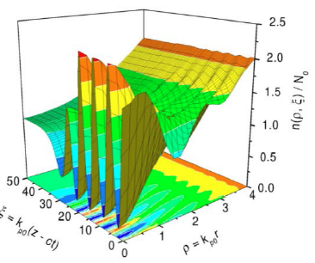
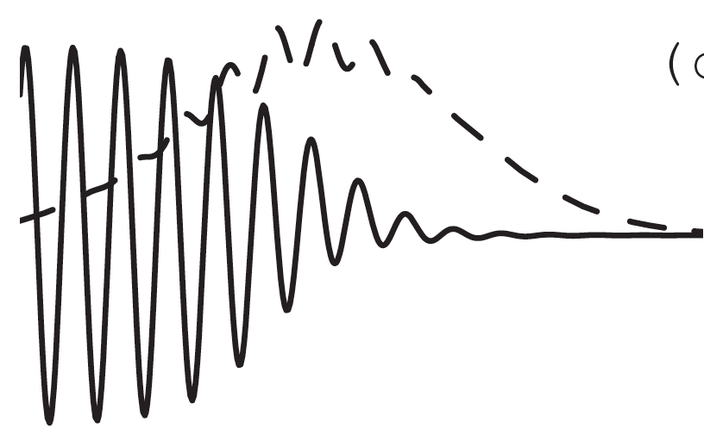
Vision: Quasi-mono-energetic LWFAs based on large, controlled mid-IR laser-driven bubbles
simulations:
N. E. Andreev et al.,
PR-STAB 6, 041301 (2003)
laser
Probe
AE95
Self-Modulated LWFA
n_{e} (cm⁻³)
τ (ps)
P (TW)
ATF CO₂
Laser pulse
~10¹⁸
4
0.5
n_{e}(ρ,ξ)/N₀
<<10¹⁸
<2
>2
e⁻
Probe
CO₂ driver
ξ = k_{p}(z – ct)
ρ = k_{p}r
55MeV, <200fs
AE93
Self-injected,
accelerated
Electrons
ATF USERS MEETING, DEC. 09, 2020

Slide 4


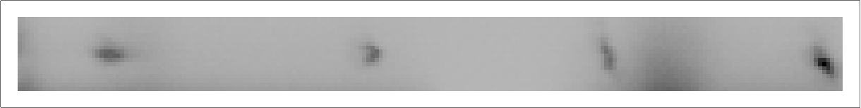
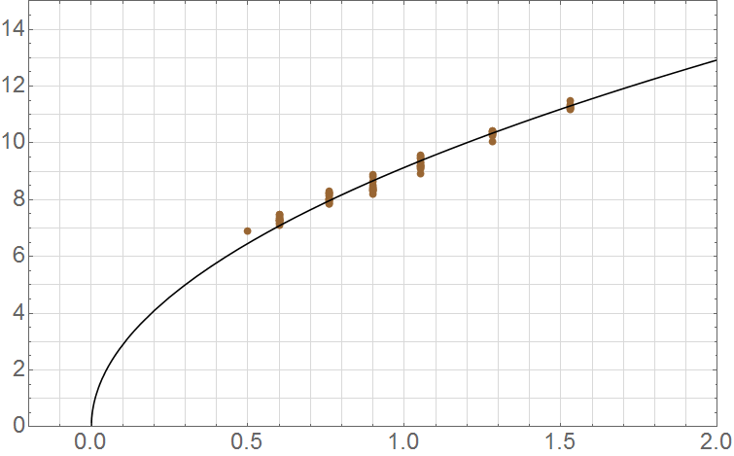

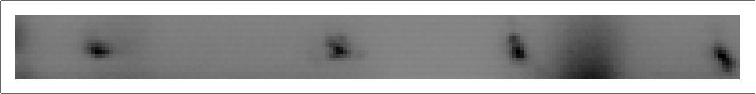
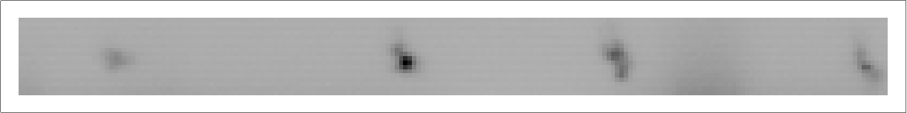
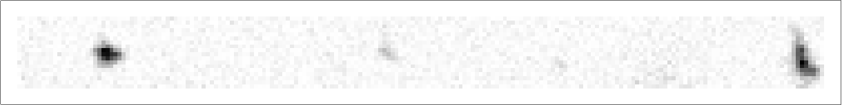
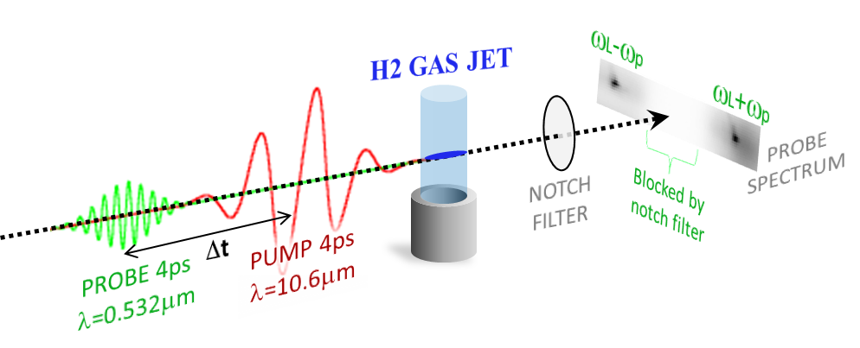
n_{e}-dependent probe spectral shifts 0.5TW, 4ps, λ=10.6µm CO₂ laser pulse drives SM-LWFA
J. Welch, “Self-modulated laser wakefields driven by a CO₂ laser,”
Doctoral Dissertation, UT Austin, August 2019.
n_{e} (10¹⁸ cm⁻³)
“red
zone”
0
0.5
1.0
1.5
2.0
Lower limit:
Notch filter
12
upper n_{e}
limit:
CO₂ laser
reflection
from jet
Notch filter blocking region
8
Mean Thomson shift (nm)
nm
4
n_{e}= 5 10¹⁷ cm⁻³
P_{cr} = 0.4 TW
λ_{p} = 47 µm
n_{e} = 1.8 10¹⁸ cm⁻³
P_{cr} = 0.1 TW
λ_{p} = 25 µm
-30
-20
10
20
30
0
0
1
2
-10
0
collective Thomson shift (nm)
Jet backing pressure (atm)
CO₂ laser pulse
drives SM-LWFA
New narrower notch filter will decrease the lower bound.
New plasma shutter has eliminated this problem.
4 ps, λ = 0.532 µm pulse probes wake via forward collective Thomson scatter as n_{e} , ∆t and P_{CO2} vary.
ATF USERS MEETING, DEC. 09, 2020

Slide 5
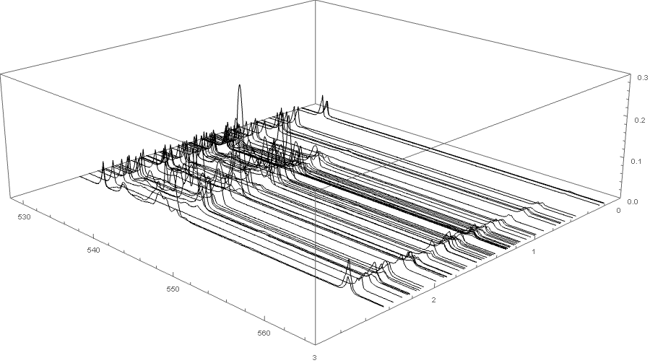
We observed the onset of self modulation near P ~ Pcrit
Leaked Probe spectrum
Stokes side band
Pump and Probe difference frequency
Blocked by interference filter
~1
wavelength[nm]
~P/Pcrit
n_{e} ~ 1.3 10¹⁸cm⁻³
Edge of notch filter blocking region has been moved closer to the probe wavelength, 532nm, by slight rotation.
P_{crit} = .017(ω/ω_{p})² TW = 0.1 TW
(P_{crit} - critical power for relativistic self-focusing)
ATF USERS MEETING, DEC. 09, 2020

Slide 6
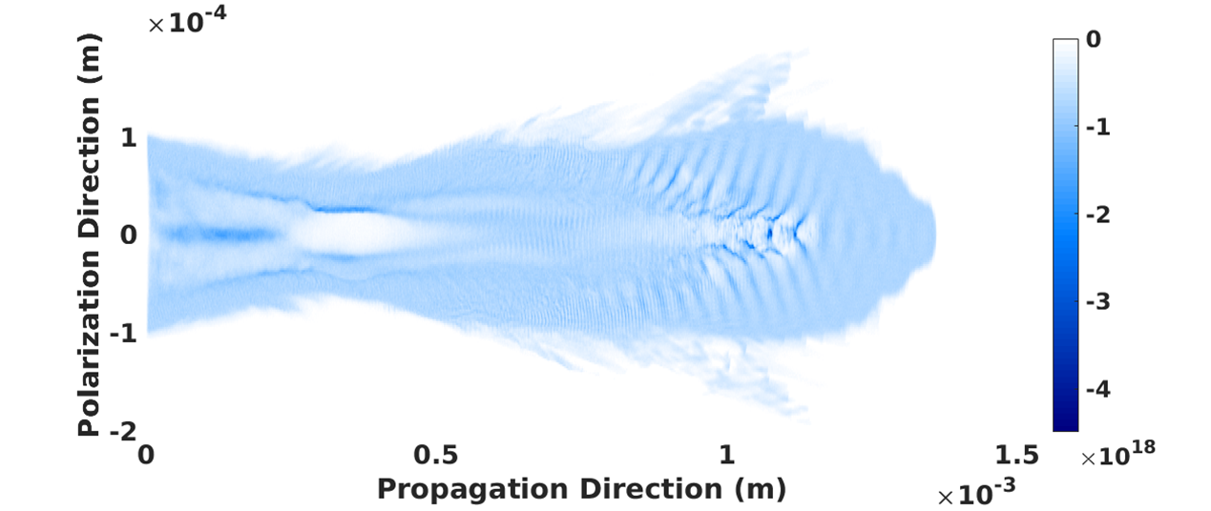
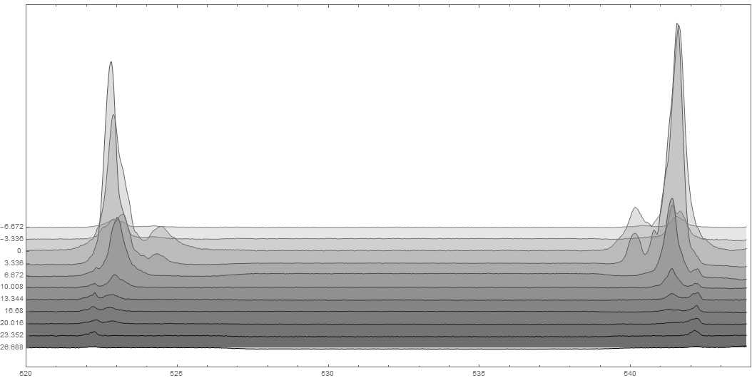
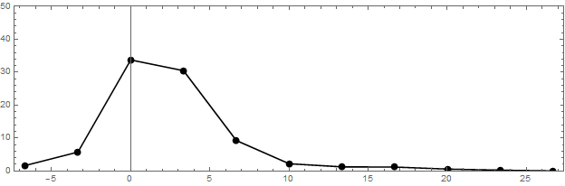
Probe-pump delay (∆t) shows wake decays 90% in ~10 ps, remnants visible at ∆t > 25 ps
K. Yu, R. Samulyak, “SPACE code for beam-plasma interactions,” Proc. IPAC, 728 (2015)
Simulation: Prabhat Kumar SPACE ¹ code
notch filter
anti-Stokes
Stokes
n_{e} = 1.5 × 10¹⁸ cm⁻³
sideband
amplitude
(arb. u.)
Spectral structure
observed around
∆t ≈ 0
average Stokes/
anti-Stokes amplitude
-6.67
0
∆t [ps]
6.67
13.33
20
Probe duration deconvolved
26.67
520
525
530
535
540
544
λ_{probe} [nm]
J. Welch, “Self-modulated laser wakefields driven by a CO₂ laser,” Doctoral Dissertation, UT Austin, August 2019.
ATF USERS MEETING, DEC. 09, 2020

Slide 7
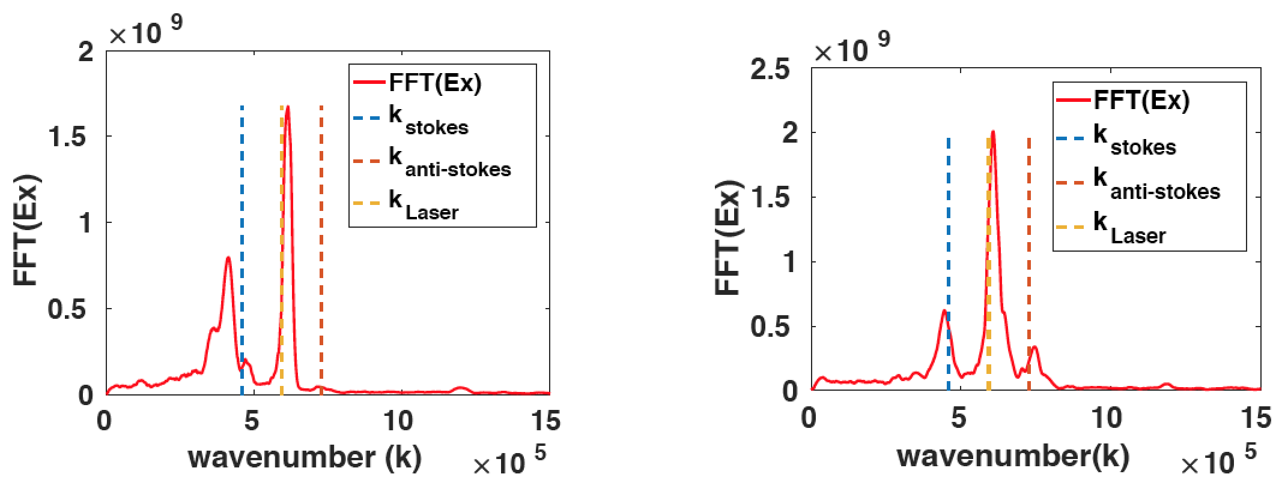
Ionization front seeds the forward Raman instability
Simulations using SPACE¹ code: P. Kumar, R. Samulyak, Stony Brook University
3D parallel, relativistic particle-in-cell code for simulating EM fields, relativistic particles, plasma & atomic processes
K. Yu, R. Samulyak, “SPACE code for beam-plasma interactions,” Proc. IPAC, 728 (2015)
P. Kumar, et al., “Simulation study of CO2 laser-plasma interactions and self-modulated wakefield acceleration”, Phys. Plasmas 26, 083106 (2019);
PRE-IONIZED PLASMA
DYNAMIC IONIZATON
1064nm PROBE SPECTRUM
On-axis Ex
On-axis Ex
0.1
0
0.1
0
Probe spectral side bands have equal amplitudes
0
0
x[mm]
n_{e}[10¹⁷cm⁻³]
x[mm]
n_{e}[10¹⁷cm⁻³]
-14
-12
-0.1
-0.1
0
Z [mm]
1.5
0.2
Z [mm]
1.3
ATF USERS MEETING, DEC. 09, 2020

Slide 8
Main findings from optical probe data at low pulse energies
• 1st detection of SM-wakes using long-λ driver
- record low n_{e} ~ 10¹⁷ cm⁻³
- wake growth: τ_{growth} ~ 1 ps
- record low P ~ 0.1 TW
- wake decay: 5 < τ_{decay} < 10 ps
- nonlinear wake structure
- complex S/AS spectral structure
(2nd-order S/AS sidebands)
- wake amp: depends non-monotonically on drive pulse energy
• Simulations confirmed observations, yielded new insight
- revealed complex, evolving wake structure
- showed ionization front seeds rapid wake growth
- showed primary SM-wake decays by exciting radial wake, ion channel
- reproduced spectrum of S/AS peaks via self-consistent probe simulation
- reproduced non-monotonic E_{CO2}-dependence
ATF USERS MEETING, DEC. 09, 2020

Slide 9
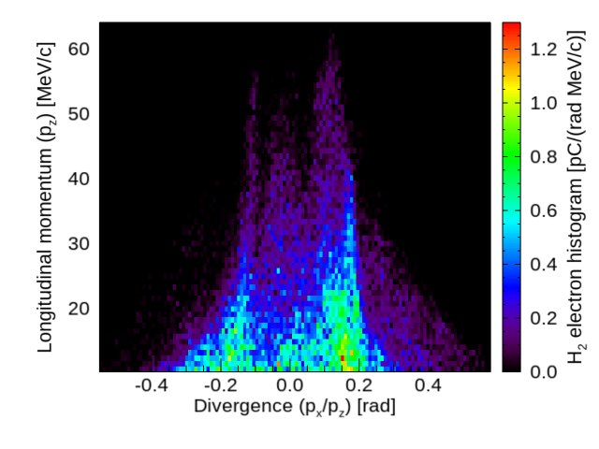
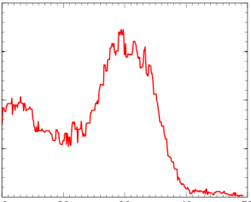

Electron self-injection and acceleration expected at current laser parameters
Simulation: Lidia Pinto de Almeida Amorim, SBU
Simulation: Chaojie Zhang, UCLA
¹
n_{e} = 4e17cm⁻³
P = 2 TW
30
3D-PIC
dq/dE (pC/MeV)
z = 4.8mm
10
w₀ = 50 µm
20
40
¹
Energy (MeV)
¹
Pump parameters
w0 =50micron , 1ps, 2J
4.8 mm H₂ jet
ne=4 10¹⁷cm⁻³
Simulation: Prbhat Kumar, SBU
Pump parameters
w0 =20micron , 2ps, 4J
1.2 mm H₂ jet
ne=7.5 10¹⁷cm⁻³
[1] R.A.Fonseca et al., NCS 2331, 343 (2002)
[2] K. Yu, R. Samulyak, “SPACE code for beam-plasma interactions,”
Proc. IPAC, 728 (2015)
SPACE² code
ATF USERS MEETING, DEC. 09, 2020

Slide 10
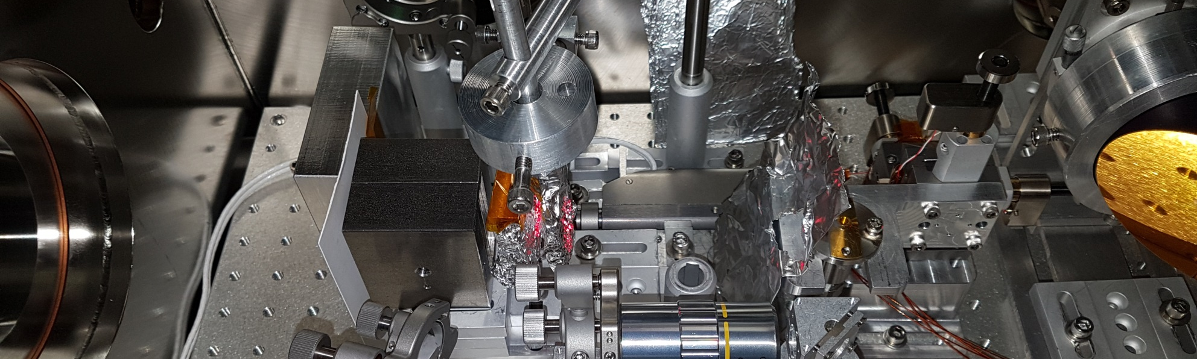
First Demonstration of SM-LWFA in the mid-IR
H2 gas jet 4mm length
n_{e} ~ 5e16 to 5e17/cc
From CTS probe measurement
magnet
Steel slit
B
slit
Lanex
Ref mask
Al foil
20micron
CO2 laser pulse: w0~30μm ,~2ps, 0.5J to 5J
CCD w/objective
ATF USERS MEETING, DEC. 09, 2020

Slide 11
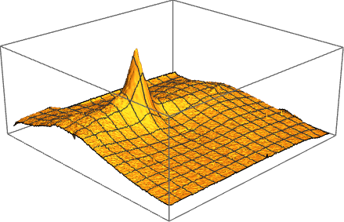
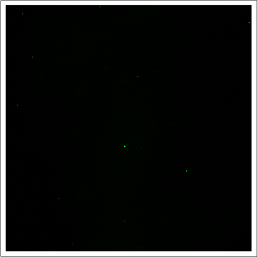
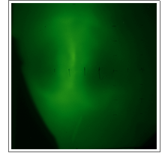
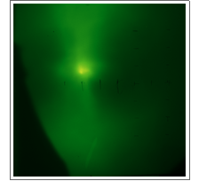
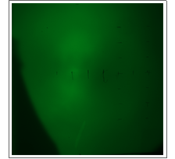
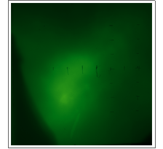
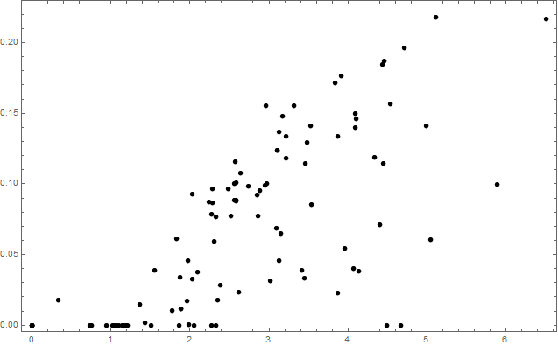
Upgrade to 2 TW, 2 ps CO₂ drive pulses resulted in copious few-MeV electrons
~60 mrad FWHM
1.0J
No Injection
1.8J
2.3J
4.0J
6.5J
E_{laser}
~0.3 rad
Lanex
4mm length
n_{e} = 4 x 10¹⁷ cm⁻³
from CTS probe measurement
~0.3 rad
H₂ gas jet
Lanex integrated signal [arb.]
s-pol
Al foil
20 µm
CO₂ laser pulse: 2 ps, 1 to 5 J
CCD
0 J
1 J
2 J
3 J
4 J
5 J
6 J
Laser pulse energy
ATF USERS MEETING, DEC. 09, 2020

Slide 12
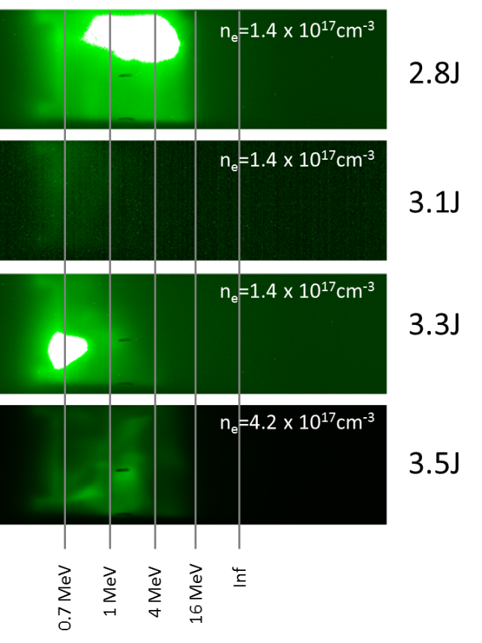
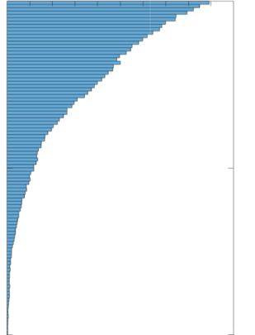
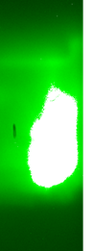
Upgrade to 2 TW, 2 ps CO₂ drive pulses resulted in copious few-MeV electrons
Variations in CO₂ laser profile lead to significant steering within plasma. As a result, the electron beam pointing also changes. Different parts of this beam fall on the spectrometer on each shot.
• several tens of pC charge
• peaked (non-exponential) energy spectrum
532nm,
2-4 ps probe
• self-injection observed down to n_{e} ~ 10¹⁷ cm⁻³ !!
(injection threshold confirmed by simulations)
SIMULATED
MEASURED
Charge (pC/eV)
H₂
jet
5
30
60
0.7
magnet
1
10
Electron energy (MeV)
Electron energy (MeV)
CCD
4
16
Lanex
15
∞
courtesy Prabhat Kumar
(SUNY-Stonybrook)
n_{e}=1.4 x 10¹⁷cm⁻³
Probe CTS Spectrum
CO₂ pulse
2TW, 2ps
Complex e-beam profiles and spectral structures are often observed at high n_{p} and/or high E_{CO2}
ATF USERS MEETING, DEC. 09, 2020

Slide 13
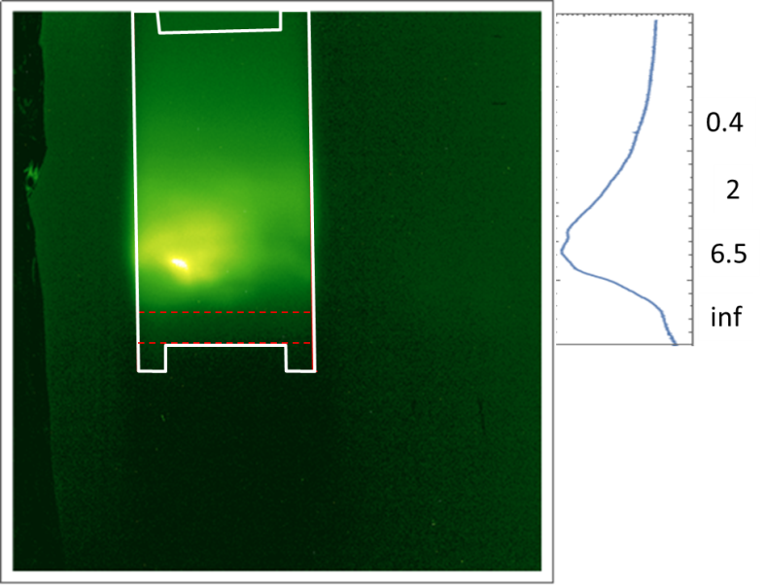
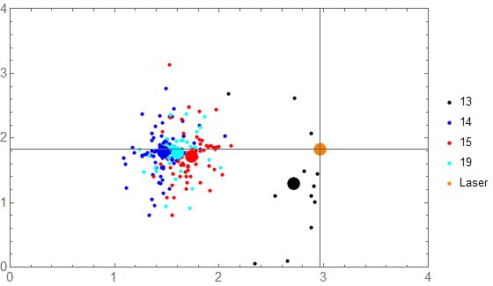
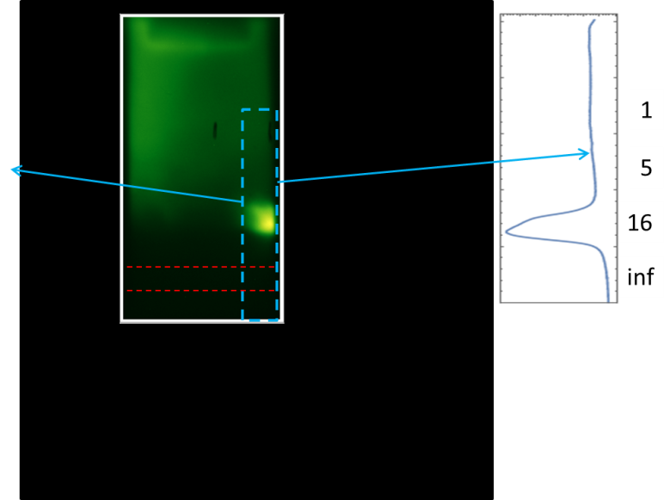
Upgrade to 2 TW, 2 ps CO₂ drive pulses resulted in copious few-MeV electrons
E= 3.8 J
n_{e} = 5.7 x 10¹⁷ cm⁻³
Variations in CO₂ laser profile lead to significant steering within plasma. As a result, the electron beam pointing also changes. Different parts of this beam fall on the spectrometer on each shot.
Significant pointing variation makes the use of a slit problematic
Total charge above ~1 MeV
> 0.8 pC
2mm slit
Magnetic deflection UP
[mm]
E= 4.2 J
n_{e} = 7.5 x 10¹⁷ cm⁻³
[mm]
Total charge above ~1 MeV >1.3 pC
2mm slit
Magnetic deflection UP
Complex e-beam profiles and spectral structures are observed at high n_{p} and E_{CO2}
ATF USERS MEETING, DEC. 09, 2020

Slide 14
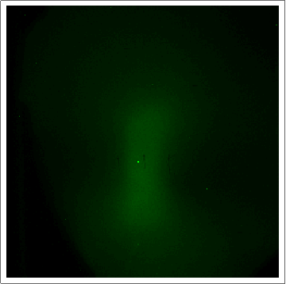
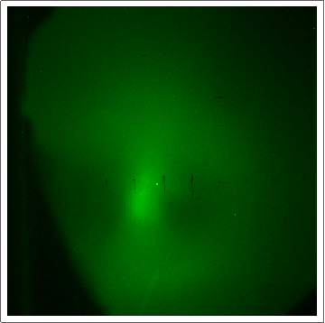
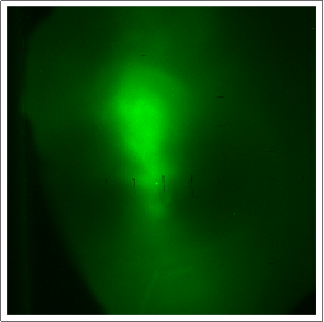
Accelerated electrons display evidence of Direct Laser Acceleration (DLA)
1.1J
No Injection
1.7J
2.4J
4.8J
E_{laser}
Lanex
~0.3 rad
4mm length
n_{e} = 1.4 x 10¹⁷ cm⁻³
from CTS probe measurement
H₂ gas jet
• e-beam profile
elongated along
E_{laser}
• e⁻ depleted
perp. to E_{laser}
s-pol
Al foil
20 µm
CO₂ laser pulse: 2 ps, 1 to 5 J
CCD
ATF USERS MEETING, DEC. 09, 2020

Slide 15
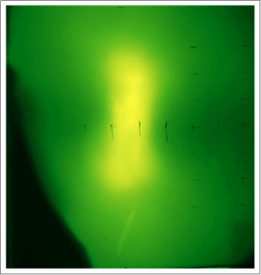
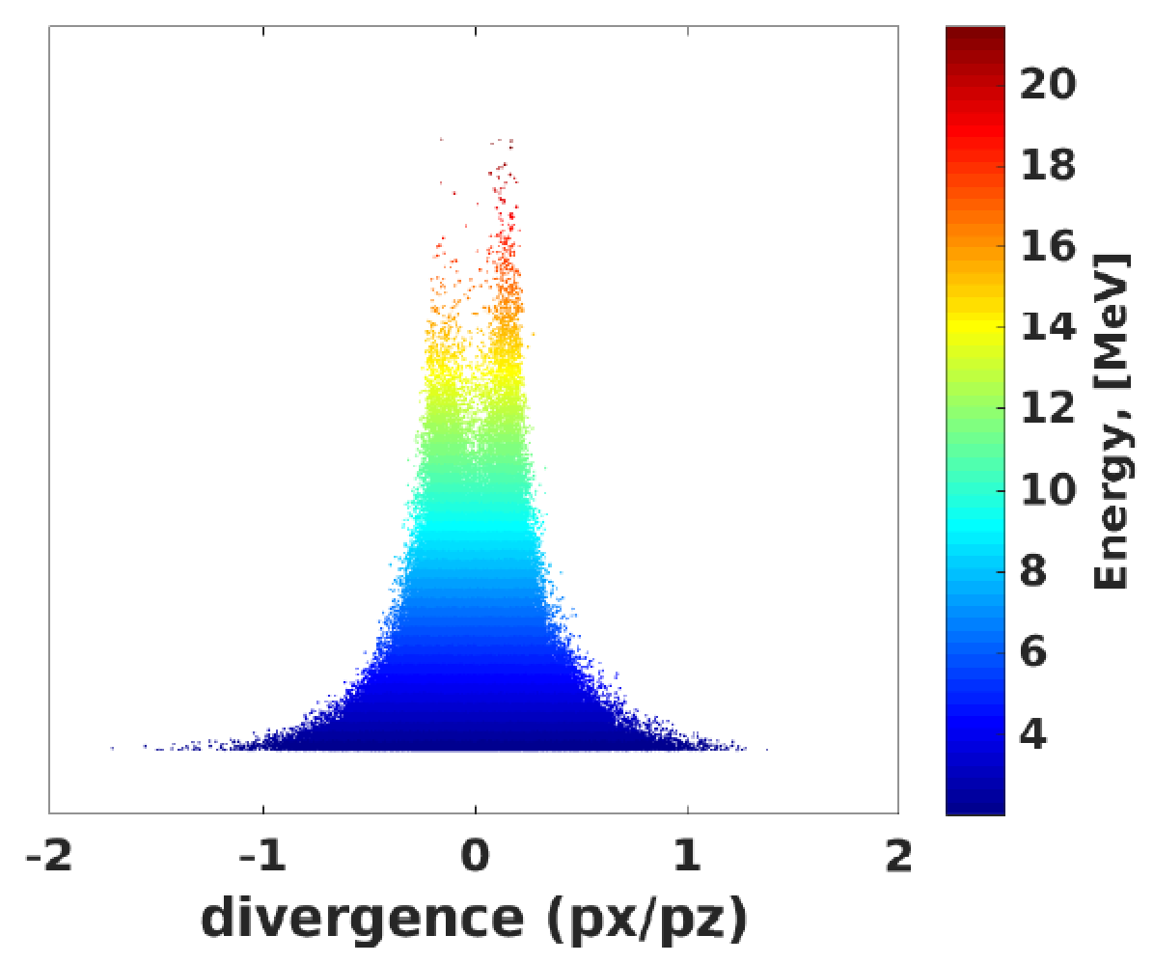

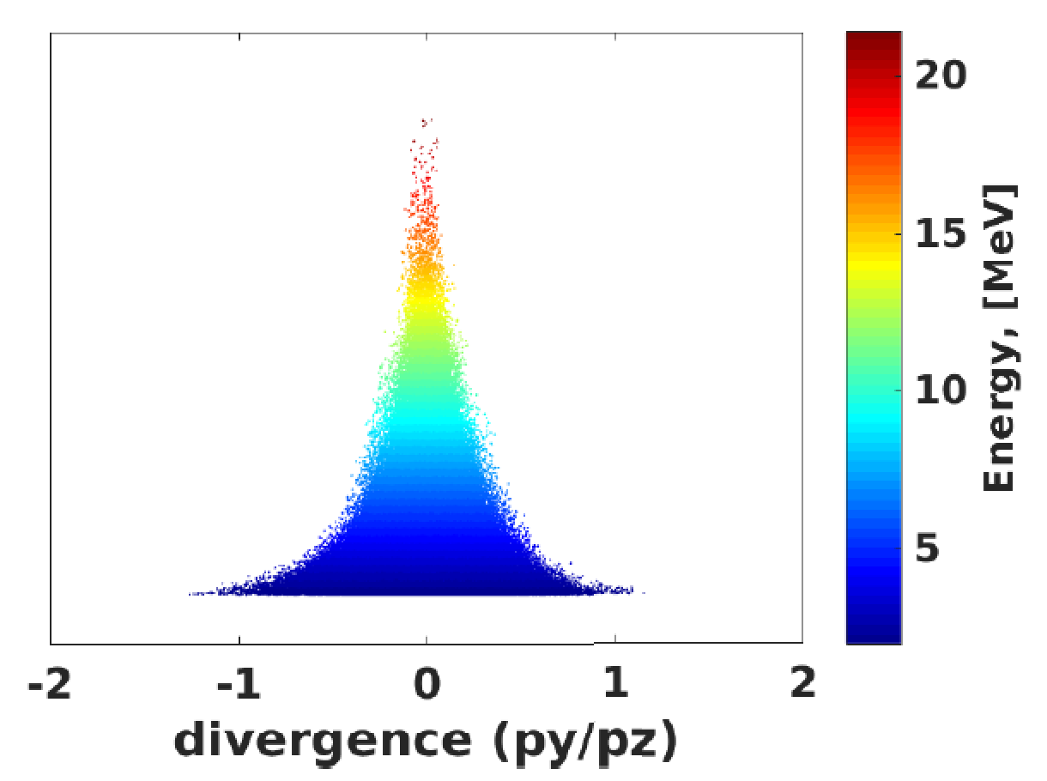
The Elongated, double-lobed e-beam profiles along E_{laser} are reproduced in simulations
n_{e} = 5 x 10¹⁷ cm⁻³
1
0
p_{x} /p_{z}
~0.1 rad
-1
E_{CO2} = 1.4 J, τ_{CO2} = 2 ps
5
10
15
20
Electron energy
[MeV]
-1
0
1
p_{y} /p_{z}
Simulation: Prabhat Kumar SPACE code
ATF USERS MEETING, DEC. 09, 2020

Slide 16
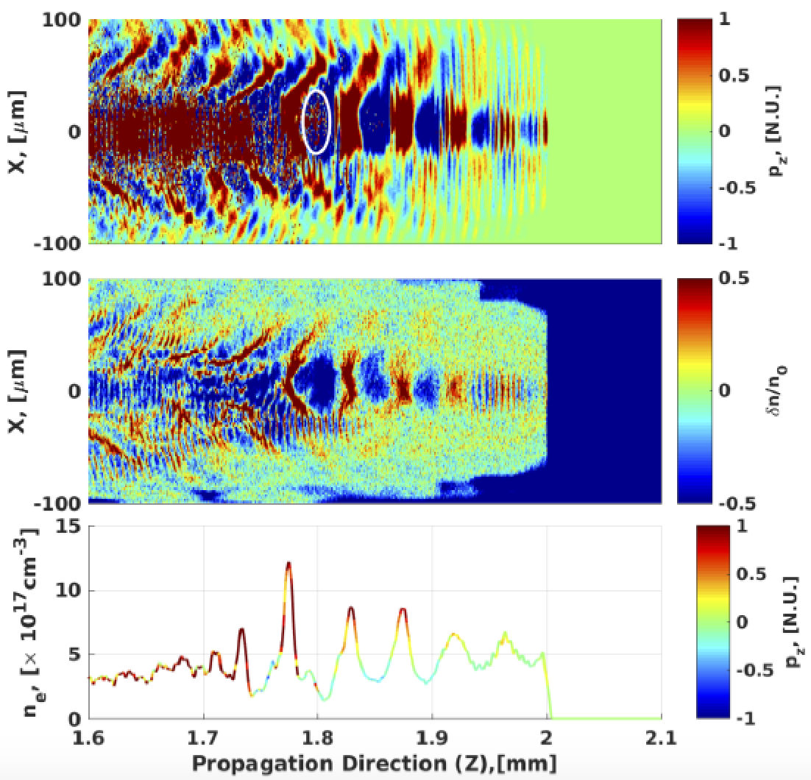
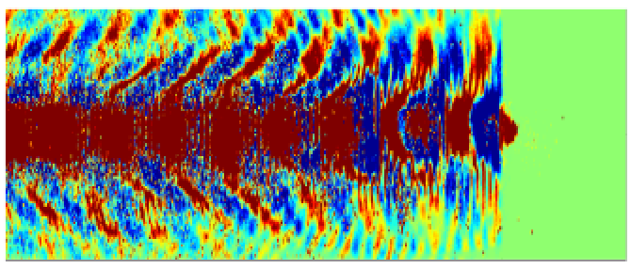
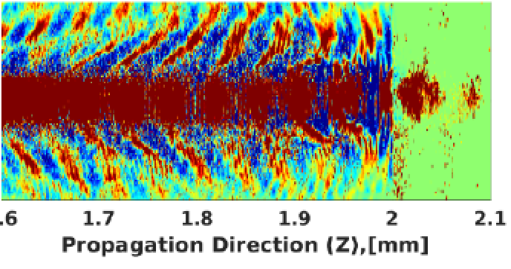
SPACE code simulations elucidate injection and acceleration in the new laser parameter regime.
• Self-injection coincides with wave-breaking
• Trapped e- move forward in wake thru
drive laser fields² before emerging
t
t +
300 fs
x [µm]
e-injection
p_{z} [norm. u.]
x [µm]
δn/n₀
t +
600 fs
wave-breaking
n_{e} [10¹⁷ cm⁻³]
lineout
of above
p_{z} [norm. u.]
¹ Laser: λ = 9.2 µm, w₀ = 20 µm, τ = 2 ps, E = 4 J
Plasma: n_{e0} = 5 x 10¹⁷ cm⁻³
² inducing Direct Laser Acceleration (DLA)
Prabhat Kumar et al., “Evolution of the self-injection process in long wavelength infrared laser driven LWFA,” Physics of Plasmas, ACCEPTED
ATF USERS MEETING, DEC. 09, 2020

Slide 17
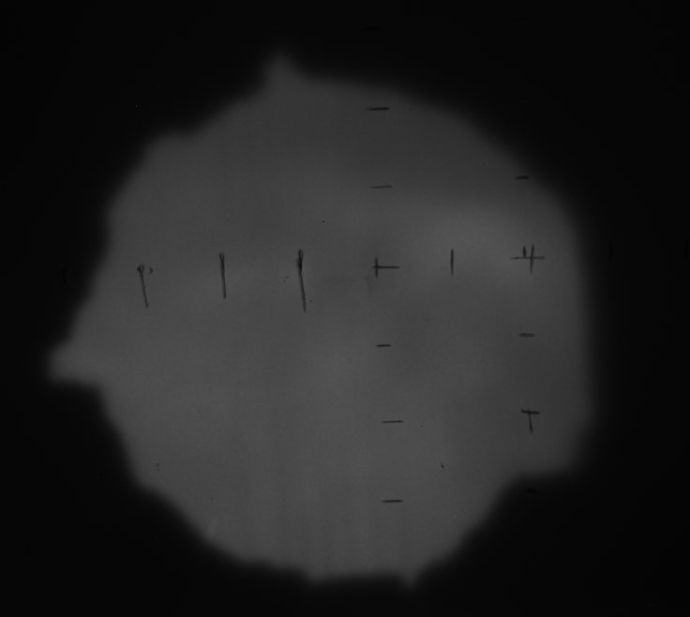
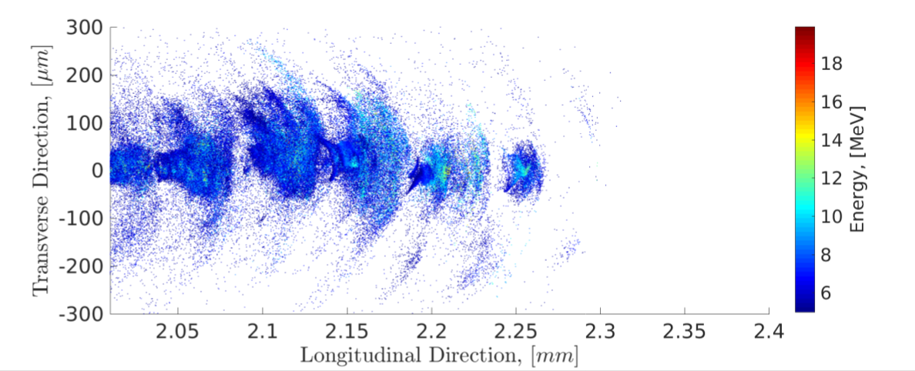
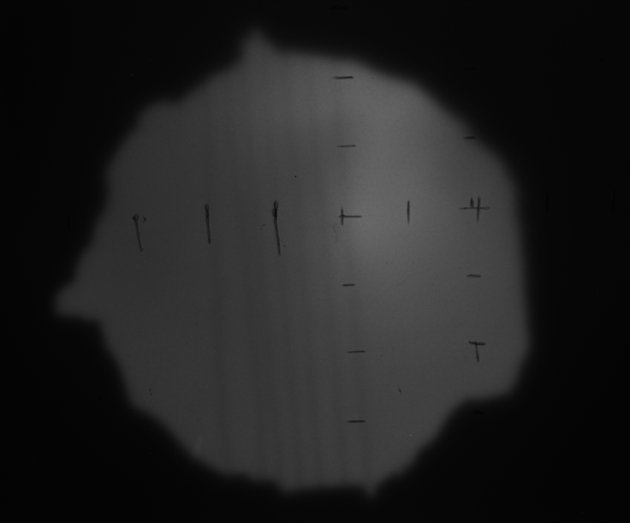

Simple electron bunch source size test
$$n_{e}=7.5×{10}^{17}cm^{−3}$$
Simulation: Prabhat Kumar SPACE code
5.5J
50micron wires
H2 gas jet 4mm length
n_{e} ~ 5e16 to 5e17/cc
From CTS probe measurement
Steel slit
2.6J
slit
Lanex
Ref mask
Al foil
20micron
CO2 laser pulse: ~2ps, 0.5J to 5J
CCD w/objective
ATF USERS MEETING, DEC. 09, 2020

Slide 18
CONCLUSIONS
• 1st detection of SM-wakes using long-λ driver
4ps and 0.5TW
- record low n_{e} ~ 10¹⁷ cm⁻³
- wake growth: τ_{growth} ~ 1 ps
- record low P ~ 0.1 TW
- wake decay: 5 < τ_{decay} < 20 ps
- nonlinear wake structure
(2nd-order S/AS sidebands)
- complex S/AS spectral structure
- wake amp: depends non-monotonically on drive pulse energy
• 1st detection of self-injection and acceleration in SM-wakes using long-λ driver
Upgraded CO2 laser <2ps and 1-2TW
- Injection and acceleration at record low n_{e} ~ 10¹⁷ cm⁻³
- Electron beam structure consistent with presence of DLA
- Unexpected quasi-monoenergetic features in electrons spectra
FUTURE PLANS
Improved electron spectral measurement. Larger spectral resolution and accuracy.
Optical measurements of plasma density with new short pulse TiSapp laser probe. Using both Thomson scattering and interferometric techniques for more accurate measurement of plasma density structures.
Correlation of plasma density, electron properties and radiographic measurements to create a fuller image of the laser plasma wakefield acceleration process.
Improved characterization of CO2 profile and possibly phase for simulation input. Spectral measurements before and after the interaction.
Continued push toward the bubble regime and external injection.
Thank you!
ATF USERS MEETING, DEC. 09, 2020

Slide 19
Electron Beam Requirements
Parameter | Units | Typical Values | Comments | Requested Values
Beam Energy | MeV | 50-65 | Full range is ~15-75 MeV with highest beam quality at nominal values | N/A
Bunch Charge | nC | 0.1-2.0 | Bunch length & emittance vary with charge | N/A
Compression | fs | Down to 100 fs (up to 1 kA peak current) | A magnetic bunch compressor available to compress bunch down to ~100 fs. Beam quality is variable depending on charge and amount of compression required. NOTE: Further compression options are being developed to provide bunch lengths down to the ~10 fs level | N/A
Transverse size at IP (σ) | μm | 30 – 100 (dependent on IP position) | It is possible to achieve transverse sizes below 10 um with special permanent magnet optics. | N/A
Normalized Emittance | μm | 1 (at 0.3 nC) | Variable with bunch charge | N/A
Rep. Rate (Hz) | Hz | 1.5 | 3 Hz also available if needed | N/A
Trains mode | --- | Single bunch | Multi-bunch mode available. Trains of 24 or 48 ns spaced bunches. | N/A

Slide 20
CO₂ Laser Requirements
Configuration | Parameter | Units | Typical Values | Comments | Requested Values
CO₂ Regenerative Amplifier Beam | Wavelength | μm | 9.2 | Wavelength determined by mixed isotope gain media
 | Peak Power | GW | ~3
 | Pulse Mode | --- | Single
 | Pulse Length | ps | 2
 | Pulse Energy | mJ | 6
 | M² | --- | ~1.5
 | Repetition Rate | Hz | 1.5 | 3 Hz also available if needed
 | Polarization | --- | Linear | Circular polarization available at slightly reduced power
CO₂ CPA Beam | Wavelength | μm | 9.2 | Wavelength determined by mixed isotope gain media | 9.2
Note that delivery of full power pulses to the Experimental Hall is presently limited to Beamline #1 only. | Peak Power | TW | 2 | ~5 TW operation is planned for FY21 (requires further in-vacuum transport upgrade). A 3-year development effort to achieve >10 TW and deliver to users is in progress. | 5
 | Pulse Mode | --- | Single |  | single
 | Pulse Length | ps | 2 |  | 2
 | Pulse Energy | J | ~5 | Maximum pulse energies of >10 J will become available in FY20 | 5
 | M² | --- | ~2 |  | 2
 | Repetition Rate | Hz | 0.05 |  | 0.05
 | Polarization |  | Linear | Adjustable linear polarization along with circular polarization will become available in FY20 | Adjustable Linear + circular

Slide 21
Near IR Experimental Laser Requirements
Ti:Sapphire Laser System | Units | Stage I Values | Stage II Values | Comments | Requested Values
Central Wavelength | nm | 800 | 800 | Stage I parameters have been delivered, while Stage II parameters will be available for user experiments once our vacuum transport installation is complete (now planned for FY21 after COVID-19 delays) | 800
FWHM Bandwidth | nm | 20 | 13
Compressed FWHM Pulse Width | fs | <55 | <75 | Transport of compressed pulses will initially include a very limited number of experimental interaction points. Please consult with the ATF Team if you need this capability. | 60
Chirped FWHM Pulse Width | ps | ≥50 | ≥50 |  | ~2ps
Chirped Energy | mJ | >30 | 200
Compressed Energy | mJ | >14 | 100 |  | ~1
Energy to Experiments | mJ | >10 | >80
Power to Experiments | GW | >250 | >1067
Nd:YAG Laser System | Units | Typical Values | 2021 Modifications | Comments | Requested Values
Wavelength | nm | 1064 | 1064 | Single pulse
Energy | mJ | 5 | 100
Pulse Width | ps | 14 | <20
Wavelength | nm | 532 |  | Frequency doubled | 532
Energy | mJ | 0.5 |  |  | 0.5mJ
Pulse Width | ps | 10 |  |  | 1-4ps

Slide 22
COVID-19 Pandemic Impacts
Closure of UT – remote work and associated complications
Inability to travel to BNL to conduct experiments

Slide 23
Special Equipment Requirements and Hazards
Electron Beam
  Please indicate any special equipment that you expect to need, including (but not limited to) the transverse deflecting cavity, shaped bunch using mask technique, plasma capillary discharge system, bolometer/interferometer setup etc.: NONE
CO₂ Laser
  Please note any specialty laser configurations required here: polarization control
Ti:Sapphire and Nd:YAG Lasers
  Please note any specialty non-CO₂ laser configurations required here: Doubled Yag and Ti:Sapphire laser beams at LWFA chamber: NONE
Hazards & Special Installation Requirements
  Large installation (chamber, insertion device, etc.):NONE
  Cryogens:NONE
  Introducing new magnetic elements: Spectrometer magnet <1T
  Introducing new materials into the beam path: NONE
  Any other foreseeable beam line modifications: Compressor for electron beam

Slide 24
Experimental Time Request
CY2021 Time Request
Capability | Setup Hours | Running Hours
Electron Beam Only |  | 0
Laser* Only (in FEL Room) |  | 0
Laser* + Electron Beam | 80 | 240
Time Estimate for Remaining Years of Experiment (including CY2021)
Capability | Setup Hours | Running Hours
Electron Beam Only | 0 | 0
Laser* Only (in FEL Room) | 0 | 0
Laser* + Electron Beam | 160 | 480
* Laser = Near-IR or LWIR (CO₂) Laser

