Slide 1
UF97 - LDRD for UEM Demonstration of feasibility of sub-nm, picosecond electron microscope for the life sciences
Xi Yang
Representing UEM LDRD Team
Principal Investigators: Lewis Doom, Timur Shaftan
Other Investigators: Xi Yang, Sean McSweeney, Yimei Zhu, Qun Liu, Jing Tao, Victor Smaluk
LDRD Project No. 19-016 (EPS/PS) (approved and received)
23rd ATF Users’ Meeting
December 7 - 11, 2020

Slide 2
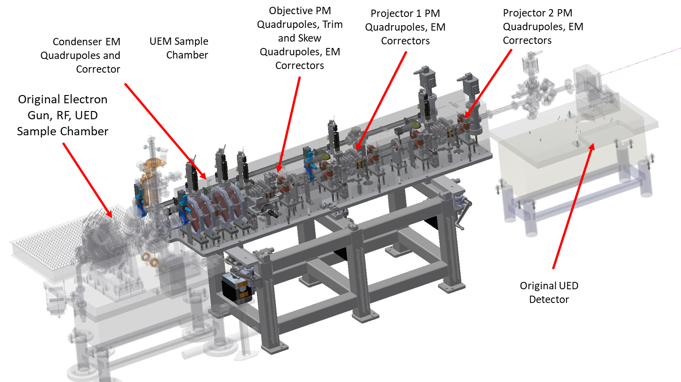
Goals
The main goal is to demonstrate imaging of big biological samples (10 µm diameter) utilizing pulsed relativistic electrons with an energy of 3 MeV.
Design and test of a proof-of-concept system, not an operational experimental instrument.
Modular design allows the UEM system to be integrable with the current UED facility with minimal interference.
Advantages
Focusing tunability of ±5% (adjustable drifts between magnets and electromagnetic trim quadrupoles)
High (MeV) beam energy allowing us to image thick biological samples
Complementarity to the NSLS-II Cryo-EM and CFN programs
Best resolution of the system is about 1 nm with all spherical and chromatic aberration optimized up to the 5th order. Now the resolution is limited to 100 nm (dominated by chromatic aberration) due to the ATF electron beam quality.
Expected Results:
Phase I: Determine the UEM design and the required tolerances through accelerator physics studies.
Phase II: Engineering design.
Phase III: Install Equipment and finish proof of principle experiments on whole cells.

Slide 3
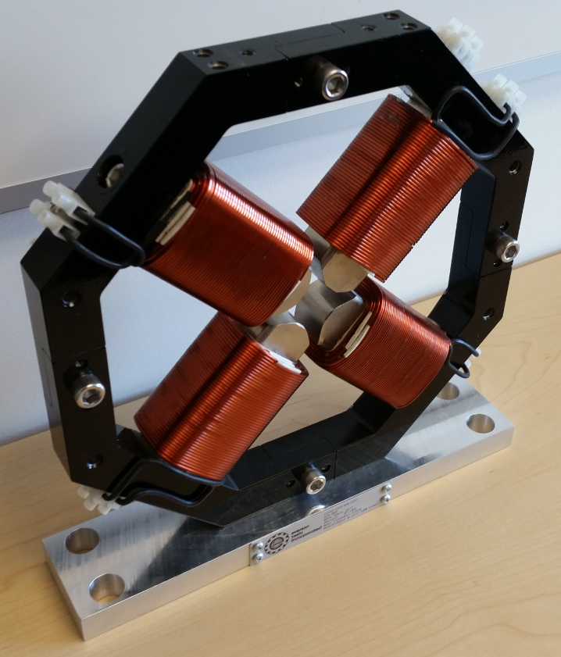
Overall construction and accomplishments
Unified magnet design:
The Objective, Projector 1 and Projector 2 are all the same
Re-use parts from the previous UED LDRD:
Condenser and corrector magnets and power supplies
Vacuum components, ion pumps and power supplies
Vacuum gauges and controllers
Flags, cameras, filter wheels
Controls electronics, switches
Funding
LDRD 19-016 | FY19 | FY20 | Total
Approved Funding | $ 378,794 | $ 671,860 | $ 1,050,654
Funds Expended | $ 378,085 | $ 348,362 | $ 726,447
Balance Remaining | $ 709 | $ 323,498 | $ 324,207
Present status: manufactured 90% of all required parts
Sample chamber assembly with specimen holder and position control
Aperture assemblies with position control
High magnification and resolution flag assembly optics
Design and released all manufacturing drawings.
Magnet measurement station for permanent magnet assembly, adjustment and positioning.
Major issue: large energy jitter of the ATF beam

Slide 4
RF jitter problem
RF measurement (J.Rose)
Beam-based measurement (X.Yang et al.)
Phase jitter: 1.138°(klystron) & 0.534° (drive amplifier)
25mV Peak/6.82V = 0.0037 → 0.37% Regulation @ Spec = 0.05%
Difference of specification to performance is due to mismatch in power supply sizing to requirement.
New PS rated at 0.01% repeatability, matched to requirement for 100% rating
Measurement @5Hz
Energy jitter: 0.004 Sources: RF amplitude (0.28%) and phase jitter (1.3⁰)
Spatial pointing jitter: 20 𝜇rad (ver), 12 𝜇rad (hor)
Measurement @25Hz
Energy jitter: 0.004 Sources: RF amplitude (0.4%) is dominating
Spatial pointing jitter: 25 𝜇rad ver), 14 𝜇rad (hor)
Potential improvement of the UEM upgraded with a precise High-Voltage Power Supply and a Solid-State drive amplifier
Phase jitter due to klystron is 1.138 degrees
Phase jitter due to drive amplifier is 0.534 degrees
The klystron jitter can be likely reduced by factor of 5
The drive amplifier improvement is unknown at this time, but could be similar
Laser-to-RF jitter is completely unknown and never measured at UEM
If the RF is driven by laser pulses, and the laser pulse-to-pulse jitter << RF jitter, then the factor of 5 could be realized

Slide 5
2020 Activities & Impacts Associated with this Experiment
Invited Talks:
May 13, 2020: A Novel Nondestructive Diagnostic Method for Mega-Electron-Volt Ultrafast Electron Diffraction, X. Yang et al., 11th International Particle Accelerator Conference (contributed talk).
Manuscripts:
X. Yang, J. Li, M. Fedurin, V. Smaluk, L. Yu, W. Wan, Y. Zhu and T. Shaftan, A novel nondestructive diagnostic method for mega-electron-volt ultrafast electron diffraction, Scientific Reports 9 (2019) 17223
X. Yang, W. Wan, L. Wu, V. Smaluk, T. Shaftan, Y. Zhu, Toward monochromated sub-nanometer UEM and femtosecond UED, Scientific Reports 10 (2020) 16171
X. Yang, W. Wan, V. Smaluk, T. Shaftan, L. Wu, L. Wang, Y. Zhu, Start-to-end self-consistent simulation of the UEM beamline, BNL-220640-2020-TECH
Theses awarded:
none
Patents and/or hardware delivered:
Hardware: UEM beamline including magnets, vacuum system, beam diagnostics, and controls.
Other:
Start-to-end simulations from the photocathode to detector recommended by the Preliminary Design Review Committee.
The shot-to-shot energy jitter has been identified as the ultimate limit of the UEM resolution. Improvement of the RF system stability is being implemented.

Slide 6
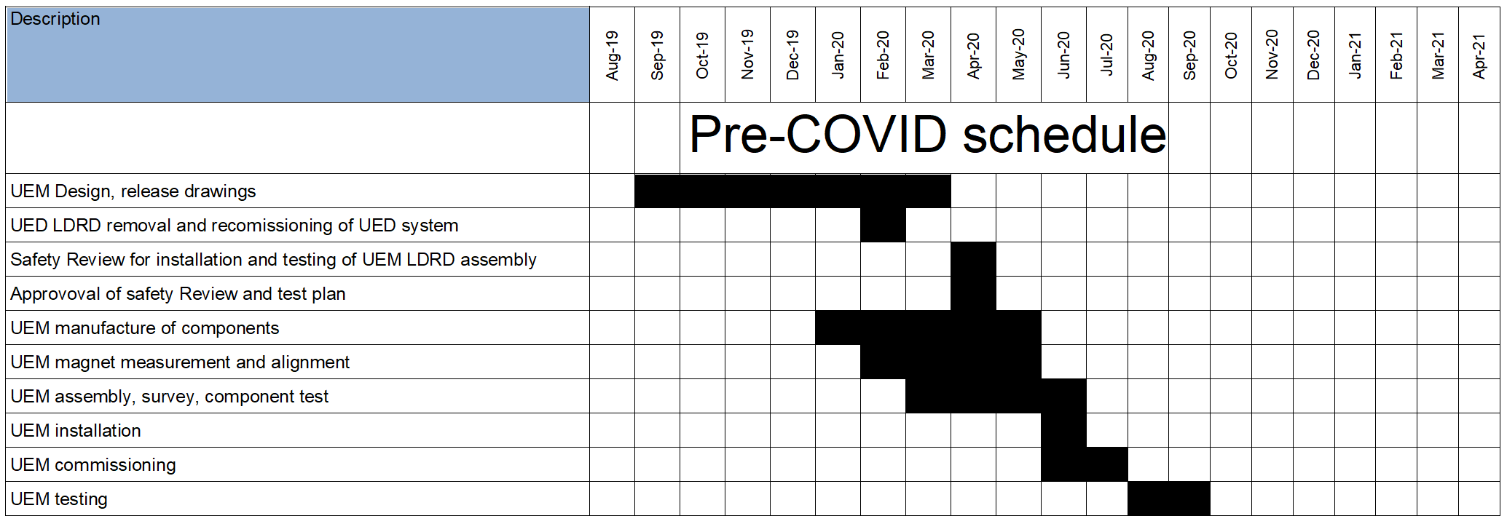
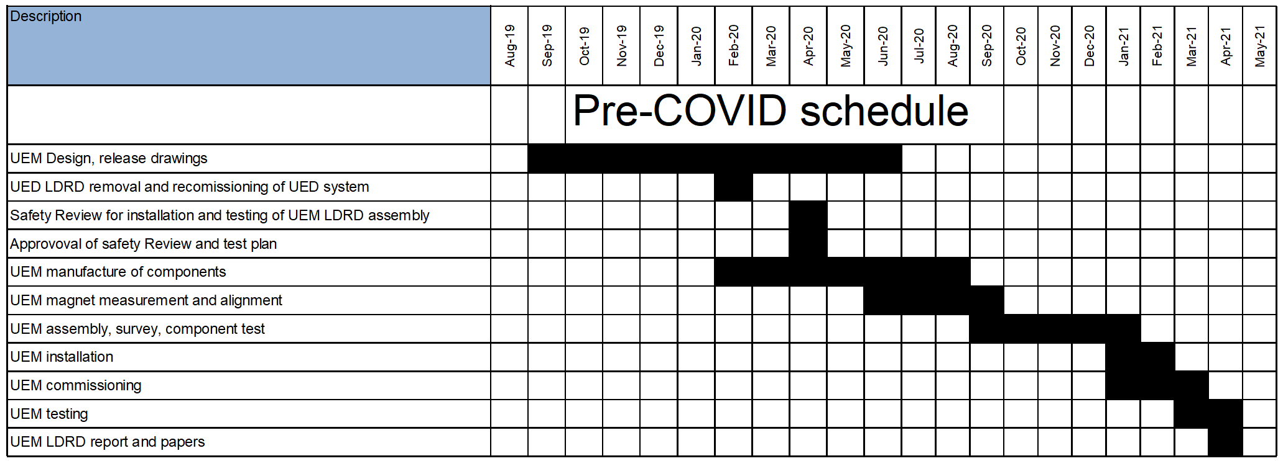
Impact of COVID-19 on Schedule and Spending
Significant delays have been incurred due to the COVID-19 pandemic and related effects. Future efforts will take longer than original estimates.
Delays Include:
Manufacture and purchasing components
System Assembly
Magnet measurement and alignment
Installation
The UEM LDRD team is working with ATF/UED management to adapt to the updated schedule. Details are still in progress.
Delays have not had a significant overall spending impact but have caused the spending profile to shift out into FY2021. Estimates are in progress.
Future effort and duration estimates will take longer than expected due to social distancing and other COVID-19 related restrictions.
Due to delays related to the COVID-19 pandemic and Min-Safe restrictions this project was not completed in FY2020

Slide 7
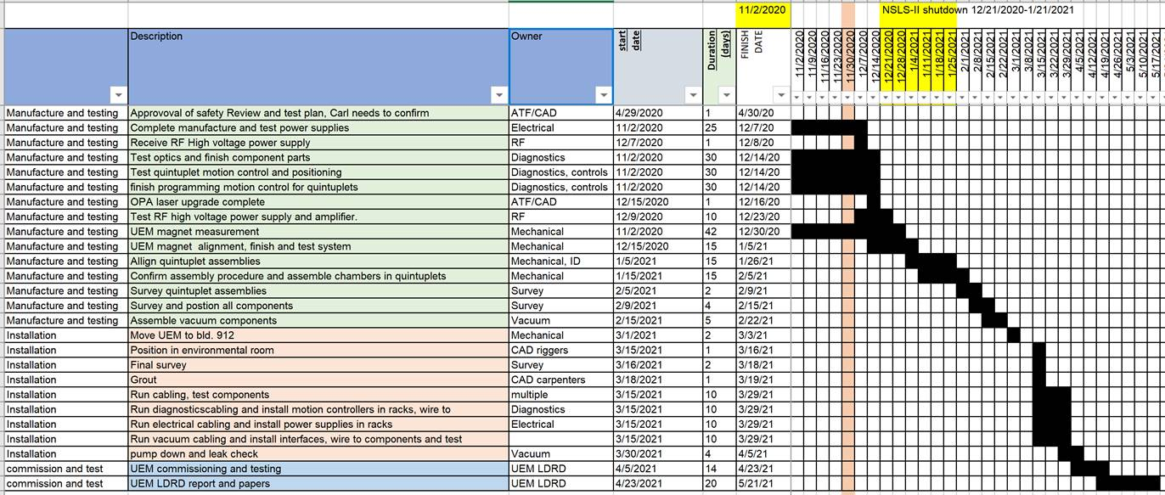
Experiment Time Request
CY2021 Time Request
Capability | Setup Hours | Running Hours
UED Facility | 160 | 360
Experiment Time Request

Slide 8
Special Equipment Requirements and Hazards
User Sample and Setup
Golden and TaS₂ single crystal samples.
Candidate biological samples:
Fatty acid synthase (Cryo-EM structure) http://www.rcsb.org/structure/6TA1
2) T4 baseplate-tail tube complex (the largest structure in PDB) (Cryo-EM structure) http://www.rcsb.org/structure/5IV5
3) Eukaryotic ribosome (Crystal structure) http://www.rcsb.org/structure/4V88
Special Equipment:
UEM assembly
Pump Laser Requirements: No
Hazards & special installation requirements:
Large installation (UEM assembly): Y
Cryogens: Y
Introducing new magnetic elements: Y
Introducing new materials into the beam path: Y
Any other foreseeable beam line modifications: N

Slide 9
Conclusion
UEM physics design with <200nm resolution is complete
Beam physics and pulse jitter studies provide risks assessment
Mitigation plans are under implementation:
Precise HVPS and SS drive amplifier installation scheduled this week
Funded SBIR projects related to BNL UEM
Design of a new superconducting gun
Objective lens with high-gradient PM and pulsed 2 T solenoid to reach sub-nm resolution
Remaining Goals
Complete the manufacture, assembly and testing of all components
Install the UEM system into the ATF/UED facility and complete integrated testing
Commission system with beam
Demonstrate imaging of thick and large objects (e.g. biological samples, 10 µm diameter) with 200 nm resolution
Produce images of “calibration standard” and biological samples
Issues/Concerns
Poor contrast of images via scattering of soft biological (low-Z) targets needs to be resolved
High energy jitter at ATF/UED is still a significant concern and requires additional investigation of this

