Slide 1
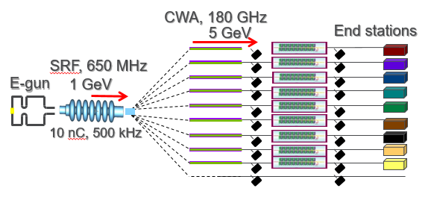
Collinear wakefield accelerator based on corrugated waveguide
Continuing experiment: 306051
drhgfdjhngngfmhgmghmghjmghfmf
Funded by LDRD at ANL
PI: A. Zholents, APS/ANL
W. Jansma, A. Nassiri, S. Sorsher, K. Suthar, E. Trakhtenberg, G. Waldschmidt, J. Xu (APS/ANL)
S. Doran (HEP/ANL)
S. Siy, N. Behdad (University of Wisconsin)
M. Fedurin, K. Kusche, M. Palmer (ATF/BNL)
ATF User meeting, December 9, 2020

Slide 2
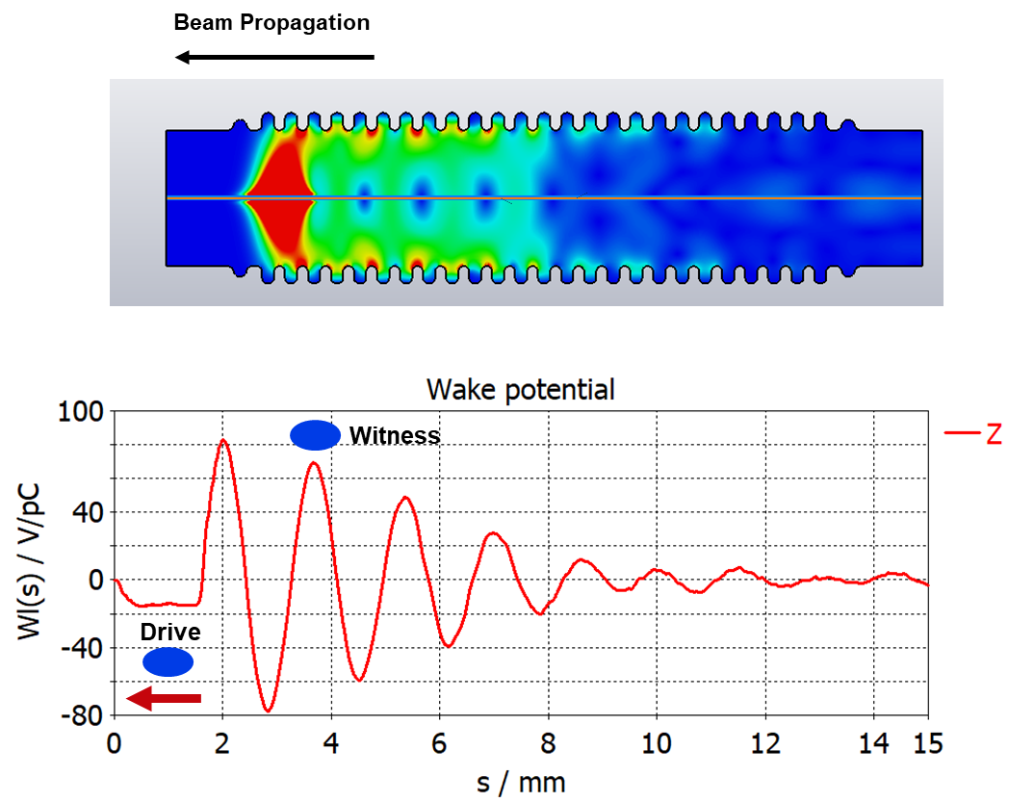
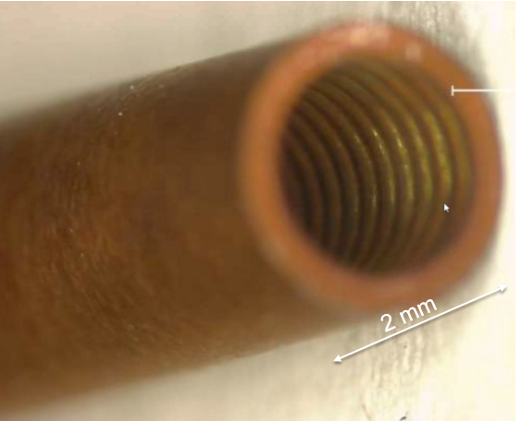
GOAL is to characterize accelerator components
2 mm
E⁺
E ⁻
Near term plan:
measure both longitudinal and transverse wakefields
measure spectrum of the sub-THz Čerenkov radiation
measure group velocity of the fundamental mode.

Slide 3
Main results of the first experiment March 9 -13, 2020
Measurements of the wakefield induced by the corrugated waveguides agree with the calculations

Slide 4
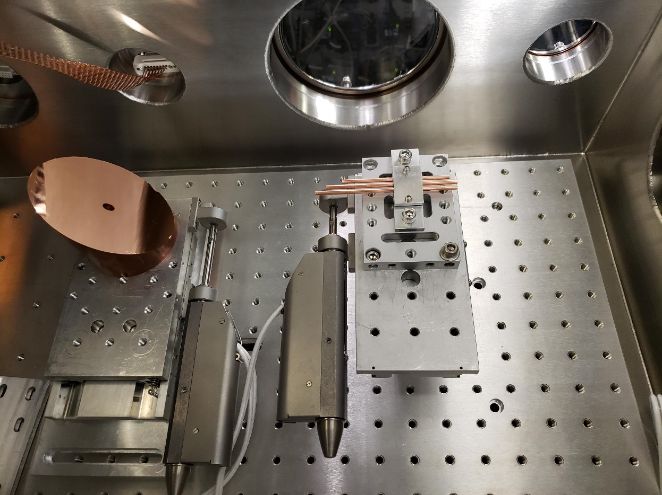
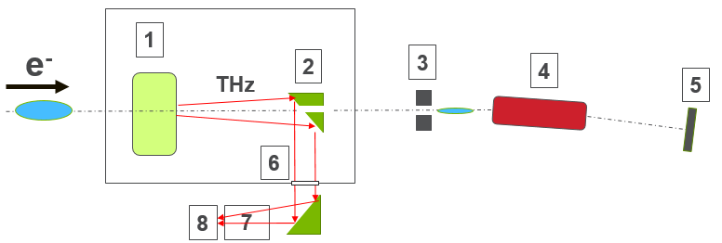
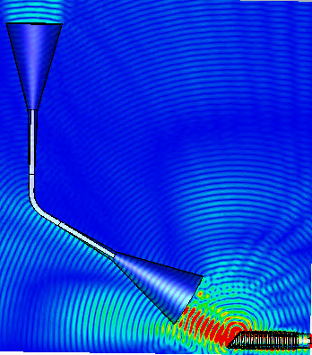
Installation at ATF
ebeam
Tubes and a tube holder mounted on the translation stage
Paraboloid mirror to collect sub-THz radiation

Slide 5
Calibration of the spectrometer
These two plots are used to calibrate screen’s energy resolution and to obtain 0.776 keV/pixel (see below).
30.4 A
Lower field or higher energy is at the left side and higher field and lower energy is at the right side of the screen.
30.1 A
First image was taken using spectrometer magnet current of 30.4 A
Second image was taken using spectrometer magnet current of 30.1 A
coeff = (0.7764 ± 0.0005)
keV/pixel

Slide 6
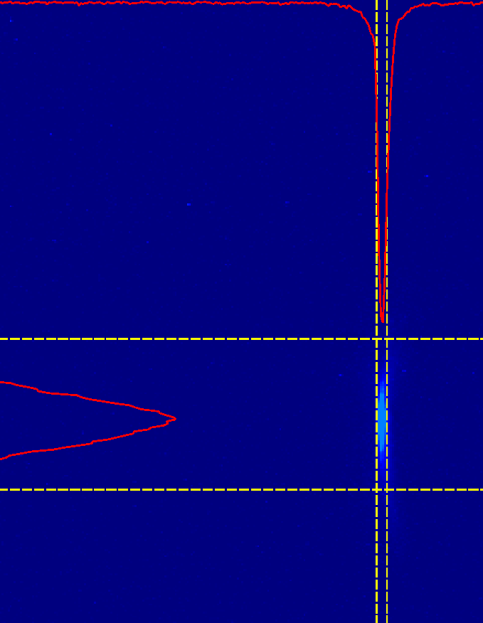
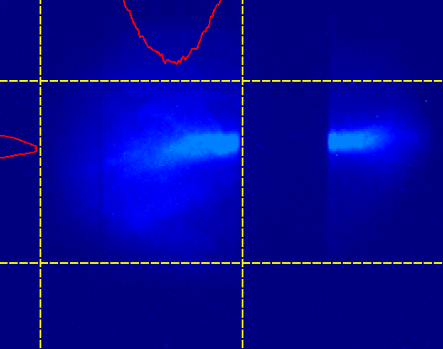
Beam energy spread measurement
Beam size measured with linac running on crest using energy collimator screen
FWHM = 4.5 pixels or approximately 4.5*50/sqrt(2)=160 keV (assuming equal betatron and synchrotron sizes and 50 keV/pixel calibration), i.e., σ_{E}=68 keV
Wire trace
5 mm/85 pixels
3 mm/52 pixels
Energy collimator window

Slide 7
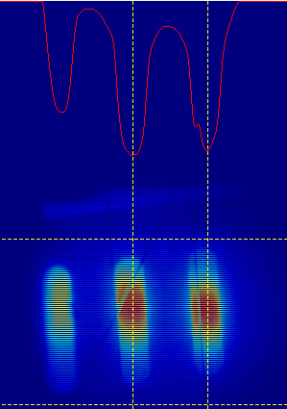
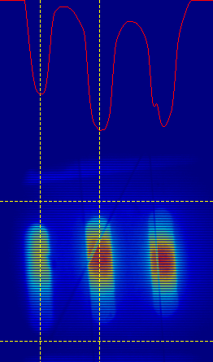
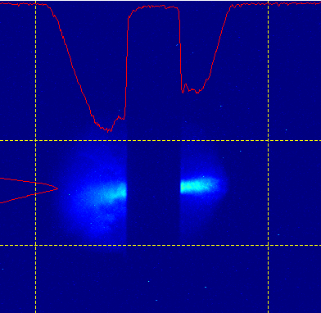
Determine bunch length, Thursday
Beam image taken after energy collimator in second point in a dog-leg with a large dispersion
76 pixels
74 pixels
Window
34 pixels
242 pixels
The window size in energy collimator is 242/75*0.46 = 1.48 mm or 4.95 ps
(Coefficient 0.46 is defined in the next slide)
The microbunch length is 34/75*0.46 = 0.21 mm or 0.7 ps

Slide 8
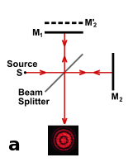
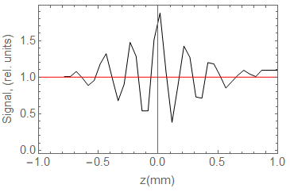
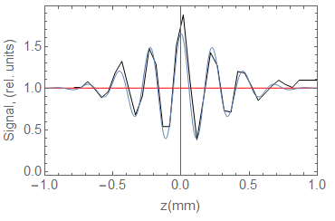
Determine bunch length, Thursday
Use interferogram produced by three equally spaced bunches selected by the horizontal mask located in the energy collimator area
Michelson interferometer
THz
balometer
Interferogram taken on Thursday: five peaks are expected from a train of three bunches giving five overlapping regions.
Fit with the damped oscillator formula:
Thus, the distance between the centers of the bunches is: 2 * 0.23 mm = 0.46 mm

Slide 9
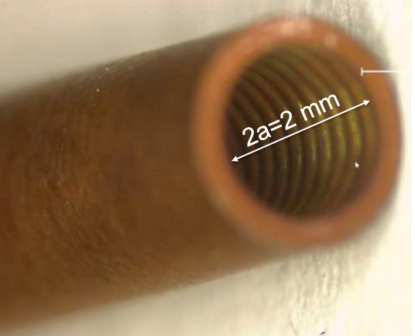
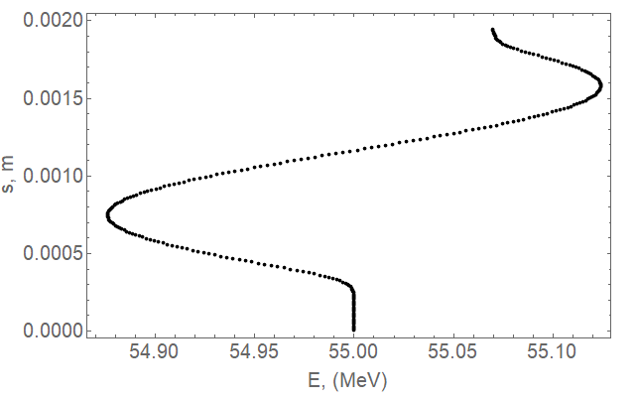
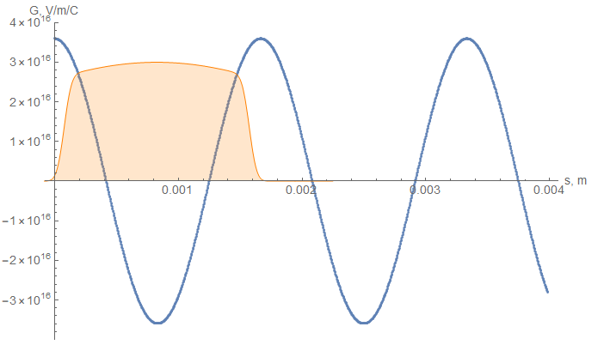
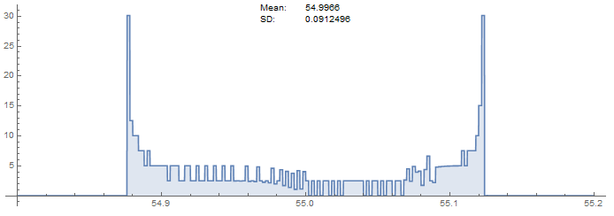
Wakefield
Impact of the wakefield on slice medium energy
Loss factor:
A=
= 3.6x10¹⁶ V/m/C
Charge =0.2 nC
f₀=180 GHz
Green’s function, V/m/C
Peak current, (rel. units)
A Cos(2πf₀t)
Energy histogram
FWHM = 1.5 mm (~ 5 ps)
s, m

Slide 10
Difference between smooth pipe and Unobstructed path
Data collected on Tuesday 03102020
Use as the reference for Unobstructed path: file name 2020031017061940_Spectr_no_mask_SLIT_IN.asc
Use for the Smooth pipe: file name 2020031017374064_Spectr_no_mask_SLIT_IN_Smooth_Pipe.asc
The difference is shown below: file name Diff 2020031017374064 Smooth minus Unobstructed 17061940.asc
No visible difference between the unobstructed pass and a pass through the smooth pipe is seen after adjustment of horizontal shift caused by the beam drift.
Charge=140 pC, bunch length = 5 ps flattop
Note: the beam shifted horizontally between measurements by ~ 31 pixels
Spectrometer screen

Slide 11
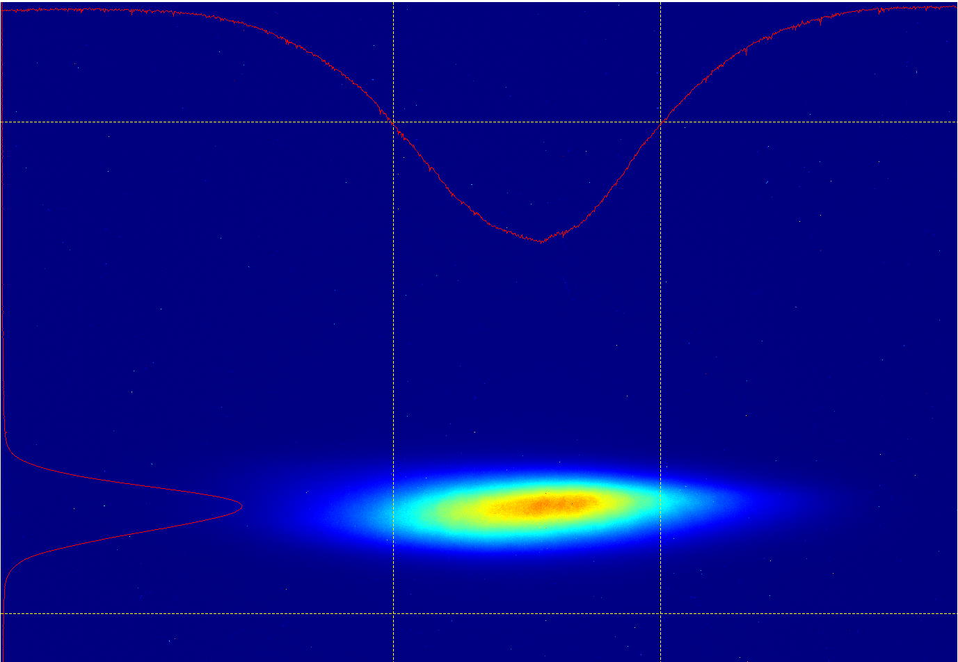
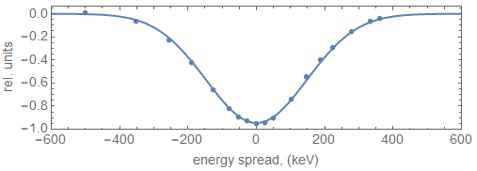
Use spectrometer measurement in the case of a smooth pipe to define energy distribution in the beam
Data collected on Tuesday 03102020
Use as the reference for Smooth pipe: file name 2020031017374064_Spectr_no_mask_SLIT_IN_Smooth_Pipe.asc
309 keV=0.776 keV/pixel*399 pixels
399 pixels / 309 keV FWHM
Gaussian fit
Higher energy
Lower energy
Measured energy spread includes energy chirp
Higher energy
Lower energy
Charge=130 pC, bunch length = 5 ps flattop

Slide 12
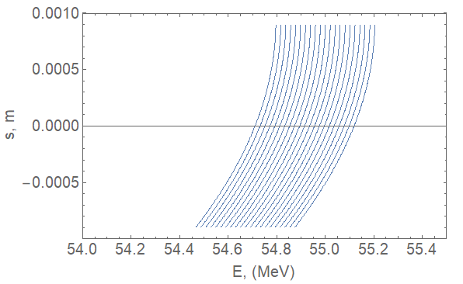
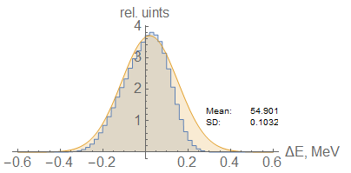
Measurement of the energy chirp
Histogram of beam energy distribution
±3.15σ_{E}
Modeled
Measured
The best fit is obtained using 3.2 degree of RF phase. Model accounts for 68 keV rms incoherent energy spread.

Slide 13
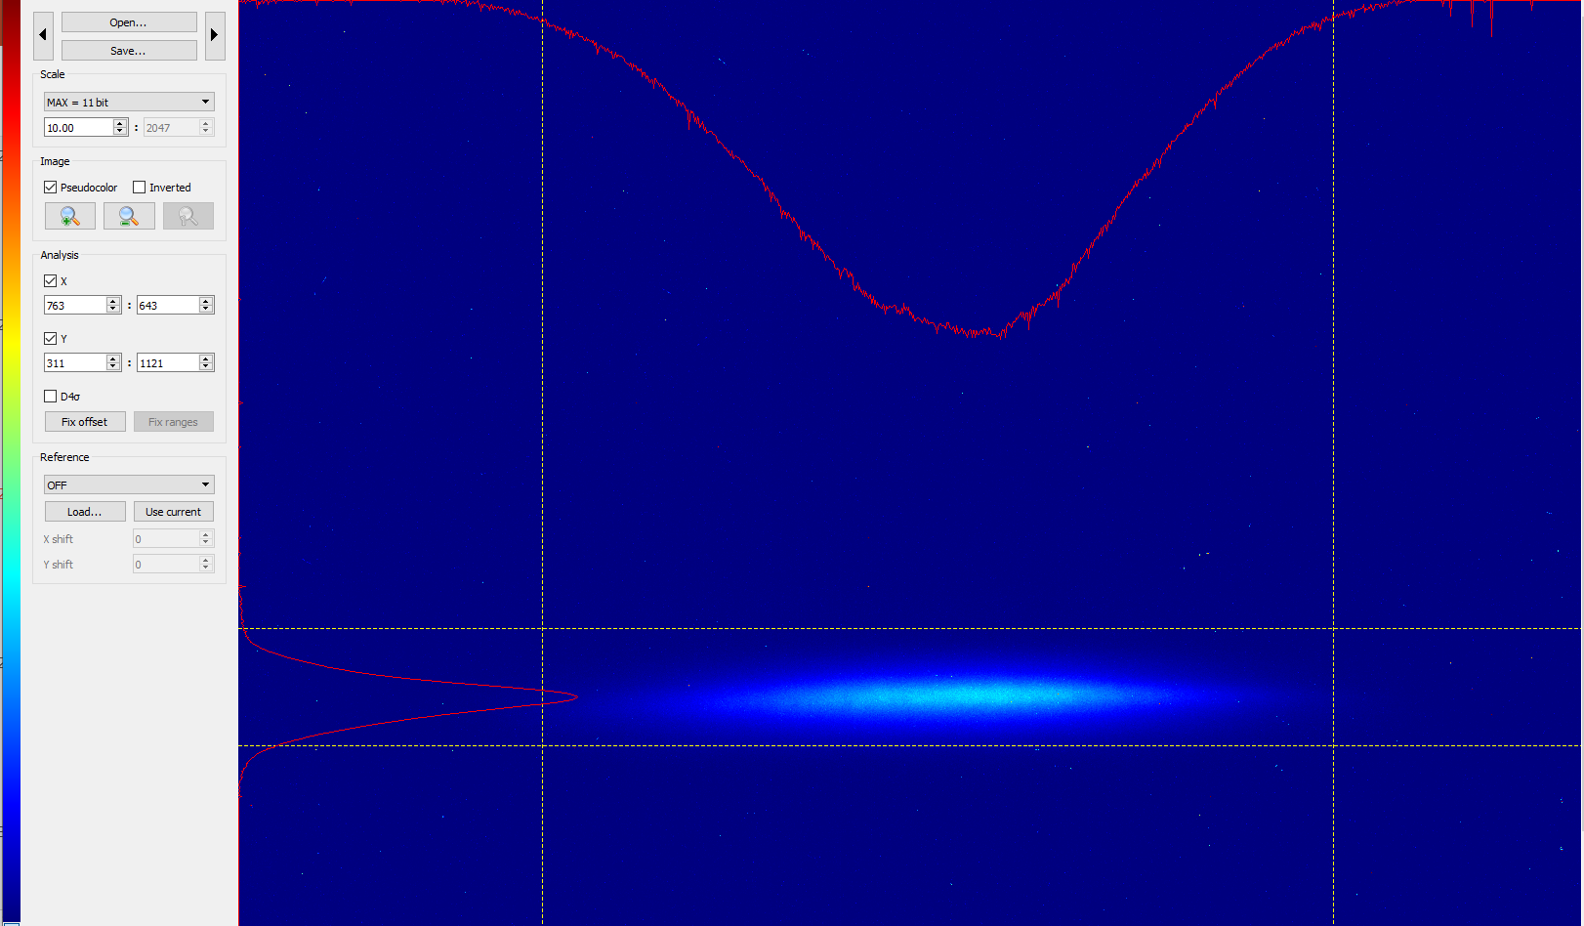
smooth pipe
Data collected on Tuesday 03102020
Use the same reference for Smooth pipe: file name 2020031017374064_Spectr_no_mask_SLIT_IN_Smooth_Pipe.asc
Smooth pipe
Charge=130 pC, bunch length = 5 ps flattop
Higher energy
Lower energy

Slide 14
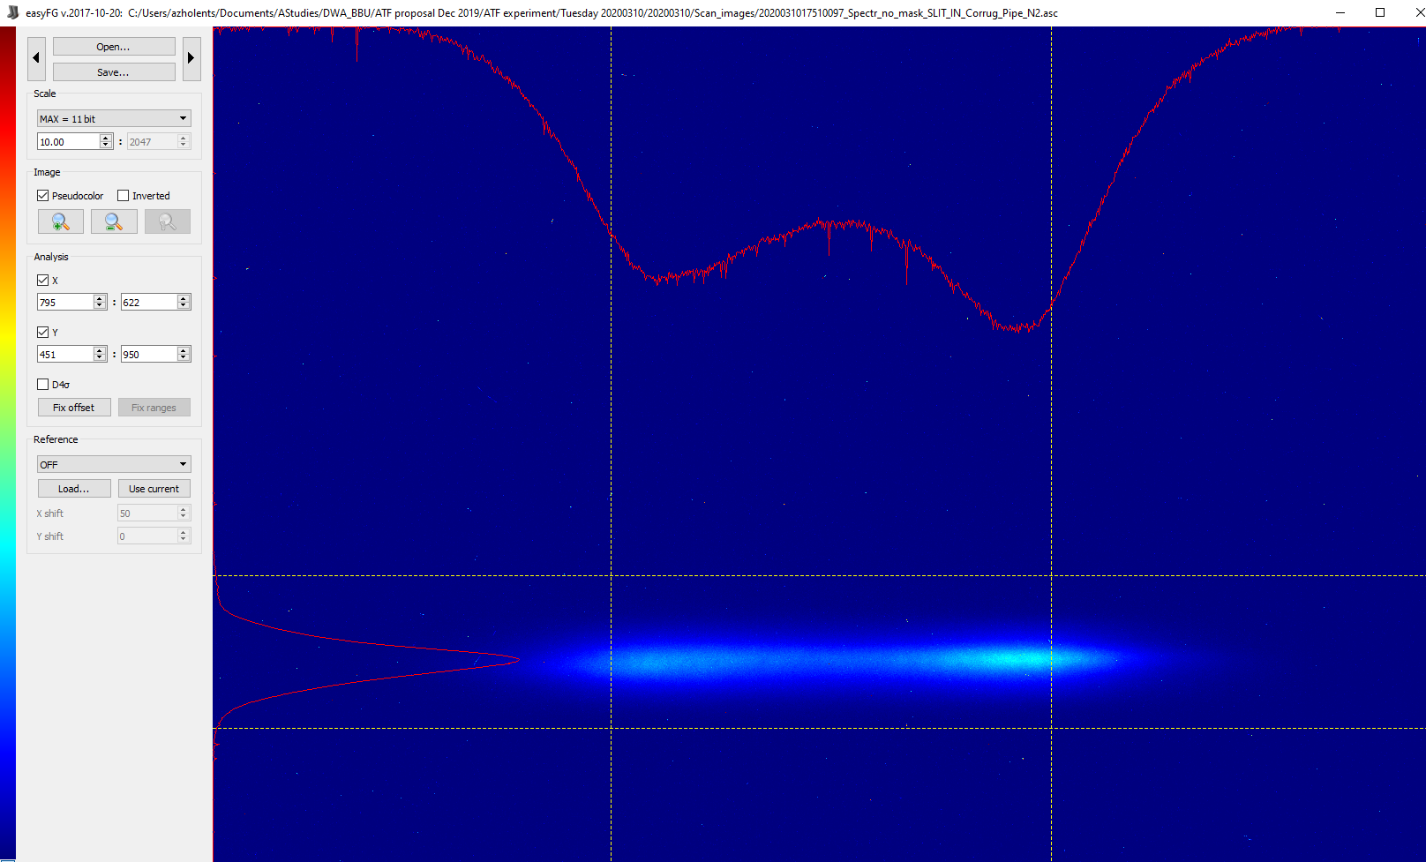
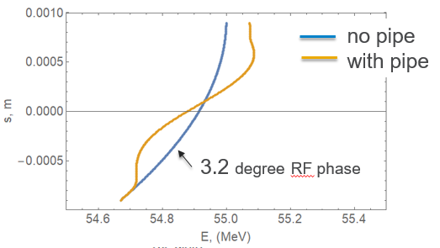
Find Difference between pipe 2 and a smooth pipe (p.2)
Data collected on Tuesday 03102020
Use for the Pipe 2: 2020031017510097_Spectr_no_mask_SLIT_IN_Corrug_Pipe_N2.asc
Pipe 2 with corrugations
Charge=170 pC, bunch length = 5 ps flattop
Pipe length = 92.58 mm

Slide 15
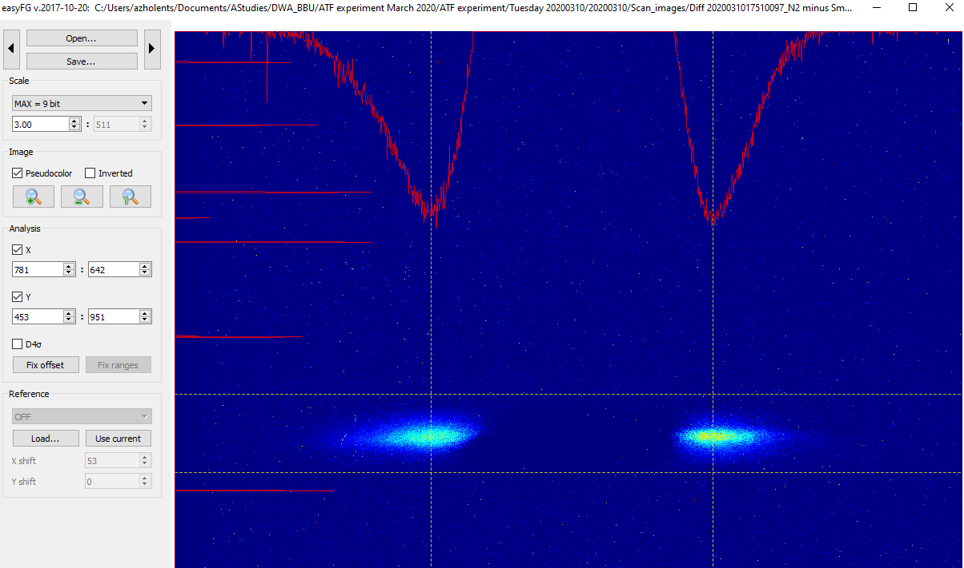
Find Difference between pipe 2 and a smooth pipe (p.3)
Data collected on Tuesday 03102020
The difference between Pipe 2 and Smooth pipe is shown below:
file name Diff 2020031017510097_N2 minus Smooth 2020031017374064.asc
Charge=170 pC, bunch length = 5 ps flattop
Pipe length = 92.58 mm
498pixels / 386 keV
Error estimate 1.5 pixel/1.0 keV
Note: the beam shifted horizontally by ~ 50 pixels

Slide 16
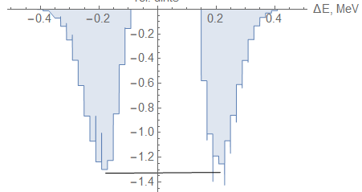
Find Difference between pipe 2 and a smooth pipe (p.4)
Data collected on Tuesday 03102020
The difference between Pipe 2 and Smooth pipe is shown below:
file name Diff 2020031017510097_N2 minus Smooth 2020031017374064.asc
Charge=170 pC, bunch length = 5 ps flattop
Pipe length = 92.58 mm
Error estimate 1.5 pixel/1.0 keV
498pixels / 386 keV
394 ± 10 keV
rel. units

Slide 17
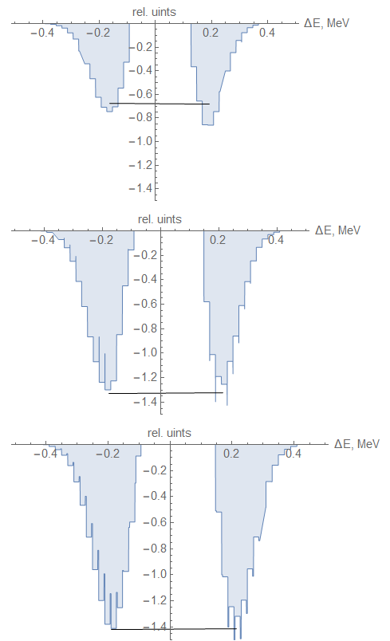
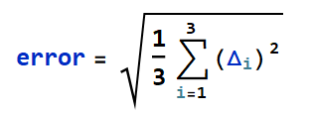
Summary of measurements
Pipe 1
T-theory; M-measurement
T-M=(357 – 351) keV
Pipe 2
Δ =(theory –measurement)
= 8.58 keV
T-M=(394 – 386) keV
relative error =8.58/394=0.022
Pipe 3
T-M=(404 – 415) keV

Slide 18
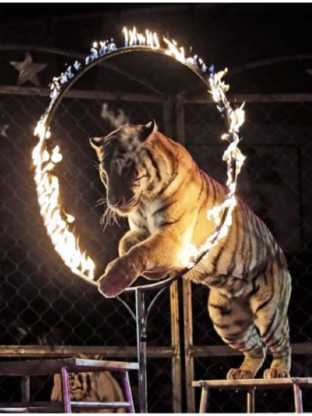
Second ATF experiment using corrugated waveguides
December 14 -18, 2020
Difficult but doable

Slide 19
The Experiment Goal
1. We will use four corrugated waveguide samples and measure
the impact of the wakefield using the spectrometer
THz spectrum using Michelson interferometer
to find 180 GHz signal
to determine group velocity of THz signal
2. We will compare four samples with different lengths and determine
a) scaling with the sample length
b) spread in THz frequency measurements

Slide 20
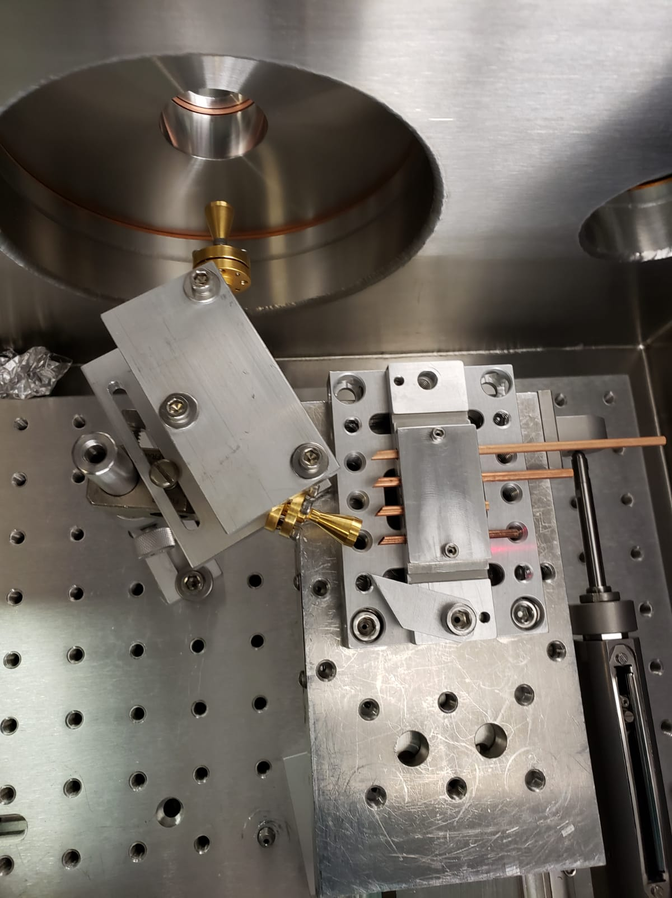
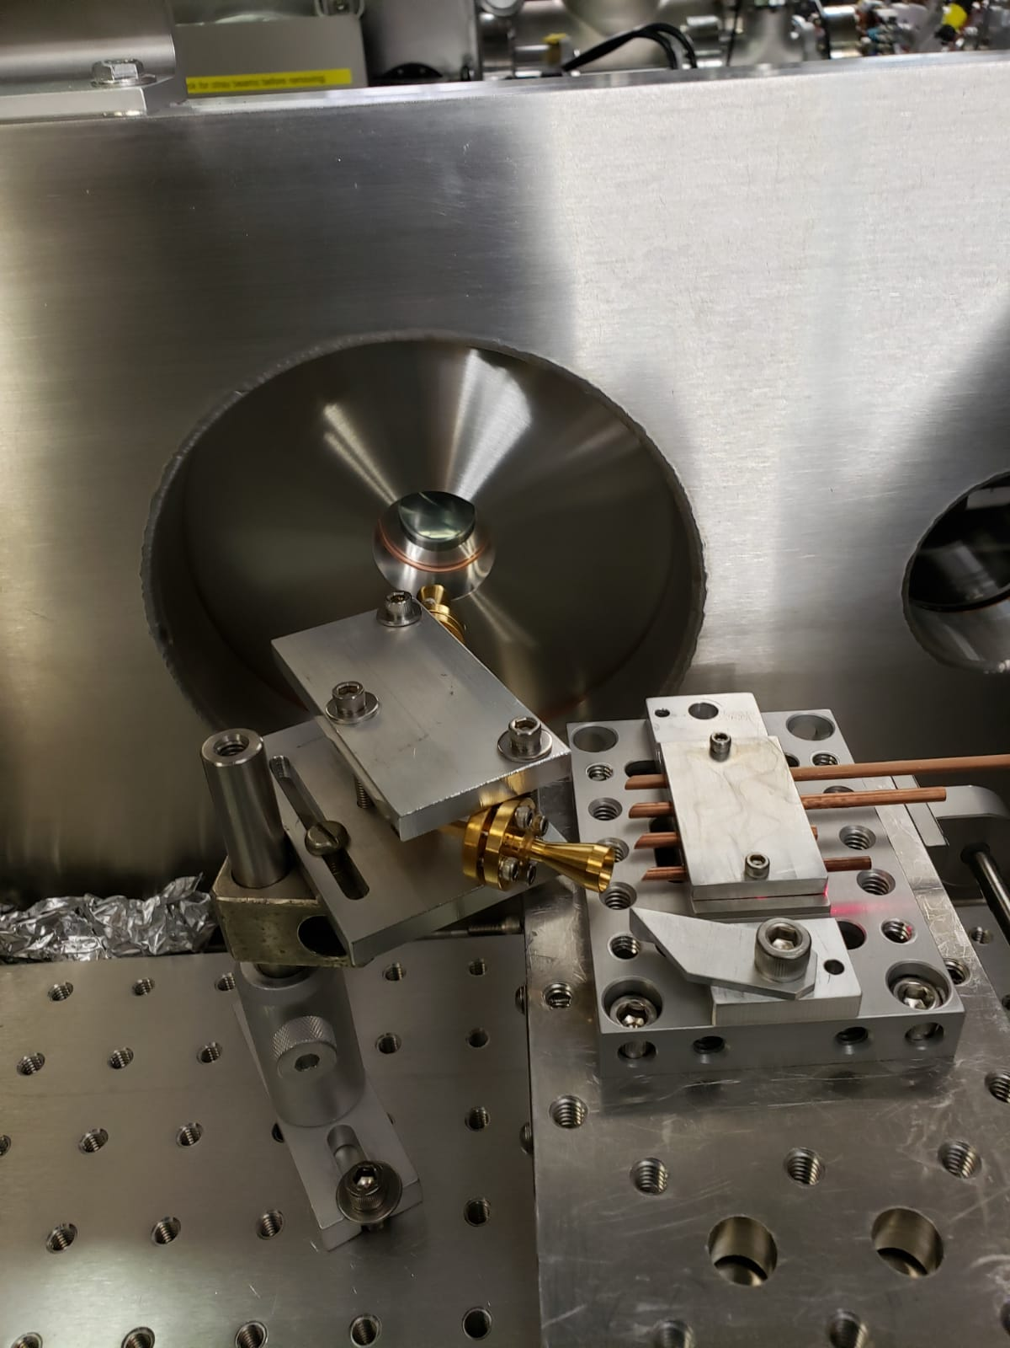
Experimental setup
Top view
Side view
TPX window
Unobstructed beam path
Beam target for a transition radiation
Horn collecting THz radiation

Slide 21
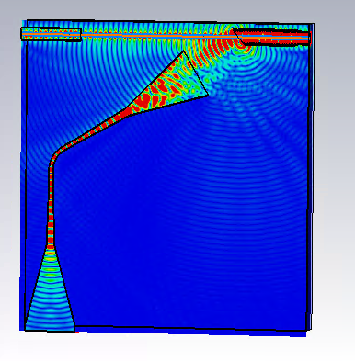
ATF experiment setup
A conceptual diagram of an experiment at ATF
1
e⁻
3
4
5
THz
2
6
CST MICROWAVE STUDIO®
8
7
1) device under the test,
2) horn and waveguides,
3) horizontal slit,
4) spectrometer magnet bending trajectory in horizontal plane,
5) diagnostic screen
6) TPX window
7) Michelson interferometer
8) LiHe cooled bolometer/Gentech bolometer

Slide 22
2020 Activities & Impacts Associated with this Experiment
Practically the same talk was given at two different online events:
Invited Talks:
November 17, 2020, “A compact high repetition rate free-electron laser based on the advanced wakefield accelerator technology”, A. Zholents et al., OSA: High-brightness Sources and Light-driven Interactions Congress. Compact (EUV and X-Ray) Sources.
Contributed talk
May 11, 2020, “A compact high repetition rate free-electron laser based on the advanced wakefield accelerator technology”, A. Zholents et al., Int. Part. Acc. Conf. 2020.
Continuation of LDRD in ANL was granted in part because of the success of the experiment at ATF.

Slide 23
COVID-19 Pandemic Impacts
No impact beyond inconvenience

Slide 24
Electron Beam Requirements

Slide 25
Special Equipment Requirements and Hazards
Electron Beam
A special equipment that we expect to need:
shaped bunch using mask technique (likely),
bolometer/interferometer setup,
horizontal translation stage (levered at the beam height)
the horizontal slit,
diagnostic screen,
alignment laser.
Hazards & Special Installation Requirements
No known hazards

