Slide 1
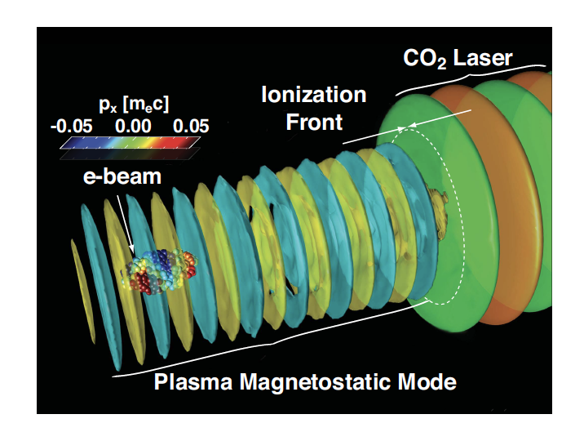
Directional x-ray radiation produced by plasma magneto-static undulator (AE99)ß
P.I. C. Joshi
Team: M. Sinclair, Yipeng Wu, Nie Zan
and Chaojie Zhang, F. Fiuza and W.B. Mori
UCLA
F. Fiuza, L. Silva and C. Joshi PRSTAB 13(8):080701, Aug 2010
W.B. Mori, Phys. Rev. A 44, 5118 (1991)
Currently supported by DOE-NNSA, DOE-HEP

Slide 2
Activities and impacts for past year
Experiment officially approved in June 2020
AE88, AE 98 and AE99 have either a scientific, diagnostic, set-up overlap
Had a series of meetings between these PIs and the ATF staff
Low power
CO2
Electron
spectrometer
Gas jet,
Electron
beam
probe
AE88
Thomson
scattering
Beam
AE99
High power CO2
E- beam
IR spectrometer
TW, 800 nm
Counter propagating to CO2
AE98

Slide 3
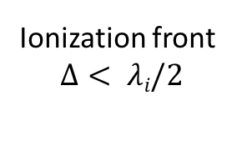
What happens when e.m. wave is incident on a relativistic underdense plasma ionization front?
Ionization front
$$Δ< λi/2$$
Free Space
Containing Gas
Transmitted Wave
$$ωt=ωi(1+\frac{ωp2}{4ωi2})$$
Incident wave
$ωi$ and 2$γfωi$ > $ωp$
Ionization front f
$γf$= $ωd/ωp$
Drive Laser $ωd$
Magneto-static mode
$$ωs=o, ks≈2ki$$
Reflected Wave
$$ωr=4γf2ωi$$
Boundary conditions at the ionization front are E and B must be continuous and J=0 since electrons are born at rest
3 boundary conditions allows for 3 modes
Ref: F. Fiuza, L. Silva and C. Joshi PRSTAB 13(8):080701, Aug 2010

Slide 4
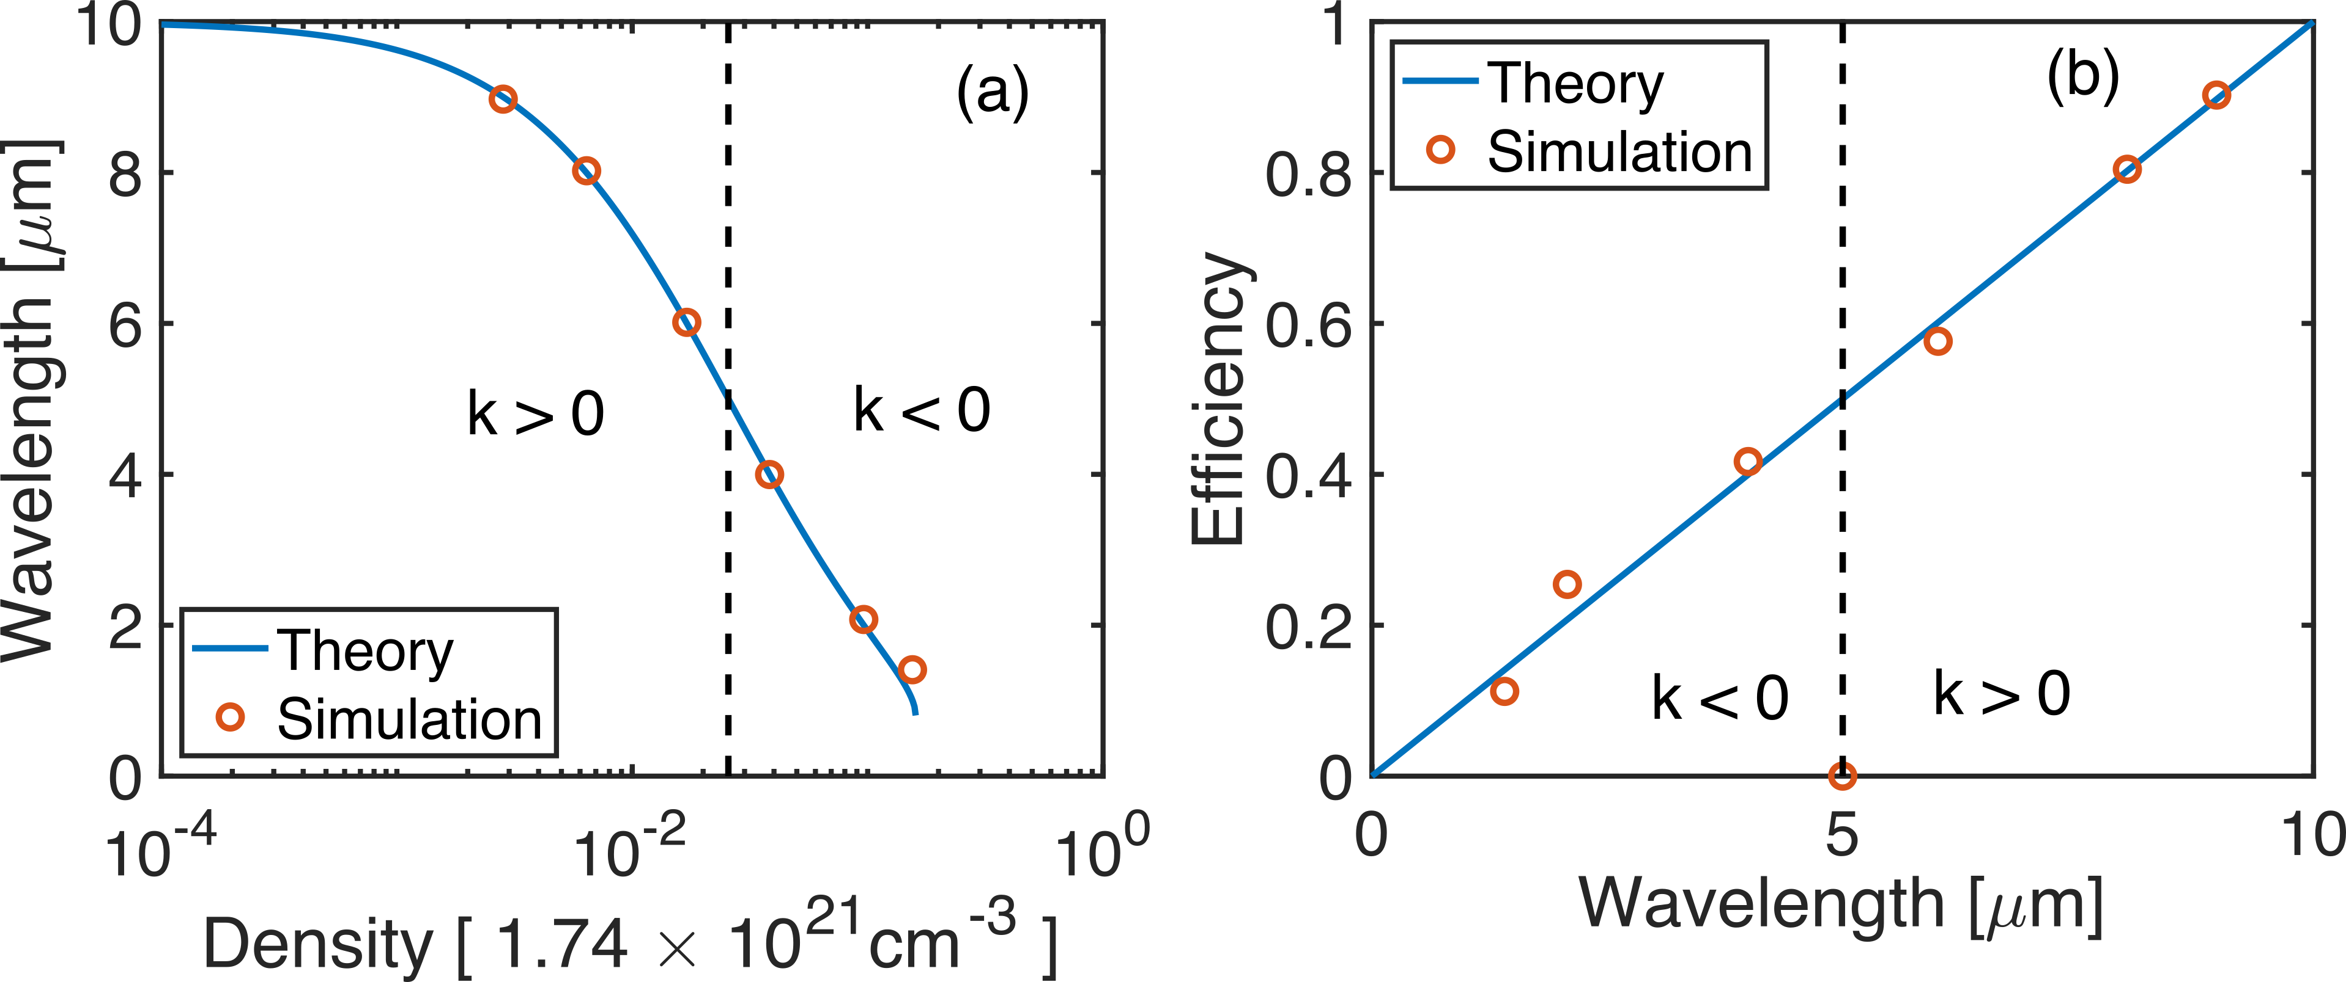
Observable 1:Transmitted and reflected frequency upshifted em waves
For 10.6 um incident
Up to density of 4x10¹⁹ cm-3
The upshifted wave is transmitted
Beyond this density the wavenumber
of the wave becomes –ve
The upshifted wave therefore
Is now reflected.

Slide 5
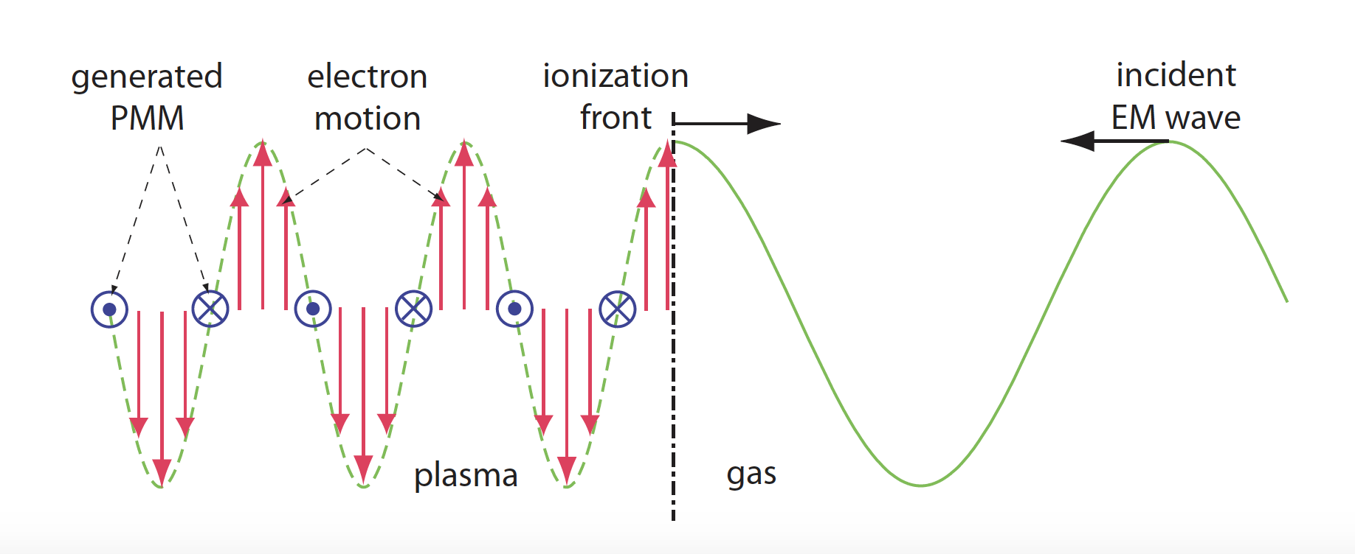
Observable 2: MS mode
W.B. Mori, Phys. Rev. A 44, 5118 (1991)
½ m v_{osc}² = 1.5 kV for CO2
Relativistic
Ionization front must be narrower than ½ wavelength of CO₂ radiation

Slide 6
Goals of Yr1 experiment
1)Characterize a very high density hydrogen jet.
2) Measure the frequency shift of the transmitted radiation and shoe that it is consistent with theory. (IR spectrometers in both reflected and transmitted directions to CO2- need only the 0.8 and 9 um lasers colliding)
3) Direct probing of the M.S. mode using the e-beam probe (if both lasers and e-beam are available- covered in Chaojie’e AE98 talk)
4) Measure the ion density fluctuations associated with the M.S. mode by Thomson scattering using the transversly propagating 800 nm probe laser.

Slide 7
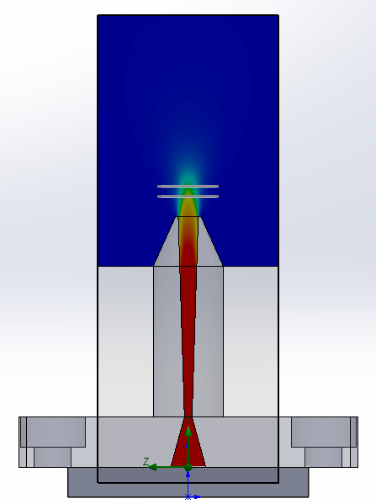
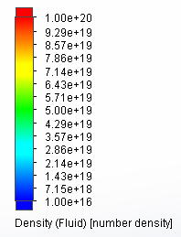
Goal 1:High density Gas jet for AE99
Electron density at 2 mm above nozzle exit
Backing pressure: 800 psi

Slide 8
Goal 2: TR and R- IR spectrometer
TR Spec.
Collimating
lens
Wavelength
dispersive
element
Focusing
lens
CO2 laser
Pyrocam IV
Transmission IR Spectrometer
10-5 micron range
Dispersion element: CdTe prism
Resolution better than 0.1 um
Detector: Pyrocam
Reflection IR Spectrometer
5-1 um range
Dispersion element : CdTe prism
Resolution better than 0.1 um
Detector: Pyrocam
Ti:Sapph
OAP
Ti:Sapph
Beam dump
Quads
Linac
BPM
gas jet
PMQ’s
IP
e- diag
mirror
CO₂
OAP
Focusing
lens
Wavelength
dispersive
element
Collimating
lens
Pyrocam IV
R Spec.

Slide 9
Details of TR and R- IR spectrometer

Slide 10
Goal 4: Thomson scattering for probing density fluctuations associated with MS (AE99) and Weibel modes(AE98)
AE98
There may exist (ion) density fluctuations associated with Weibel instability
Wavelength: 10-0.1 ω_{p}/c (3-300 μm for n_{e}=10¹⁸ cm⁻³)
Wavevector: parallel to the CO2 propagation direction
Δn/n0 ~ <1%
AE99
A large density modulation (plasma grating) is expected to form when a magnetostatic mode is excited
Wavelength: 2.3 μm
Wavevector: parallel to the CO2 propagation direction
Δn/n0 ~ >10%

Slide 11
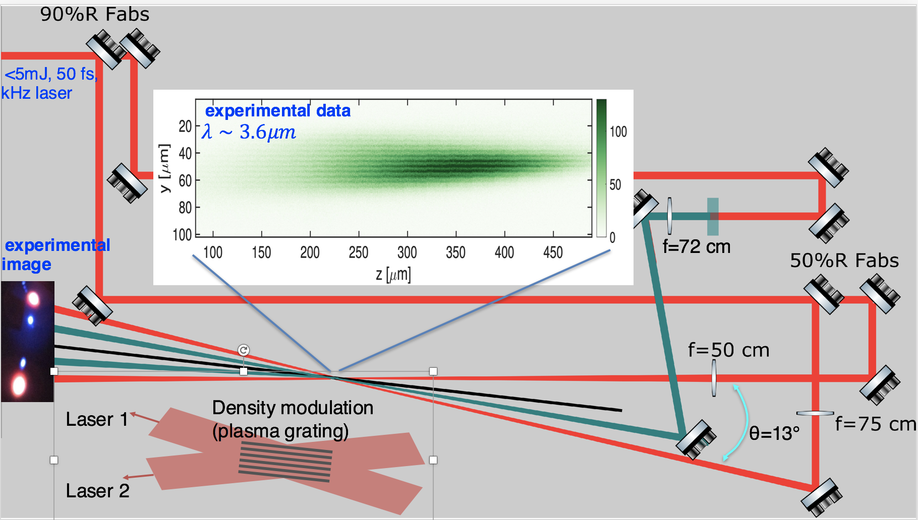
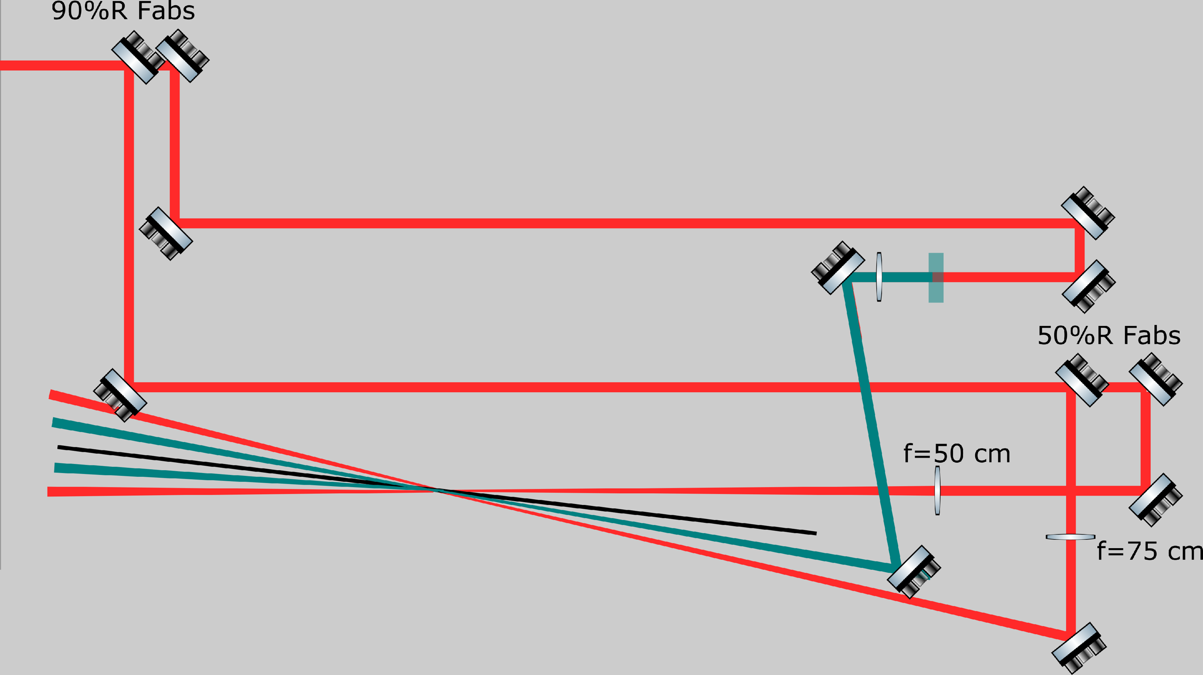
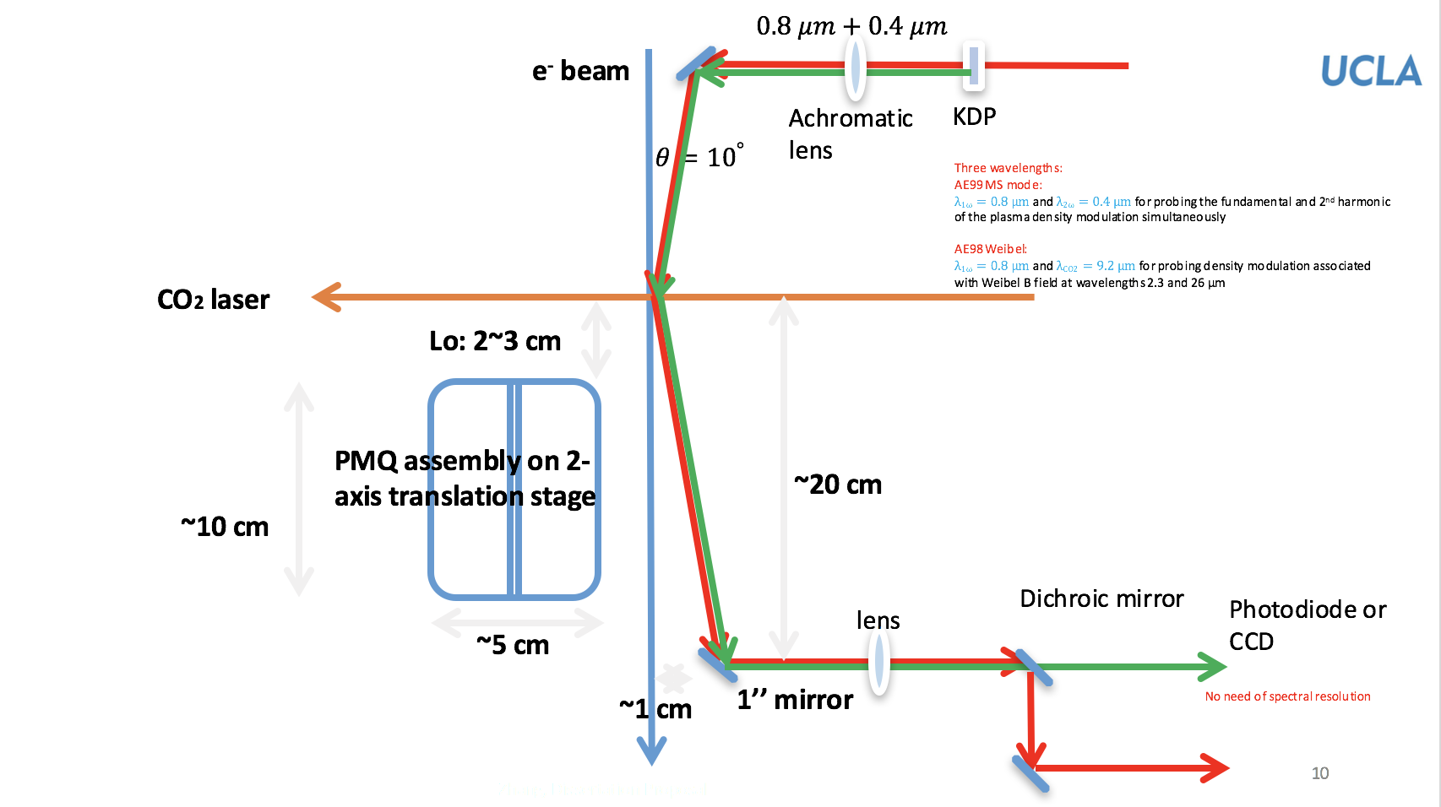
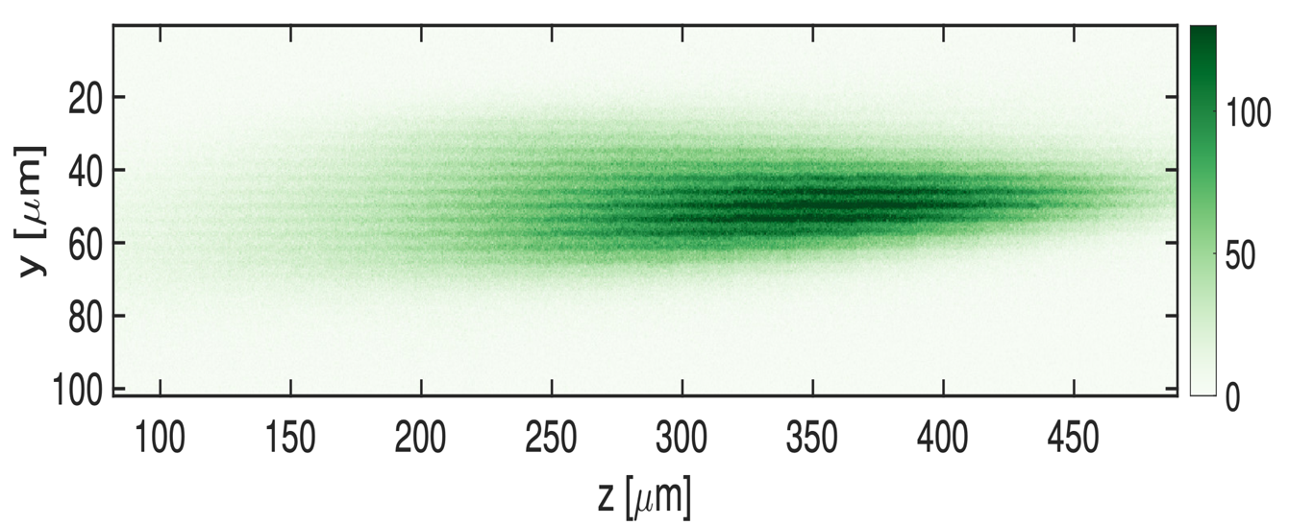
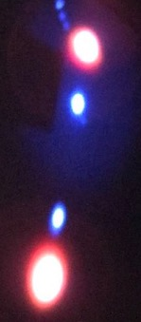
GOAL 4: Measure Plasma density fluctuations associated
with the MS mode directly by Thomson Scattering
experimental data
$$λ∼3.6μm$$
A benchtop experiment done at UCLA to show that we can measure 3.6 um wavelength density fluctuations
Density modulation (plasma grating)
Density modulation (plasma grating)
Laser 1
Density modulation (plasma grating)
Laser 1
Laser 1
Laser 2
Laser 2
Laser 2

Slide 12
Summary: Timeline of the Experiment
Dec.20-March 21: assembly and testing of diagnostics at UCLA
Current-May 21: discussions with Navid and ATF personnel regarding
assembly, synergies and conflicts with other experiments
Jan21-ongoing discussion with ATF staff regarding availability of e-beam,
CO₂ laser and TW Ti-sapphire laser
Aug 15-31st Set up AE98 and AE99
Sept 1st0-Sept 30 Experimental run time.

Slide 13
COVID 19 impact
1. Travel to ATF was not possible
2 We Set up experimental teams for AE98 and AE99
3 Between Sept and November had a number of bi-weekly meetings
4 Zan Nie gave an invited talk at the Online APS-DPP meeting
5 Invited talk written up for publication in PoP
6 Quadrupole permanent magnets needed for imaging diagnostic and
7 The IR spectrometers designed and parts ordered
8 Gas nozzles needed for both AE 98 and AE 99 aquaired
9The Thomson scattering diagnostic set up and shown to work at UCLA

Slide 14
Electron Beam Requirements
Parameter | Units | Typical Values | Comments | Requested Values
Beam Energy | MeV | 50-65 | Full range is ~15-75 MeV with highest beam quality at nominal values | 50-55 MeV
Bunch Charge | nC | 0.1-2.0 | Bunch length & emittance vary with charge | 0.1
Compression | fs | Down to 100 fs (up to 1 kA peak current) | A magnetic bunch compressor available to compress bunch down to ~100 fs. Beam quality is variable depending on charge and amount of compression required. NOTE: Further compression options are being developed to provide bunch lengths down to the ~10 fs level | 100-200 fs
Transverse size at IP (σ) | μm | 30 – 100 (dependent on IP position) | It is possible to achieve transverse sizes below 10 um with special permanent magnet optics. | 30x100 um
Normalized Emittance | μm | 1 (at 0.3 nC) | Variable with bunch charge | <1 um
Rep. Rate (Hz) | Hz | 1.5 | 3 Hz also available if needed | 1 Hz-1 shot/m
Trains mode | --- | Single bunch | Multi-bunch mode available. Trains of 24 or 48 ns spaced bunches. | Single bunch
Same as AE88 and AE98

Slide 15
CO₂ Laser Requirements
Configuration | Parameter | Units | Typical Values | Comments | Requested Values
CO₂ Regenerative Amplifier Beam | Wavelength | μm | 9.2 | Wavelength determined by mixed isotope gain media | 9.2
 | Peak Power | GW | ~3 |  | 3
 | Pulse Mode | --- | Single |  | single
 | Pulse Length | ps | 2 |  | 2
 | Pulse Energy | mJ | 6 |  | 6
 | M² | --- | ~1.5 |  | ok
 | Repetition Rate | Hz | 1.5 | 3 Hz also available if needed | ok
 | Polarization | --- | Linear | Circular polarization available at slightly reduced power | linear
CO₂ CPA Beam | Wavelength | μm | 9.2 | Wavelength determined by mixed isotope gain media | 9.2
Note that delivery of full power pulses to the Experimental Hall is presently limited to Beamline #1 only. | Peak Power | TW | 2 | ~5 TW operation is planned for FY21 (requires further in-vacuum transport upgrade). A 3-year development effort to achieve >10 TW and deliver to users is in progress. | 2
 | Pulse Mode | --- | Single |  | ok
 | Pulse Length | ps | 2 |  | ok
 | Pulse Energy | J | ~5 | Maximum pulse energies of >10 J will become available in FY20 | ok
 | M² | --- | ~2 |  | ok
 | Repetition Rate | Hz | 0.05 |  | ok
 | Polarization |  | Linear | Adjustable linear polarization along with circular polarization will become available in FY20 | ok

Slide 16
Near IR Experimental Laser Requirements
Ti:Sapphire Laser System | Units | Stage I Values | Stage II Values | Comments | Requested Values
Central Wavelength | nm | 800 | 800 | Stage I parameters have been delivered, while Stage II parameters will be available for user experiments once our vacuum transport installation is complete (now planned for FY21 after COVID-19 delays) | OK
FWHM Bandwidth | nm | 20 | 13 |  | OK
Compressed FWHM Pulse Width | fs | <55 | <75 | Transport of compressed pulses will initially include a very limited number of experimental interaction points. Please consult with the ATF Team if you need this capability. | OK stage 2
Chirped FWHM Pulse Width | ps | ≥50 | ≥50 |  | 50 fs
Chirped Energy | mJ | >30 | 200 |  | OK200 mJ
Compressed Energy | mJ | >14 | 100 |  | 100 mJ
Energy to Experiments | mJ | >10 | >80 |  | >80
Power to Experiments | GW | >250 | >1067

Slide 17
Special Equipment Requirements and Hazards
Electron Beam
Same as AE88 and AE 98. Only the location of the screen to detect the deflected electrons will be different.
CO₂ Laser
Prefer 2TW capability but can begin with 3GW
Ti:Sapphire and Nd:YAG Lasers
Thomson scatterring can be done with a few mJ beam but need 80-100 mJ fully compressed capability for ionization front generation.
Hazards & Special Installation Requirements
None expected

Slide 18
Experimental Time Request
CY2021 Time Request (combined for AE 98 and AE 99
Capability | Setup Hours | Running Hours
Electron Beam Only | 30 | 30
Laser* Only (in Laser Rooms) | Not known | Not known
Laser(s)* + Electron Beam | 15 | 90
Time Estimate for Remaining Years of Experiment (including CY2021)
Capability | Setup Hours | Running Hours
Electron Beam Only | 50 | 60
Laser* Only (in FEL Room)
Laser(s)* + Electron Beam | 40 | 250
* Laser = Near-IR or LWIR (CO₂) Laser

Slide 19
EXTRA SLIDES

Slide 20
What is a plasma magneto-static (MS)mode
The two normal electrostatic modes (collective waves) in an unmagnetized plasma are Bohm Gross Waves or electron plasma waves and ion acoustic waves.
Unmagnetized plasma can support another mode. It has zero frequency but a spatially periodic magnetic field –magneto-static (MS) mode.
How is it produced? it is produced by a periodic excitation of dc currents in the plasma.
There is a connection between this mode and the filamentation/Weibel instability produced magnetic field (see Chaojie Zhang’s proposal)
This mode has hitherto not been observed.

Slide 21
Design
A
B
B
A
Lo
Lp
L1
L2
L1
object plane
image plane
Beam energy: 50.5 MeV
Components | 0.5m (AE98) | 0.85m (AE99)
A | 165T/m，1.5cm | 165T/m，1.5cm
B | 380T/m，1.5cm | 380T/m，1.5cm
L1 | 1.5cm | 1.5cm
L2 | 1.50479cm | 1.50479cm
Lo | 2.86732cm | 2.03262cm
Lp | 35cm | 70cm
Magnification factor | -4.5378 | -9.24049
In the experiment, L₂ can be
adjusted using a moving stage
with micron-level precision.

Slide 22
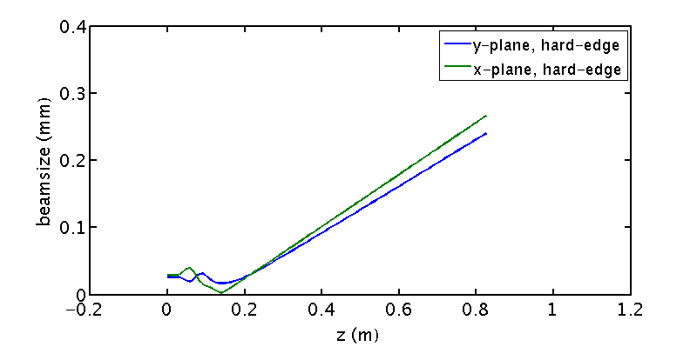
Simulation results using the particle tracking code ASTRA
Space charge force included
0.85m case
The magnification factor:
X plane 9.49; Y plane 9.40
PMQ region (the smallest inner diameter ~6mm, no beam loss)

Slide 23
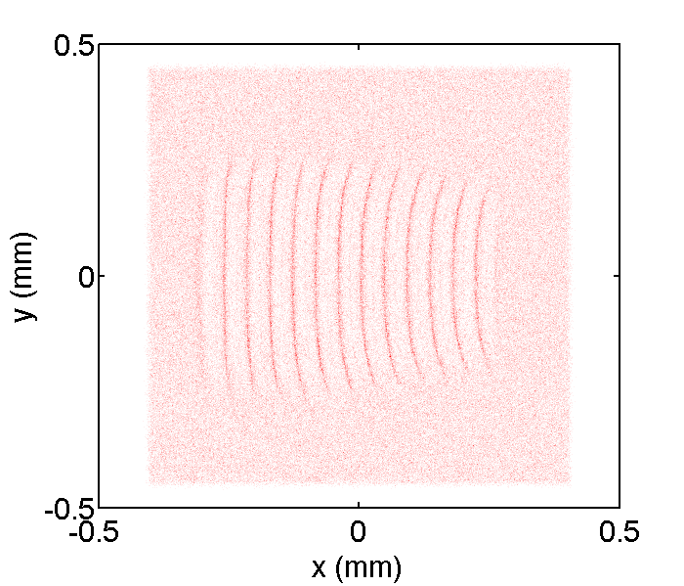
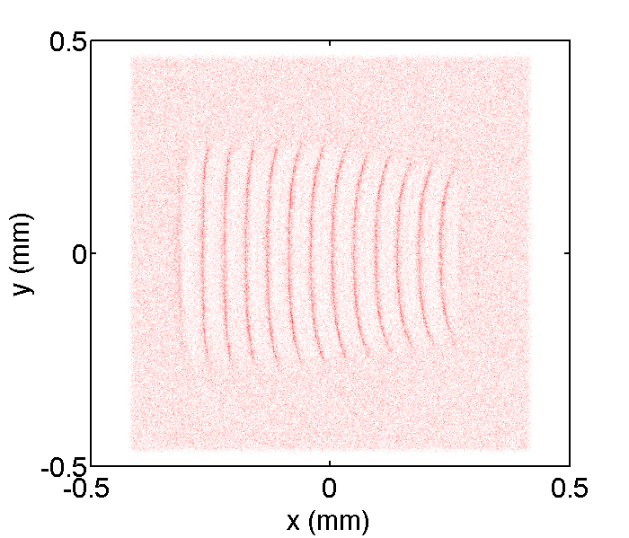
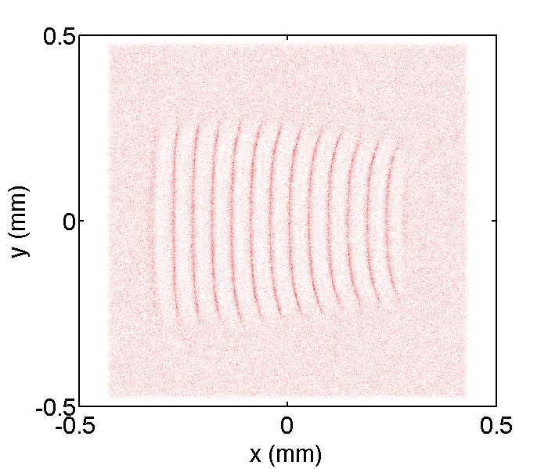
Scan the position of the image plane (Lp)
0.85m case
z=0.81m
z=0.83m
z=0.85m

Slide 24
Simulation results using the particle tracking code ASTRA
quasi point-to-point (R₁₂≈0)
0.85m case
z=0.81m
z=0.85m

