Slide 1
Proposal ID: UED 103
Proposal title: Structural phase transition and phonon excitation in non-equilibrium Cu₂S
PI: Jing Tao
Co-PI: Junjie Li, Wei Wang, Yimei Zhu
Condensed Matter Physics & Materials Science Division
Brookhaven National Laboratory
Funding Source (Received): U. S. DOE, BES, Division of Materials Science and Engineering, and Early Career Award
Collaborators:
Brookhaven National Laboratory
PM: L. Wu, W-G. Yin, R. Konik, M. Dean, I. Robinson
ATF: M. Babzien, M. Fedurin, R. Malone, M. Palmer
CFN: D. Lu
University of Arkansas
J-Y. Chen
American Physical Society
Y. Li
Princeton University
R. J. Cava
University of Michigan
K. Sun
ATF Users’ Meeting 2020

Slide 2
Outline
Objective: understanding the mechanism of structural phase transition in Cu₂S
Introduction: a background of the material and significance of UED observations
Preliminary results and future experimental plan
ATF Users’ Meeting 2020

Slide 3
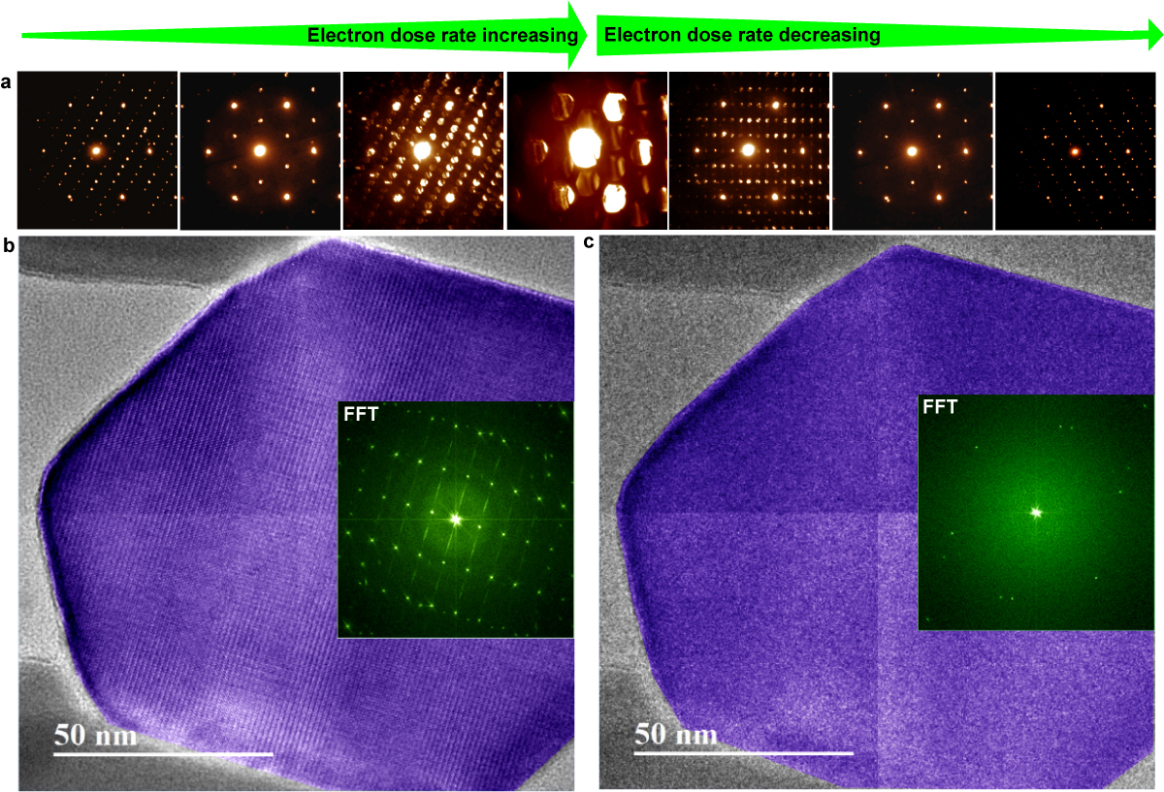
Reversible structure manipulation in Cu₂S
J. Tao et al., PNAS 114, 9832 (2017)
ATF Users’ Meeting 2020

Slide 4
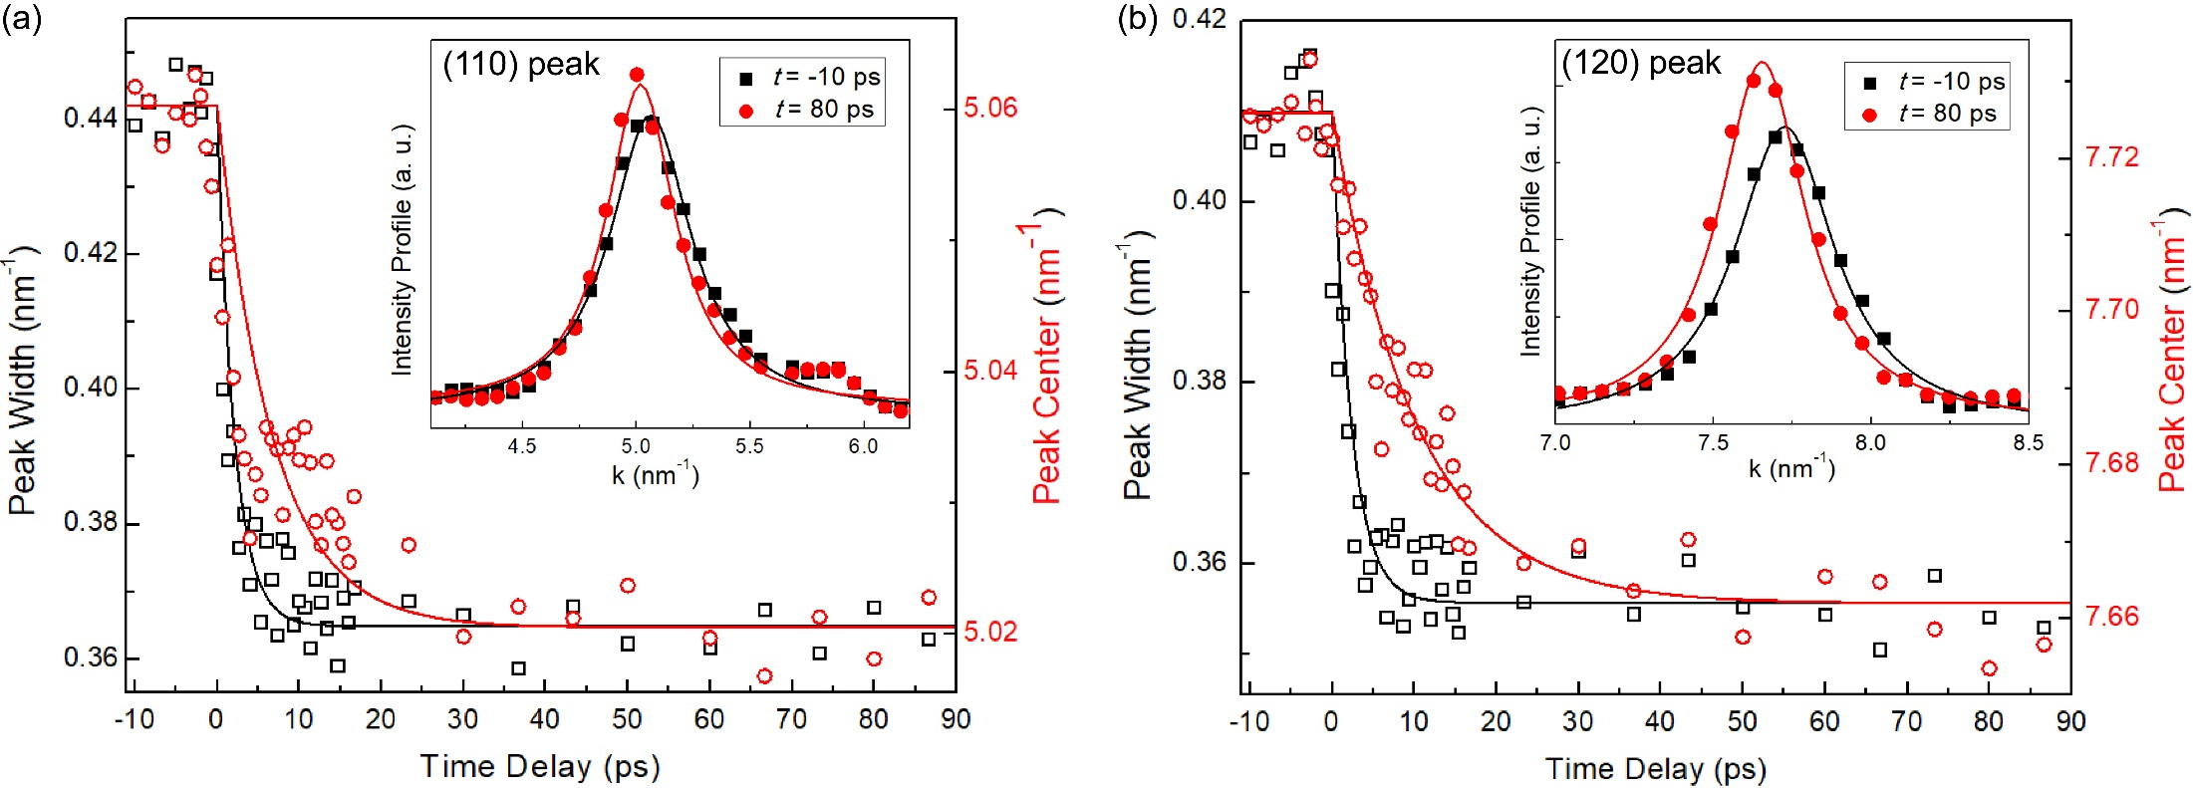
Peak width and peak center position measurements
Time constant ~ 2.3 ± 0.2 ps for the peak width and ~ 10.2 ± 0.3 ps for the peak center for the (120) peak. The temporal characteristic in crystal symmetry change is the same as in electronic structures.
Illustrated that crystal symmetry changes first, followed by lattice expansion.
Suggested the transition mechanism in Cu₂S to be electron-phonon coupling.
ATF Users’ Meeting 2020

Slide 5
Outline
Objective: understanding the mechanism of structural phase transition in Cu₂S
Introduction: a background of the material and significance of UED observations
Preliminary results and future experimental plan
ATF Users’ Meeting 2020

Slide 6
Timeline
Year 1: Single-crystal Cu₂S UED samples would be prepared and MeV-UED patterns with good quality will be obtained. Time-resolved UED results will be tested.
Year 2: Complete sets of time-resolved UED results will be collected. Data analysis and the structural interpretation(i.e., how are the intensity measurements associated with the structures, atomic displacements, and phonon modes)will be done.
Year 3: Time-resolved UED results will be collected and data analysis will be completed in a parameter space, i.e., under various temperatures and pumping fluences for a better understanding of photoexcitation mechanism.
ATF Users’ Meeting 2020

Slide 7
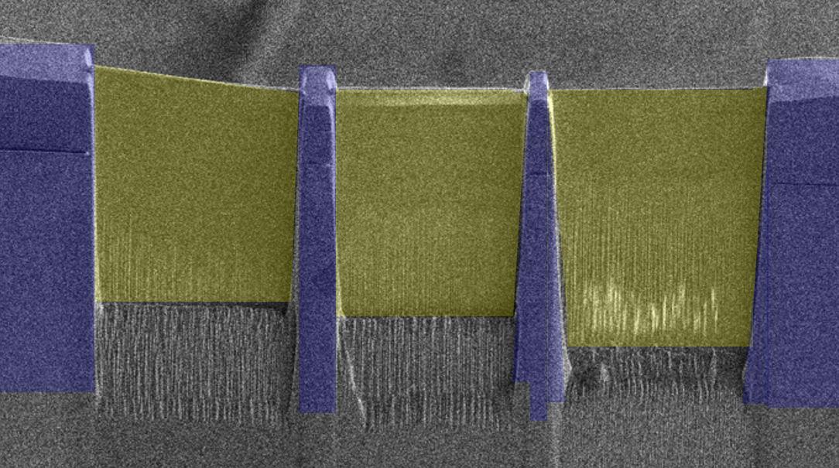
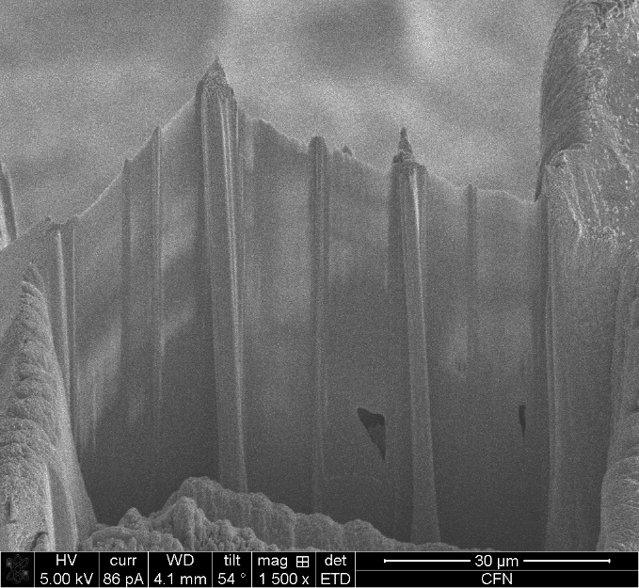
UED sample prep from 3D single crystals
Challenges in MeV-UED sample preparation from single crystals:
Approaches:
Mechanical polishing, focused ion beam milling, noble-gas ion sputtering
Nano-fabrication, lithography, and plasma etching
Uniformly thin for electron transparence (< 100 nm along beam direction)
Large lateral size of thin area (> 100 µm as diameter)
Cu₂S UED samples prepared by FIB
20 μm
ATF Users’ Meeting 2020

Slide 8
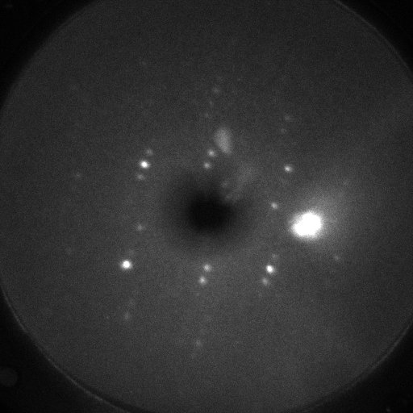
UED pattern from Cu₂S single crystals
Pump-probe experiments were performed under various pumping fluences; No measurable intensity change was observed with laser fluence up to 6 mJ/cm².
MeV-UED, BNL-ATF
ATF Users’ Meeting 2020

Slide 9
2020 Activities & Impacts Associated with this Experiment
None to this date.
COVID-19 Pandemic Impacts
Significantly reduced UED beam time;
Significantly reduced UED sample prep time (CFN FIB beam time);
Unexpected instrument malfunction after COVID-19 lockdown.
ATF Users’ Meeting 2020

Slide 10
Special Equipment Requirements and Hazards
Sample Cu₂S and Setup
Experimental setup is normal. No special equipment is needed.
Pump Laser Requirements
800 nm (1.55 eV) with various pump fluence.
Up to 9 μm (140 meV) using OPA (just arrived and under installation) for selective phonon excitation.
New UED camera?
Hazards & Special Installation Requirements
Double-tilt sample stage.
Cryogens: liquid nitrogen.
No new magnetic elements.
No new materials into the beam path.
No beam line modifications.
ATF Users’ Meeting 2020

Slide 11
Experimental Time Request
CY2021 Time Request
Capability | Setup Hours | Running Hours
UED Facility | 2 - 3 days (48 – 72 hours) | 1 - 2 weeks (40 – 80 hours)
Time Estimate for Remaining Years of Experiment (including CY2021)
Capability | Setup Hours | Running Hours
UED Facility | 10 days (240 hours) | 3 – 6 weeks (120 – 240 hours)
ATF Users’ Meeting 2020

Slide 12
Thank you!
ATF Users’ Meeting 2020
Notes:
Thank you very much!

