Slide 1
UED-306057: Photoinduced Structure phase transition in Weyl semimetal MoTe2
PI: Junjie Li, Yimei Zhu
Condensed Matter and Material Science Division, BNL
Sponsored by the U. S. DOE, BES
Division of Materials Sciences and Engineering
22nd ATF Users Meeting: Application for New UED experiment

Slide 2
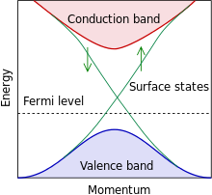
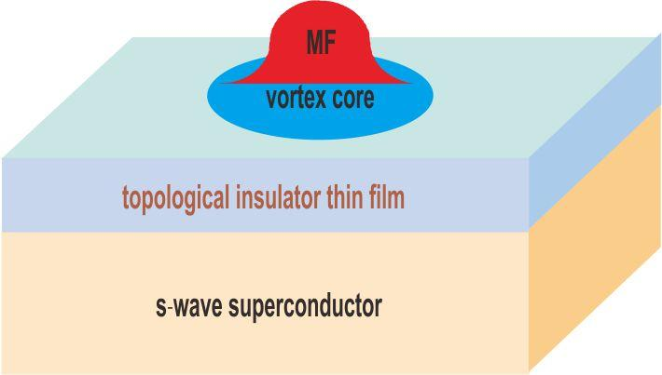
Science Background:
The unique properties of MoTe₂
Topological Insulator
Artificial Topological Superconductivity and Majorana Fermions
MoTe₂ : have both topological surface sates and superconductivity in bulk

Slide 3
Motivation of the project: switch of topological states in MoTe₂
Monoclinic 1T’
High T, high pressure
orthorhombic T_{d}
Low T, No pressure
Topological Insulating property
94˚
90 ˚
Inversion symmetry Broken
Switch of topological insulating properties

Slide 4
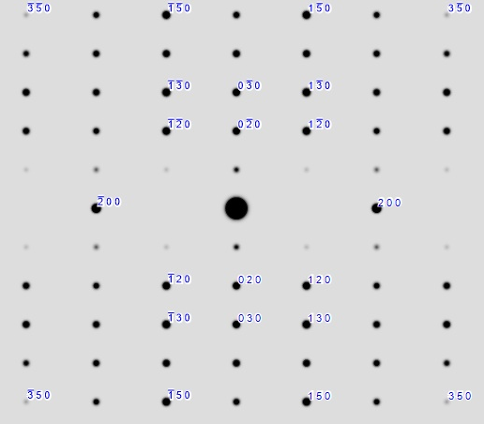
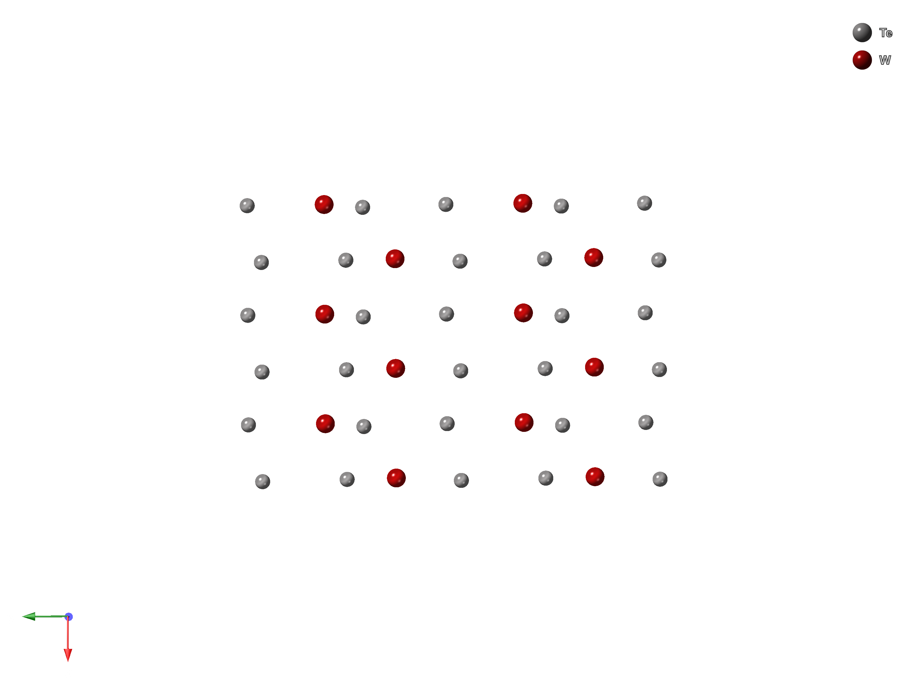
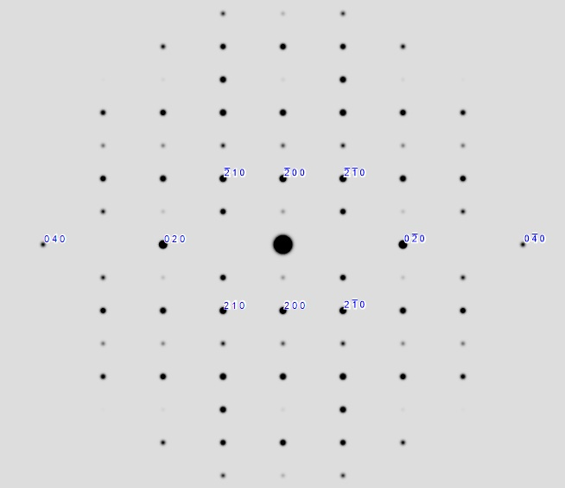
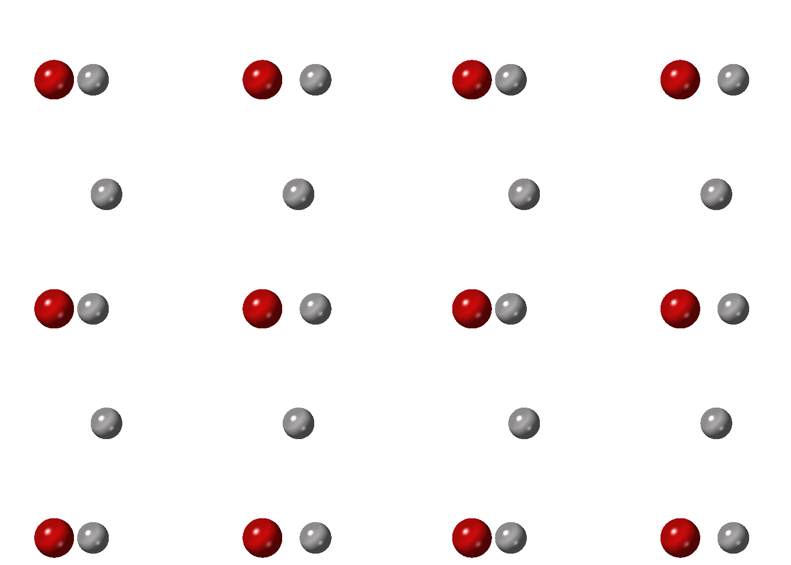
Structure transition and
Electron diffraction along 001 direction
Atomic layout along 001
Simulated Electron Diffraction
T < Tc
orthorhombic T_{d}
90 ˚
~250 K
T > Tc
Monoclinic 1T’
94˚

Slide 5
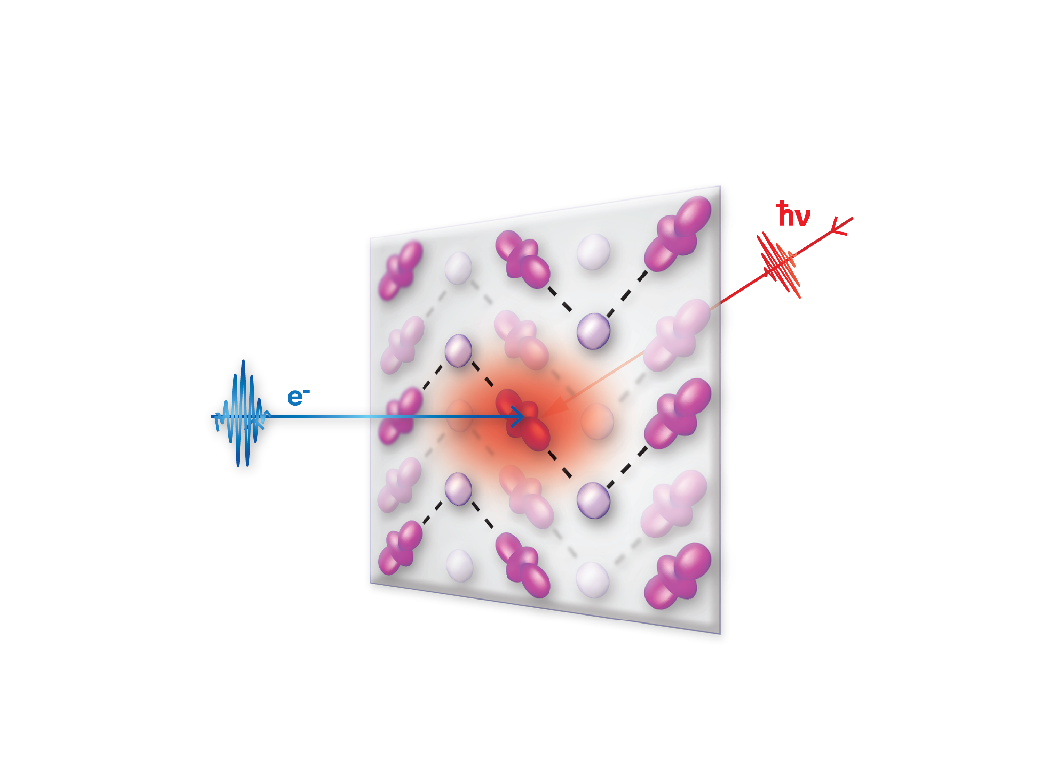
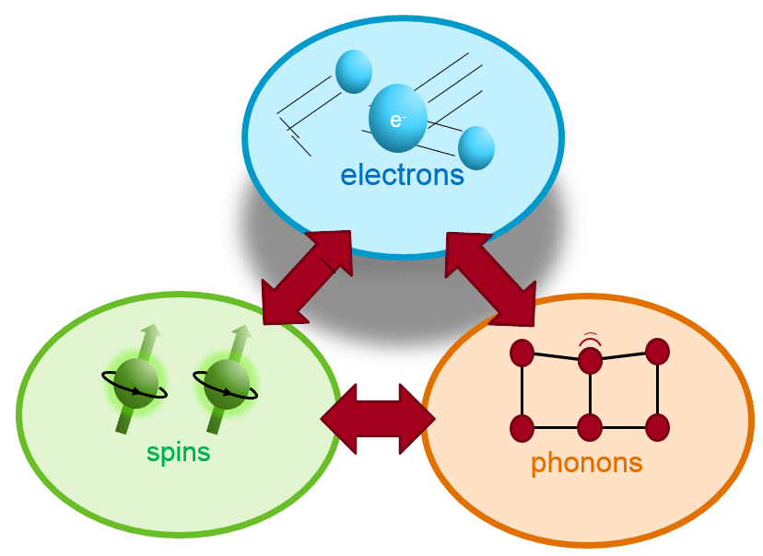
Time-resolve measurement with Ultrafast Electron Diffraction
Optical pump
800 nm, 180 fs
2.8 MeV
electrons
~10fs
~1ps
spins
~100ps
phonons
Electron probe
Diffraction from 001 orientation
Objective to resolve:
Evolution from Monoclinic to Orthorhombic
Correlation of lattice change and electronic structure

Slide 6
THz induced phase transition in WTe₂
Electron diffraction
from 001 orientation
Peak intensity change
Differentiated pattern
Partial phase transition
Sie, E.; et al.,Nature, 565, 61 (2019)

Slide 7
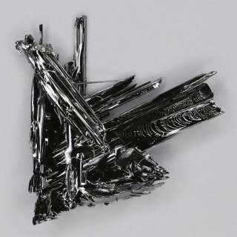
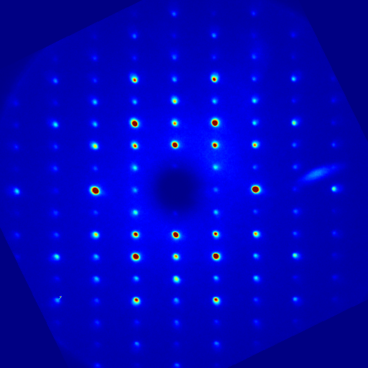
UED measurement
Exfoliation from bulk sample
1T’-MoTe2, semimetal
Electron diffraction along 001 orientation
at room temperature

Slide 8
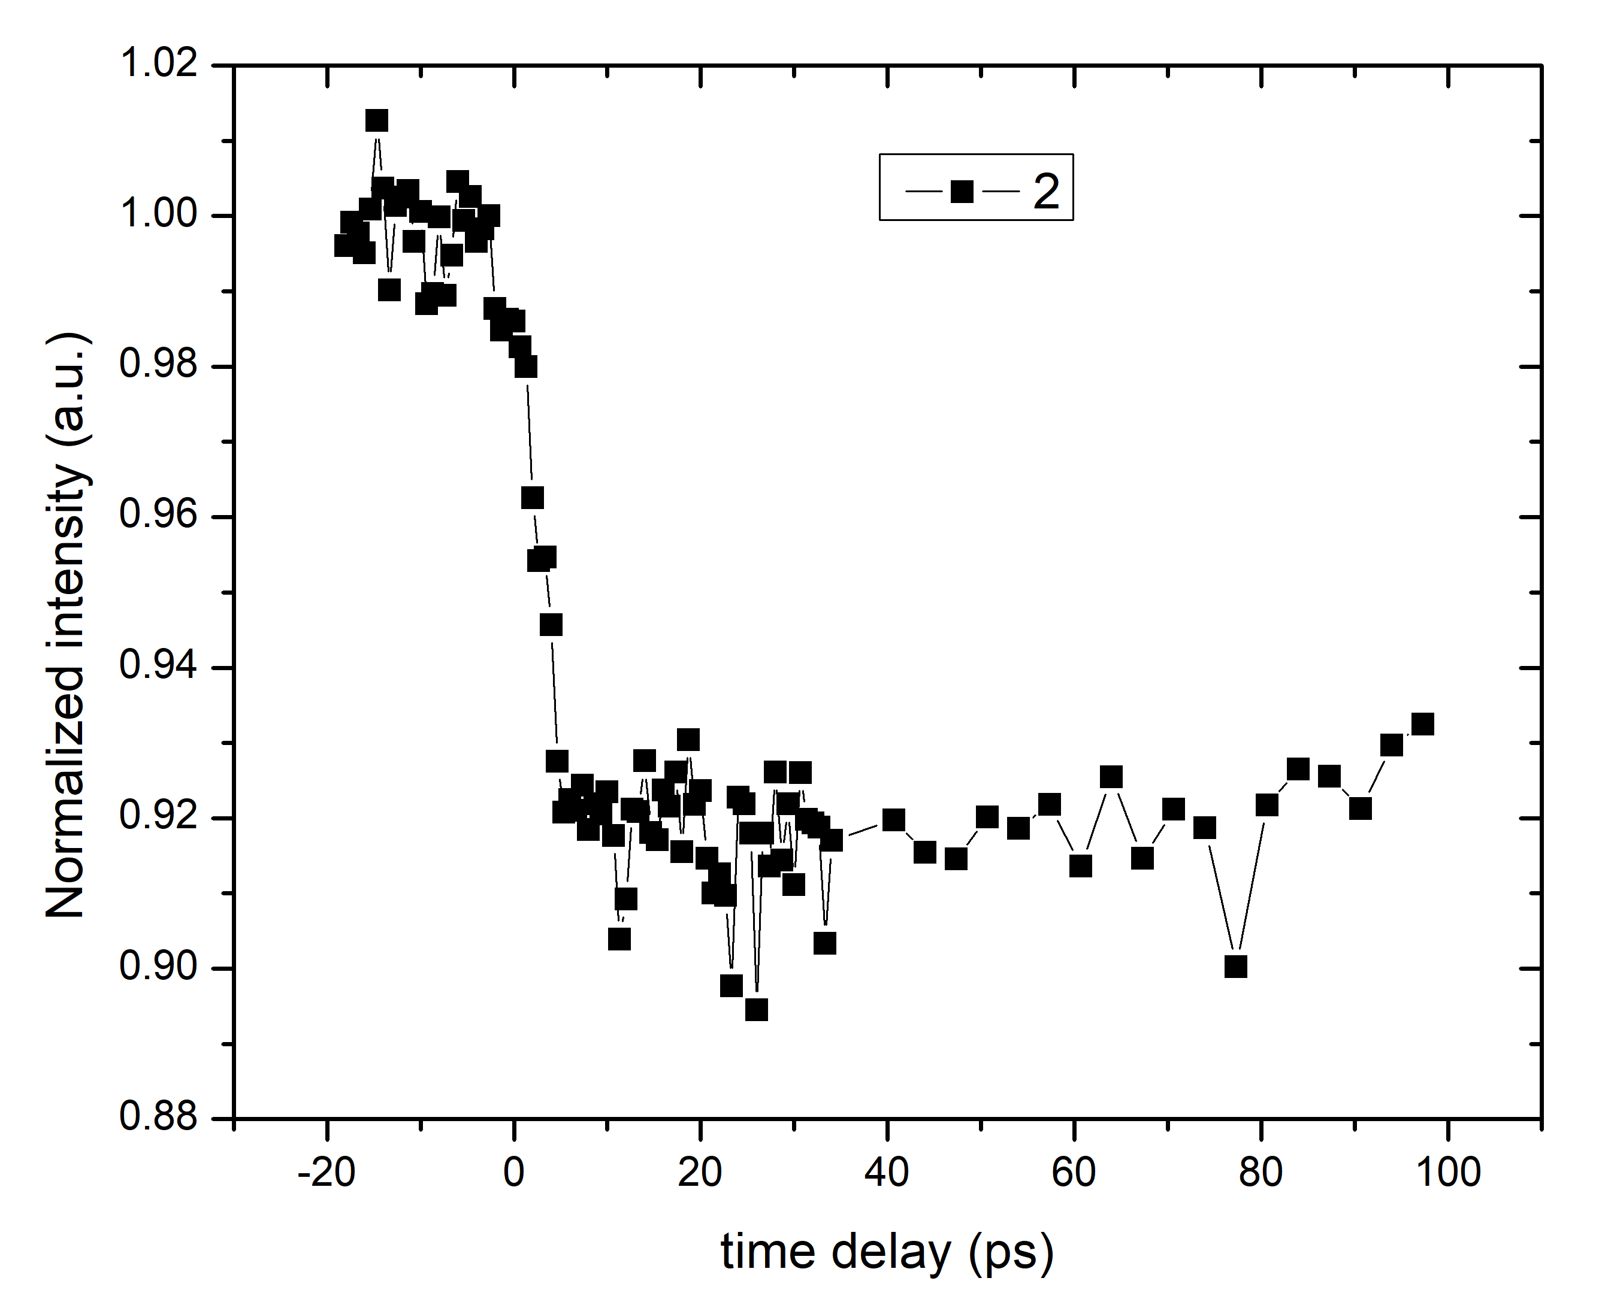
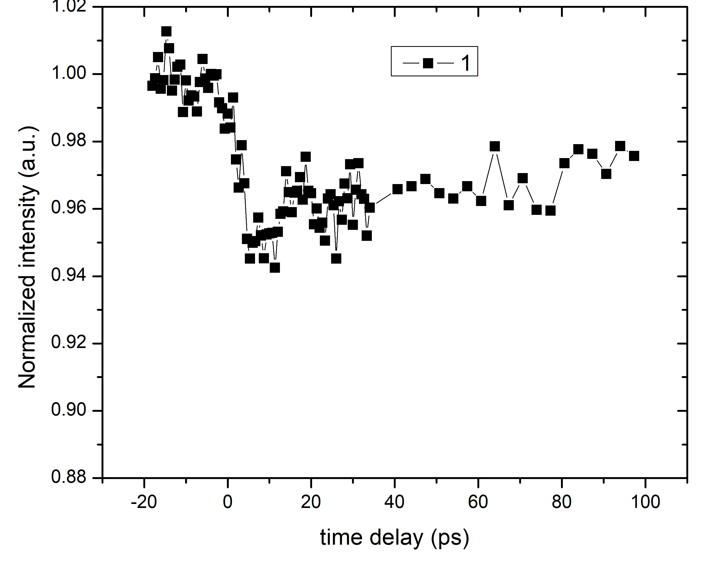
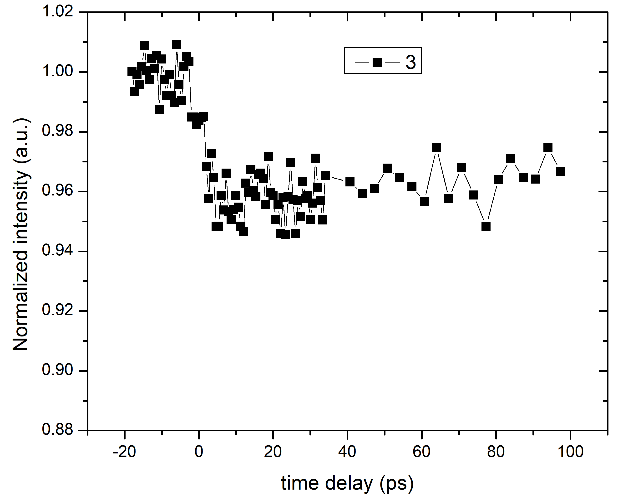
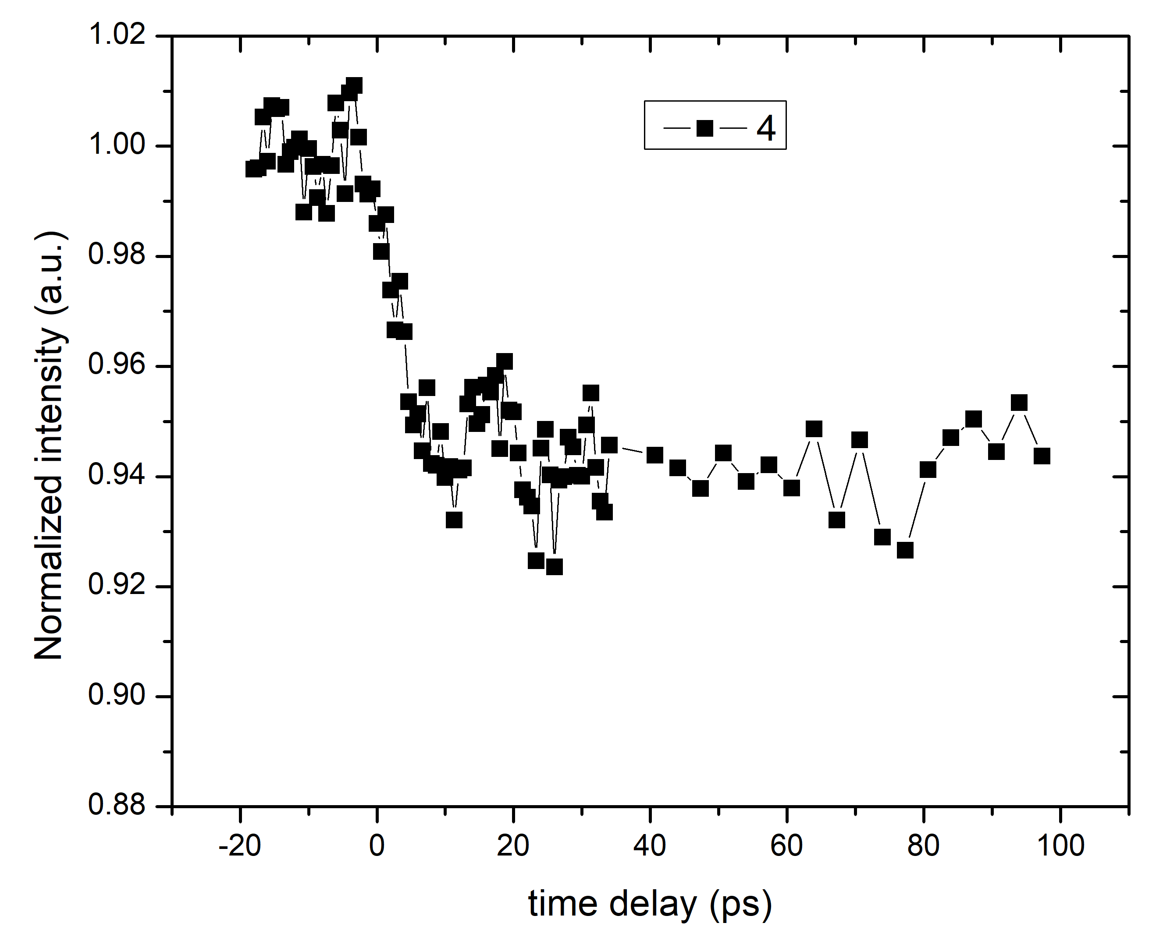
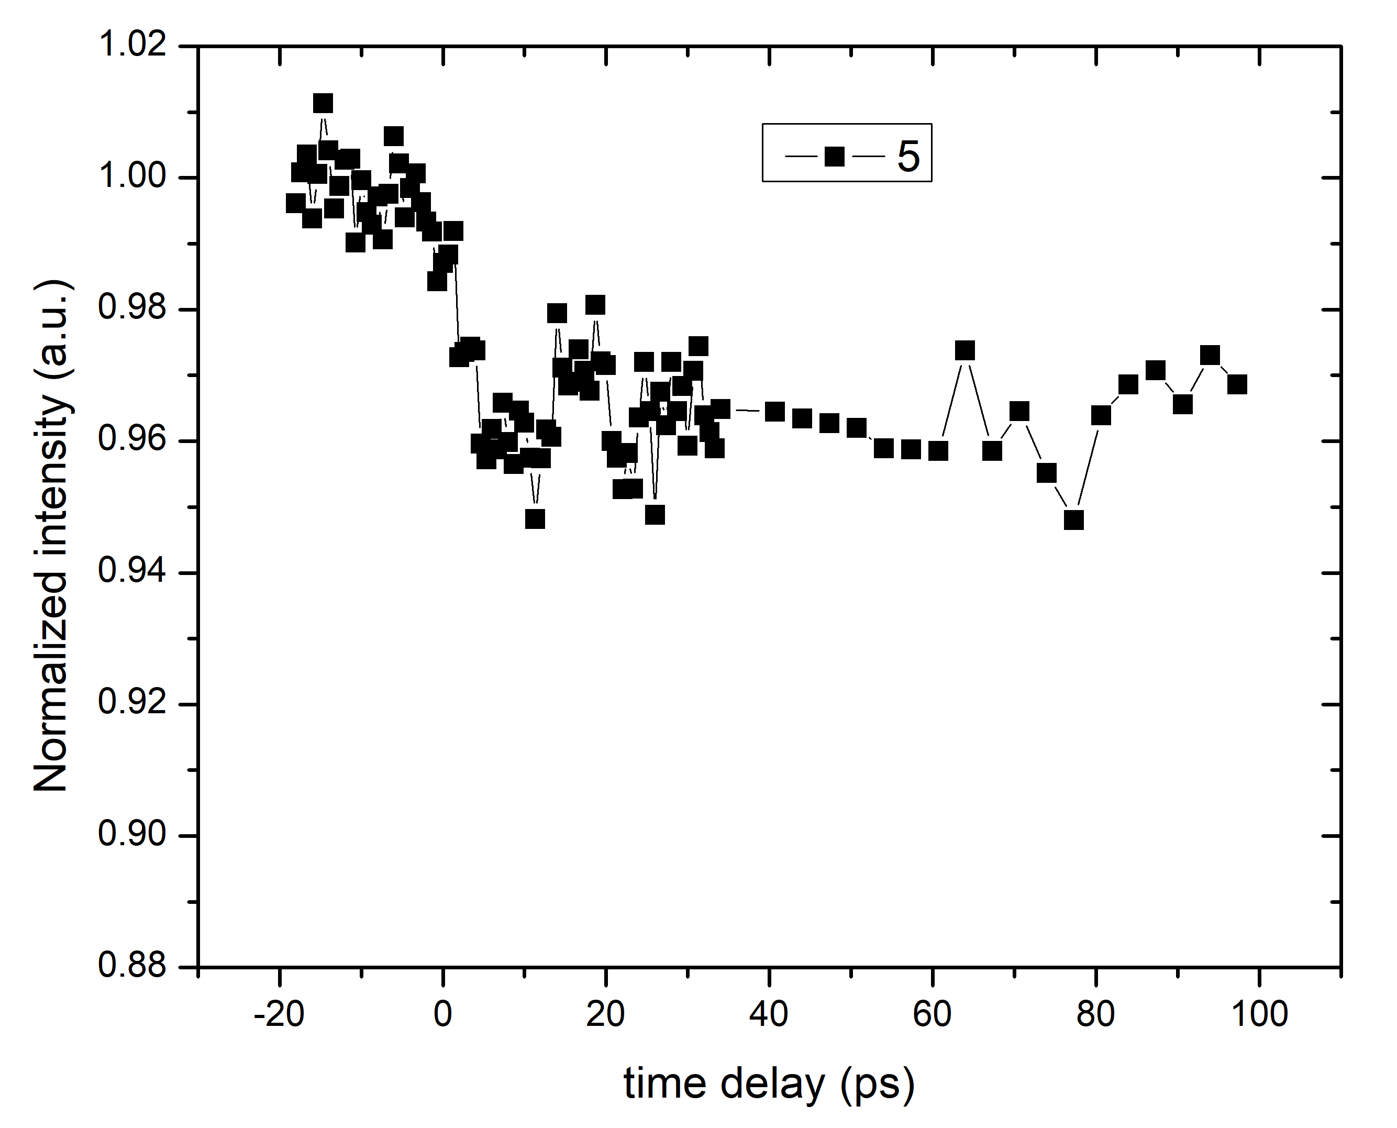
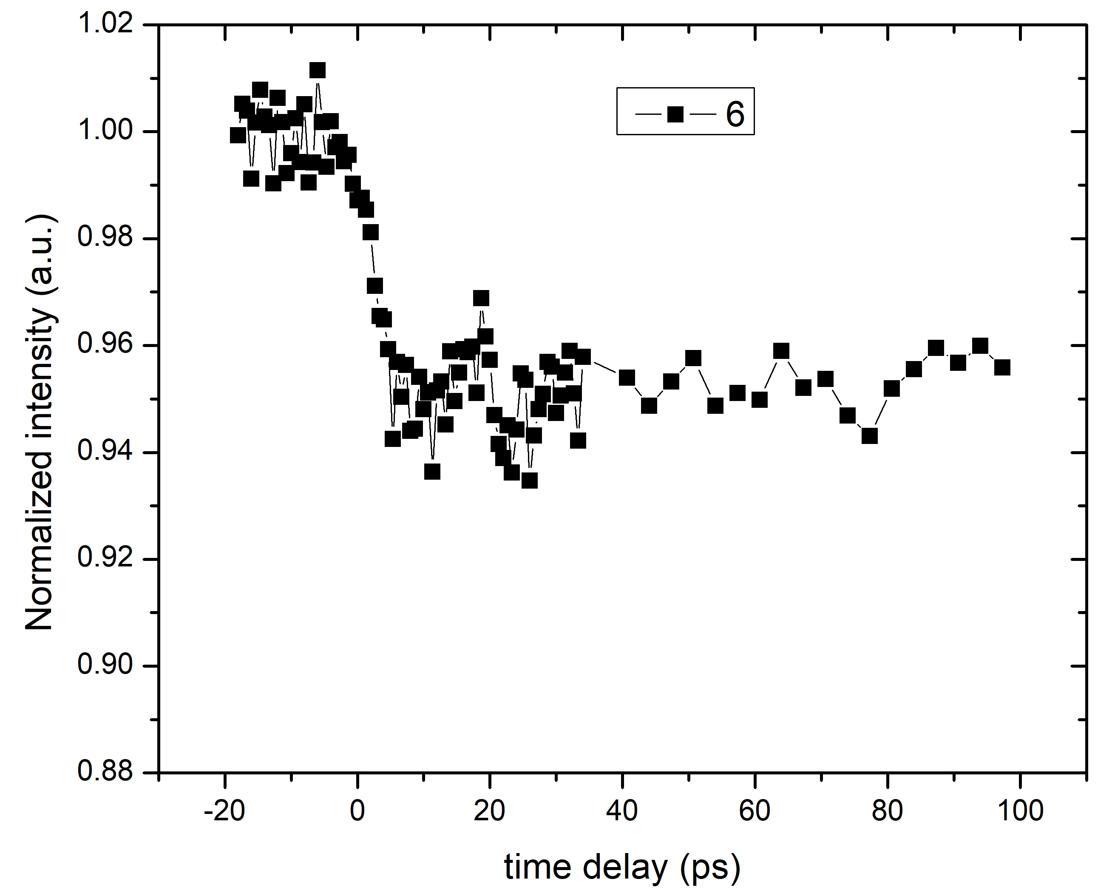
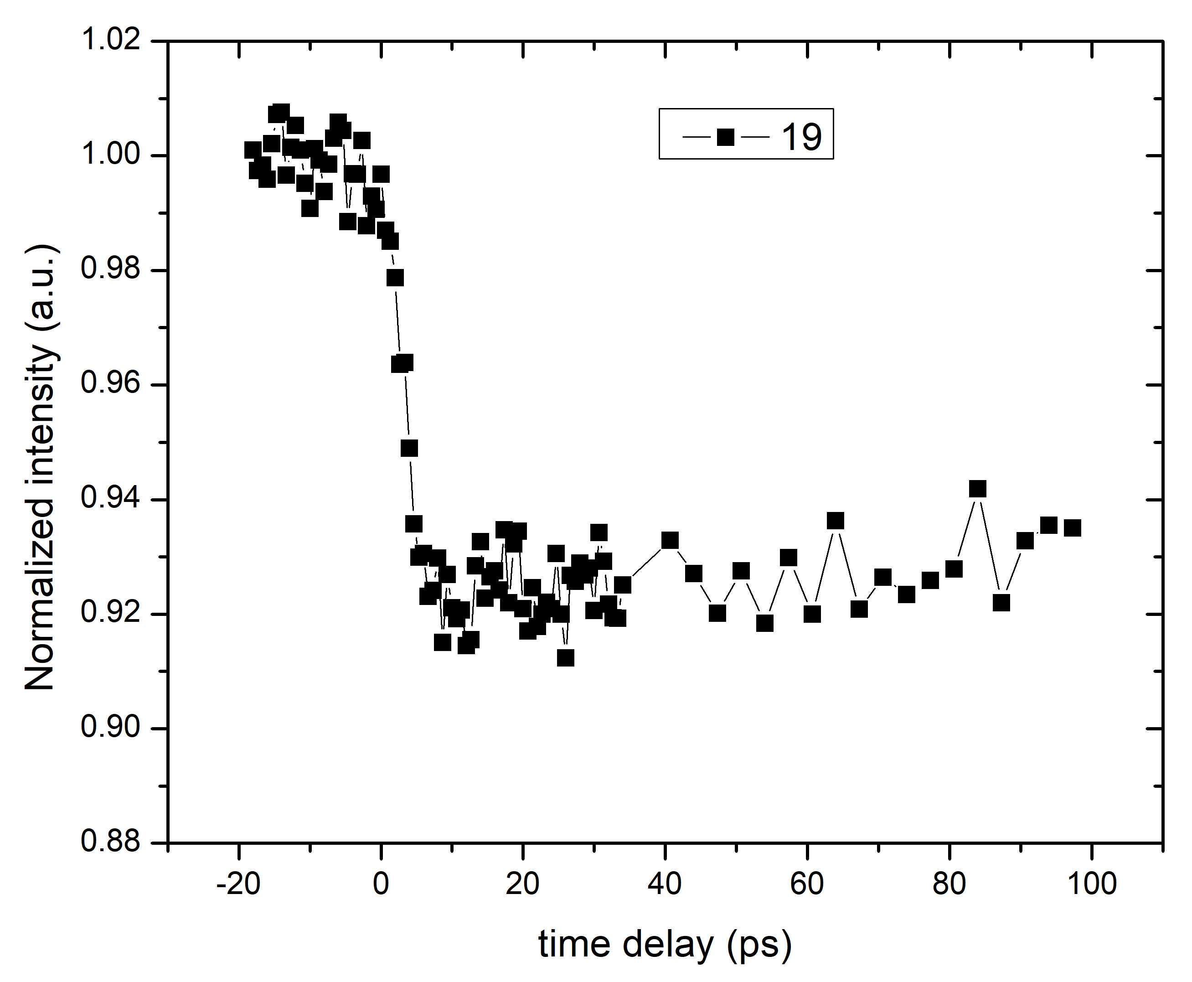
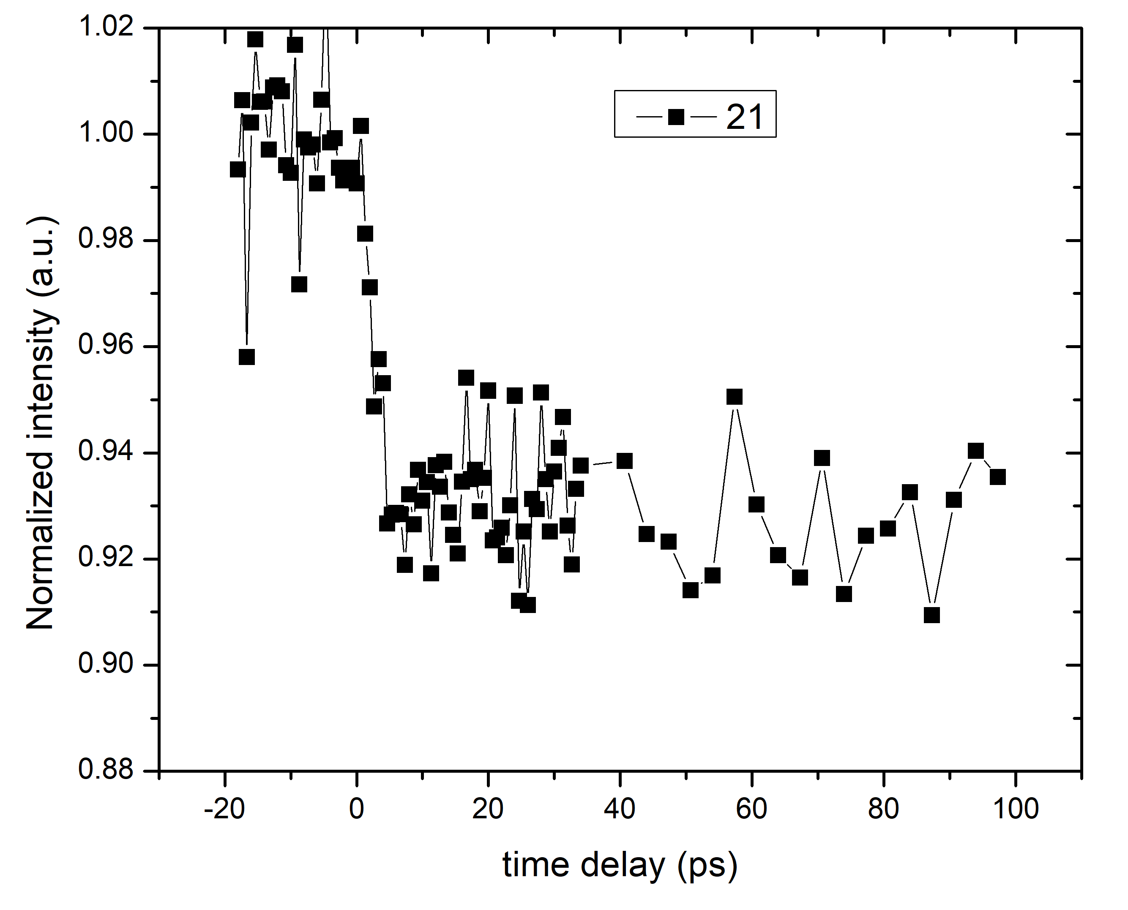
Preliminary result of peak Intensity
Room temperature, under pump 1.5 mJ/cm²
Combined structure change and thermal random motion
1
5
3
2
6
4
7
8
7
8
Measurements are going
at 77K and 220 K

Slide 9

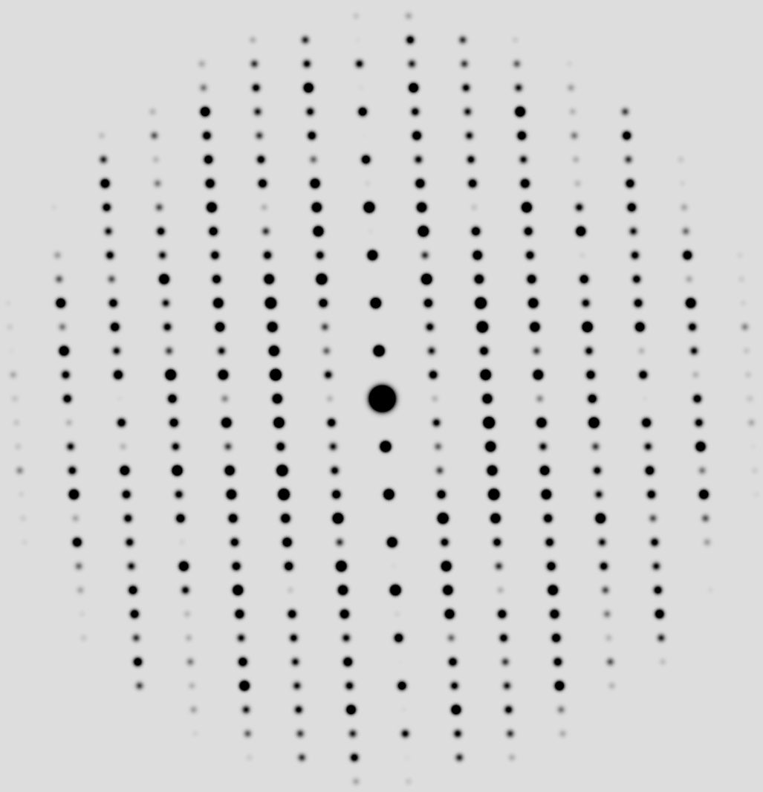
Following experiment plan:
Diffraction from 100 orientation
Simulated Diffraction from 100 orientation
T < Tc
orthorhombic T_{d}
90 ˚
~250 K
Structure dynamics along layer-stacking direction
Construct 3D model of structure dynamics
Challenge: sample preparation
T > Tc
Monoclinic 1T’
94˚

Slide 10
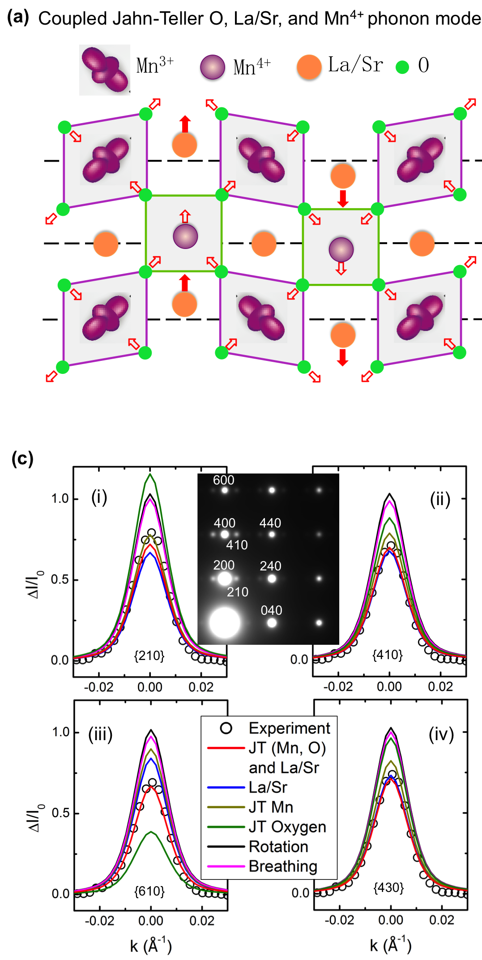
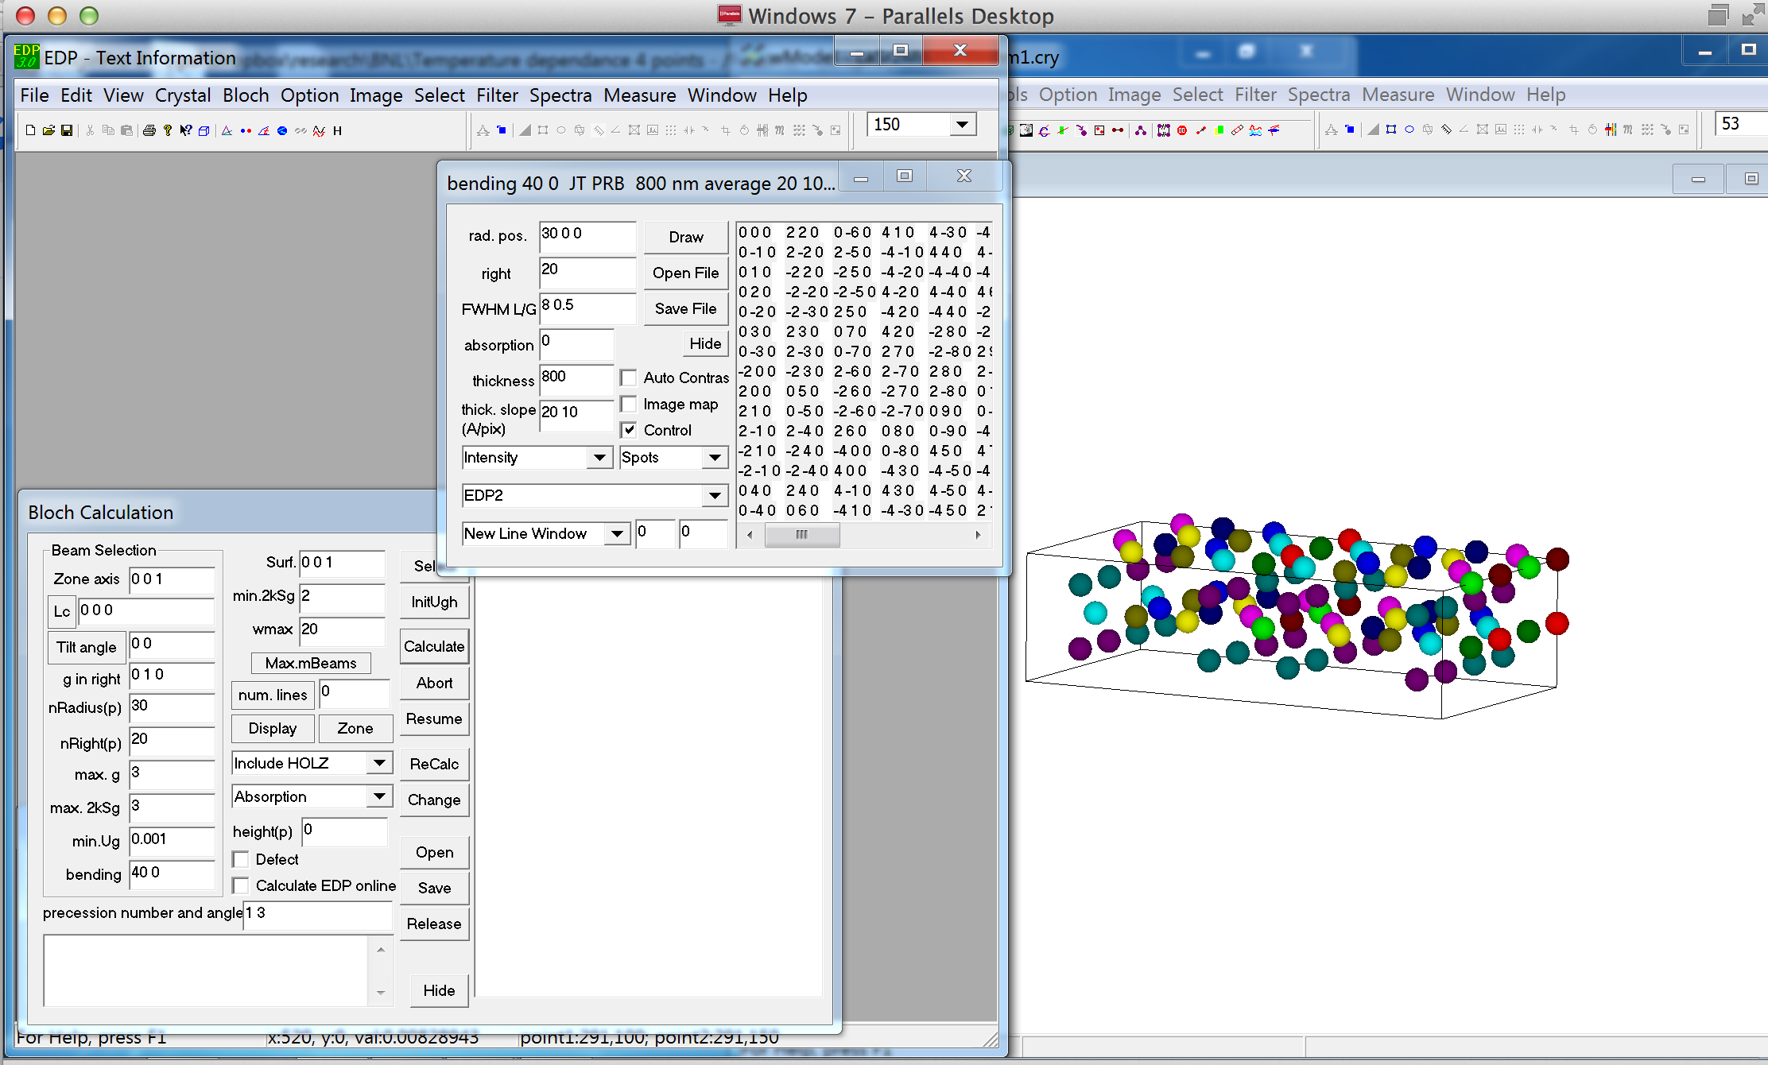
Crystallographic structure refinement with Home-made computer codes
Li, J., npj Quantum Materials 1, 16026 (2016)
Notes:
Home made program

Slide 11
Summary
We have done UED measurement on the MoTe2 at room temperature, measurements at 77 K and 220 K is being carried.
Results of measurement at room temperature shows promising results
Planning direct measurement of structure change along layer-stacking direction by electron diffraction along 100 orientation

Slide 12
Thank You!

Slide 13
ATF Users’ Meeting
Instructions for New UED (Bldg. 912) Proposals

Slide 14
Experimental Time Request
CY2021 Time Request
Capability | Setup Hours | Running Hours
UED Facility | 60 | 400
Time Estimate for Full 3-year Experiment (including CY2021)
Capability | Setup Hours | Running Hours
UED Facility | 60 | 400

Slide 15
Instructions for UED Proposal Presenters
All proposal presentations are 25 minutes in duration: 20’ presentation + 5’ questions
Proposal Title Slide - Please include:
  Proposal ID & Proposal Title
  PI Name
  A list of all collaborators and institutions
  Funding source
  Status of funding (“Proposed” or “Received”)
Please fill out the “Special Equipment Requirements and Hazards” slide for your experiment and include at the end of your presentation
Please fill out the “Experimental Time Request” slide for your experiment and include at the end of your presentation

Slide 16
Special Equipment Requirements and Hazards
User Sample and Setup
  Please indicate any special equipment that you expect to need bolometer/interferometer setup etc.: NO
Pump Laser Requirements
  Please note any special pump laser requirements here: NO
Hazards & Special Installation Requirements
  Large installation (chamber, insertion device, etc.): NO
  Cryogens: YES (liquid Nitrogen)
  Introducing new magnetic elements: NO
  Introducing new materials into the beam path: YES
  Any other foreseeable beam line modifications: NO

Slide 17
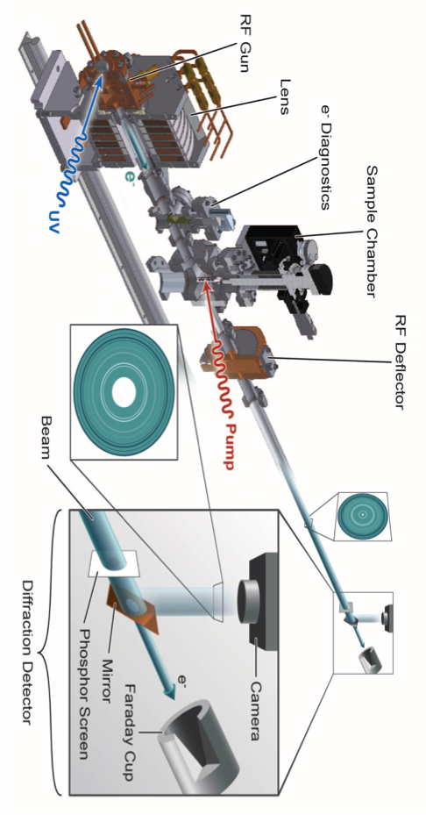
BNL MeV-Ultrafast Electron Diffraction
Acceleration voltage = 3 MeV
10⁶ electrons per pulse
Temporal resolution ~ 180 fs
Notes:
Here shows a typical optical pump probe measurement. The pump pulse will arrive first to initiate a dynamical process, This involves the interaction between laser and sample. Also it set the time-zero or the beginning of the whole process. Then after a short time-delay, at t1, the probe pulse arrives to measure the reflectivity. By adjusting the time delay, we finally can get a whole curve of how the optical properties change during the dynamic process initiated by the pump pulse.
Nowadays, there are many kinds of pump probe technique. They all use laser pulse to pump, but probe varies a lot.

