Slide 1
Proposal ID: UED 105
Proposal title: Charge order and
lattice dynamics in photoexcited cuprates and iridates
PI: Jing Tao
Co-PI: Junjie Li, Wei Wang, Yimei Zhu
Condensed Matter Physics & Materials Science Division
Brookhaven National Laboratory
Funding Source (Received): U. S. DOE, BES, Division of Materials Science and Engineering, and Early Career Award
Collaborators:
Brookhaven National Laboratory
PM: C. Petrovic, L. Wu, W-G. Yin, R. Konik, M. Dean, I. Robinson
ATF: M. Babzien, M. Fedurin, R. Malone, M. Palmer
CFN: D. Lu
University of Michigan
K. Sun
Princeton University
R. J. Cava
ATF Users’ Meeting 2020

Slide 2
Outline
Material change and project modification
Introduction: a background of the material
Progress report
ATF Users’ Meeting 2020

Slide 3
Timeline
Year 1: Single-crystal UED samples of cuprates and iridates would be prepared and MeV-UED patterns with good quality will be obtained. Time-resolved UED results will be tested. Liquid-helium cooling will be tested.
Year 2: Complete sets of time-resolved UED results will be collected at low temperatures where CDW states are expected to be seen in the UED patterns. Data analysis and the structural interpretation (i.e., how are the intensity measurements associated with the structures, atomic displacements, phonon modes and electron diffraction simulations) will be done.
Year 3: Time-resolved UED results will be collected and data analysis will be completed in a parameter space, i.e., under various temperatures and pumping fluences. Competing driving mechanisms, such as Coulomb energy, elastic energy, magnetic energy and thermal excitations, will be taken into account in the study.
ATF Users’ Meeting 2020

Slide 4
2020 Activities & Impacts Associated with this Experiment
None to this date.
COVID-19 Pandemic Impacts
Significantly reduced UED beam time;
Significantly reduced UED sample prep time (CFN FIB beam time);
Unexpected instrument malfunction after COVID-19 lockdown.
ATF Users’ Meeting 2020

Slide 5
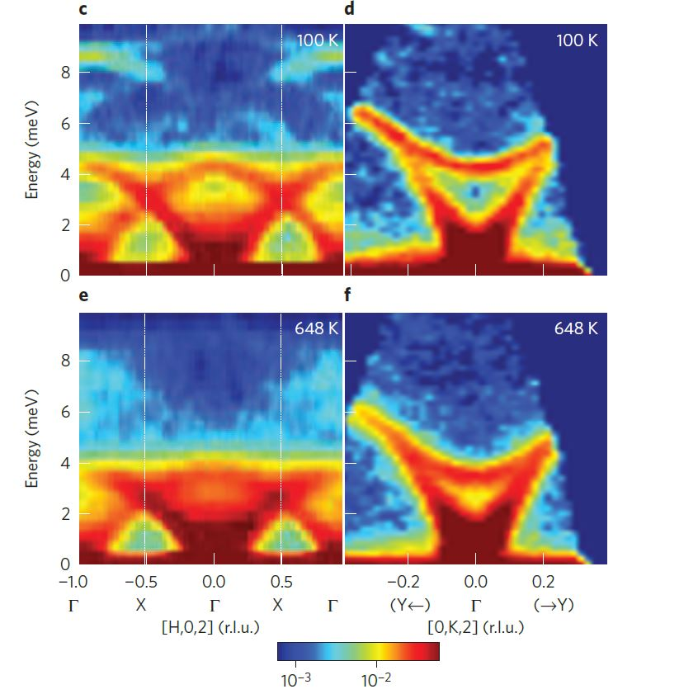
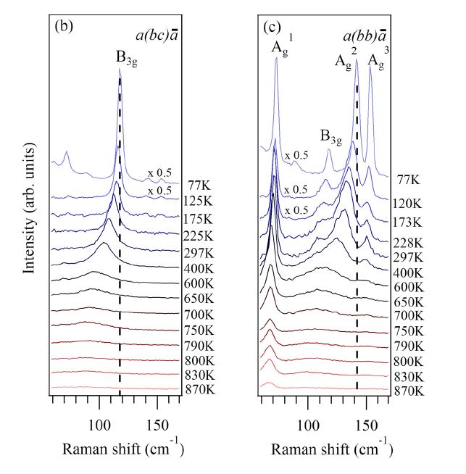
Exploration of electron & lattice dynamics
(charge distributions, atomic positions, lattice vibrations)
Good thermoelectricity
Anisotropic physical / structure properties
Phonon softening and condensation
Material: SnSe
Inelastic neutron scattering
Raman spectroscopy
ATF Users’ Meeting 2020

Slide 6
UED patterns and pump-probe results
ATF Users’ Meeting 2020

Slide 7
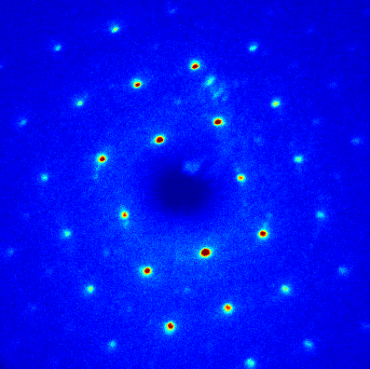
UED measurements: anisotropic Bragg peak intensities
(002)
(020)
The origin of UED intensity variation comes from both atomic displacements and lattice vibration.
ATF Users’ Meeting 2020

Slide 8
UED measurements: lattice dynamic observations vs temperature
More investigation of the temperature effect on the intensity measurements
ATF Users’ Meeting 2020

Slide 9
Special Equipment Requirements and Hazards
UED Samples and Setup
One single-crystal LBCO 1/8 sample and one iridate sample.
Experimental setup is normal. No special equipment is needed.
Pump Laser Requirements
800 nm (1.55 eV) with various pump fluence.
Up to 9 μm (140 meV) using OPA for selective phonon excitation.
Hazards & Special Installation Requirements
Double-tilt sample stage.
Cryogens: liquid nitrogen and liquid helium (if possible).
No new magnetic elements.
No new materials into the beam path.
No beam line modifications.
ATF Users’ Meeting 2020

Slide 10
Experimental Time Request
CY2021 Time Request
Capability | Setup Hours | Running Hours
UED Facility | 2 - 3 days (48 – 72 hours) | 2 - 3 weeks (80 – 120 hours)
Time Estimate for Remaining Years of Experiment (including CY2021)
Capability | Setup Hours | Running Hours
UED Facility | 10 days (240 hours) | 6 – 9 weeks (240 – 360 hours)
ATF Users’ Meeting 2020

Slide 11
Thank you!
ATF Users’ Meeting 2020
Notes:
Thank you very much!

